Slide 1
SECO and OCB
Ian
Aug 2018

Slide 2
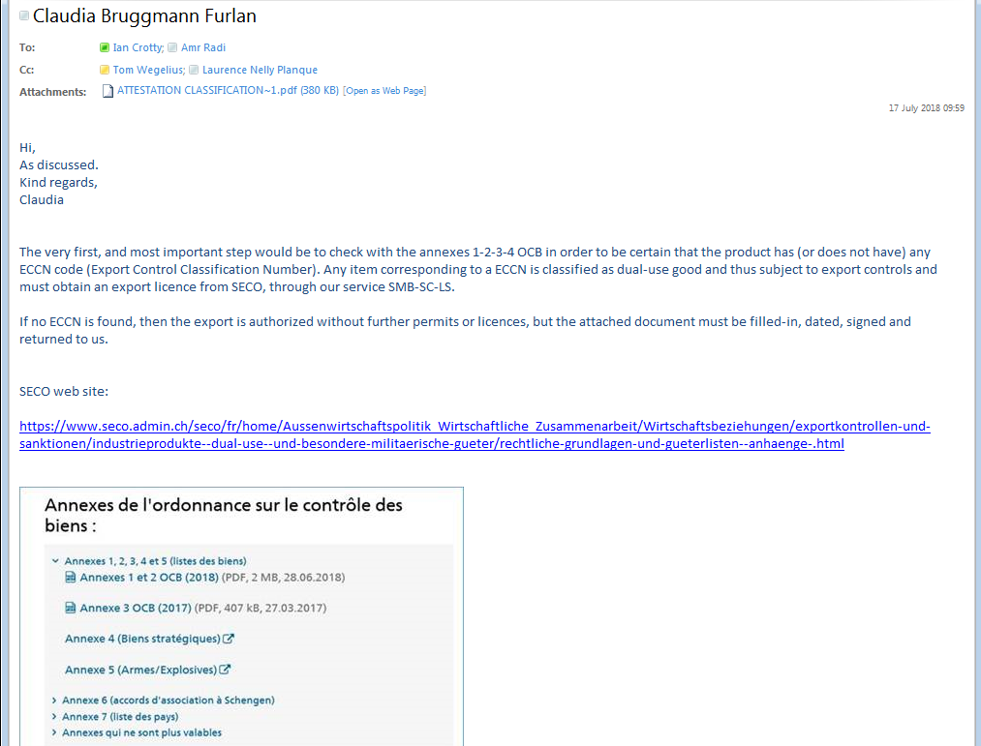
The “new” person deputy to Tom for export control

Slide 3
Swiss SECO web site
https://www.seco.admin.ch/seco/fr/home/Aussenwirtschaftspolitik_Wirtschaftliche_Zusammenarbeit/Wirtschaftsbeziehungen/exportkontrollen-und-sanktionen/industrieprodukte--dual-use--und-besondere-militaerische-gueter/rechtliche-grundlagen-und-gueterlisten--anhaenge-.html
See the next page for the web site.

Slide 4
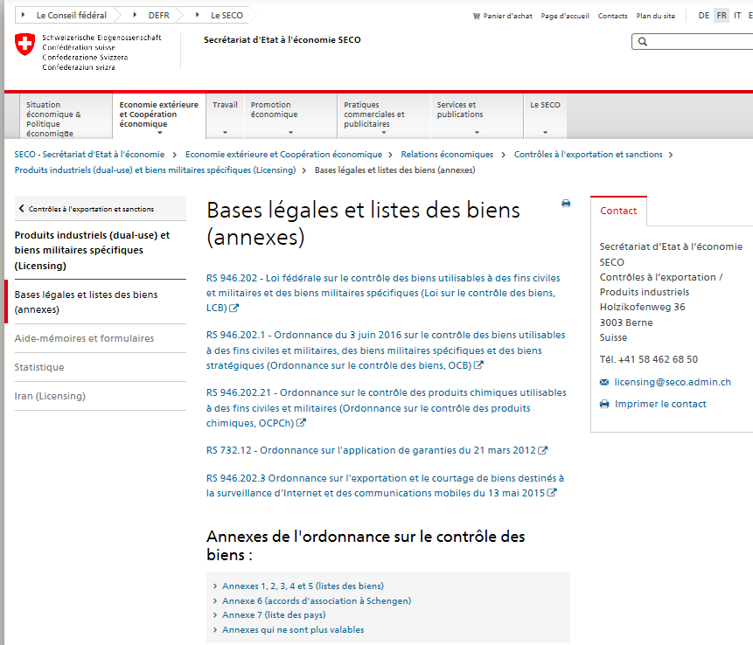

Slide 5
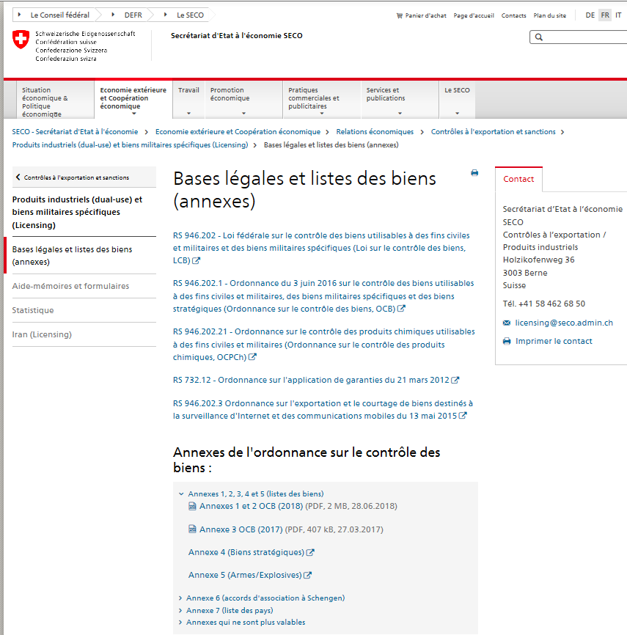
https://www.seco.admin.ch/seco/fr/home/Aussenwirtschaftspolitik_Wirtschaftliche_Zusammenarbeit/Wirtschaftsbeziehungen/exportkontrollen-und-sanktionen/industrieprodukte--dual-use--und-besondere-militaerische-gueter/rechtliche-grundlagen-und-gueterlisten--anhaenge-.html#accordion1533894460818
See email from Claudia

Slide 6
See annex 1, 2 & 3 on the RPC RE4 web site;
http://rpc-cms-re4-upscope.web.cern.ch/rpc-cms-re4-upscope/RPC/Chamber%20Institutes/Shipping/SECO/SECOdocMay2018/

Slide 7
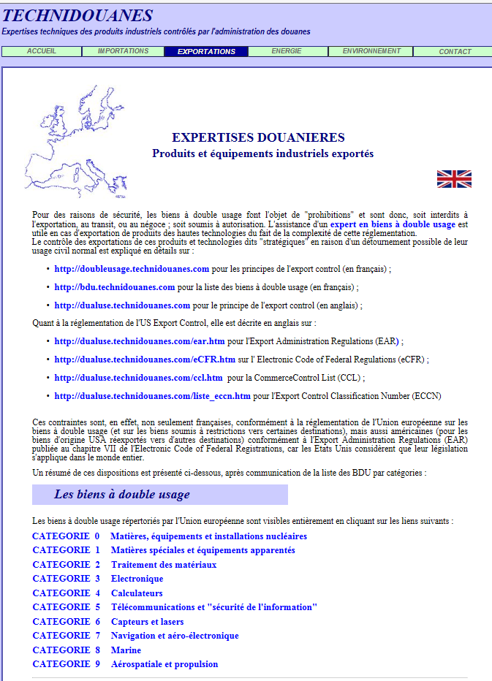
Expert en biens à double usage
http://www.technidouanes.com/exportations.htm
This part is very similar to the swiss version

Slide 9
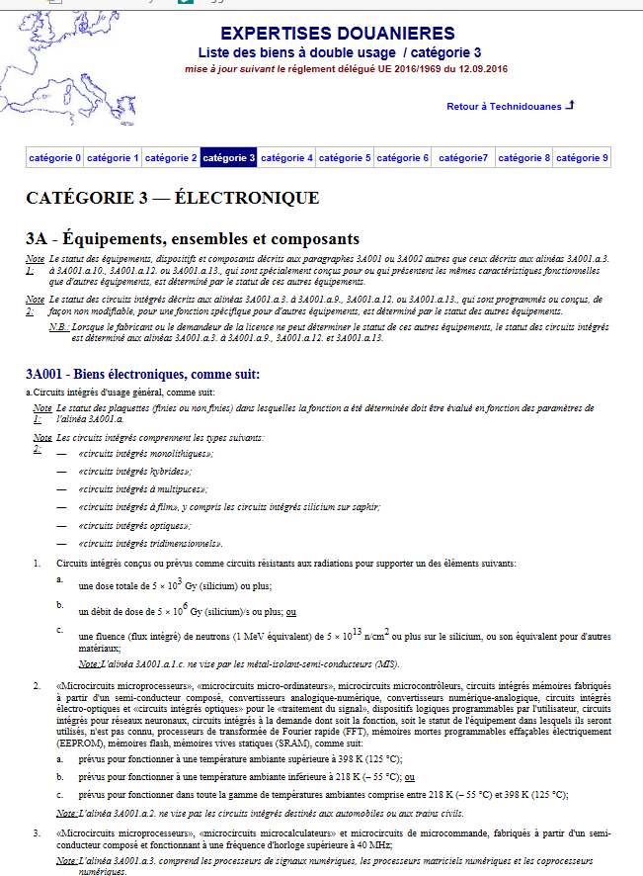
As an example
This appears identical to the Swiss version
http://bdu.technidouanes.com/categorie_3.htm

Slide 10
ECCN
https://en.wikipedia.org/wiki/Export_Administration_Regulations
This appears to be only for material coming from USA…..? No implemented by all member countries !!
https://www.bis.doc.gov/index.php/licensing/commerce-control-list-classification/export-control-classification-number-eccn
http://jwallen.com/blog/2014/09/eccn-what-is-it-why-and-when-is-one-needed-why-is-it-important

Slide 11
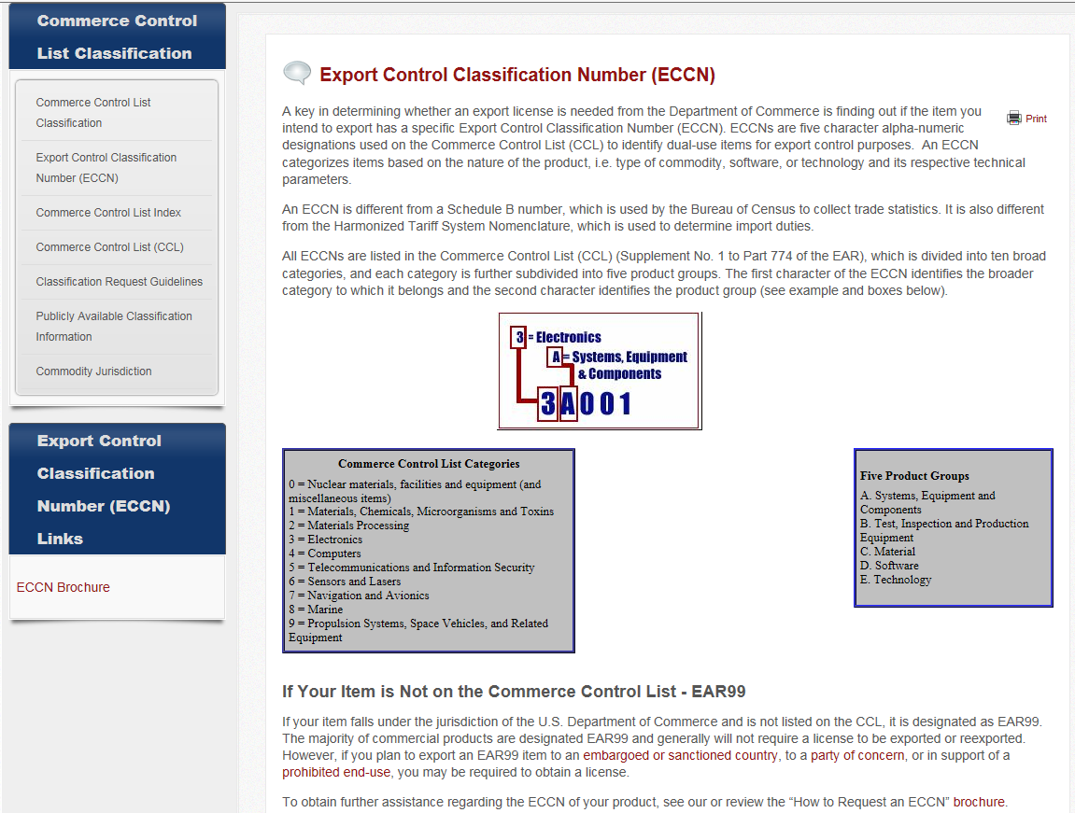

Slide 12
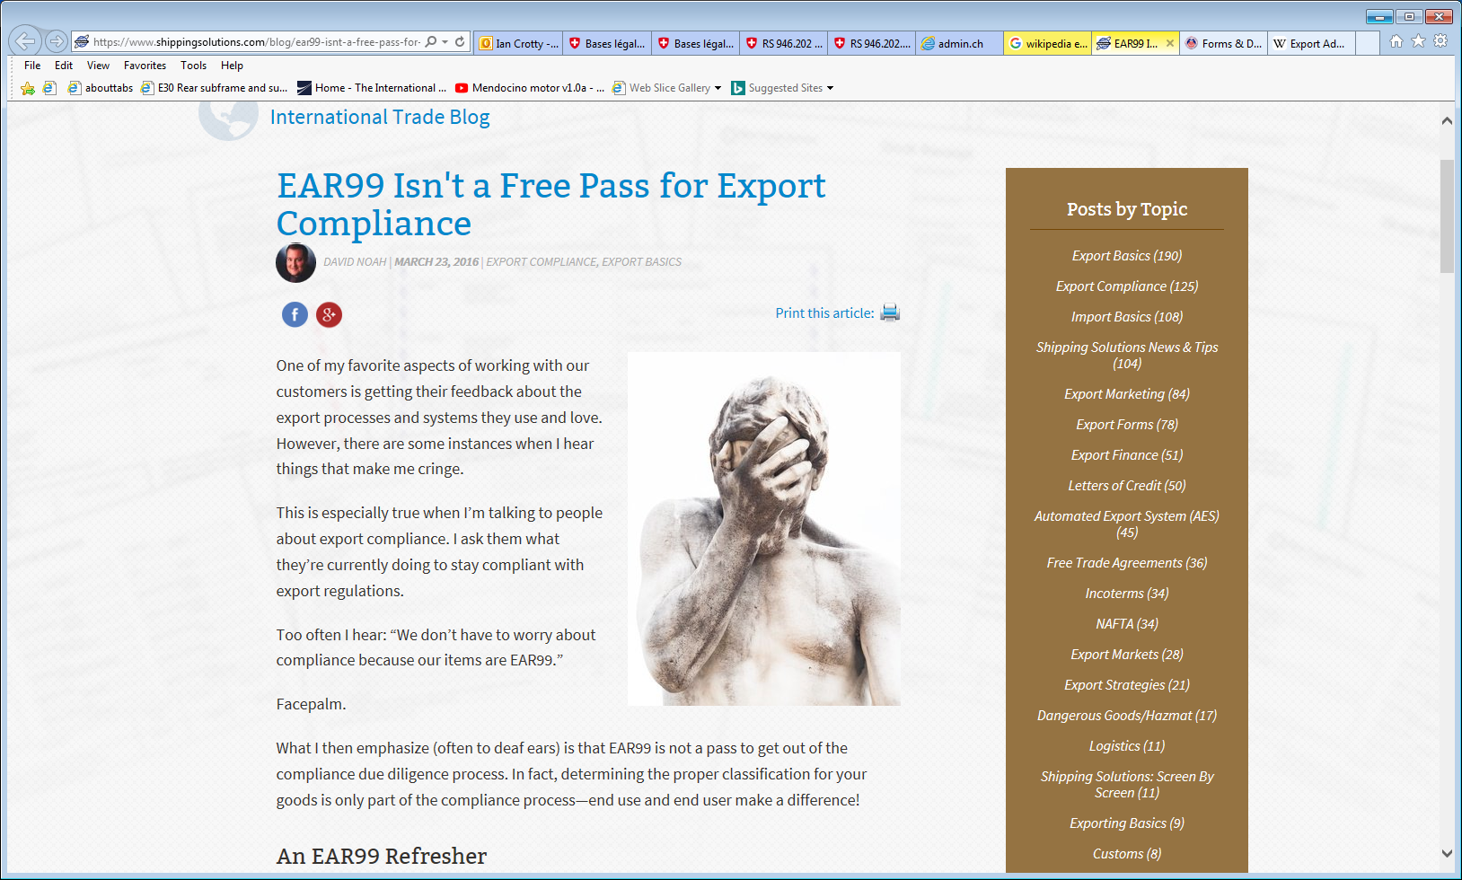
https://www.shippingsolutions.com/blog/ear99-isnt-a-free-pass-for-export-compliance

Slide 13
From the Bureau of Industry and Security (BIS): EAR99 is a classification for an item. It indicates that a particular item is subject to the Export Administration Regulations (EAR), but not specifically described by an Export Control Classification Number (ECCN) on the Commerce Control List (CCL).23 mars 2016

Slide 14
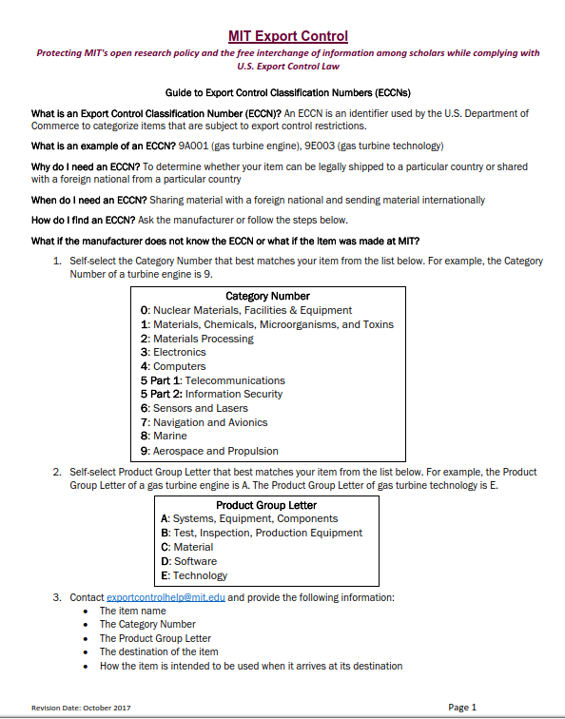
MIT has guide lines for export
https://osp.mit.edu/sites/osp/files/uploads/guide-export-control-classification-numbers-eccns-2017-10-05.pdf

Slide 15
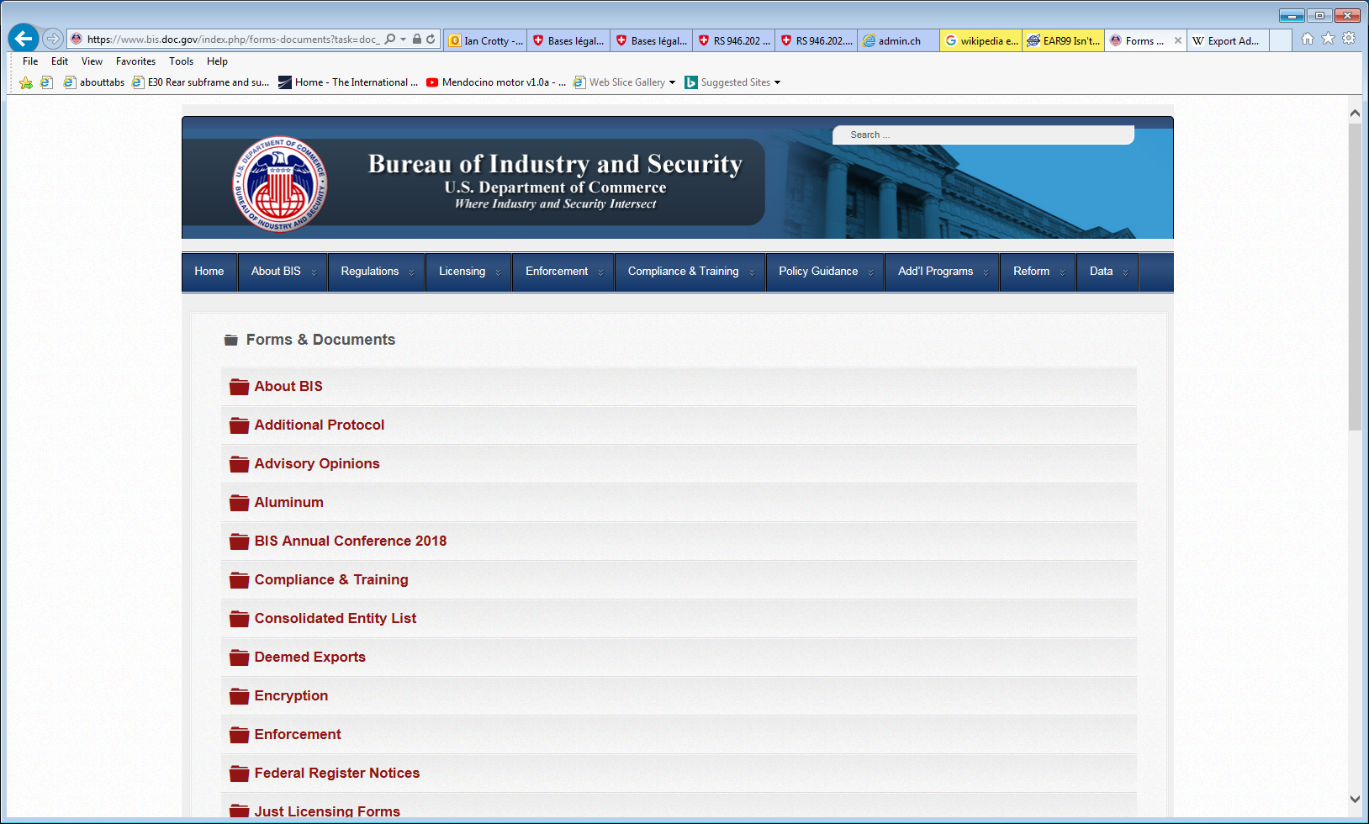
https://www.bis.doc.gov/index.php/forms-documents?task=doc_view&gid=143

