Slide 1


HV/LV Power System
&
On board electronics
Waqar Ahmed
National Centre for Physics-Islamabad

Slide 2
Introduction
High Voltage (HV) and Low Voltage (LV) is required to power up 144 RPCs which will be installed on RE+4 and RE-4.
The same solution from CAEN, Italy i.e. EASY3000 (Embedded Assembly SYstem) will be used for RE4 HV and LV system.
  To save cost for HV boards, HV distributor boxes will be produced locally as it was done previously for RE1, RE2 and RE3.

Slide 3
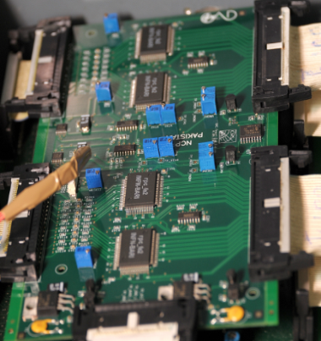
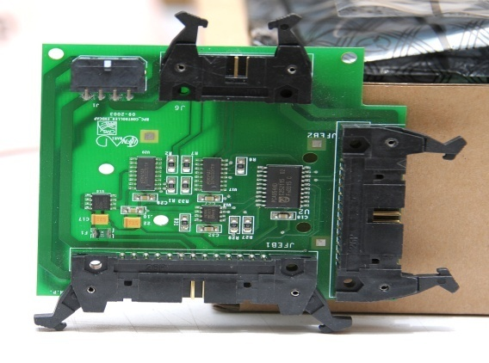
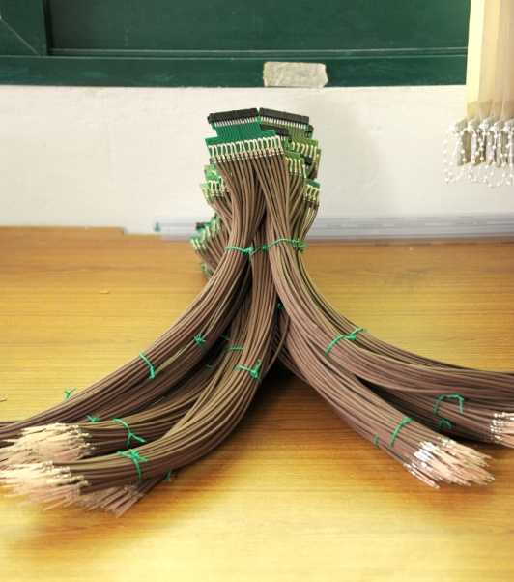
FEB/DB/Coaxial cable with Adapter
Current status
The total requirement of 200 Chambers
  FEB = 600 with 10% contingency
  DB = 200 with 10% contingency
  Coaxial cable with adapter Boards= 200
S.no | Components | Current Status | Estimated Delivery
1. | FEB (1st batch shipment, 200 Boards) | Completed
2. | FEB (Final Shipment, 450 Boards) |  | 1st week of August
3. | DB (1st batch shipment,100 Boards) | Completed
4. | DB (Final batch shipment, 150 Boards) |  | 1st week of August
5. | Coaxial cable with adapter (1st batch shipment, 40 Chambers) | Completed
6. | Coaxial cable with adapter (Final batch shipment, 160 Chambers) | Completed

Slide 4
Cabling Current Status
S.No | Components | Current Status | Expected delivery | Remarks
1. | HV cables RE+4 | Tested in 904 | Completed | P5-installation
2. | HV cables RE-4 |  | 1st week of August
3. | LV cable RE+4 | Patch panel connector pending | Completed | P5
4. | LV cable RE-4 |  | 1st week of August
5. | Signal cable RE+4 | Tested in 904 | Completed | P5-Installation
6. | Signal cable RE-4 | Tested in 904 | Completed | 904 (1 damage,2 increase length)
7. | DCS cable RE+4 | Tested in 904 | Completed | P5- Installation
8. | DCS cable RE-4 | Tested in 904 | Completed | 904

Slide 5
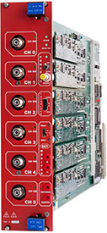
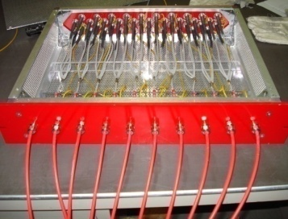
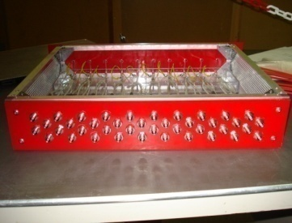
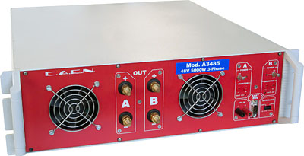
H.V Module Current Status
S.no | Components | Requirement | Expected Delivery
1. | SY1527 | not required
2. | EASY Crate | not required
3. | HV Board A3512N (6 Channel Board) and 3 HV boards per rack in USC | 12 +2 | September
4. | A3485(3-phase 400 Vac . 48 Vdc (2 ch x 2.5 kW) Converter) | 1 | September
5. | Branch Controller | not required
6. | HV Distributor Box (20 input 55 output) | 8 + 4 | September

Slide 6
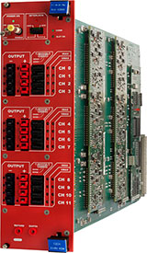
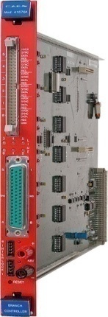
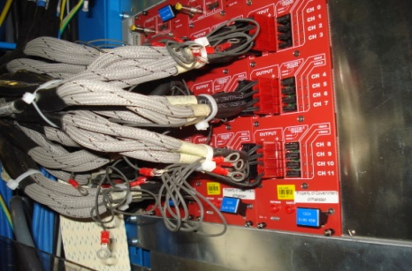
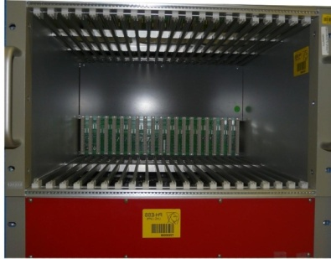
L.V Module Current Status
S.no | Components | Requirement | Status | Expected delivery | Remarks
1. | SY1527 | not required
2. | EASY Crate | 4 | 2 | September
3. | LV Board A3009 (12 Channel Board) | 12 | 5 | September
4. | MAO (A3486/A3486S) | 2 |  | September
5. | Branch Controller | 2 | 4 |  | Completed

Slide 7
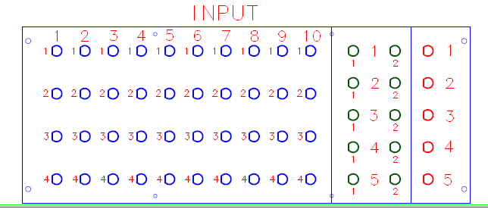
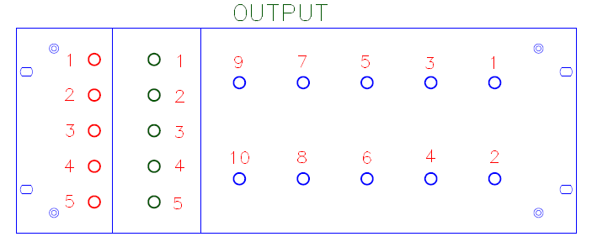
H.V Distributor
H.V distributor will be prepare with new scheme and new method, develop easily 1-4, 1-2 and 1-1 circuit combination with less components(white blocker, ring , ground cable and less sty-cast and glass box).

Slide 8
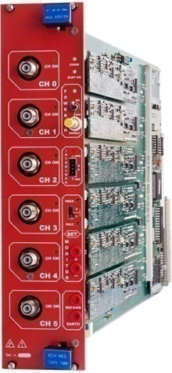
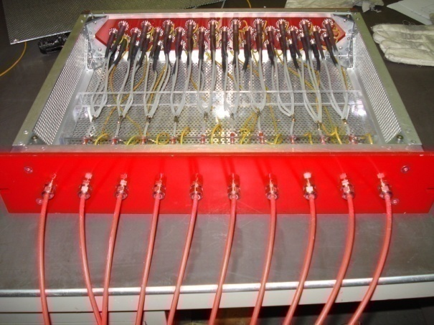
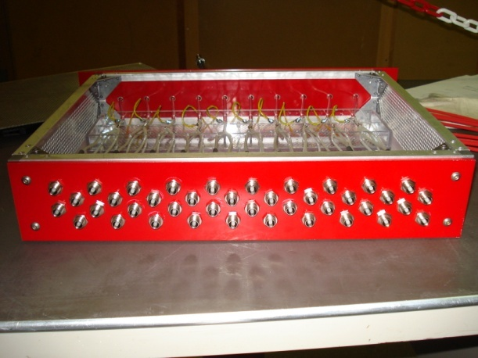

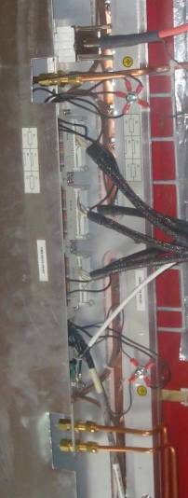


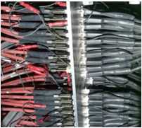
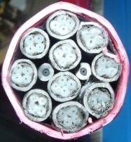
H.V Scheme
Jupiter Connector
HV Module
Distribution Box Input Side
Distribution Box Output Side
UXC
USC
HV cable
Female Tripolar Connector
200 meter long cable
Patch panel
RPC

Slide 9
H.V Distributor requirement
Components requirement for 12 H.V distributors
S.No | Components | Quantity | Status
1. | H.V cables | 360 m | Order in July
2. | Sty-cast + catalyst | Six each | Order in July
3. | Shrink wrap sleeve | 80 m | Order in July
4. | Ground cable (1.5 mm) | 160m | Order in July

Slide 10
H.V Dist. Testing criteria
Wait ~ 24 hours to dry the epoxy.
Put the caps at all the 55 outputs of the distributors.
Connect the 20 input cables with the high voltage power supply.
Gradually increase the voltage with 1000V steps at 10kV and wait about 10 minutes each steps and note the current values.
If all channels remain below 0.2uA then.
Increase the volts at 11, 12, 13, 14kV for ~ 1 hour each and note current carefully it should be below 0.4uA.

Slide 11
H.V Dist. Testing criteria
Then leave the distributor at 15kV for 12 hours at least and monitor it, the current of all channels should be less than 0.5uA
If after 12 hours all channels current remain below 0.5uA then this is a good distributor and eligible to go in the final HV system at point 5.

Slide 12
H.V/L.V
Power Estimation

Slide 13
LV cable status
H.V/L.V Power Status
For one LV analog channel, Power = V.I = 7(V) x 1.2(A)max =8.4 Watts.
Similarly, for one LV digital channel = 7.5(V) X 2(A)max = 15 Watts.
Therefore for A3009 board i.e. (6x8.4) + (6x15) = 140.4Watts.
  For one EASY Crate it will be around = 104.4 x3 = 421.2 watts.
Adding safety factor we can say total power for EASY Crate =
600 Watts approximately. (Total Power for LV = 2.4KW)
For HV system, as the current drawn is very small i.e.~15micro Ampere for applied HV ~9700V. Therefore for one HV channel the estimated power using same formula P = V.I = ~0.1455 Watt.
Power for 144 RPC’s = 144 * 0.145 = 20.882 W
  Total Power for HV = (20.882 W)

Slide 14
Miscellaneous
For RE4 LV system, we need to route cables from USC to UXC.
    These cables are control cables and service power cables from branch controller to MAO.
There is no need to route cables from USC to UXC for HV system.
LV and HV Cables will be connected to LV and HV boards as we did for RE2 and RE3.
  These cabling schemes for RE4 HV and LV system are ready.
All the RE4 hardware will be tested in building 904 RPC test setup before installation in point 5.

Slide 15
Miscellaneous
H.V/L.V
Grounding

Slide 16
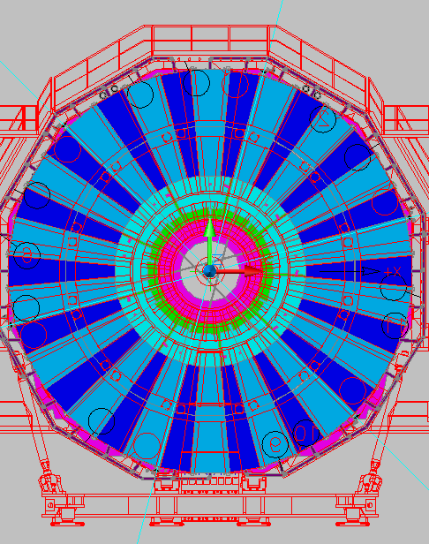
Overall Electronics and cabling Scheme
USC55
OPTICAL LINKS
Link Box
Cavern
Link Box
TRIGGER CRATES
Easy (LV) A3009
Easy (LV) A3009
LV cable
Signal and I²Ccable
Easy crate (HV)‏
Link Box
Link Box
HV A3512N
HV A3512N
HV A3512N
HV A3512N
HV A3512N
Link Box
Link Box
MAO A3486S
MAO A3486S
SY 1527
Easy (LV) A3016
Easy (LV) A3016
Branch Controller
Branch Control.
Branch Control.
Branch Control.
Branch Control.
Branch Control.
Branch Control.
Link Box
Link Box
48 V
Link Box
Link Box
Easy (LV) A3009
Easy (LV) A3009
(A3485) AC/DC
HV cables
HV cables
Link Box
Link Box
10 x 4-pole shielded cable
HV PatchPanel
HV PatchPanel
BC Control & 48 V
PatchPanel
SF4
Control shielded cable + 48 V (service)‏
Notes:
16

Slide 17
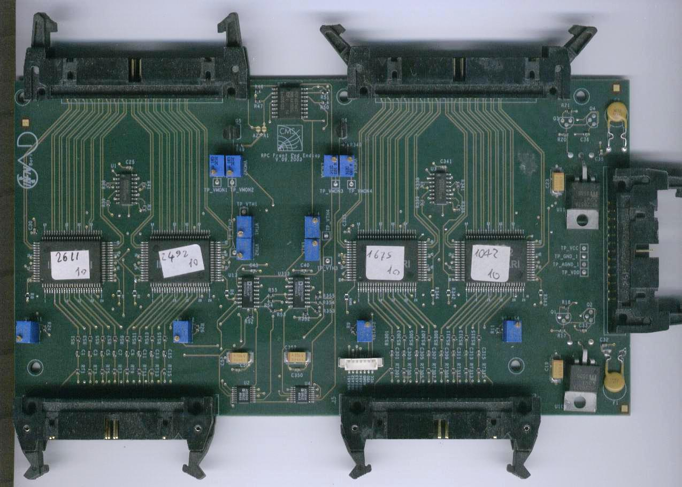
Chamber Layout
Chambers RE4/2, RE4/3 contain:
3 FEBs (each with 32 channels and 2 output cables)
1 Distrib. Board
FEB
Output connectors (each: 16 LVDS out + 4 LVDS test_in)
FEB
FEB
Service connector:
Power Supply
I²C
Distribution Board
To Link Board
Input connectors (each: 16 Signal-GND pair)

Slide 18
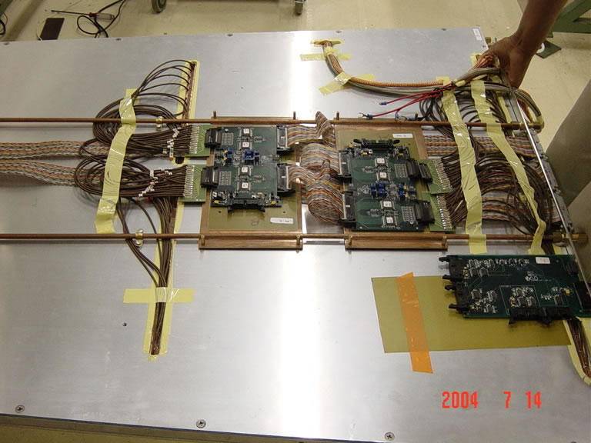
Chamber Layout
The FEBs are connected to input strips with coaxial cables through adapter boards
The output cables are:
  twisted flat cables inside the chambers, until the front panel
  round, shielded and twisted from front panel to Link Boards
The power cables are:
  round/shielded from LV Board (A3009) to Distribution Board
  flat cable from Distribution Board to FEBs (connected in parallel)

Slide 19
Internal Gnd Connection
Distribution Board
FEB
LV Current returns
Floating LV Power supply
DGND
Coax cables
AGND
Cu Foil
(signal ground)
(1)
Gaps
(2)
Cu Foil
HV connector
HV current return
Al chassis
Define the STAR Center on the front panel (close to HV connector)
  (1) Connect the Cu Foil (AGND) to Star Center with Cu braid
  (2) Connect the HV c.r. (from HV connect.) to Star Center with Cu braid
Floating HV Power supply
The Al enclosure must be tied to safety GND
  RPC is mechanically connected to Yoke (Now in mounting on post)
  Proper connection (short) from Chamber to Yoke with wide Cu braid
LV-HV-Signal-DCS shields connected to front-panel with short connections

Slide 20
Shielding connection
HV 3-pole shielded cable
10 x 4-pole shielded cable
HV P.P.
A3512N
in USC55
YOKE (Mounting Post)
Tower RACK
Link Board
Link Board
Ctrl Board
FEB
FEB
FEB
6 x 40 poles LVDS FEB Out and Test
CAEN A3016
8 poles LVDS I²C cable (SCL, SDA)‏
D.B.
LV 8-pole shielded cable
CAEN A3009
All external cables are shielded
The shields are connected (only) on the chamber frame
The far-ends are provided with ground straps, to be connected if useful
Rack
earth

Slide 21
Thanks

