Slide 1


Results Overview
RPC Gaps
18th of December 2012
Department of Physics and Astronomy

Slide 2
Different Gas leak cuts applied
Gap Type | RE4/3 TW | RE4/3 TN | RE4/3 B
Leak to be certified for 600s with +20mbar (CERN) | 0.1mbar | 0.3mbar | 0.4mbar
Leak to be certified for 600s with +20mbar as decided on the 10th of May (KODEL) | 0.3mbar | 0.4mbar | 0.5mbar
Leak to be certified for 600s with +20mbar as decided on the 23rd of October (KODEL) | 0.2mbar | 0.3mbar | 0.4mbar
1mm in the water column (precision of the reading) | 0.2mbar (0.4mbar) | 0.2mbar (0.4mbar) | 0.2mbar (0.4mbar)
New possible cuts for the sites | 0.2mbar | 0.2mbar | 0.2mbar

Slide 3
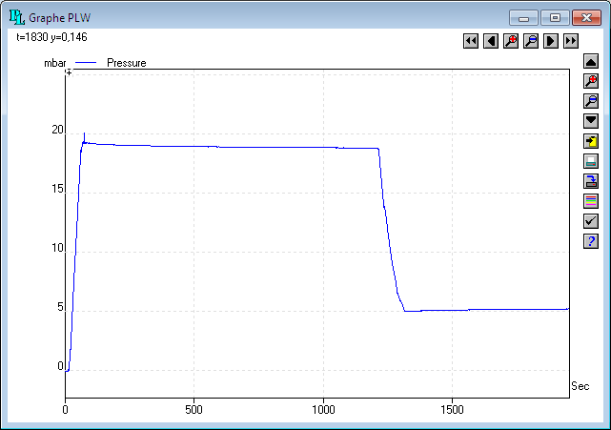
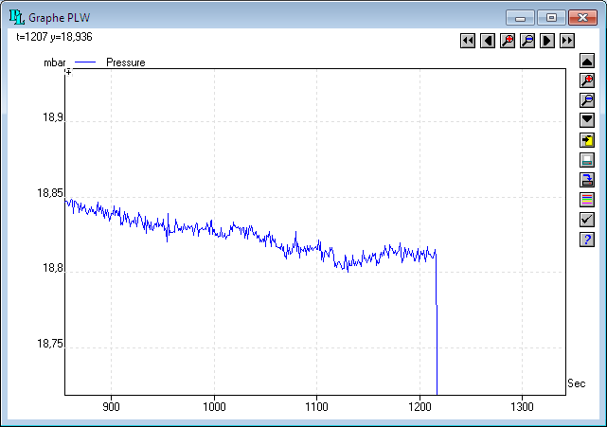
Leak tests using a PicoLog ADC
Slope calculation over 200sec after 1000sec for +20mbar tests
Same procedure after 1800sec for +5mbar tests

Slide 4
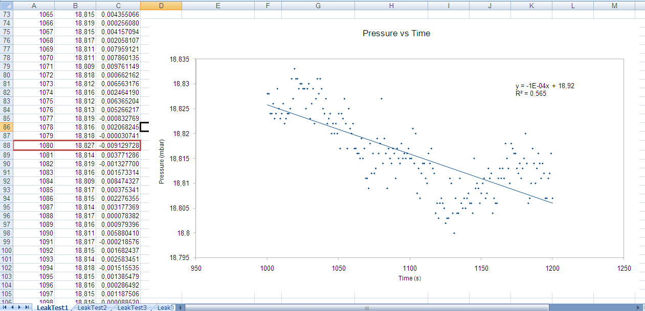
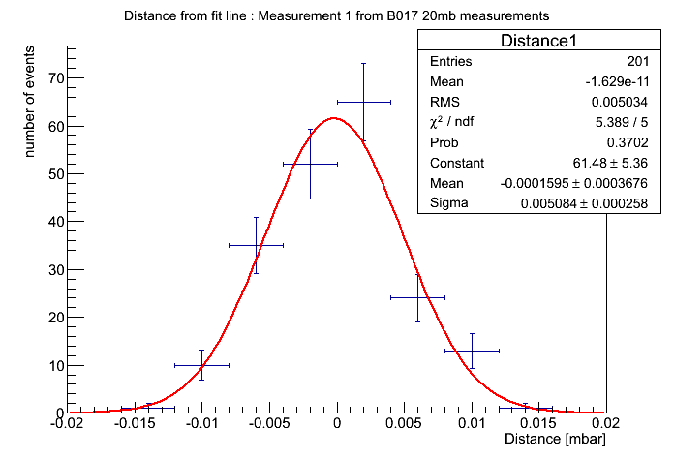
Measurement of the dispersion on the B017 gap
Slope = -0.0001 mbar/s
Dispersion of the points around the fit line
Sigma = 0.005mbar

Slide 5
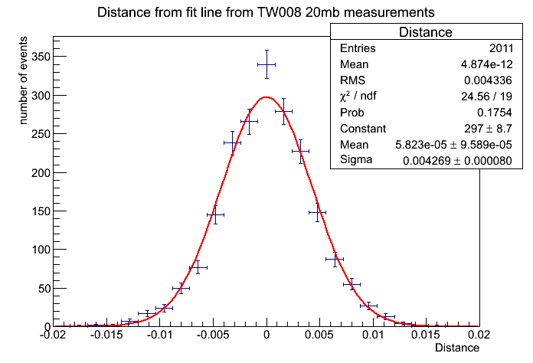
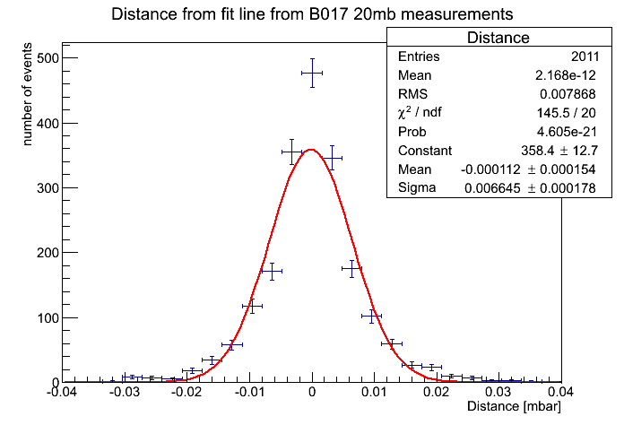
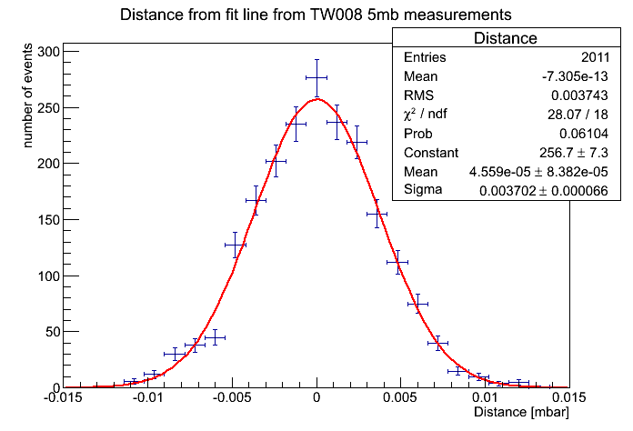
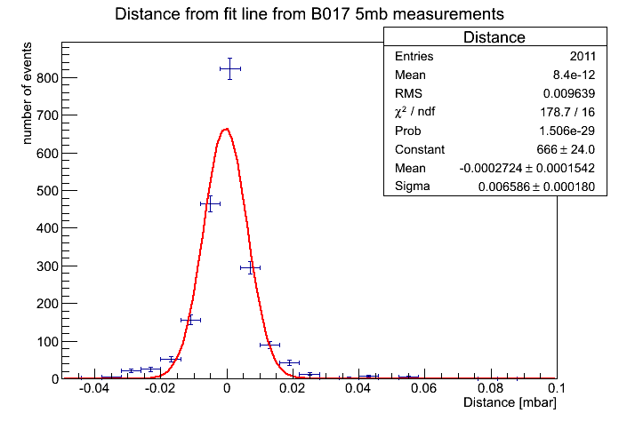
Repeatability of the measurements
10 measurements on gaps B017 & TW008
2 different overpressures : +20mbar and +5mbar
Conclusion : dispersion is ~0.01mbar
RMS = 0.004 mbar
RMS = 0.008 mbar
RMS = 0.004 mbar
RMS = 0.010 mbar

Slide 6
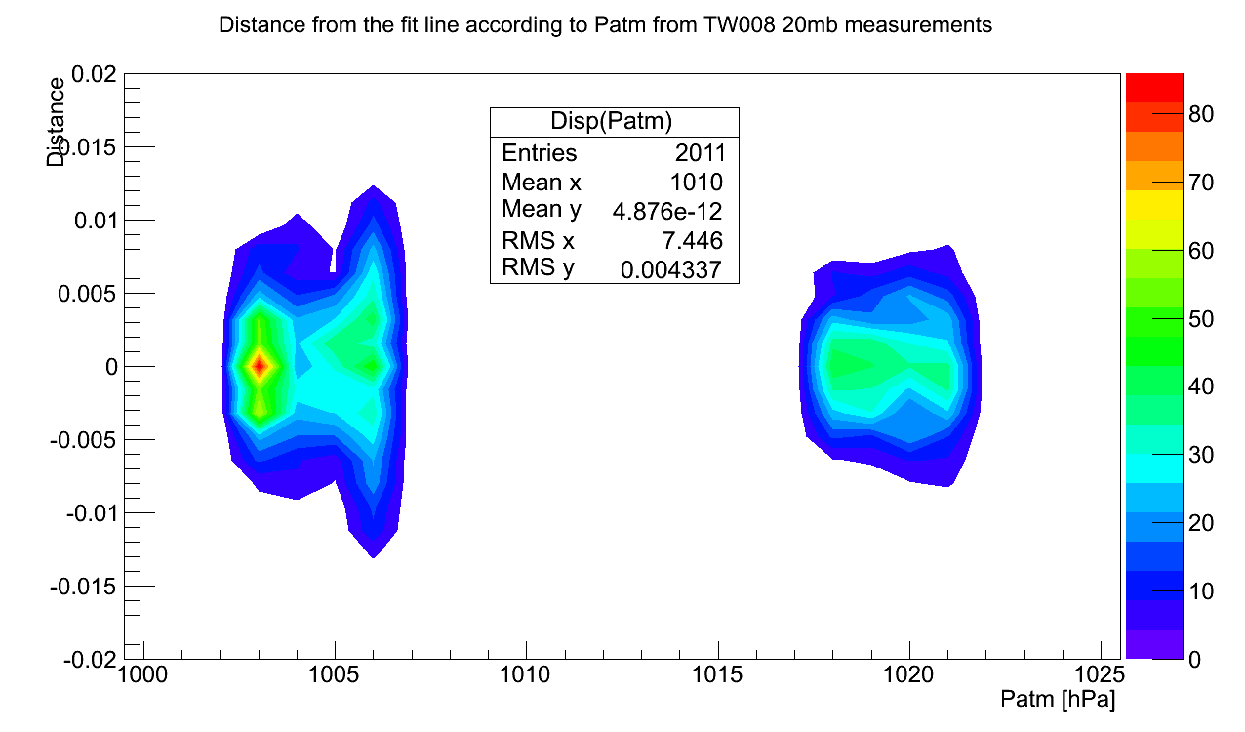
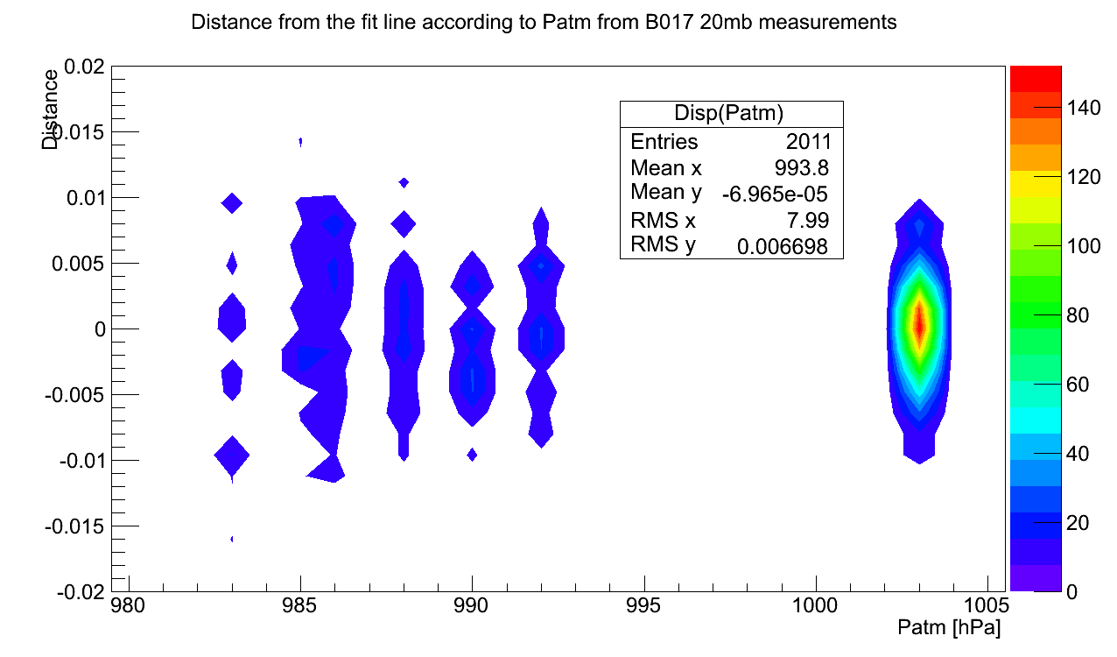
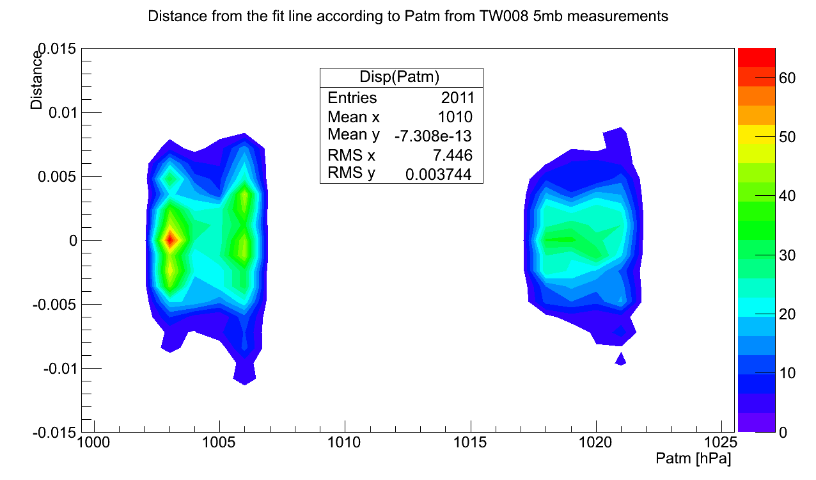
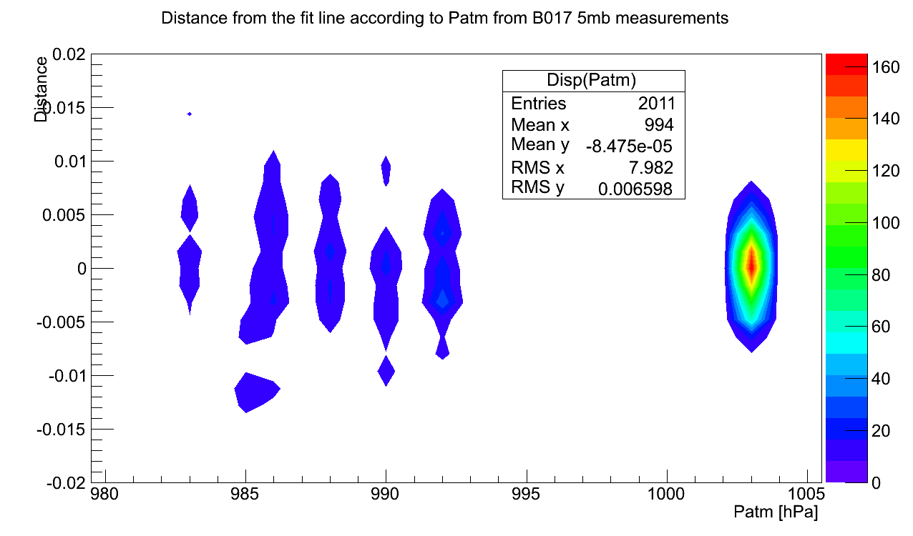
Dispersion as a function of P_{atm}
Dispersion has no link with the Atmospherical Pressure

Slide 7
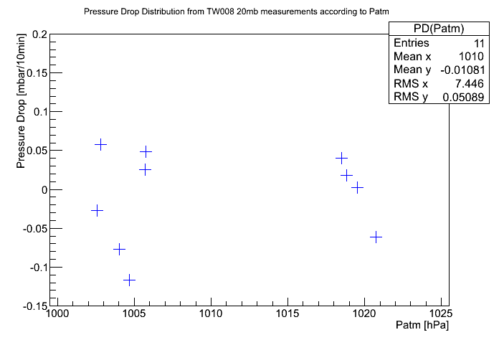
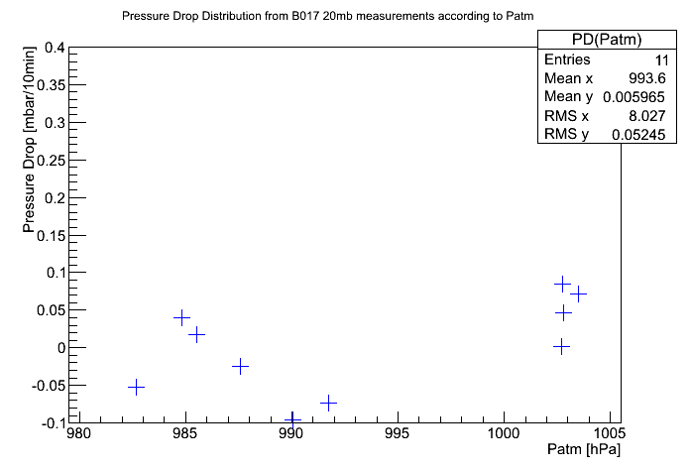
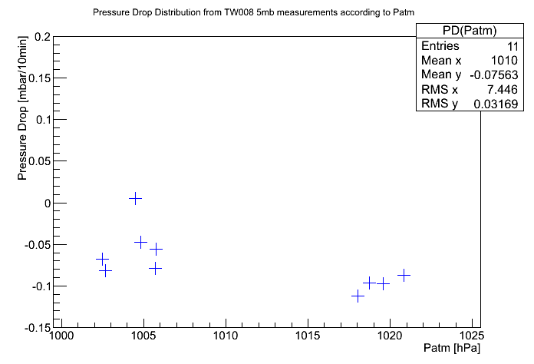
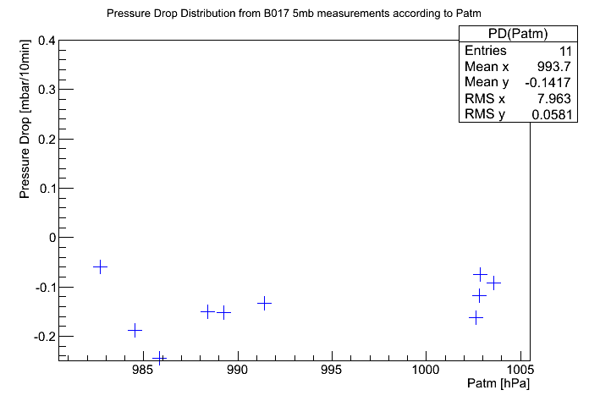
Pressure Drop values
Values in the DB for the TW008 :
KODEL 0.12mbar/10min
GENT 0.07mbar/10min
Values in the DB for the B017 :
KODEL 0.10mbar/10min
GENT 0.06mbar/10min
Negative leak value
=
No Pressure Drop

Slide 8
Gap Type | RE4/3 TW | RE4/3 TN | RE4/3 B
Leak to be certified for 600s with +20mbar in the sites ? | 0.2mbar +0.1mbar | 0.3mbar +0.1mbar | 0.4mbar +0.1mbar

Slide 9
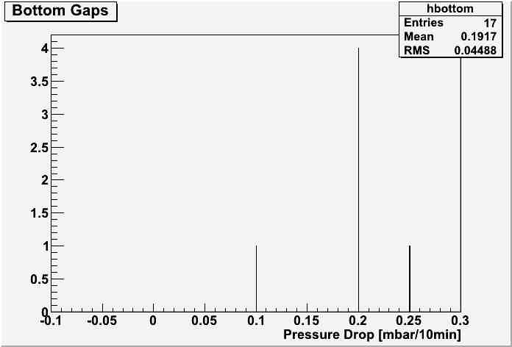
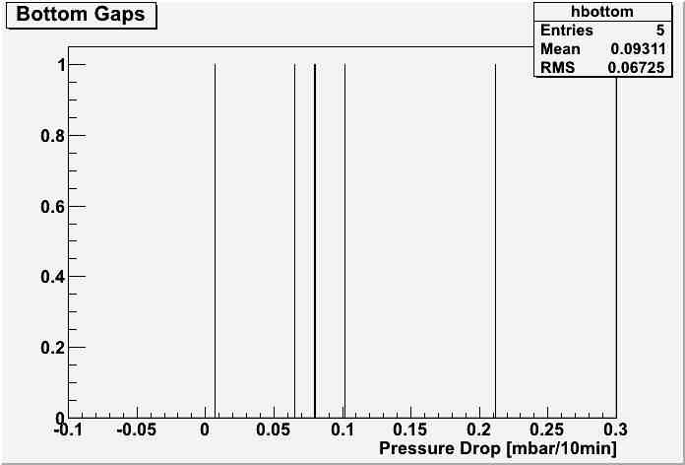
Comparison of the Results
KODEL
GENT

Slide 10
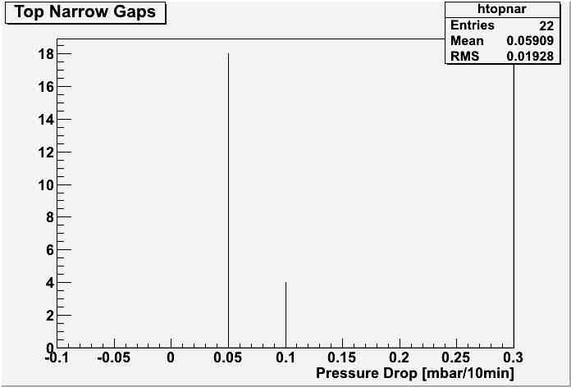
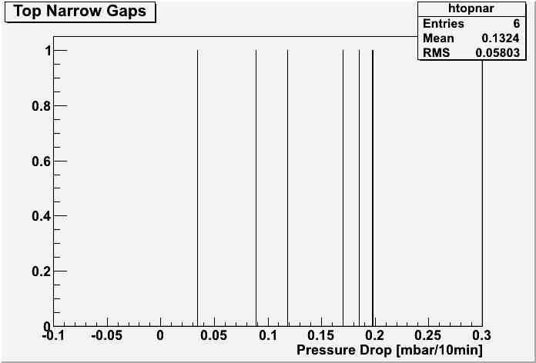
Comparison of the Results
KODEL
GENT

Slide 11
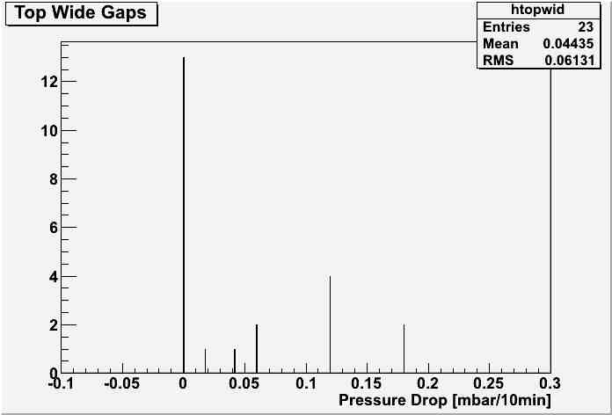
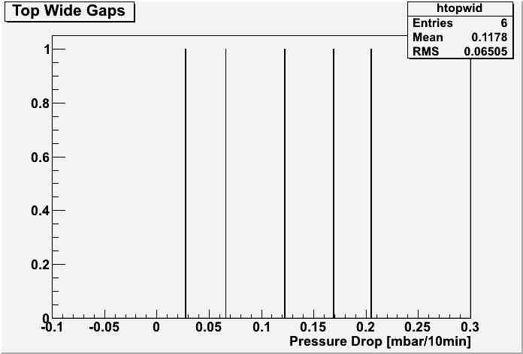
Comparison of the Results
KODEL
GENT

Slide 12
Conclusion
17 over 21 gaps have a leak rate lower than 0.2 ± 0.01 mbar/10min

