Slide 1
GT expedition to check on PU contamination as reported by KODEL
Paolo Vitulo
Ian Crotty
23/4 February 2012

Slide 2
Contents
Sample inspection before cleaning(from Riva)
Cleaning with Acetone, IPA, MEK.
Compression of Kraft onto HPL.
Abrasion of layers.

Slide 3
Sampling from Batch
22 sheets were inspected from the box of 360.? Probability of find a missing a bad one with 90% bad while taking 10 samples,
= x 10^-9
All were found to be “clean from cutting”.
That is there is some dust in the areas of the cut.
Bakelite is very shiny making it difficult to focus on the surface with a camera.
Bar Code example; 8E19E111215020793

Slide 4
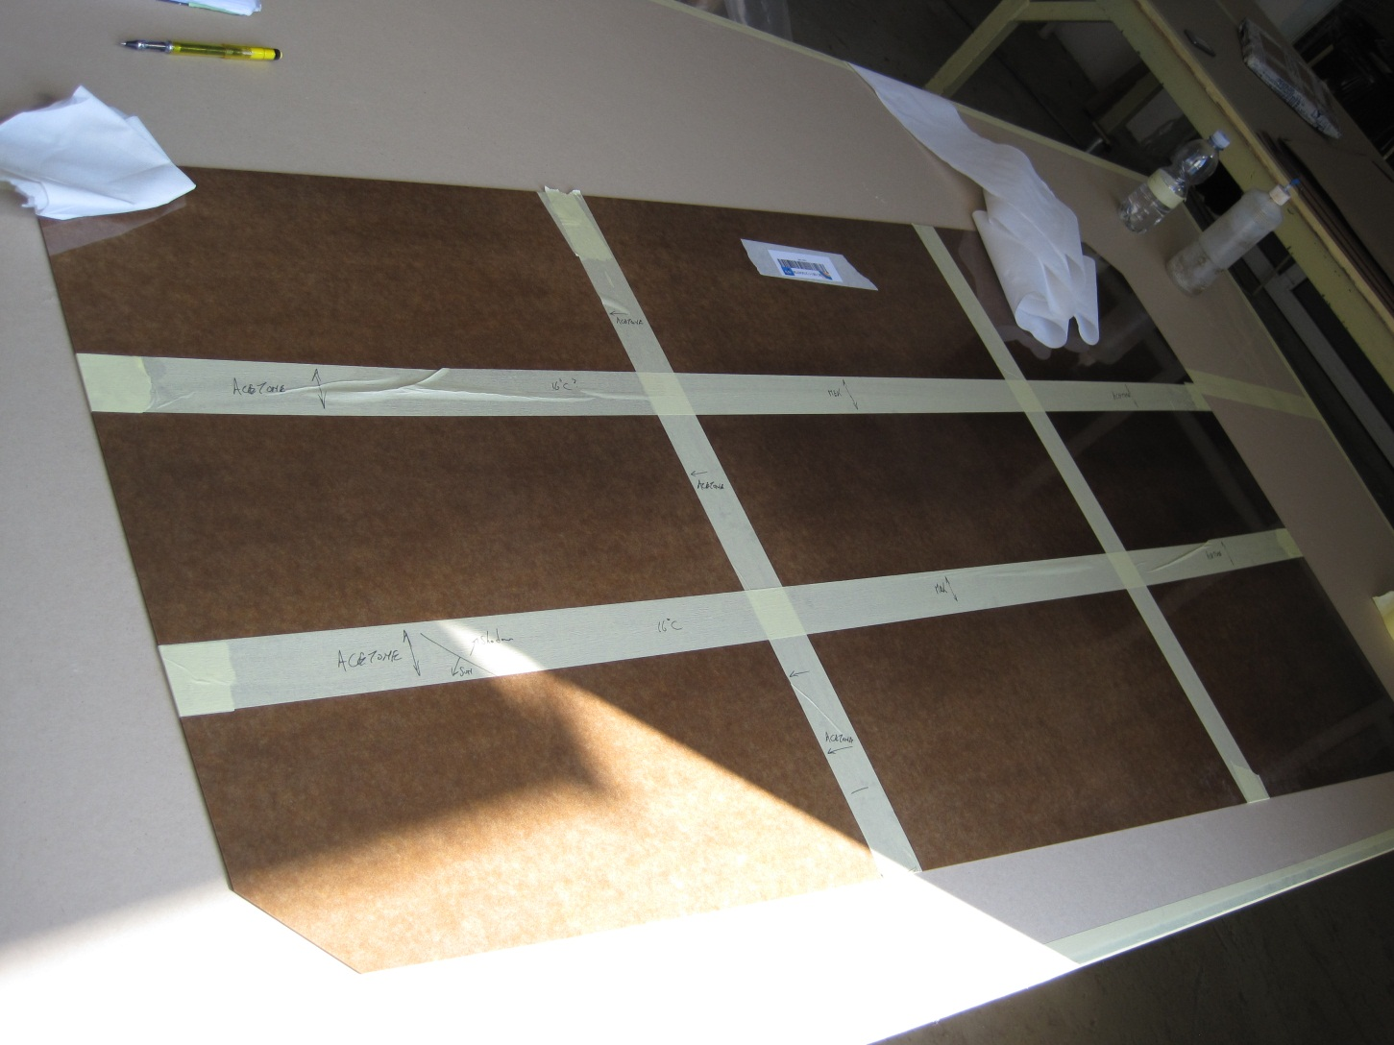
Layout of (9)test areas
Bar Code: 8E19E111215020793
Acetone
MEK
IPA
3 methods of cleaning;
Pour on & leave to evaporate
Pour on wipe immediately
Wipe with wet cleaning paper.
Temperature in the shade ~16degC

Slide 5
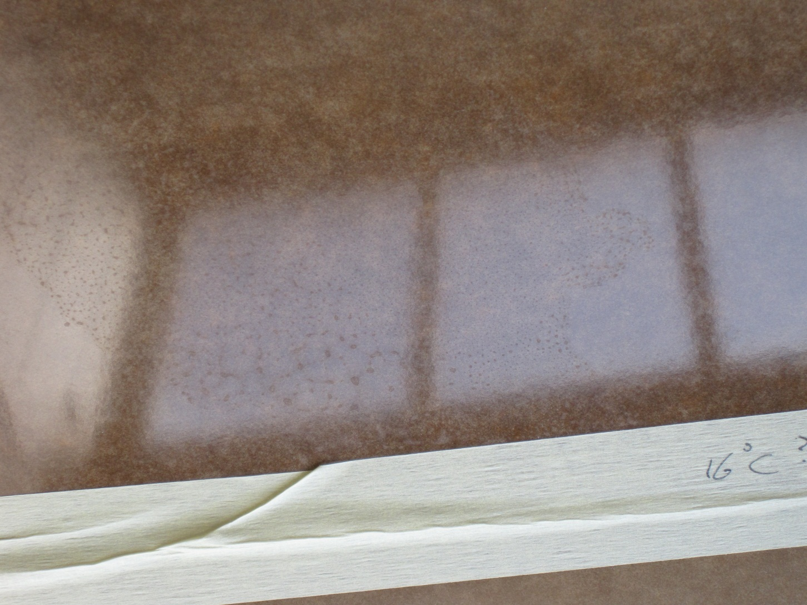
Cleaning with Acetone
Wiping off the Acetone left a clean surface with no marks
Acetone (from a squeeze bottle) after evaporation leaves fine deposits as shown. These can be readily removed with IPA.

Slide 6
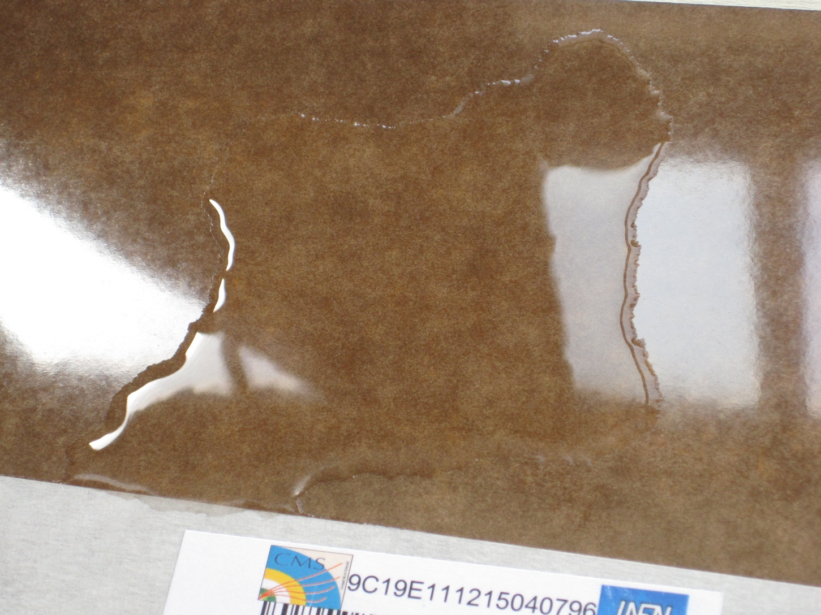
Cleaning with MEK from clean source
Large pool, 15-20cm) of clean MEK, left to evaporate.

Slide 7
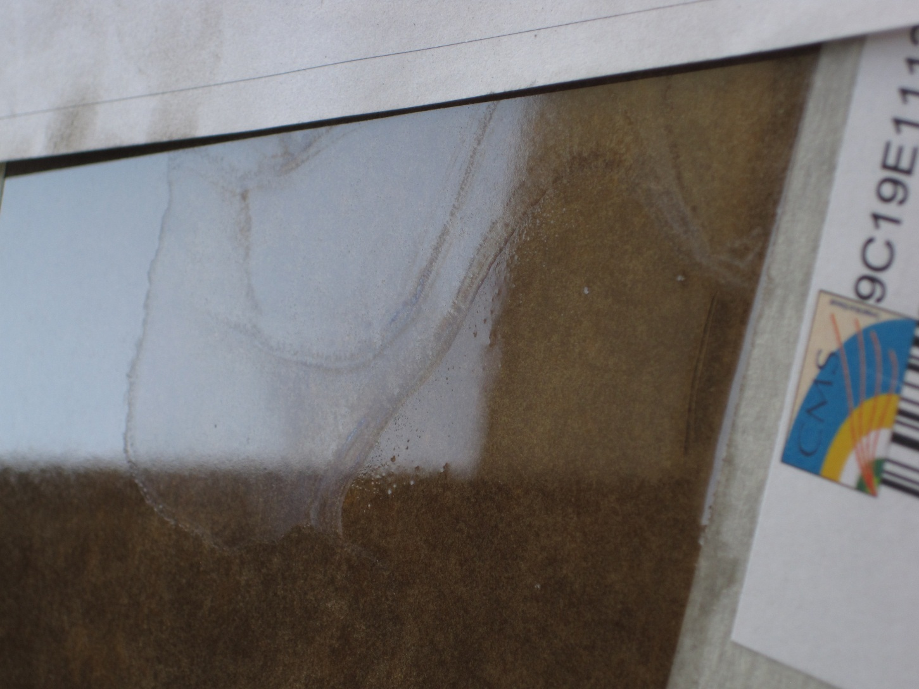
Cleaning with MEK from clean source
Interference patterns after evaporation

Slide 8
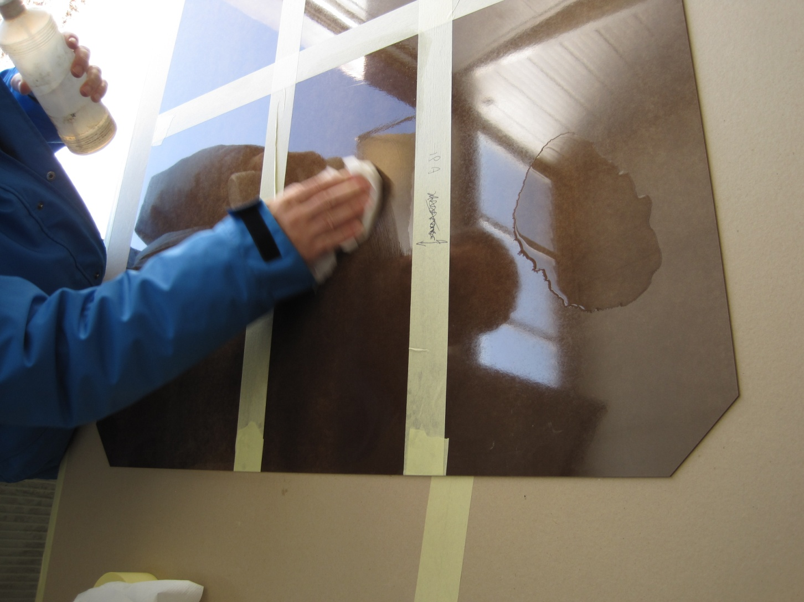
Cleaning with IPA

Slide 9
Conclusion after cleaning with Acetone,MEK & IPA
In all 3 cases the wiping method removes all traces.
In the evaporating pool method ;
Acetone leaves small round dry deposits.
MEK leaves dry interference patterns.
IPA leaves the slightest dry deposits.
The slightest wipe with paper & IPA removes all marks.

Slide 10
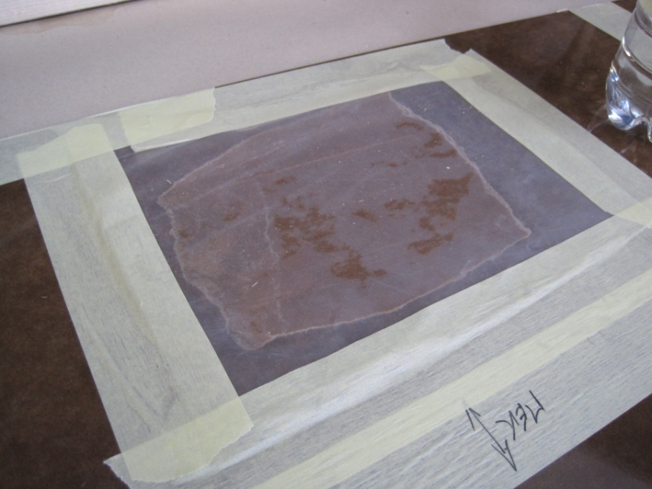
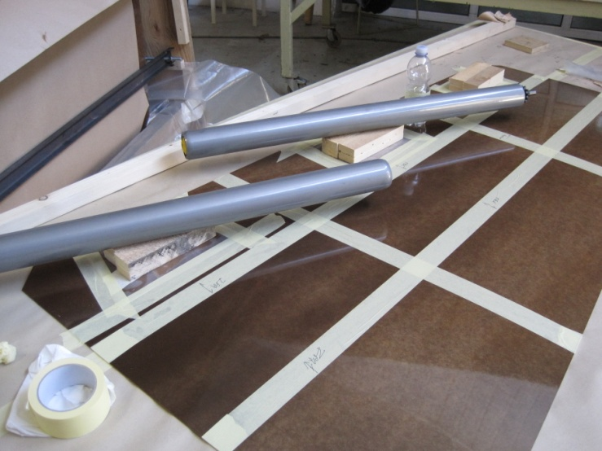
Will the kraft paper stick to the HPL due to panels remaining wet while packing them ?
Kraft paper soaked in one of the 3 solvents and enclosed uner PE sheet .
Weights were applied over night

Slide 11
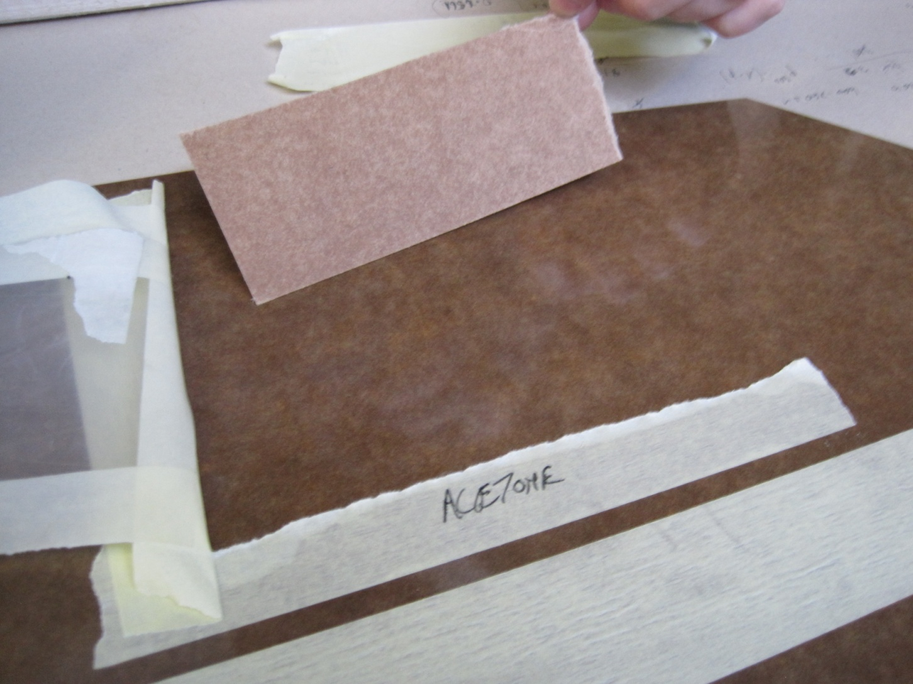
No sticking of papers to HPL
The paper is released leaving almost no traces

Slide 12
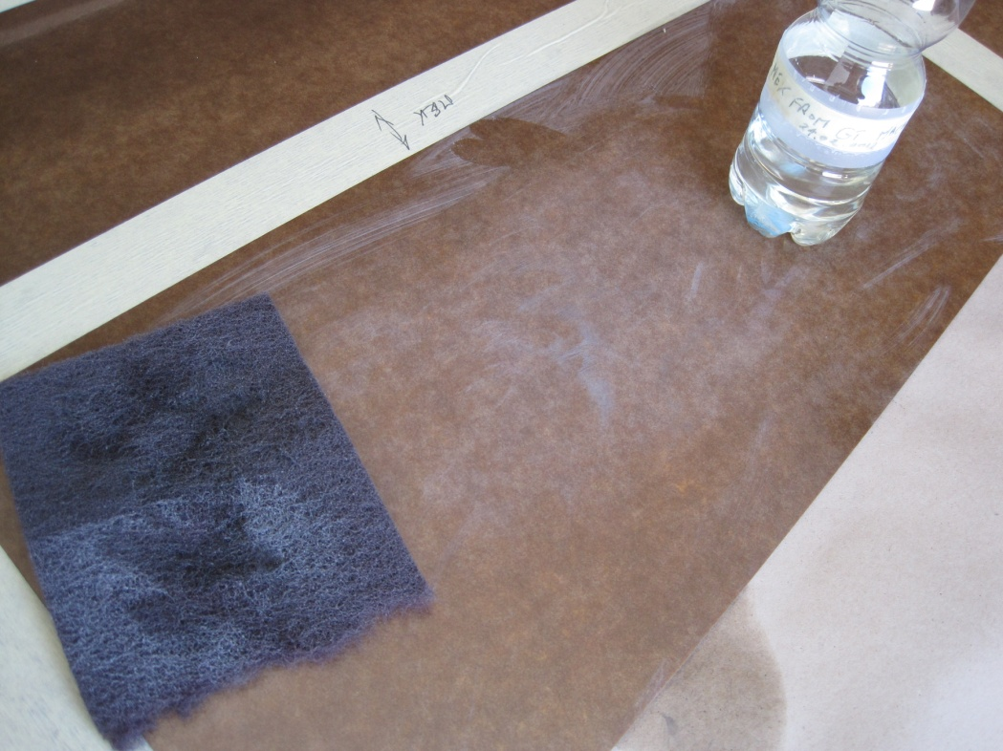
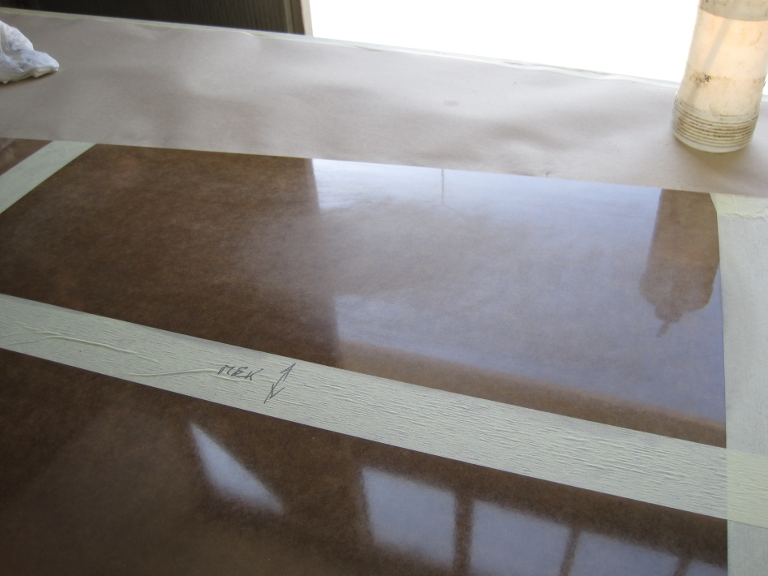
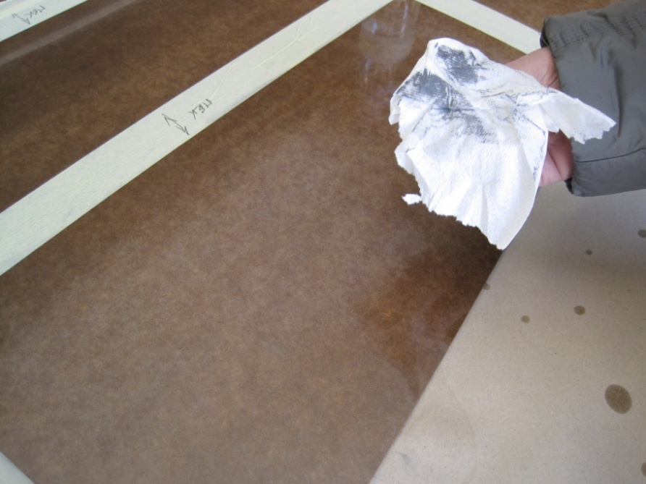
Is there anything leaching out of the HPL and remaining on the surface ?
Abrading with MEK from the GT cleaning machine & “Scotch Bright”
Cleaning with IPA
Clean dry & dull finish
Also vigorously with the 2 other solvents

Slide 13
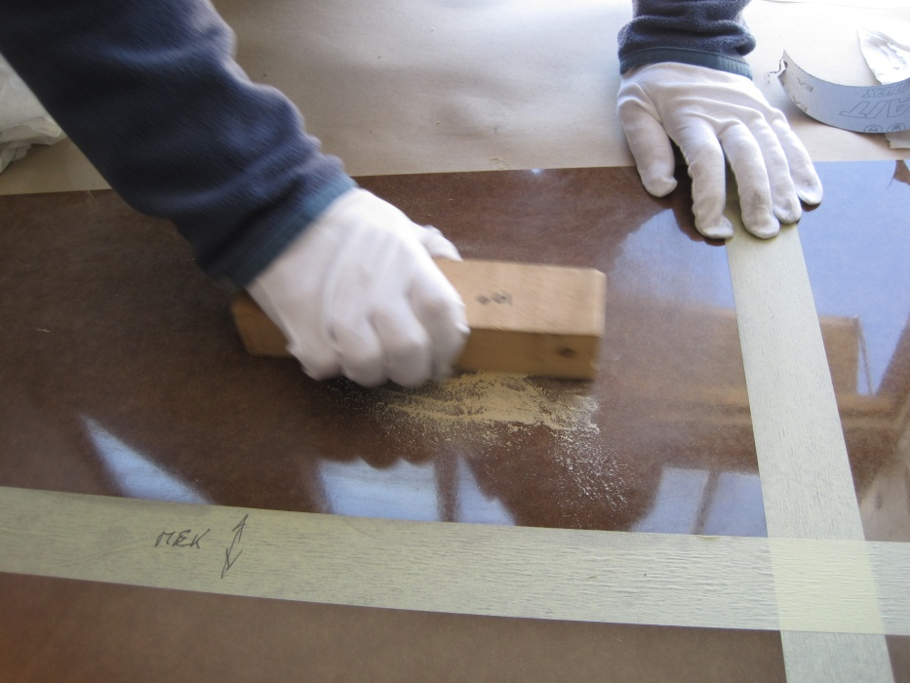
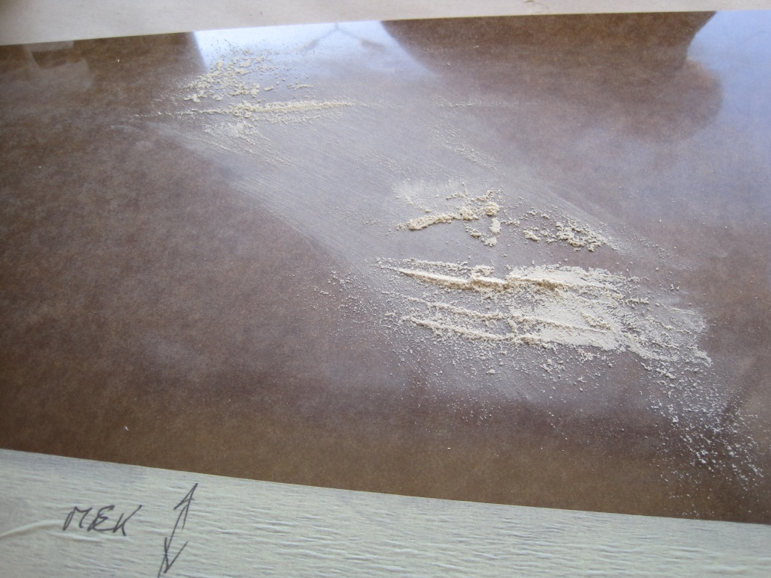
Going into the melamine layer of the HPL
The surface is dry, no leaching of “oil” type products
Using 125 abrasive paper some small quantity of the melamine surface was taken for analysis. We will have these with the week

Slide 14
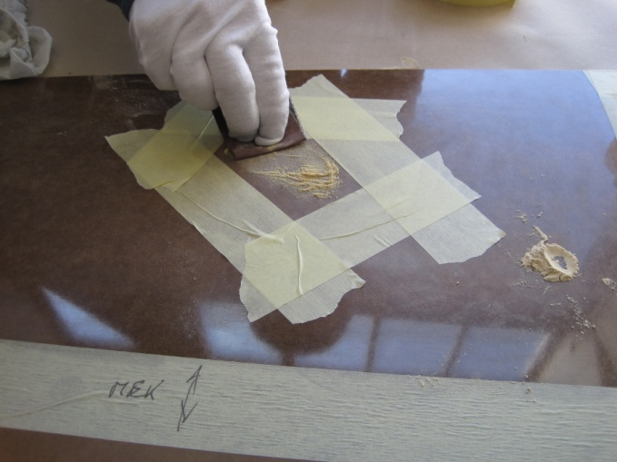
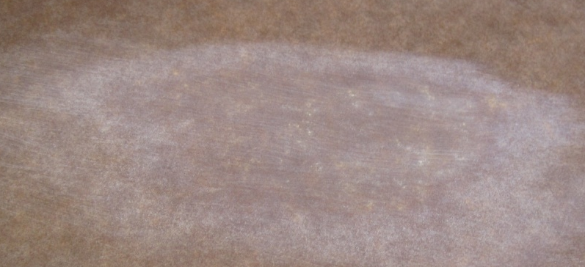
Going to the Phenolic core
Still no leaching of a “wetting” or “dirty” substance coming from within the HPL core. This procedure was performed on both faces of the HPL.
Phenolic layer
Melamine extent
Again another sample (phenolic) was taken for analysis

Slide 15
Conclusions
The sheets(of one box) of HPL delivered from Riva, after cutting, are clean except for the usual dust due to milling out the various formats.
Cleaning with Acetone, MEK or IPA produces a good clean (to the eye) surface.
Kraft paper does not tend to stick to the HPL due to it being wet & compressed with any of the 3 solvents, including the MEK from the GT machine.
4 different levels (superficial, dulling of the mirror finish, abrading of melamine and finally grinding into the core of the panel) of the HPL were tested for leaching of any dirty or oily type products. None were observed by eye.
Samples of the MEK in the GT machine, the roller material, the bristles of the brush, the powder from the upper(melamine) abrading and the core of the HPL have been sent for analysis at CERN labs. None of the samples taken in GT have yet been analysed since their delivery this Monday.

Slide 16
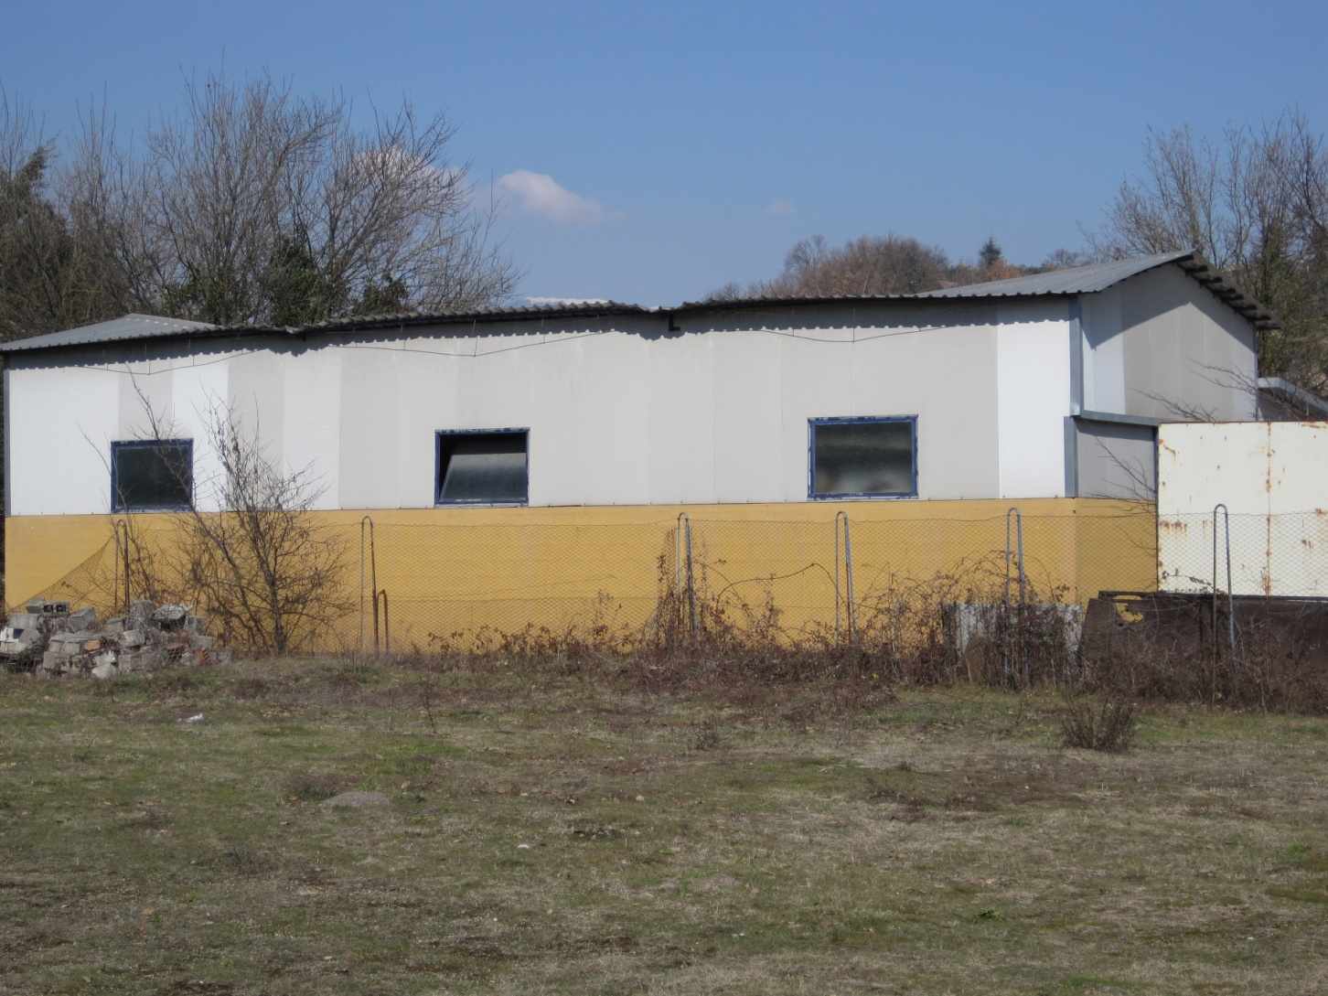
GT damaged due to snow !!

Slide 17
Other photos
http://rpc-cms-re4-upscope.web.cern.ch/rpc-cms-re4-upscope/RPC/Chamber%20production/Components/HPL/CleaningGT/GTVisit2324Feb2012/

Slide 18
Wild goose chasse
http://www.phrases.org.uk/meanings/wild-goose-chase.html

