Slide 1
Bakelite surface vs Gap production
Ian, Paolo, Salvatore
Evaluation of First samples sent back from Korea
Tests and QC of panels presently in GT
Evaluation of second set of samples sent back from Korea
Proposed Strategy to discuss/endorse

Slide 2
First message about dirty surface
In Feb 3rd we were informed by KODEL colleagues that some panels have dirty surface, difficult to clean. “The more they clean, the more they get dirty oily material coming out of panels !”
Salvatore reminded acceptance test in KODEL was positive at reception in December and no warning was raised during 2 RE4 January meetings.
We have to understand the source of this dirty residual (to avoid in future batches) and check if possible to cure them in these batches and avoid in next batches.

Slide 3
First set of samples back from Korea
In Feb 10th we received 4 samples of bakelite with one side graphited and opposite side very dirty, with clear traces induced by a sort of rolling.
Edges (not graphited) of graphited side look very clean.
Dirty residuals on opposite side are not easy to remove by hand

Slide 4
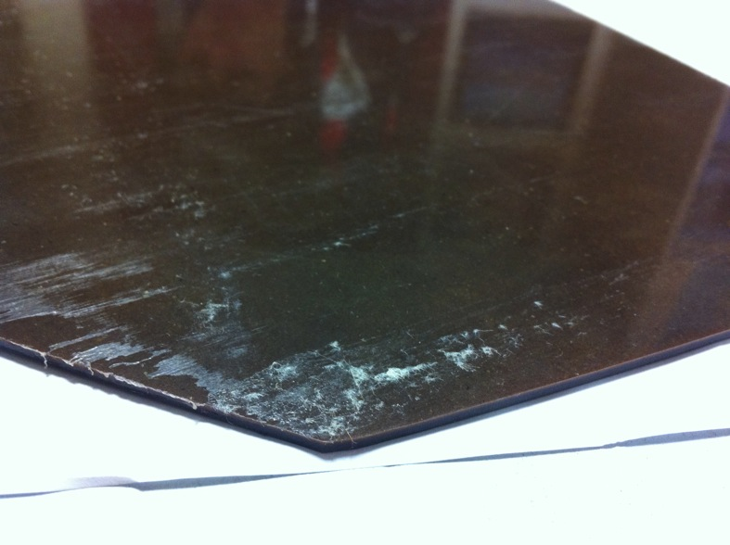
Sample n.1

Slide 5
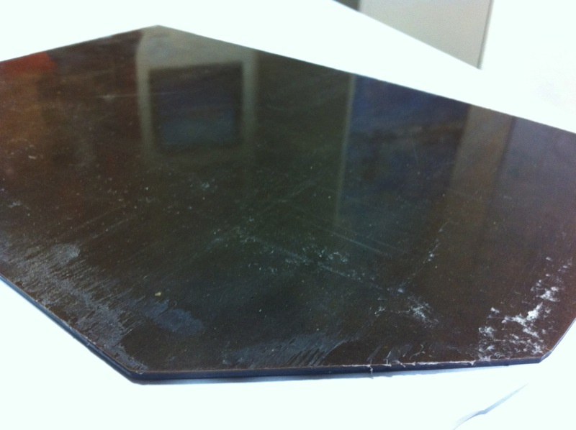
Sample n.1

Slide 6
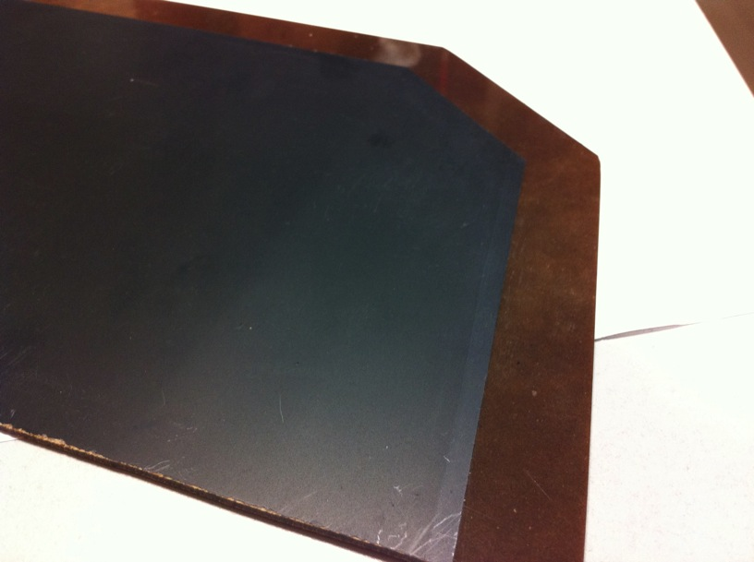
Sample n.1

Slide 7
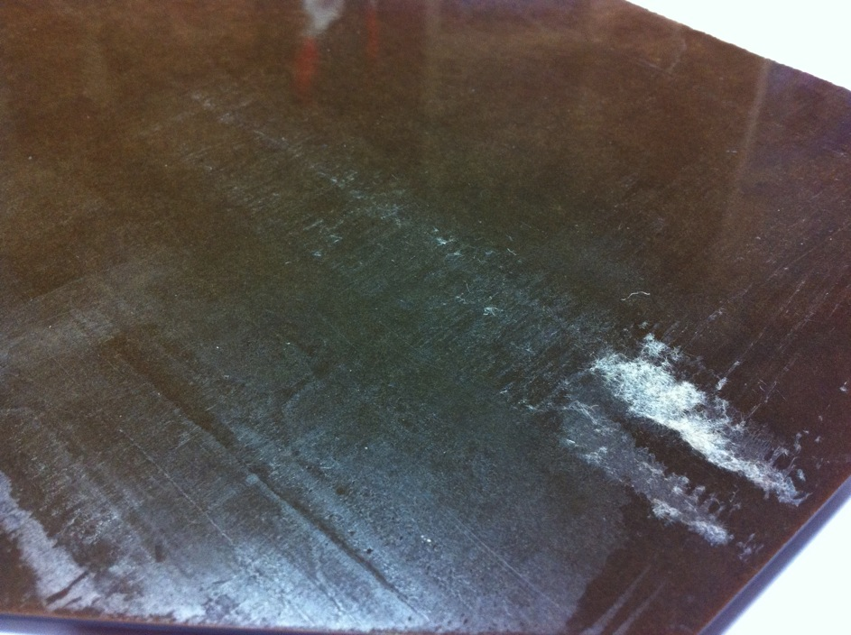
Sample n.2

Slide 8
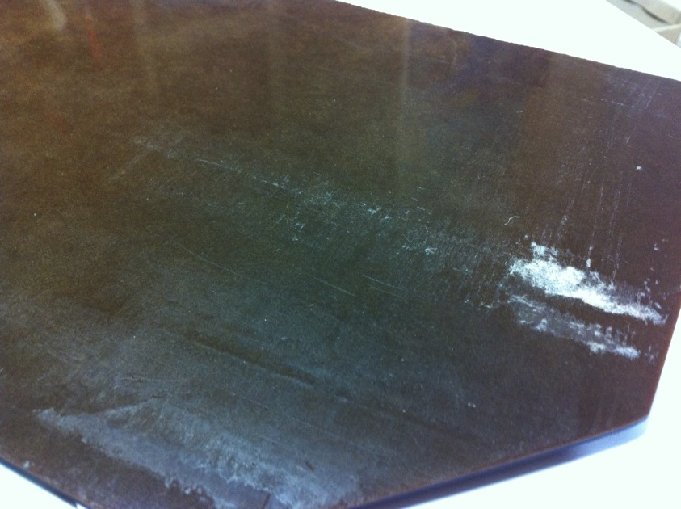
Sample n.2

Slide 9
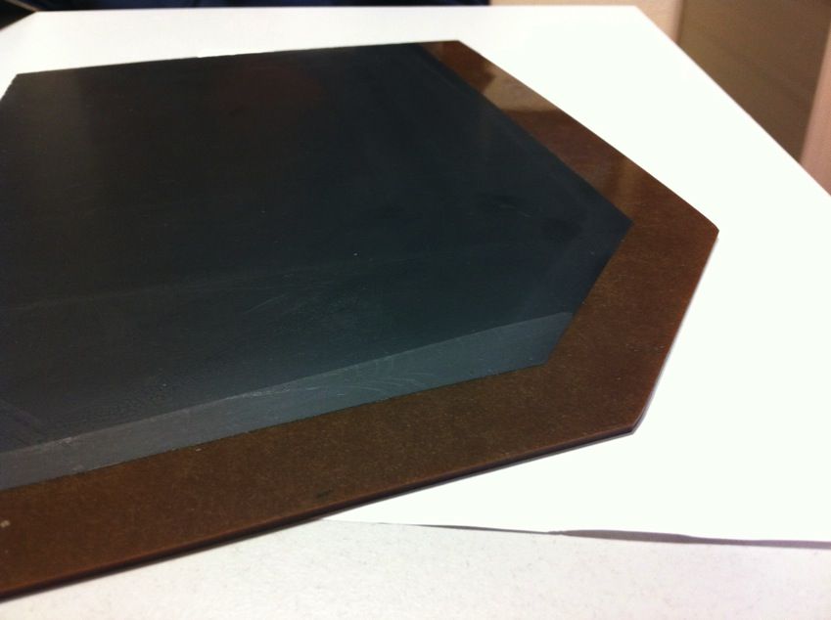
Sample n.2

Slide 10
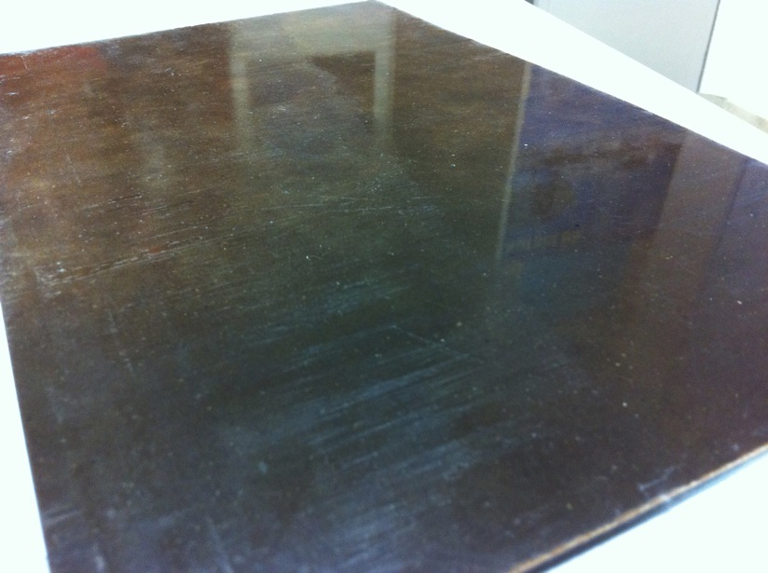
Sample n.3

Slide 11
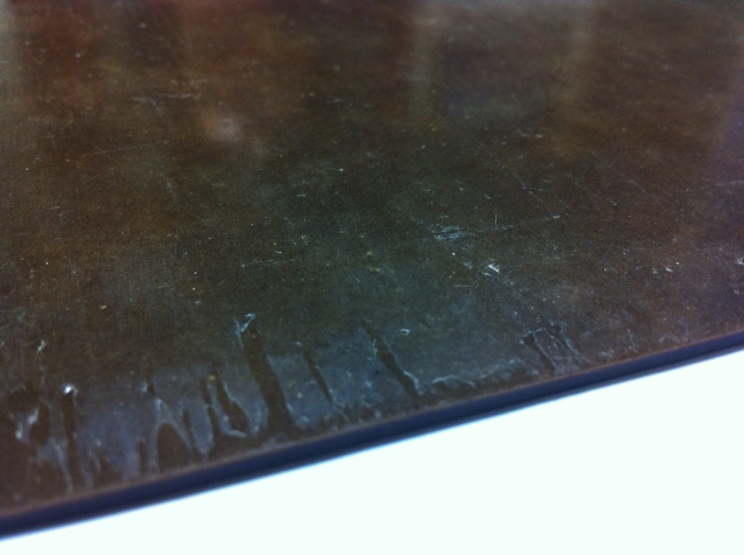
Sample n.3

Slide 12
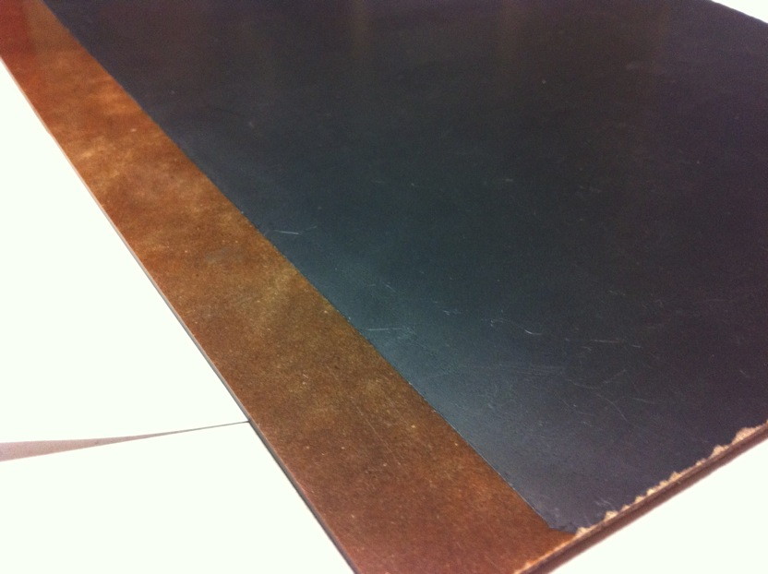
Sample n.3

Slide 13
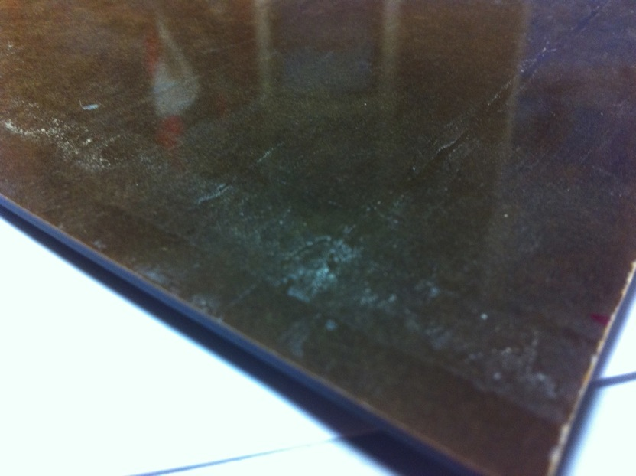
Sample n.4

Slide 14
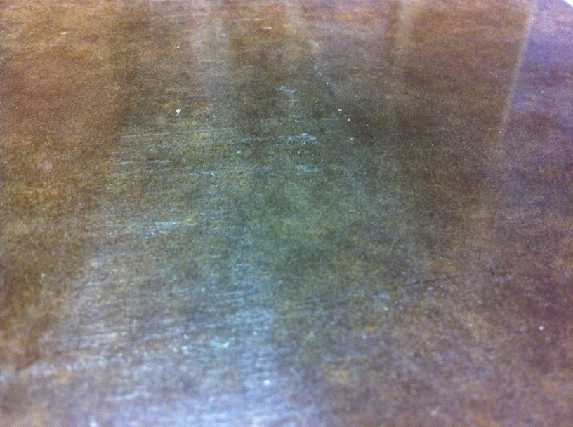
Sample n.4

Slide 15
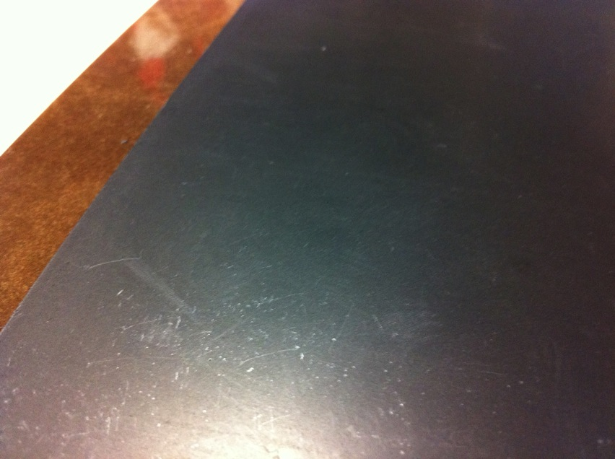
Sample n.4

Slide 16
First set of samples back from Korea
Chemical evaluation of dirty residual done at CERN: Urethane (where is coming from !?) (for more details see talk from Ian in last RE4 meeting)
Questions:
why the material was graphited even being so dirty on one side?
Why the edges on graphited side are so clean and opposite site so dirty?

Slide 17
Trial to detect source of Urethane
Check in Puricelli/Pavia/Riva sites if any oily/greasy/Urethane component in direct contact with panels during panel manufacturing/handling:
NO !!!

Slide 18
Visit and tests in GT
Last site to check in HPL panel handling sites in Italy is GT where the surface cleaning with MEK is performed.
Last week Paolo and Ian spent 2 days in GT to evaluate the material still to wash sitting there, and to get samples of material in direct contact with panels during washing operation: samples under chemical evaluation in CERN chemical service
They did also tests of direct contact of MEK, Acetone and IPA with panel to check chemical compatibility (See Ian/ Paolo talks for more details)
Not possible to wash some panels due to electric problems on the line there (part of electric system out of order due to bad weather in previous weeks, affecting the roof structure)

Slide 19
Visit and tests in GT (2)
Preliminary conclusions:
No problem detected on material delivered from Riva (so excluded any problem of dirty material in previous sites, Puricelli, Pavia, Riva)
No chemical incompatibility found with detergents tested there (MEK, IPA, Acetone)
Still to be controlled surface of panels soon after washing operation (planned for next Thursday).

Slide 20
Request of details (steps) in Gap procedure
Step1: Visual inspection of HPL sheets to cjeck any defect on the surfaces.
Step2: Cleaning on surfaces of the side to be silkscreened by IPA.
Step3: Tapping on silkmask along the peripheries to creat 22-mm-wide HV offsets
Step4: Graphite silkscreening of the HPL surface to creat one part of the electrode
Step5: 7-day drying at room temp.
Step6: Measuring surface resistivity for the graphite electrode -> QC data
Step7: PET coating for electrical insuration with EVA hotmelt glue
Step8: Cleaning on other surfaces of the HPL by IPA to be glued.
Step9: Gluing gaps
Step10: Oiling (20 gaps each time)
Step11: Oil polymerization with 30^oC air for 72 ~ 96 hours (rel. humidity 40%)
Step11: EVA-glue shielding along the peryphery of the gap
Step12: Attaching PET film along for perypheries of gaps for an extra protection of gap edges
Step13: Connections of HV and ground cables
Step14: HV test (spending 7 days including gas circulation) -> QC data
Step15: Leak & pop-spacer tests -> QC data
Step16: Attaching Gap serial barcode labels with HPL barcodes -> QC data
Step17: Attaching thin films on both PET-coated surfaces of gaps to protect from HV breakdowns.
Step18: Packing 60 gaps in each shipping box

Slide 21
Request of details (steps) in Gap procedure
Apparently the dirty surface conditions were NOT detected in visual inspection, NOR in step 2 (IPA cleaning before Graphiting), but only in step8 (cleaning with SAME IPA but on opposite side.
Request to try the IPA cleaning BEFORE ANY other action on the material to detect if problem of dirty residuals is on both sides or only in GT washed side.
Result provided yesterday: the cleaning before graphiting is less precise and residual material is NOT giving relevant problem on that side before graphiting.
The cleaning on opposite side at step 8 is more detailed and demands much more detailed treatment, present result is negative ror large size panels.
If same detailed cleaning procedure is applied on both sides the material stays dirty at same level and “oily residuals come out of material”.

Slide 22
Second set of samples back from Korea
Requested additional samples of panels from Korea BEFORE any action on them.
Material received at CERN on feb 24th. Some samples provided yesterday to CERN chemical service for chemical analysis of residuals on surface

Slide 23
Second set of samples back from Korea
Preliminary conclusions:
in many cases material seems to be easier to be cleaned wrt samples in first set. Do steps 2-7 (graphiting, PET, hot melt) affect the hardness of dirty residuals?
Trials of fast cleaning on half of the surface with IPA on ALL received samples gave positive results.
NO Oily material coming out of the panels (same results also in GT tests – see Ian/ Paolo talk)

Slide 24
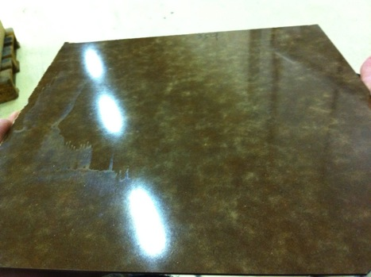
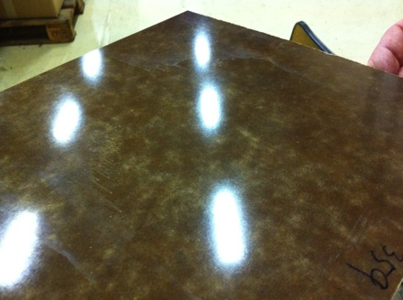
Second set of samples back from Korea
Before cleaning
After cleaning half surface
Half NOT cleaned
Half cleaned
Batch 10
Cleaning with IPA in 5 sec

Slide 25
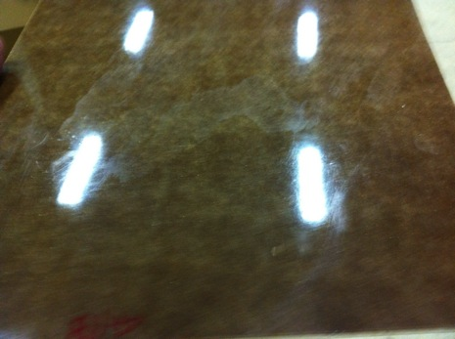
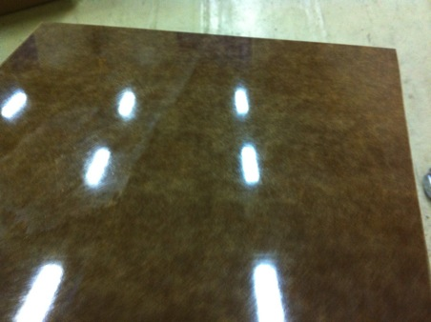
Second set of samples back from Korea
Before cleaning
After cleaning half surface
Half NOT cleaned
Half cleaned
Batch 12
Cleaning with IPA in 5 sec

Slide 26
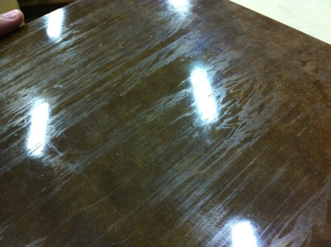
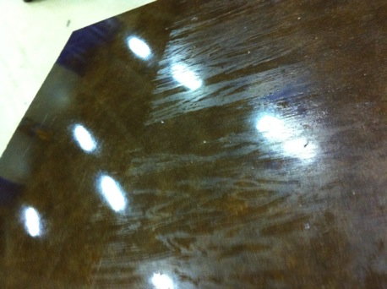
Second set of samples back from Korea
Before cleaning
After cleaning half surface
Half cleaned
Half NOT cleaned
Batch 13
Cleaning with IPA in 5 sec

Slide 27
Proposed Strategy to discuss/endorse
Question n.1: where this residual is coming from?
We do NOT know yet. We have to detect it in order to prevent for next batches. Anyway we can EXCLUDE it is produced by the panel itself (and/or amplified during IPA cleaning). Source excluded in Puricelli/Pavia/Riva.
Still to be re-checked the washing procedure in GT (next thursday).
Reminder: Ian was supervising the first washing actions for these batches in last november and NO problem detected !
Still to get details/samples of material in direct contact with Panels in Kodel procedure (steps 1-7)

Slide 28
Proposed Strategy to discuss/endorse
Question n.2: Is this dirty material compatible for Gap production, even cleaning both surfaces by hand with IPA BEFORE any action on them (step 2 for both sides)?
Cleaning trials at CERN seem to show this is not so difficult, nor time consuming.
If YES let’s proceed with Gap production and tests in KODEL
If NO please ship the material back to CERN

Slide 29
Proposed Strategy to discuss/endorse
Question n.3: some doubts were raised about the chemical compatibility of this bakelite with KODEL gap production procedure.
Reminder: melaminic material (paper+ resin) is the same as Pampla. Gluing tests showed NO problem in October (both in GT and Kodel). Only pending test is about oiling efficiency.
We have no alternative material !
If this statement is true (for any reason in KODEL), we have to test its compatibility with Gap production procedure in GT

