Slide 1

Validation of RE4 Cu cooling systems
for mass production
L. M. Pant^{1,*}, Manish Kumar²
¹Nuclear Physics Division
²Mechanical Design & Prototype Development Division
Bhabha Atomic Research Centre
Mumbai - 400085, INDIA
* email : lmpant@barc.gov.in

Slide 2
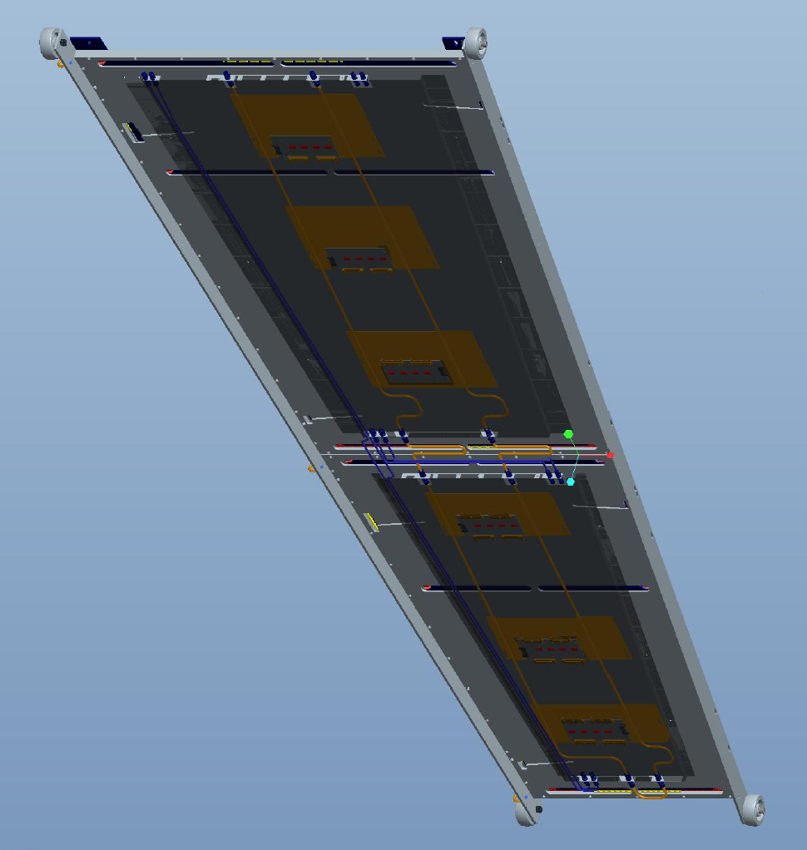
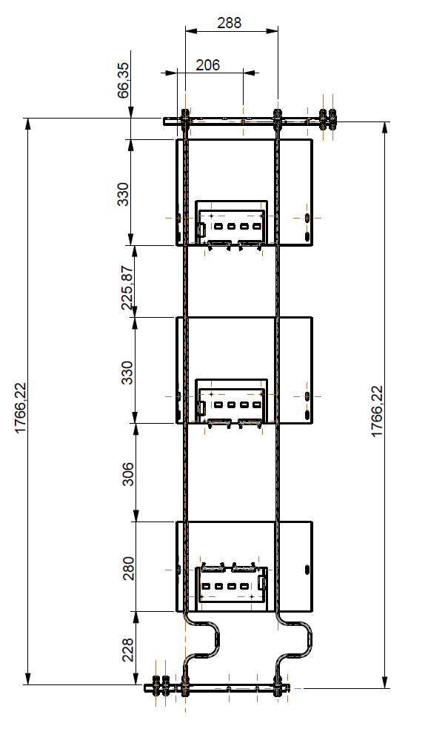
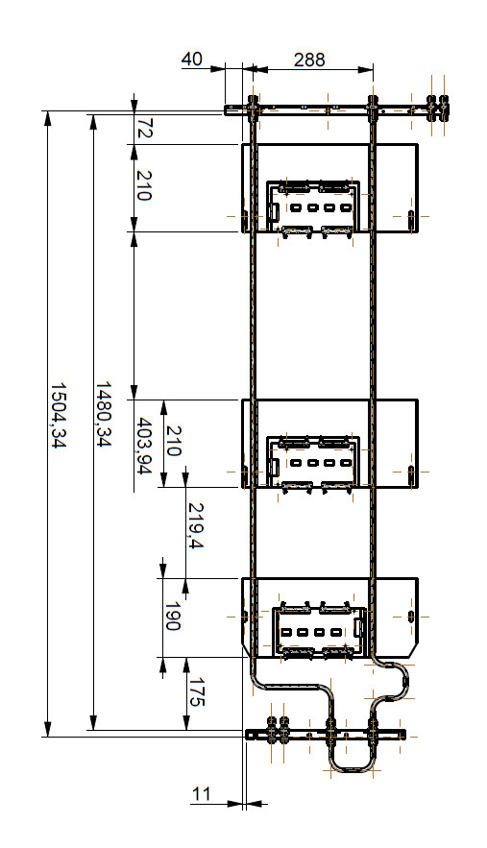
RE4/3
RE4/2

Slide 3
Specifications : Cu plates and pipes
Vicker’s Hardness (HV5) : 90-100
Cu Plates : 1 mm thick
Cu Pipes : 8 mm OD
: 6 mm ID
Chemical Compositions :
Plates (OFC) : 99.95% (Min) Cu
Pipe (DHP Cu) : 99.85% (Min) Cu
: 0.013 - 0.050% P
Solder (Sn62) : Sn : Ag : Pb & other 62 : 02 : Remaining
Leak test : 20 bar of Ar

Slide 4
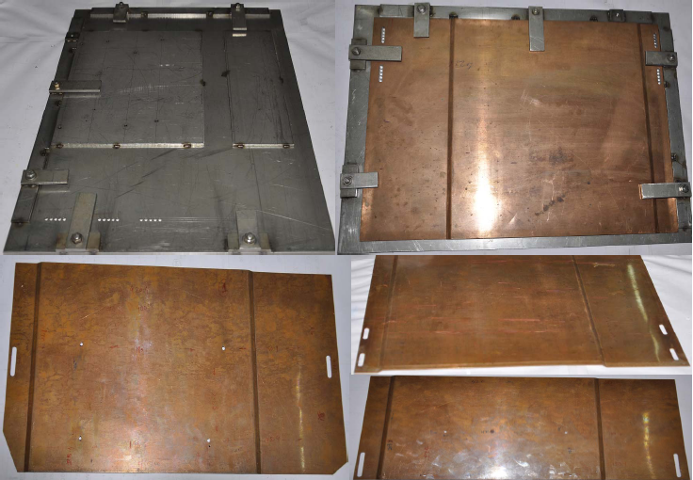
Cutting, bending and drilling of Cu plates

Slide 5
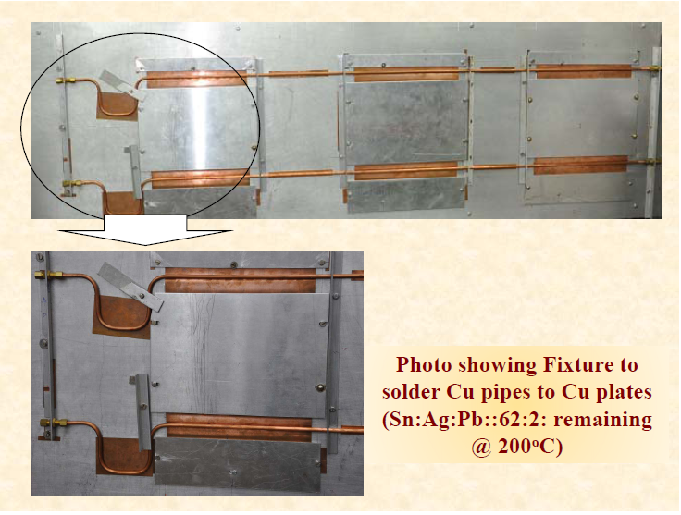
Cu cooling assembly being soldered in a jig

Slide 6
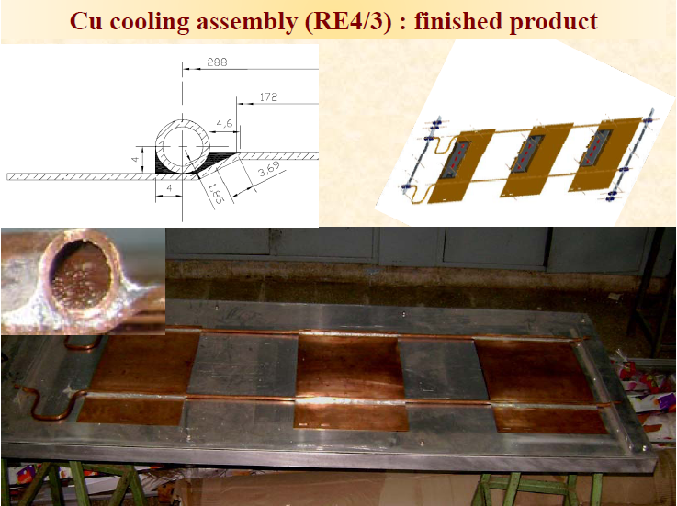
Cu cooling assembly (RE4/3) finished product

Slide 7
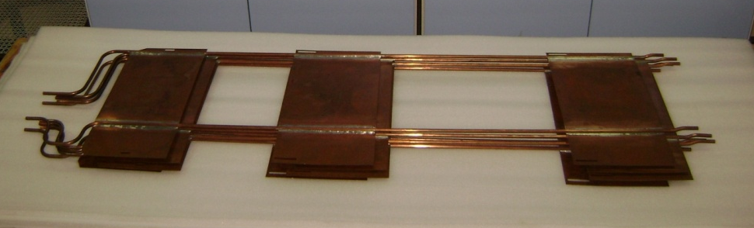
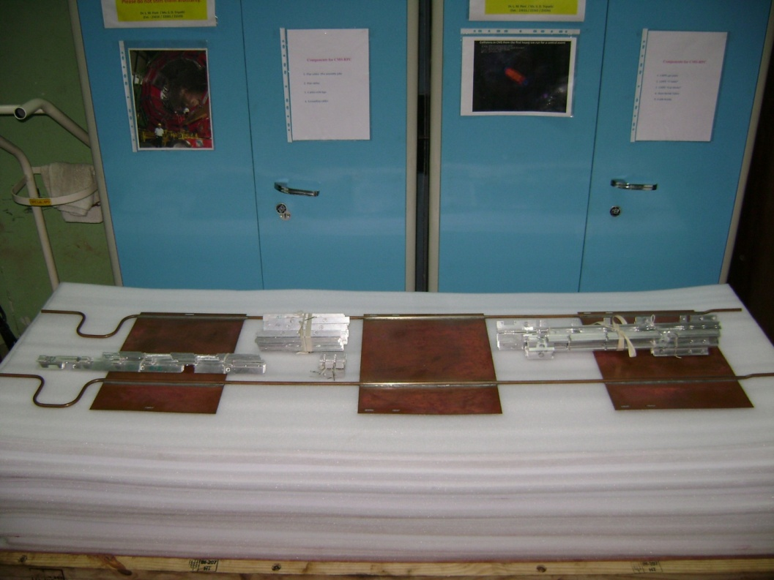
RE4/2 and RE4/3 Cu cooling system, in queue for leak tests

Slide 8
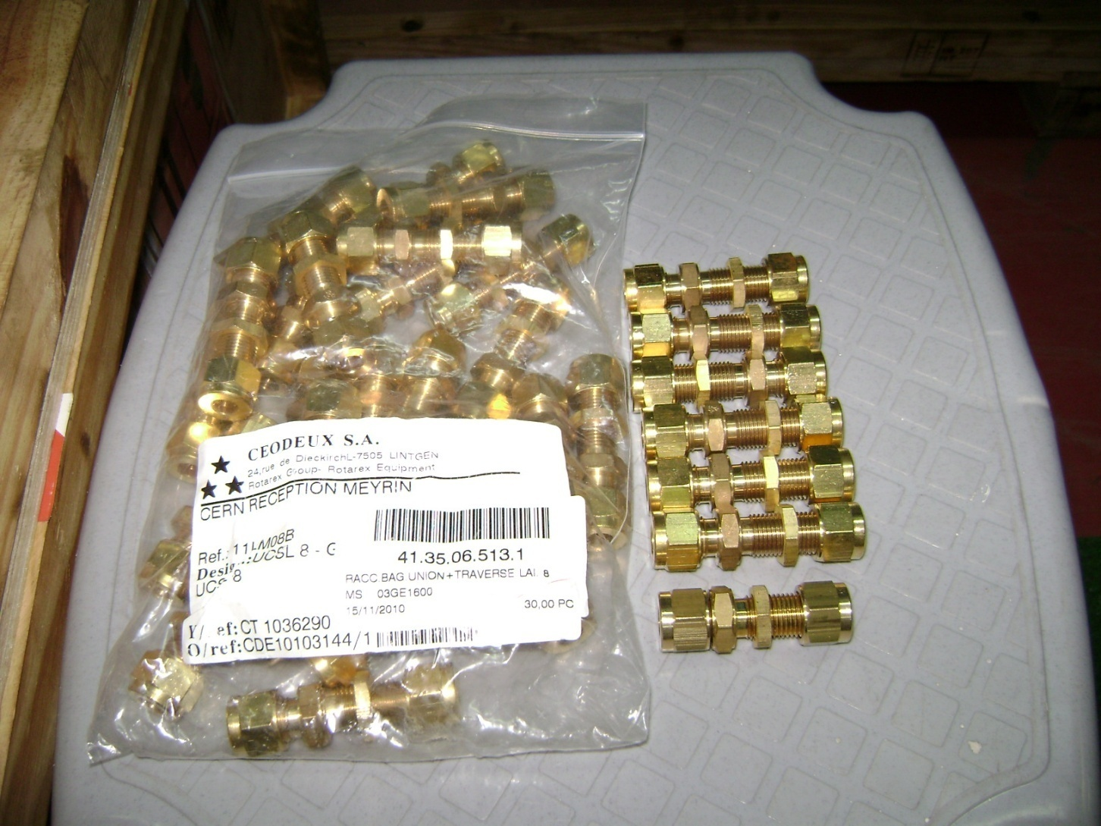
SAGANA connectors sent from CERN
Some of the connectors
had ferrules missing
inside them

Slide 9
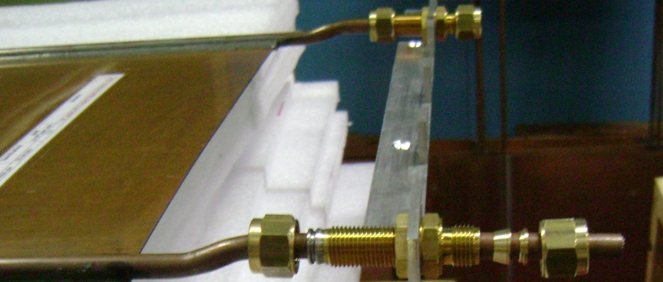
SAGANA Nuts with double ferrules on Cu cooling assemblies, mounted on Al patch panel
SAGANA Nuts
Double SS ferrules
from ROTAREX
“crimped”
Double Brass ferrules,
on the other side
“not crimped”

Slide 10
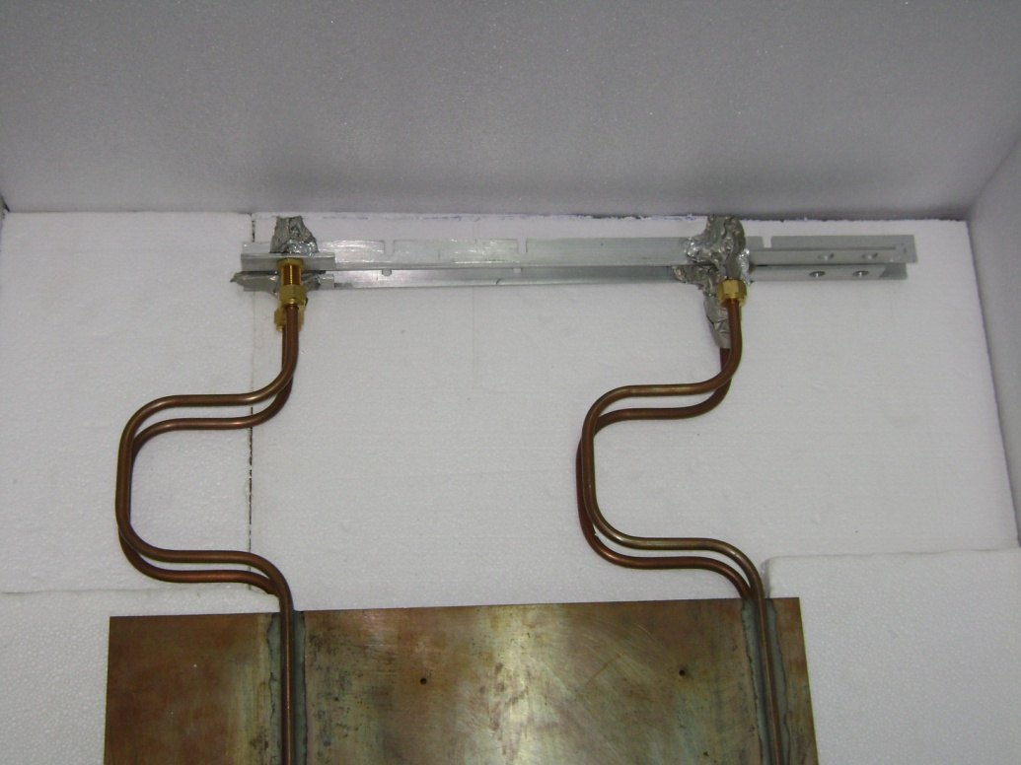
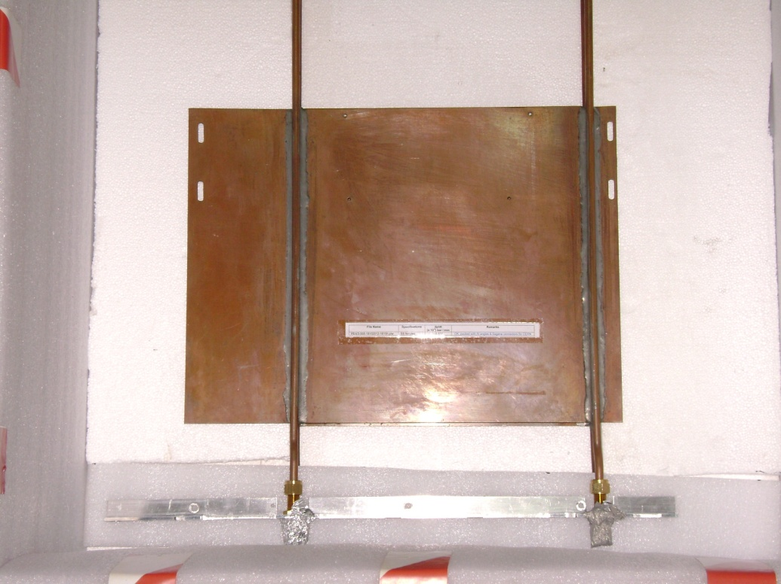
Cu cooling system placed in the Box for dispatch

Slide 11
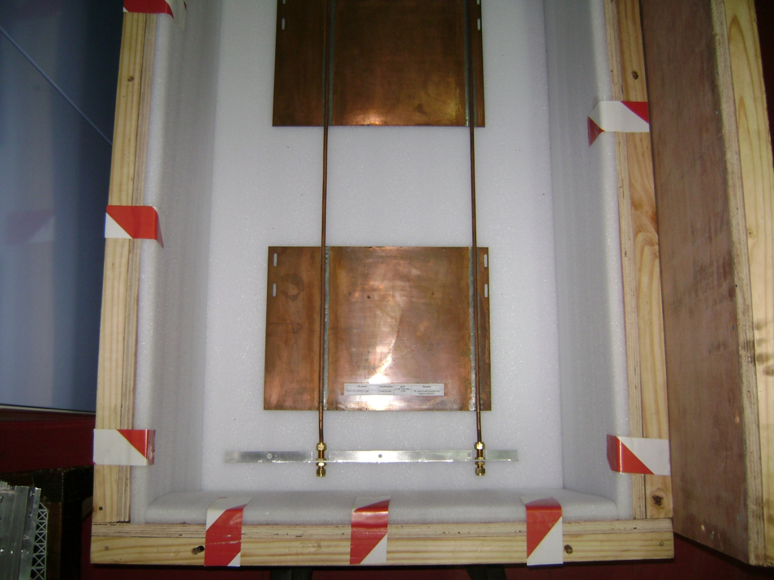
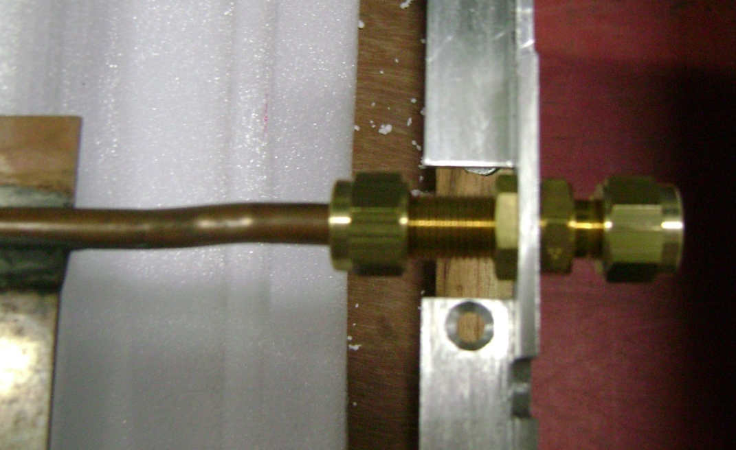
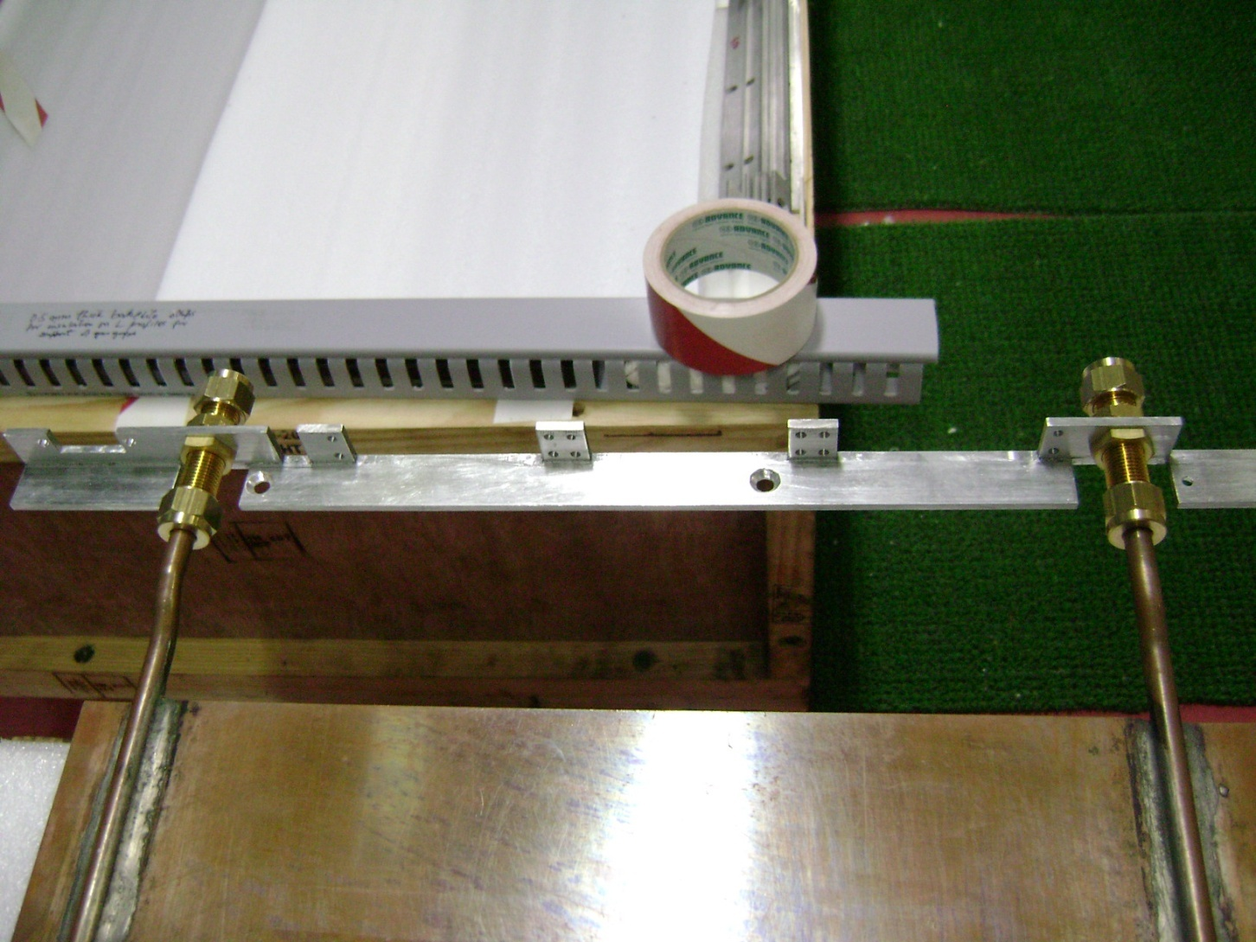
Some of the SAGANA couplings connected to Cu cooling systems

Slide 12
Some of the SAGANA couplings connected to Cu cooling systems

Slide 13
Some of the SAGANA couplings connected to Cu cooling systems
Aluminum patch panel,
conforming with
old HV Tripolar
Longer side of
SAGANA coupling is
towards the inside of
the “L” profile

Slide 14
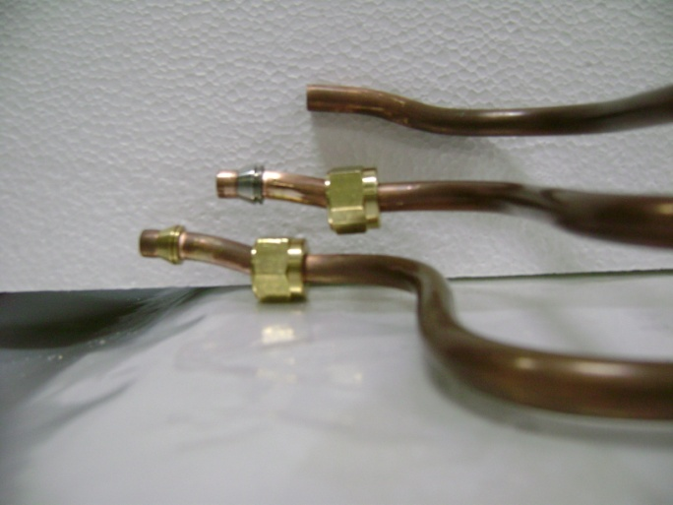
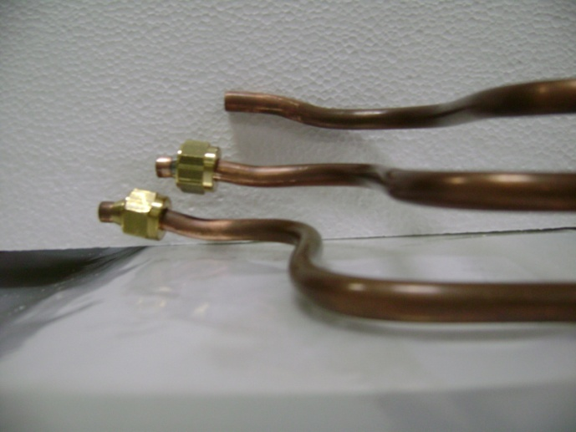
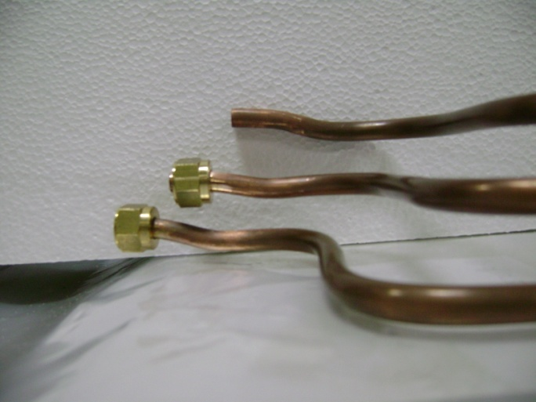
Difficulties in taking the Brass nut over the bend in the pipe

Slide 15
Cu pipes raised much earlier near the “U” bend

Slide 16
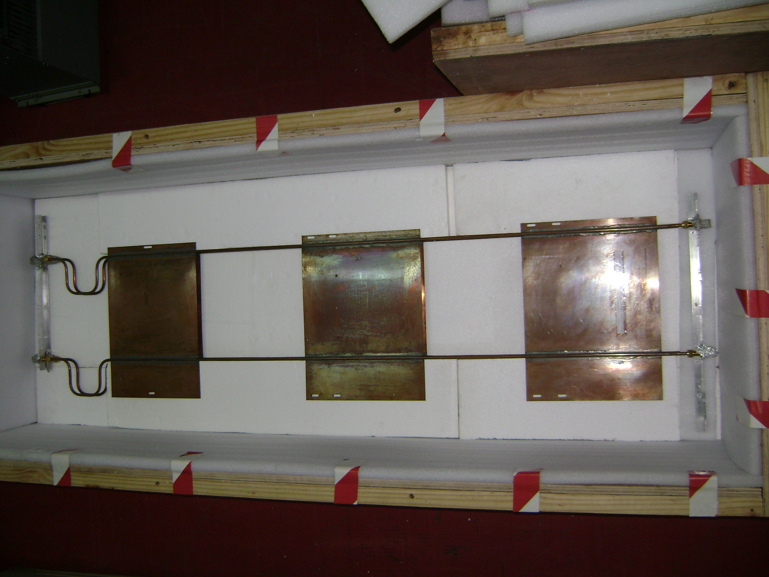
Cu cooling system placed in the Box for dispatch to CERN and Ghent

Slide 17
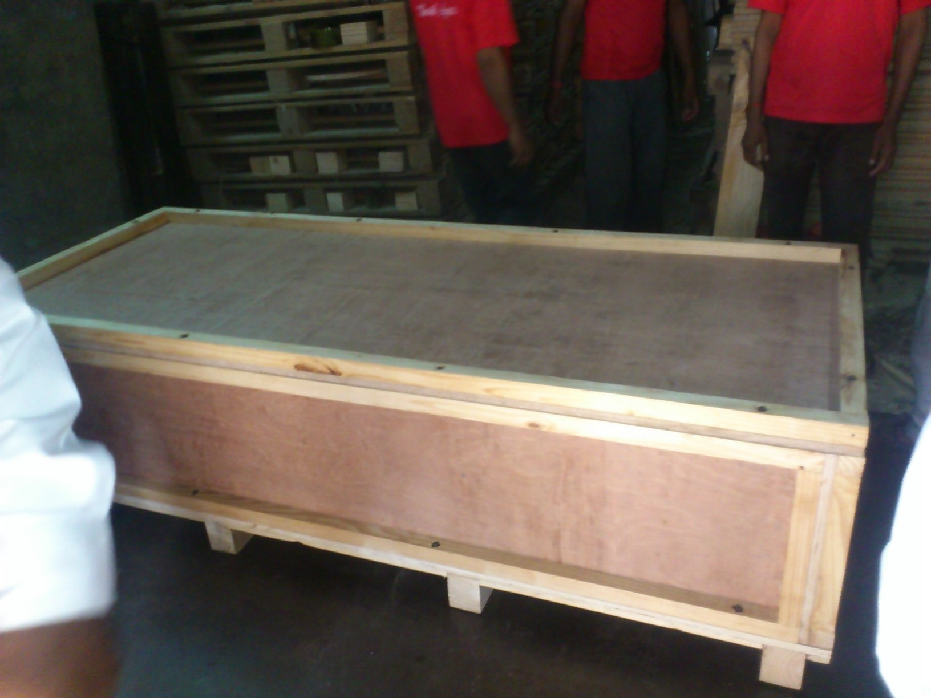
Heat Treated wooden box for transportation of
Cu cooling assemblies to CERN & Ghent
Inside size (L x B x H) : 1900 mm x 700mm x 400 mm
Outtside size (L x B x H) : 2015 mm x 820 mm x 550 mm
Weight of empty box : 96 Kg

Slide 18
Pilot run for production of first 30 sets of
Cu cooling systems for RE4 dispatched on 07th Nov. 2012
RE4/2 : 05 sets : fabricated, leak tested and dispatched to CERN
RE4/3 : 05 sets : fabricated, leak tested and dispatched to CERN
RE4/3 : 10 sets : fabricated, leak tested and dispatched to Ghent
        : Both the boxes have been received at CERN and Ghent
        on 11th Nov. 2012
RE 4/2 : 10 sets : under fabrication for BARC, at the moment
After the delivery of the Cu cooling sets, we would like to profit from your expertise and feedback to launch the mass production of the remaining 170 sets, including discussion on SS ferrules and Brass nuts

Slide 19
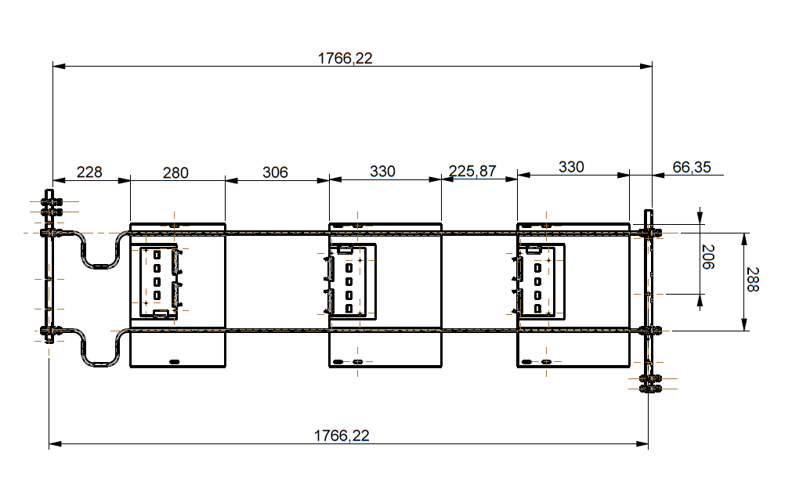
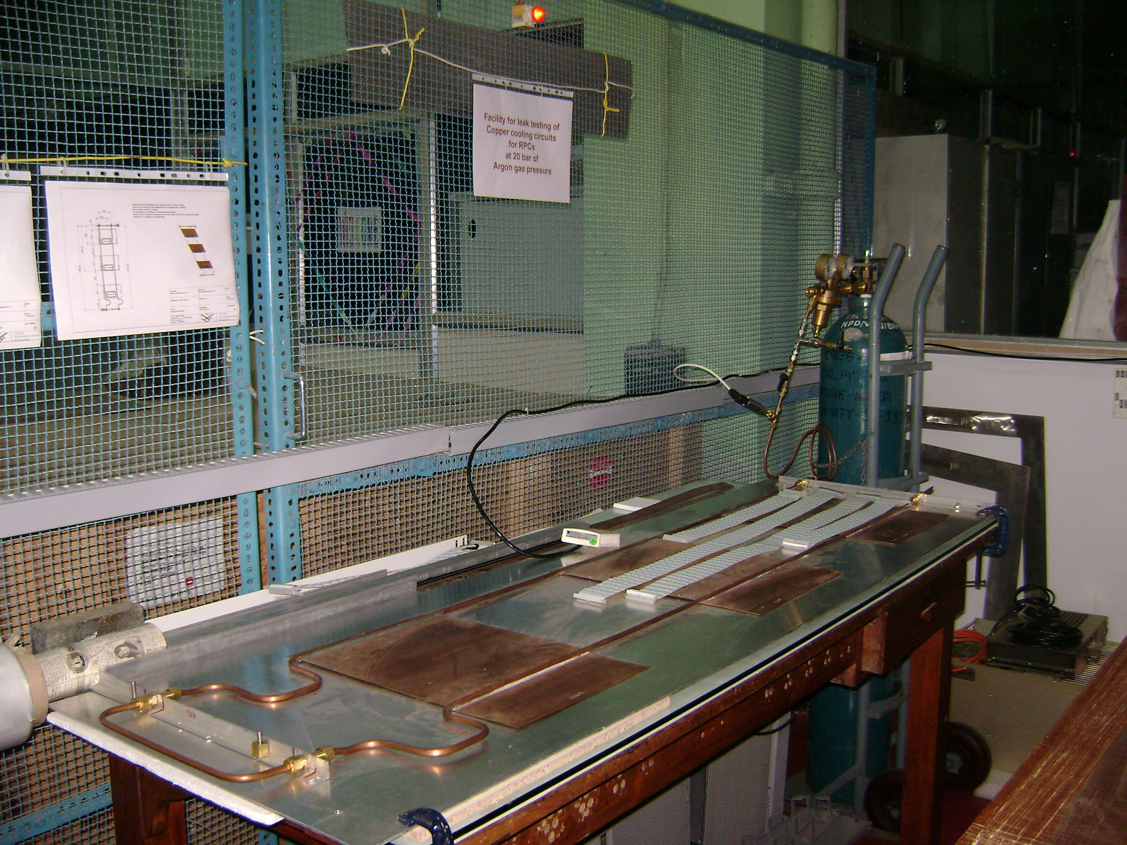
Leak test for Cu cooling systems
Cu tubes :
OD = 8 mm φ
ID = 6 mm φ
thickness : 1 mm

Slide 20
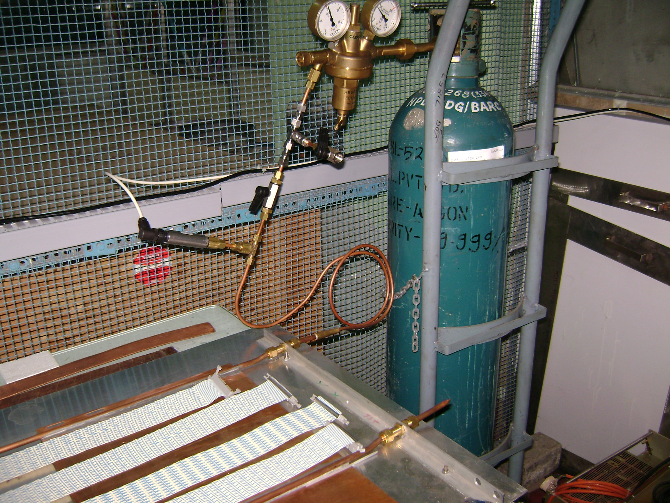
Details of leak test facility
Outlet Pressure
20 bar
Inlet pressure
∼ 80 bar
Valve A open
Safety release
0 -35 bar
pressure transducer
Argon gas
Extra Cu pipe : OD = 6 mm
length = 100 cm
Cu tube pinched at one end

Slide 21
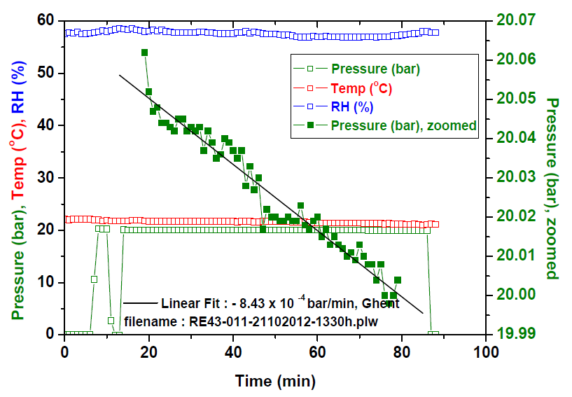
Fall in pressure : dp/dt = - 8.43 x 10 ⁻ ⁴ bar / min
Leak Rate measured = - 18.27 x 10 ⁻ ⁴ mbar . litre / s

Slide 22
Differences in dp/dt : explanation
Same RE4/3-001 Cu cooling assembly
25th Aug. 2012 : dp/dt : - 2 .0 x 10 ⁻ ² mbar /sec
: Valve A open (19 joints)
(6 more joints exposed)
06th Sept. 2012 : dp/dt : - 4.7 x 10 ⁻ ³ mbar /sec
: Valve A closed (13 joints)
Valve A

Slide 23
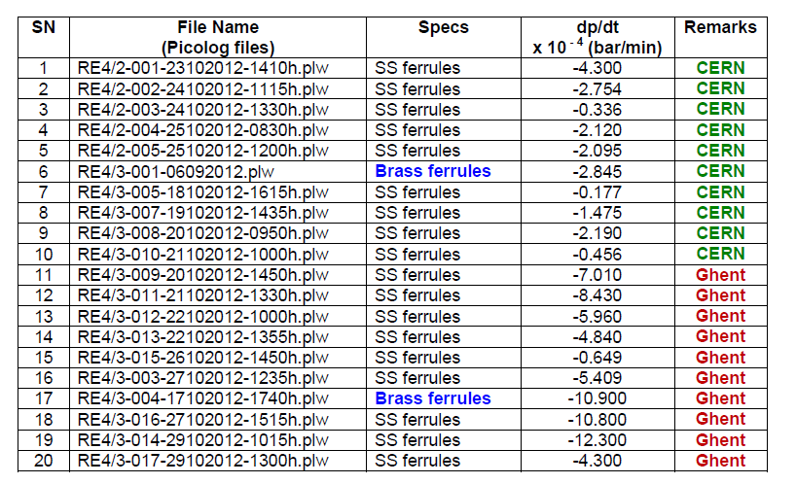
fall in pressure, dp/dt, for 20 Cu cooling systems

Slide 24
Y axis : fall in pressure (- dp/dt) x 10 ⁻ ⁴ bar . min ⁻¹
CERN
Ghent
Brass ferrules
(-dp/dt ) x 10 ⁻ ⁴ bar . min ⁻¹
Brass ferrules

Slide 25
dimensions of Cu tubes for RE4/2 and RE4/3
 | A mm | B mm | C mm | D mm | Total length (A+B+C+D) mm | Total length cm | Internal radius cm | Vol E cm³ | Volume of fixed Cu tube ID = 0.4 cm & l = 100 cm F cm³ | Total volume (E+F) cm³ | Total Volume litre
RE4/2 | 1504 | 1504 | 288 | 144 | 3440 | 344.0 | 0.3 | 97.264 | 12.566 | 109.83 say 110.00 | 0.110
RE4/3 | 1766 | 1766 | 288 | 288 | 4108 | 410.8 | 0.3 | 116.151 | 12.566 | 129.08 say 130.00 | 0.130
Vol _{RE4/3 Cu tube}
= 1.194
Vol _{RE4/2 Cu tube}
RE4/2 : x 10 ⁻⁴ bar/min → x 1.833 x 10 ⁻⁴ mbar . litre . s⁻¹
RE4/3 : x 10 ⁻⁴ bar/min → x 2.167 x 10 ⁻⁴ mbar . litre . s⁻¹

Slide 26
Y axis : Leak Rate : x 10 ⁻ ⁴ mbar . litre . s ⁻¹
CERN
Ghent
x 10 ⁻ ⁴ mbar . litre . s ⁻¹

Slide 27
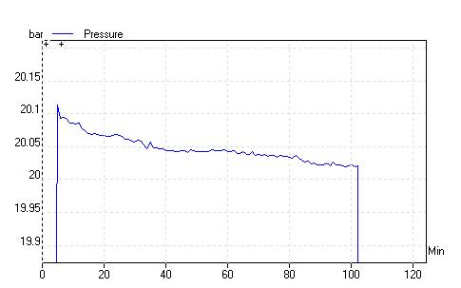
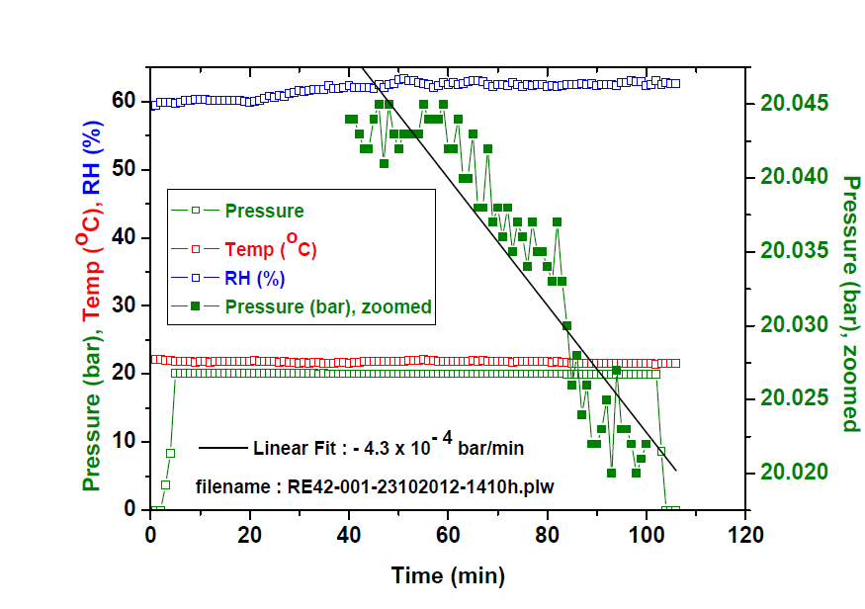

Slide 28
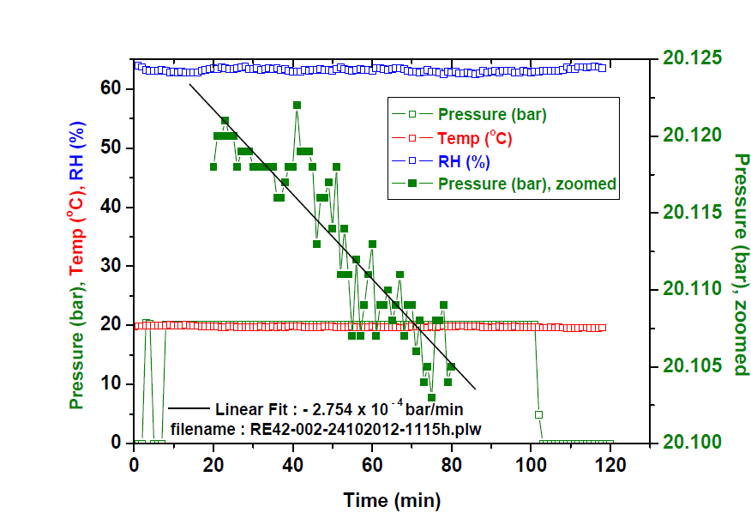
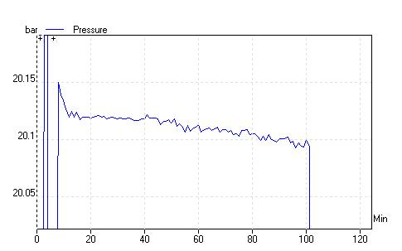

Slide 29
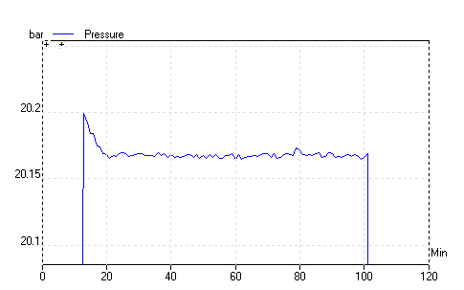
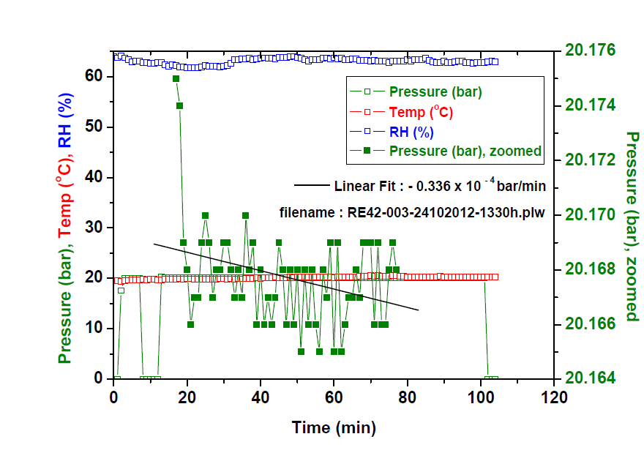

Slide 30
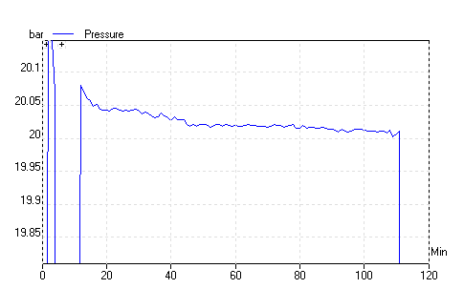
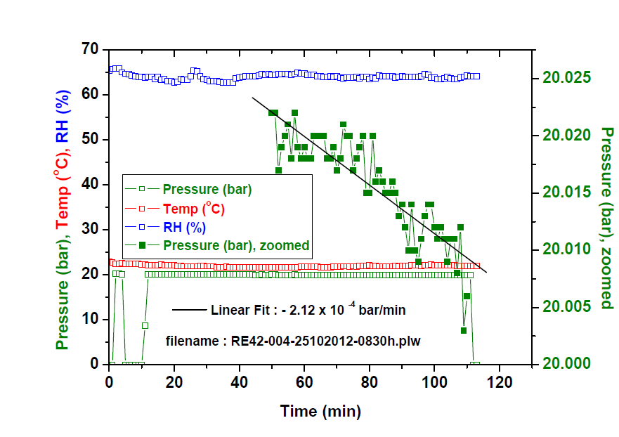

Slide 31
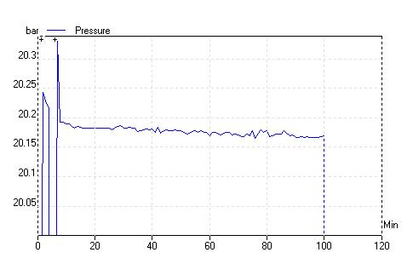
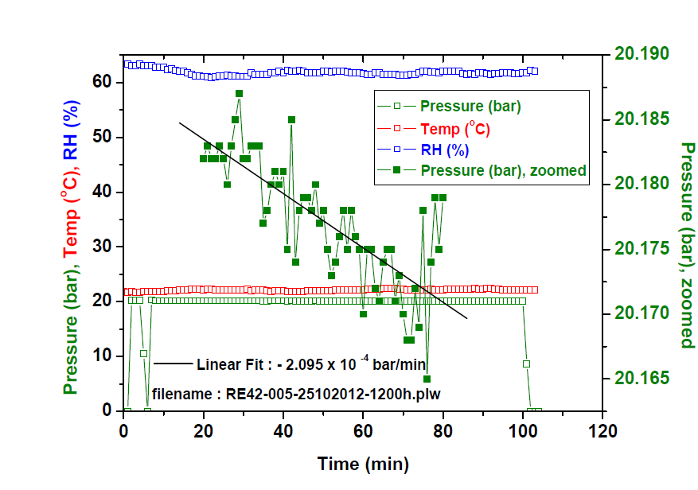

Slide 32
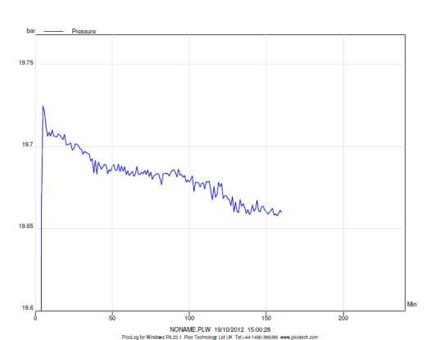
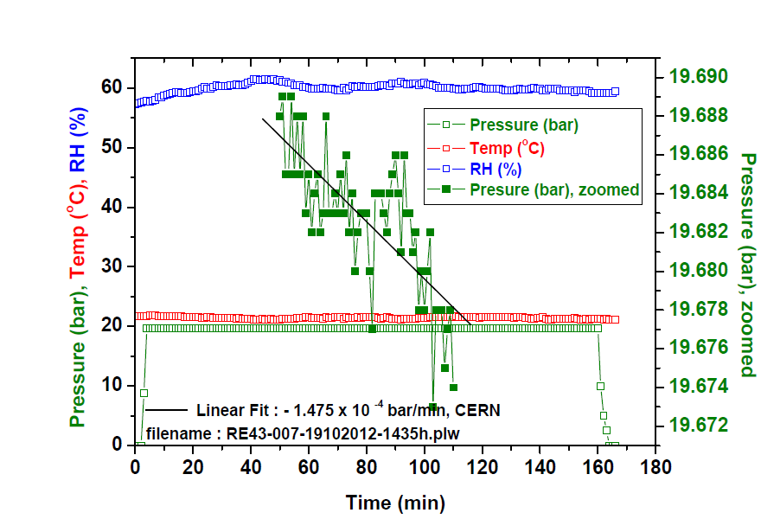

Slide 33
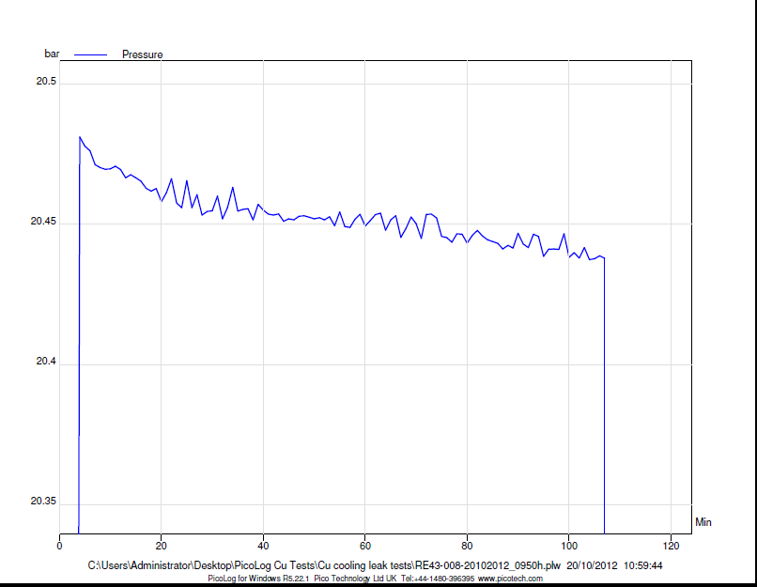
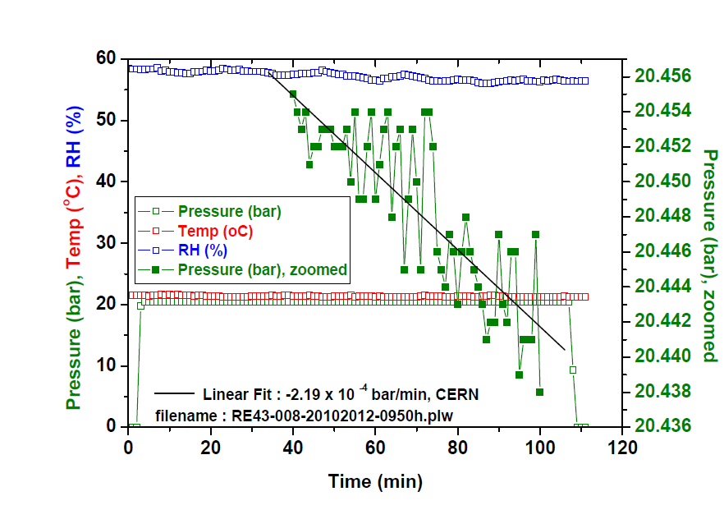

Slide 34
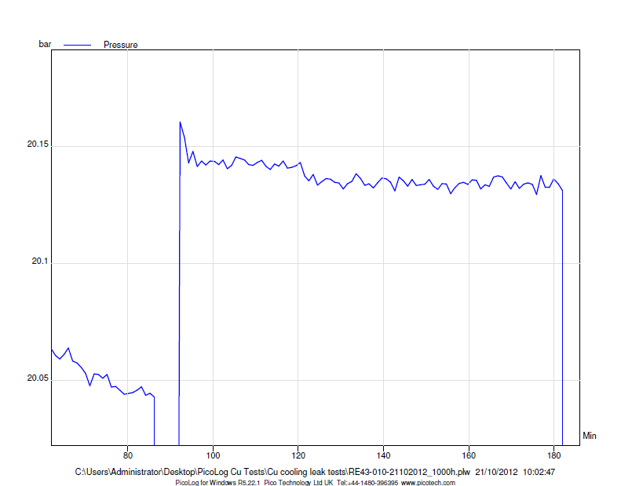
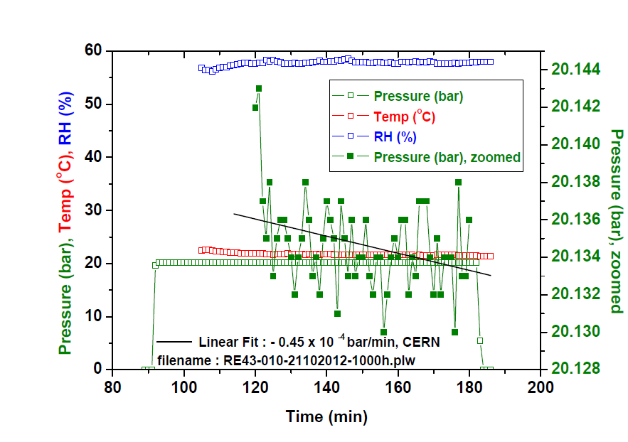

Slide 35
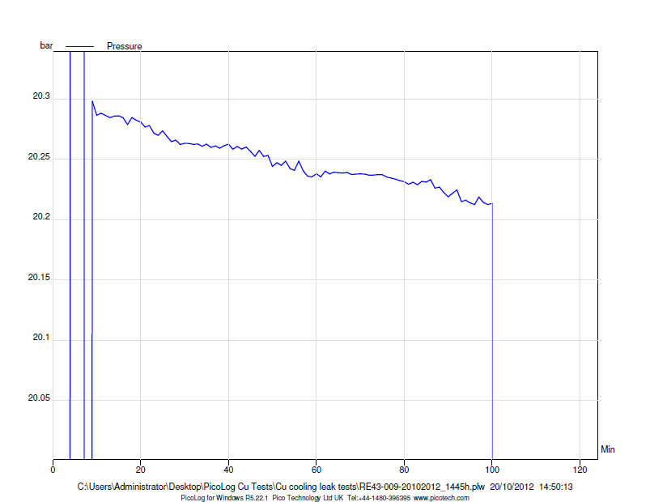
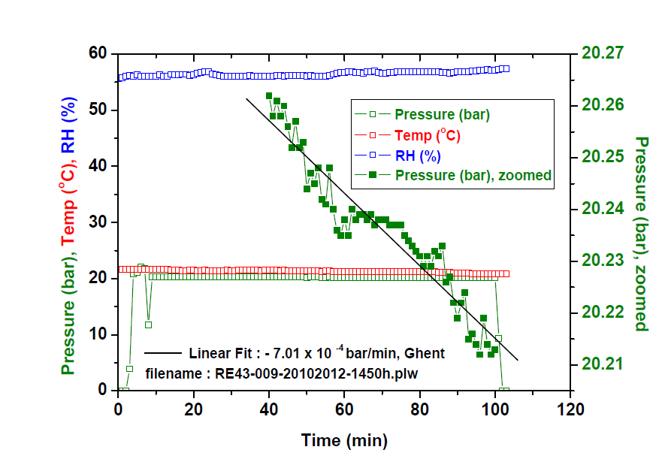

Slide 36
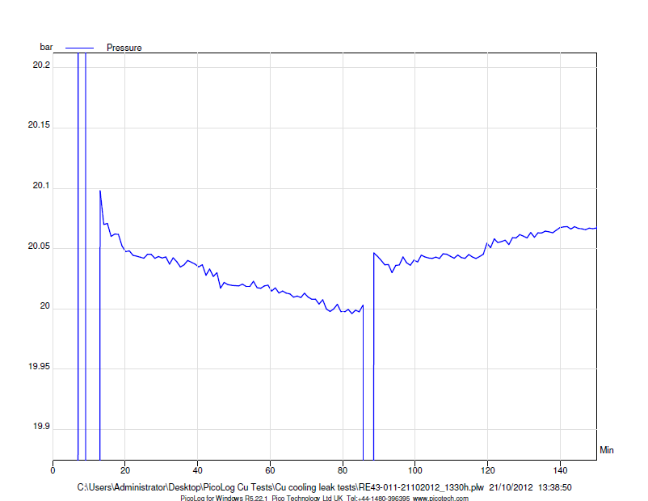
AC Off

Slide 37
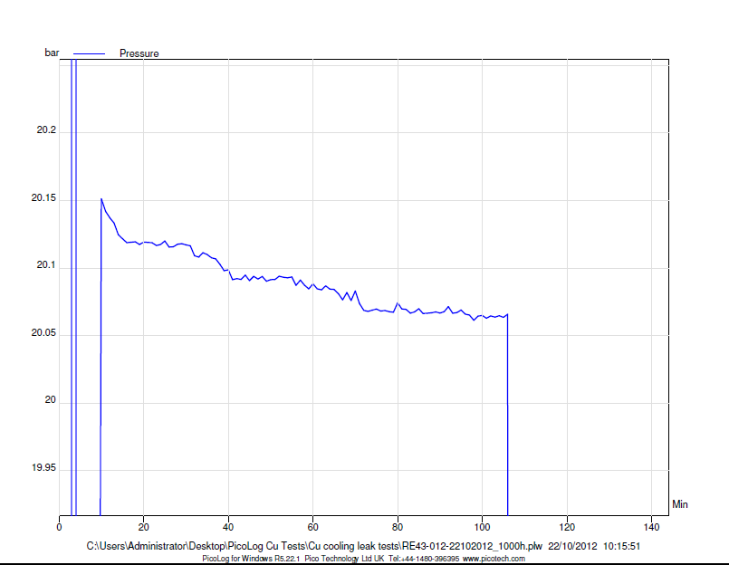
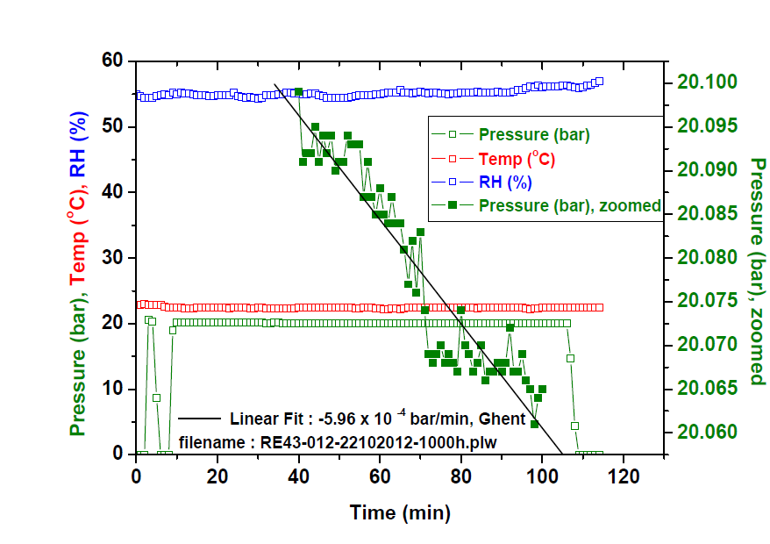

Slide 38
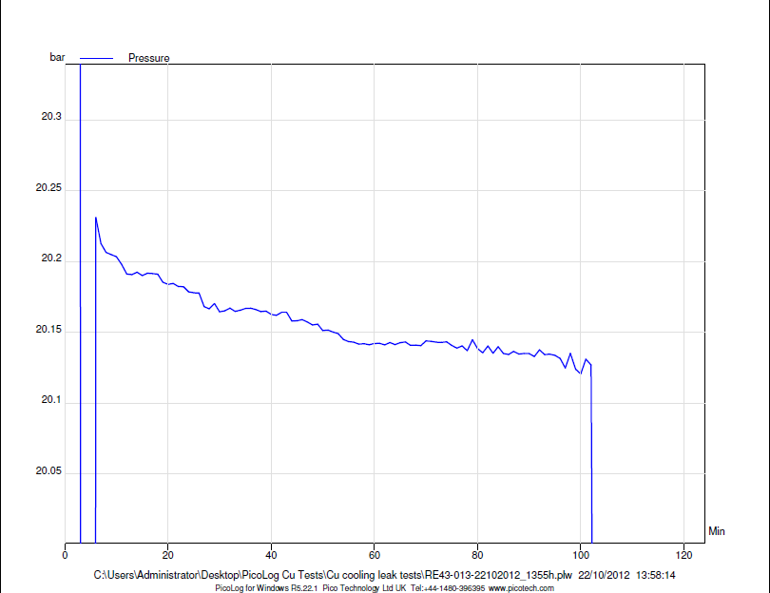
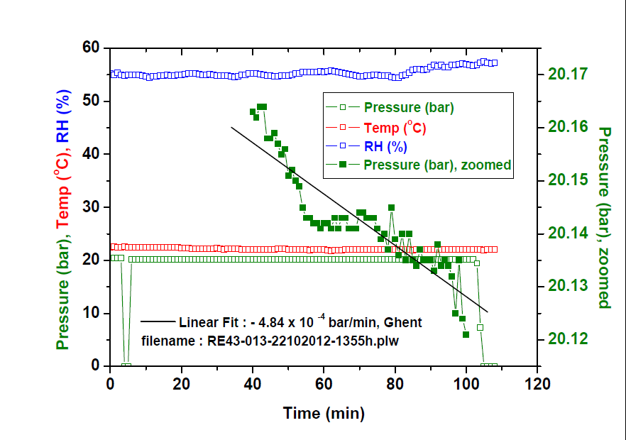

Slide 39
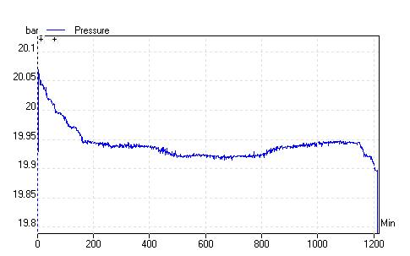
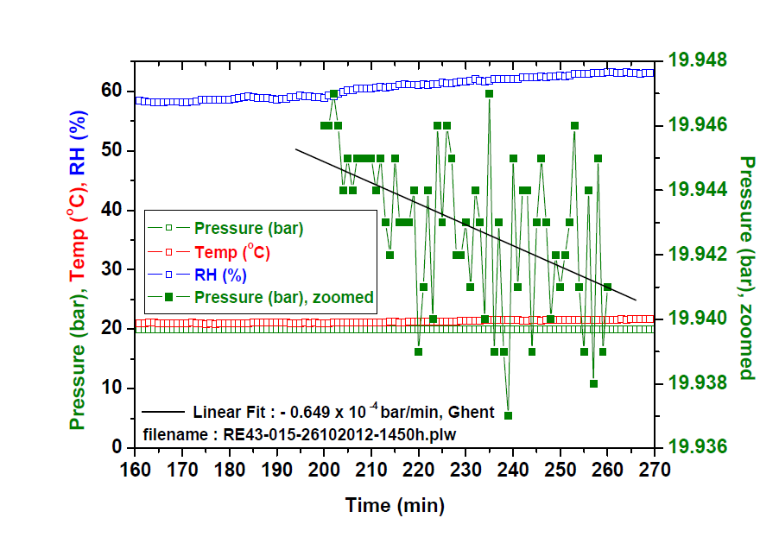


Slide 40


∼ - 2.857 x 10 ⁻⁴ bar/min

Slide 41
Mass production of remaining 170 sets of
Cu cooling systems for RE4
Material in terms of Cu pipes, Cu plates, solder etc. have been procured
Fabrication has started : cutting and bending of pipes and plates in progress
We would like to finish the mass production in one go
Tentative schedule of delivering 130 sets at CERN by July 2013
    RE4/3 : 85 sets
    RE4/2 : 45 sets
    Total : 130 sets
    Remaining : 40 sets of RE4/2 for BARC
The above mentioned 130 sets include the Cu cooling systems for Ghent too,
which shall be delivered at CERN
Please arrange the delivery of SAGANA couplings and SS ferrules as soon as possible
for 170 sets

