Slide 1
Hv 3 Pole connectors, correlation of break down, voids & dimple/indents
Ian Crotty
13 Nov 2012

Slide 2
Four categories of connectors tested to 15kV
New Delivery assembled (Imtiaz) connectors x10
Mrs Wang break down connectors x11
Old (RB) connectors x6 (tested for 8 days)
New delivery unmade connectors( not tested) x11

Slide 4
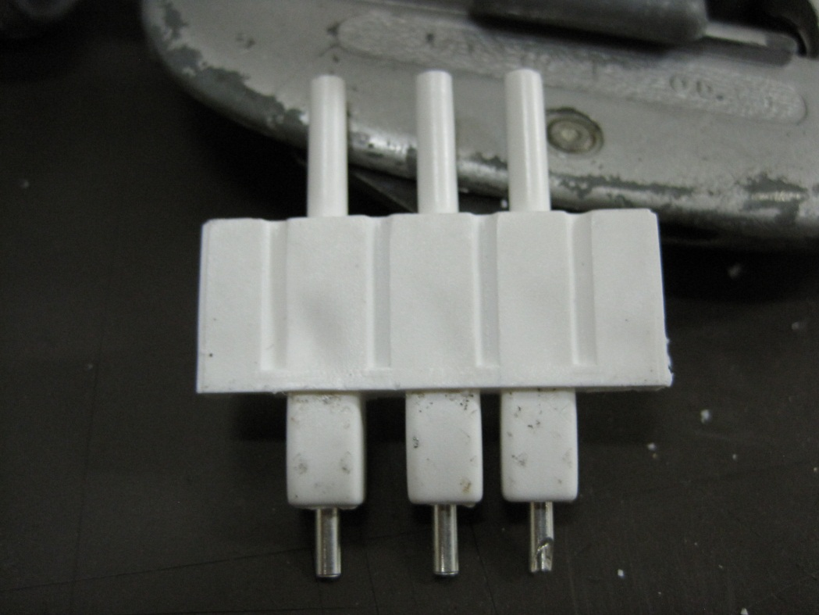
External indents or dimples
Voids and “non-dimples” correlate very well.
Dimple

Slide 5
Conclusion
With 15/27 cases the correlation of break down and voids is not conclusive.
The break down may be due to voids but there seems to be in addition another source of beak down.
Voids may be identified by simple observation
The voids will, at least, compromise the HV integrity over time.
Voids are in almost all connectors

