Slide 1
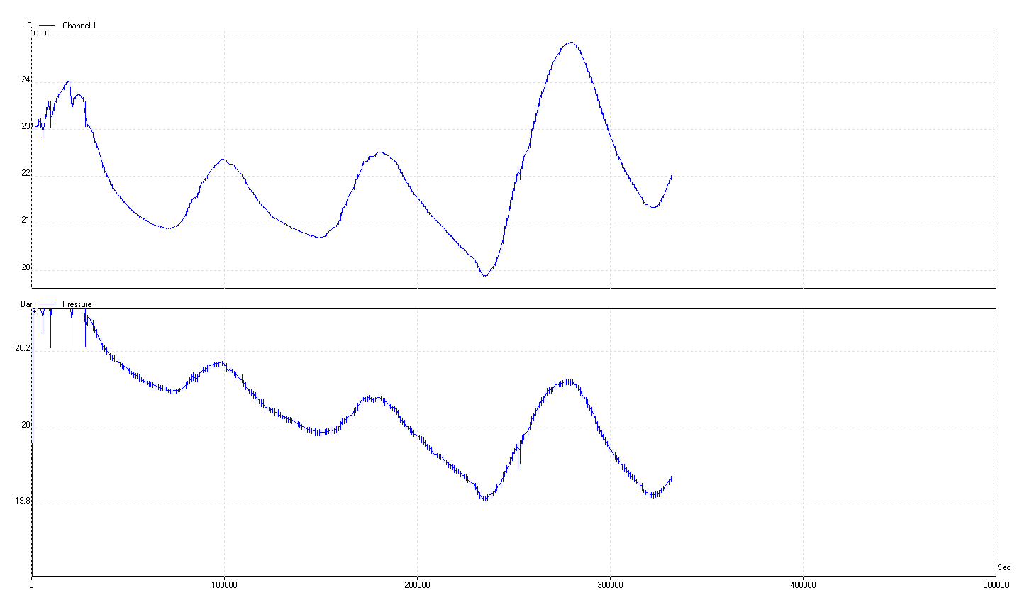
Leak Tests conditions
Summer has come and we are under a steel un-insulated roof. Giving rapid temp changes through IR transfer both at day & night.
1 Day

Slide 2
Results
SM002 3.5E-04 [mbar.l/s]
SM003 5.5E-03 [mbar.l/s]
SM004 1.26E-05 [mbar.l/s]
SM005 1.58E-04 “U” changed
SM006 1.02E-04 [mbar.l/s]
SM007 3.17E-04 [mbar.l/s]
SM008 1.25E-02 [mbar.l/s]Needs rework

Slide 3
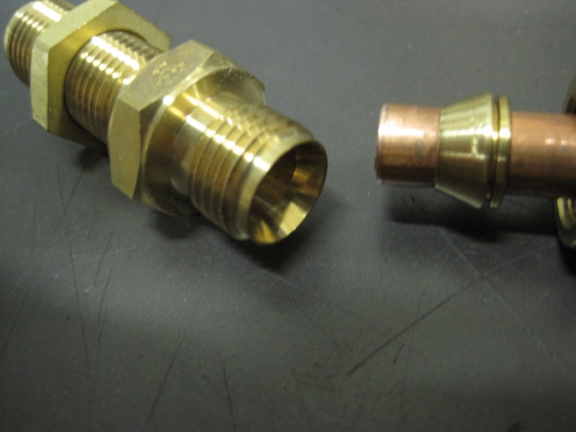
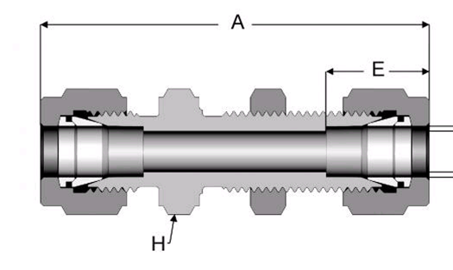
Correct assembly & tightening
All Ferrules will be verified for presence and orientation.
All of the locknuts x4/ch and all nuts x8 must be checked at each step of assembly
The correct tools must be used, 17mm and no adjustable spanners, as the jaws are too wide.

Slide 4
Conclusions
The conditions in 904 during summer are not excellent, IR from the
un-insulated steel roof.
Cooling Jig works.
Template for the calculation of leak rate almost ready.
The chambers are not ready for SM assembly.
The “U” & “C” pipes are giving problems for the SM assembly as shown by the leak test. No clear evidence is visible.
Correct assembly technique is essential, There are 24 points to control during SM assembly.
Re check doubtful cases in QC4 lab ?

Slide 5
Curious log plot

