Slide 1
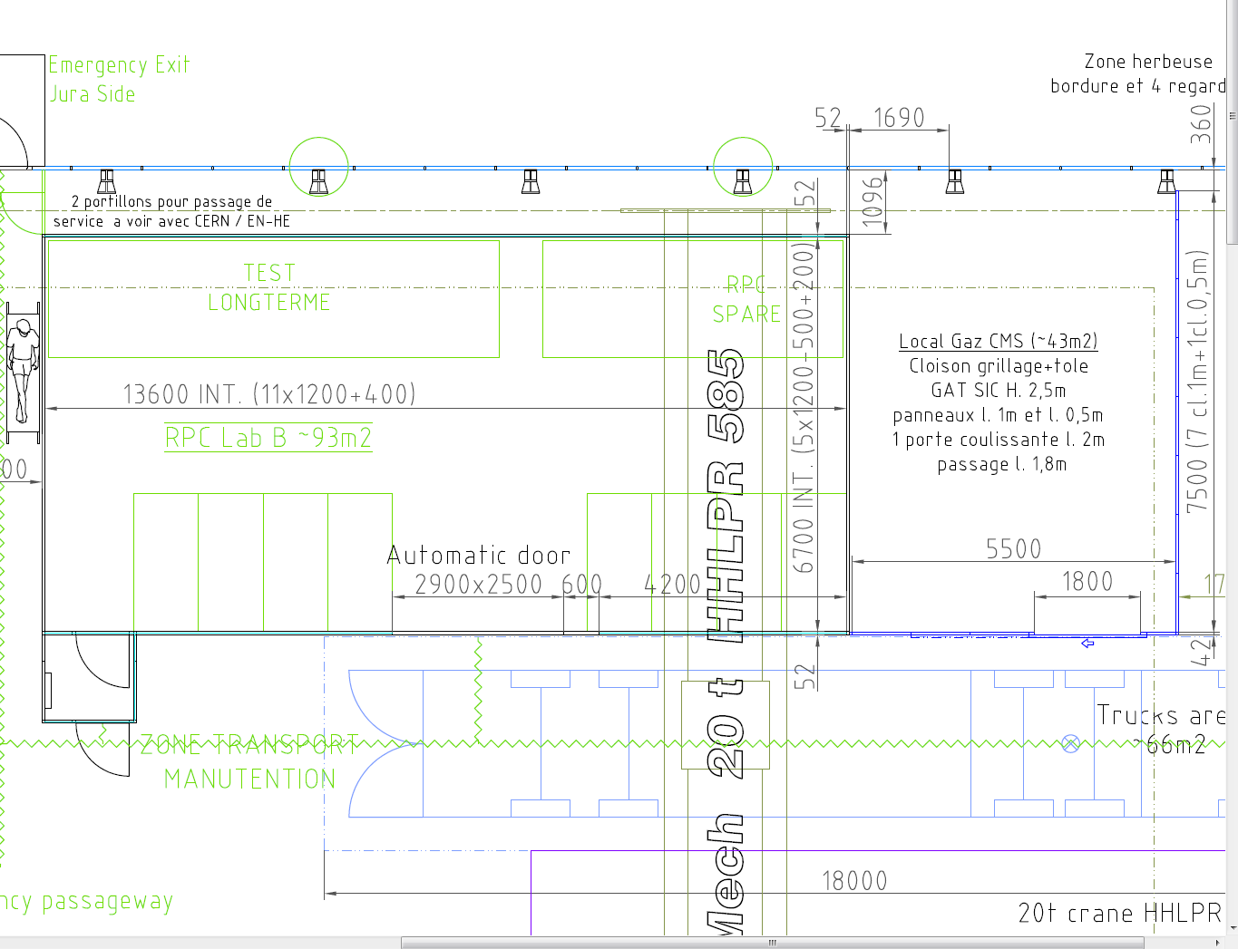
QC-4 area
Which FRAME for long term stability ?
QC4-1 single chamber tests AREA
SM storage AREA
SM Assembly & test

Slide 2
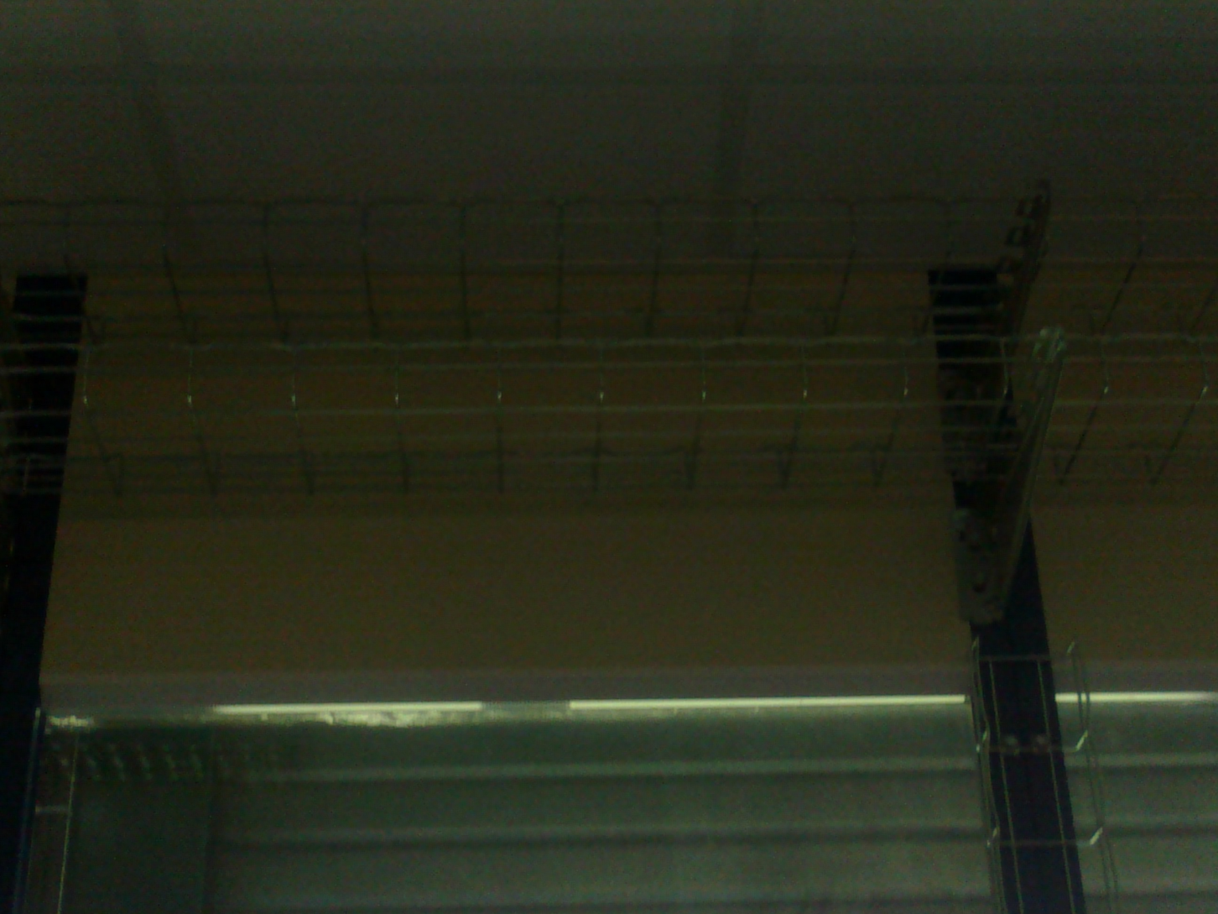
Cable trays are installed
Gas pipes
HV cables
Cables trays for the long term

Slide 3
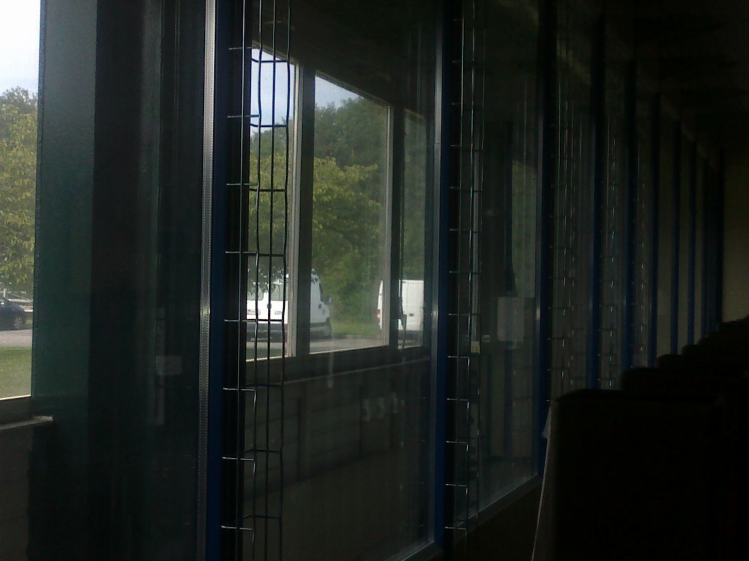
QC-4 (long term )
QC-4 long term area

Slide 4
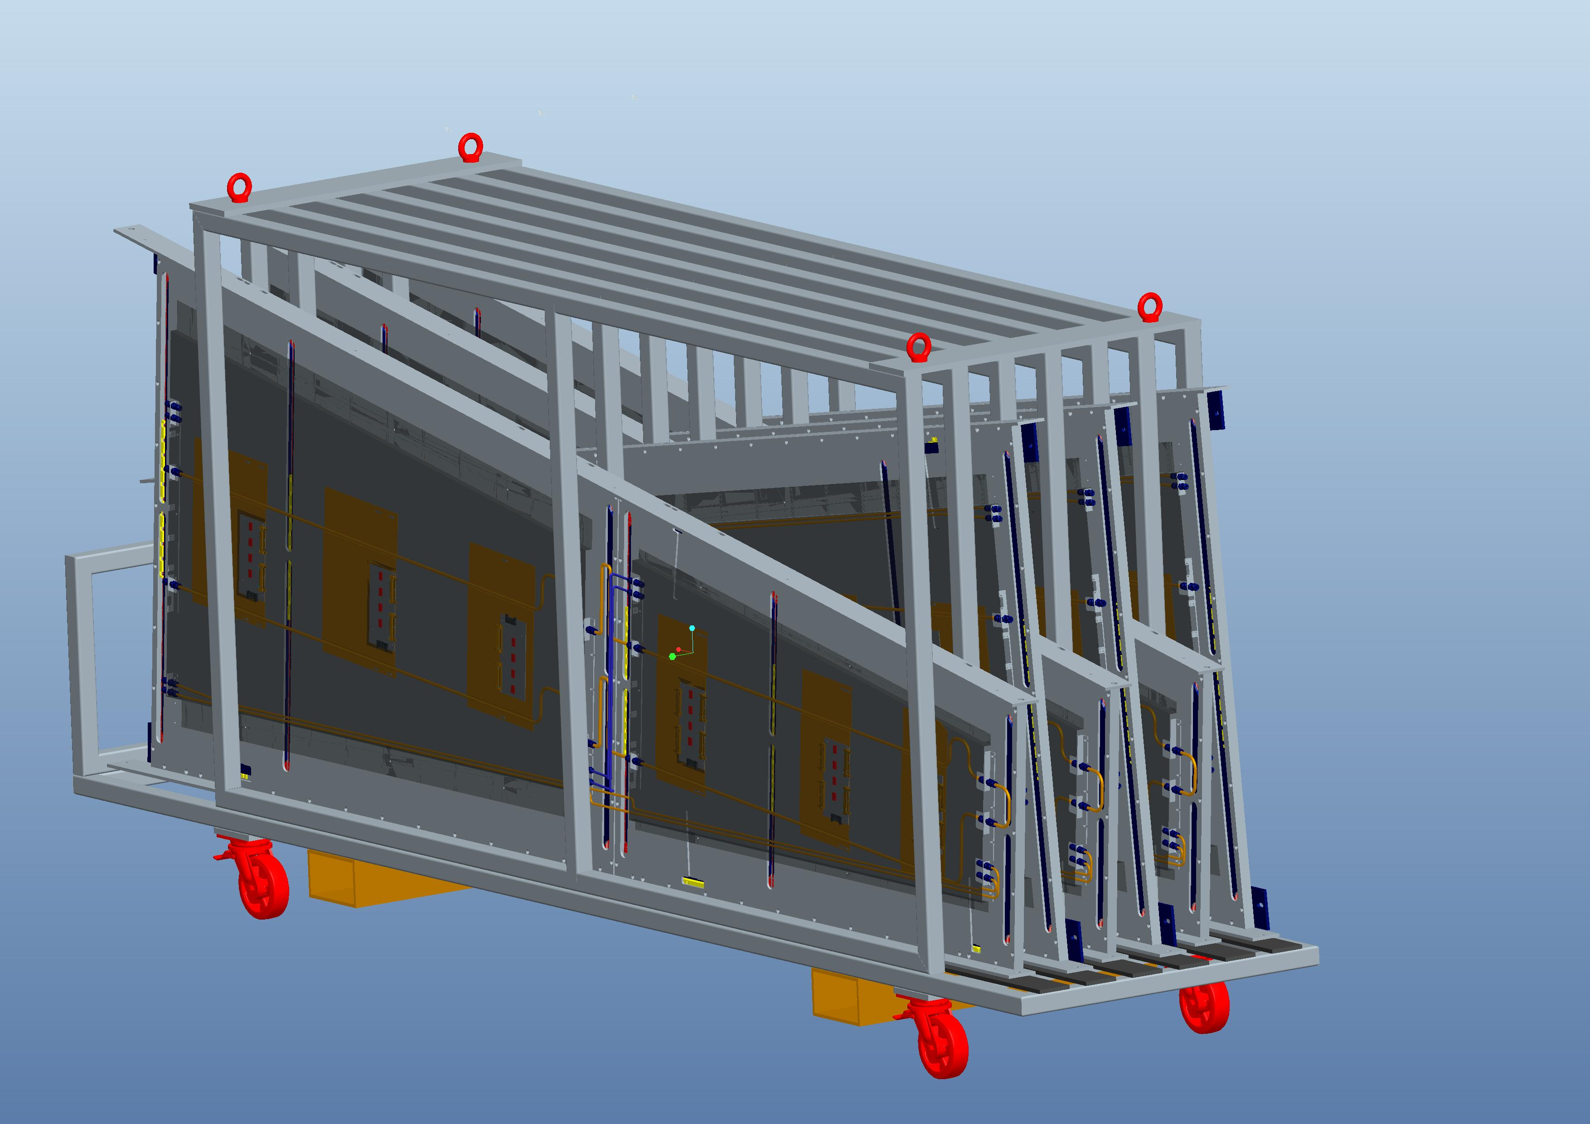
SuperModule FRAME
1800
4050
900

Slide 5
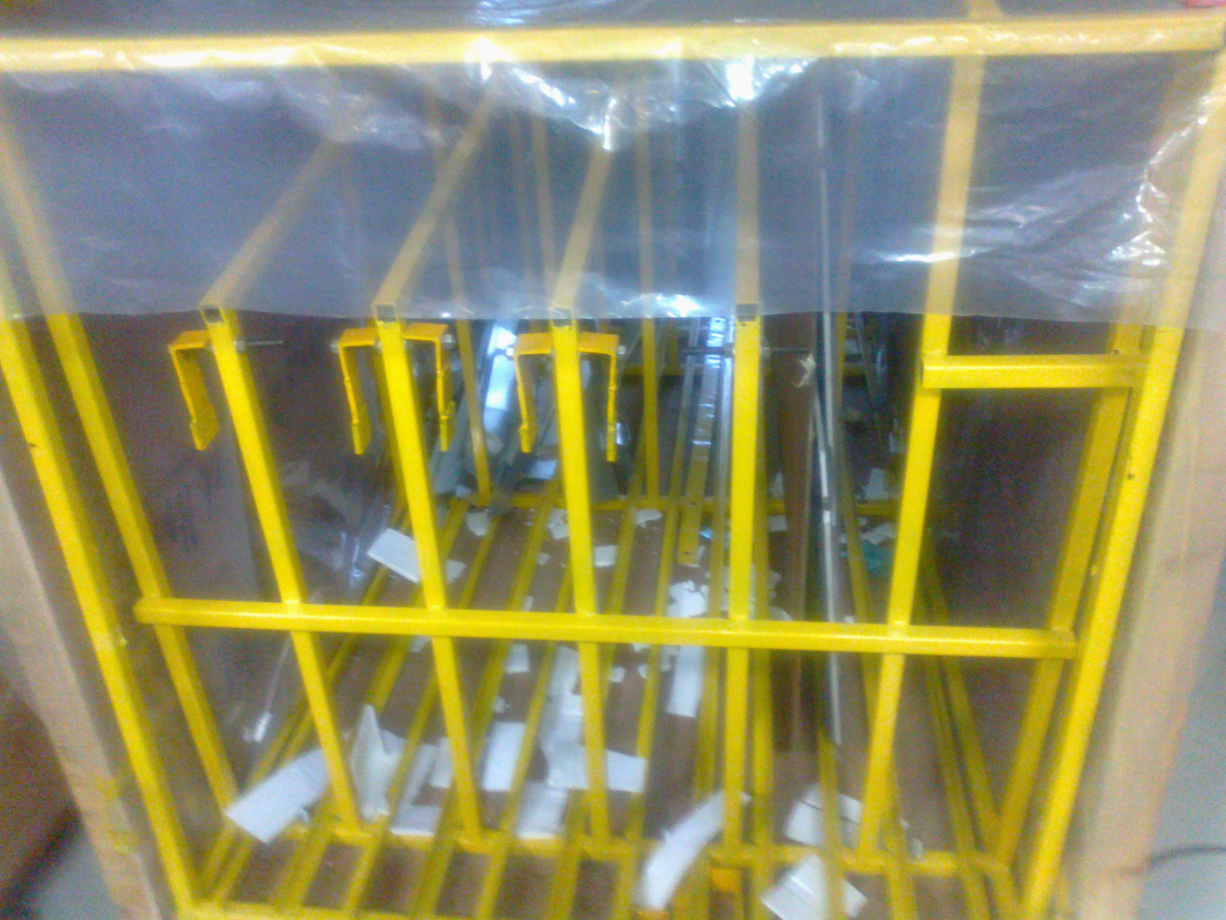
Chamber Box
India Box :
Width=1.28m, Height=1.72, length=2.21

Slide 6
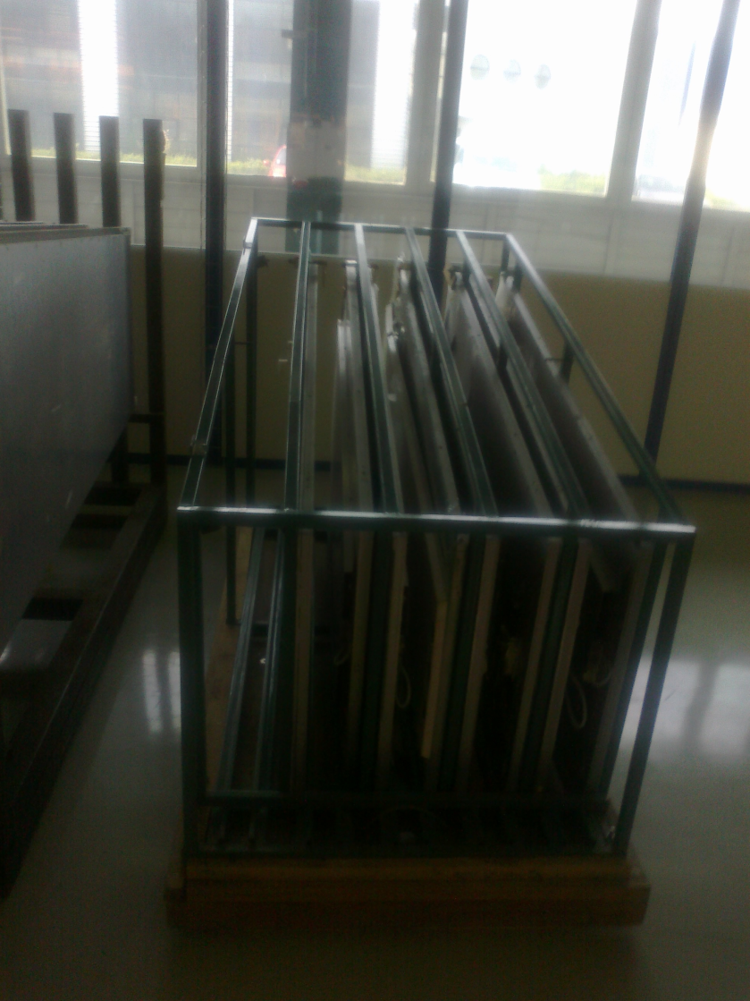
Chamber Box
Re*2 Box :
Width=1.05m, Height=1.32m, length=2.08m

Slide 7
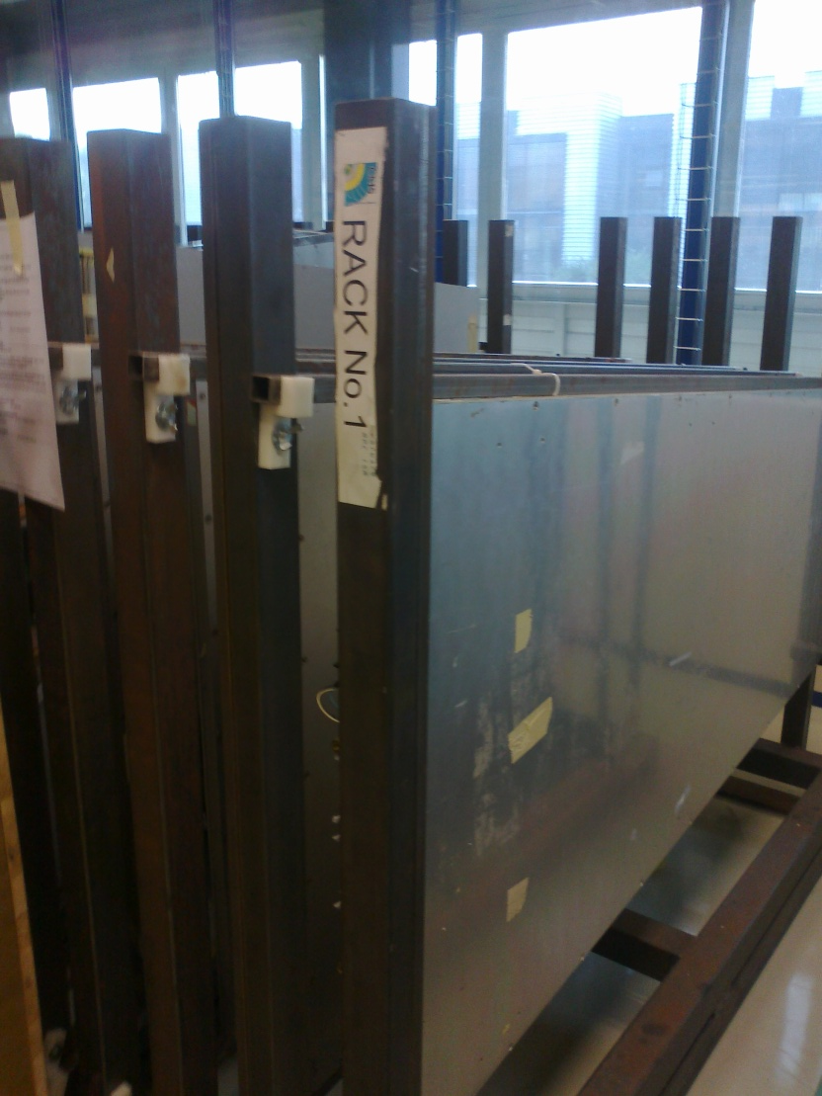
CERN Chamber Frame
Width=0.86m, Height=1.62m, length=2.13m

Slide 8
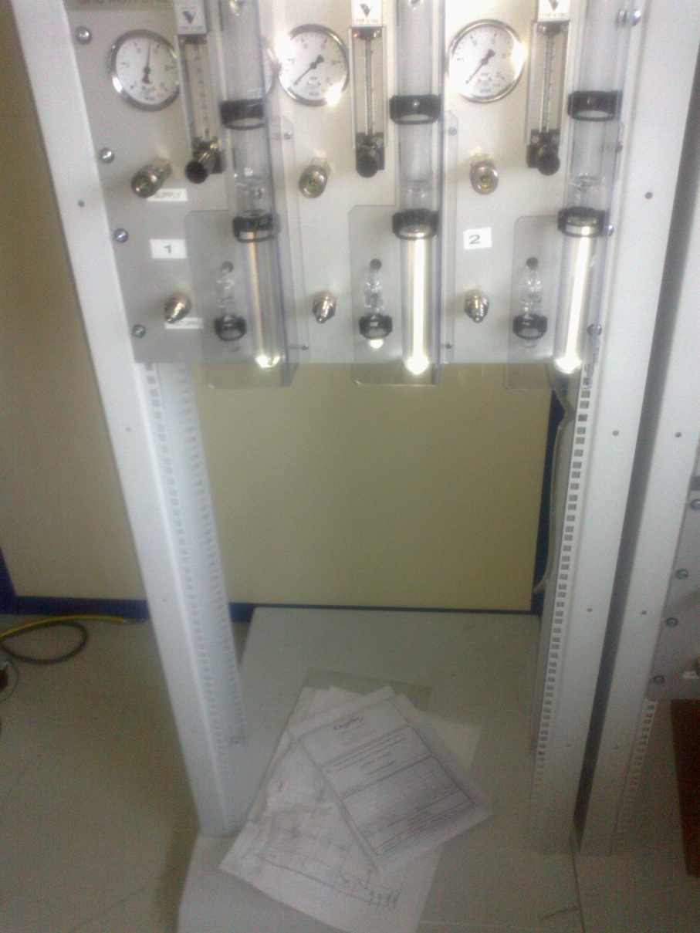
QC-4 gas rack
Gas channels :
1 +1 (chamber) , 12+1 (long term)
Total : 14 channels , Now 12 →
We need an additional gas panel of three channels but…

Slide 9
QC-4 area Gas
The actual Gas system designed for only 10 channels, total capacity of gas volume : 150 l/hour.
10 + 10 + 14= 34 channels → Total gas Volume now = 150 l/h :needs to be increased →
official request to the Gas group

