Slide 1
GIF ++ cables
Ian Crotty & Nicolas Zaganidris

Slide 2
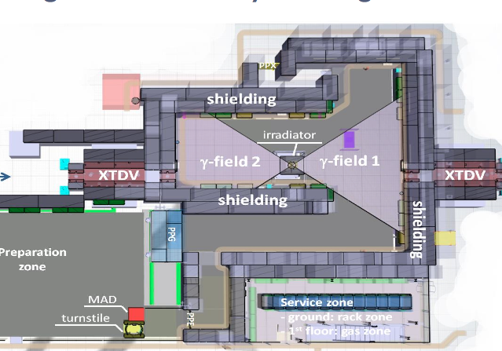
(Very) Preliminary set-up
RPCs High eta
RPCs Gas studies
RPCs consolidation
The detector position will better be defined as soon as the γ flux will be measured and when the requests of all users will be defined.

Slide 3
Muon chambers @ GIF++
5 RPC (barrel and endcap)
  1 RB3 + (1 RE4 + 1 RE3) (now under test at GIF)
  Bakelite (spare production)
  CMS electronics
  2 new barrel RPC
  Improved gas system - new mechanics & service box & Distribution Board
5 RPC for High eta region
  3 RE4-1
  Low resistivity Bakelite (≈ 2 10¹⁰ Ωcm, or less)
  CMS electronics - New electronics (Atlas chip)
  new geometry (smaller gap thickness and multi-gaps)
2 RE4-1 chambers
  Low resistivity glass
  Double or multi-gaps
  2 (glass and Bakelite) RPC prototypes for gas studies
  common test with ALICE, ATLAS and CMS

Slide 4
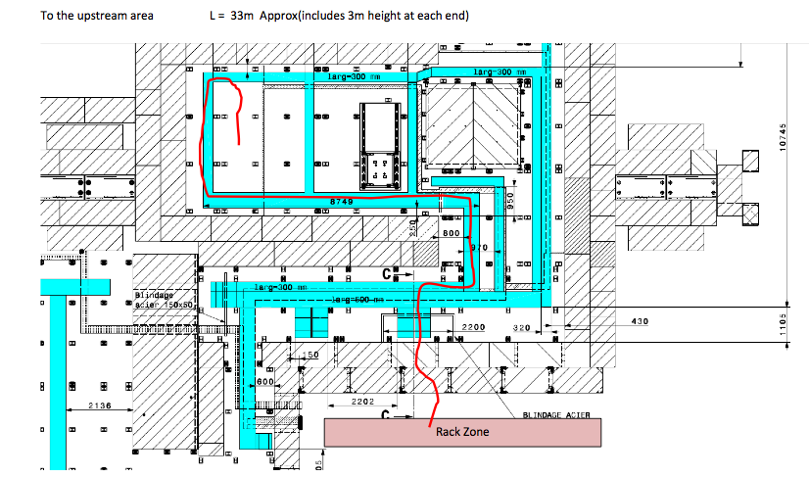
UPstream
Patch Panel:
10 HV cables
5 LV
5 I2C
Signal Cables
5 chambers

Slide 5
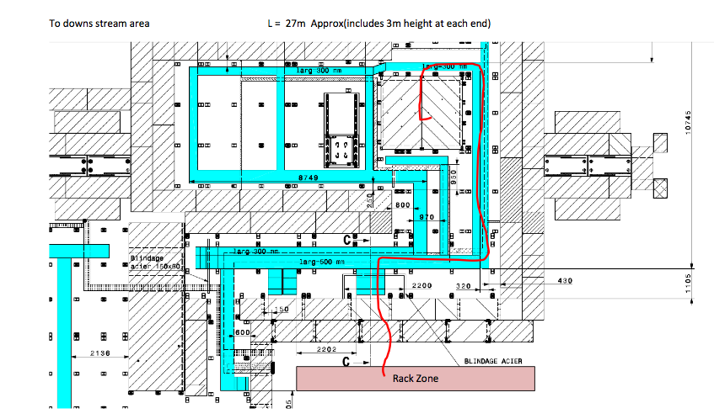
Down stream
Signal Cables
?
Patch Panel:
10 HV cables
5 LV
5 I2C

Slide 6
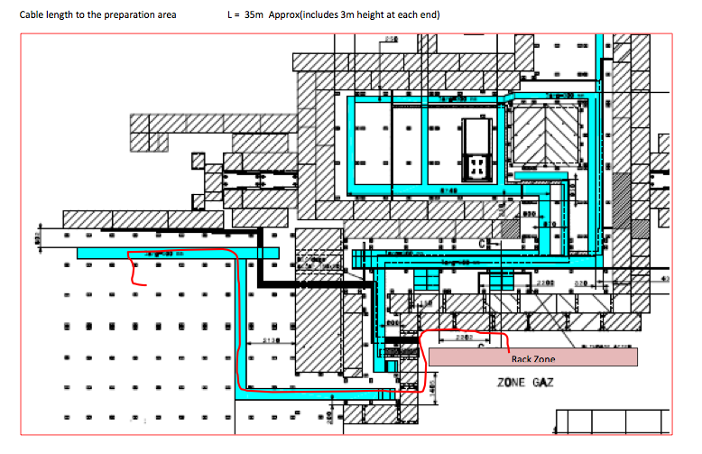
Preparation zone
HV
10 cables

