Slide 1
Coordinate system for the GIF as defined for CMS RPCs
Nicolas and Ian
13 Oct 2015

Slide 2
Aims
Establish 2 measured parameters to readily keep up to date the diagram of the chamber positions in the GIF++.
Establish the coordinates of the chamber position with respect to the source and nominal beam positions.
Contents
Defining the coordinate systems
Base Bunker diagram ( no details, gas panels etc)
Trolley specification, with present chamber position.

Slide 3
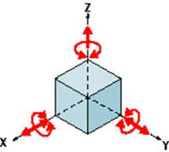
Our chambers have potentially 6 degrees of freedom.
We will only deal with translations and no rotations

Slide 4
Steps to defining the strip position
Measurement of each trolley position (X,Z) within the Bunker volume.
Definition of each chamber in the trolley, (X,Y,Z)
Definition of each strip or eta division within the chamber structure.
Nota the case of the rolling chambers in T0/3 must be defined wrt the trolley and or the Jura wall for each “X” position.

Slide 5
Diagrams and Referentials
Diagram defining the possible positions of the trolleys within the bunker, constrained by cable trays, Gas PP, rails for TGC shielding etc.
First establish base diagram of Bunker & infrastructure for establishing chamber position wrt the beam and source .
Second referential points on the trolleys wrt the source centre.
Third the location of the chambers wrt ref point on the trolleys.
Fourth the position of the strips wrt the trolleys.

Slide 6
Final strip spacial definition with respect to Source in X,Y & Z.
“Y”
“Z”
Strip
“X”
(0,0,0)
Source
Ian Crotty
1 Oct 2015

Slide 7
Bunker parameter Space capital X,Y & Z.
T0
(X,Y,Z)
Measure “X”
Source
Measure “Z”
Down Stream Wall
Jura wall
Ian Crotty
1 Oct 2015

Slide 8
Chamber positions on T0
2nd Co-ordinate definition
Small “y” coordinates
Small “z” coordinates
Small “x” coordinates

Slide 9
Strip positions on chamber
3nd Co-ordinate definition
Small “z” coordinates
Small “y3” coordinates
Small “x” coordinates

Slide 10
Final strip spacial definition with respect to Source in X,Y & Z.
“Y”
“Z”
Strip
“X”
(0,0,0)
Source
Ian Crotty
1 Oct 2015

Slide 11
Base diagram of facility
X = 0 @ Centre of source positive values are towards Jura with the source at 2748 + 530mm = 3278mm from Jura wall.
Y = 0 @ Centre of source positive values upwards.
Z = 0 @ Centre of source positive values are down stream.
Nominal Beam and source are 1640mm above steel floor (LHC ref 2060mm above 887 hall floor).
Source aperture open angle = 74degrees.
Bunker height upstream 4386mm
Bunker height down stream 5183mm

Slide 12
Base diagram
12025
2748
4825
+X
6177
BEAM
Source
+Z
730
Nominal Beam Line
1545
1530
2800

Slide 13
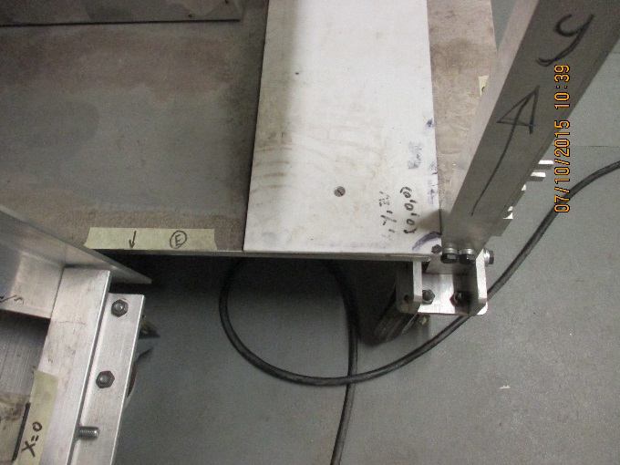
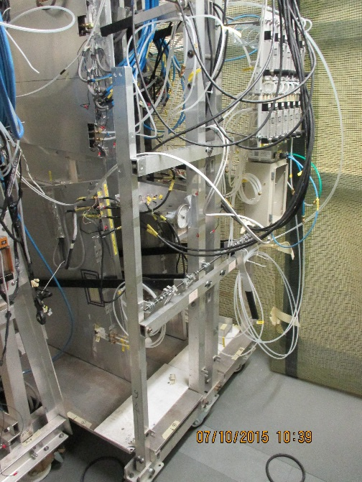
Trolley T1 specifications and ref points
Y
Y=0 from surface of PTFE plate
X=0
Z=0
Y
X
Z

Slide 14
T1 zero ref points and chamber positions
1045
360
2197
1378
1383
Represents (0,0,0)
Position in Z ??
Height 282

Slide 15
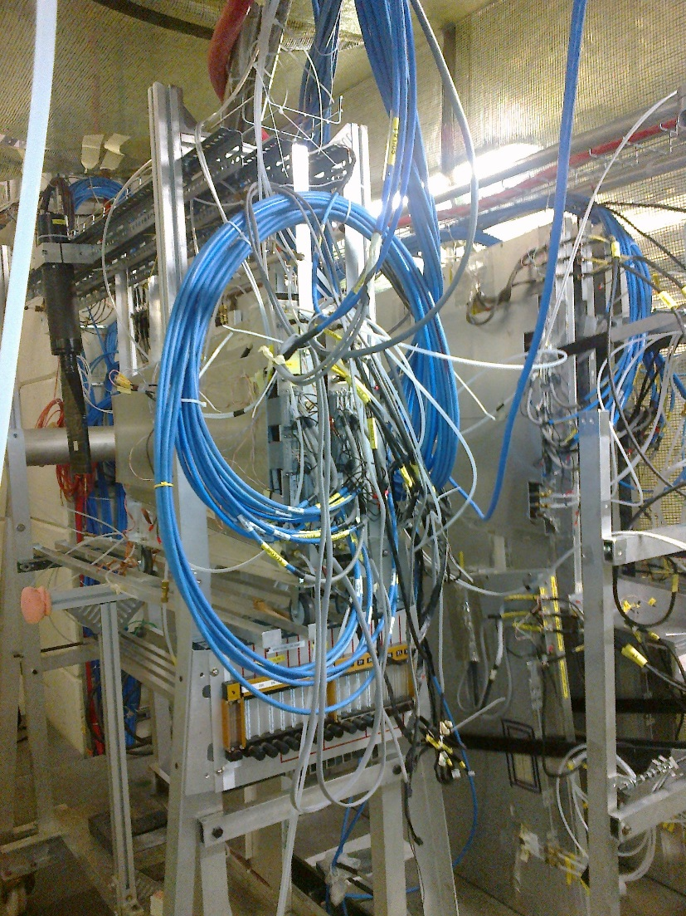
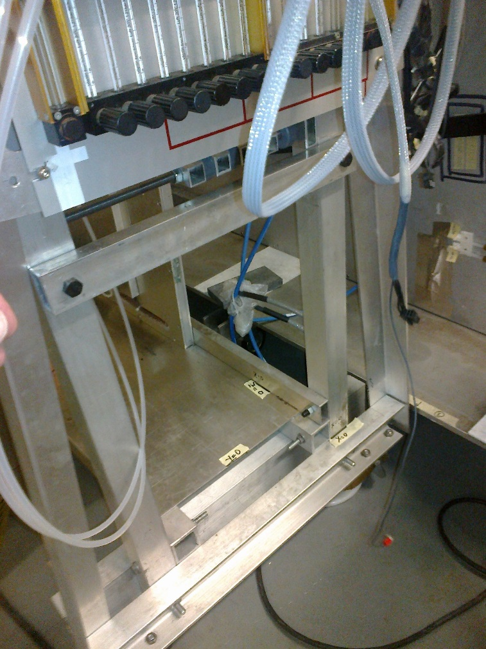
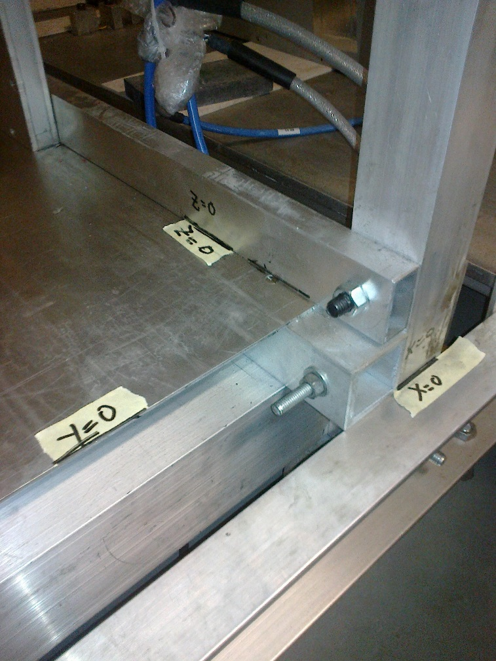
Trolley T0 specifications and ref points (1)
Y
Z=0
T1
Y=0
T0
X
X=0
Z
Ref points at base of trolley T0

Slide 16
T0/3
Represents (0,0,0)
160
Nota. The horizontal chambers can roll in “x” so must be specified for each new position.
1650
± 1
Height = 353
410

Slide 17
Positions Trolley 30Aug to 16 Sept 2015
  T1
Ref point to Jura wall 2770mm
Ref point to upstream wall 2509mm
Ref point to Saleve wall 2856mm.
T0
Korea chambers from Jura wall 3104mm
Front Korea chambers to source 3229mm
Korea chambers occupy a Z space of 194mm

Slide 18
Positions Trolley 16 Sept to 8 Oct 2015
T1
Ref point to Jura wall 1507mm
Ref point to upstream wall 1529mm
Saleve wall to trolley edge 1292mm.
T0
RE vertical chamber from source 4447mm
Korea, front, chamber from source 4185mm
Korea chambers to Saleve wall 2846mm
Korea chambers to Jura wall 1731mm
Glass RPCs frame from source 1892mm

Slide 19
Glass RPC 24 Sept 2015
Glass RPC closest to source centre ( not the frame) is 2129mm in Z.
X and Y are not known/measured.

Slide 20
 |  | Coordinate table to convert Bunker wall measurements to trolley coordinate system.
 |  | 30 Aug to 16 Sept 2015
 |  |  |  | Source to down stream wall = Zs |  |  |  | Source to Jura wall |  | 3278 |  | T1 = 282 above floor |  | 282
 |  |  | Source Upstream | 6177 |  |  |  | Source to Saleve wall |  | 1545 |  | T0 above floor |  | 353
 |  |  |  |  |  |  |  | Source to Alcove wall |  | 2350
 |  | Zm | Zm | Zs | Zs | [+]Zf |  | Xm | Xm | (+)Xf |  | Ym | Ym | Yf
 |  | Down stream wall | Upstream wall | Down stream | Upstream |  |  | Jura wall | Saleve wall |  |  | Floor | Trolley
30Aug to 16 Sept | T1 |  | 2509 | NA |  | -3668 |  | 2770 |  | 508 |  |  |  | -1358
 |  |  |  |  |  |  |  |  | 2856 | 506
 | T0
 | Korean chamber |  |  |  | 3229 | -3681 |  | 3104 |  | 174 |  |  |  | -1287
16 Sept to 8 Oct | T1 |  | 1529 |  |  | -4648 |  | 1507 |  | 1771 |  |  |  | -1358
 |  |  |  |  |  |  |  |  | 1292 | 253
 | T0
 | Vertical Chamber |  |  |  | 4447
 | Korean Front
 |  | Source 1/2 valu in Z |  | 452
 |  | Source 1/2 valu in X |  | 530
 |  | Source above floor |  | 1640
DRAFT Version
Document is here; http://rpc-cms-re4-upscope.web.cern.ch/rpc-cms-re4-upscope/RPC/GIFPlusPlus/Installation/Coordinates/CoordinateGIF05Oct2015.xlsx

Slide 21
Position of chambers within Trolley.
T0
Base of RE type 2 is 355mm above steel floor.
Base of RE type 2 is 415mm from ref point.
Centre of RE type 2 is 764mm from ref point.
Front face of RE2 is 10266mm from down stream wall.
Korean chambers above steel floor are 1650 ±1mm.
Horizontal rails (L>1.6m) above steel floor are 1250mm.
Dimension between uprights is 1390mm.
T1
RE type 2’s Centre Line are 1665mm above steel floor.

Slide 22
Available space to manoeuvre Trolleys in Bunker
Hand rail to far end of alcove is 3620mm.
End of alcove to down stream wall less shielding rail for TDC is 1400mm.
Gas panels are 250mm from wall. And 100m for piping.

Slide 23
Source and hand/guard rails
Nominal Beam line.
730
905
Distance to Saleve wall = 1545
1060
1940
Distance to Jura wall = 2308
1665

Slide 24
Subdetectors occupation in “Z”
T1 1100mm
T0 800mm
Glass 800mm
MDT 1400mm
Micromegas 500 or 600mm.

Slide 25
Conclusion
The base diagram by Fabiola should be done to scale in mm.
The reference points for the trolleys works well except for the Korea chambers, and others that translate in x, where their distance from the walls will be given.
There is a mixture of the above two systems as this is the first attempt.
The spread sheet has to be improved in clarity.
Position of chamber structure can be defined in all 3 coordinates using the spread sheet.
The diagram defining available space in the bunker is not yet done.
The method to calculate the strip/eta division is not done.
The other detectors in the bunker are not noted.
The available space with respect to infrastructure is not done.
This document is here; http://rpc-cms-re4-upscope.web.cern.ch/rpc-cms-re4-upscope/RPC/GIFPlusPlus/Installation/Coordinates/CoordinateSystemGIF24Sept2015.pptx.

Slide 26
Additional material

Slide 27
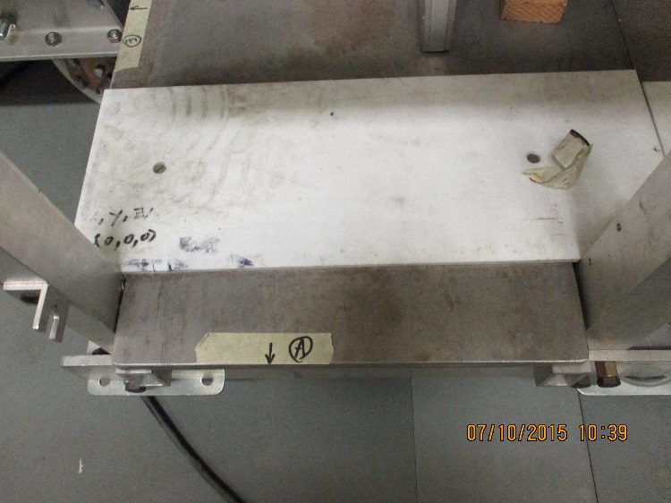
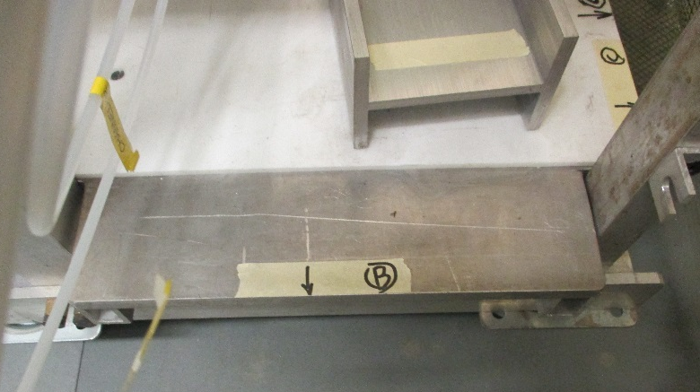

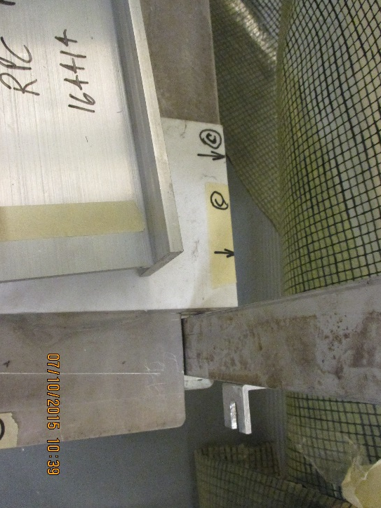
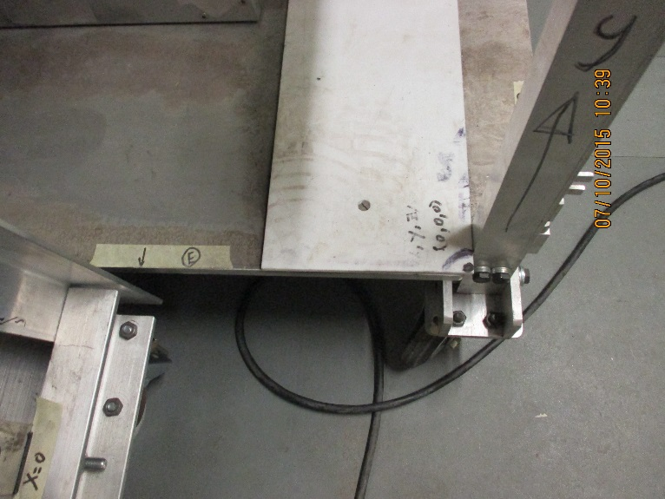
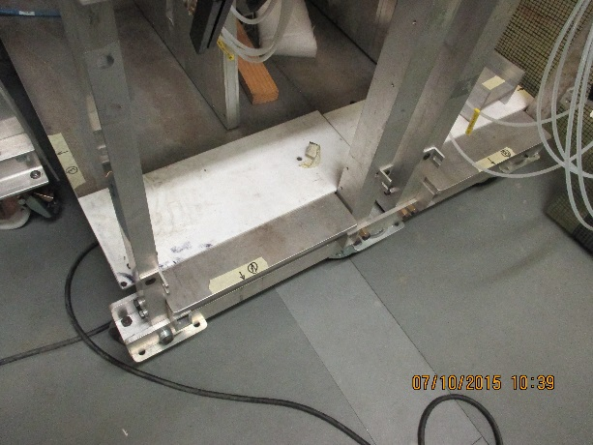
Trolley T1 Measurements and ref points

Slide 28
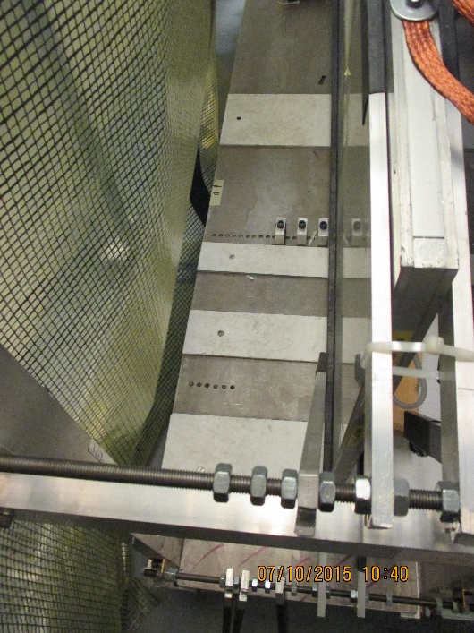
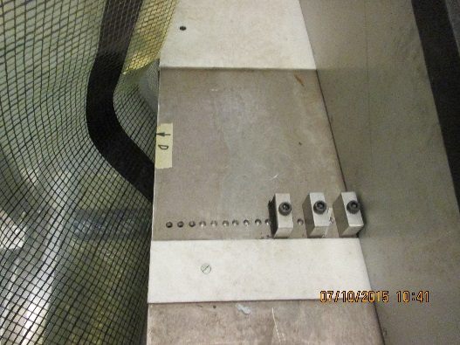
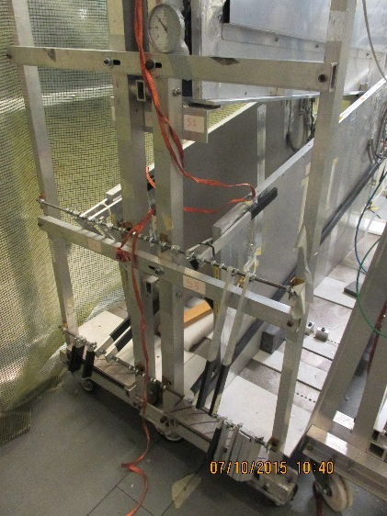
Trolley T1 Measurements and ref points
Saleve side

