Slide 1
Tables & degrees of freedom in GIF++
Ian Crotty
10 March 2015

Slide 2
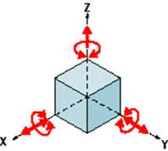
An object has 6 degrees of freedom

Slide 3
We want 4 degrees
“Y” Vertical
Beam Line
X Rotation
“X” transvers
Horizontal
“Z” Longitudinal Horizontal

Slide 4
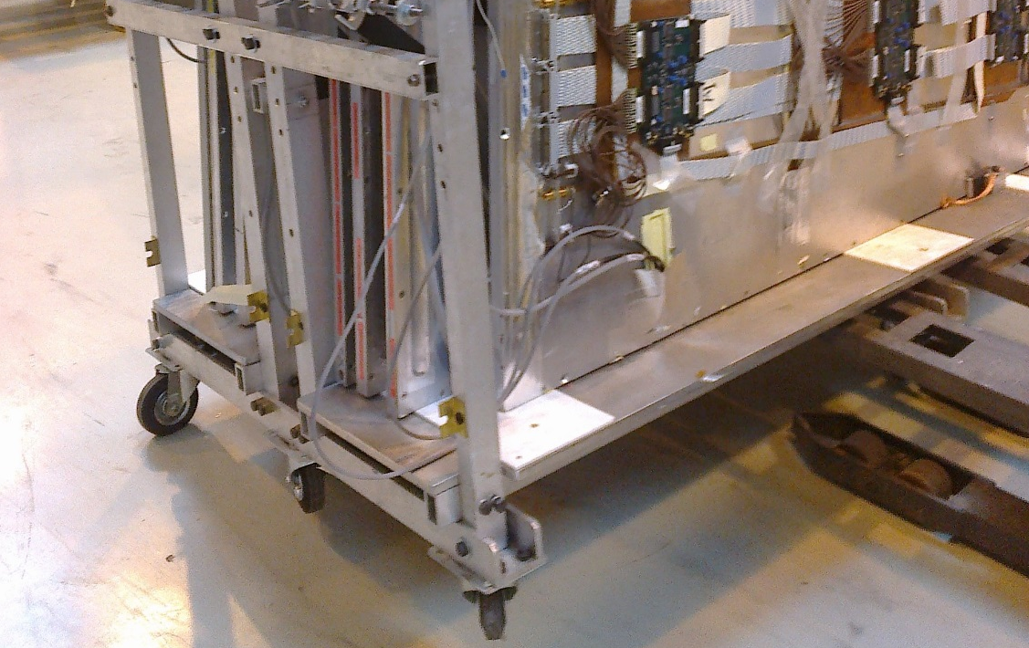
The x and z are for free but not precise
Wheels on the base.
How to obtain the reproducible points
What level of precision

Slide 5
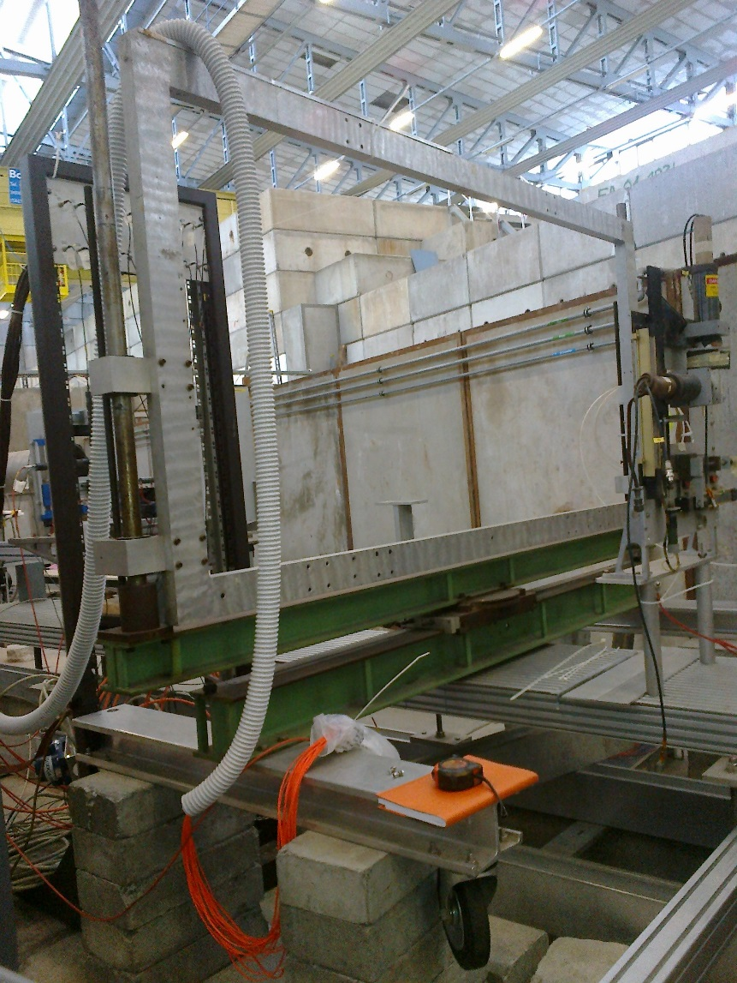
We have this frame with “Y” translation
Alu frame dimensions 110cm x 215cm

Slide 6
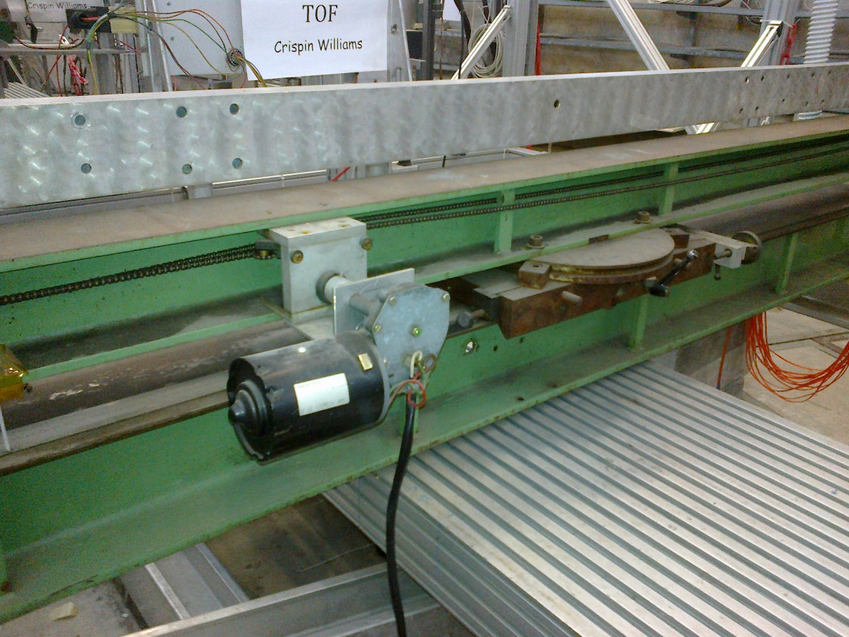
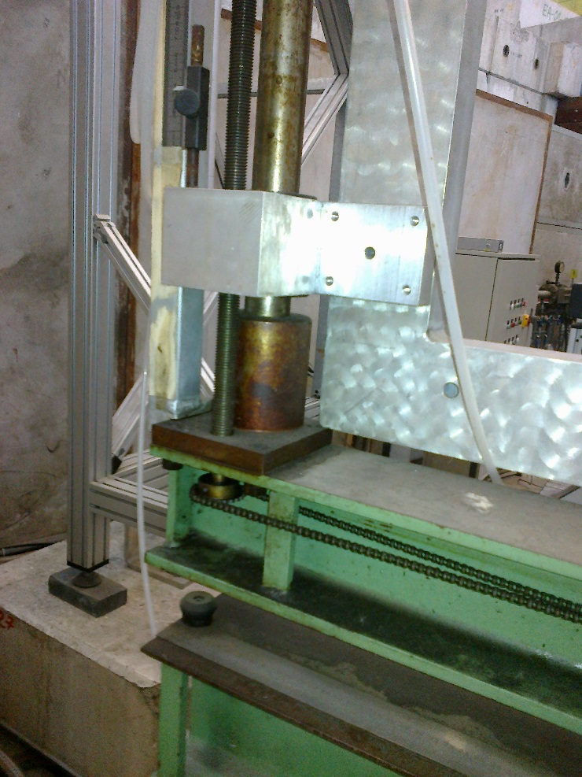
Motorised “Y” axis
Manual Rotation about “Y”
Motor driven mechanism for translation in “Y” approx. 60cm

Slide 7
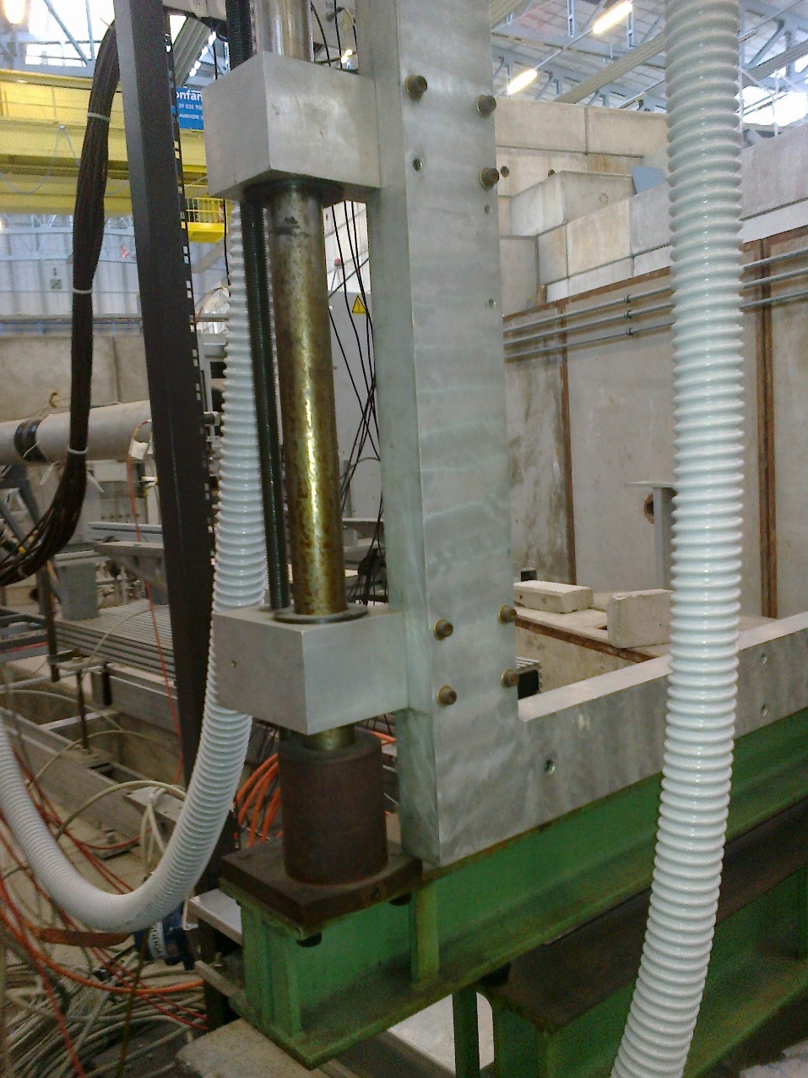
Details of frame
Sliders for vertical translation require cleaning

Slide 8

Vertical position definition
The present system can be monitored with a shielded camera

Slide 9
Conclusion
We have a frame that must be modified to accommodate the ration in “X” horizontal axis
and mount the chamber(s).
The height must be adjusted to the beam height.
The frame requires some renovation, cleam and grease.
Require cable and power supply for E. Motor
Require camera to give the vertical position for remote operation

