Slide 1
CMS
Safety Tour ITINERARY during LS2
Useful phone numbers
CMS Technical shift | 75140
CMS Shift leader | 77111
CMS Technical shift mobile phones | 16 8648 16 8649 16 2137 16 2129
Technical Coordination on-call | 16 5000
V3.5.4., Mar 27, 2019
Edited by Noémi Béni, Zoltán Szillási, Roberto Perruzza and Niels Dupont
EDMS 1253288
If this document is damaged or needs to be updated, please inform the editors

Slide 2
Electronic document
This document can be found here:
https://twiki.cern.ch/twiki/bin/viewauth/CMS/OnlineWBSLIMOSInstructions
and in EDMS:
https://edms.cern.ch/document/1253288

Slide 3
Emergency Numbers
MAIN NUMBERS
IN CASE OF EMERGENCY, ACCIDENT OR FIRE: | 7 4444 | 7 4444
TI Technical control room (electrical and cooling piquet, access): | 7 2201 | 7 2201
Fire Brigade (non emergency): | 7 4848 | 7 4848
IN CASE OF ANY TECHNICAL PROBLEM CALL: | 16 5000 | 16 5000
Backup
Wolfram ZEUNER | 16 2541
Niels DUPONT | 16 5186
Zoltan SZILLASI | 16 5114
Austin BALL | 16 0408
Tristan LOISEAU | 16 2426
If you have any doubt concerning the tour or in case of a busy shift when the safety tour is not foreseen to be performed, call:
Alberto ZAMBOTTI (16 1280) or Roberto PERRUZZA (160863)
Report general infrastructure problem 72201 (only day time)
(bad doors, bad windows, broken light, etc) and post an e-log note
Always inform shift leader before and after the tour!

Slide 4
Personal accessories check list
Before starting the safety tour check, that you have:
  Access to USC55
  Your CERN ID card & your Personal Dosimeter (or token)
  Mobile phone (take the Technical Shifter’s one in case you don’t have one)
  Safety helmet
  Torch or headlamp
  Safety shoes
Moreover:
  Register your name, write the time and your phone number on the Access Sheet

Slide 5
General instructions
The aim of the Safety tour is to check the P5, CMS area, and identify any problem which has to be reported (e-log, phone)
You have to use your senses during the tour (smell, sight, hearing, touch, personal feeling)
The following general things to be checked during the whole tour:
  LOOK FOR WATER LEAKS EVERYWHERE
  Also check for bad or burning smells
  Listen to unusual noises, vibrations
  During evenings and weekends don’t forget to check for colleagues working in the area!
  Check the lights: fluorescent lights, safety lights, bulbs in warning signs (cryo, RP, magnet and laser warning). If they are bad or going to be bad, mention it in your e-log
  Check the key glass box of the First Aid, the Red cabinets, Chemical kit, Water Mist activation and DSS Panel
And Act
  Close left open doors, windows, access points (specially the surface buildings)
  But never intervene on something you are not familiar with!

Slide 6
Safety tour ON The Surface
During night time (or snow/black ice hazard), there is no obligation for you to perform the safety tour outside.
You can drop the stations 3b and 4 (see next page), and access the SX5 via the building 3594.
If you still want to go outside, you can take one of the light torches available in the cabinet at your desk.

Slide 7

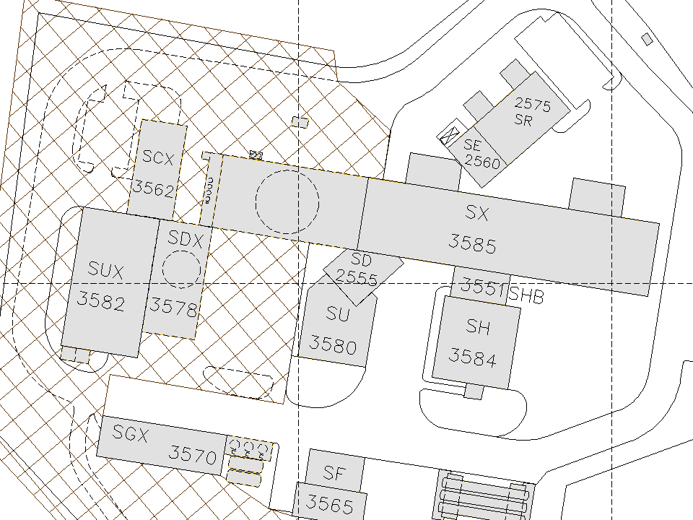

Safety Tour Itinerary 1 (SI 1)
Surface Zone
SLIMOS
Surface Point 5
Red cabinet and First
Aid cabinet in the
control room
1
2
3594
3a
5
4
3b

Slide 8
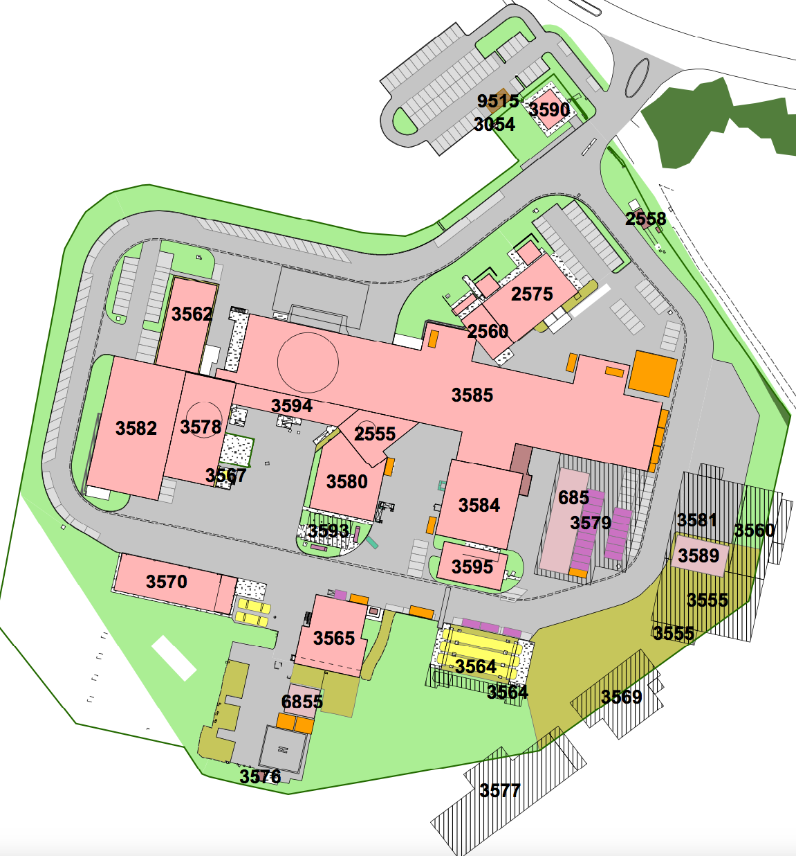
Optional: Helicopter landing pad
If possible, check the Helipad located close to SY5 looking through the fence
New Helipad
1
Check that there are no objects located on or close to the helicopter landing pad.
If you find that the pad is blocked, report it to Niels Dupont (165186) (call only during working hours) and in your Elog.

Slide 9
Safety Tour Itinerary 1 (SI 1)
Surface Zone
  Follow the itinerary as indicated on the map and check the followings:
  SI1-1 (SCX5, Surface Control Room building) Access screens, Webcams, Sniffer and CMSSafetyPanel screens, TETRA, Red and First Aid cabinet, defibrillator
  SI1-2: SX5 and 3594
  SI1-3: SDX5 - Emergency Inertion N2 (check outdoor during daytime)
  SI1-4 (Outdoor) – Waste area
  SI1-5 At PM54 – dosimeter readers checks (if you have a personal dosimeter), check the IMPACT screen, the PAD screens, visitor counter screen

Slide 10
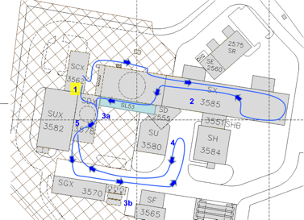
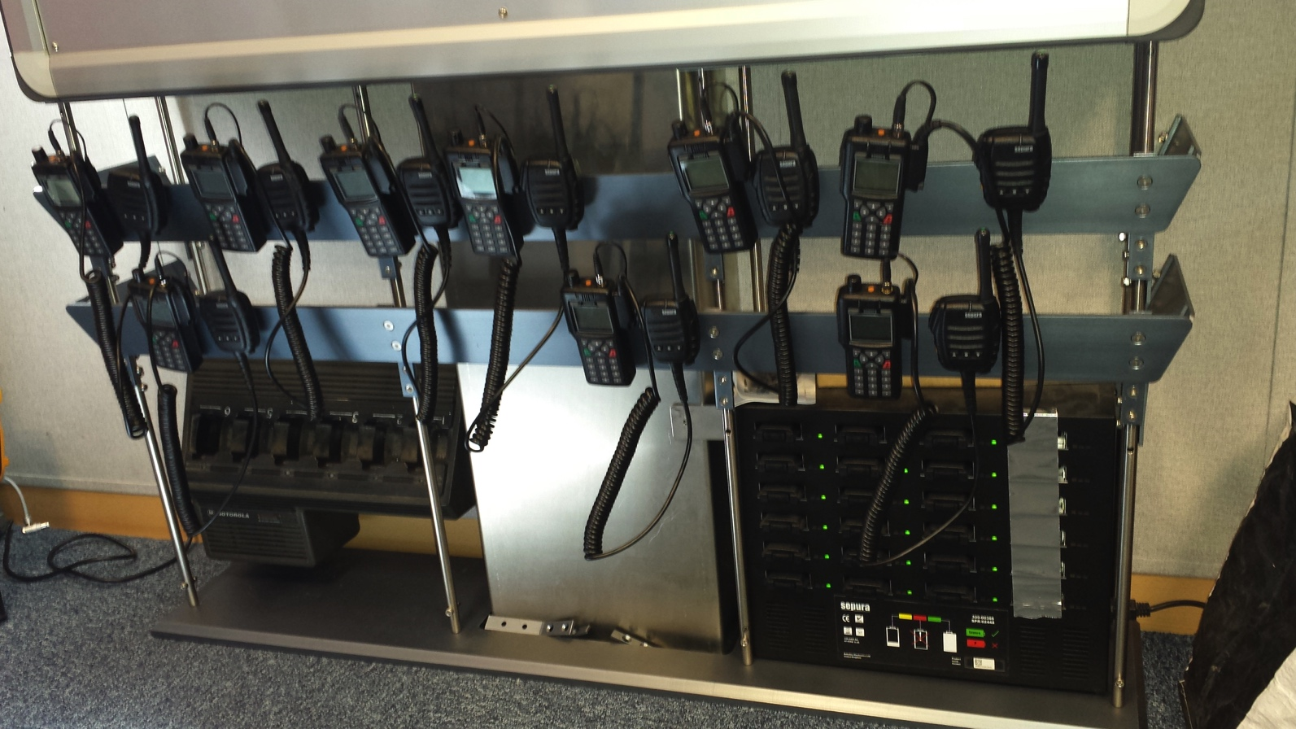
SI1-1 SCX5: Control room – Check TETRA charger
Battery charger
TETRA charger check
You can find the TETRA radios and their charger below the hardware DSS panel in the control room
Check that all LEDs of the battery charger are ON (green or orange are OK)
If not, mention it in your e-log

Slide 11
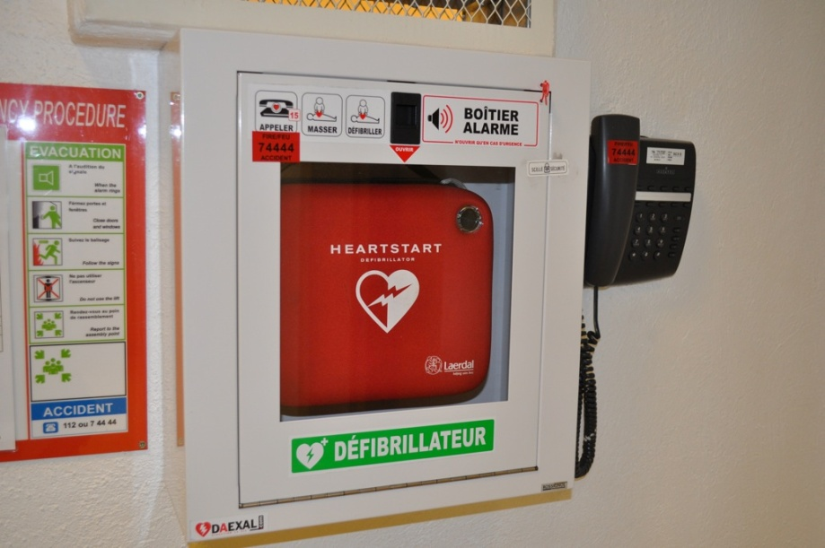
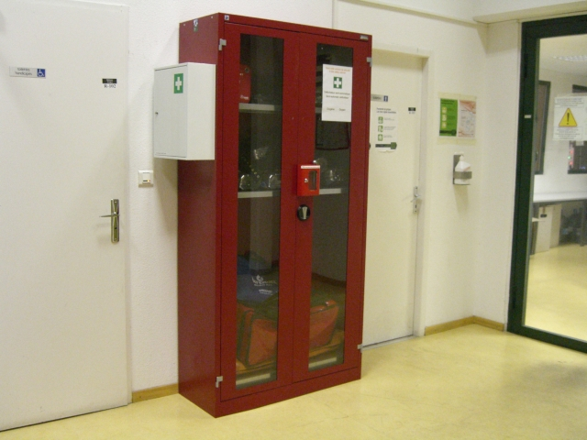
SI1-1 SCX5: Surface Control Room
Check the defibrillator:
This cabinet is at the entrance of the Control room near to the toilets.
Check the seal on the box (red seal) should be intact
Check that the green light is blinking
If you see that one of the seal is broken or missing or the green light is not blinking, take a note in your e-log and inform Davide Pagnani (164813) or Niels Dupont (165186) (Call only during working hours)
Check the Red and First Aid cabinet*:
This cabinet is at the entrance of the Control room near to the toilets.
Check the key of the cabinet. It should be in the small red box.
Check the glass of the small red box.
Check if the glass-breaker is there.
Check that light is working by disconnecting/connecting the plug.
This cabinet may or may not contain any Self-recue mask.
If you see any abnormalities (missing key, broken glass … etc.), take a note in your e-log and inform Davide Pagnani (164813) or Niels Dupont (165186). (Call only during working hours)

Slide 12
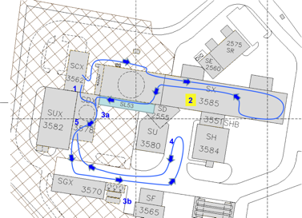
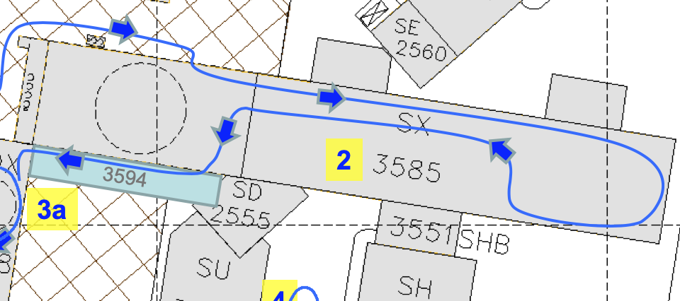
SI1-2: SX5 and 3594
Go to the SX5 building. Walk inside the building. Look around and close the those doors which are left open or blocked open.
Go through 3594 building. Look around while you walk through.
SX5

Slide 13
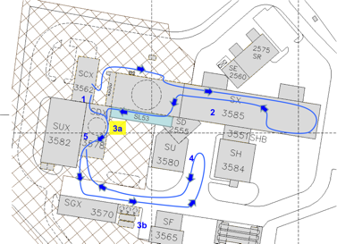
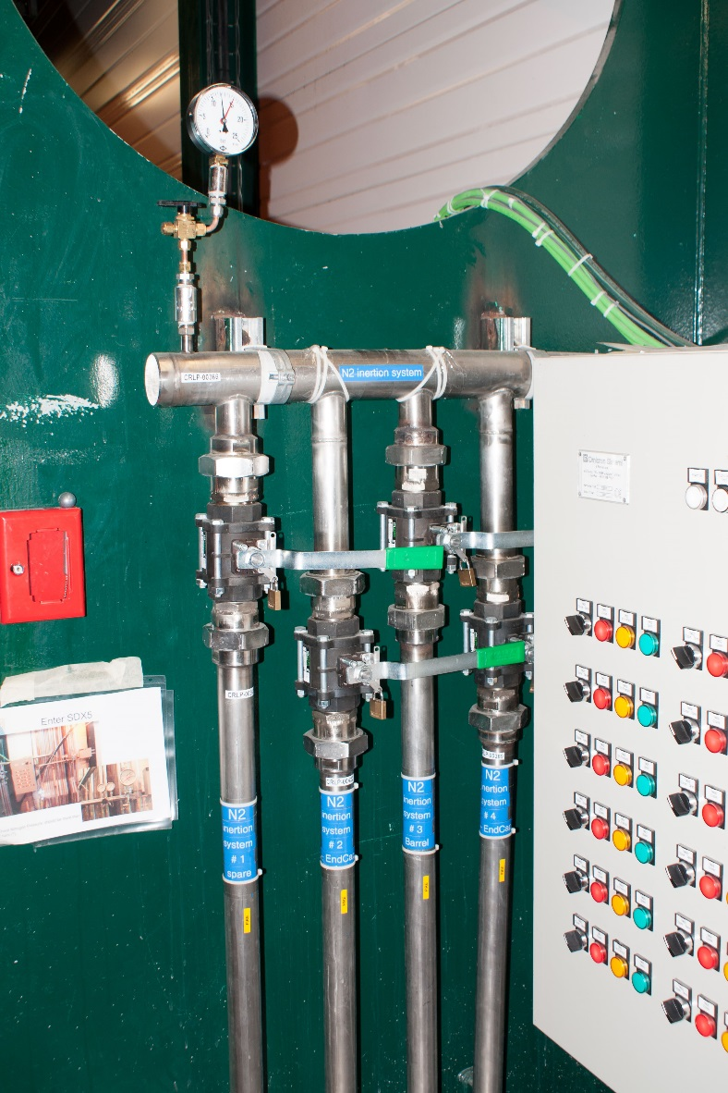
SI1-3a: SDX5 - Emergency Inerting N2
Check that:
All lights on the panel are green
The window of the red box is not broken and the key is still inside
There is no need to check the pressure on the manometer
Check the manometers at the N2 tank outside only during daytime (see next page)
In case of discrepancy, take a note in your e-log and inform Niels Dupont (165186) (Call only during working hours)

Slide 14
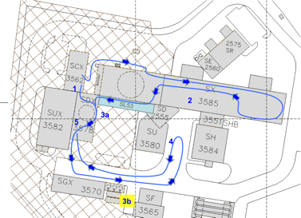
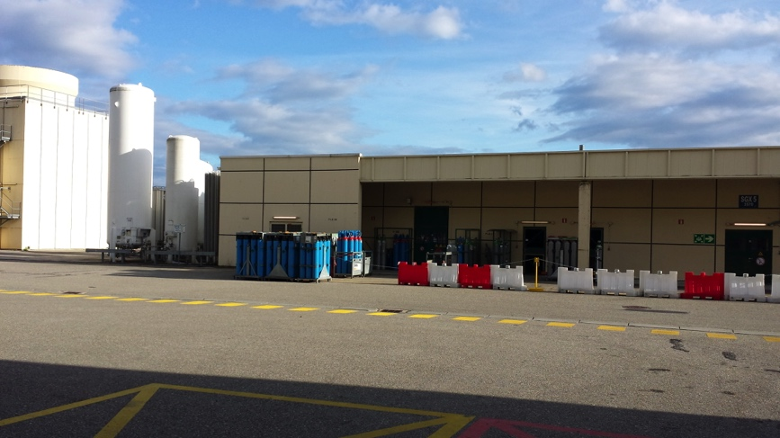
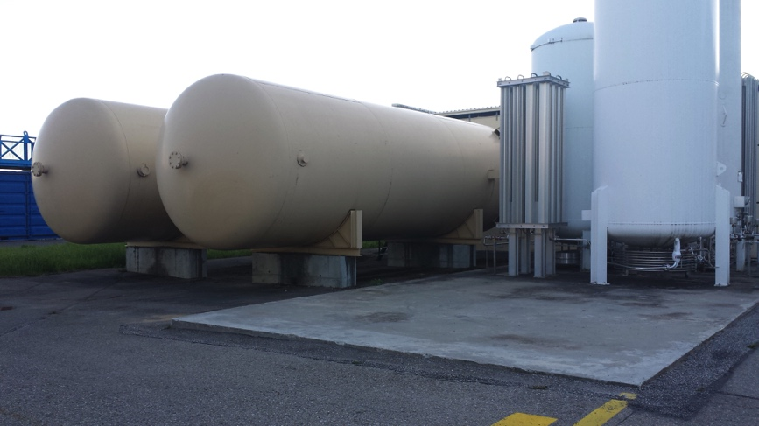
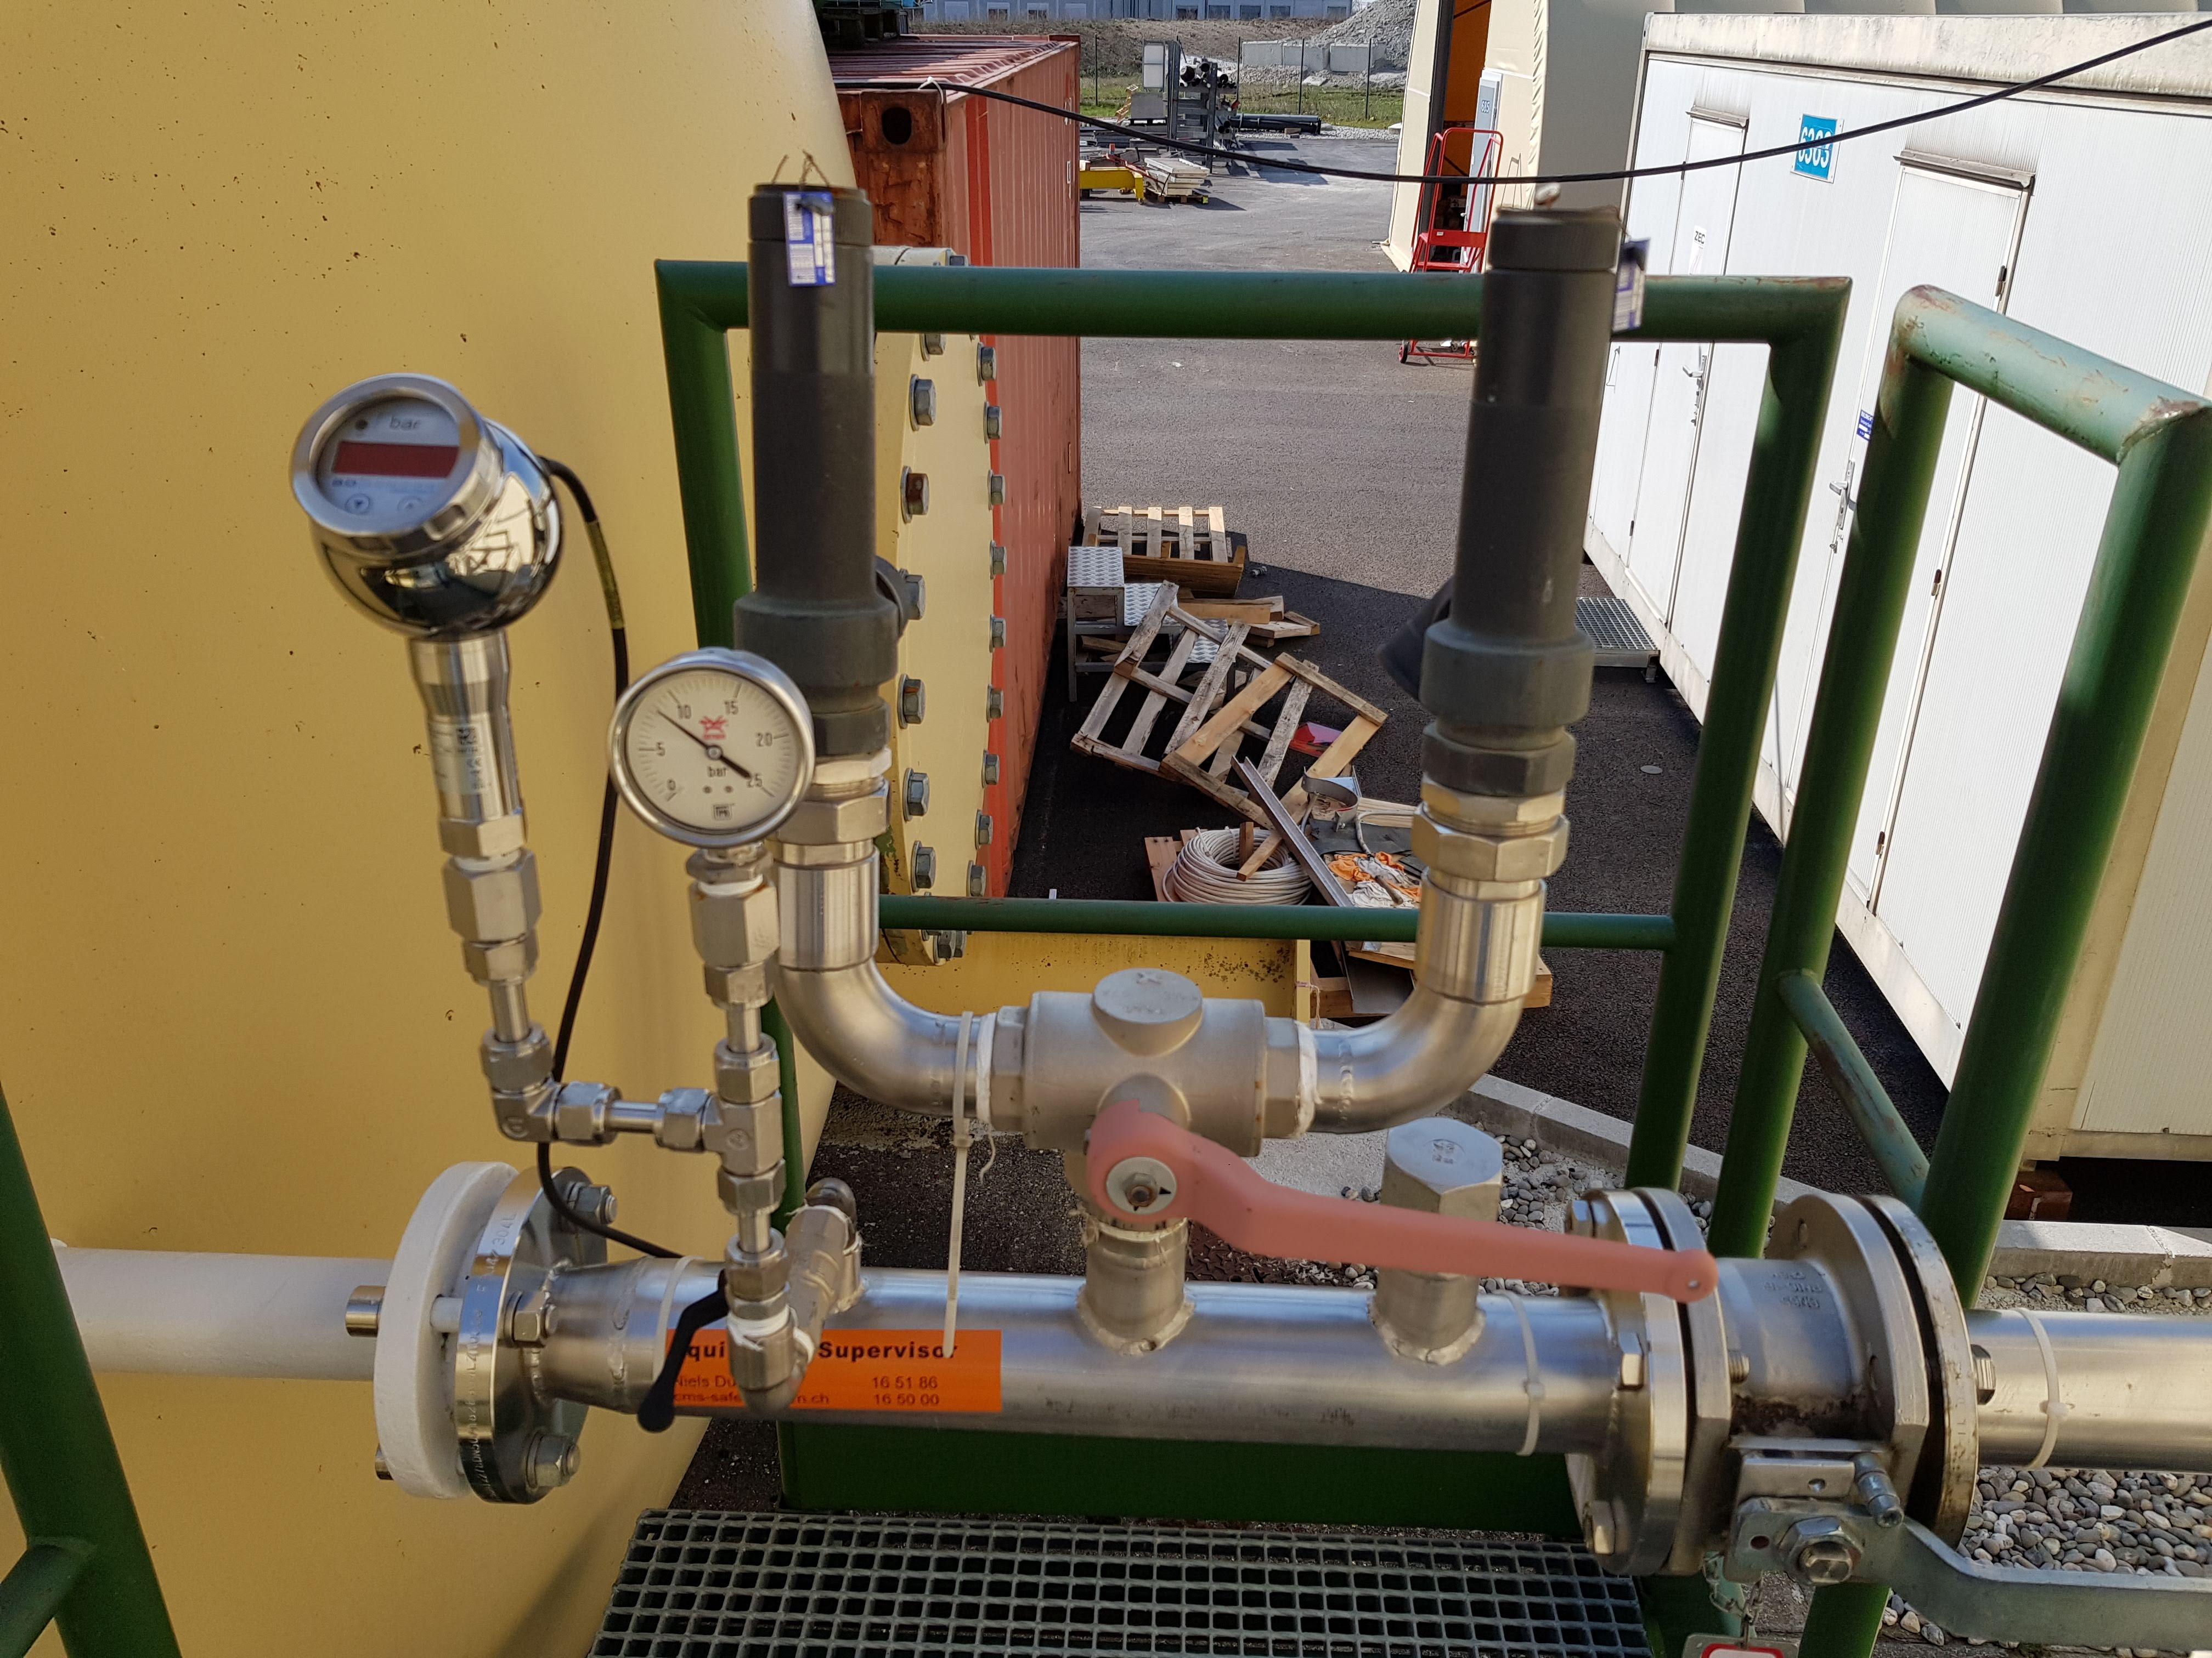
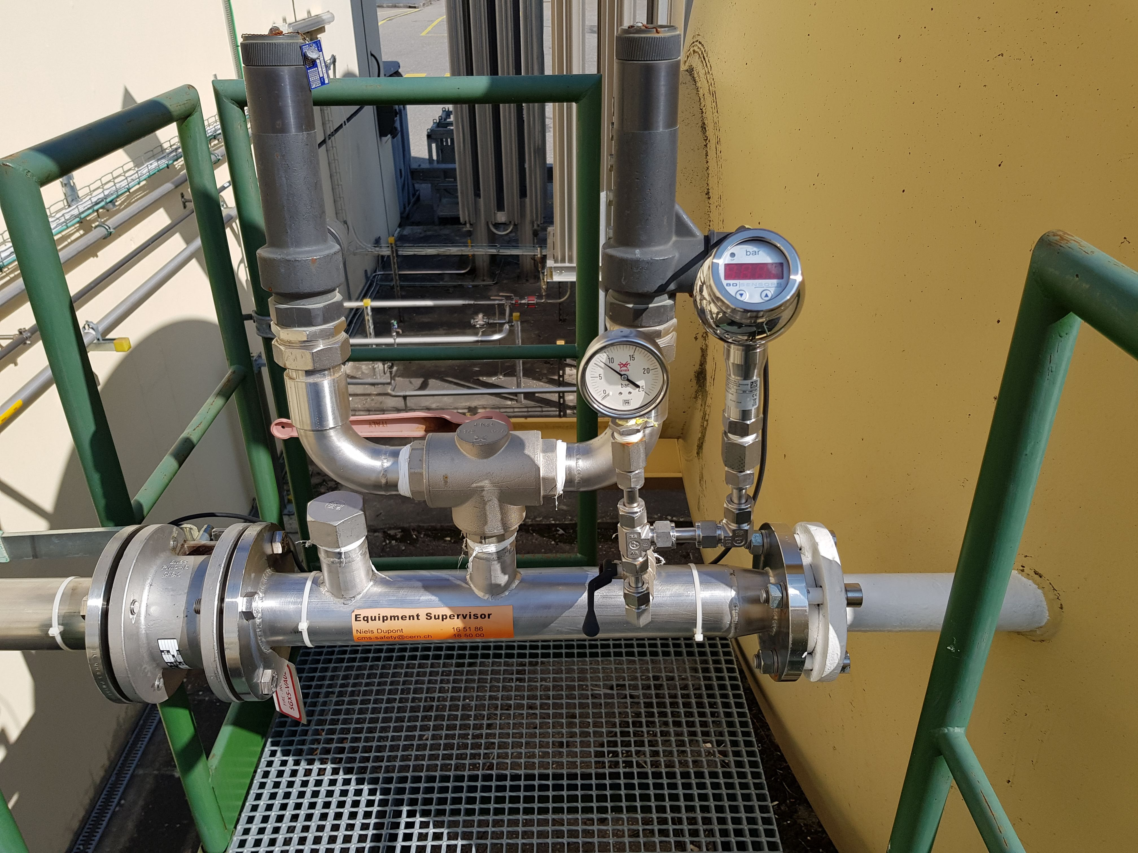
SI1-3b: SDX5 - Emergency Inertion N2 cont. check manometers at N2 tank outside only during daytime!
1
2
I.
I.
Go outside SDX5 and go towards the gas building (SGX5).
Go to the N2 tank on the left side (two yellow colored one behind the white colored ones)
Check the manometers of these N2 tanks:
  You can reach one on the top of the stairs, walk between the two tanks.
The normal pressure is between 10 and 14 bars.
  If you find one of them below 10 bars, report it to Niels Dupont (165186) (Call only during working hours)
  If you find one of them above 14 bars take a note in your e-log

Slide 15
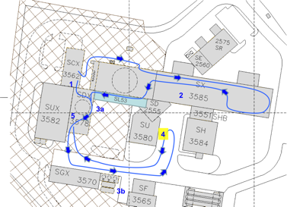
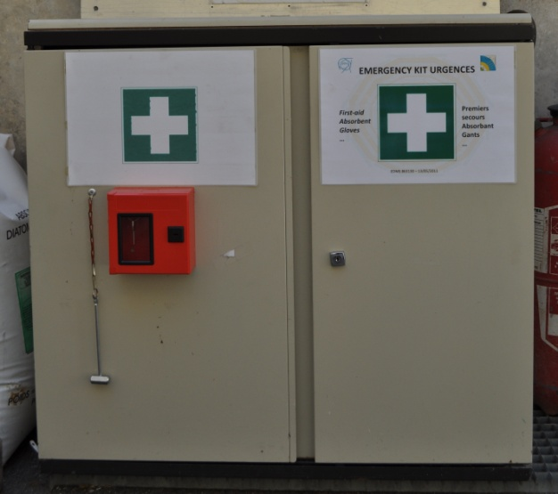
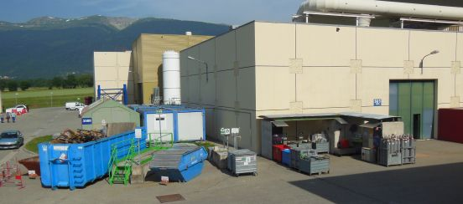
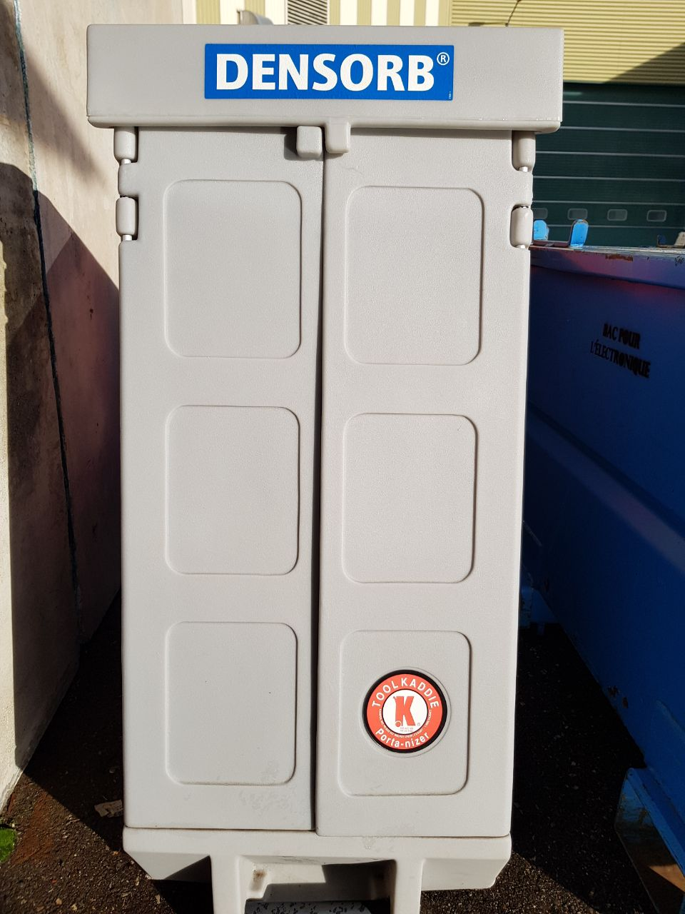
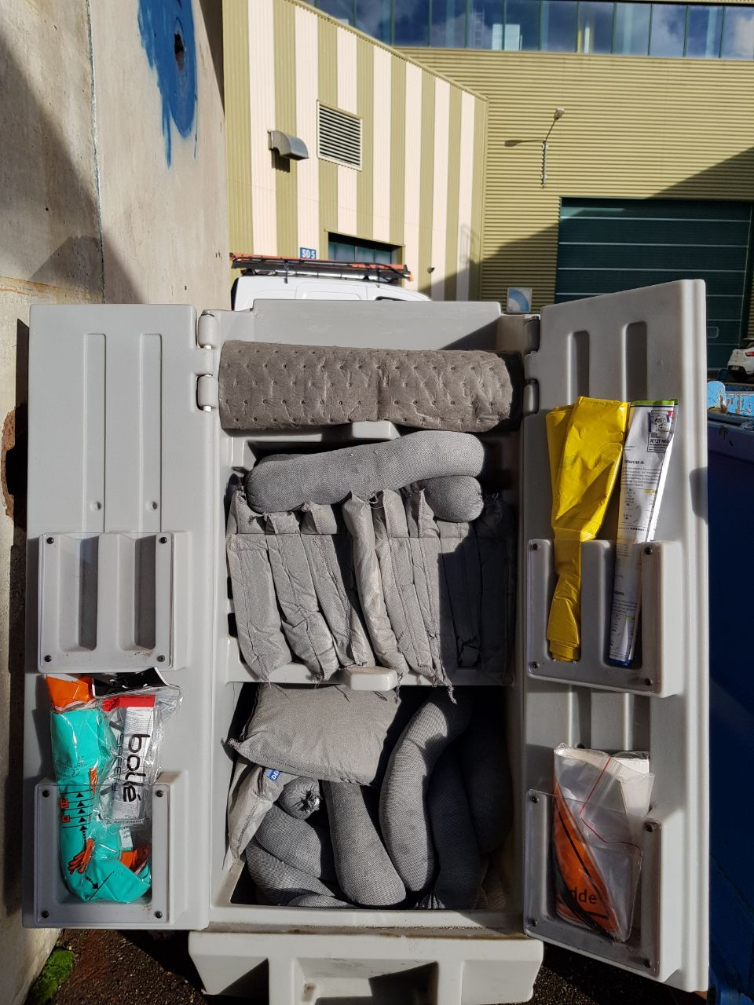
SI1-4 Outside: Waste area
Check the waste area (see images):
Check that there is no leak, no messy storage, no full bin/container
  In case of spill, messy storage of full bin/container take a note in
  the e-log and inform Romuald Bihery (160647) or Niels Dupont (165186). (Call only during working hours)
Check the first aid cabinet
  The key of the cabinet should be in the small red box.
  Check the glass of the small red box.
  Check if the glass-breaker is there.
3. Check the Emergency spill kit integrity
2
1
3
If you see any abnormalities (missing key, broken glass … etc.), take a note in your e-log and inform Davide Pagnani (164813) or Niels Dupont (165186). (Call only during working hours)

Slide 16
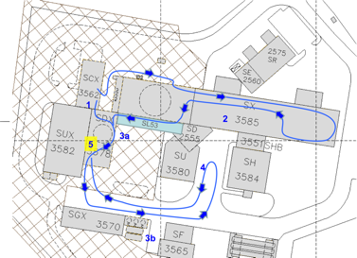
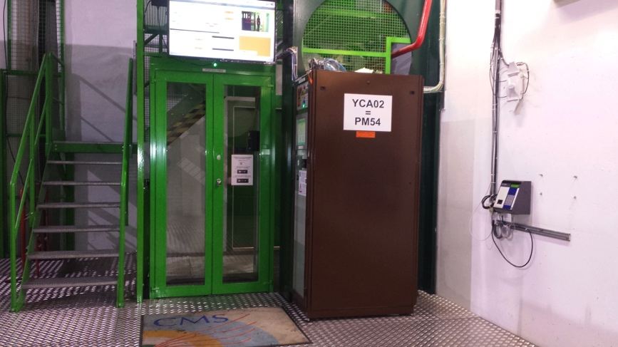
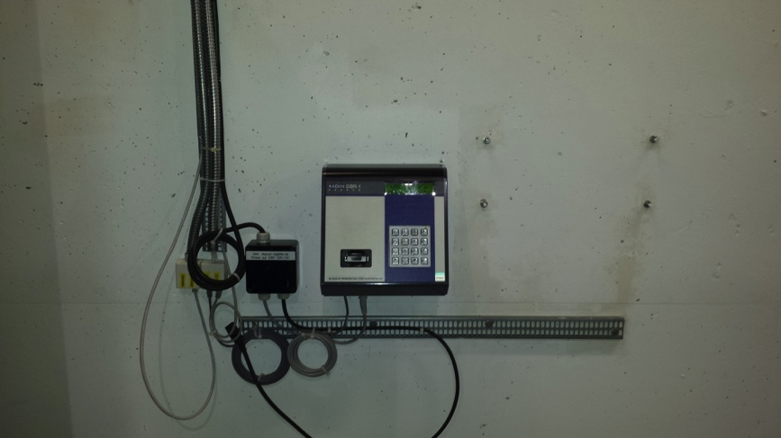
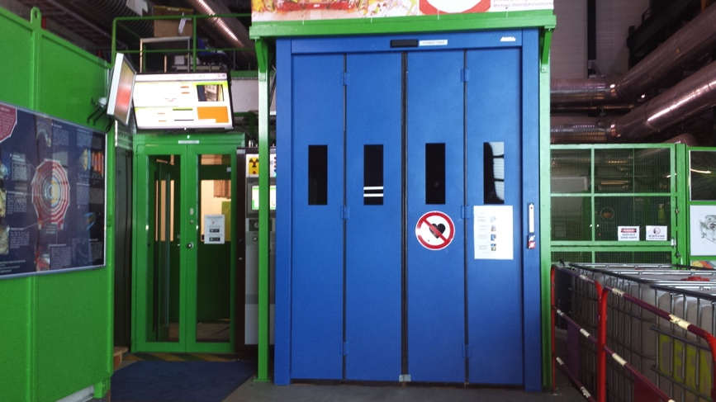
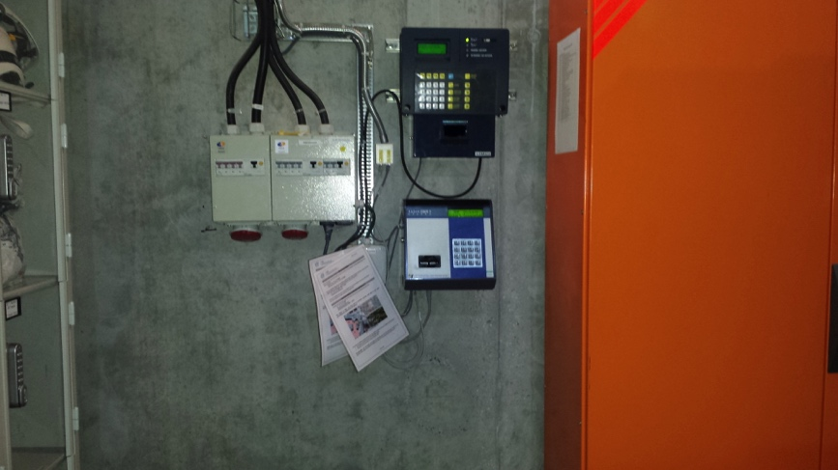
SI1-5 at PM54 – dosimeter readers checks
1
1
2
2
Before to go to the USC55, check that the three dosimeter readers close to the PM54 access devices are ON.
There are three dosimeter readers:
At the single door
2 at the double door
If you have a personal dosimeter, read it with both readers.
If you find any abnormalities, report it in your e-log

Slide 17

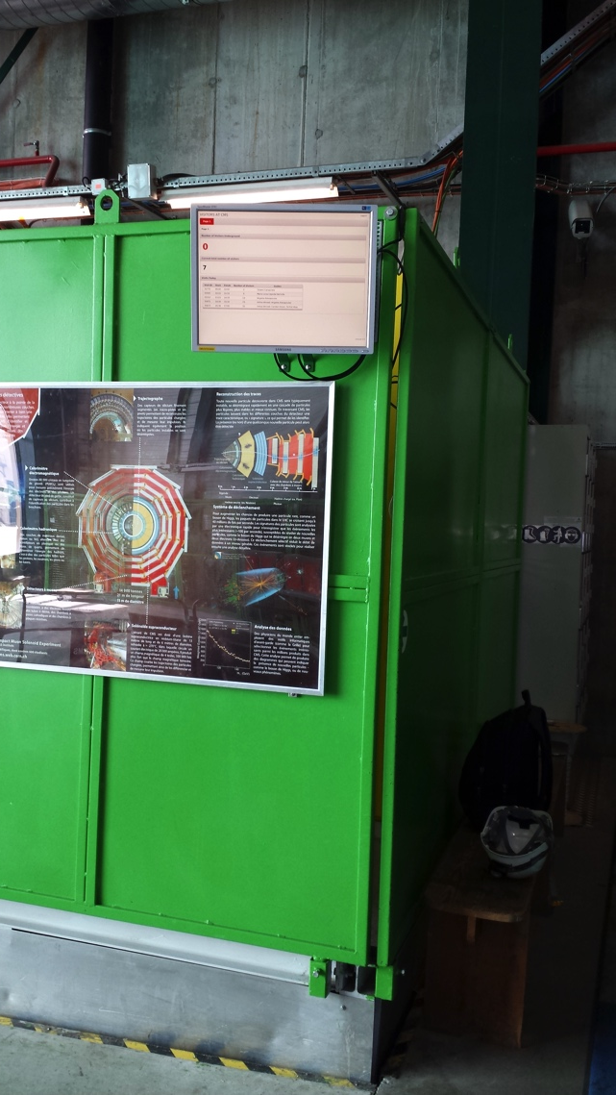
SI1-5 at PM54 – info screens check
Before to go to the USC55, check the 3 screens
visitor counter close to the PM54 MAD door
simple alert message (SAM) on top of the PAD,
IMPACT list (on top of the dosimeter reader)
Check that the screens are switched on and show the information (visitor counter webpage, IMPACT list, Point 5 infor).
If you find any abnormalities inform Zoltan Szillasi or 165000, via e-mail and report it in your e-log

Slide 18
Safety Tour in the USC55

Slide 19
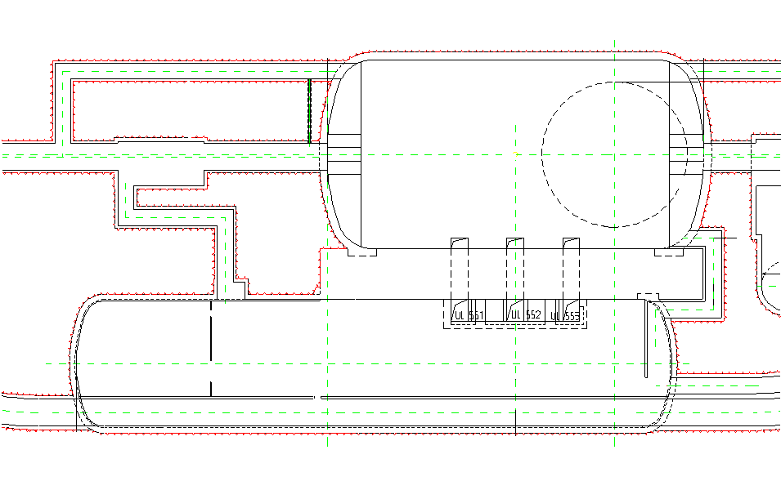
Orientation Underground
Experimental Cavern
UXC 55
Service Cavern
PM54 Lift
USC 55
Level -1: | Access to the S2 rack area, underground control room, magnet area, S4 rack area No direct access to the UXC55 cavern
Level -2: | Access to the S1 rack area, EN-CV room, Gas Room Access to beam pipe level of UXC55 cavern (Balcony X3 near, visitor platform)
Level -3: | Access to the US54 (Buffer zone) and UXC55 cavern (X1 near)

Slide 20
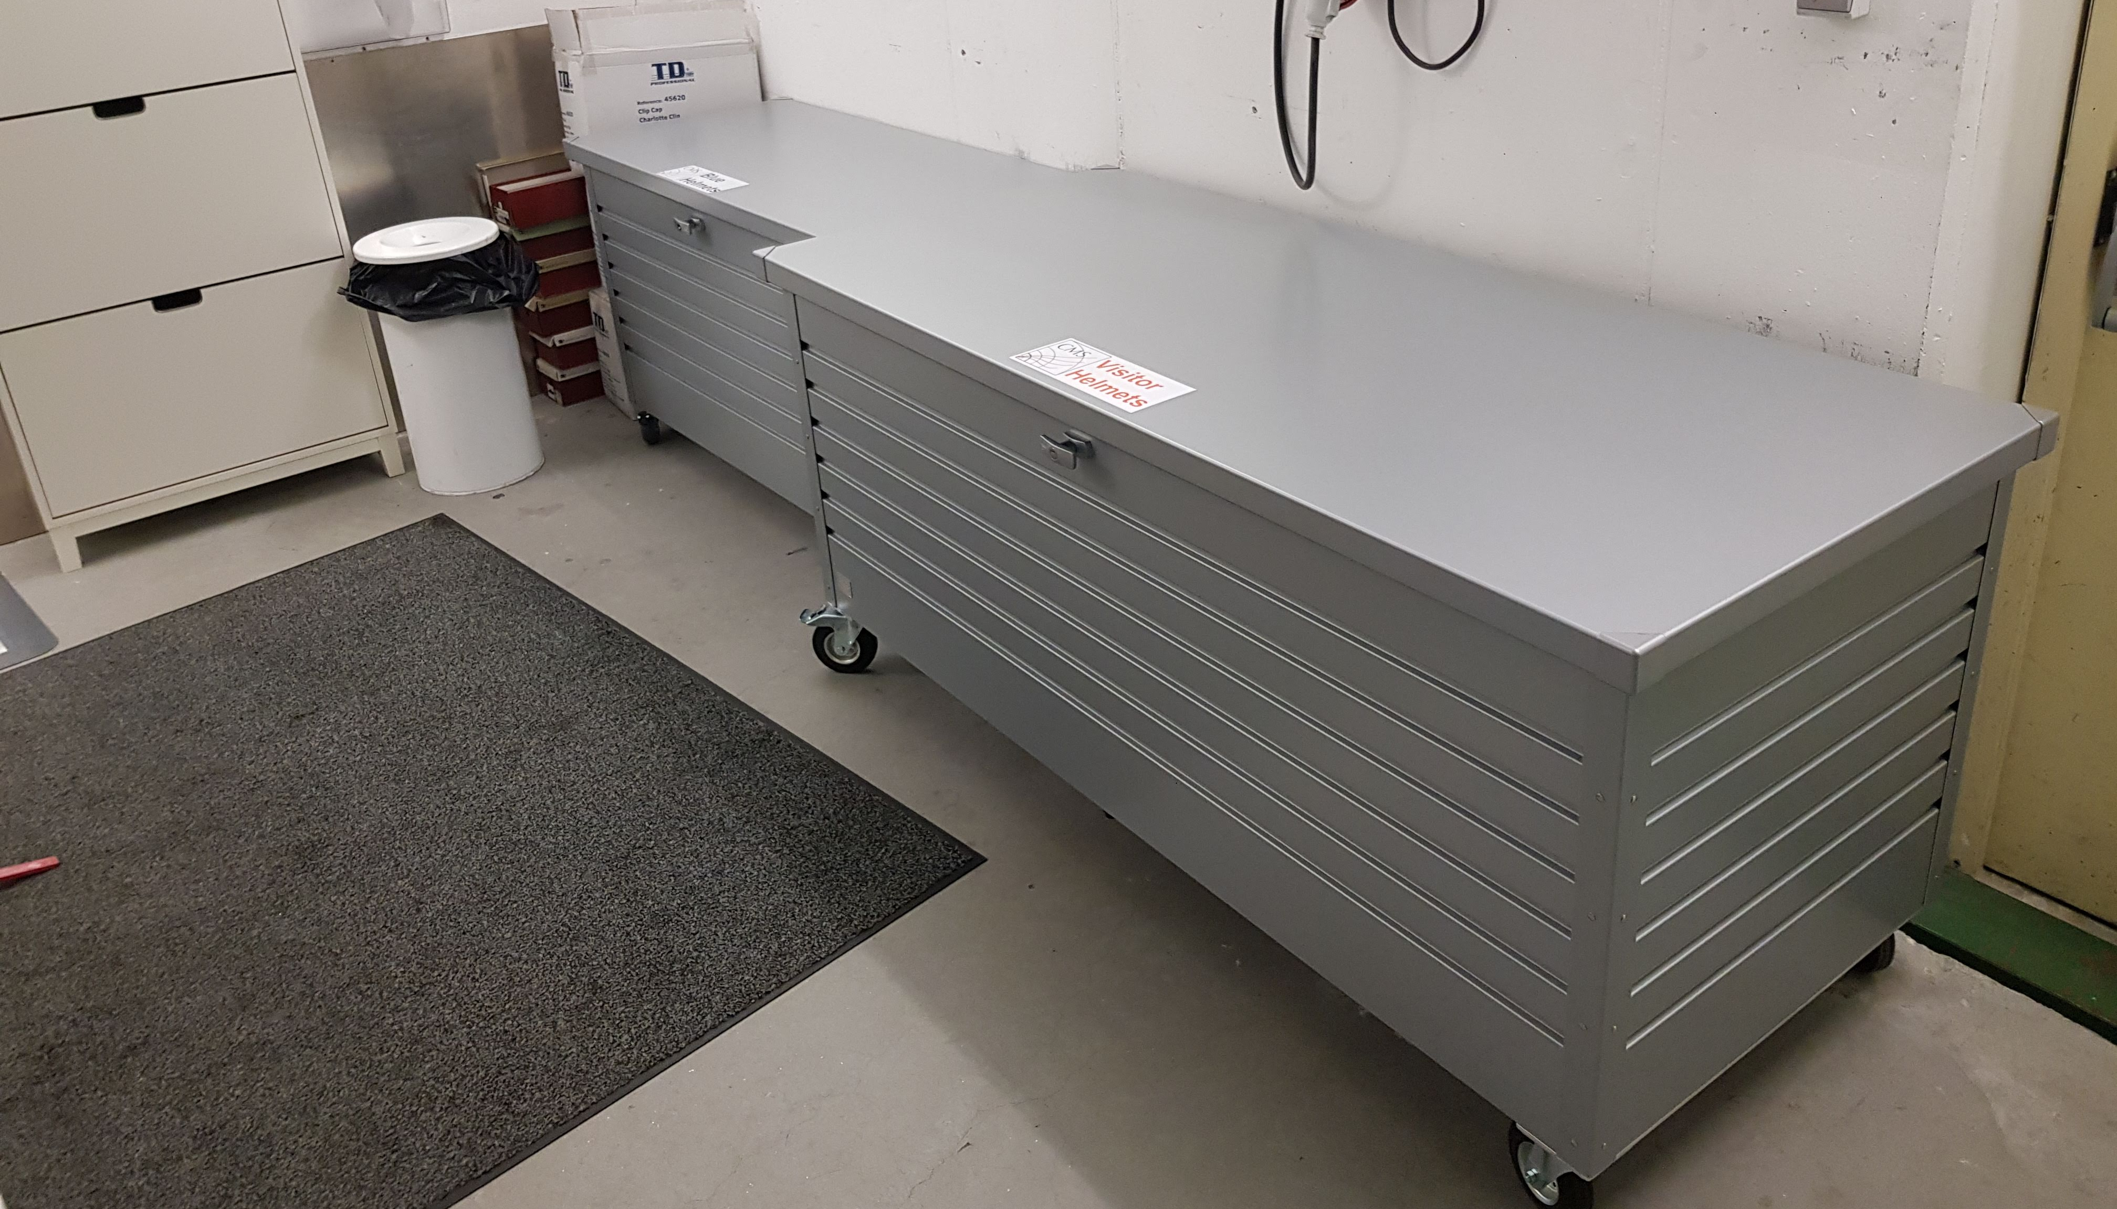
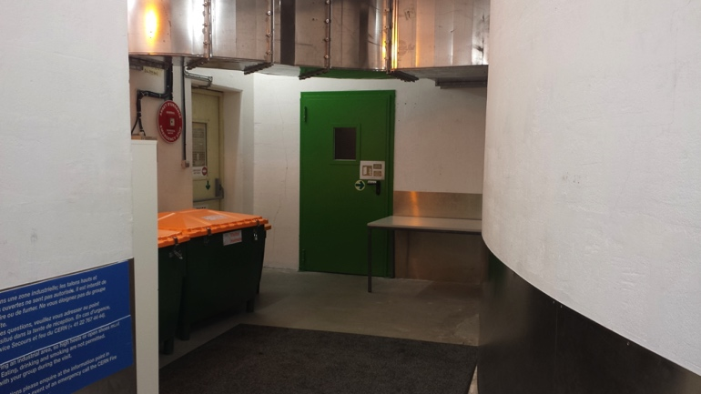
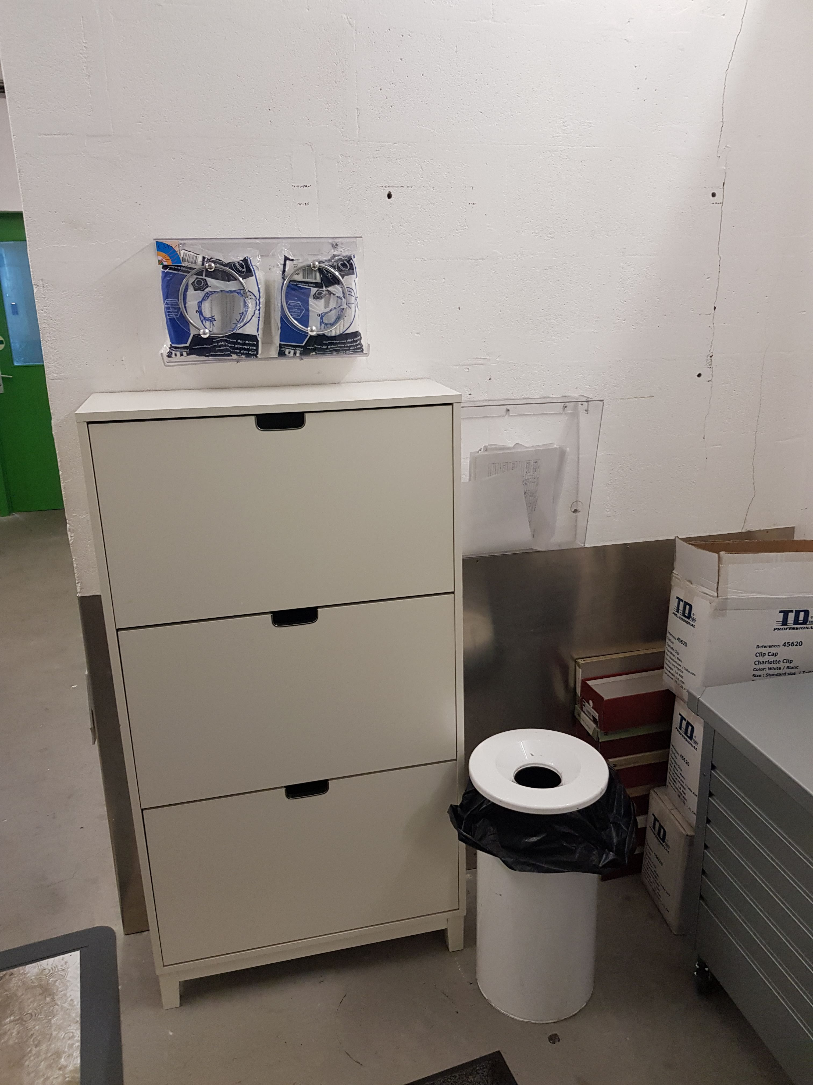
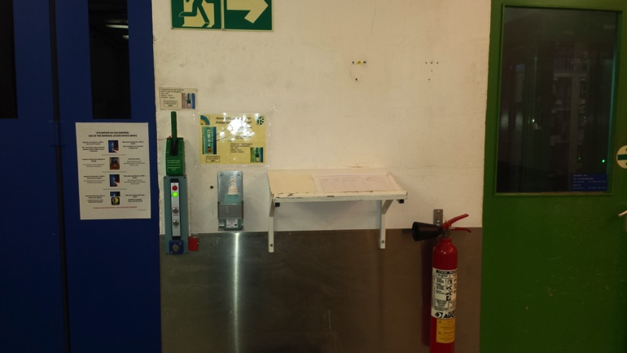
SI2-0 – Level 0 at PM54 elevator
2
1
Door of pressurized staircase
3
Refill of charlotte
Before take the elevator check the followings in the room:
Check that the door of the pressurized staircase is closed, and that no object obstruct the opening, and try to open it.
Check that the helmet boxes for the visitors (grey) are closed and locked (only when there are no visitors in the room)
If you find the boxes open, close them and report it in your e-log.
Check that there are enough hygiene caps (charlotte) for the visitors (above shoe cabinet).
If not, refill it from the cardboard box on the right bottom next to the cabinet
Check that there are enough clear page left in the visitors logbook. Take a note in your e-log if you find that this logbook is almost full (one clear page left)
4

Slide 21
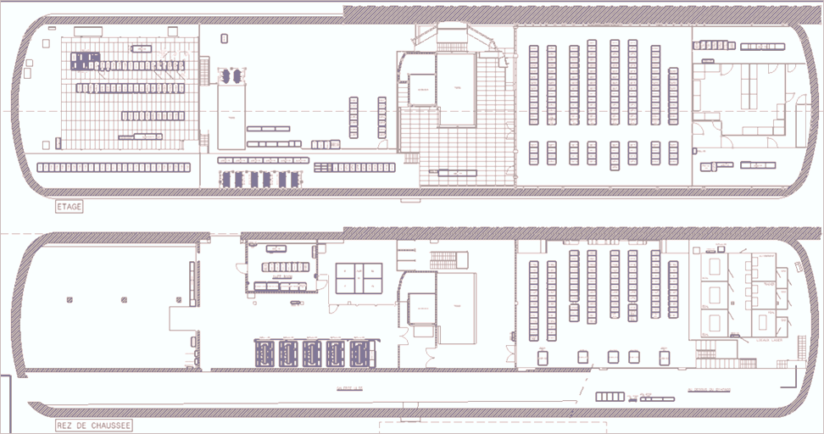
Safety Tour Itinerary 2 (SI2)
USC55
2
PM54
Level -1
4
Magnet Area
S2 Counting room
Control
room
6
3
S4 area
down
5
11
PM54
Level -2
S1 Counting room
9
up
to
S4
1b
Gas room
to UPX56
EN/CV area
10
8
1a
down
7

Slide 22
Safety Tour Itinerary 2: (SI2)
USC55
  All safety doors should be closed.
  LOOK FOR WATER LEAKS EVERYWHERE. Also check for bad or burning smells. Listen to unusual noises, vibrations.
  Check the Red and First Aid cabinets (instructions at the end of itinerary)
  SI2-1 Go to lift level -2 – Check first aid cabinet, check electrical safety equipment, check the chemical emergency kit. Enter the EN-CV Zone S3 Pump Room
  SI2-2 Take stairs up to the S4: Magnet Area – Check S4 area and the Magnet Area.
  SI2-3 Pressurized zone in lift level -1 – Check the first aid cabinet
  SI2-4 Pass lift area at level -1
  SI2-5 S2 counting room – Listen for abnormal noise and vibrations, check the temperature
  SI2-6 Go down the stairs behind the USC55 control room – Check the area below false floor of S2.
  SI2-7 Go to UGX5 (gas room) at the UPX56 end of USC55 at the S1 level – Look around, check for water leaks
  SI2-8 Check the UPX56 access device – Check the green handle is in upright position.
  SI2-9a On the way to S1 counting room - On the way back check the Fire detection panels, red and first aid cabinet, the defibrillator, then check the area below false floor of S1.
  SI2-9b S1 counting room – In the rows of S1 Racks: listen for abnormal noise, check the temperature sensor
  SI2-10 Check the toilets – Open each door and take a look inside. Check for people.
  SI2-11 Go to the lift. Go to lift level -3 – Check UP55 access device, check the door of MAD (blue door).
  SI2-12 RP buffer zone - Check RP buffer zone and Foam System (US54)

Slide 23
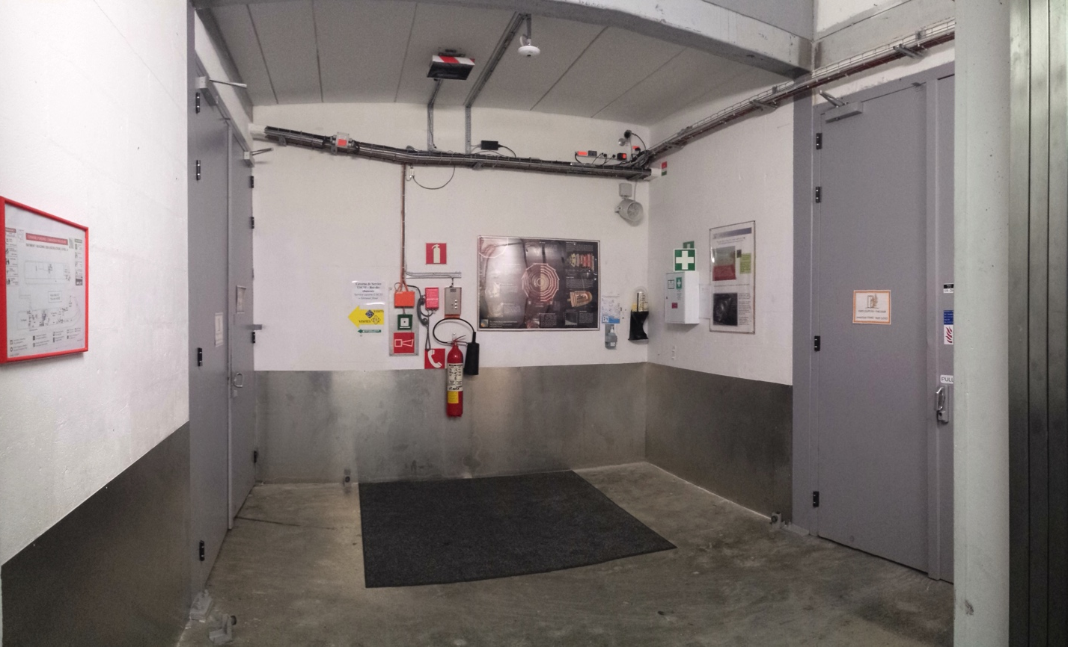
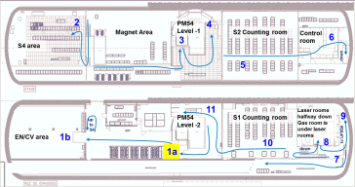
SI2-1a: Check of First Aid box and the door of pressurized staircase
First Aid
Go to lift level -2
Check the First Aid cabinet in the corner (more instruction at the end of itinerary)
Make sure the pressurized area is kept empty – no materials may be stored here. Make a note in your Elog and inform 165000 (during working hours) if this area is not completely free.
Then enter the grey door on the right, which leads to the EN/CV area

Slide 24
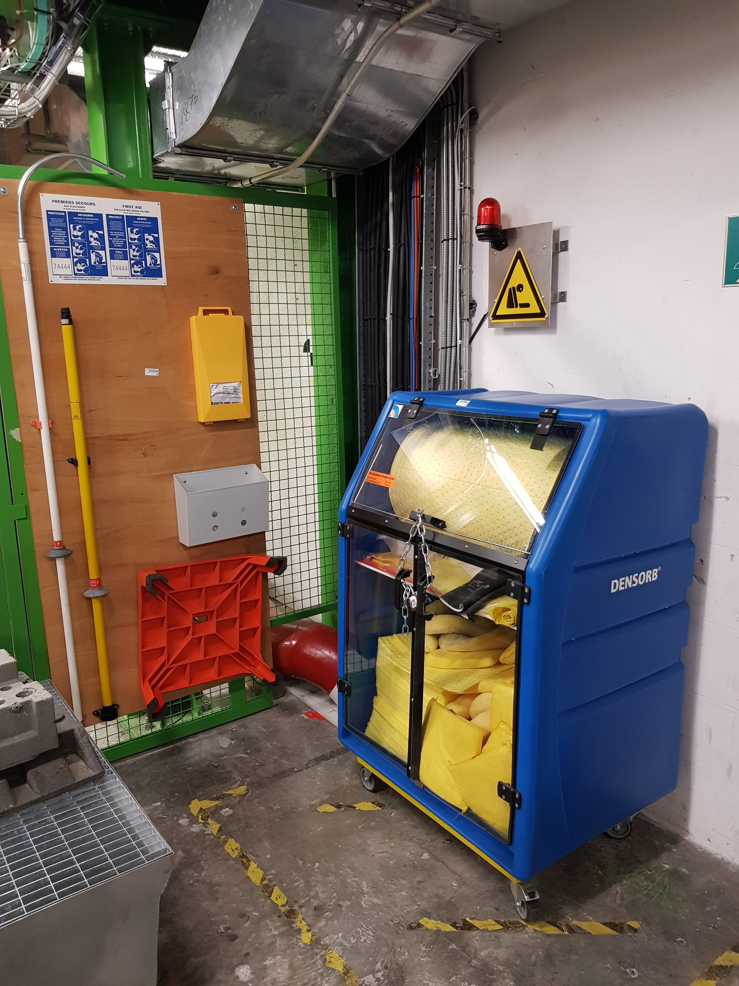
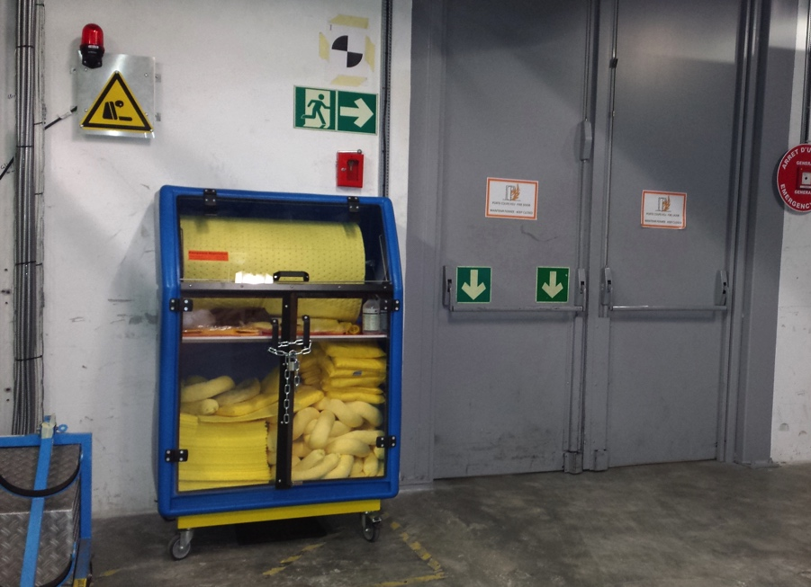
SI2-1b: Check chemical emergency kit and the electrical safety equipment on the way to EN-CV room
Chemical emergency kit
Electrical safety equipment
Pressurized zone door
b
a
c
d
Turn back and on the left side of the door you will find the chemical safety equipment and on the right side the electrical safety equipment
Check the chemical safety equipment:
  check that the padlock is on the equipment and it is locked
  check that the key for the padlock is in the small red box.
  check if the glass of the small red box is intact.
  check if the glass-breaker is there.
  In case you found any abnormalities on this kit (missing padlock, key, … etc), mention it in the e-log.
Check the electrical safety equipment
  Safety gloves (a), long rod with high voltage detector (b), long rod with hook (c), tabouret (d) should be in place.
Then continue the way to EN-CV area (next page)

Slide 25
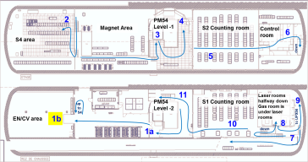
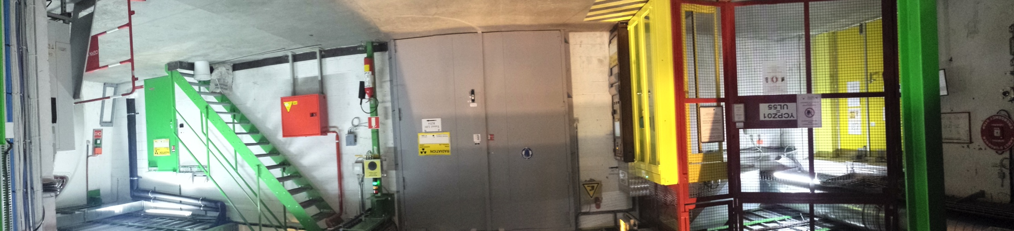
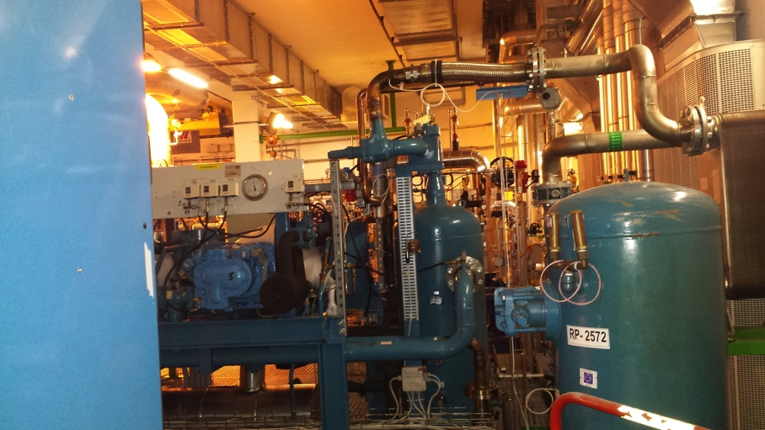

SI2-1c: EN-CV Zone S3 Pump Room
1
Temp sensor
Go straight to the grey door.
Check the temperature sensor on the wall next to the grey door: The usual temperature = 18-25°C
If the difference between temperature and dewpoint less than 5, call 165000
(more details at the end of itinerary)
Enter into the EN-CV Zone S3 Pump Room via green door
ENTER THIS ROOM only if you have a PERSONAL dosimeter!! Otherwise skip this room.
  Listen for noise and vibrations.
  Look for water leak.
  If you see strange noise vibration or a leak, report it in your e-log entry.
  DO NOT TOUCH THE PUMPS, HEAT EXCHANGERS, THEY MIGHT BE VERY HOT OR VERY COLD
2

Slide 26
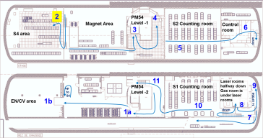
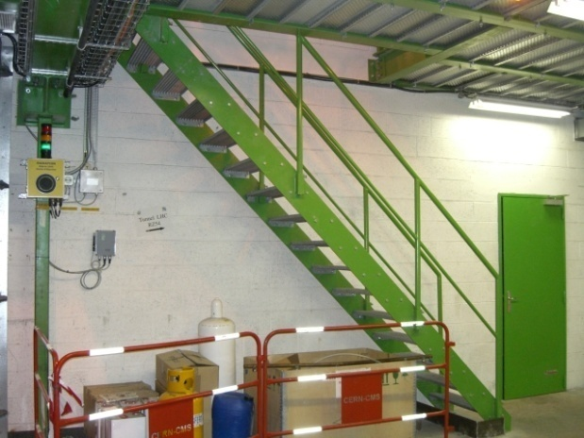
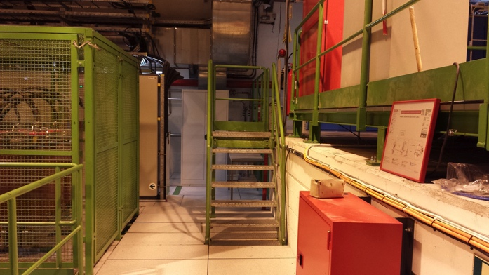
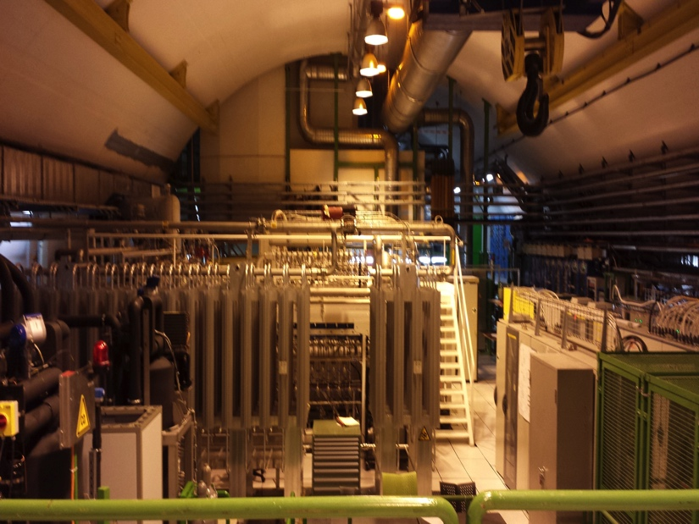
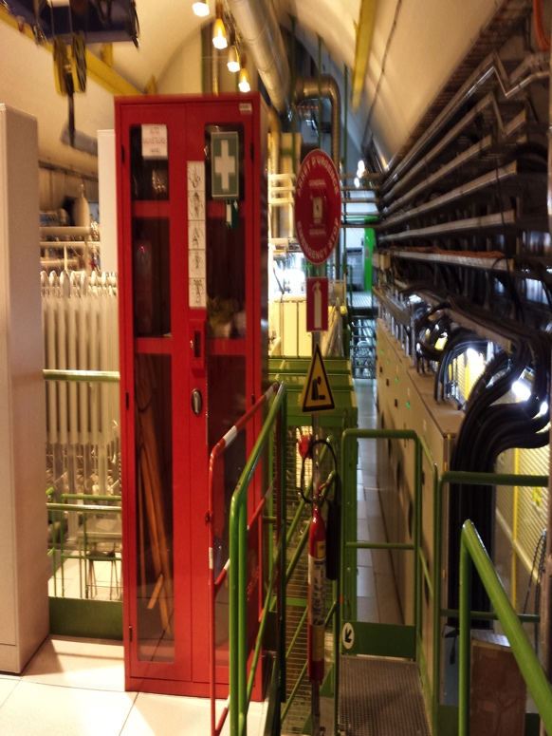
SI2-2: Magnet Area and
S4 area
1
  Turn left and take the stairs up to S4 (go to the next stairs then turn right)
  Check all rack rows in S4 and look the Magnet Area
  Check the Red and First Aid cabinets here (instructions at the end of itinerary)
  Then go towards to the elevator
  (On the way check the temperature of the power cabinets. Use your hands)
Note: There is a weird noise of the pump as you enter to this level. You can find a recording of this sound in the Twiki page and compare to what you hear
2
3

Slide 27
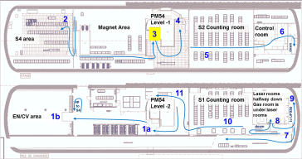
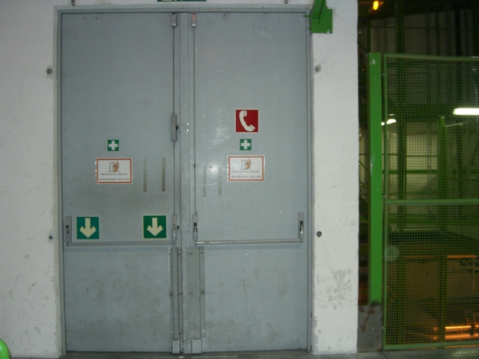
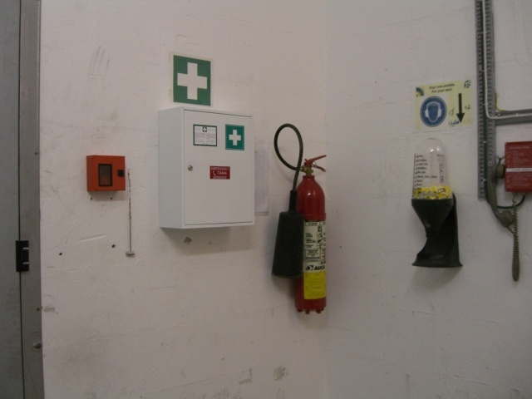
SI2-3: Pressurized zone in lift level -1
1
Go to the pressurized zone of the elevator (see the door in the image).
Then turn left. Check the First Aid cabinet here
(instructions at the end of itinerary)
Make sure the pressurized area is kept empty – no materials may be stored here. Make a note in your Elog and inform 165000 (during working hours) if this area is not completely free.
2

Slide 28
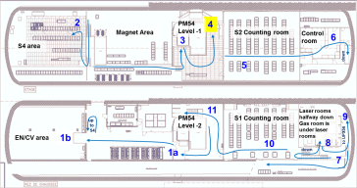
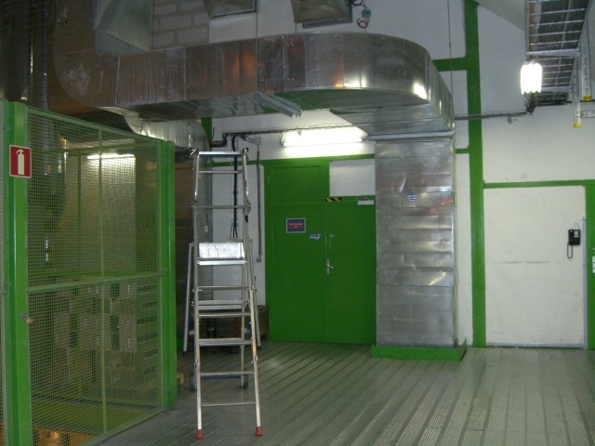
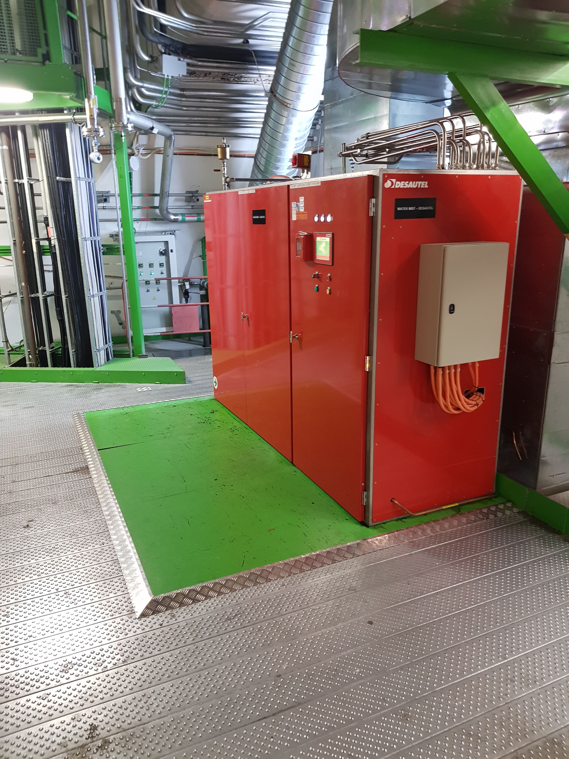
SI2-4: Staircase at S2 Counting room
1
Go out from the pressurized zone then turn left then turn left again.
Before entering to S2 counting room check the staircase area. Look around.
Check the Desautel Water Mist system:
  No leaks are present;
  The green area is free
  The control panel is ON
Then turn back and go to S2
3
Control panel

Slide 29



SI2-5: S2 counting room
1
Enter to the S2 counting room
Go through the room and check every rack row: Listen for abnormal sounds, look for water leaks.
2
Check the temperature sensor on the wall (at the end of rack row S2G##):
The usual temperature = 18-25°C
If the difference between temperature and dewpoint less than 5, call 165000 (more details at the end of itinerary)
Temp sensor

Slide 30




SI2-6: S2 false floor
1
Go down the stairs behind the control room
When you are at the end of the staircase, turn left.
Go further until you reach the end of the corridor and on the way check the area below false floor of S2 (right side). Look for water leak. Then turn back
2

Slide 31




SI2-7: UGX5 (gas room)
1
2
3
Disable lift’s key glass box
Check the integrity of the Disable lift’s key glass box
Go to UGX5 at the UPX56 end of USC55 at the S1 level
This is a door of the underground gas room. Use your dosimeter/token to enter. Please note that even though there are radioactive sources present in the room, the area is not classified as “supervised” and can be entered without a dosimeter, just using a token.

Slide 32


SI2-7: UGX5 (gas room)
4
5
Look around in the room.
Check the valves of the N2 inertion system. You can find them at end of the second row from the left, on the wall.
All of these valves should be in open position. If you find a closed one, mention it in the e-log.

Slide 33




SI2-8: UPX56 access device
1
  Go to the UPX56 gate. Turn to left, then turn right.
  Check the UPX56 access device:
    Check the green handle. If it is broken to open, please write an e-log entry
2

Slide 34


SI2-9a: on the way to S1
Fire detection units
Hand-Foot-Monitor
Defibrillator and self-rescue masks cabinet
Go back towards the S1 counting room
Check the Fire detection panels. Call 165000 if you see any abnormalities. (call only during working hours)
Check the Red and First Aid cabinet here (instructions at the end of itinerary)
Check the defibrillator on the wall. Instructions below
Test the Hand-Foot-Monitor by standing on it a putting both your hands on the corresponding spaces

Slide 35


SI2-9a: on the way to S1
Defibrillator check:
This cabinet is on the right wall, near to the entrance door of gas room.
Check the seal on the box (red seal) should be intact
Check that the green light is blinking
If you see that one of the seal is broken or missing or the green light is not blinking, take a note in your e-log and inform Davide Pagnani (164813) or Niels Dupont (165186) (Call only during working hours)
Defibrillator
door of gas room
Red and First Aid cabinets
TETRA charger check
Check that all LEDs of the battery charger are ON (green or orange are OK)
If not, mention it in your e-log

Slide 36





SI2-9b - S1 counting room
Check the area below the false floor (look for water leaks)
Check the S1 counting room:
listen for strange noise, vibrations, look for water leak.
Check the temperature sensor on the wall: The usual temperature = 18-25°C
If the difference between temperature and dewpoint less than 5, call 165000 (more details at the end of itinerary)
to S1
to S1 false floor area
3
4
Don’t check this type of temperature sensor
Temp sensor

Slide 37





SI2-10: Check the platform and check the toilets
1
  Turn to right, go towards to the toilets (near to the staircase)
  Check the platform on the left
    Check that nothing is stored on this platform
    Check that nobody is on the platform
    Check that the door to the platform is closed and locked with a padlock
    In case of abnormalities, report it in your e-log
    Note: during Technical Stops the platform can be opened
  Continue your way and check the toilettes. Open each door and take a look inside. Look for people.
  Test the water flow. Check the soap and paper towels supplies.
  Then go to the pressurized zone and go to level -3
Platform
2
3

Slide 38




SI2- 11: UP55 access devices
1
First Aid
2
Hand-Foot-Monitor
3
RP Buffer Zone
UP55 access
Go to the lift. Go to lift level -3.
Make sure the pressurized area is kept empty – no materials may be stored here. Make a note in your Elog and inform 165000 (during working hours) if this area is not completely free.
Turn to the right and you will see the access device. Check the UP55 access gate. Check if the door of MAD (blue door) is closed
Test the Hand-Foot-Monitor by standing on it a putting both your hands on the corresponding spaces
Check the First Aid box (instructions at the end of itinerary)
Go to the RP Buffer zone (next page)

Slide 39


SI2-12: RP buffer zone and Foam System (US54)
2
3
1
Light switch of UXC55
As soon as you enter to this area:
  You can see the light switchboard of UXC55 lamps on the right side (lights on if the button light, lights off if the button not light).
  Check these lights switches. If they are switched on during run time (data taking, beams in LHC). Note the time, then switch off them. Then inform the shift crew about it and also report it in your e-log.
  Yellow stairs leads to the RP buffer zone (fenced with yellow fences)
  Go to left: you will find the areas with the water sumps
Look for people in this area, check for leaks. Report any strange noise and problem with lighting.
Check the area below the Firedos platform (foam system):
If you see anything abnormal (noise, leak, etc), take a note in your e-log and inform Niels Dupont (165186). (Call only during working hours)

Slide 40
Perform the next part only if you have
a personal dosimeter and
access to the UXC55

Slide 41

Coordinate system of UXC55

Slide 42

UXC55 tour during Technical Stops
If you have access rights to UXC55, go to UXC55 through UP55 access device and inspect the cavern at level X1 (naming convention on the next slide), not need to go up or down stay on the same level as you enter the cavern.
Look around the cavern, look for water leaks, unusual noises, bad or burning smells.
Connect to the charger those cherry pickers and scissor lift which are unplugged. If you can’t do it take a note about it and mention it in your e-log.
After the visit of the UXC5, go back to the elevator through UP55 access device.
Go up to the surface with the PM54 elevator and write your e-log.

Slide 43




UXC55: X1 level
1
2
4
3.4
Use the UP55 PAD to enter the UXC55. You arrive on X1 level at –Z end near side of the cavern.
Check the trash bins and the toilets which are located to your right
  Verify that the toilets are empty
  Check the water flow. Verify that there is enough paper towels and soap
Check the seal on the First Aid cabinet
Walk around on X1 and:
  Watch out for water or oil puddles and leaks. Especially inspect the areas below the HF on +Z and –Z ends.
  Watch out for equipment blocking the evacuation path (stored material, working in height equipment etc.)
  Watch out for broken lights
  Make sure there is no storage on the X0 evacuation hatch at –Z end, far side
Check the seal and the position of the emergency handle on the door leading to the area below CMS (X0).

Slide 44



UXC55: X3 level, UP55
1
2
3
Make sure that there is no storage on all evacuation paths on X1 and X3 on both near and fare sides
On near side of X3, go through the visitor platform to the UPX56 door. Check the seal on it.
Finish your tour by going out through the UP55. Check the seals on both the PAD and the MAD of UP55

Slide 45
End of the tour
This is the end of the tour
… and please don’t forget to write the elog entry
(elog → General → SLIMOS)

Slide 46
Numbering Convention of UXC55 levels

Slide 47


First Aid and Red cabinet check
Check the First Aid and Red Cabinets during the tour.
You can find these in the following places:
Red cabinets and First Aid cabinet
  level -1 in USC55 in the magnet area
  level -2 in USC55 by the gas room
only First Aid cabinet
  in the pressurized area in level -1, -2 and -3 in USC55
  UXC55 X1 NEAR+
(see map for the locations in USC55)
One Red and First Aid cabinet is in the control room building near to the entrance.
PM54
Level -1
First Aid
PM54
Level -2
Red cabinet and First Aid
First Aid cabinet
Red and First Aid cabinets
Check the cabinet:
check the key of the cabinet. It should be in the small red box.
check if the glass of the small red box is intact.
check if the glass-breaker is there.
Check that light is working by disconnecting/connecting the plug.
If you see any abnormalities (missing key, broken glass … etc.), take a note it in your e-log and inform Davide Pagnani (164813) or Niels Dupont (165186). (Call only during working hours)
The key is inside red box

Slide 48


Temperature Detector Check
Check temperature and dewpoints also on website later (cmsonline → DSS)
http://cmsonline.cern.ch/portal/page/portal/CMS%20online%20system/DSS/Environment
Located in S1, S2 on the right wall seen
from the lift
Temperature
This type can not display the dewpoint temperature
The usual temperature = 18-25°C
If the difference between temperature and dew point becomes less than 5 degrees, call 16 5000
Dewpoint
temperature

