Slide 1
CMS End-of-the-Year Safety Tours 2018
Once a day the following short tour through Point 5 has to be done
The exact time of the tour can be chosen by the shift crew in mutual agreement
Any shift crew consists of two people
On the tour the following places have to be visited:
SCX5 – Building of the CMS control room – accessible with your access card
SX 5 – Surface hall
Building 3584 – Membrane Plant and Dry Air Plant
SL53 – office building
SDX5 – Area between control room and elevator
USC55 – Underground Service Cavern including CV room and gas room
UXC55 – Underground Detector Cavern
All necessary keys are in the control room on the desk of the access control PC
In case of problems call 16 5000 (or +41 75 411 5000)
Technical problems e.g. lift failure must be reported to TCR 72201
Problems with the access system must be reported to 72201
(Only) for Emergencies call 74444
Fire brigade technical assistance can be called by 74848
DO NOT GO UNDERGROUND IF THE LIFT FAILED OR THERE IS ANY ALARM
IN DOUBT CALL 16 5000

Slide 2
In Case of Problems with the Access System
Surface PM54
If the access is not given to one of the shifters the second one
should let in the colleague via the MAD from the inside
If both shifters cannot enter, open the MAD from the outside to enter.
Underground UPX56
If one of you will have no access to UXC you can enter in UPX56
by turning the handle.
In this case you MUST reset the handle afterwards with the key
If the key box does not open when exiting, please wait 5 minutes
then badge again – if the system takes the key give it, otherwise
let it time out (don’t take another key!!) and bring the key up to the
control room. Please make a note in the shift report.

Slide 3
Control Room
Your Tour starts and ends in the control room
Before you go downstairs open the PM54 on the terminal of the access system
Click on the on the green “General” button to open (and confirm)
Before you leave please make sure you
Checked for Sniffer alarms
Checked the cooling screen
Checked temperatures and dew points
Closed the PM54 - Click on the on the red “Closed” button to close (and confirm)
Have put back keys and documentation

Slide 4
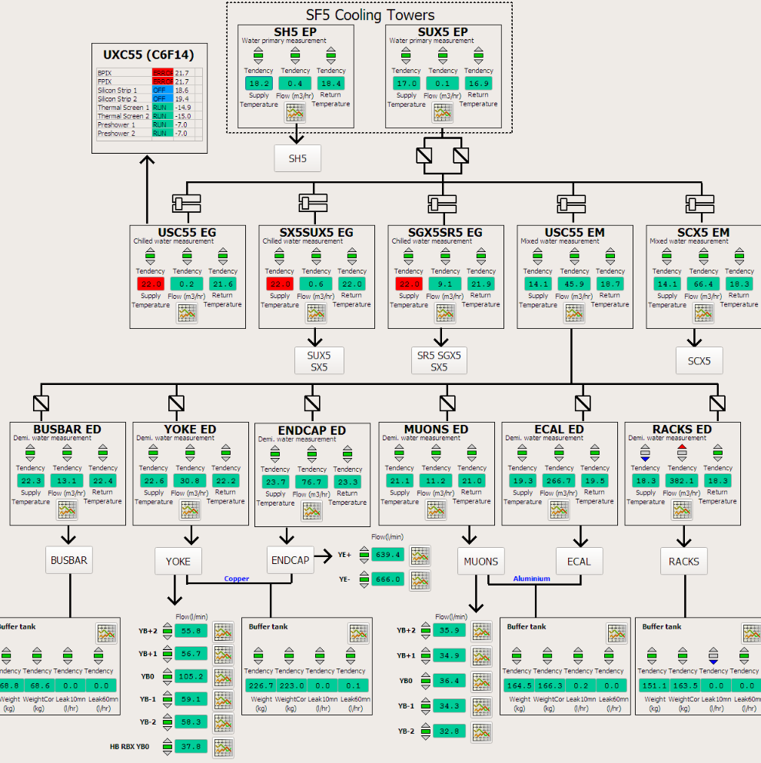
Cooling Screen
Must be
running
In case any of the
fluxes is 0 or any
Temp is >25º C,
please call
165000
4

Slide 5
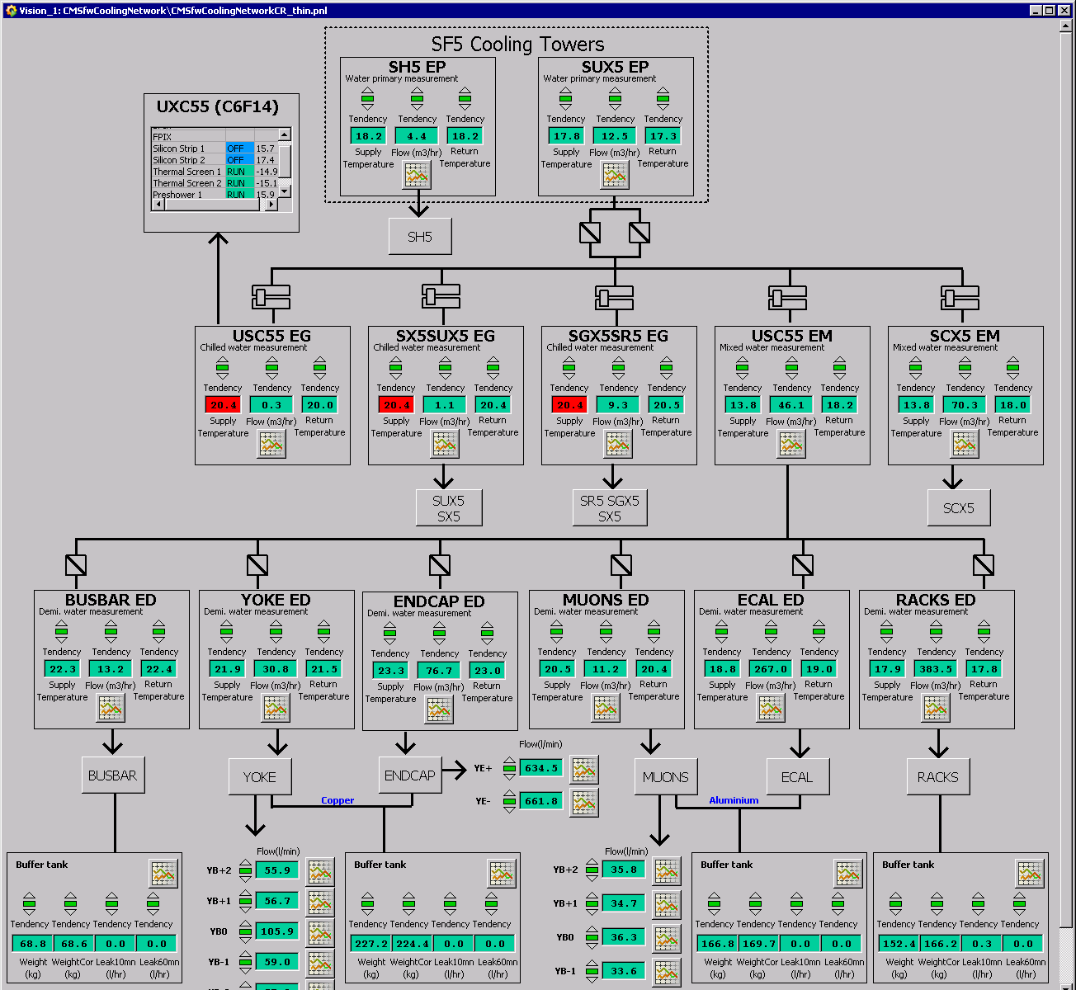
Status of CMS cooling circuits until week 3-2019
Circuits stopped – do not care about temperature or flow warnings/alarms
C6F14 cooling –
Fpix, Bpix, Silicon Strip 1&2 stopped
Thermal Screen 1&2 and Preshower 1&2 running on backup chiller
Circuits running on backup chiller – temperature or flow warnings/alarms to be notified
Circuits running – temperature or flow warnings/alarms to be notified
Circuit leak warnings/alarms – temporary leak warnings/alarms may occur during working hours, stable leak warnings/alarms to be notified

Slide 6
Shift Report, Temperatures and Dewpoints
After the tour a short E-log in the category GENERAL→SLIMOS should be created http://cmsonline.cern.ch/ and click on Elog
The report can be written on one of the PCs in the control room or at home
IMPORTANT
Please also check the temperatures and dew points in USC &UXC :
http://cmsonline.cern.ch/ and click on DSS and Environment
The entries are ordered by alphabet
USC: If the difference between temperature and dewpoint becomes less than
5 degrees, please call 16-5000
UXC: If the dewpoint is larger than +5 degrees call 165000
The temperatures in USC and UXC should be between 15 and 23 degrees

Slide 7
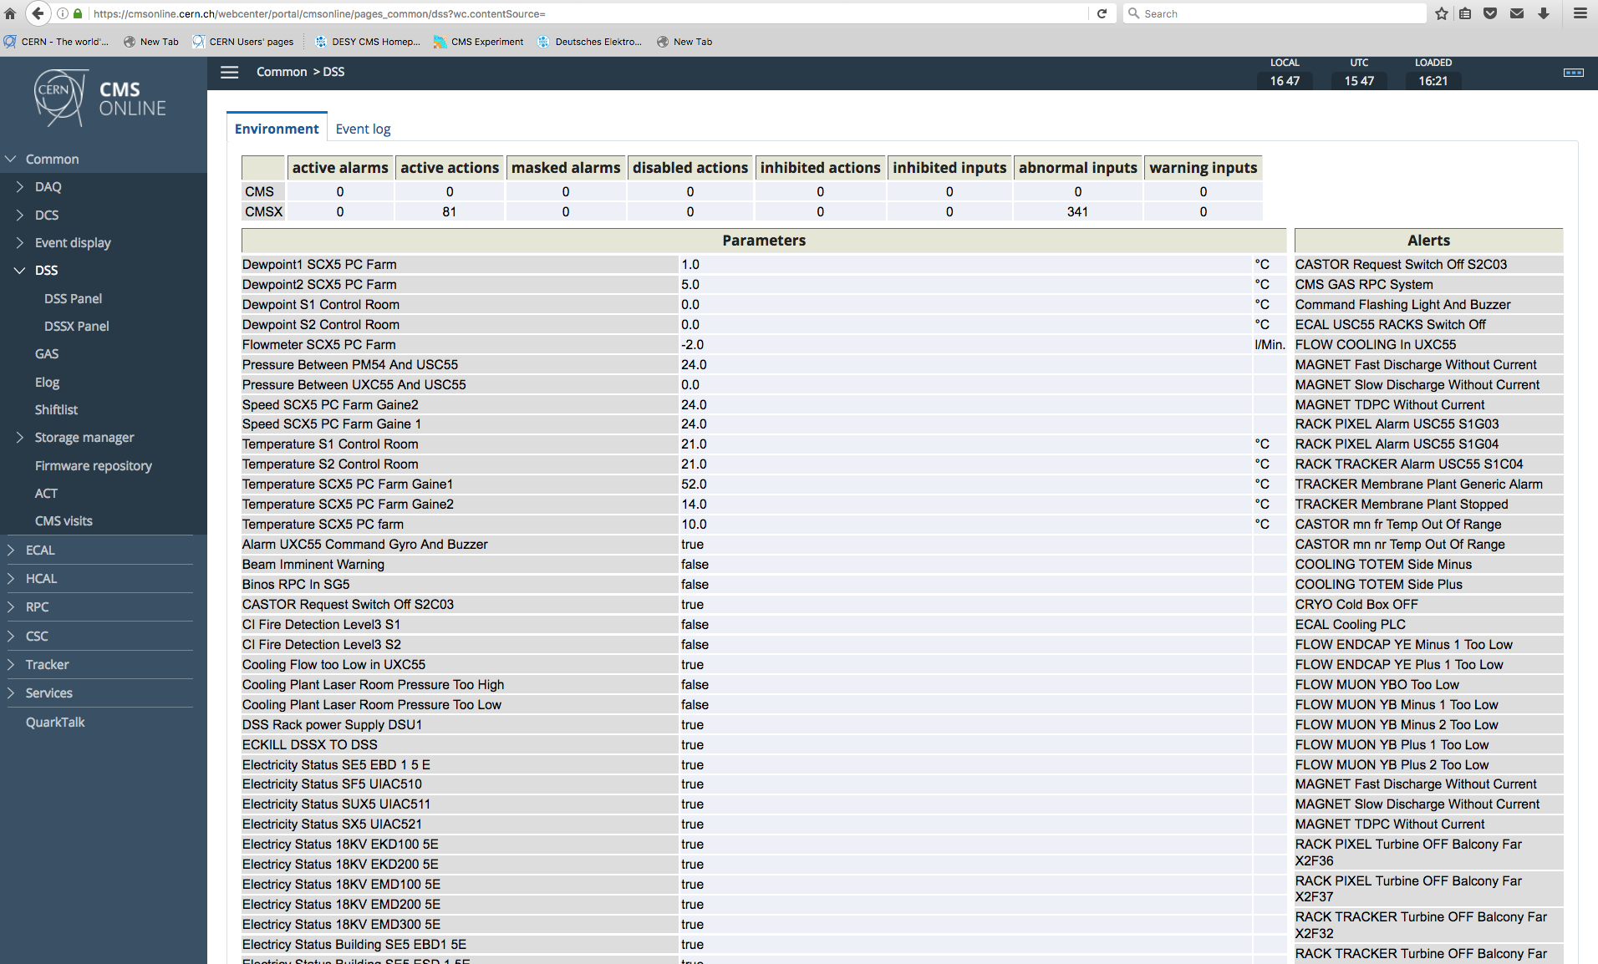
Temperatures and Dew Points – DCS
CMSONLINE – DSS - Environment
Dew points,
Temperature USC, for UXC scroll down

Slide 8
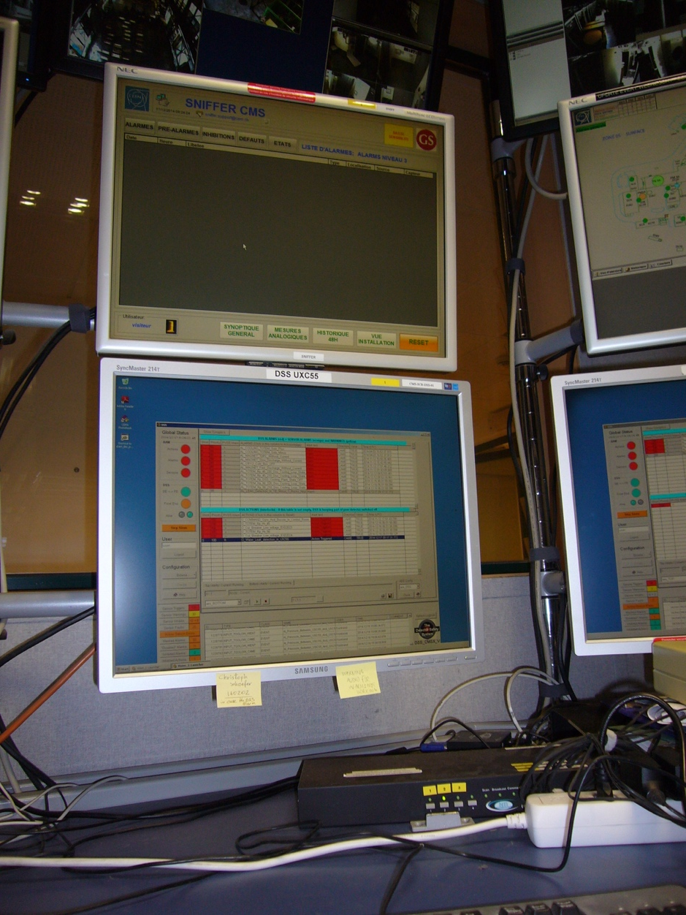
Sniffer Alarms
Please check for any new sniffer alarm
In case there is a new alarm
Try to reset it
Press 2 on the black box
Use the mouse to press the
Reset on the sniffer screen
If the alarm does not disappear
call 16 5000
else
write the alarm message into your
shift report mentioning you have
reset it

Slide 9
SCX5 & SX5
Enter SCX5 with your access card on the ground floor
Check that the Computer room on the 1st floor is locked
Check control room for any obvious anomalies
Check the bathrooms
Pick up the keys for SX5 from the table of the access PC
Go to SX5 and take the tour
Walk around in SX5 and look for any obvious anomalies
Check that all doors are locked
Check the Pixel clean room in RP-zone
Check the Membrane and Dry Air Plants in building 3584 details Transp. 11-15
Continue through SL53 – check the bathrooms on both floors
Go to the elevator to continue the tour underground through SDX5
The access system underground is in RESTRICTED AUTOMATIC MODE
You (as registered shifter) will have access

Slide 10
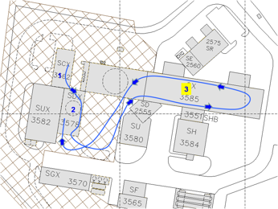
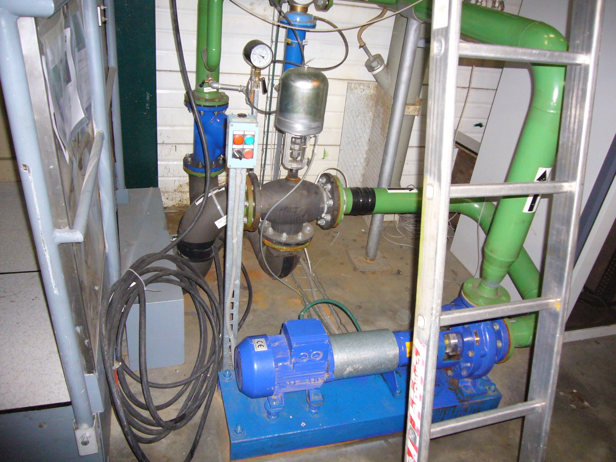
To switch on: Turn switch to local
Press green button
Turn switch to remote
In case the pump cannot be restarted
call 72201
Pump for Green Barrack

Slide 11
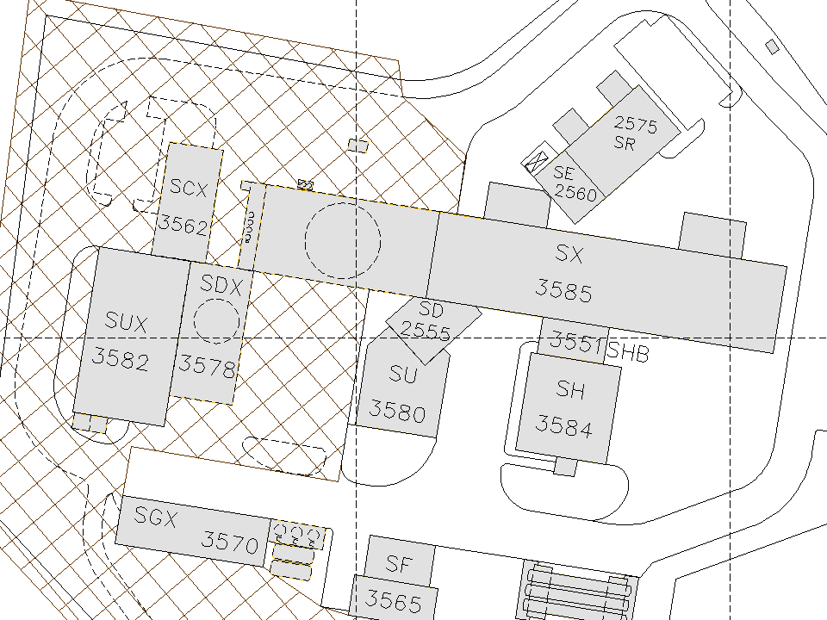
Itinerary – Surface zone
Surface Point 5
1
2
SL53 3594
3
Doors of the SX5 are locked during weekends and at night. Without key hall is accessible only through this door which is equipped with a card reader

Slide 12
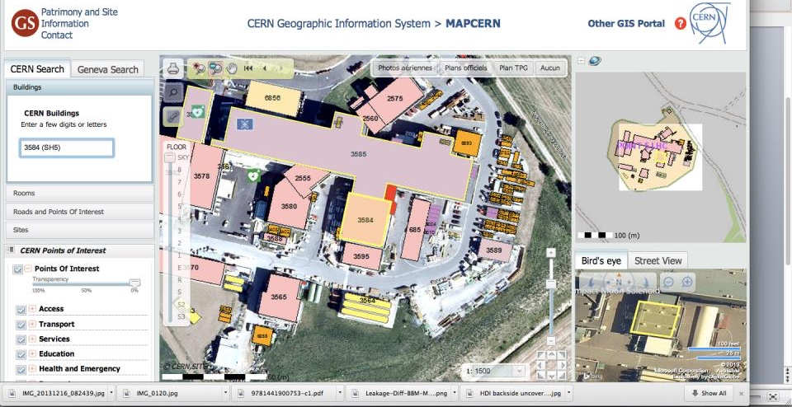
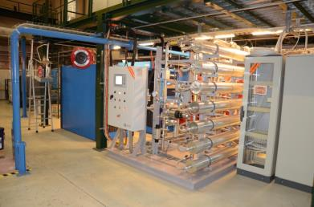
Membrane Plant
Building 3584
The membrane plant supplying dry-gas for the tracker system is
located in bldg#3584 (SH5)
The box indicates the approximate location of the plant inside the building.

Slide 13
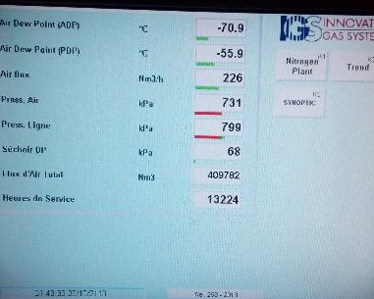
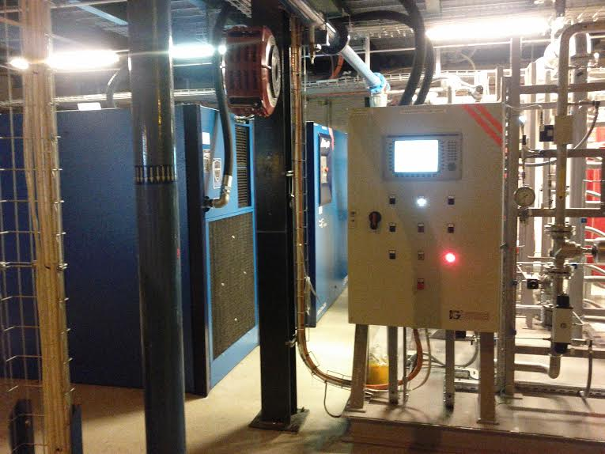
Membrane Plant
Compressor
2
Compressor
1
Control
Panel
Dew point (ADP, at -70.9 in picture above) higher than -40 deg C or pressure below 650 kPa are anomalous and you should call 165503
(if not reachable 165502)

Slide 14
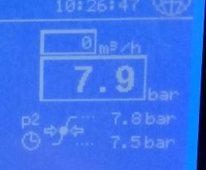
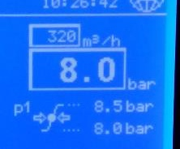
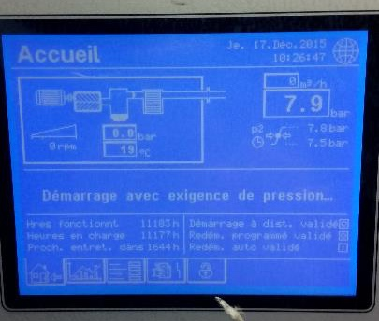
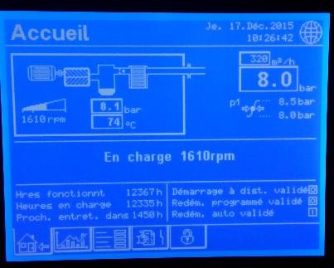
Membrane Plant
At any given time only one compressor should be active.
In case both compressors are active there is something wrong with the system call 165503 (if not reachable: 165502)
One Compressor
should have ~320 m3/h flow
Pressure should be ~8.0 bar
One Compressor Should have zero flow

Slide 15
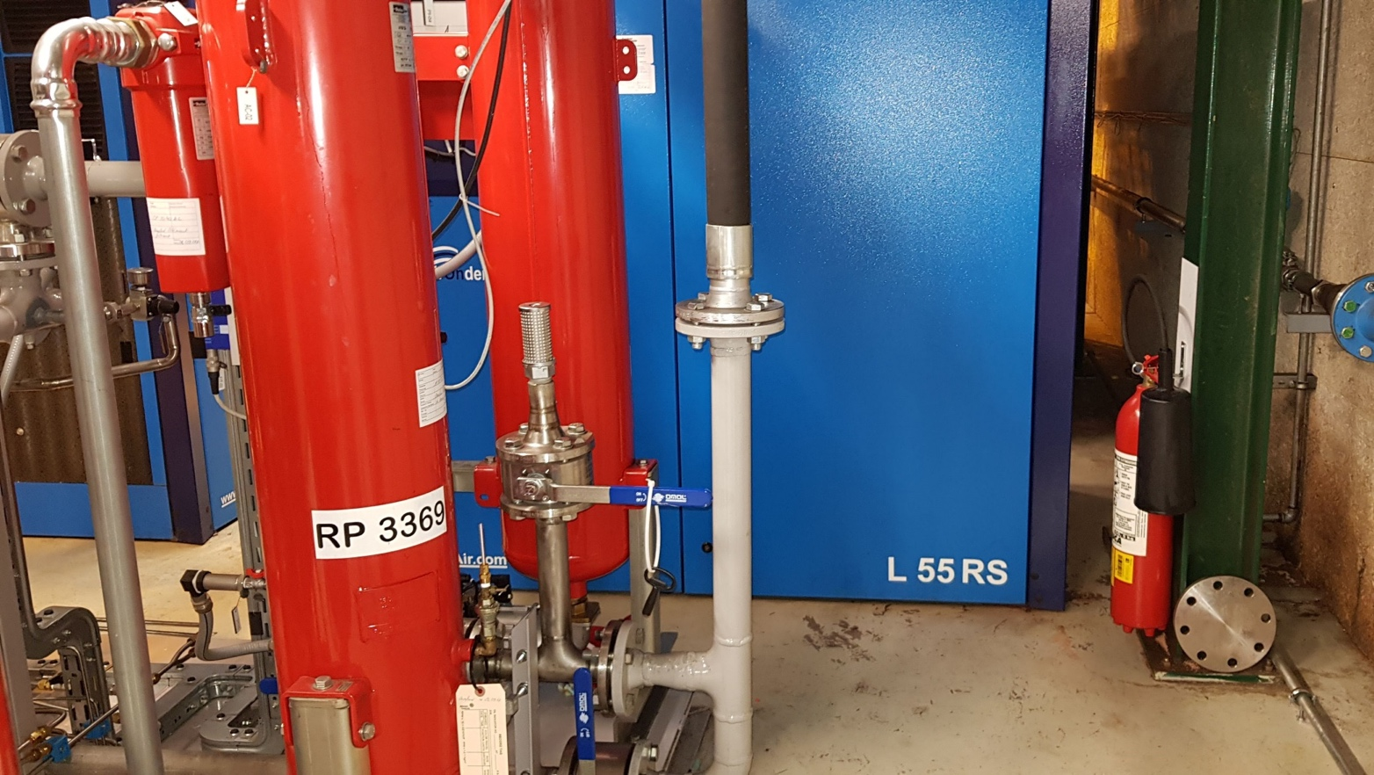
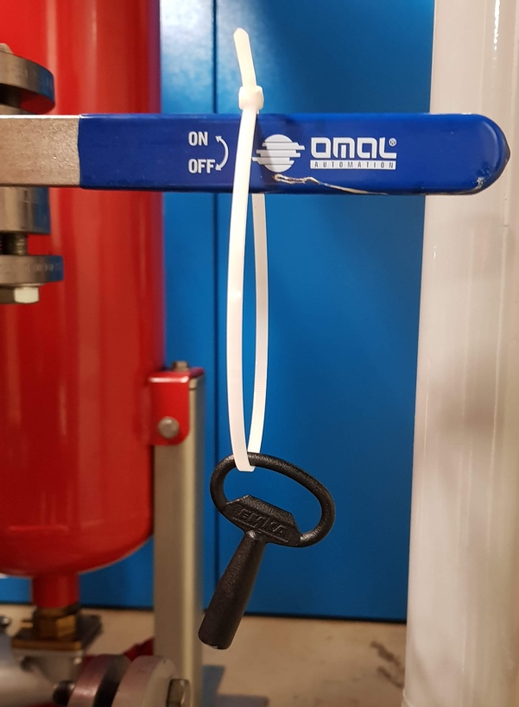
Membrane Plant
Visual Inspection of Compressor - Look for major oil leaks
Door to open
Check if there is oil outside the compressor box
Open the compressor box with the key shown on the left

Slide 16
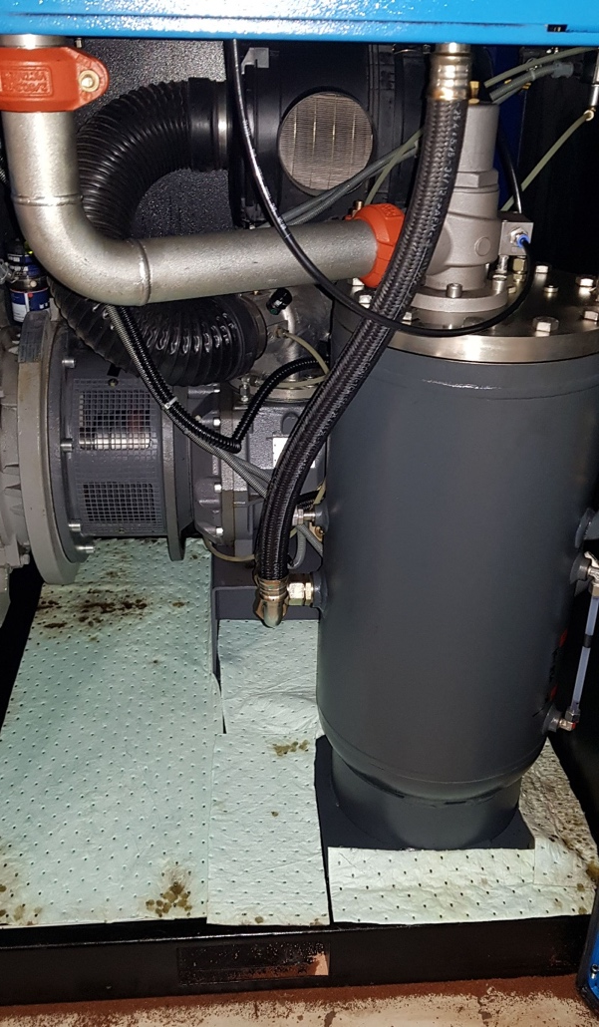
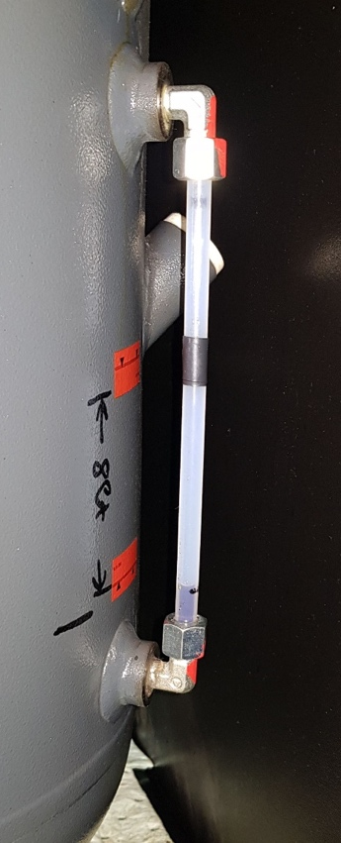
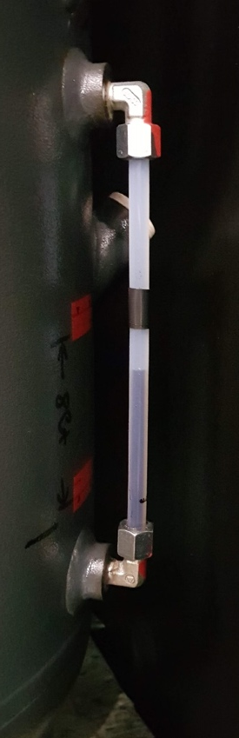
Membrane Plant
Visual Inspection of Compressor - Look for major oil leaks
Oil level (compressor ‘ON’)
Oil level
(compressor ‘OFF’)
Check inside the compressor box if there is a big quantity of oil absorbed by the absorbent paper (oil leak)
If this is the case, call 163618 or 165503 (if not reachable 165502)
Check the oil level

Slide 17
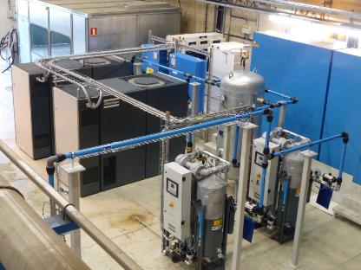
Dry AirPlant
The surface dry air plant is also located in bldg#3584 (SH5)
The box indicates the approximate location of the plant inside the building.
Compressor 1
Compressor 2

Slide 18
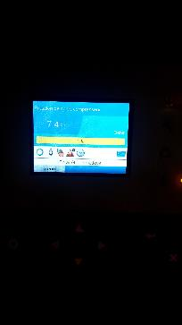

Dry AirPlant
Only one of the two compressors should be running at around 50-60% capacity
(If the touch screen is off, press one of the arrow keys to switch it on)
Consumption ~ 50-60%
Consumption ~ 0%
If both compressors are running or the
consumption is outside the indicated window
by more than 10% call 165503 ( 165502 if not reachable )
A howling noise due to varying consumption is normal

Slide 19
Access to the Underground Facilities
The PAD on the surface (PM54) should be in closed mode
For the tour it can be opened by clicking the green field on the
right side of the screen located next to access system screen in the control room
After the tour it should be closed again by pressing the red field
In case the PAD cannot be opened or your access card does not work
use the key with the blue head to open the MAD.
UPX56 will be in automatic mode and give access by batching.
In case one of the shifter cannot enter the other one should let him/her in with
the MAD key – as for visitors
In case the access system does not work at all, pull the green handle and enter.
In this case it is important to re-arm the door with the small key after the tour.
The lights in UXC should stay on all times
In case you find them off, go to level -3 and switch them back on
You have to visit:
USC 55 : S2-counting room, S4-rack area, S1-counting room,
S1-CV room, USC gas room
UXC 55
Please also check the bathrooms in USC S1 and UXC X1

Slide 20
All racks to be checked in S2/S4 in alphabetical order
S2A01 | S2B10 | S2C05 | S2D16 | S2F16 | S2G03
 | S2B17 | S2C07 | S2D19 | S2F18 | S2G04
 |  | S2C18 |  | S2F19 | S2G10
S2A12 |  |  |  |  | S2G11
S2A15 |  |  |  |  | S2G12
 |  |  |  |  | S2G13
S2A19 |  |  |  |  | S2G19
On S4, (right of the elevator) please check S4F08 & S4F09
If you find a rack off, please:
For those indicated in blue, mention it in the shift report
indicated in red, call 165503 (if not reachable: 165502)
indicated in green, send an Email to cms-dcs@cern.ch
Continue your tour by going down to level -2 (=S1)

Slide 21
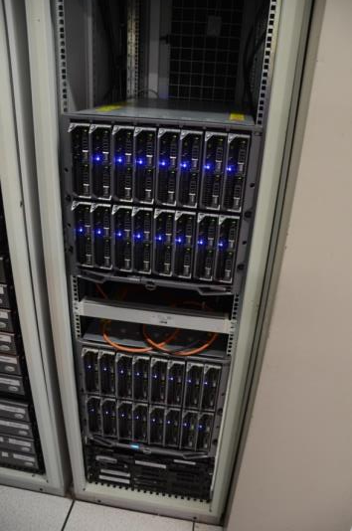
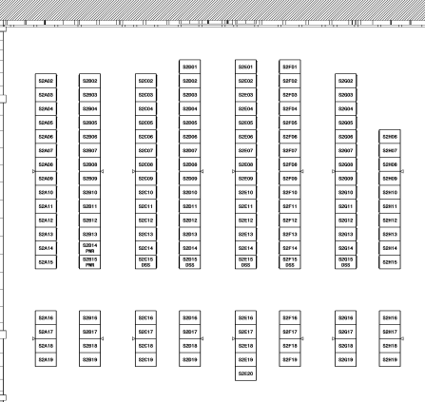
Racks in S2
Tracker Hardware in USC Counting Rooms
S2F16: DCS PCs in Dell blade system.
The two computers indicated by the boxes
should be on. If any of them is off,
call 165503 (if not reachable:165502)
S2B18
S2B17
S2F16

Slide 22
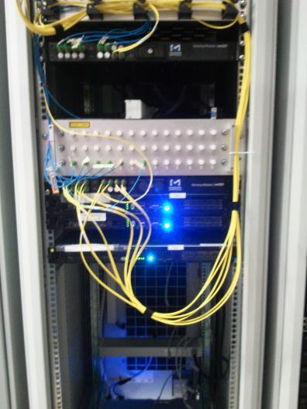
Racks in S2
Tracker Hardware in USC Counting Rooms
S2C18: DCS PCs
The two computers indicated by the boxes
should be on. If any of them is off,
call 165503 (if not reachable:165502)
S2B18
S2B17
S2C18

Slide 23
All racks to be checked in S1
in alphabetical order
S1A02 – S1A09, S1A15
S1B12, S1B13, S1B14, S1B15
S1C14
S1G02
If you find any of the racks off indicated in red, please call
165503 (if not reachable: 165502)
If you find any of the racks off indicated in green, please
send an Email to cms-dcs@cern.ch
Continue your tour by going to the CV- Cooling room

Slide 24
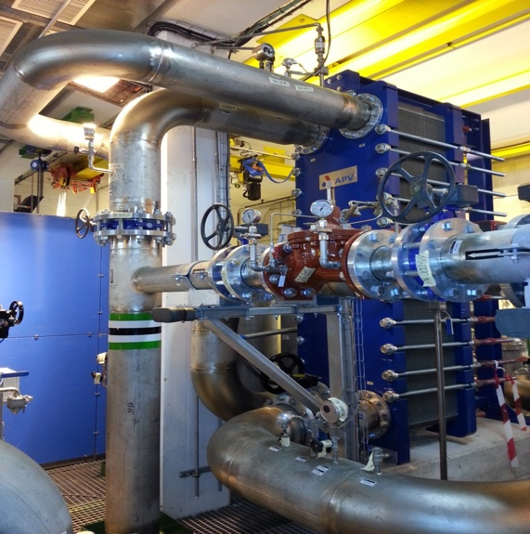
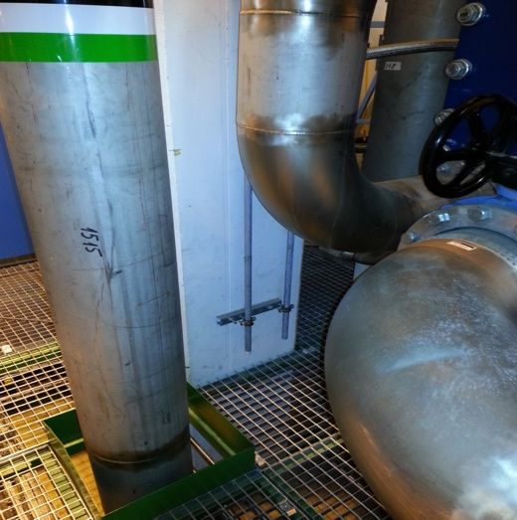
CMS cooling YETS - USC
Purgers on Rack circuit
Purge lines
CV zone - circuits in operation (pumps on)
RACK, ECAL, ENDCAP, YOKE and BUSBAR CIRCUITS
Check for water leaks next to the pumps or the purgers lines (see pictures)
In case of problems, call TI desk 72201
and ask for EN/CV piquet
Continue your tour by going to the USC gas room

Slide 25
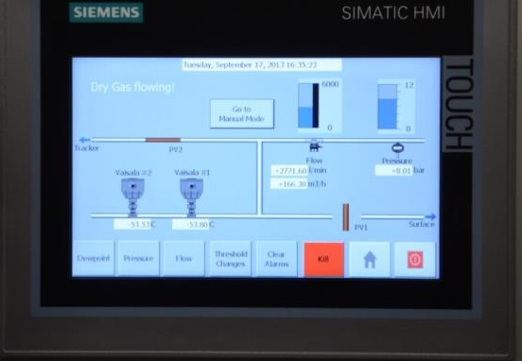
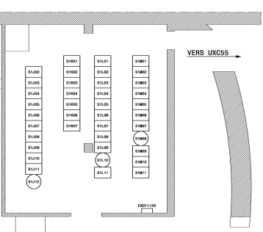
USC Gas Room (UGX5)
Rack S1K04
If anything out of limit call 16 5503
Total flow from surface plant
should be > 3000 l/min
Input pressure from surface plant
should be >6.5 bar
Exhaust valve status
should be closed
Status of valve to tracker
should be open
Dew points measured
by Vaisala sensors
should be < -40 deg C

Slide 26
USC Gas Room
Rack S1K05
should be powered,
i.e. if none of the LEDs in the rack is on
call 165503
(if not reachable:165502)

Slide 27
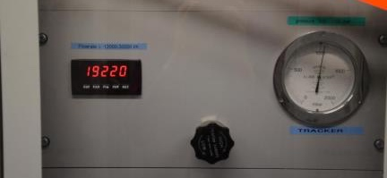
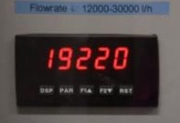
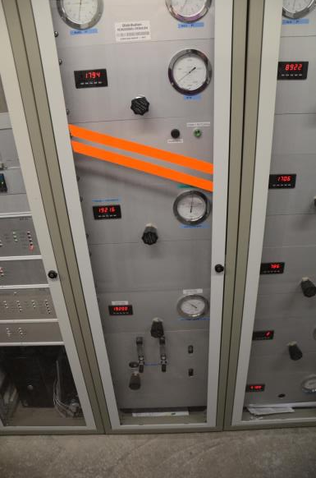
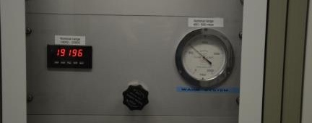
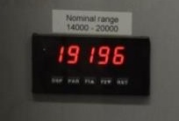
USC Gas Room
Rack S1K06
should be >17000 if
not call 165503
(if not reachable: 165502
should be >14000 if not call 165503
(if not reachable: 165502

Slide 28
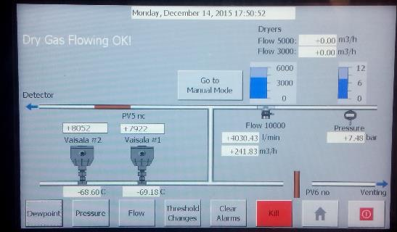
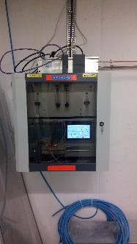
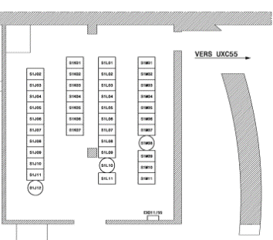
USC Gas Room (UGX5)
Dry gas panel on wall
Total flow from surface plant
should be > 3800 l/min
Status of valve to tracker
should be open
Input pressure from surface plant
should be > 7 bar
Exhaust valve status
should be closed
Dew points measured
by Vaisala sensors
should be < -40 deg C

Slide 29
Underground UXC
Leave USC on the negative end and enter UXC through the UPX56 PAD
Check for any obvious anomalies
All racks should be off
except X4 near XN23, 24, 45, 46 for ECAL temperature monitoring
If you find them noisy, hot or smoking – turn them off
If you find them off, mention in E-Log no need to call anybody
Check the cooling plants of TS and PS – details next on transparency
Go to ground floor and walk along the hall on both sides, near & far
One person should go down to X0 the other should stay in X1
Look for water
Go to the green ladders that lead underneath YB0
Climb up and look for water underneath the detector
Go to the back side of UP55 and check that the MAD is closed
Leave through the same door you came in (give back the key or rearm the door)

Slide 30
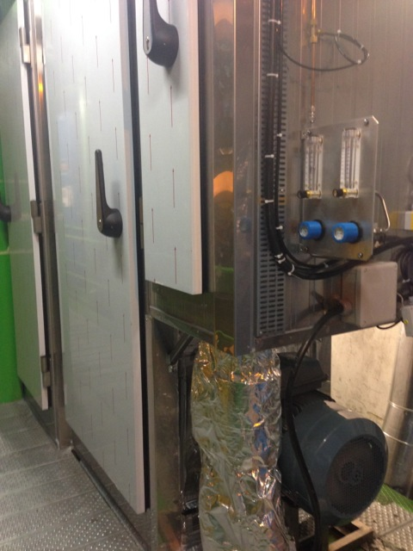
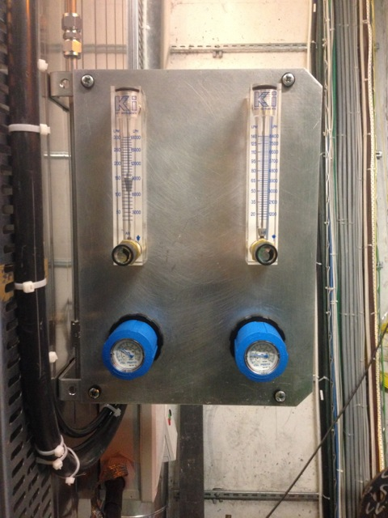
CMS cooling YETS – UXC
Cooling plants in operation: TS1, TS2 (far side, X2), PS1, PS2 (near side X2)
Pumps of the 4 plants shall be ON
Dry air of all plants shall be on (visible flow on one of the two flowmeter attached to the cabinet)
No condensation shall be visible from outside the cabinets
IF PROBLEMS: call 72201 & ask for CV detector cooling piquet

Slide 31
The End
Go back to the control room
Before leaving, please have a look on slide 2 once more
Thank You, you are done !!!

Slide 32
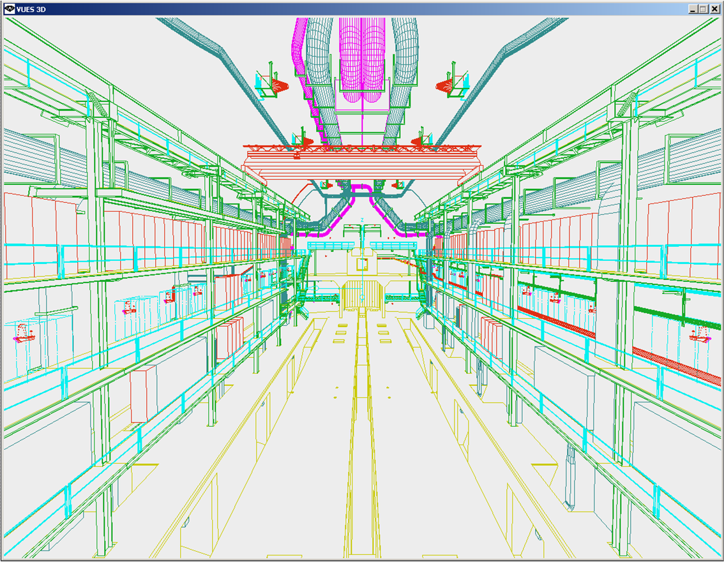
Numbering Convention of UXC55 levels
Experimental CAVERN
X6
Crane rail
X5
Top of detector
X4
X3
X2
X1
X0
(below the detector)

