Slide 1
Foam Test Some initial analysis
Ian Crotty 2 March 2015

Slide 2
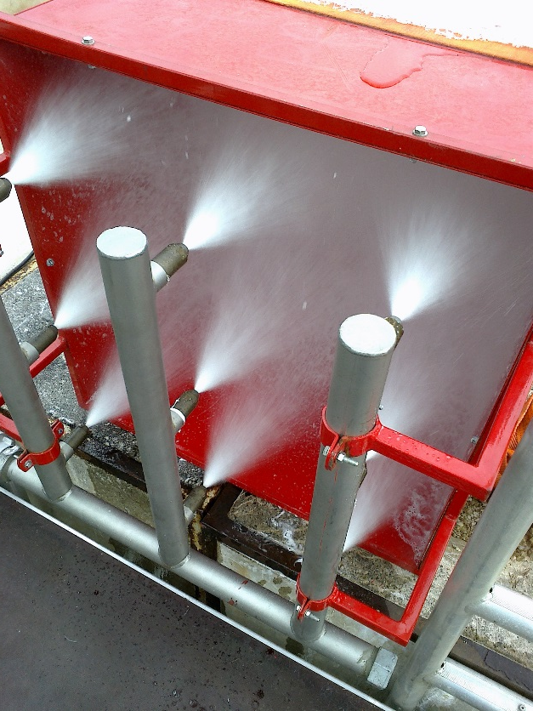
Initial Tests in new Foam Bunker
Tests done with
Santo K 4S ( old stock from P5)
Sthamex
Expandol
MeteorP Plus
Foam Generator Kidde HEFG 35 and Smoke/heat source

Slide 3
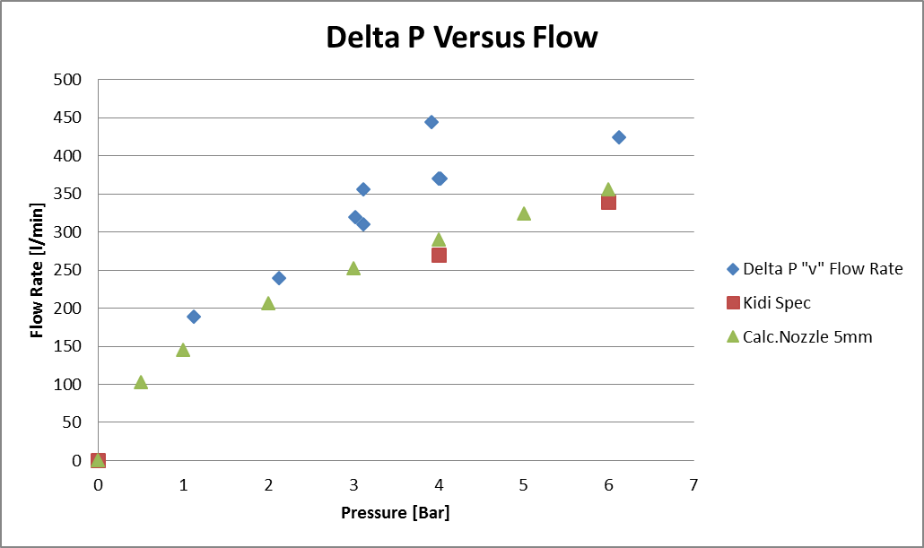
Pressure versus flow rate
The calc. nozzle and the Kidde spec agree but the measurements do not indicating an optimistic flow meter or low “P” reading.

Slide 4
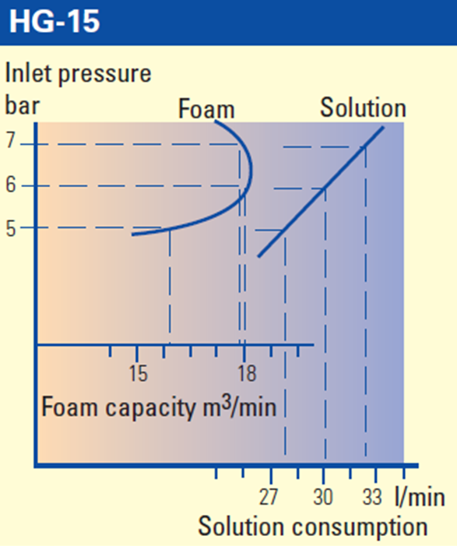
Foam Production versus inlet Pressure
The two specified operating points from Kidde are far above the test data. Results for 1 nozzle.
From a SCUM HG 15 there is a maximium in the Foam rate

Slide 5
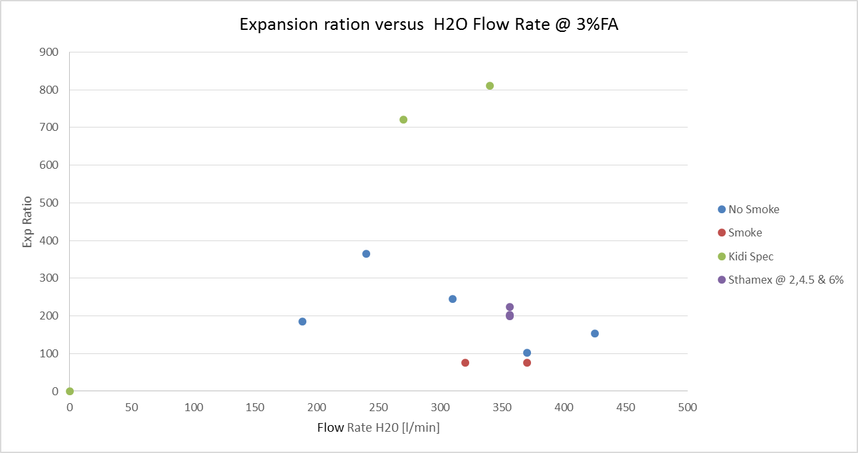
Expansion ration & Flow rate
Expansion ratio is far below spec. Smoke makes thing worse.

Slide 6
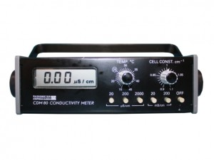
Conductivity to define proportion

Slide 7
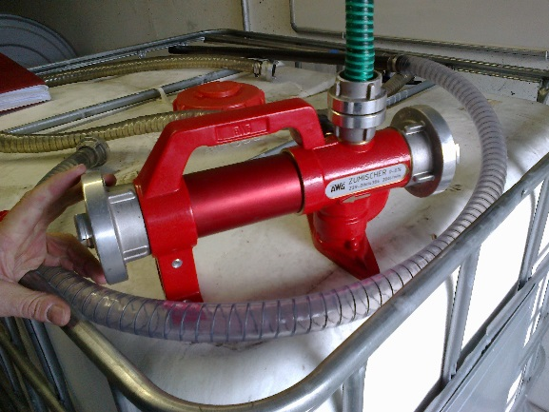
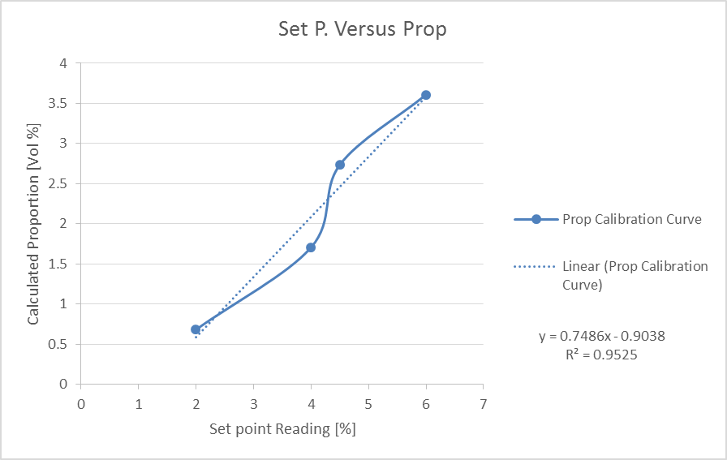
Mixture ratio off set
The real proportion is established from electrical conductivity of the mixed solution.

Slide 8
Emulsifier corrections for different Foam Agents
The method used has only been verified for the Sthamex.

Slide 9
Smoke & Temperature test measurements
Temperatures and air flow speeds were recorded.
Temperatures in the smoke generator
Time |  | FB2m | Horiz | BoxFG
[hh:mm:ss] |  | [degC] | [degC] | [degC]
17:42:?? |  | 180 | 148 | 68
17:45:?? |  | 316 | 255 | 105
17:46:05 |  | 316 | 255 | 105
17:46:10 |  | 281 | 207 | 97
17:46:31 |  | 234 | 163 | 34
17:46:52 |  | 246 | 160 | 34
17:48:18 |  | 239 | 145 | 33
17:49:07 |  | 202 | 132 | 31
17:49:32 |  | 197 | 133 | 32
FB2m = 2m above the fire box base
Horiz = position in the horizontal portion just before the FG
BoxFG = position in the shrowd infron of the FG
FG = Foam Generator
Data from;
Noemi & Zoltan
Smoke box entry to Foam Generator
Side

Slide 10
Conclusions
The time must be taken that all parameters are/ have been taken before moving on to the next run. Data points have been lost and are far from credible as essential values are not recorded.
Carry out smaller scale tests to understand the parameter space with better foam height evaluation, easier turn round and less time and cost.
The flow rate given by the Fire brigade flow meter appears optimistic.
So far we have not seen any sign of a maxima in the foam rate. This should be a goal of the tests.
Smoke and or heat appears to reduce significantly the foam production.
But we have no reliable values. These values should be understood.
The method of mixing (educator) is not reliable across different Foam Agents and perhaps not across the flow rates we were using.

Slide 11
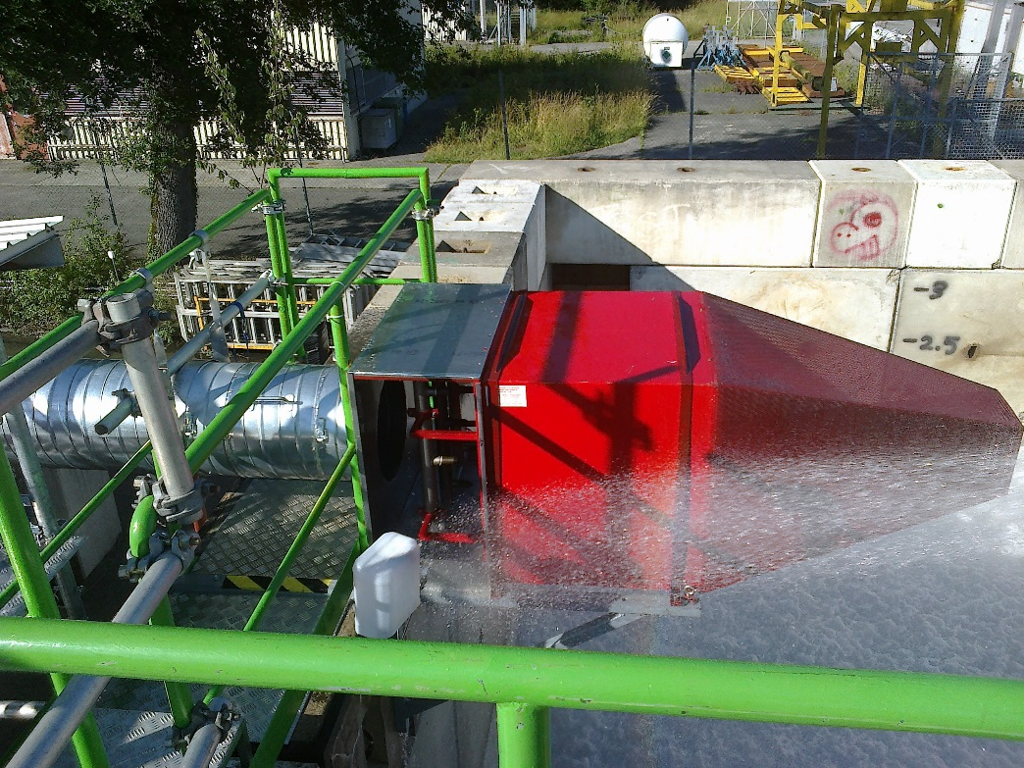
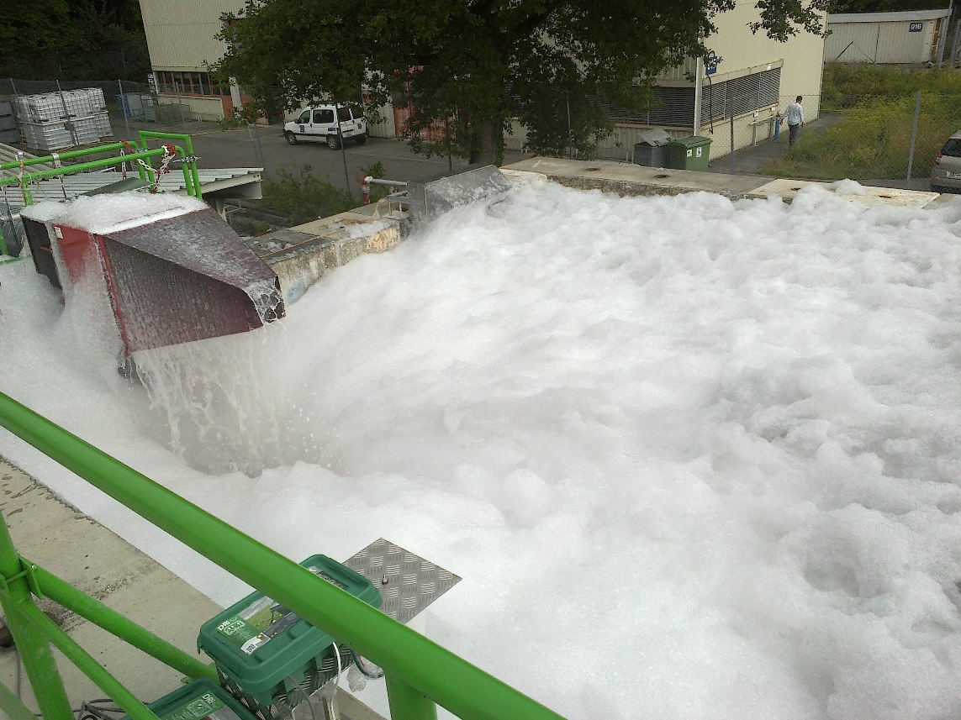
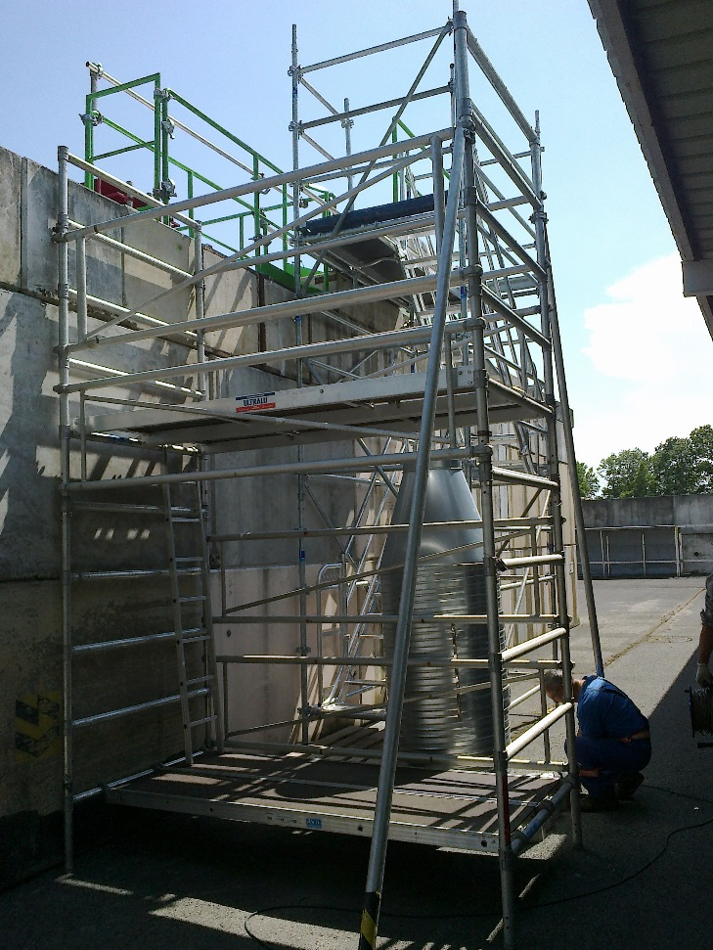
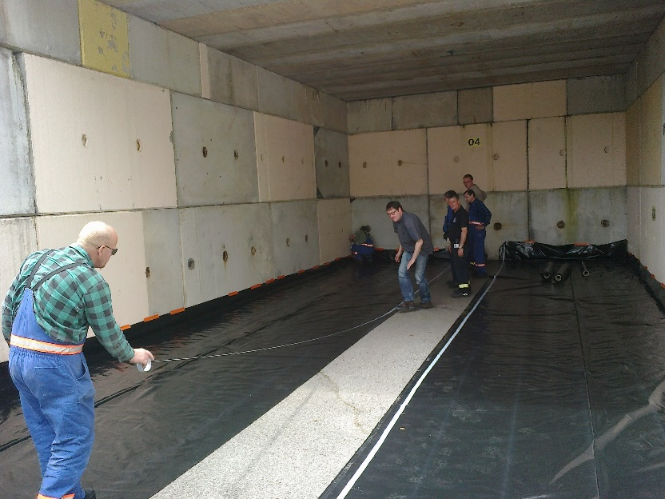
How it started
June 2014

Slide 12

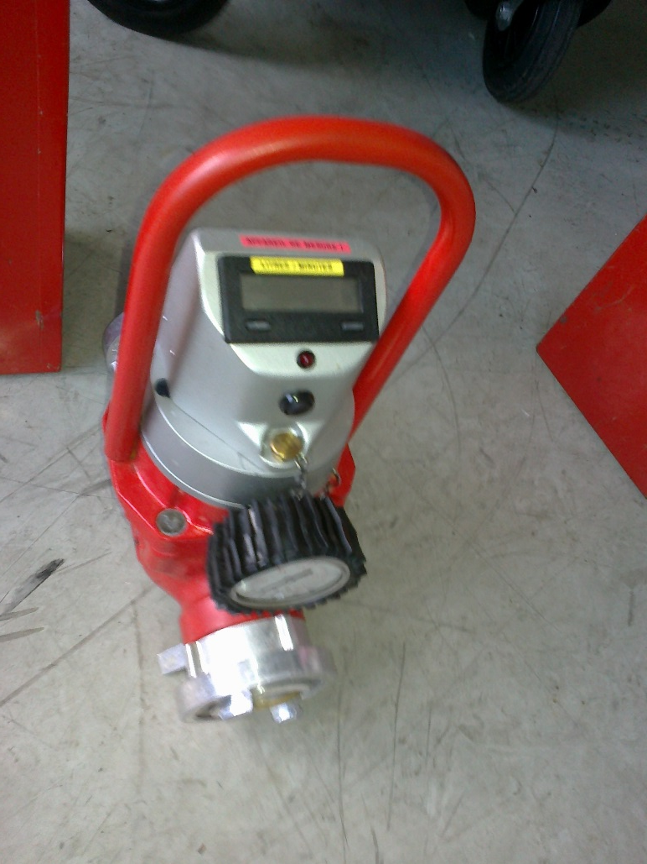
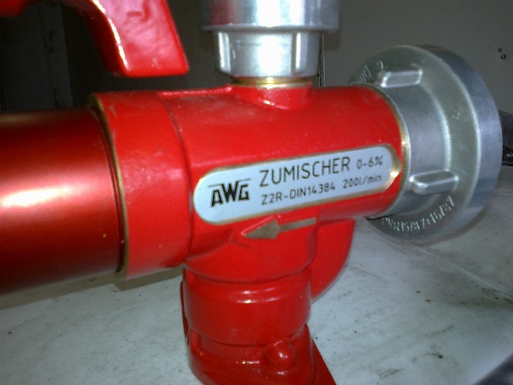
Fire Brigade eductor and flow meter

Slide 13
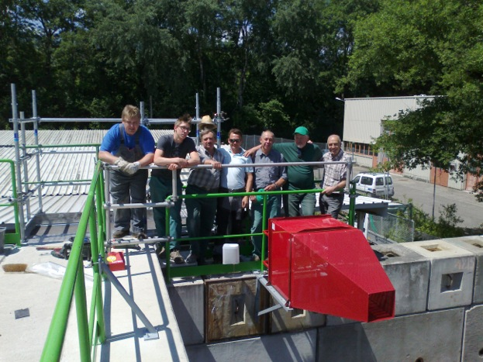
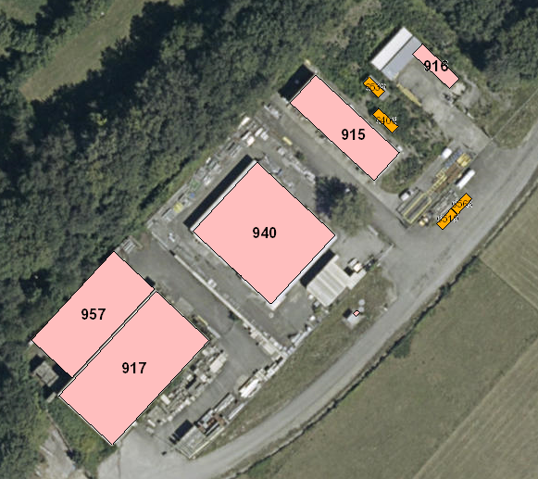
Bunker location on CERN site
Has been modified since this aerial image was taken

