Slide 1
First Foam Results from 4 May 2016
Ian Crotty on behalf of all the Foam Team
15 06 2016

Slide 2
Raw data
 | Foam test May 4 2016 |  |  |  | Ian Crotty
 |  |  |  |  | 14-Jun-16
Test # | time | Tare | Quantity Solution | Expansion ratio | Start | start weight | Foam Weight | Half time | T/2 weight | Quarter time | T4 Weight | Stop | Stop weight
 |  |  |  |  |  |  |  | T/2 |  | T/4
 |  | [N] | [ml] |  | [s] | [N] |  | [s] | [N] | [s] | [N] | [s] | [N]
1 |  |  | ?? |  |  |  | 0.00 | Fasle Start
 |  |  |  |  |  |  | 0.00
2 |  | 110.50 | 670 | 716 | 0 | 117.55 | 7.05 | 1303 | 3.65 | 2421 | 1.85 | 3829 | 0.92 | start time ? And Tare ?
3 | 11:38 | 110.60 | 700 | 686 | 0 | 117.90 | 7.30 | 1248 | 3.7 | 2399 | 1.8 | 3608 | 0.93 | goes down to -0.35N after 2hrs
4 | 14:08 | 110.20 | 650 | 738 | 0 | 116.20 | 6.00 | 1567 | 3 | 2992 | 1.45 | 4997 | 0.7 | New solution
5 | 1539 | 110.50 | ?? |  | 0 | 117.25 | 6.95 | 1514 | 3.45 | 2835 | 1.7 | 4172 | 0.85
6 | 17:06 |  | 850 | 565 | 0 |  | 6.85 | No more records |  |  |  |  |  | Solution Vol ?
 |  |  | 950 | 505

Slide 4
Parameters
Ambient temp and pressure.
Pressure at nozzle.
Pressure at pump.
Water hardness and particulate level.
Solution concentration
Smoke opacity
Solution flow rate/volume used
Calibration of electronic spring balance

Slide 5
Conclusions
Need to follow check list. Do not forget actions especially at the end of the day/week. We lost 2 of the 6 test !
Take temperature and pressure readings throughout the trail period.
Take time to do the job sufficiently carefully so we do not have to repeat tests, rigour in the method.
Stick to one established and agreed method.
Analyse the 2 (or 3) different regimes of the plots of drainage vs time. What do they represent.
Do we only take half times that are within the linear regime ?
What data do we need to take ?
Analyse the data online looking for errors and trends.
Do further tests at CERN after Madrid ?
We did far better than the trials made in Prevessin in 2014.

Slide 6
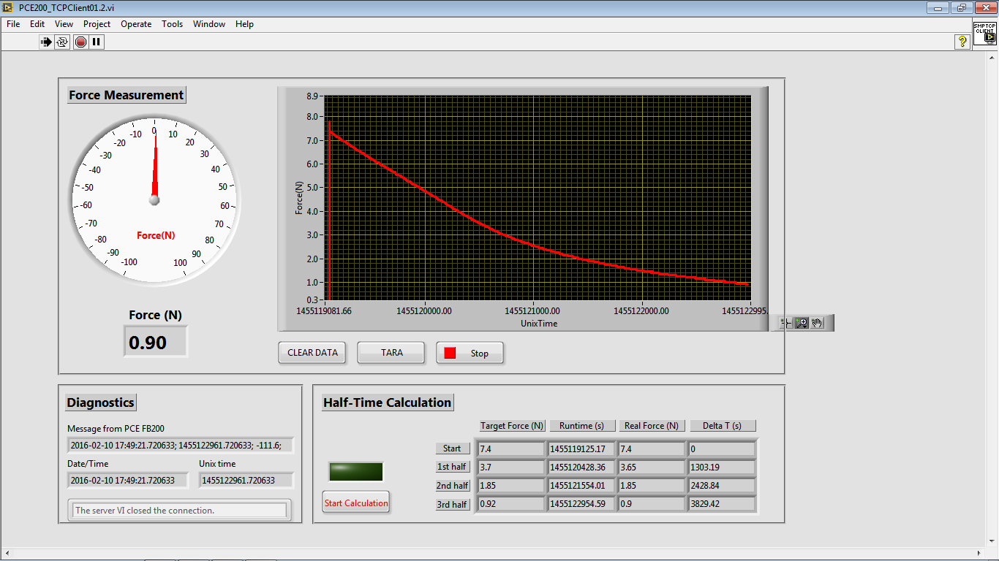
Online data to be analysed
Precious information is within these files;
Hot off the press

Slide 7
Files
Photographic log of 4 May 2016;
http://rpc-cms-re4-upscope.web.cern.ch/rpc-cms-re4-upscope/RPC/Safety/CMS%20Foam/Tests/Trials4May2016/FoamTrials4May2016.pdf
Data;
http://rpc-cms-re4-upscope.web.cern.ch/rpc-cms-re4-upscope/RPC/Safety/CMS%20Foam/Tests/Trials4May2016/Results4May2016.xlsx
Photos & videos;
http://rpc-cms-re4-upscope.web.cern.ch/rpc-cms-re4-upscope/RPC/Safety/CMS%20Foam/Tests/Trials4May2016/Photos10April2016V2/
Data Files from Zoltan and Noemi; (received 5mins ago)
http://rpc-cms-re4-upscope.web.cern.ch/rpc-cms-re4-upscope/RPC/Safety/CMS%20Foam/Tests/Trials4May2016/ZoltanNoemi/
This presentation;
http://rpc-cms-re4-upscope.web.cern.ch/rpc-cms-re4-upscope/RPC/Safety/CMS%20Foam/Tests/Trials4May2016/FirstFoamResults4May2016.pptx

