Slide 1
The physics of Foams
By Denis Weaire and Stefan Hutzler
Ian
11 Jan 2021

Slide 2
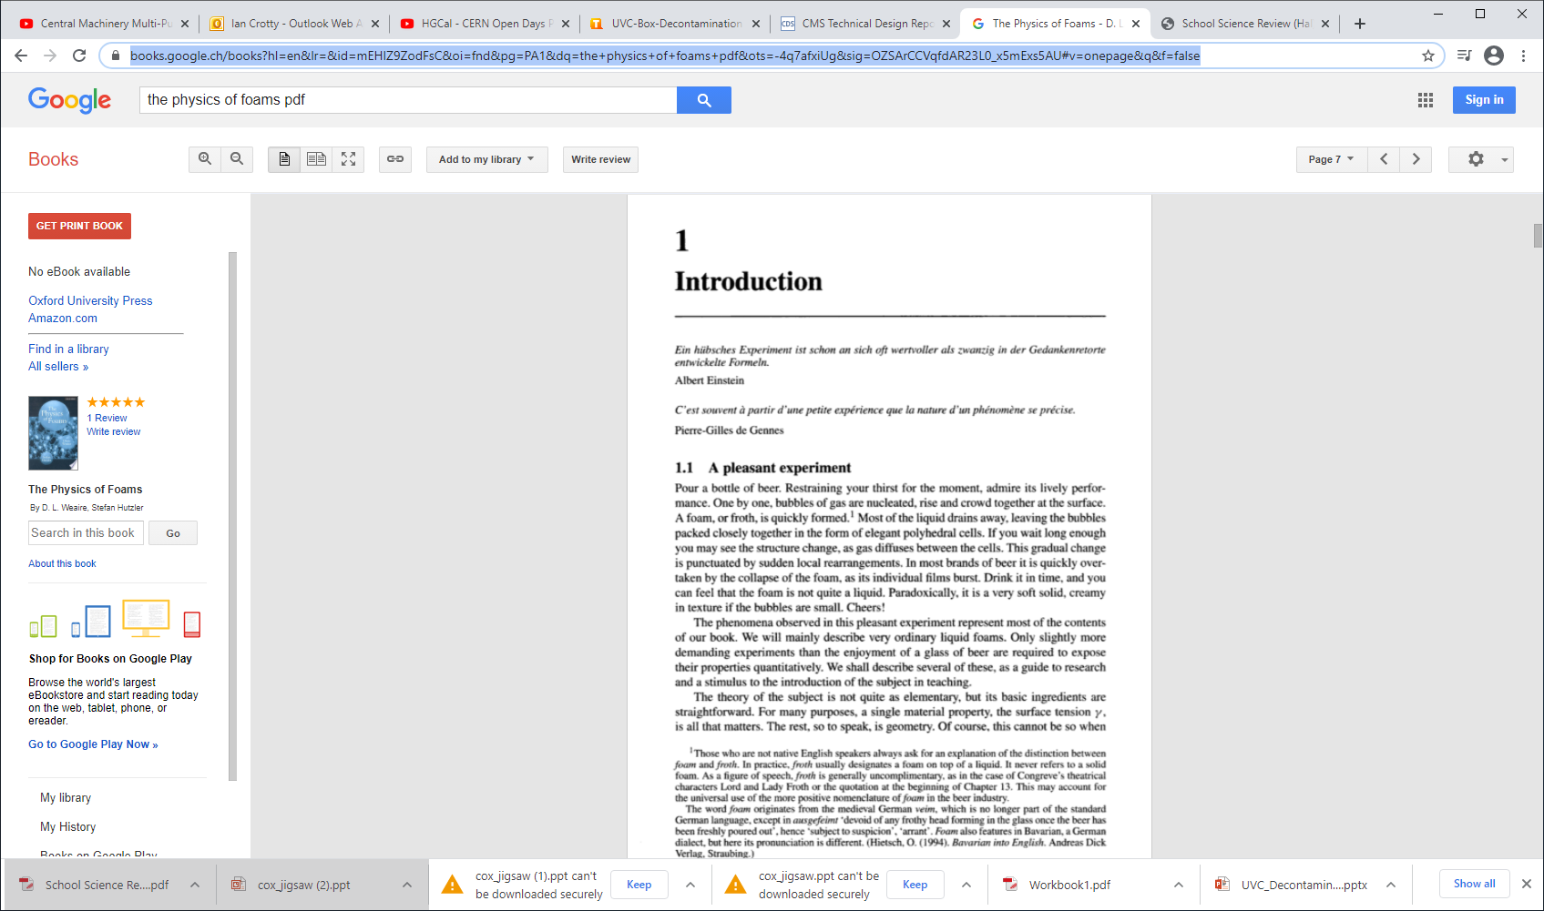
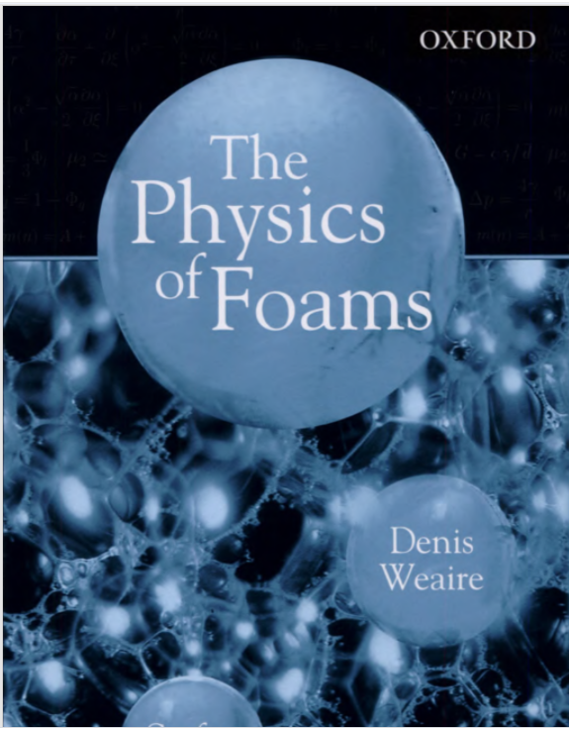
https://books.google.ch/books?hl=en&lr=&id=mEHlZ9ZodFsC&oi=fnd&pg=PA1&dq=the+physics+of+foams+pdf&ots=-4q7afxiUg&sig=OZSArCCVqfdAR23L0_x5mExs5AU#v=onepage&q&f=false

Slide 3
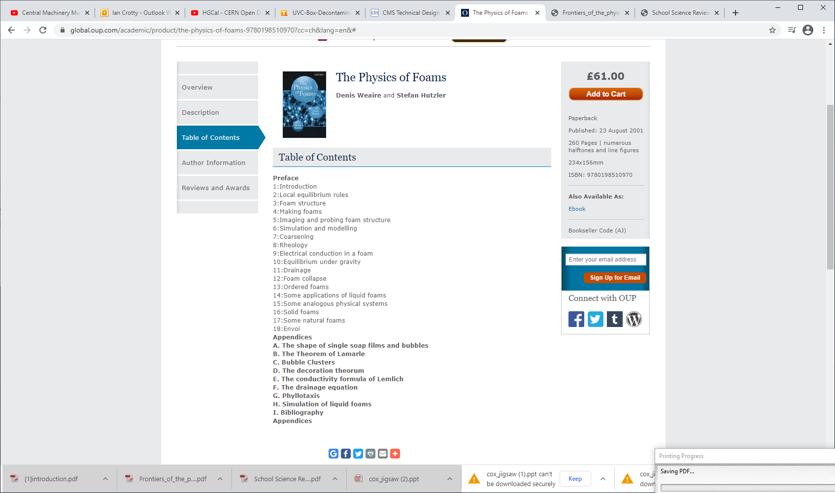

Slide 4
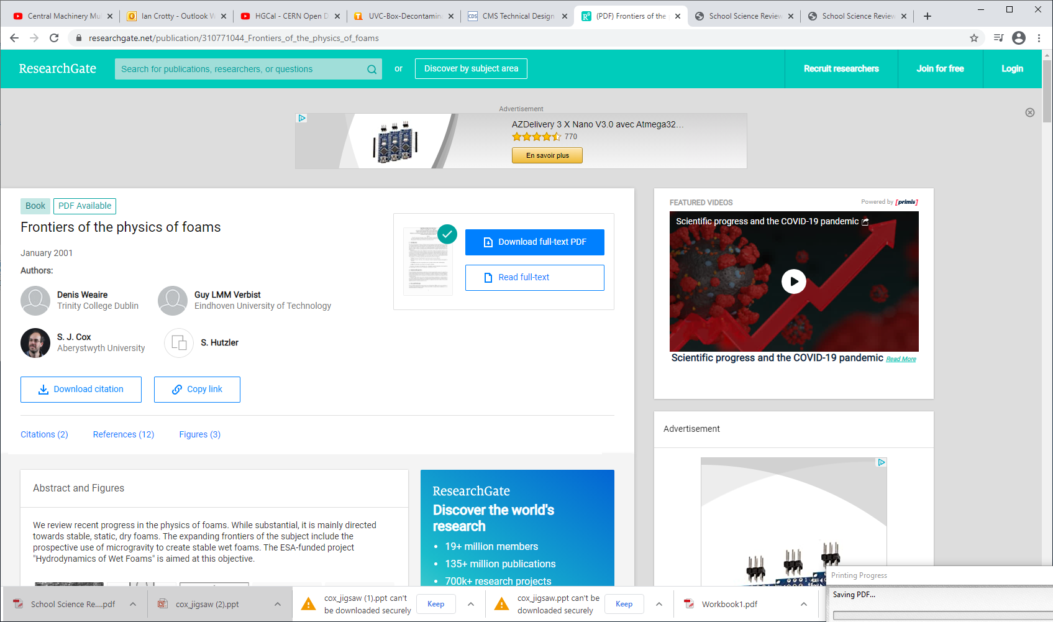
https://www.researchgate.net/publication/310771044_Frontiers_of_the_physics_of_foams

Slide 5
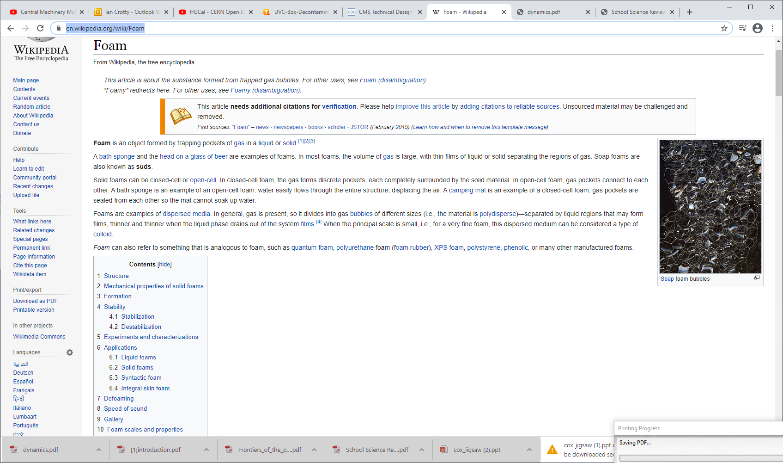
https://en.wikipedia.org/wiki/Foam

Slide 6
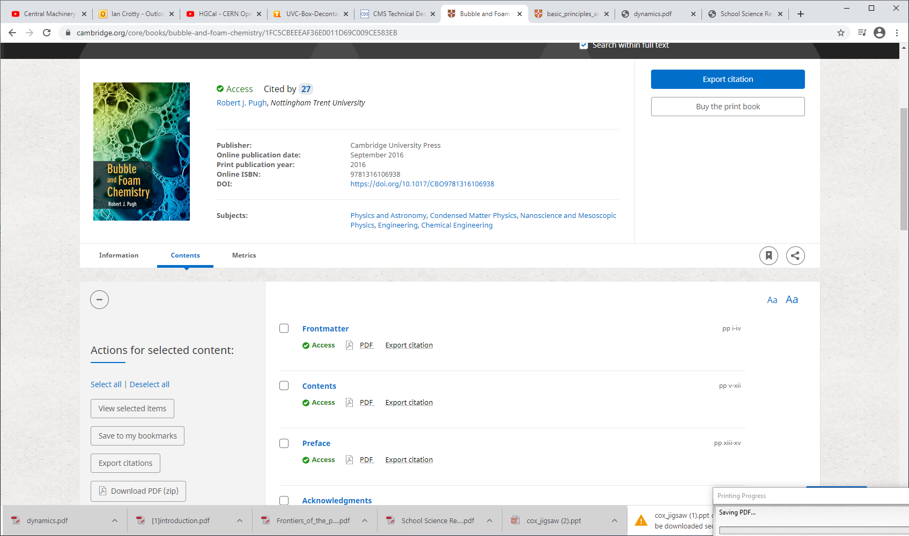
https://www.cambridge.org/core/books/bubble-and-foam-chemistry/1FC5CBEEEAF36E0011D69C009CE583EB
The whole book!! 420 pages see files with download on this folder

