Slide 1
Twiki Page
Ian
10 Aug 2020
https://twiki.cern.ch/twiki/bin/viewauth/CMS/UVC-Box-Decontamination
Zoom link
https://cern.zoom.us/s/98274698281

Slide 2
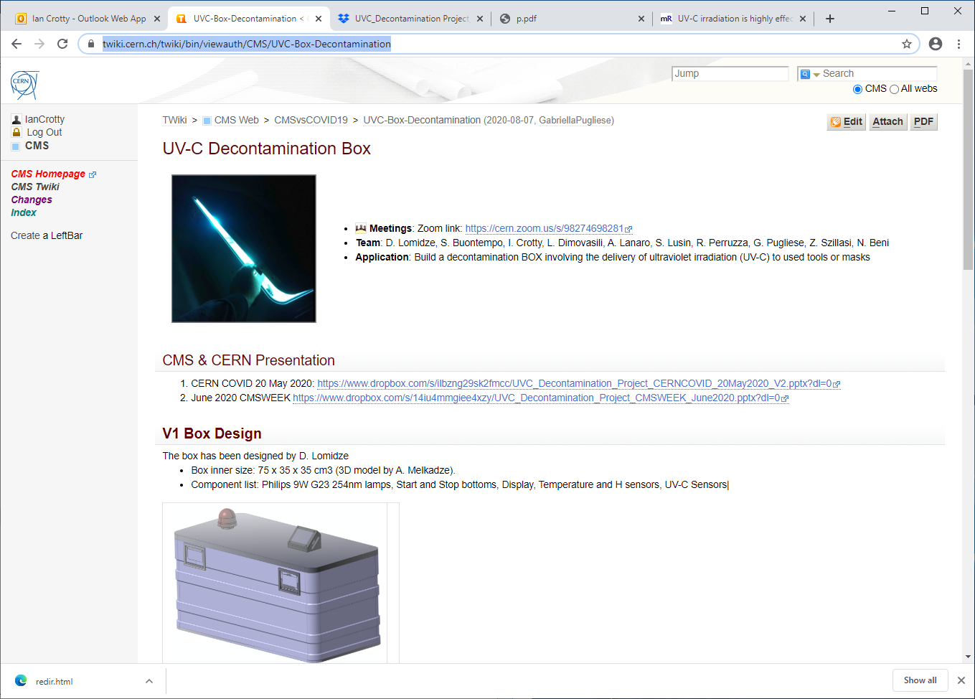
https://twiki.cern.ch/twiki/bin/viewauth/CMS/UVC-Box-Decontamination

Slide 3
Long list of papers
https://twiki.cern.ch/twiki/bin/view/CMS/Sterilisation

