Slide 1
UVC Sterilisation box Initial construction
Ian
16 july 2020

Slide 2
Construction options
Inner panelling inside Alutec box to protect cabling and Electrical components from the UVC radiation. This proposition, coming from our electrical experts, allows everything to be assembled before installation in the Alutec box. In addition future modifications can be made without degrading the integrity of the outer “light tight” envelope.
Two questions ;
What construction methods, welding or riveting. Corner construction.
2 Location of the Electrical/Electronics components.

Slide 3

Electronic/electrical location in the UVC box.
Electrical/Electronics on the bottom of the box
Electrical/electronics at one end

Slide 4
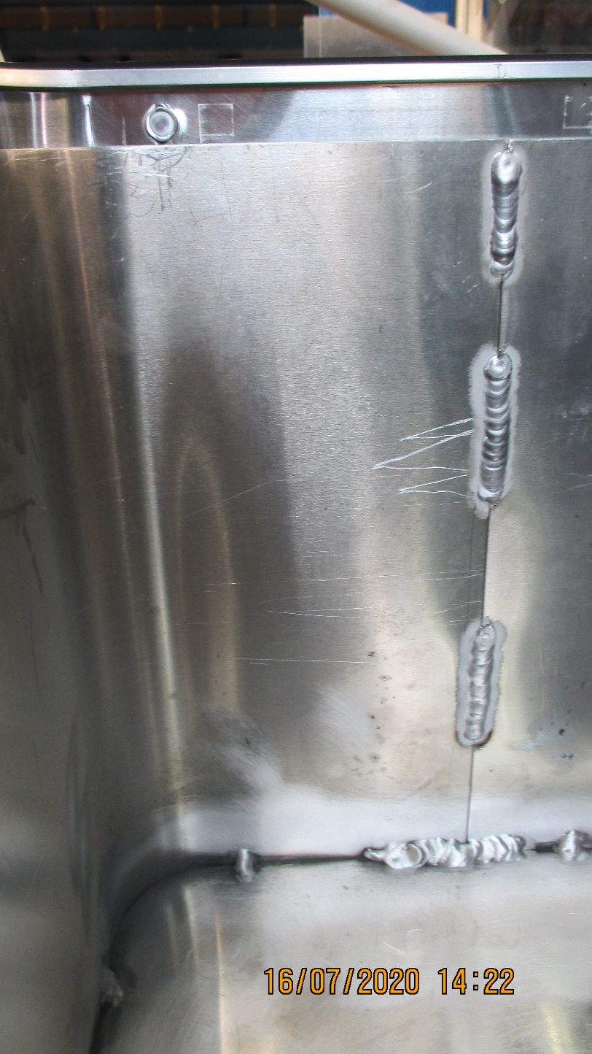
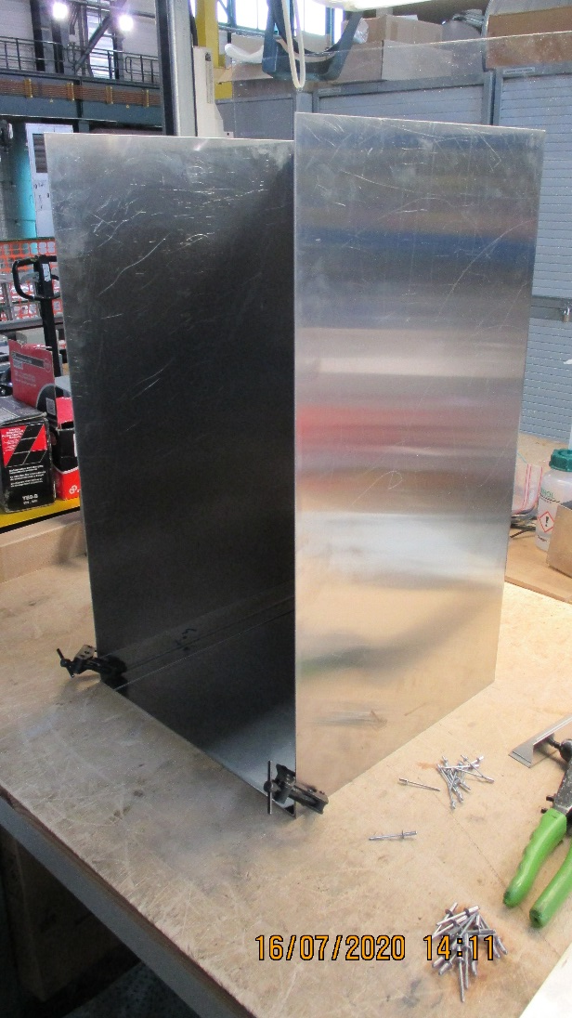
Two different construction techniques.
Riveted on the left
Welded on the right

Slide 5
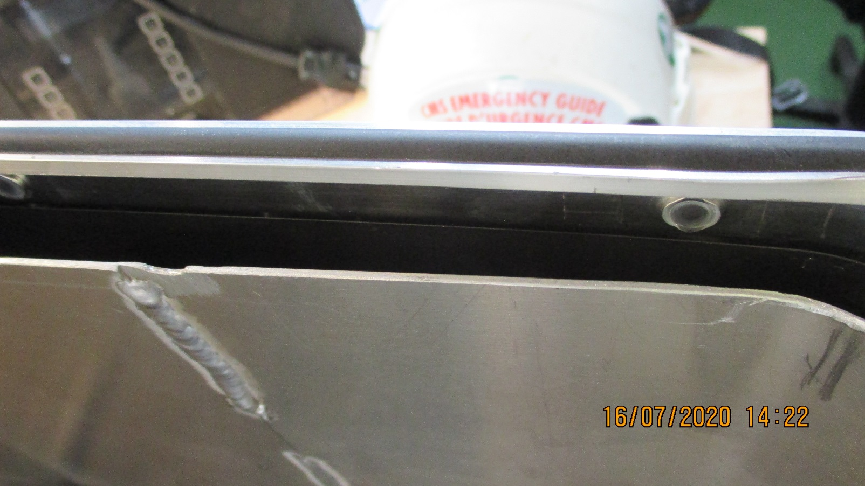
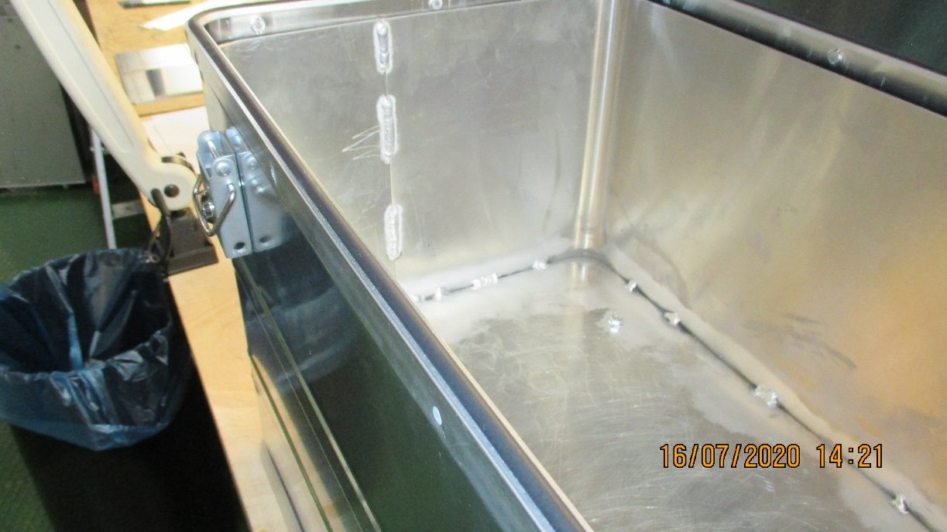
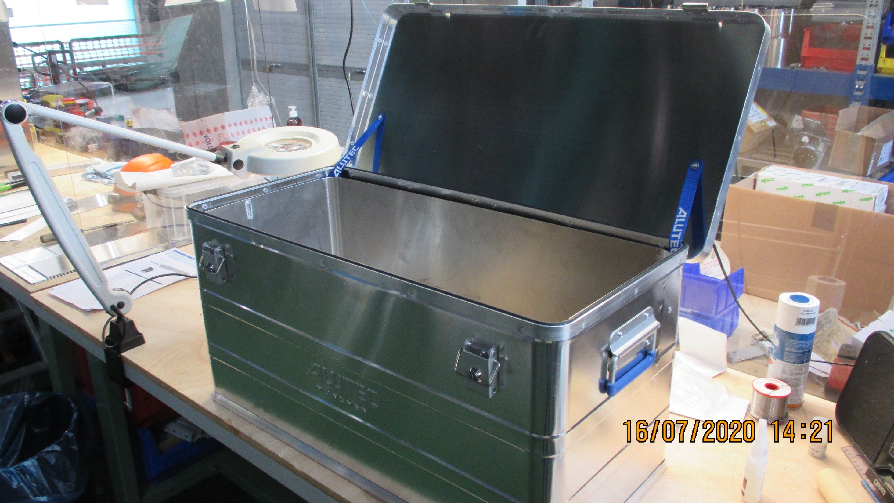
Inner box set 10-15mm inside Alutec
With components under the inner floor

Slide 6
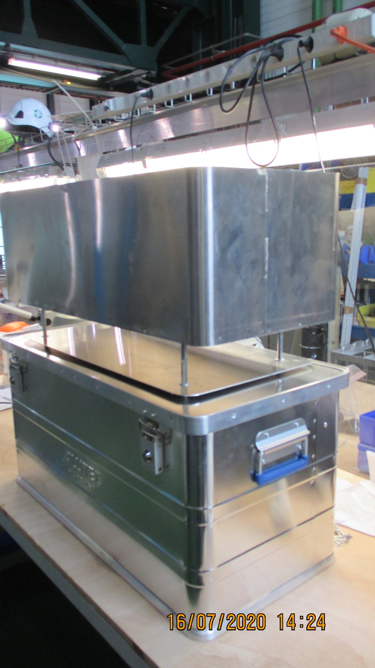
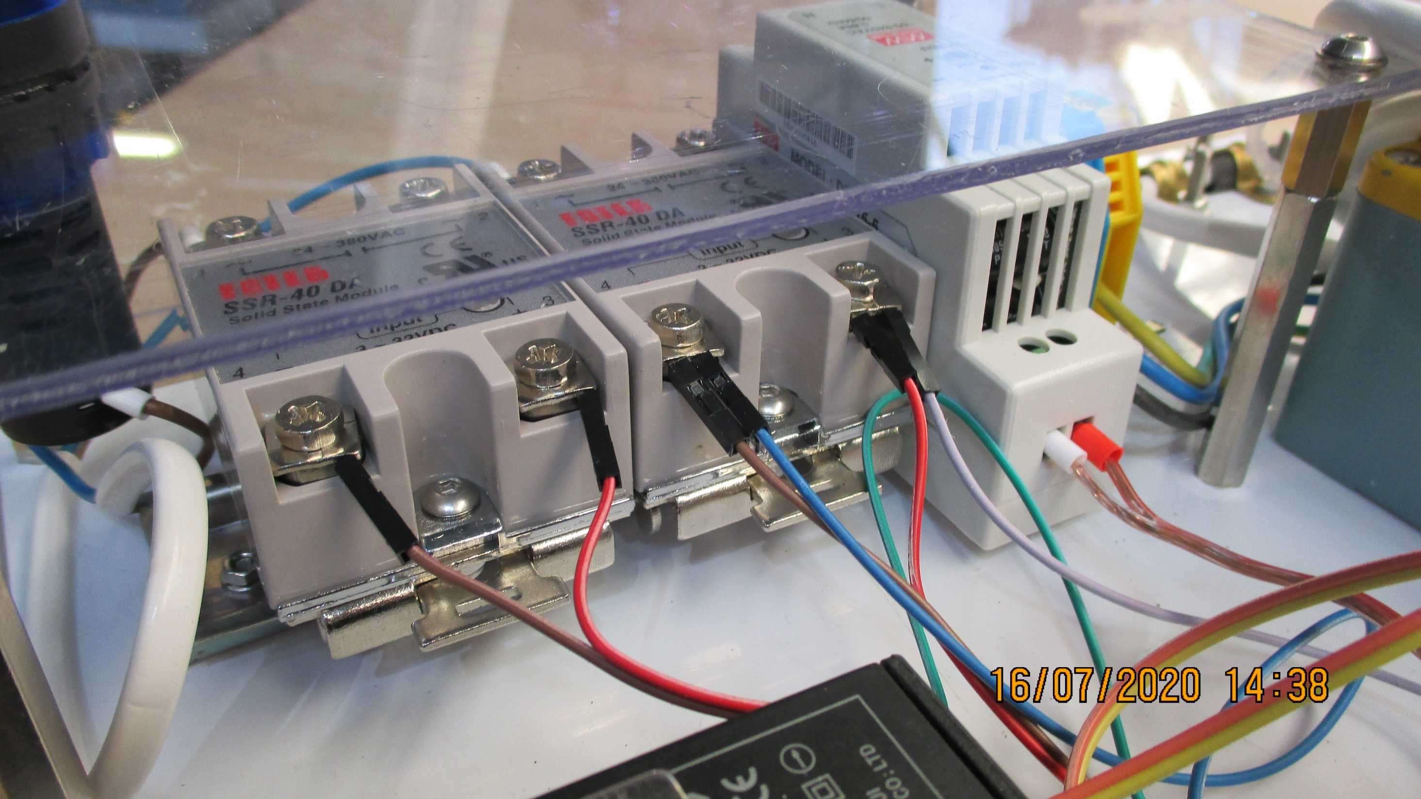
Electrical/Electronics section under the exposure zone is rather high as a minimium of 65mm to clear the AC/DC PS.
No ballasts , approx. 40mm high, are shown here.
The space under the box in the photo on the RHS is adjusted to 85mm.

Slide 7
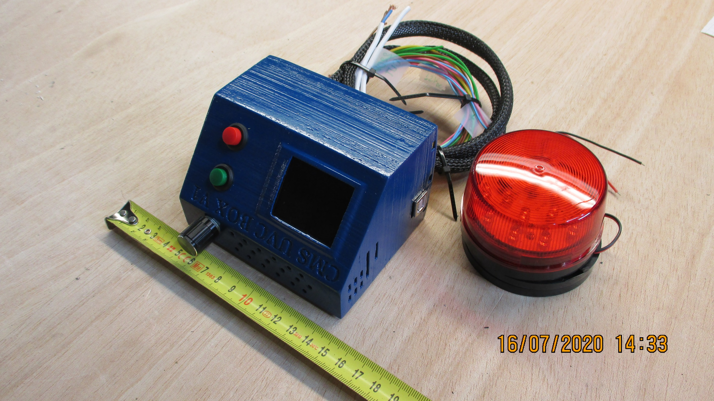
Electronics from David in Georgia
No emergency stop shown

Slide 8
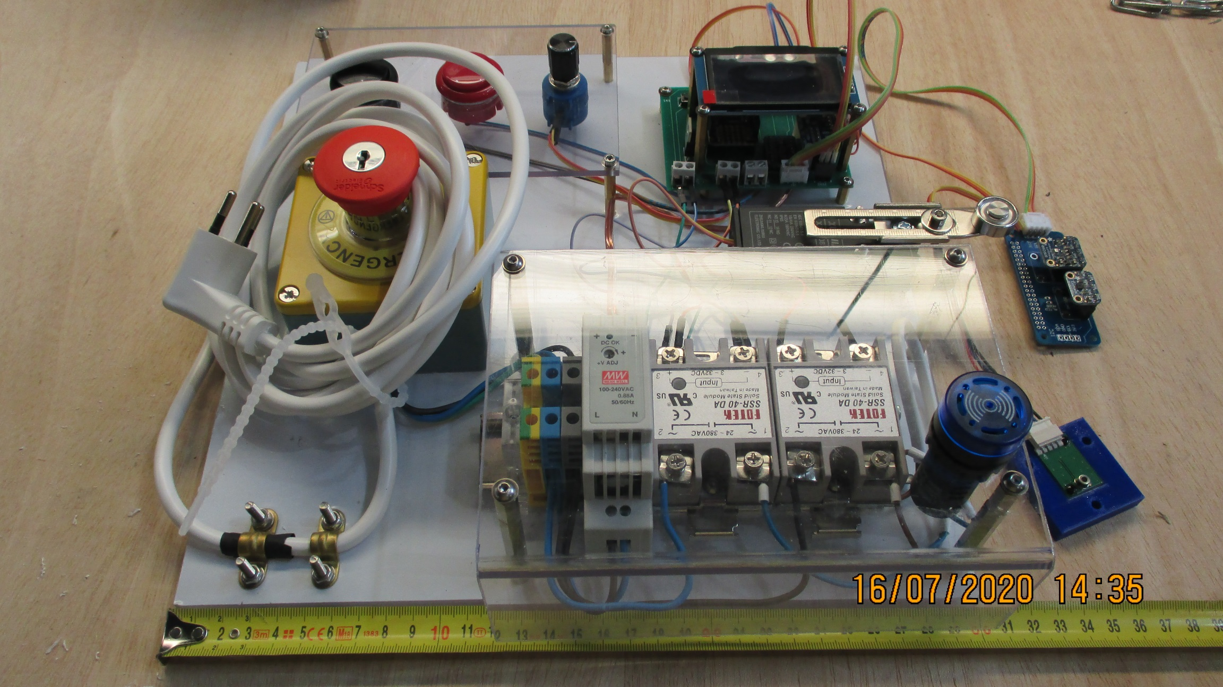
Electrical/Electronics from Zoltan and Noemi

Slide 9
The next steps are;
The lamp base installation, marked out for 8 lamps, with 8 ballasts.
The grids for the lamp protection
The installation of the ZN electronics and electrical components.
Optimisation
The option of having the components set at one end of the box will give ready access to the Control panel on the end.
The weight distribution is not optimal.
Both options for component distribution are being followed until we have something to base our decision on. Perhaps we can combine both with only the ballasts under the floor and everything else on the side or end.
We will have to consider what the electrical connections are and how they are made between the inside and outside while ensuring easy assembly/dissembly for modification and future maintenance.
Work force
The colleagues have been busy with P5 activities and work on our project when they are not all required underground.
Thanks to Raphael and Houari

