Slide 1
UVC Sterilisation box Initial construction
Ian
16 july 2020

Slide 2
Construction options
Inner panelling inside Alutec box to protect cabling and Electrical components from the UVC radiation. This proposition, coming from our electrical experts, allows everything to be assembled before installation in the Alutec box. In addition future modifications can be made without degrading the integrity of the outer “light tight” envelope.
Questions ;
What construction methods, welding or riveting. Corner construction.
2 Location of the Electrical/Electronics components.

Slide 3

Electronic/electrical location in the UVC box.
Electrical/Electronics on the bottom of the box
Electrical/electronics at one end

Slide 4
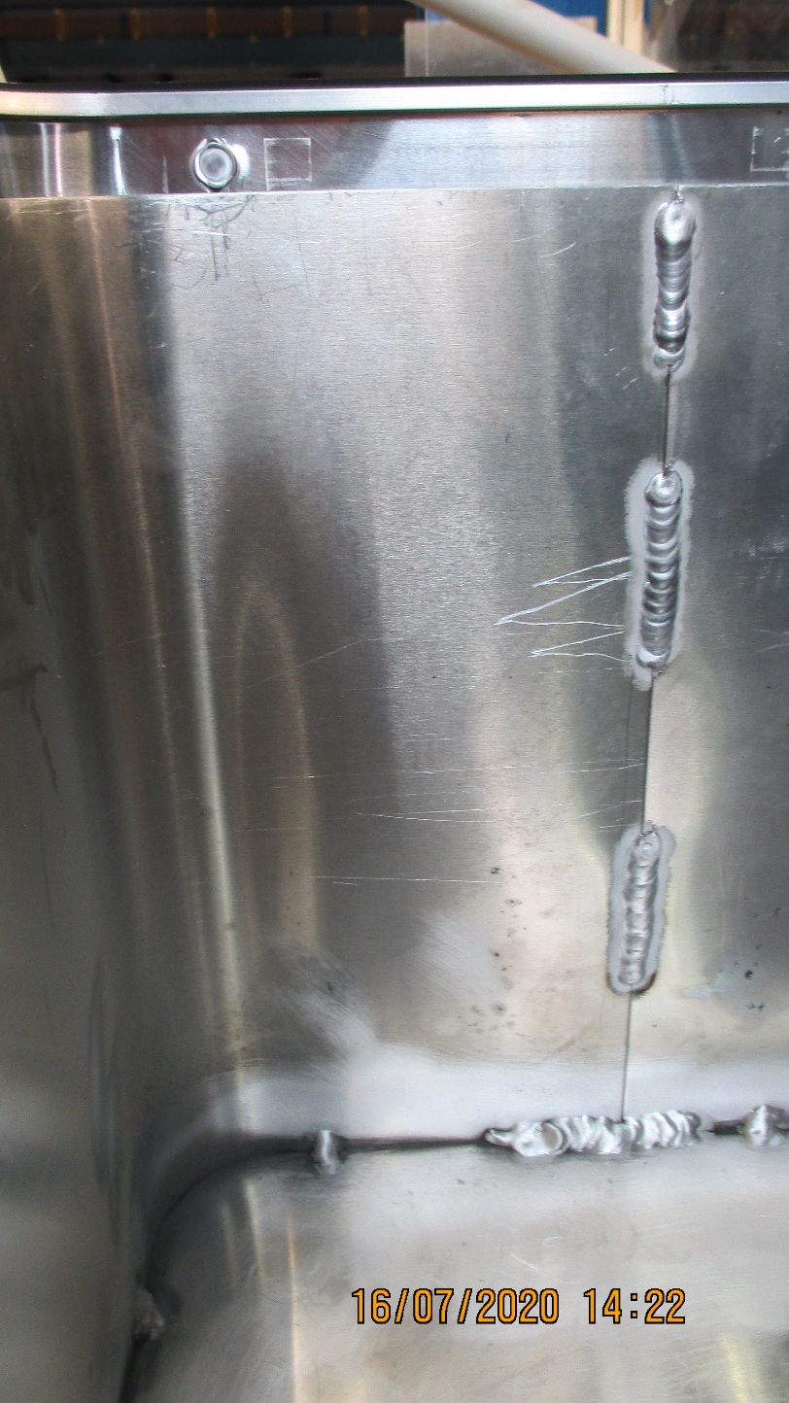
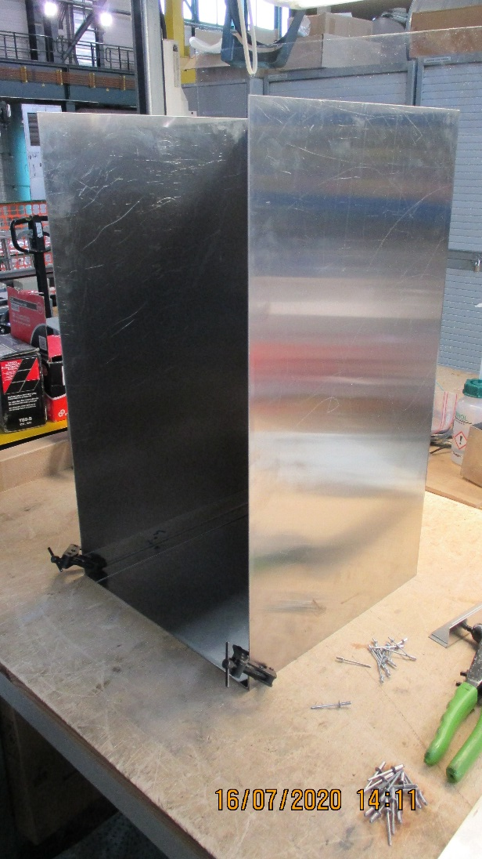
Two different construction techniques.
Riveted on the left
Welded on the right

Slide 5
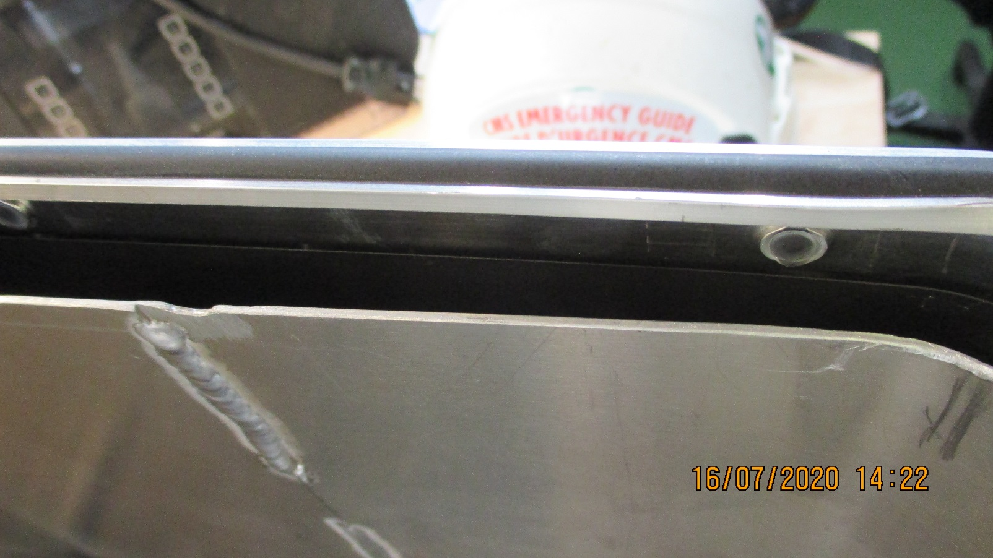
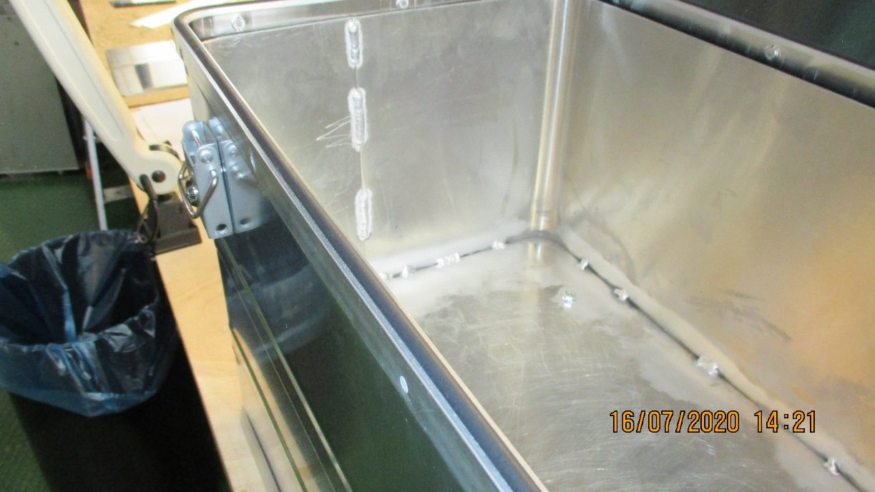
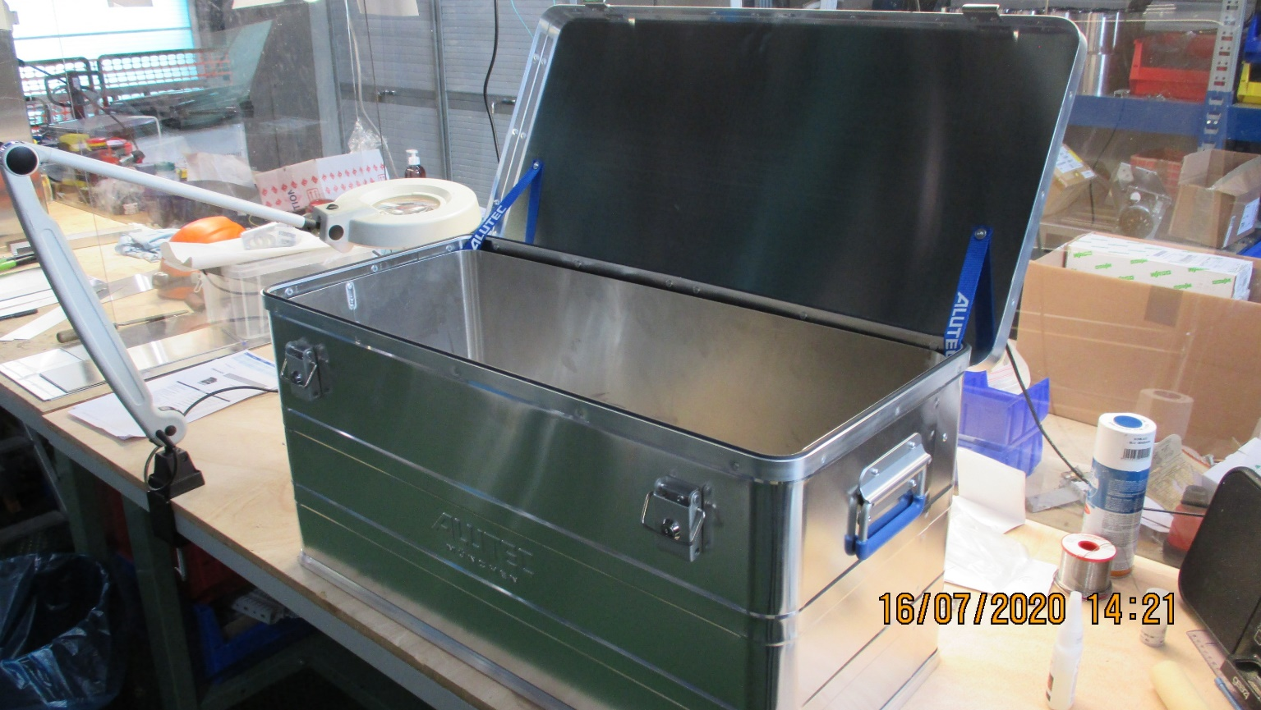
Inner box set 10-15mm inside Alutec
With components under the inner floor

Slide 6
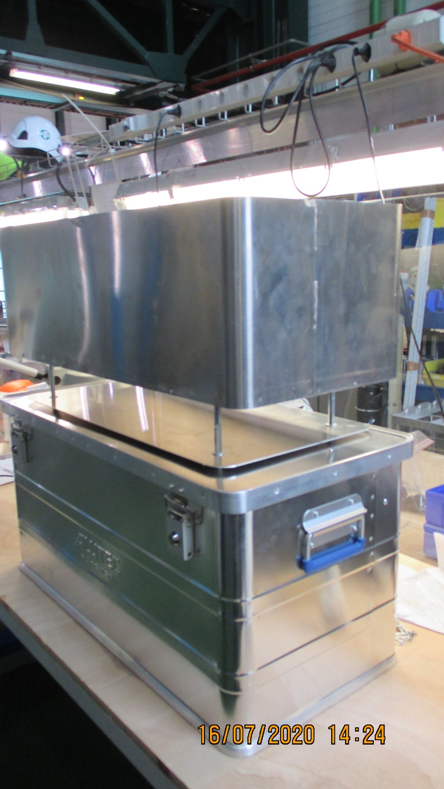
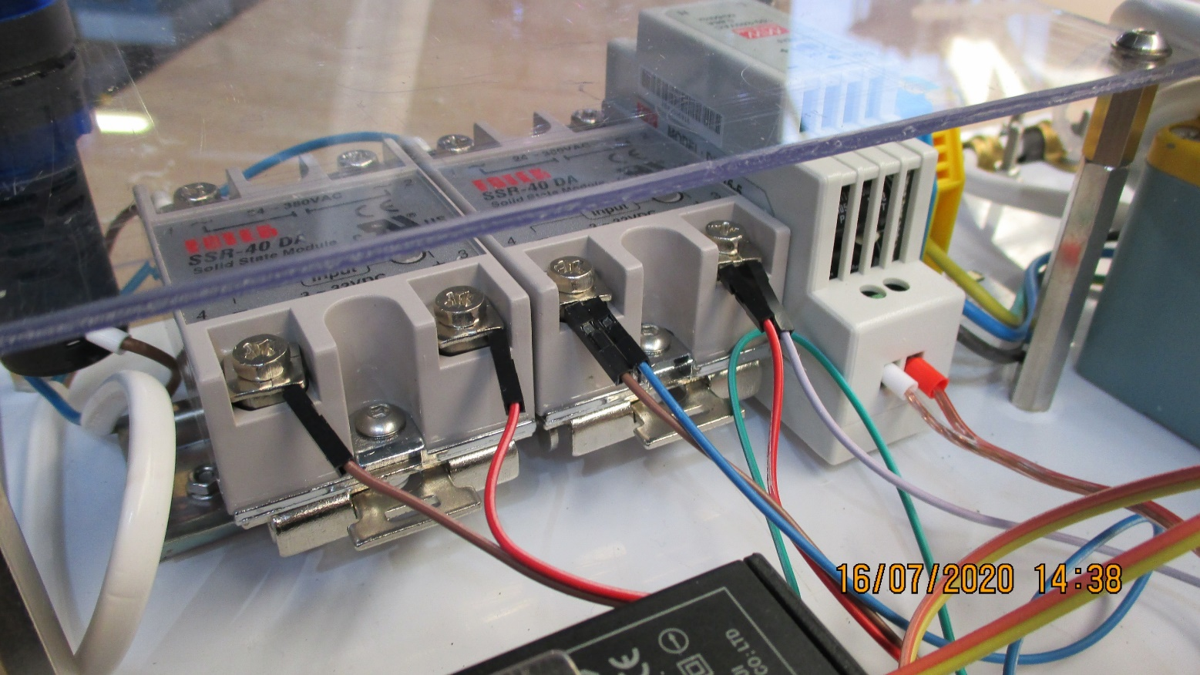
Electrical/Electronics section under the exposure zone is rather high as a minimium of 65mm to clear the AC/DC PS.
No ballasts , approx. 40mm high, are shown here.
The space under the box in the photo on the RHS is adjusted to 85mm.

Slide 7
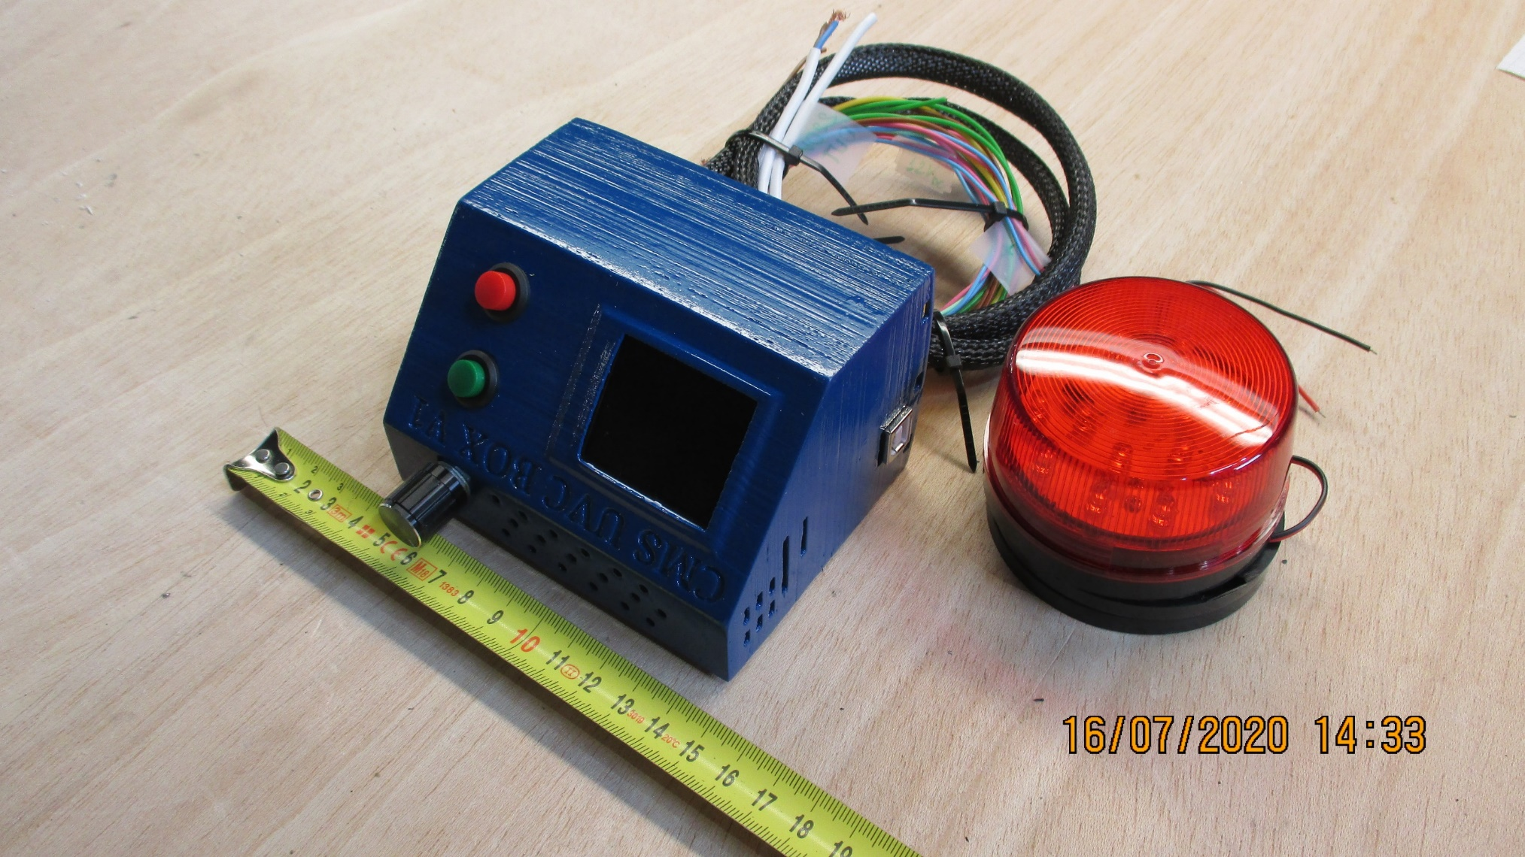
Electronics from David in Georgia
No emergency stop shown

Slide 8
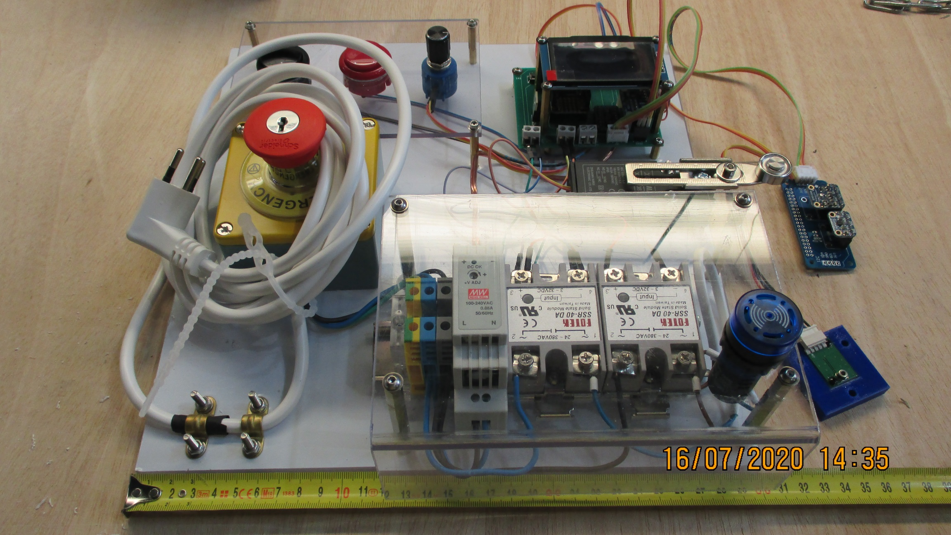
Electrical/Electronics from Zoltan and Noemi

Slide 9
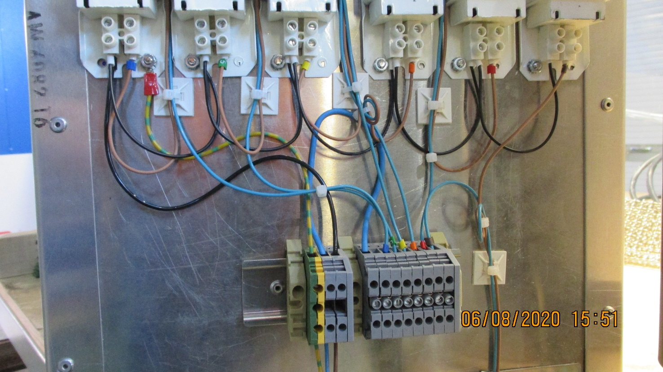
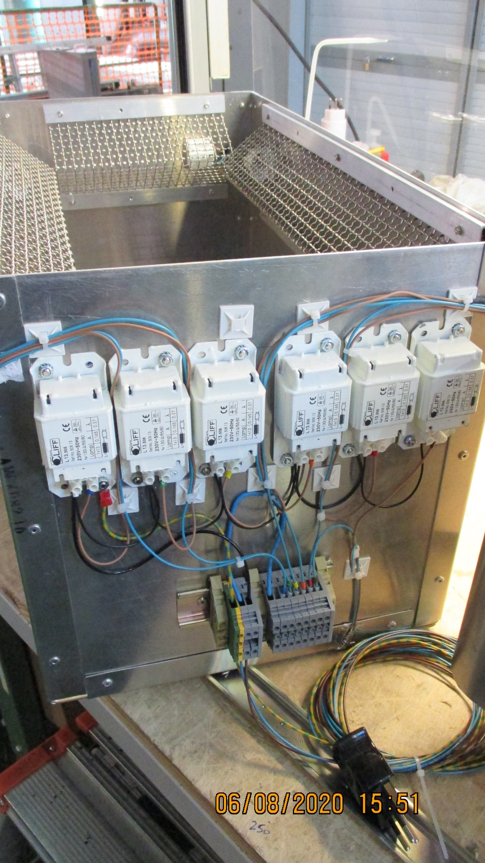
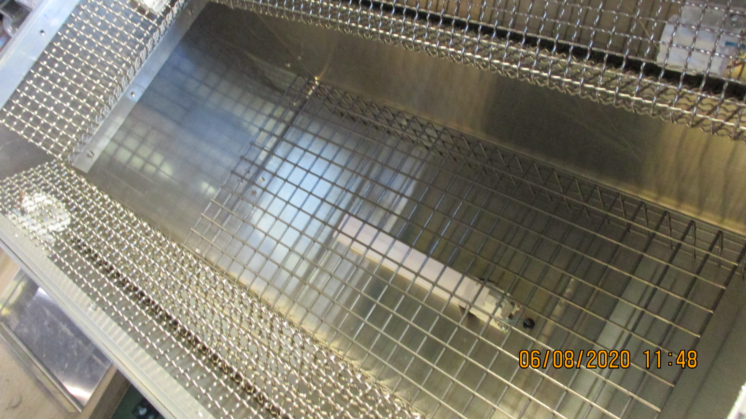
The version with the Electrical elements at one end

Slide 10
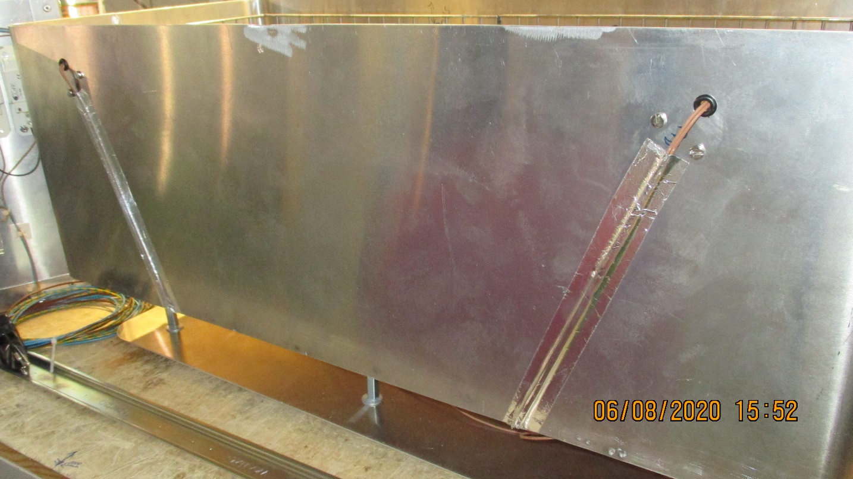
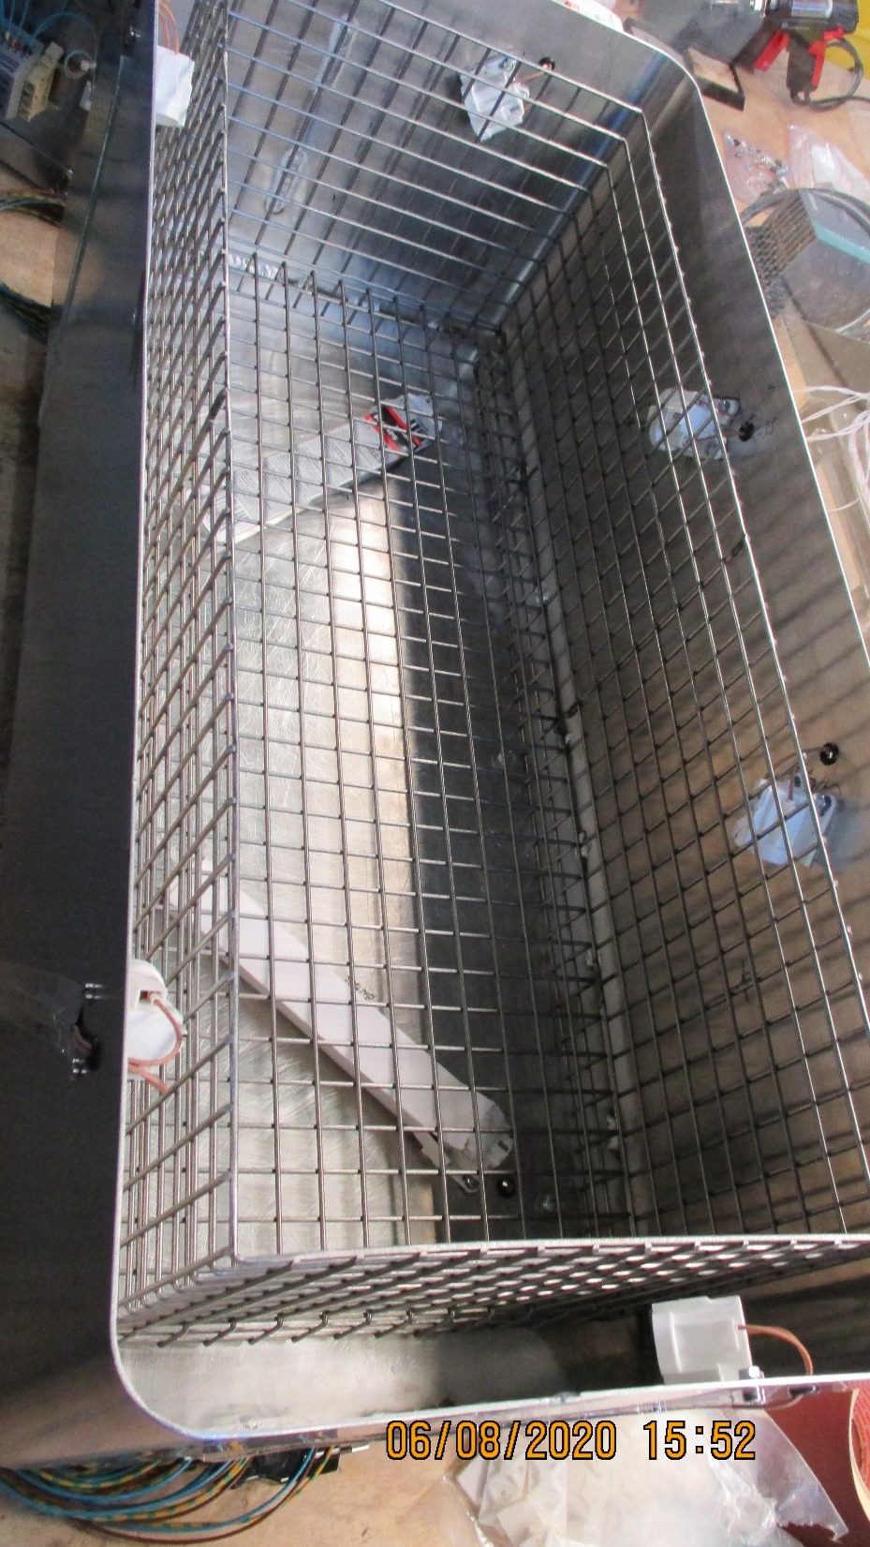
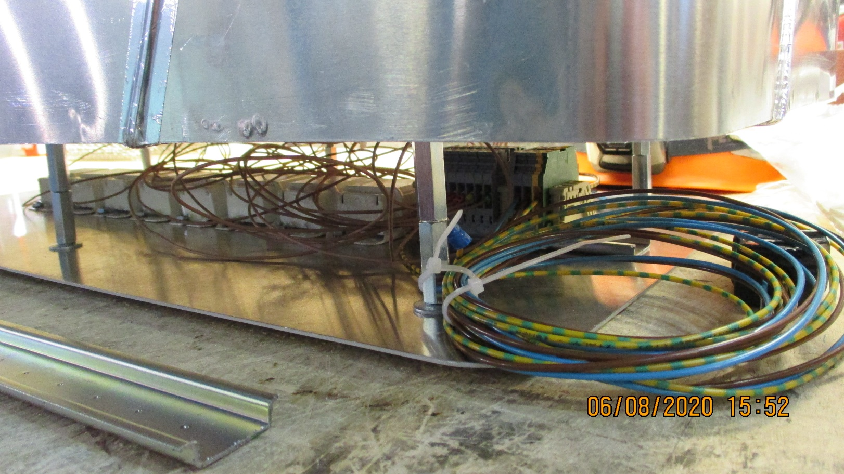
The version with the Electrical elements underneath

Slide 11
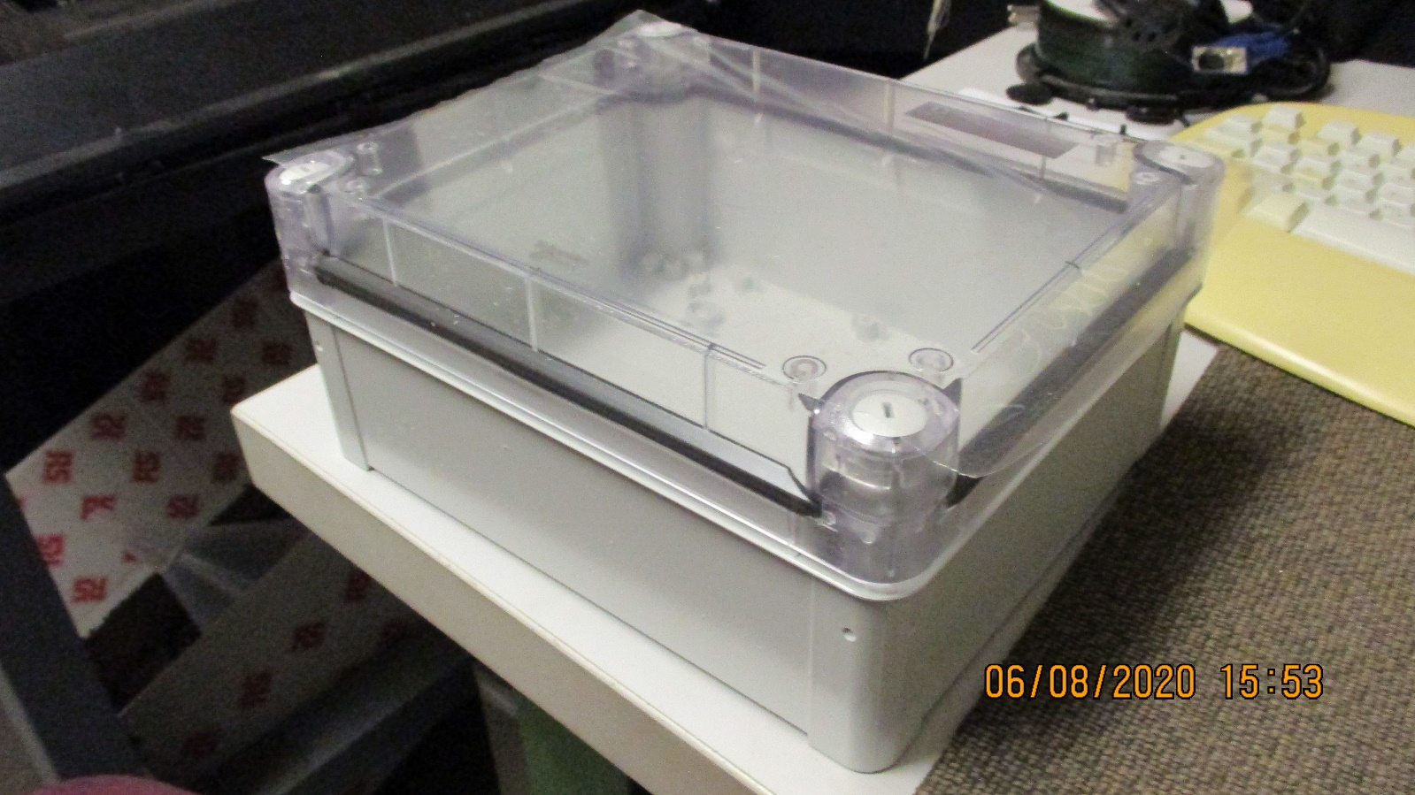
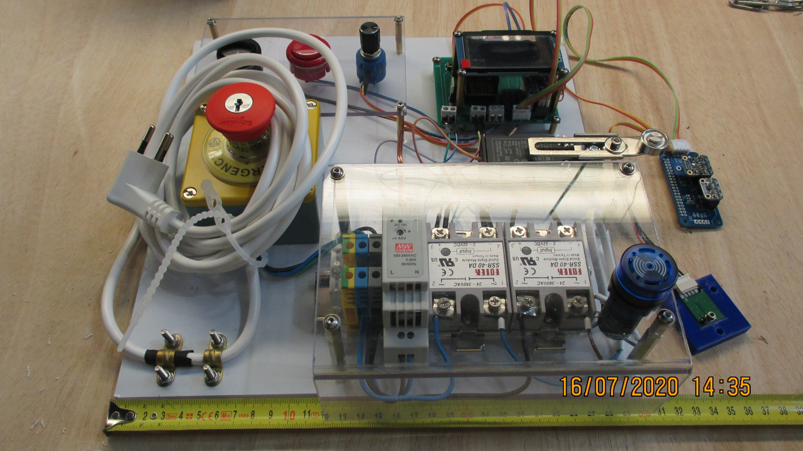
Electronics and the box it will go in on top of the UVC box

Slide 12
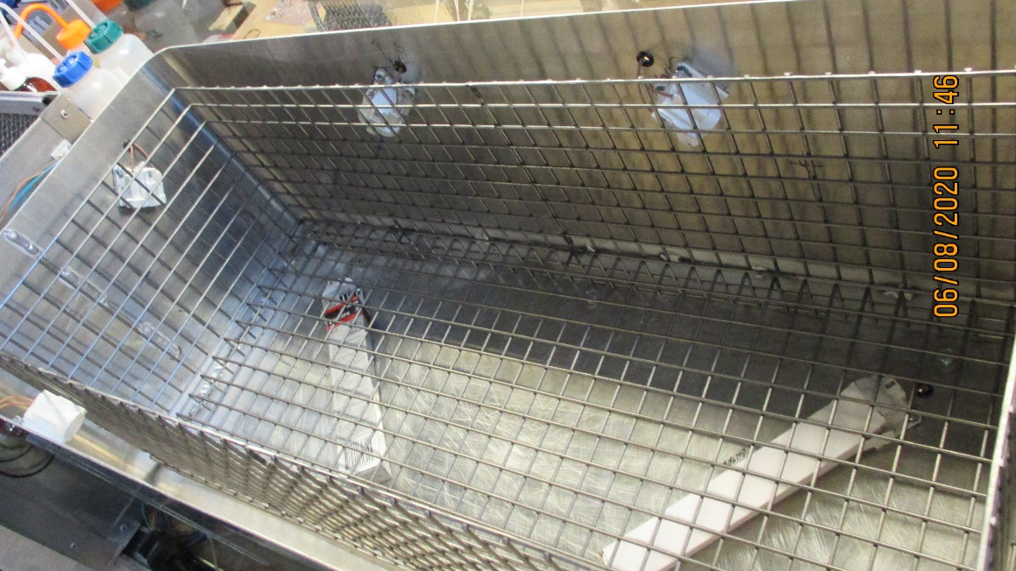
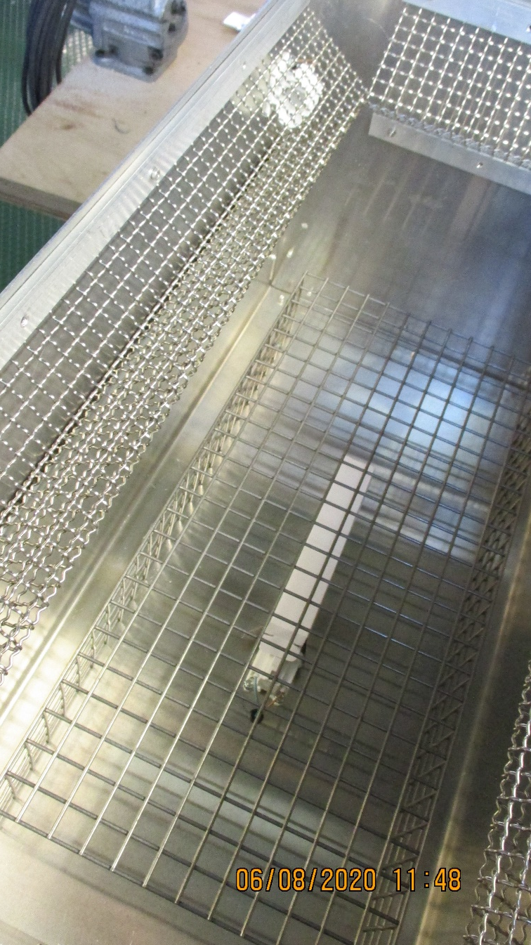
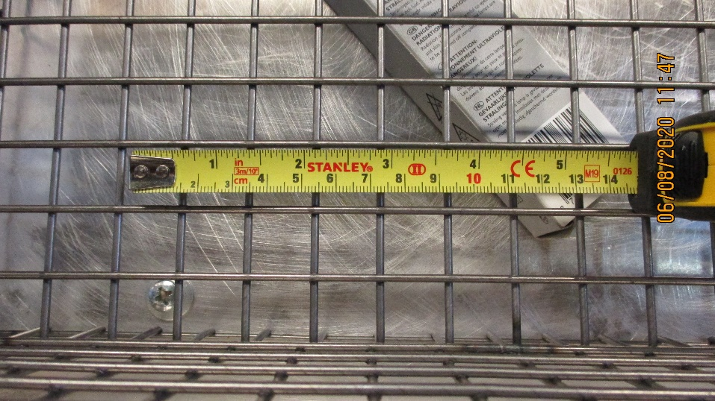
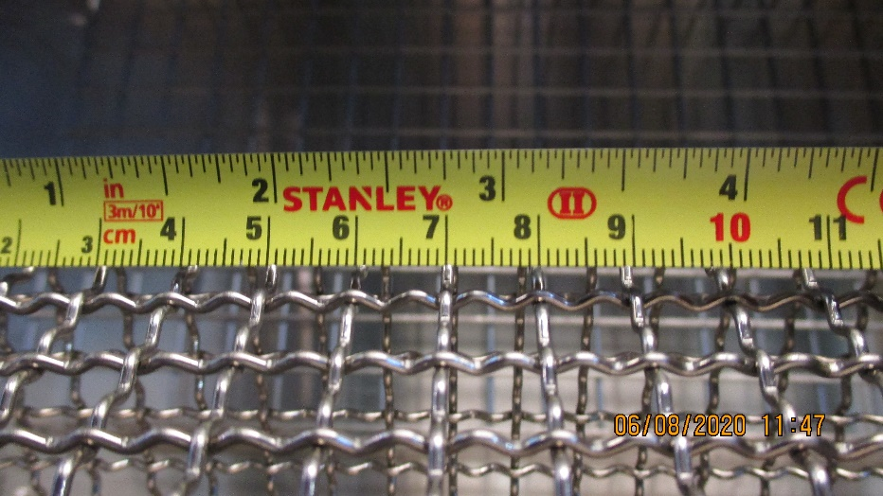
Mechanical shielding of the lamps to avoid fracture.
The health risk is just the same as the standard “neon” lights with regards to the mercury vapour however the glass fragments could cause more of an immediate hazard.
The shielding of the lamps should not obstruct the light !
The from of the protection considerably the available volume.

Slide 13
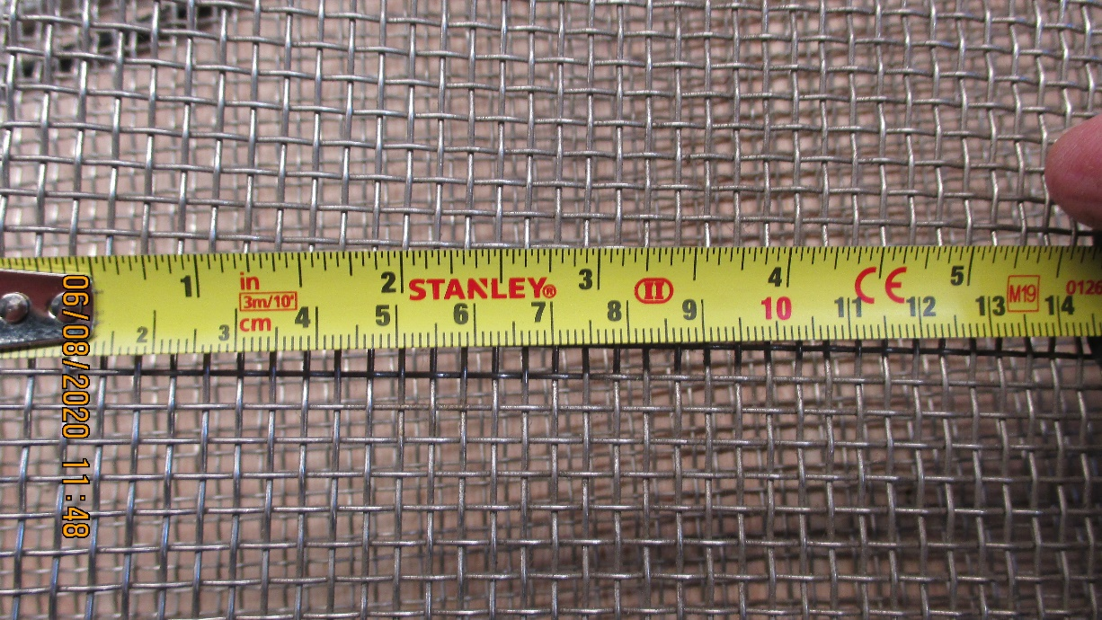
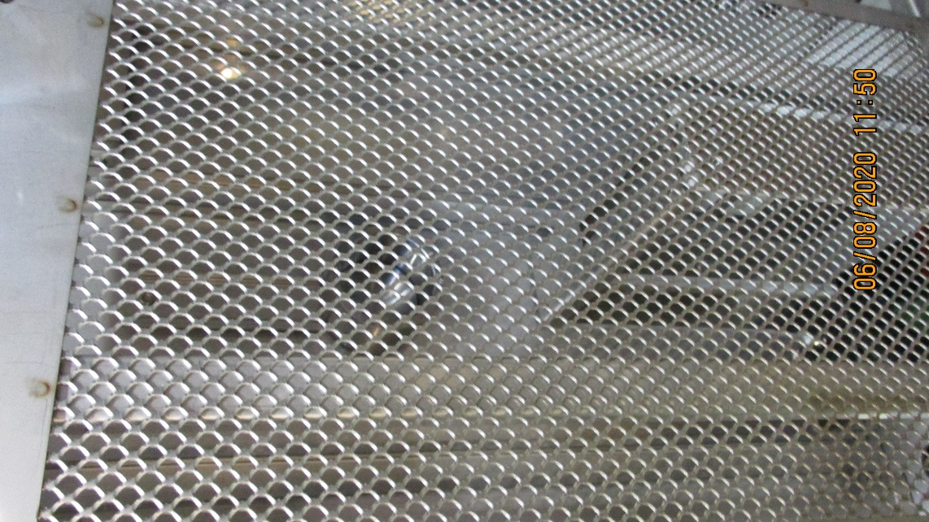
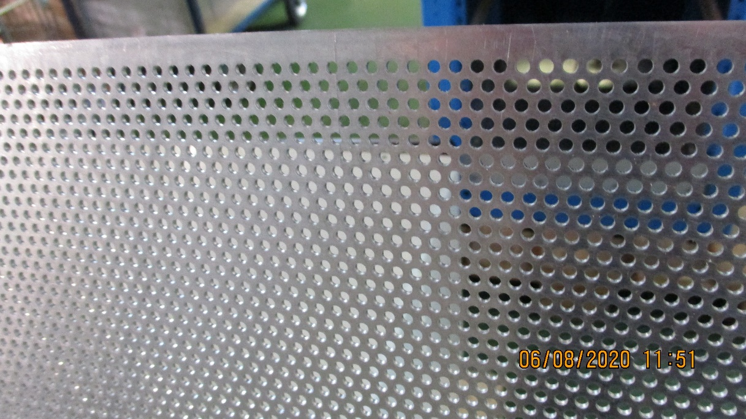
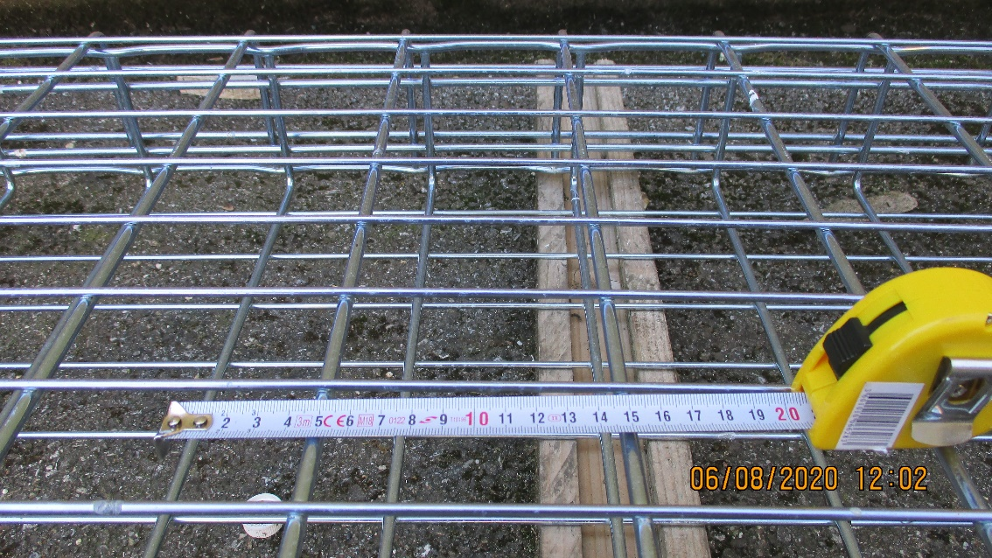
Worse examples
Better but may not be of much protection for the lamps

Slide 14
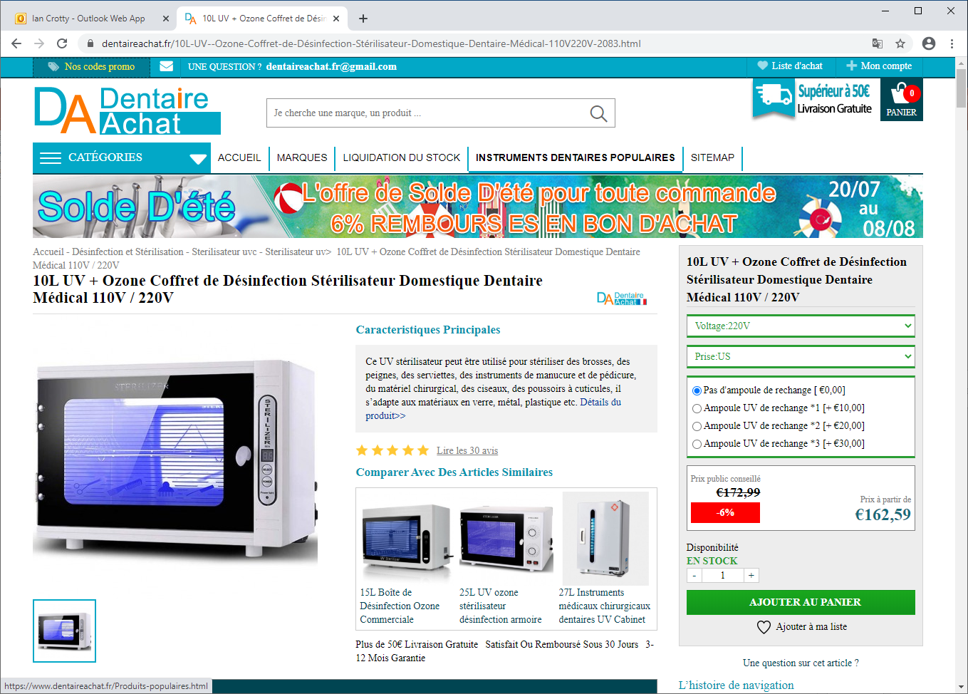
Houari has found an example of what is available on the market. 162Euro.
What can we learn from them in terms of controls, protect etc
https://www.dentaireachat.fr/10L-UV--Ozone-Coffret-de-D%C3%A9sinfection-St%C3%A9rilisateur-Domestique-Dentaire-M%C3%A9dical-110V220V-2083.html

Slide 15
Questions and next steps
The electrical connections between the ballasts and lamps is complete
The electronics will be mounted on the top of the box after discussions with our electricians, ease of access and visibility of the screen and controls. The Zoltan electronics/control will be mounted first on one of the versions.
The Georgian electronics should be studied to check for electrical standards conformity and if possible implimented on the second box version.
The choice of screening for the lampes and supply. We will do initial tests with the boxes as they are.
The commissioning of the box.
The validation method, through either the bio lab confirmed virus destruction test with one of our boxes, size and number of lamps etc
Alternative validation through flux confirmation correlating to values given in the literature. Plan “B”. This latter method will require a confirmation through a single lamp set up in front of the sensor to measure the required spectral flux.
Should we procure a standard UV box that is in use in the health sector to learn what we can rather than inventing all ?
Progress is slowed by the multiple activities in P5 and one injured team member. They will start back in earnest on Monday.

Slide 16
Previous questions from 16 July 2020

Slide 17
The next steps are;
The lamp base installation, marked out for 8 lamps, with 8 ballasts.
The grids for the lamp protection
The installation of the ZN electronics and electrical components.
Optimisation
The option of having the components set at one end of the box will give ready access to the Control panel on the end.
The weight distribution is not optimal.
Both options for component distribution are being followed until we have something to base our decision on. Perhaps we can combine both with only the ballasts under the floor and everything else on the side or end.
We will have to consider what the electrical connections are and how they are made between the inside and outside while ensuring easy assembly/dissembly for modification and future maintenance.
Work force
The colleagues have been busy with P5 activities and work on our project when they are not all required underground.
Thanks to Raphael and Houari

