Slide 1
GIF
Proposition de porte blindée coulissante interlockée
https://edms.cern.ch/document/1729102/

Slide 2
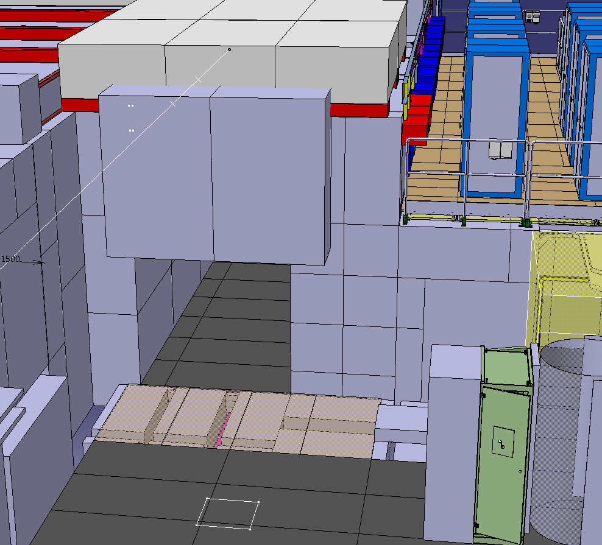
Permanent shielding
Poutres acier 3222
Concrete Pillar
Concrete Pillar
2.4 m
1.6 m

Slide 3
Steel structure + rail
Poutres acier
2.4 m
1.6 m

Slide 4
Steel structure + rail
Poutres acier
Shielded door (Lxhxl)
1.8x2.5x0.1m³
(3.5t )

Slide 5
Steel structure + rail
Poutres acier
Shielded door (Lxhxl)
1.8x2.5x0.1m³
(3.5t )

Slide 6
GIF Porte blindée coulisante
This door is operated by hand (no motor), effort < 150N, aperture time < 20s
Max 4 hours to remove the door, steel structures + concrete blocks in case a large aperture is needed. (or 2 hours for roof opening)
Cost estimate:
Item | Cost [KCHF]
Steel structure | 10
Rails + sliders | 3
Door steel plate 3.5t | 10
Steel floor modification | 2
Furnitures | 2
Access cabling | 3
TOT | 30

Slide 7
GIF Porte blindée coulisante
To be validated by RP:
Thickness of this door (steel S235, 100mm ?)
Overlap 100 mm on sides and on top with max 10 mm gap
Gap max 10 mm to floor
In case of intrusion time respond for the source to be off

Slide 8
AWAKE shielded door design

Slide 9
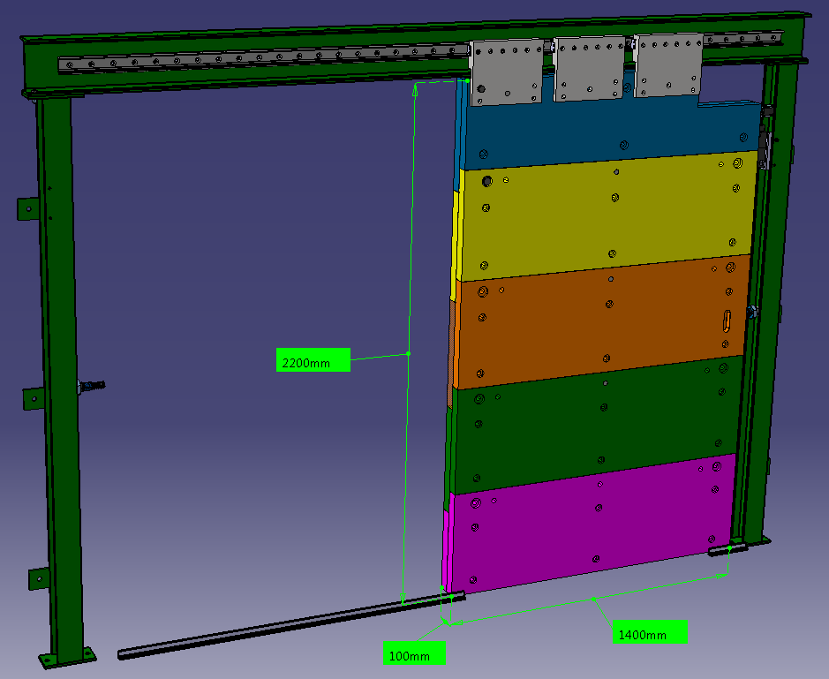
Design porte AWAKE
Dimensions:
2.2x1.4x0.1 m³
Mass: 2400 kg
Gap above floor: 10mm
Stroke: 1.4m

Slide 10
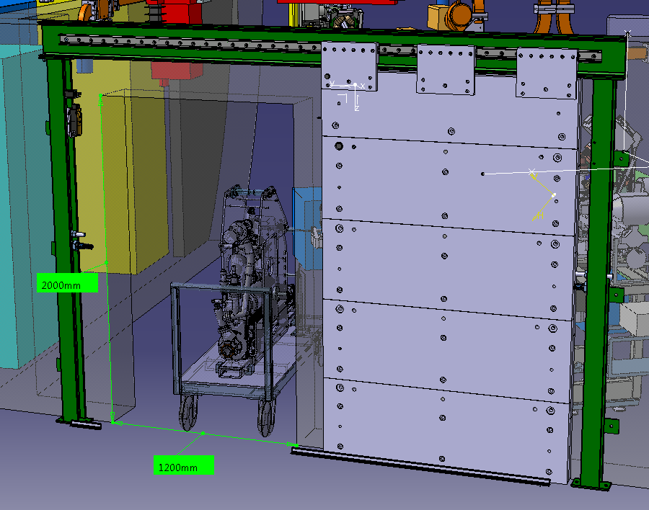
Design porte AWAKE
Free clearance:
Lxh = 1.2x2m²
The doors are operated by hand
Effort < 100N
Aperture time < 10s
(A spring or a counterweight can be added for assistance if needed)

Slide 11
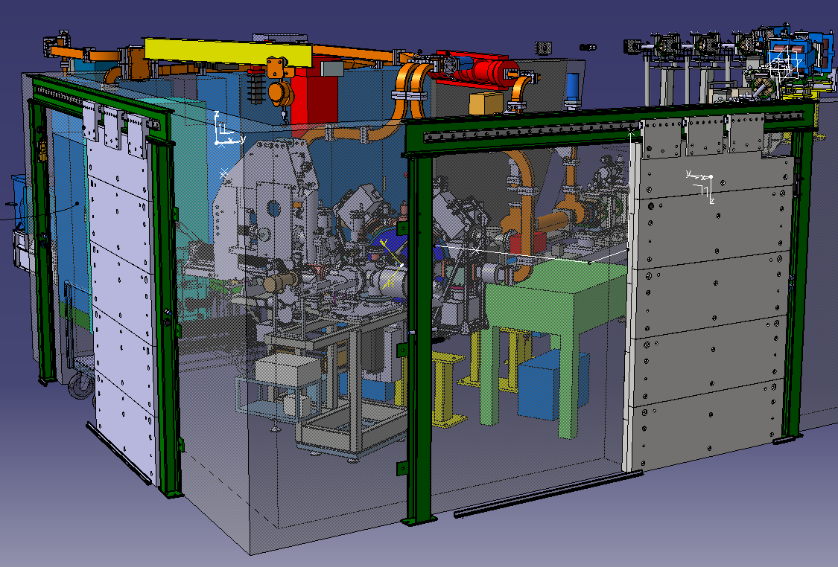
ST0746517
ST0751344

Slide 12
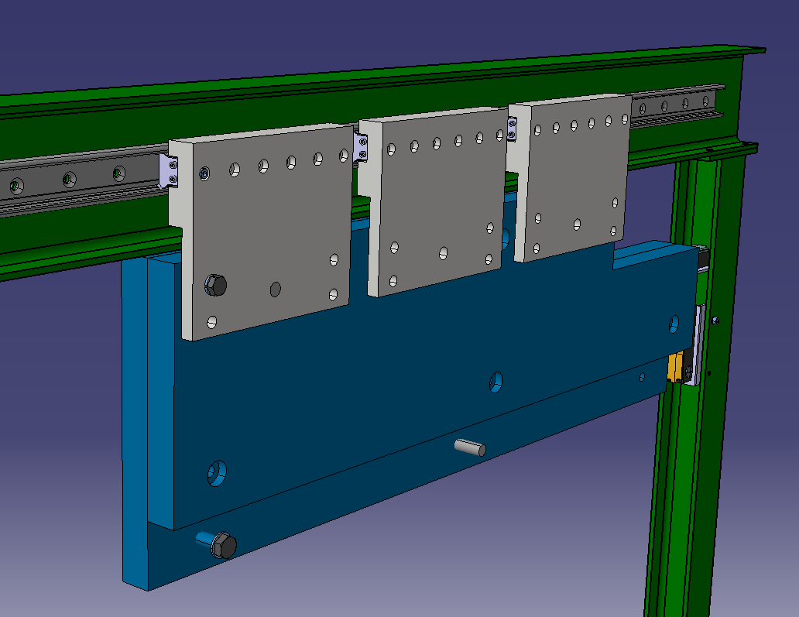
Roller
3 sliders on bearings
5 steel panel max 500 kg each
3
2
1

Slide 13
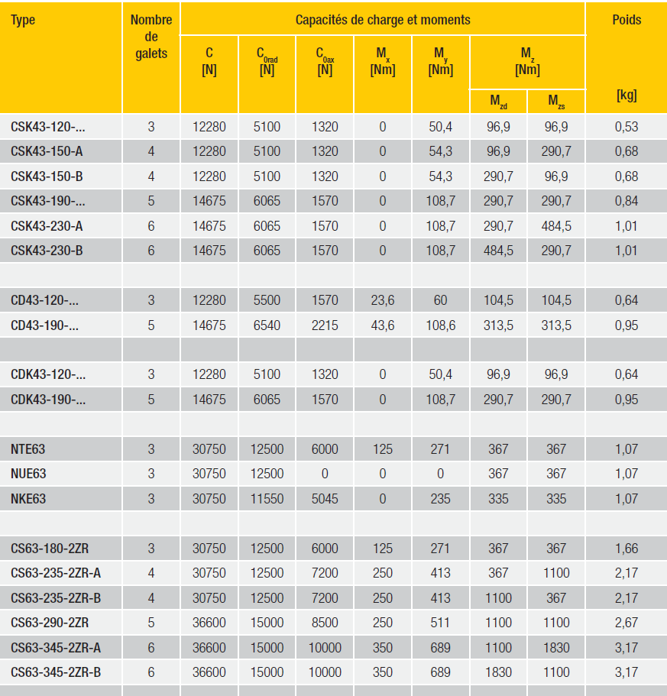
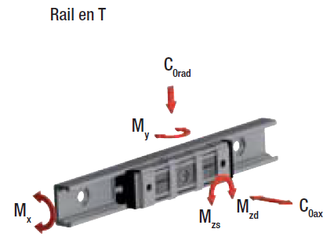
Roller capacity
http://www.rollon.com/GB/en/products/linear-line/

Slide 14
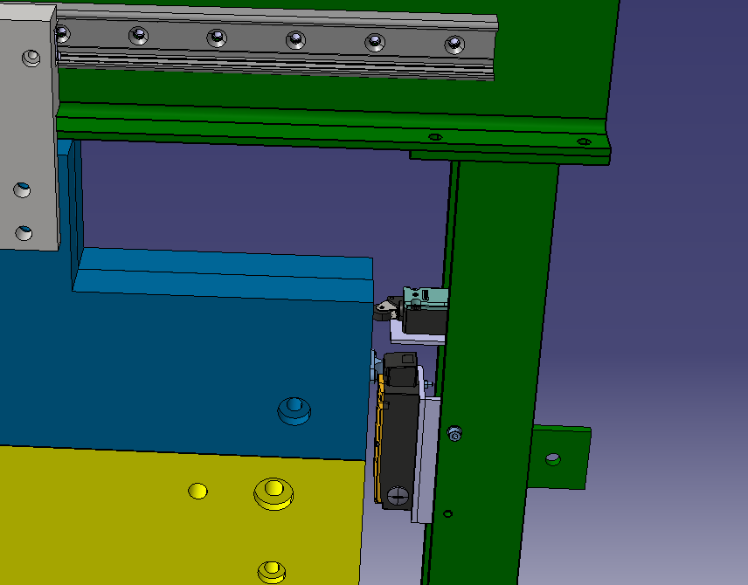
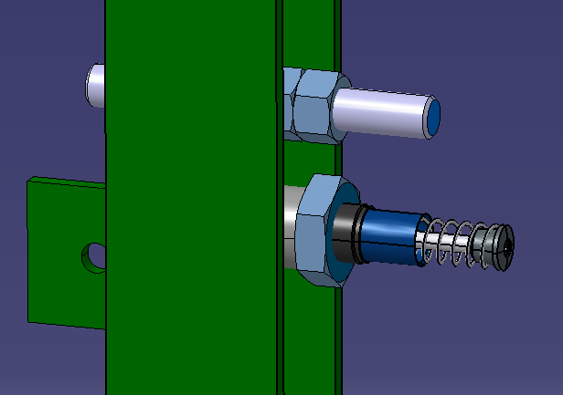
Mechanical end stops
Magnetic lock (1200N) & end switch for access system

Slide 15
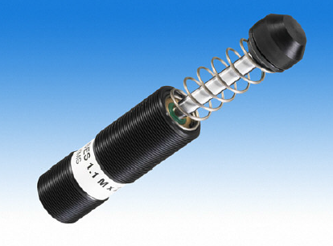
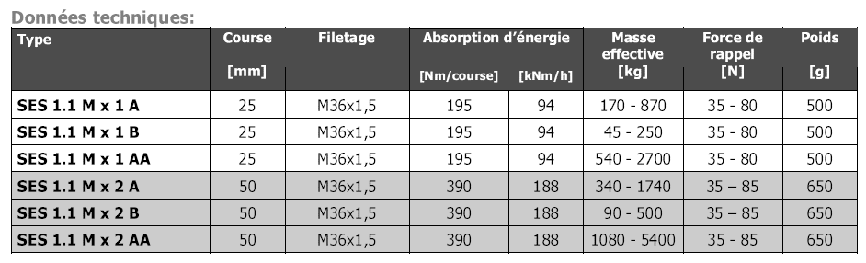

Chock absorber
$$Max speed v\sim 0.5 m/s$$
$$Energie E=\frac{1}{2}mv^{2}=\frac{1}{2}2400×0.5^{2} =300 Nm (joules)$$
http://www.rossfrance.com/amortisseur_de_choc_fr.html

Slide 16
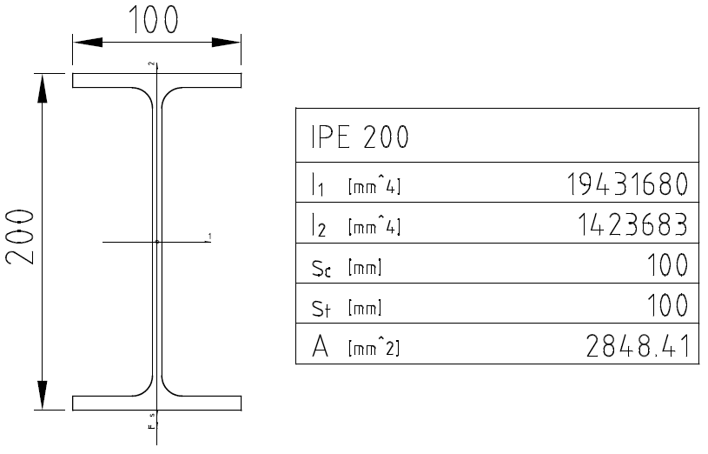
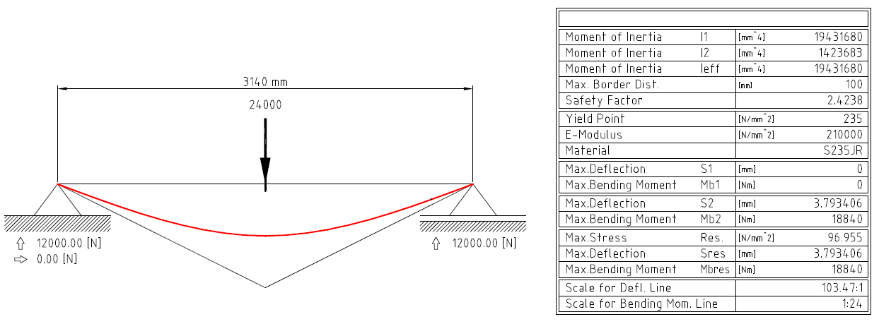
Beam calculations IPE200
Case 1:
Load on slider 2
N

Slide 17
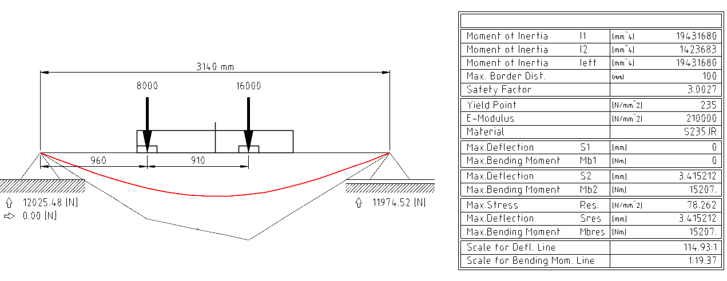
Beam calculations IPE200
Case 2:
Load on slider 1 & 3
N

