Slide 1
Cables move and additional cables GIF ++
Ian Crotty

Slide 2
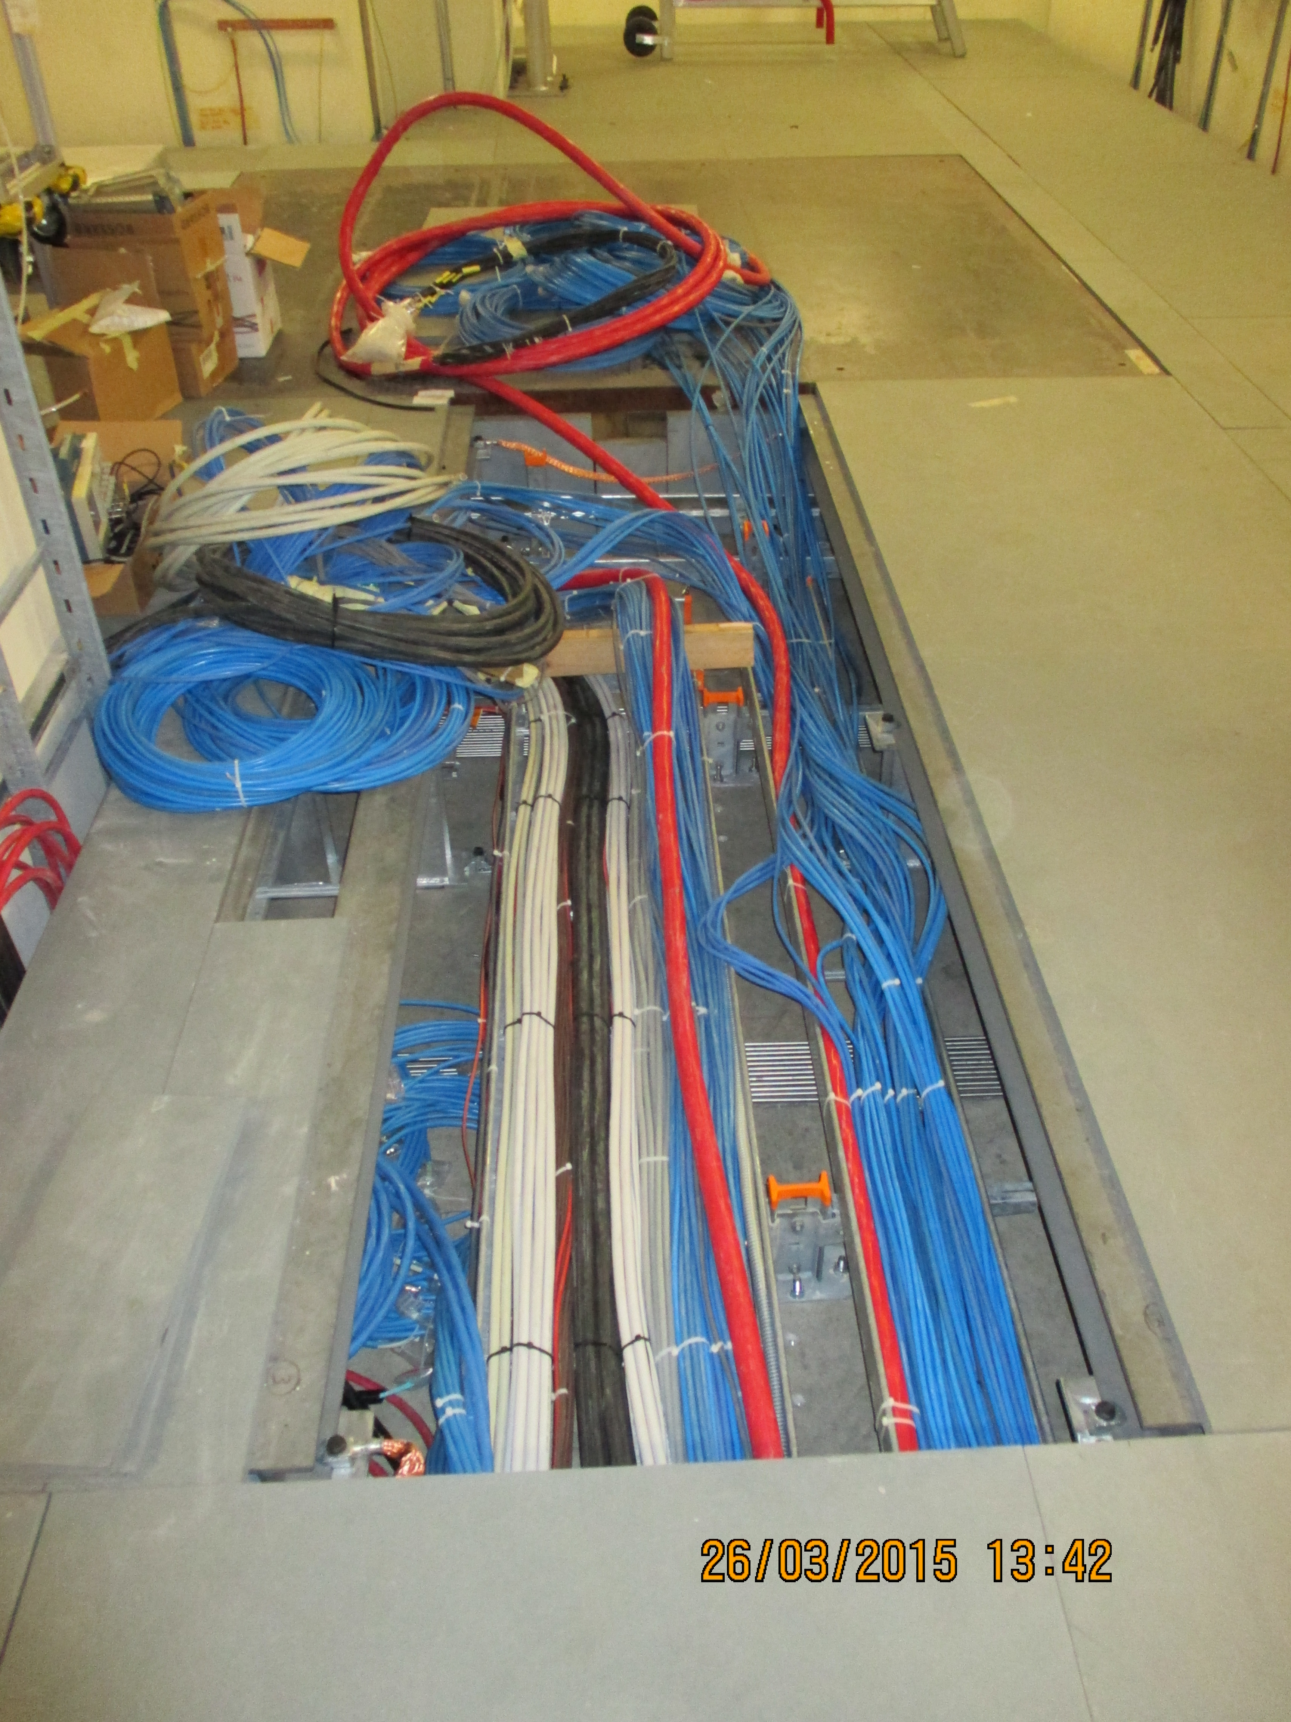
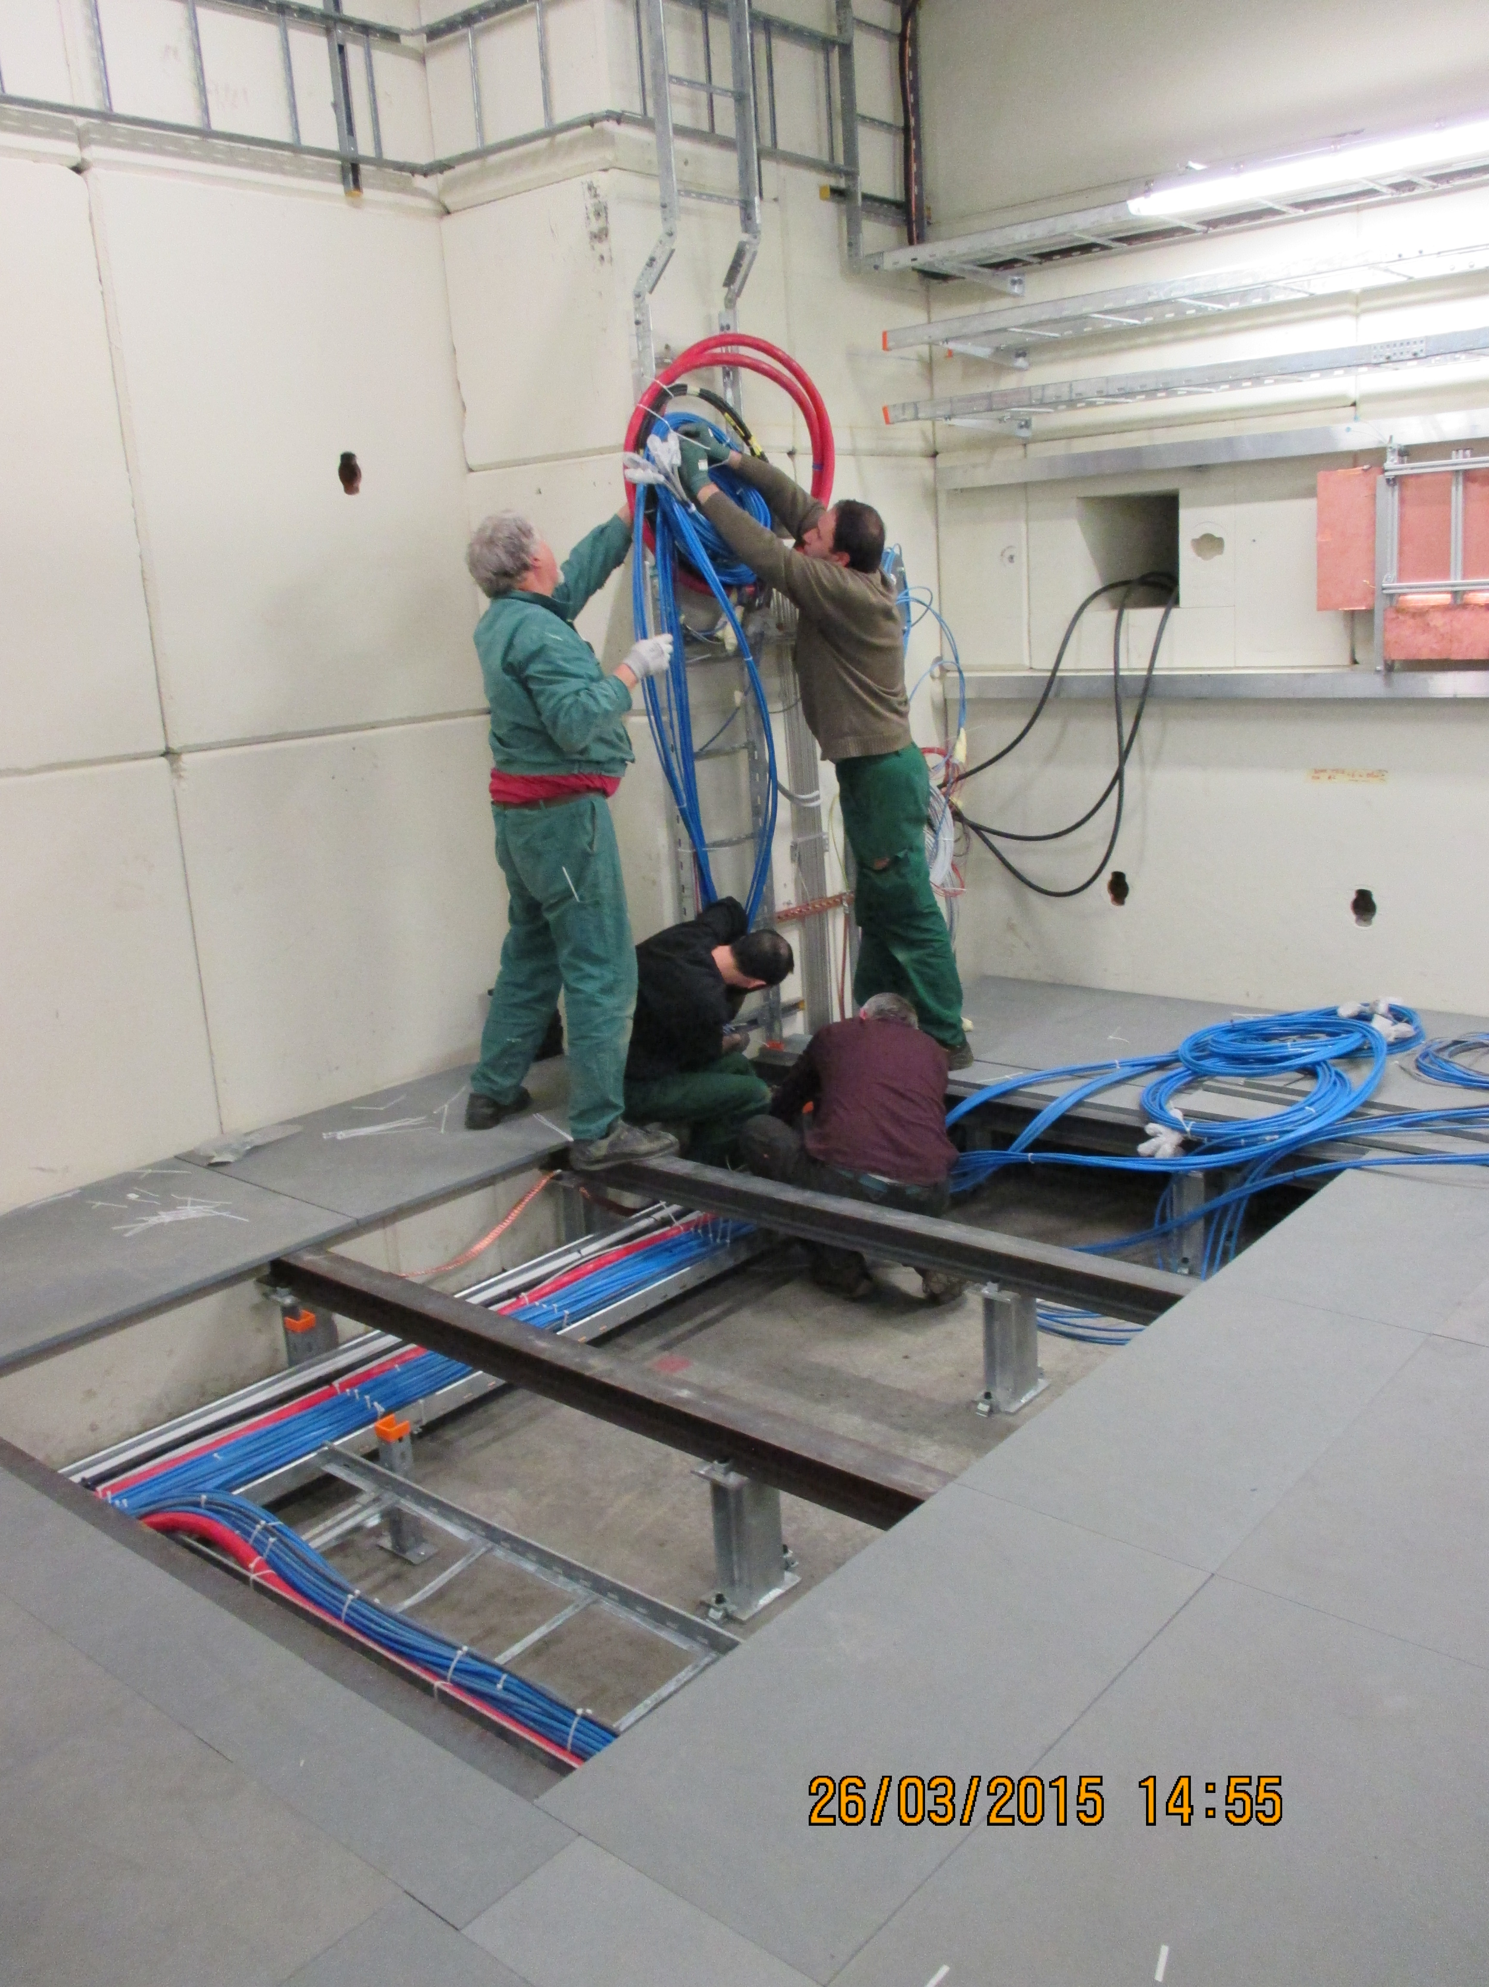
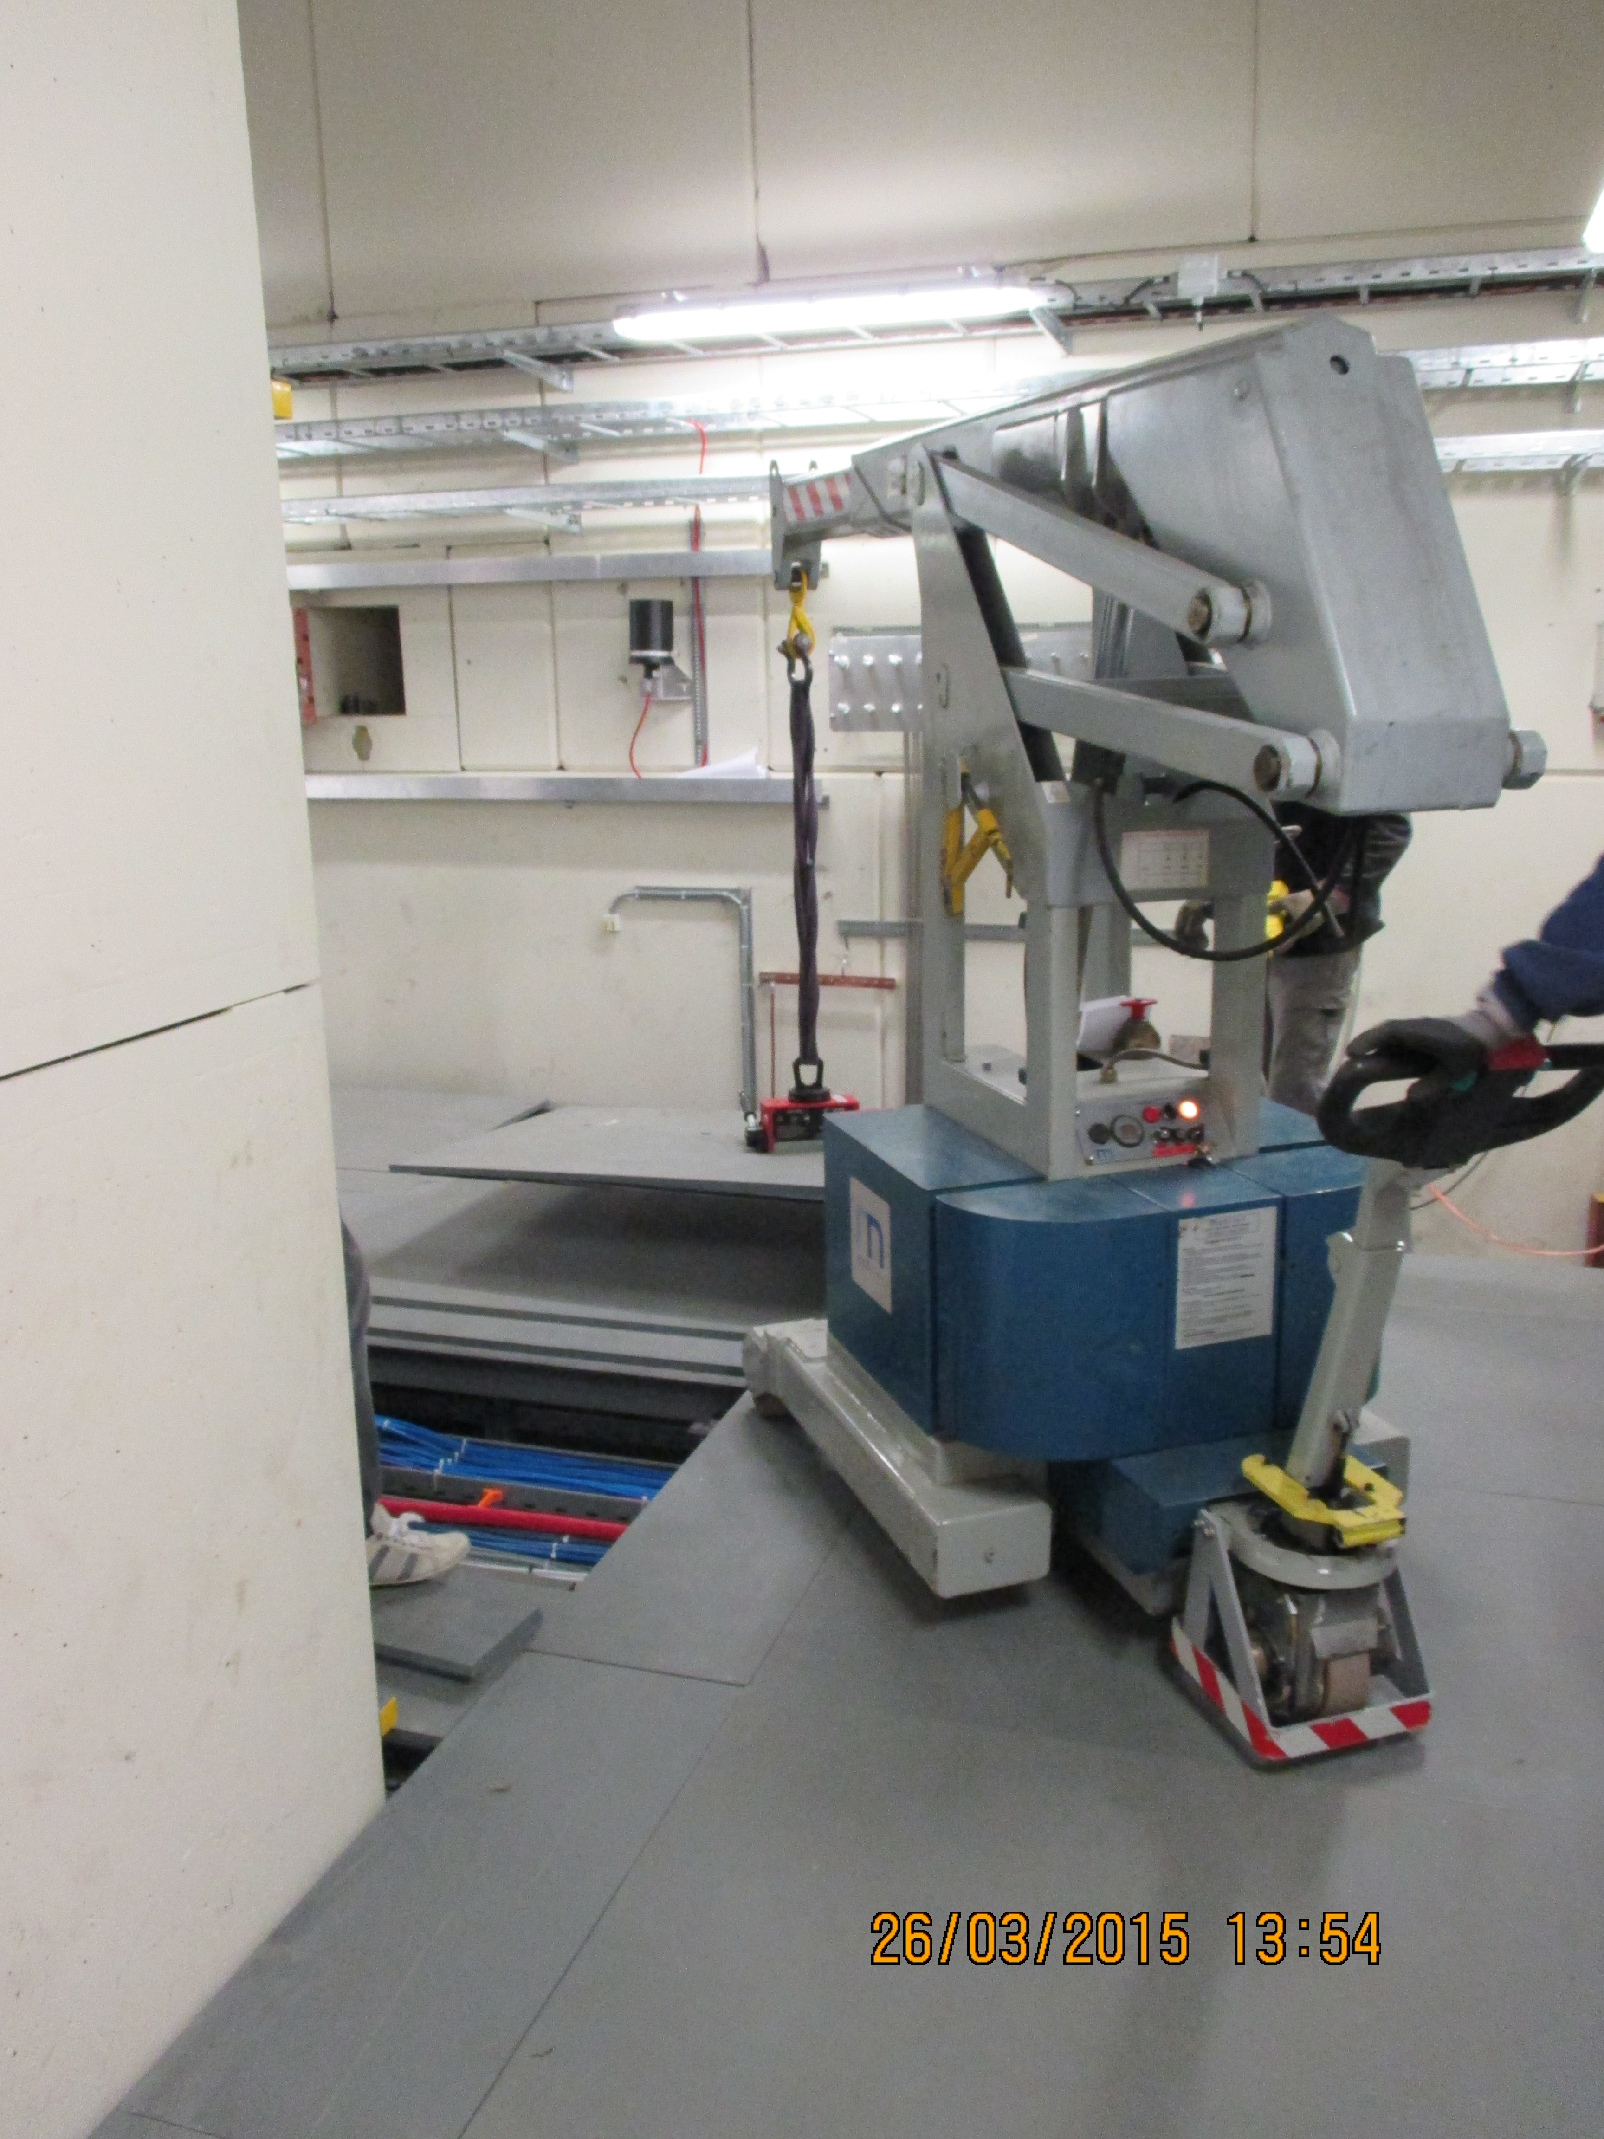
Cables gone from Down to Upstream under the floor

Slide 3
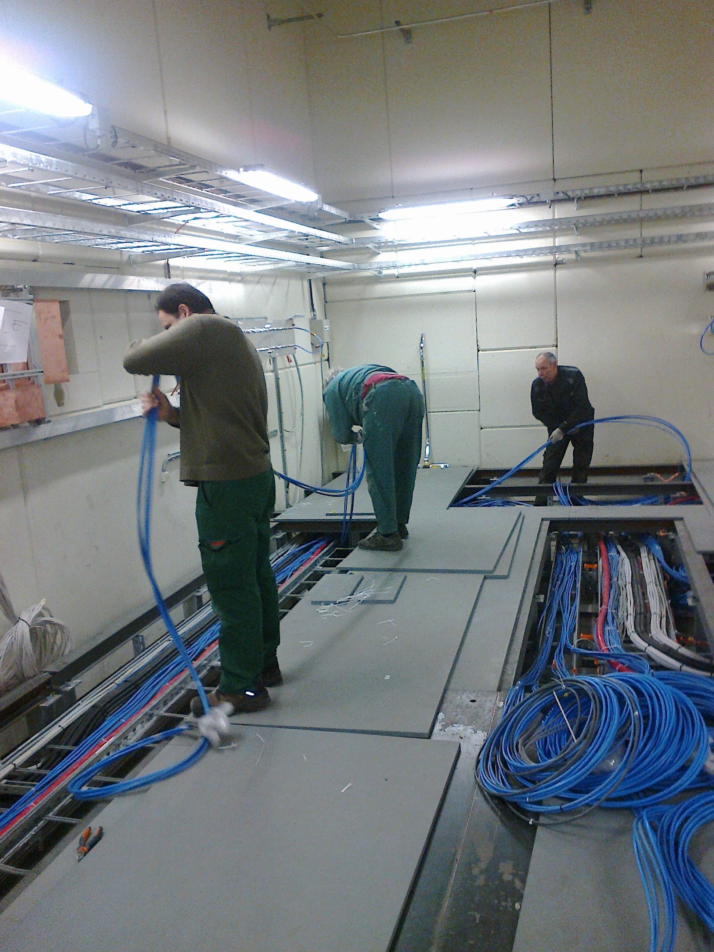
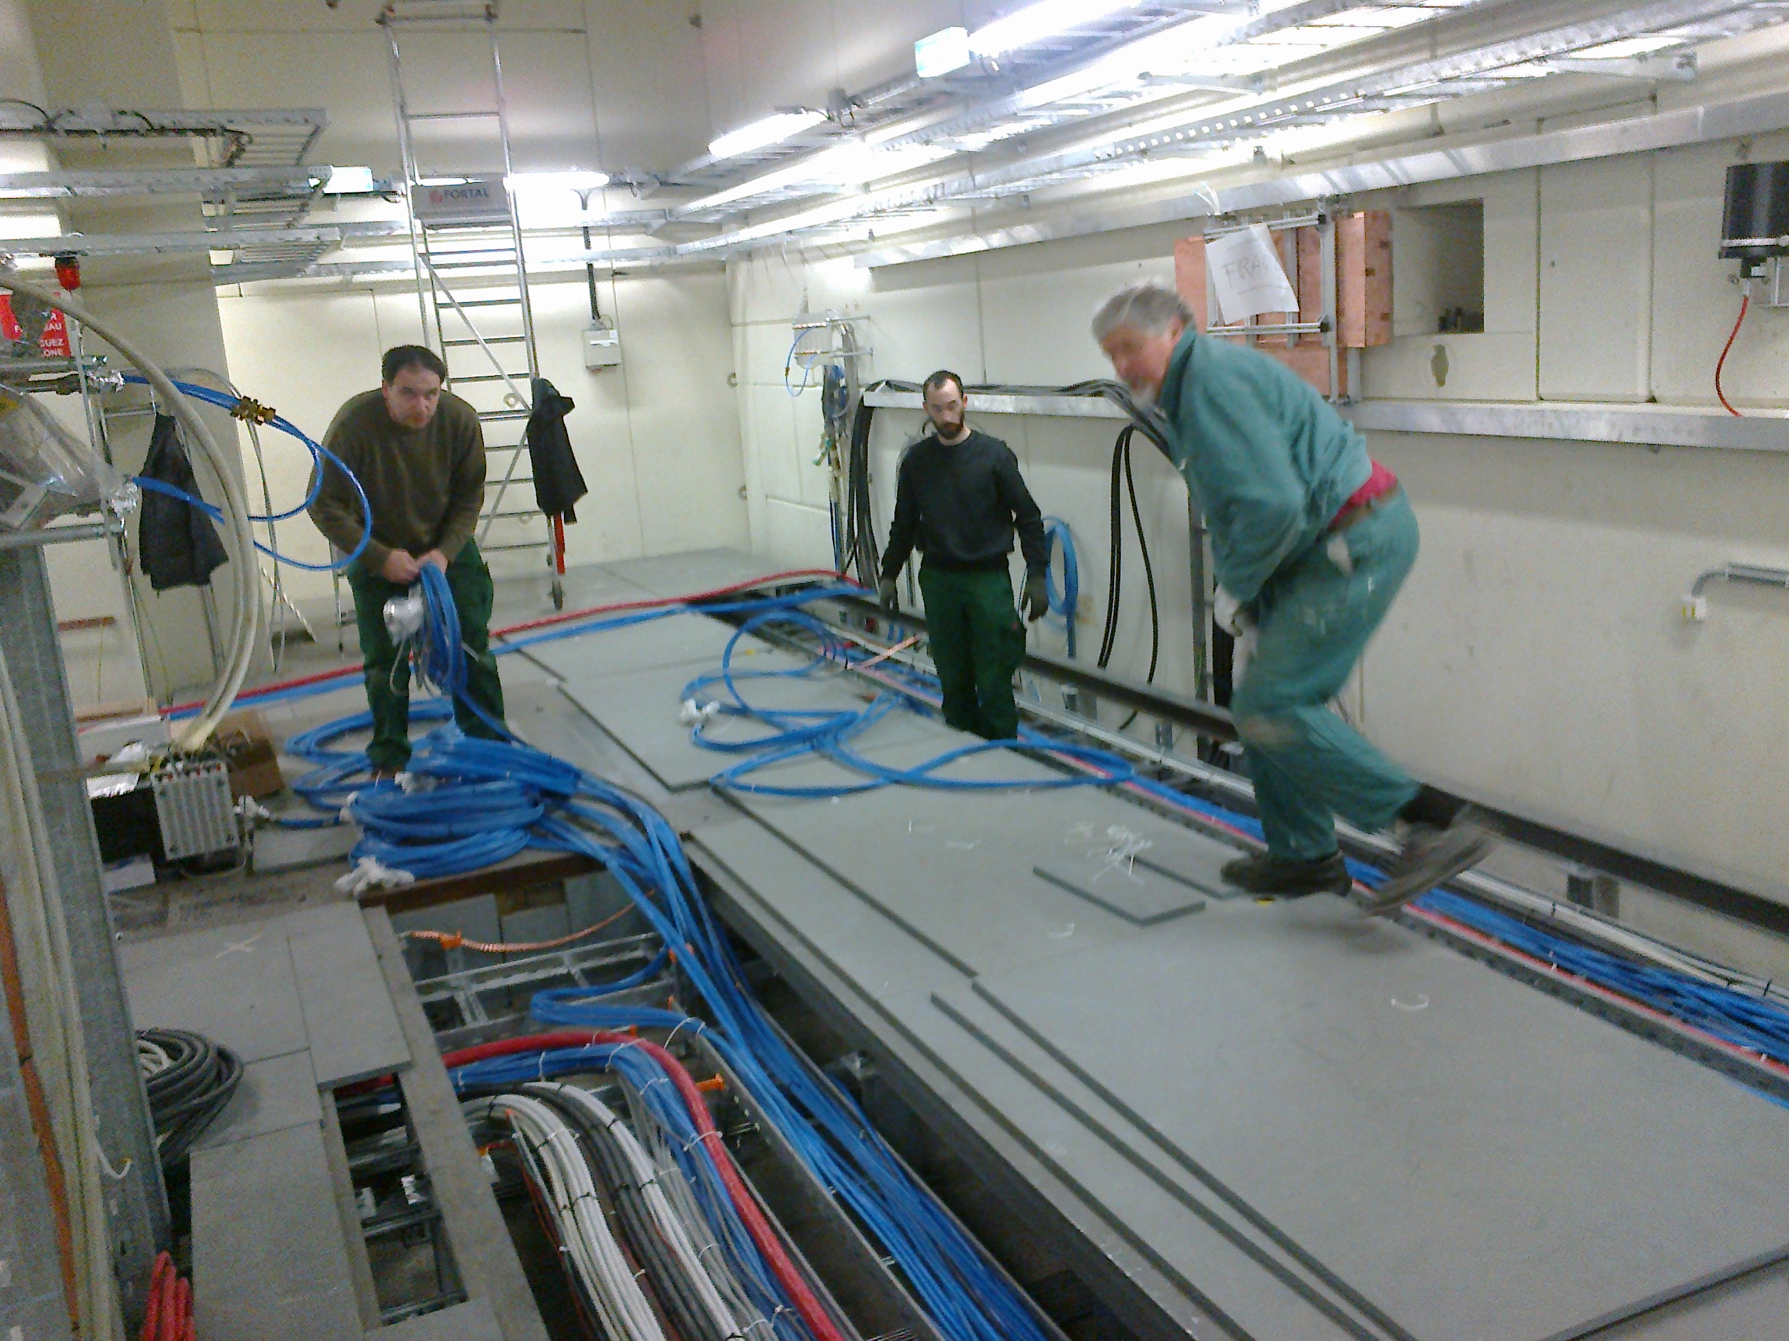
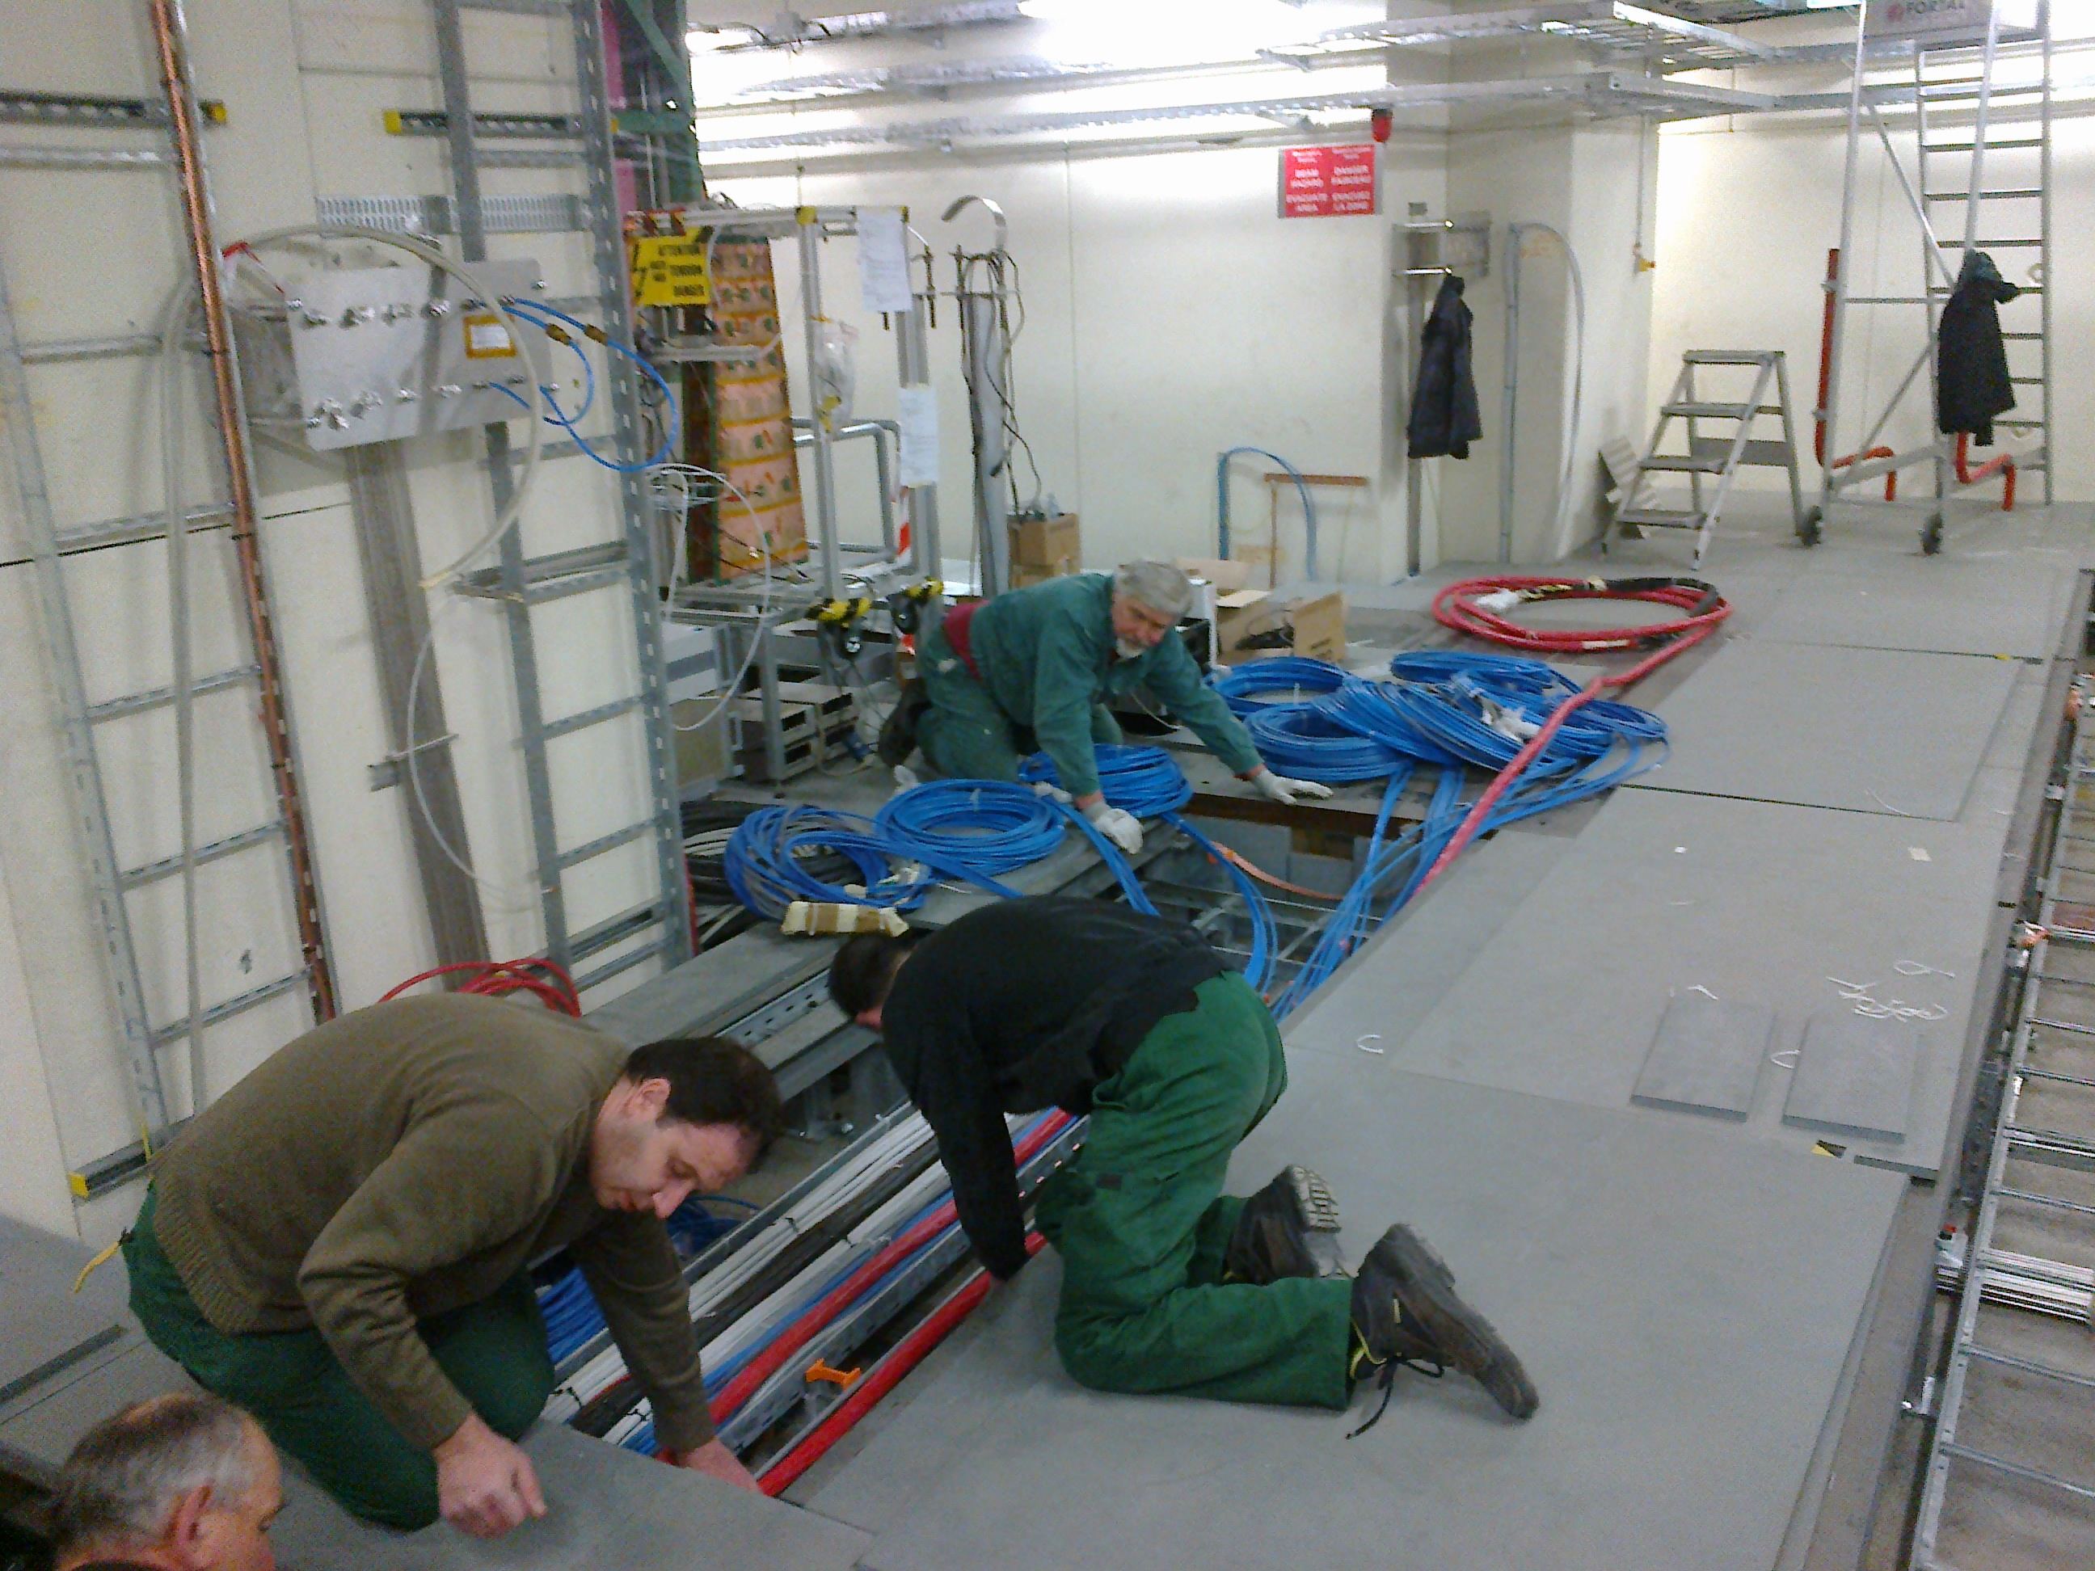

Slide 4
List of additional cables
Up-Stream
Cosmic hodoscope PMT HV(x4), Signal(4),
Current measurement (x4)
Scan Table LV Translation(x2), Monitoring(x2)
Down Stream, Umbil. HV, 2x LV, 2x? Signal, 1x DCS

Slide 5
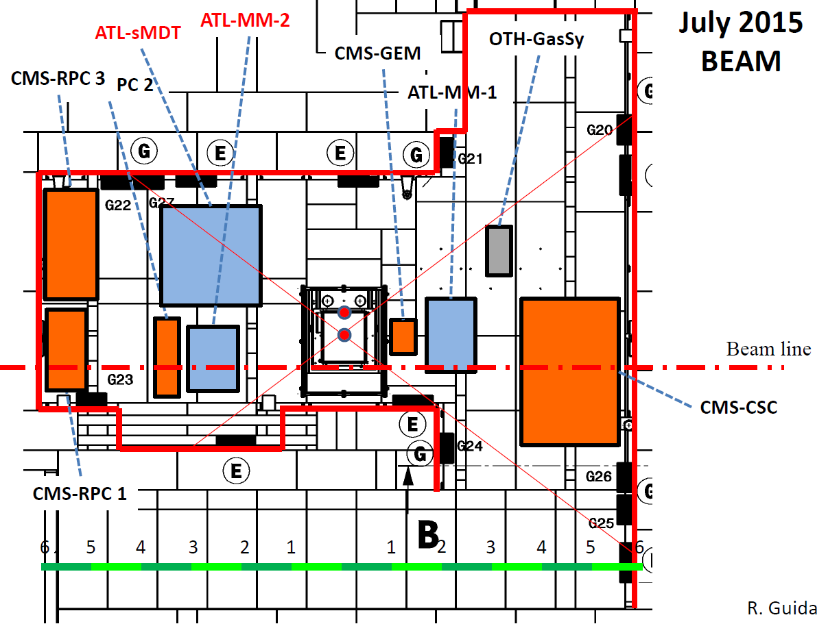
A typical layout for the GIF area
There will be little access to the floor panels under the experiments
However in the corridor area there should be no installations

Slide 6
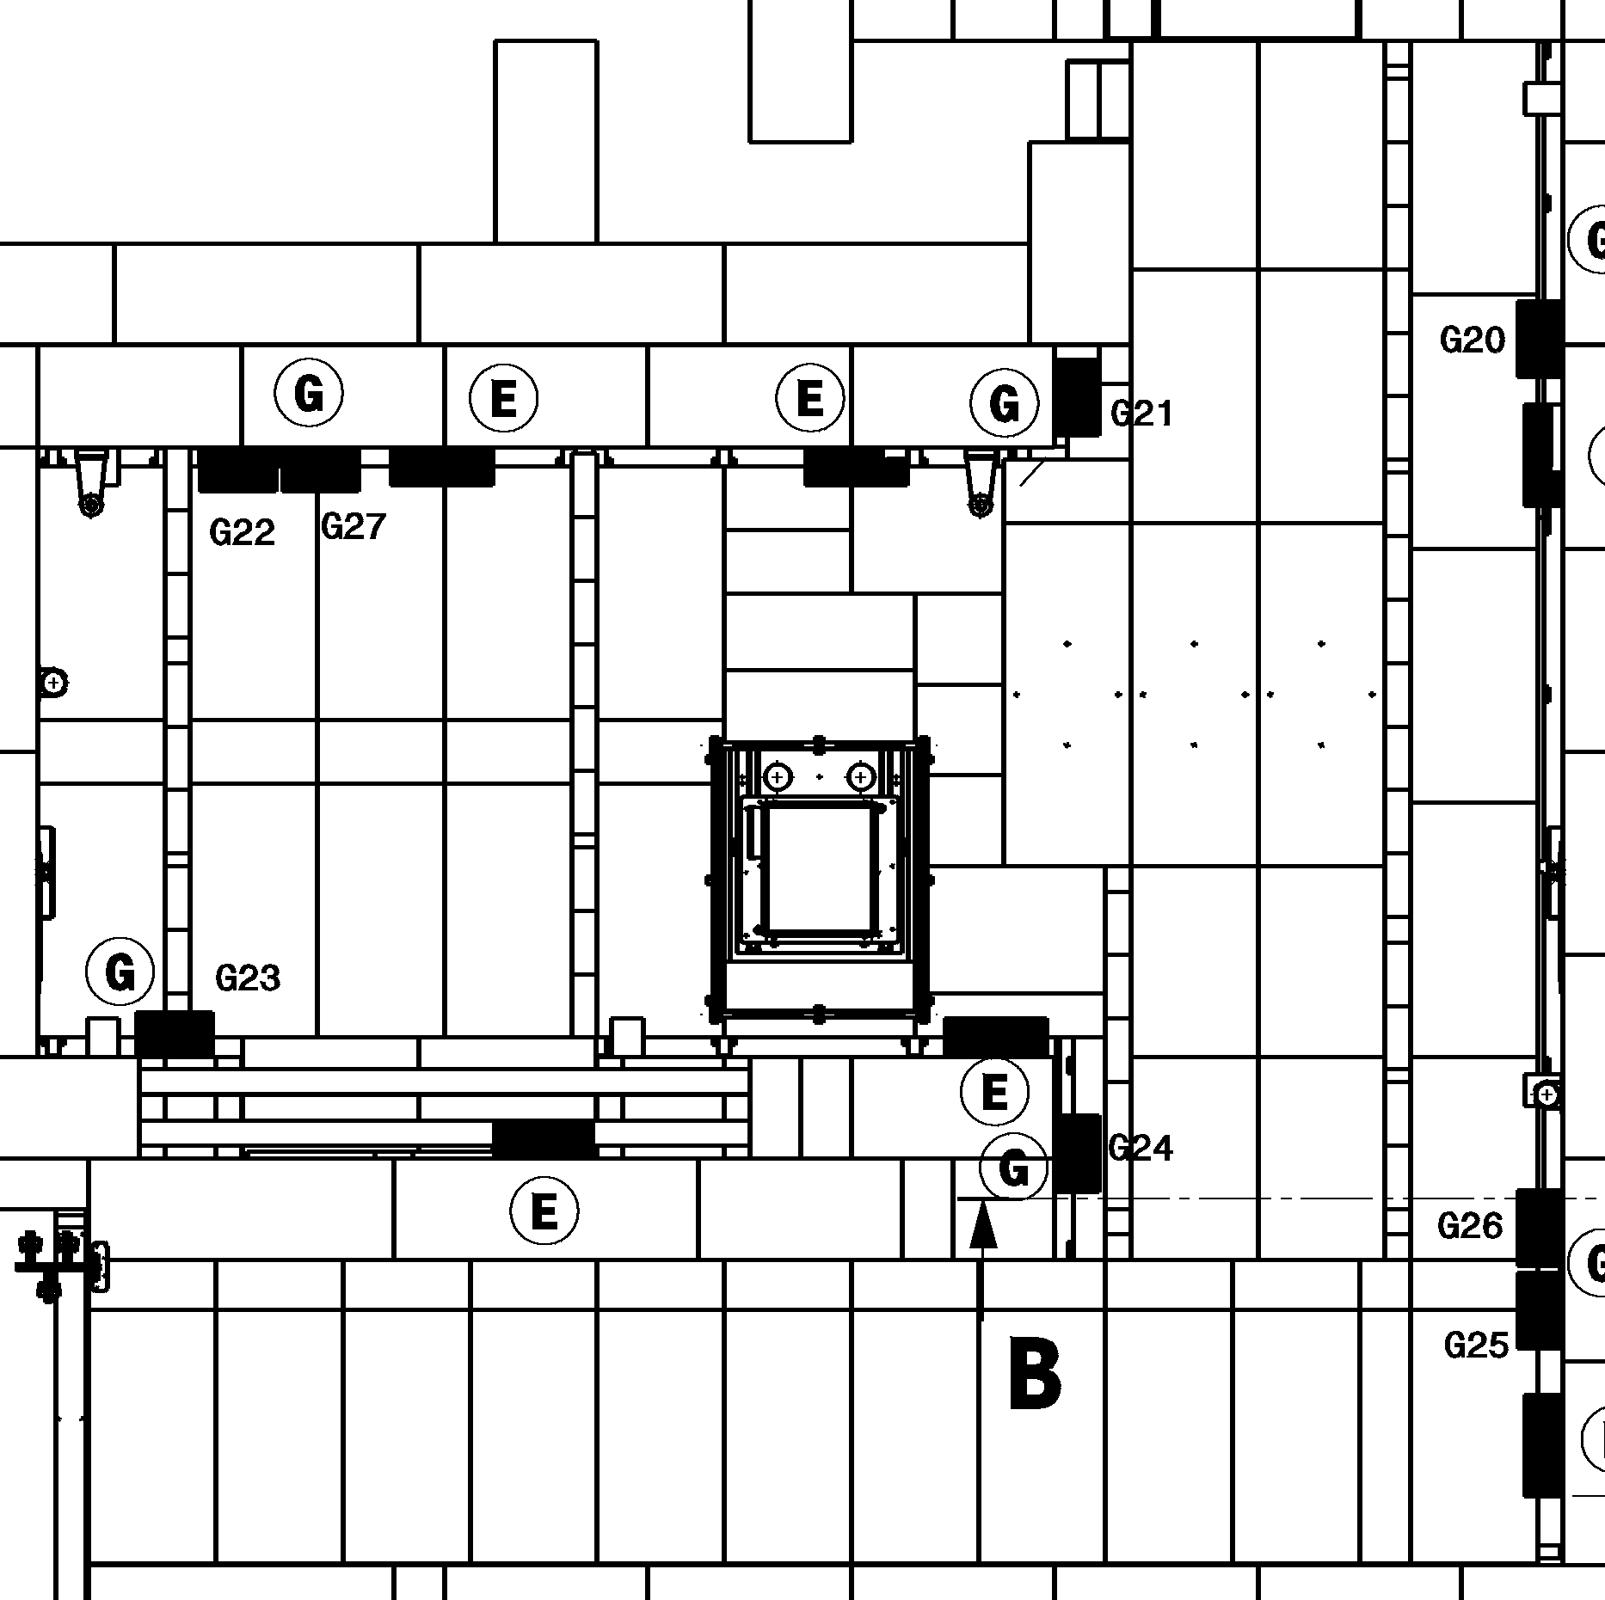
Down Stream cabling on the wall
Remove one floor panel only

Slide 7
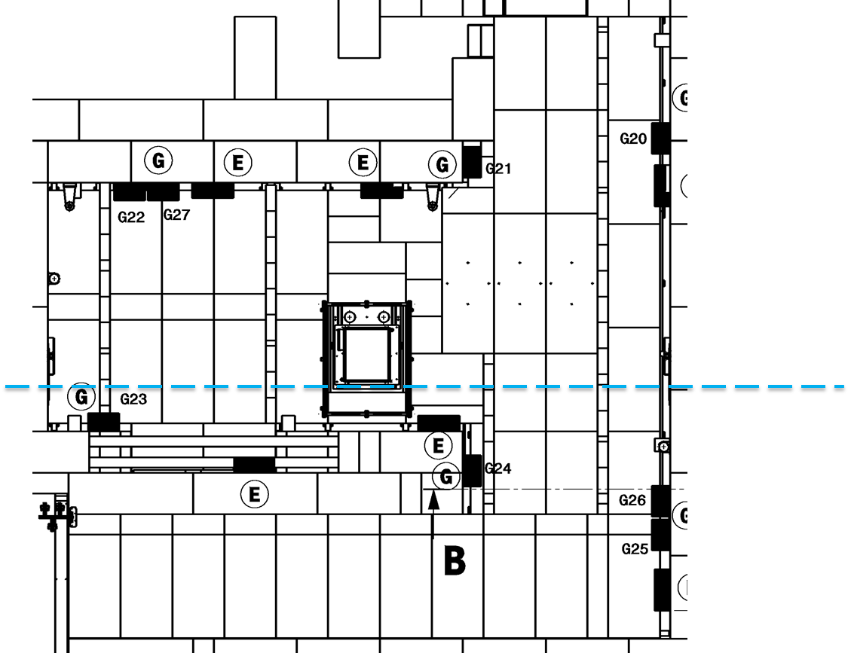
Cable up stream on the wall
Remove two floor panel only

Slide 8
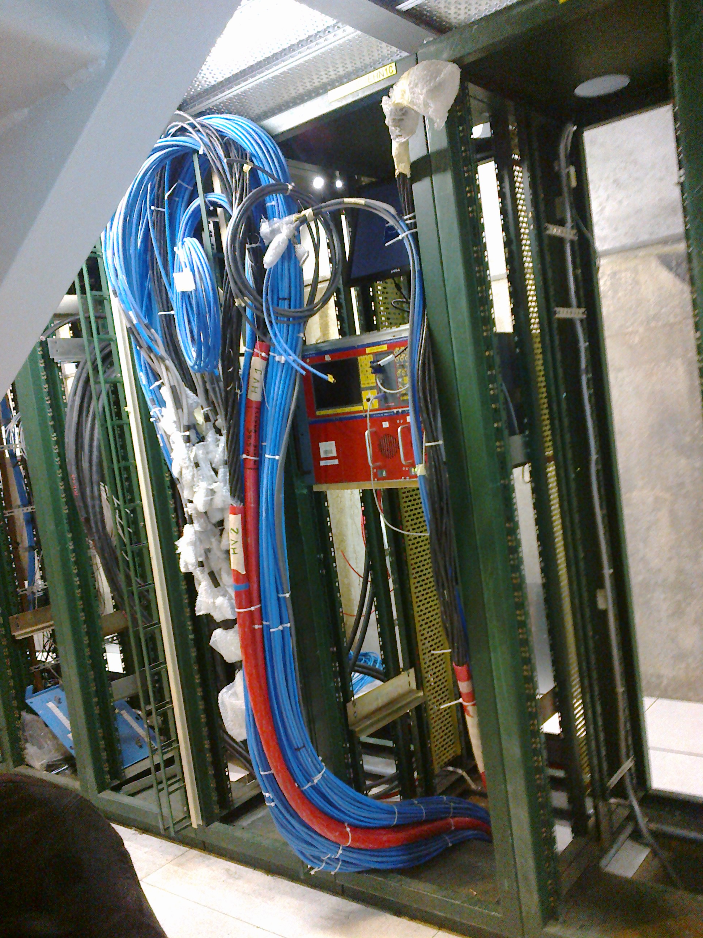
The basic cabling need connecting at the Rack end

Slide 9
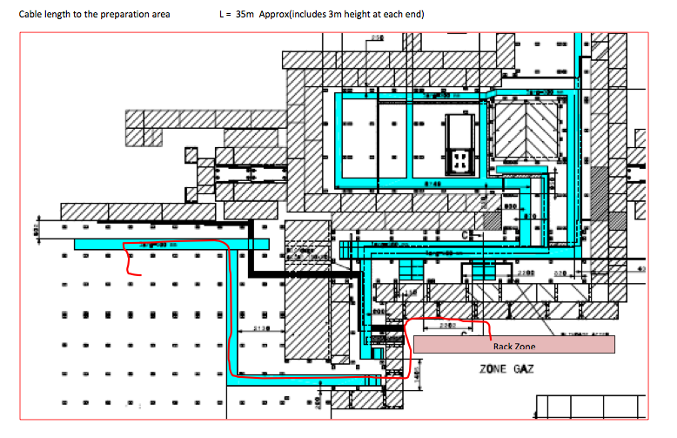
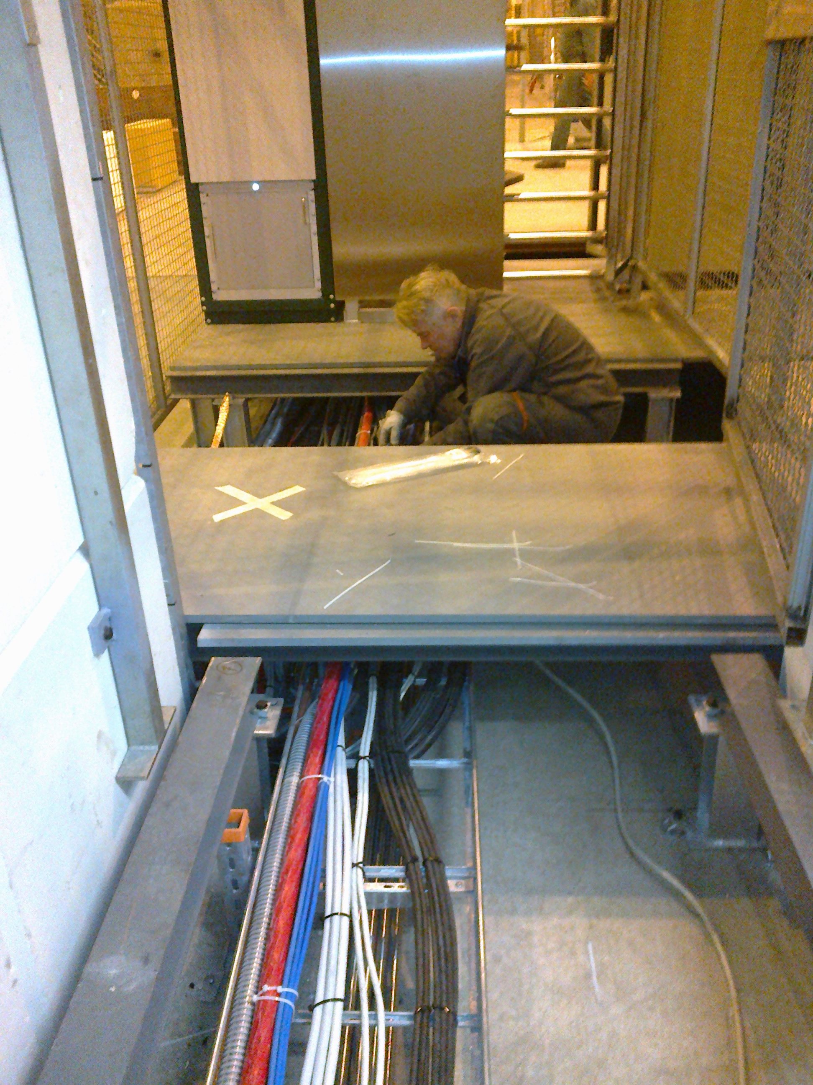
Additional cables in the Preparation zone is not yet possible
The floor has to be pulled up under the PAD, no access !

Slide 10
Conclusions
We can add additional cables in the down stream area rather easily.
In the upstream area it will be far more difficult as the cable trays are now high up on the wall requiring access devices.
We have to do the cabling in the rack area after the crates and modules are installed.
We need cabble trays in the Rack area going to the preparation zone, already pointed out to Nicolas Bourgeois.

