Slide 1
Services in GIF++
A pictorial record of the work
HV Cables
LV cables
DCS cables
Signal Cables
Ian Crotty 17 Dec 2014

Slide 2
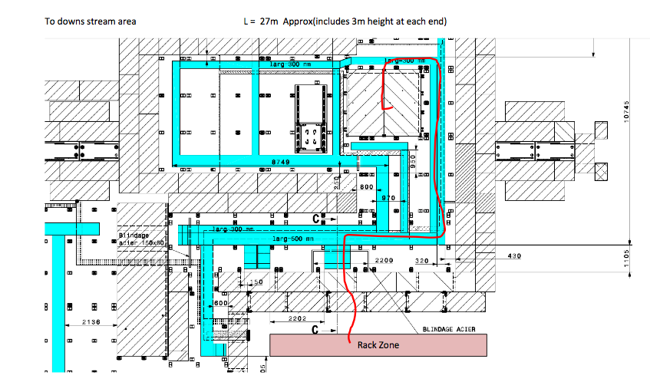
Down stream Cabling
Accepted by GIF++ coordination
Cables coming up through hole in floor
Signal Cables (x38 , Ø10mm)
HV cables (x1, Ø40mm)
LV (x5, Ø10mm)
I2C (x1, Ø10mm)

Slide 3
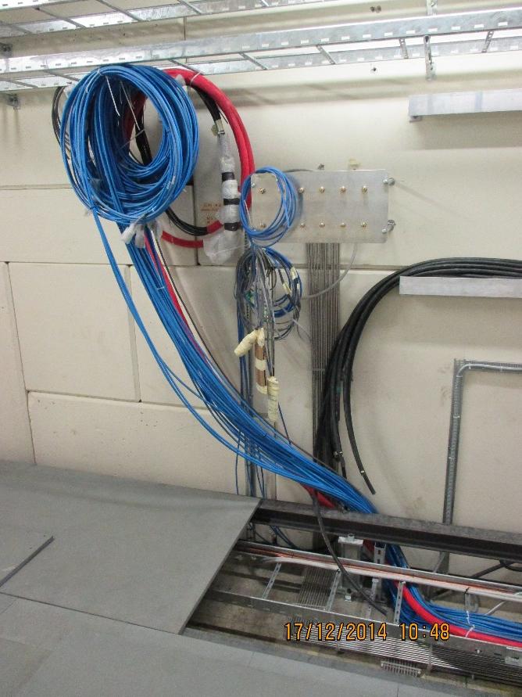
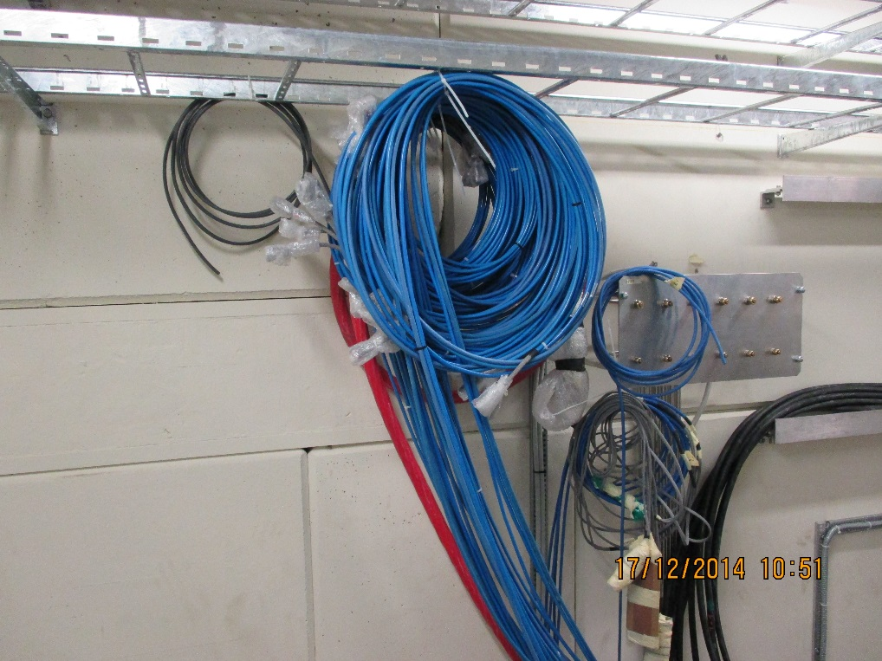
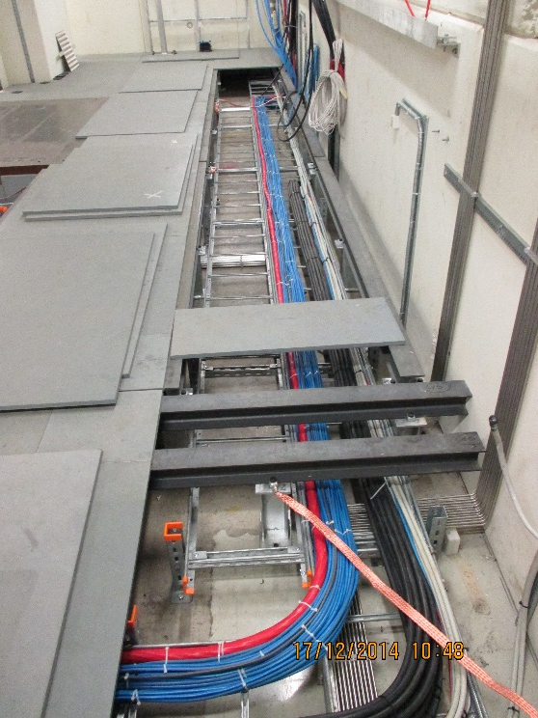
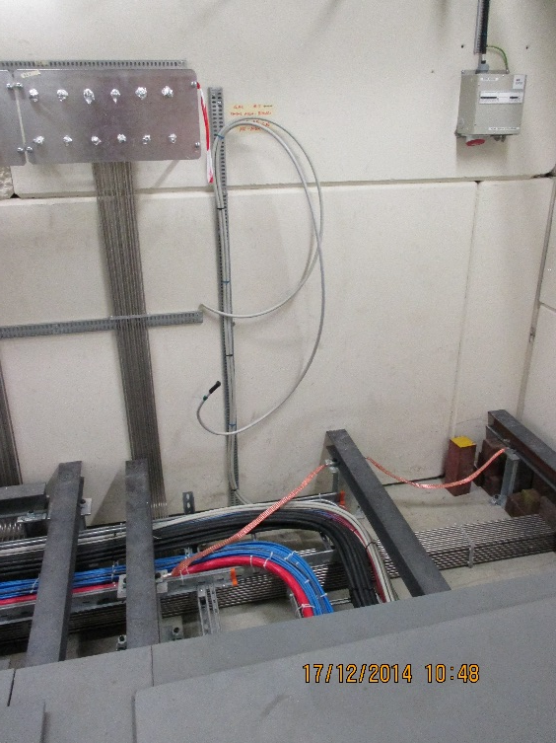
Down stream
Signal x 38
HV #1
DCS #1
LV 1

Slide 4
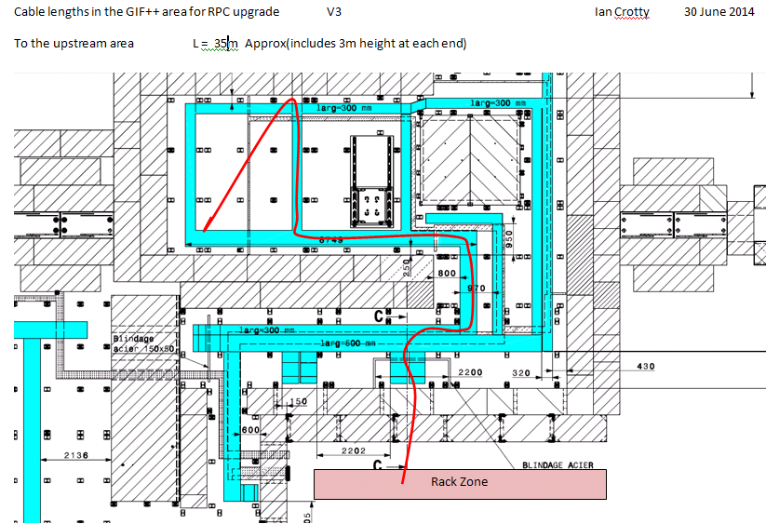
Up stream Cabling
Accepted by GIF++ coordination
Cables coming up through floor
Signal Cables (x30 , Ø10mm)
HV cables (x1, Ø40mm)
LV (x5, Ø10mm)
I2C (x1, Ø10mm)

Slide 5
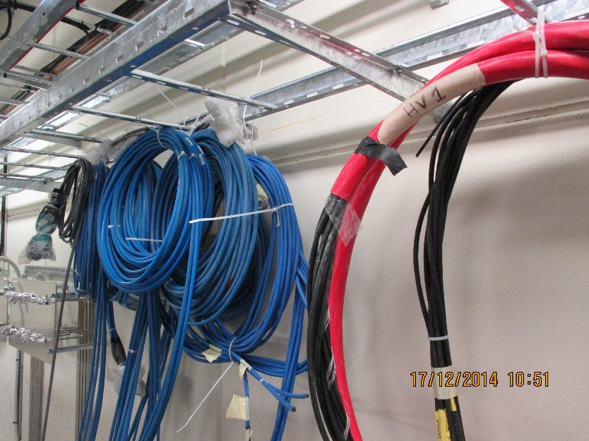
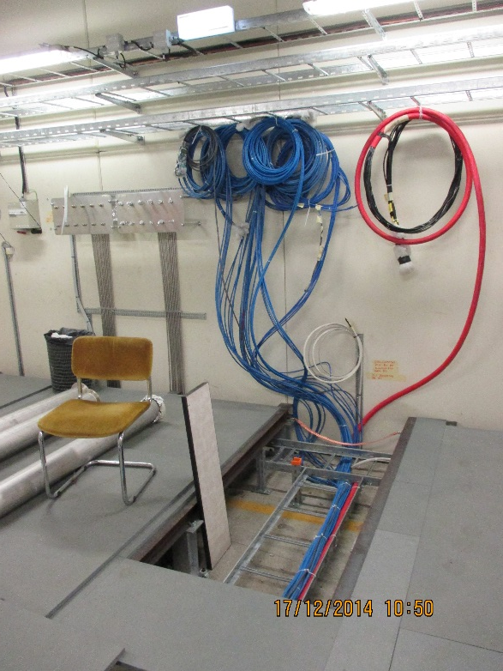
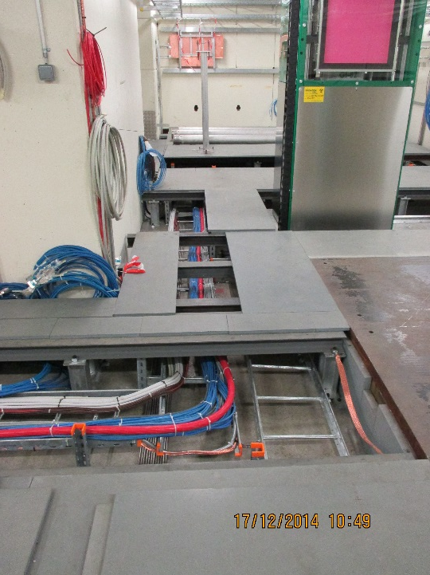
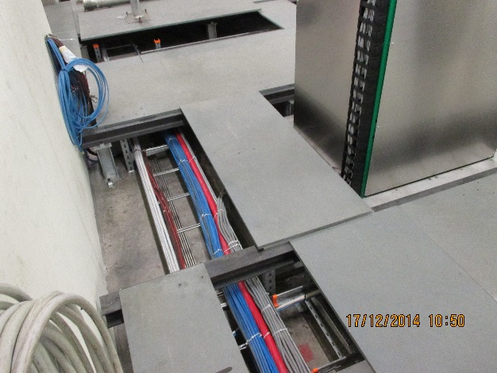
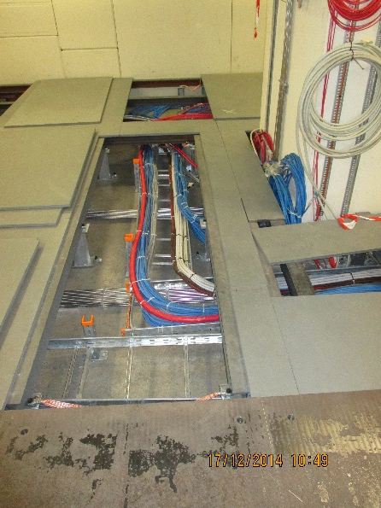
Up stream cabling
Signal x 30
HV #1
DCS #1
LV 1
Source
Upstream beam entry and TGC

Slide 6
Cable numbering & layout
Tables of cable destination are here;
http://rpc-cms-re4-upscope.web.cern.ch/rpc-cms-re4-upscope/RPC/GIFPlusPlus/Services/CablesDestinationsGIFPPDec2014.xlsx

Slide 7
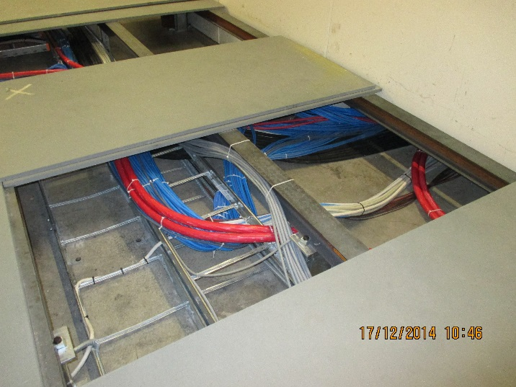
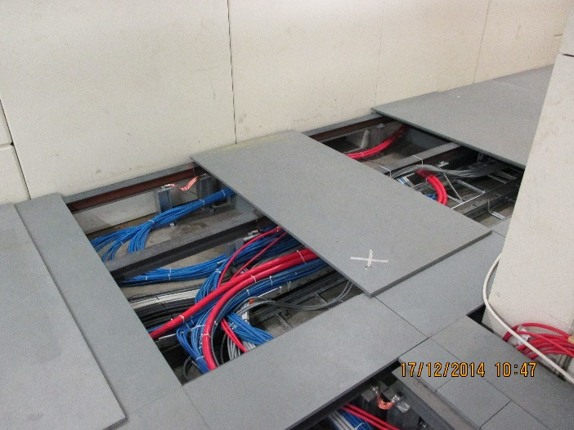
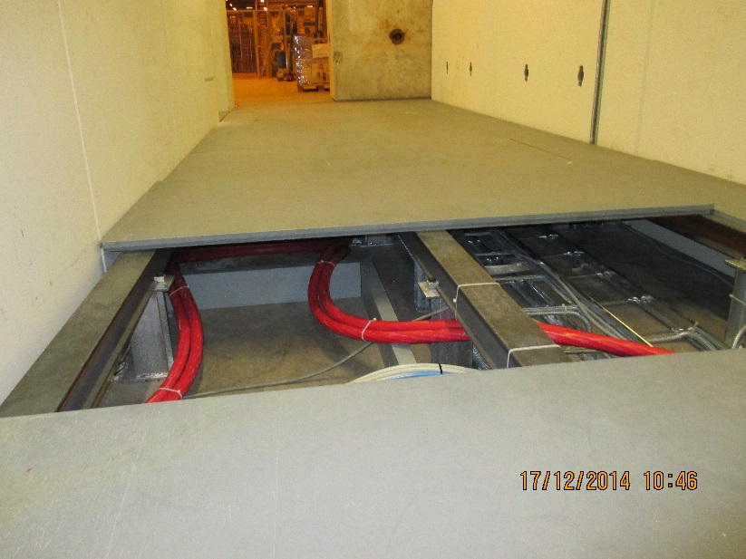
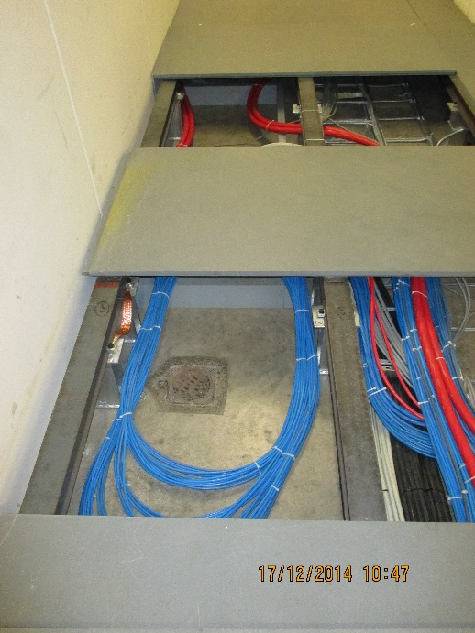
Routing under shielding wall and slack under GIF floor
Access to rack zone
HV slack
and signal slack to down stream

Slide 8
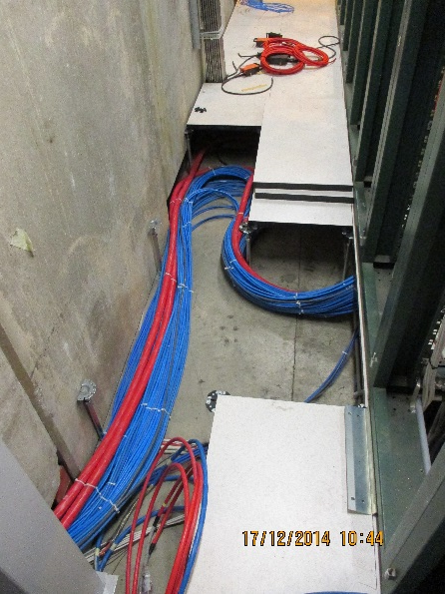
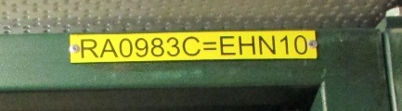
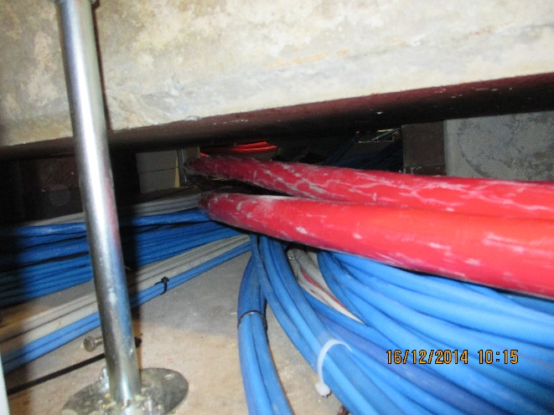
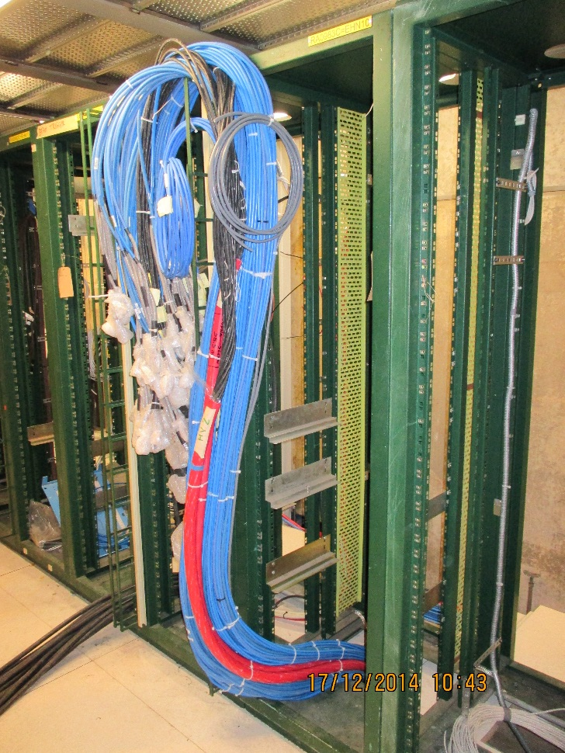
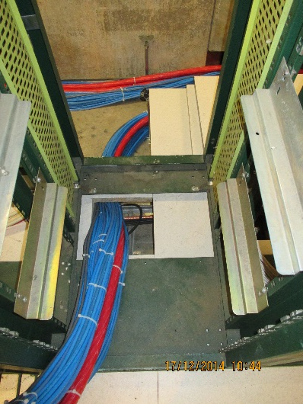
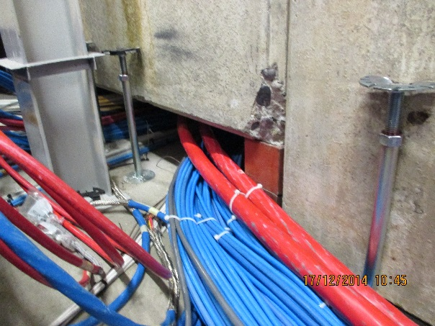
Rack side cabling and slack
Slack up against shield wall
Front of Rack
Access to GIF under shield wall
Passage thru rack floor

Slide 9
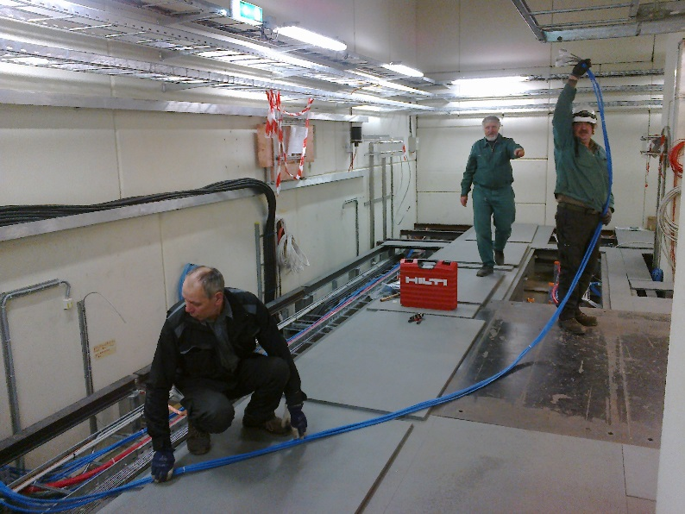
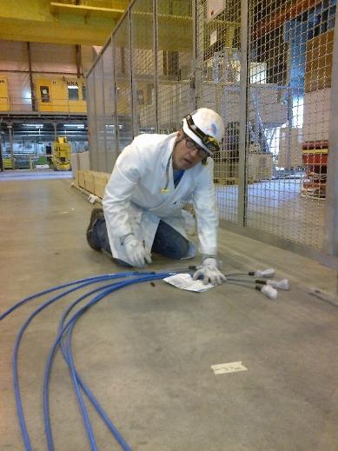
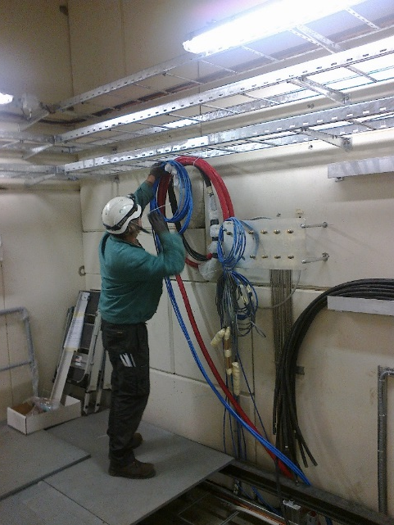
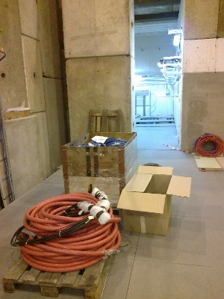
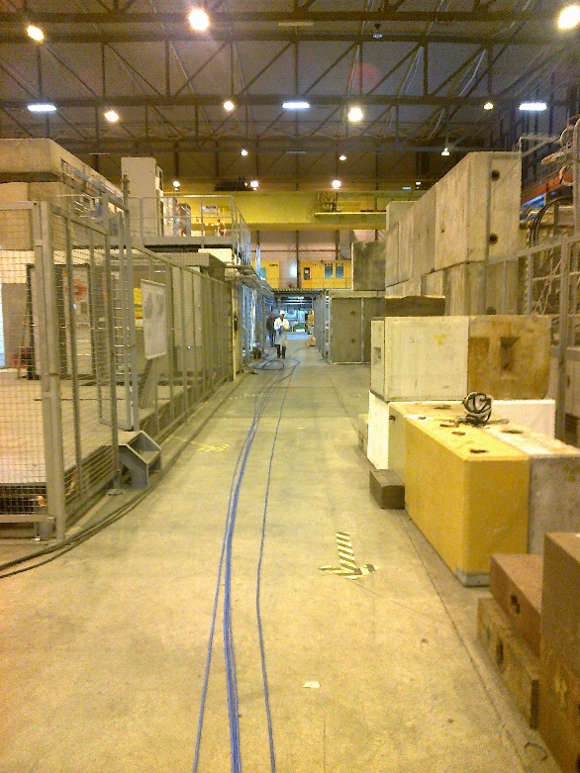
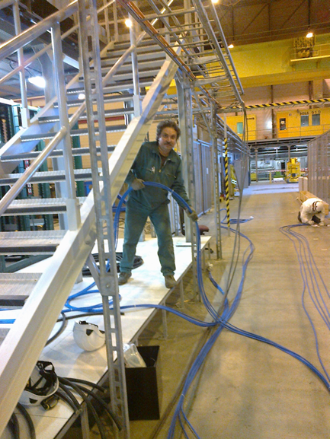
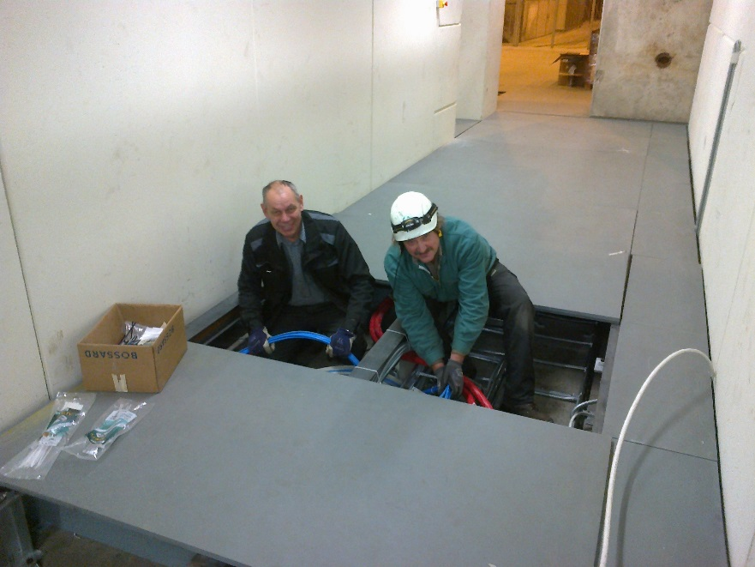
Our Russian collegeaues and Michele

Slide 10
Cabling done so far
HV, LV Signal and DCS(I2C) cables all laid from Rack to inside GIF++, Down Stream and Up Stream.
HV, Signal and 4 LV have been connectorised
The remaining LV & DCS have to be cut to length, connectors mounted and tested.
Signal cables are all labelled, see table.
LV, DCS and HV must be relabelled.
The cabling to the preparation zone has to be done, all cables are available but all need connectors except for the 2 signal.

Slide 11
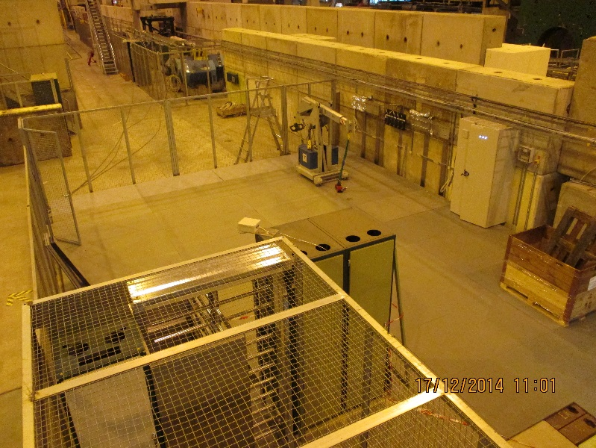
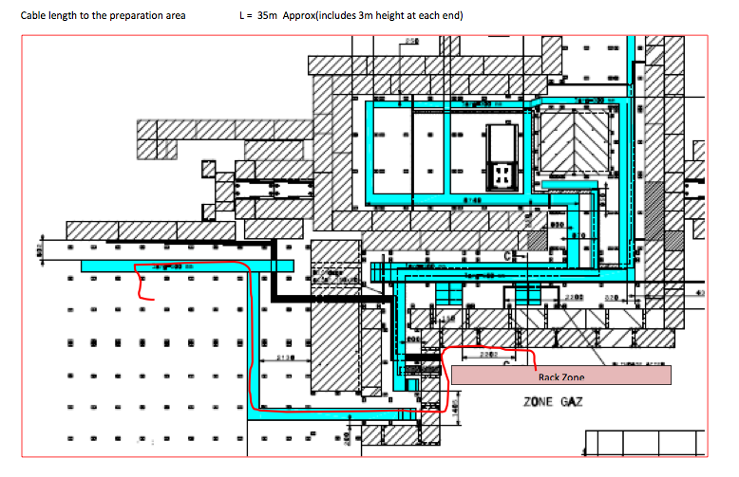
Preparation zone
Signal Cables (x2, Ø10mm)
HV cables (x1, Ø40mm)
LV (x1, Ø10mm)
I2C (x1, Ø10mm)

Slide 12
Man power & logistics required
The cabling was successful and rapid with 4 Russian cabling experts from P5, M. Franco, Silveriano and myself. The job was strenuous but rapid once the Russian cabling experts from P5 arrived.
The heavy 220kg floor panels have to be removed for the cabling In all 3 zones. These are removed with a mobile device inside the GIF++ making access difficult. Those outside may be done with the hall crane. This has to be coordinated with the crane people. “IMPACT” and EDH documents are necessary.
All colleagues need Helmets, safety shoes and dosimeter.

Slide 13
This presentation is available here;
More photos
http://rpc-cms-re4-upscope.web.cern.ch/rpc-cms-re4-upscope/RPC/GIFPlusPlus/Services/PartialCabling11to16Dec2014GIFPlusPlus.pptx
http://rpc-cms-re4-upscope.web.cern.ch/rpc-cms-re4-upscope/RPC/GIFPlusPlus/Services/PhotosCableLay11to16Dec2014/

