Slide 1
GIF ++ ambient condition
The Prep. area outside
Tent and its gradient
CSC area
Geneva meteo station
Ian Crotty 6 Oct 2015

Slide 2
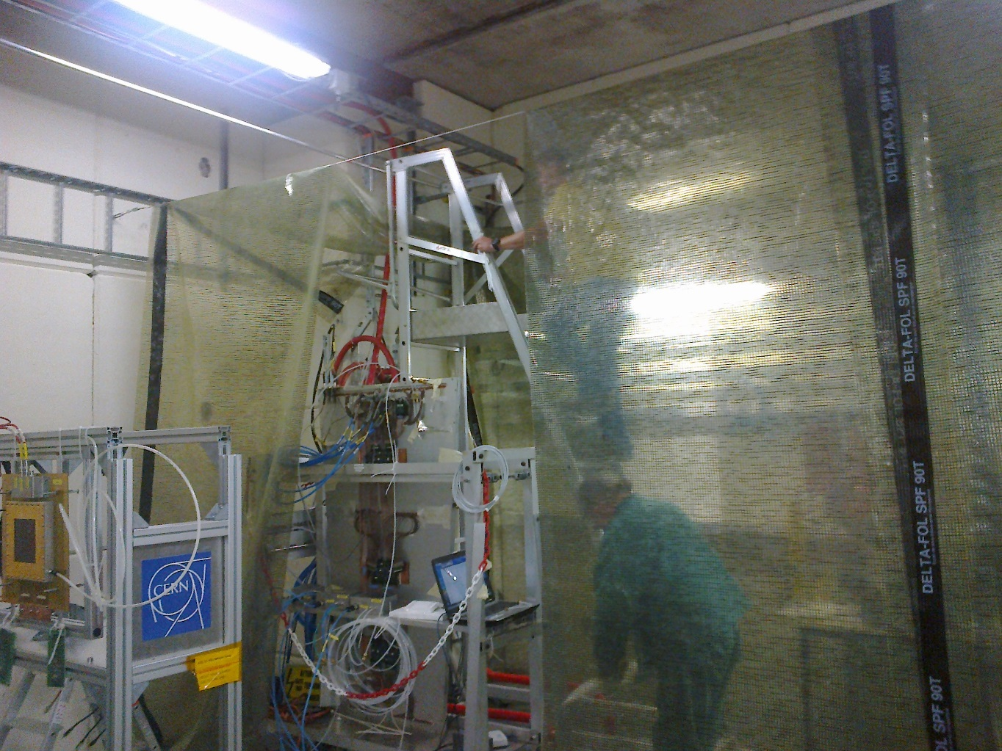
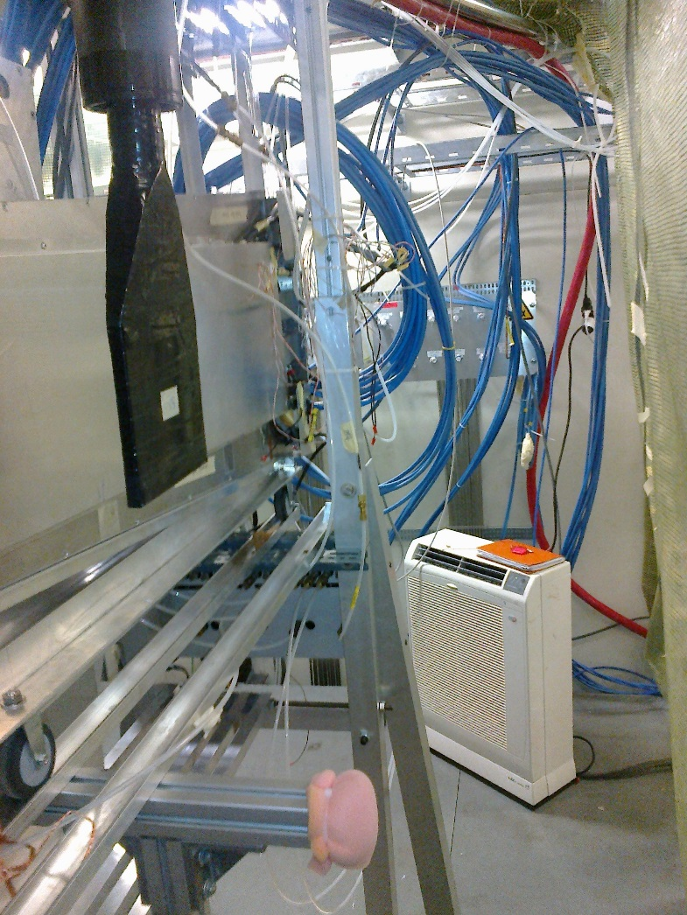
Tent
Inside with x2 AC units
Building a tunnel across the width of the GIF++ Upstream

Slide 3
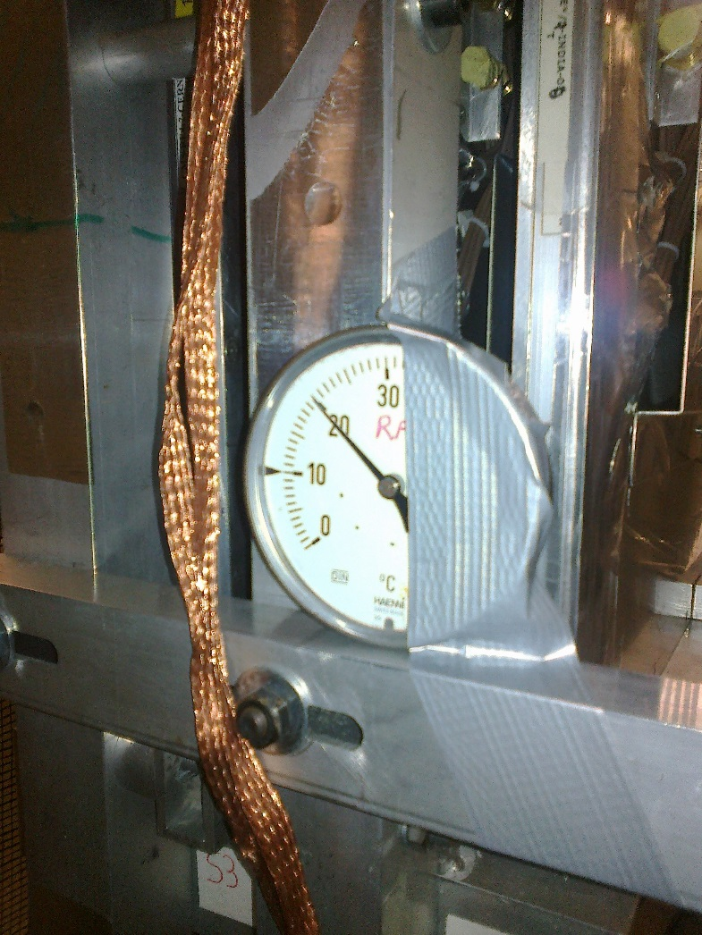
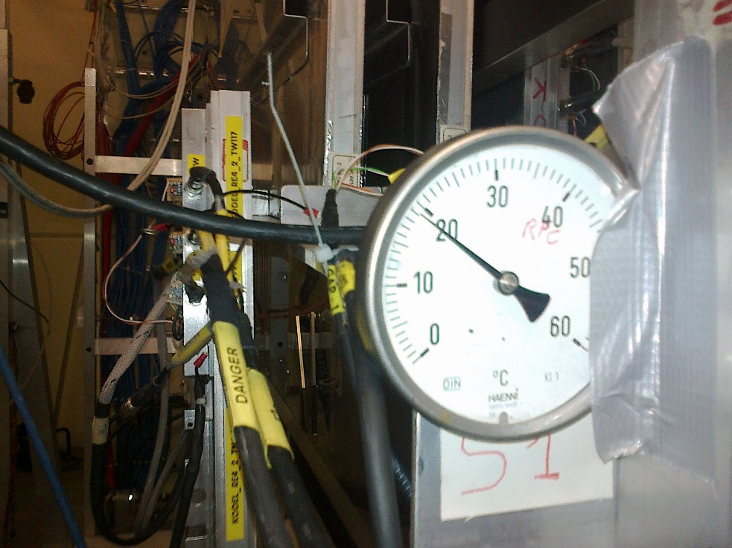
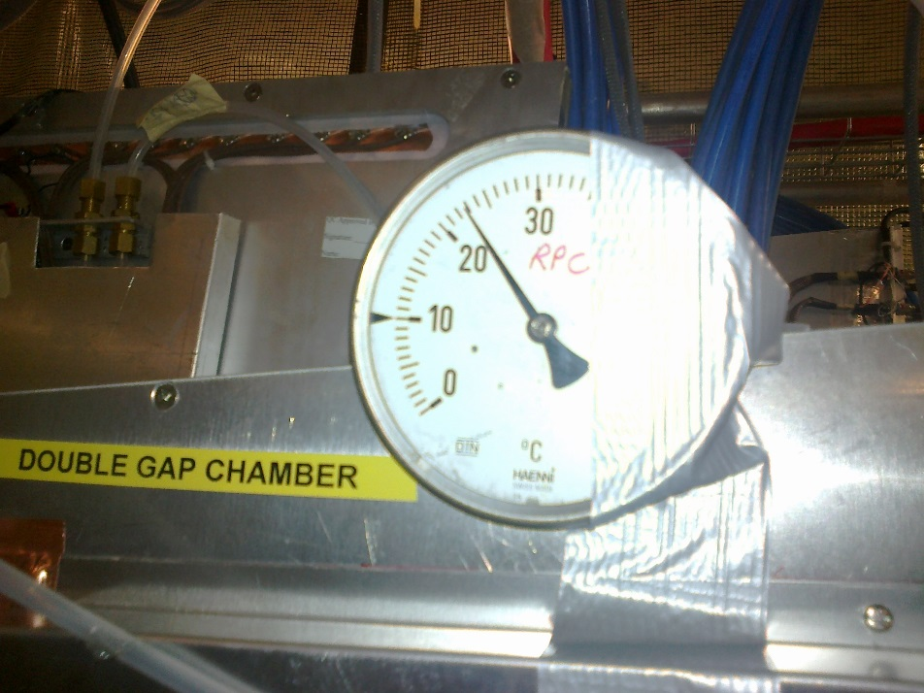
Analogue gauges (rad hard)
Gauges calibrated and checked to within ± 0.3degC
Saleve T1
T1 Jura in front of AC
Front Korea T0/3

Slide 4
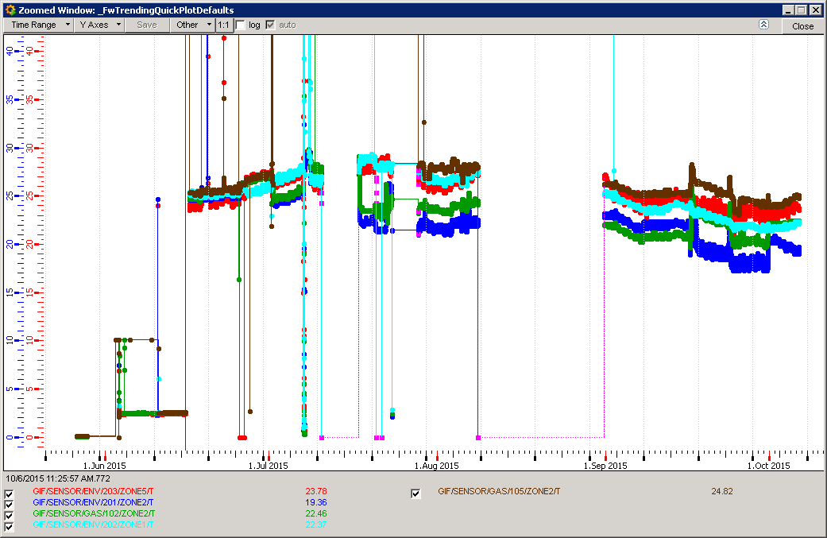
In the beginning
Unstable data and high temps in July August 2015

Slide 5
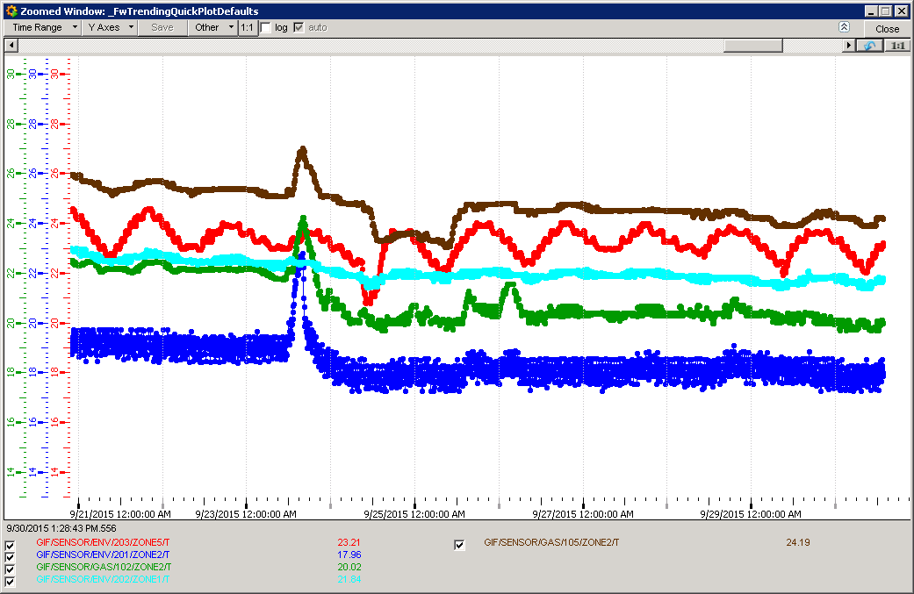
Temperatures 21 -30 Sept 2015
Access Wednesday 23 sept 2015
105 Supply RPC gas
203 Prep area
202 CSC env
102 Return RPC gas
201 RPC tent
Stable tent temp !

Slide 6
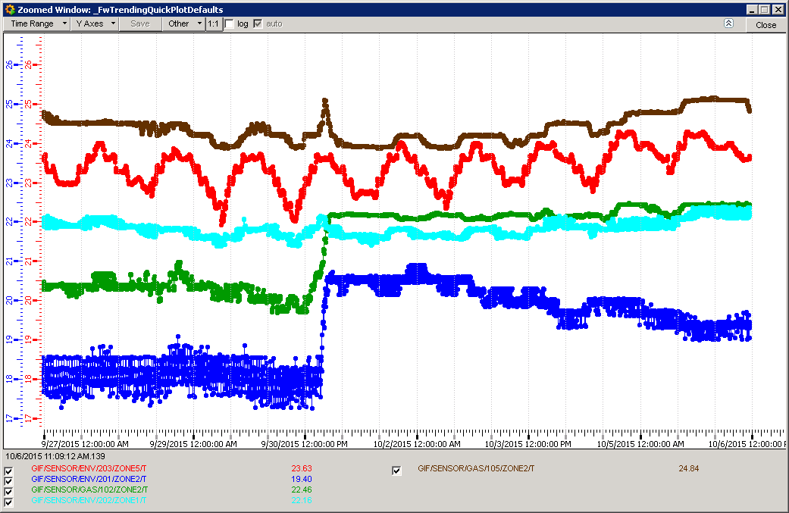
Supply RPC Gas Temp
Prep. Area Temp
CSC Temp
Return RPC Gas Temp
RPC Temp
The gas return temperature follows the indicated Tent temp ?
Set point change 16-18degC

Slide 7
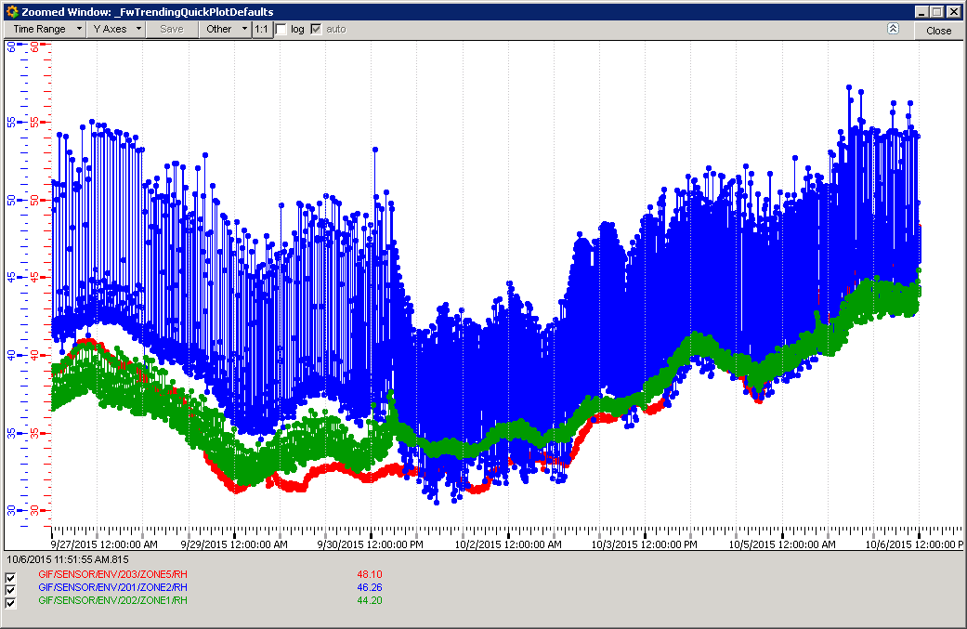
Humidity RH%
10 days
201 RPC tent
102 Return RPC gas
203 Prep area

Slide 8
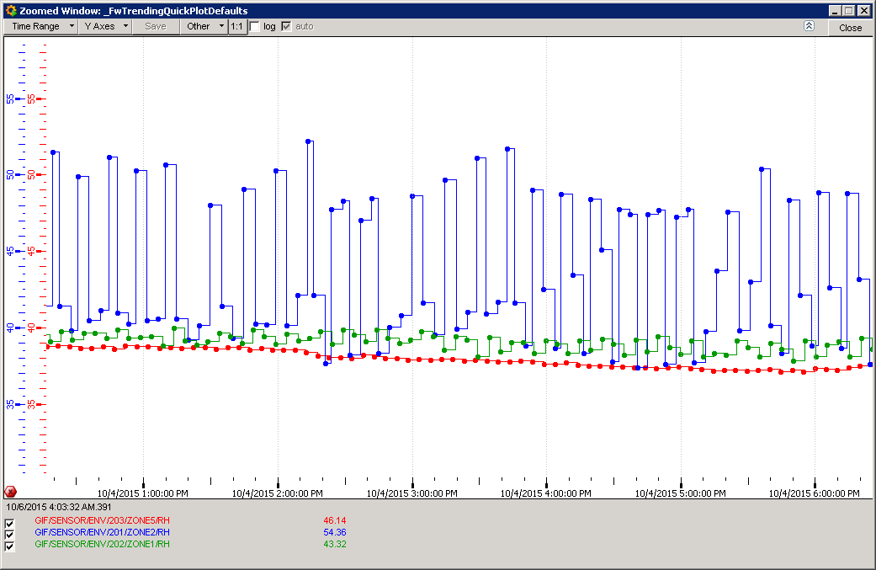
Humidity RH%
Structure is perhaps due to the AC cycle 10-20mins

Slide 9
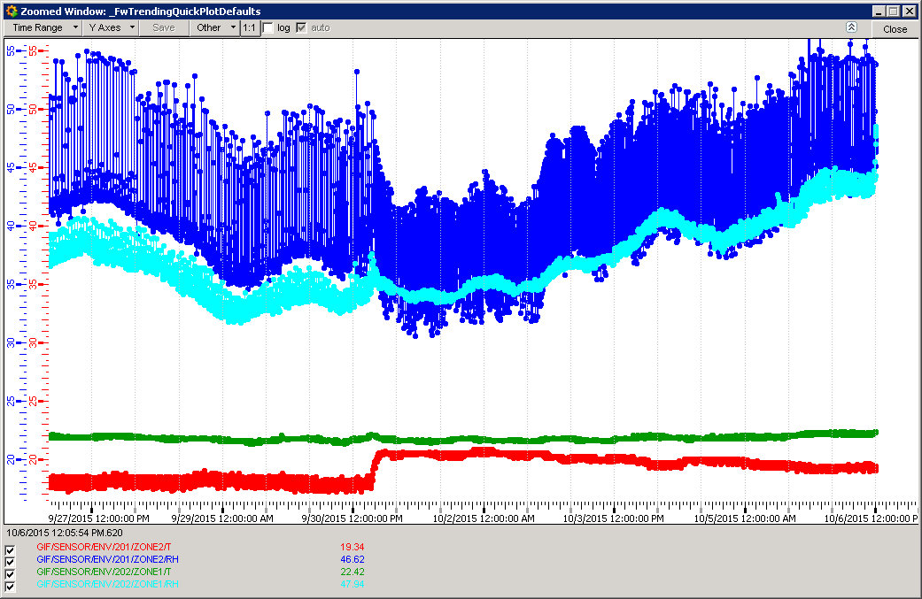
Temp & RH in Tent & CSC
10 days
201 RPC Humidity
202 CSC Humidity
Set point change from 16deg C to 18degC and both AC on, one was off on Saleve side.
202 CSC temp.
201 RPC tent

Slide 10
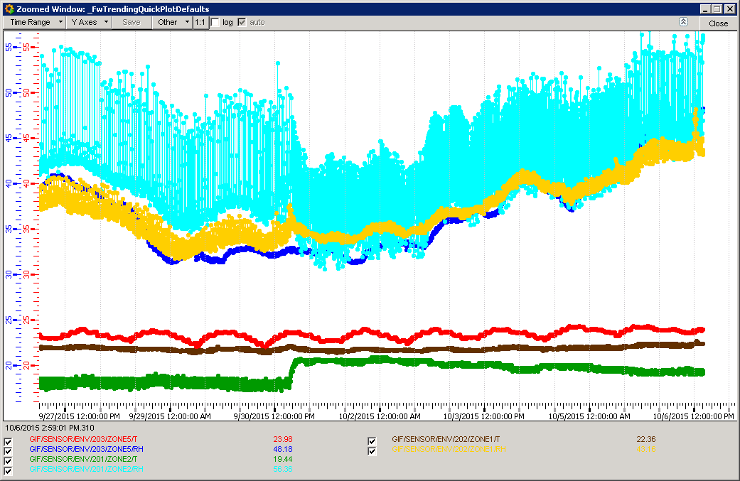
Temp,RH & RH in Tent & CSC
201 Prep Area RH
203 Prep Area RH
10 days
203 Prep Area RH
203 Prep Area Temp
202 Prep Area Temp
201 RPC Temp

Slide 11
Conclusion
4 deg temperature gradient in the tent perhaps mostly vertical as the fans are weak. To be investigated, both inside and outside, and mitigated if confirmed.
RH values are approx. 35 – 50%
Stable 20degC values with less than 0.5degC gradient within the tent are NOT yet achieved.
RPC area is indicated as 3-4 degC less than the CSC zone.
The RPC tent is stable (±0.5) up to set point change, slow response.
Gas supply temp is higher (2degC) than Prep Area, perhaps as the gas rack are higher up.
Gas return is higher than recorded tent temp. due to gradient in height.
Gas return temperature takes the chamber temperature, to be verified.

