Slide 1
Additional cables GIF ++
Ian Crotty

Slide 2
List of cables
Cosmic hodoscope PMT HV(x4), Signal(4),
Current measurement (x4)
Scan Table LV Translation(x2), Monitoring(x2)
Down Stream, Umbil. HV, 2x LV, 2x? Signal, 1x DCS

Slide 3
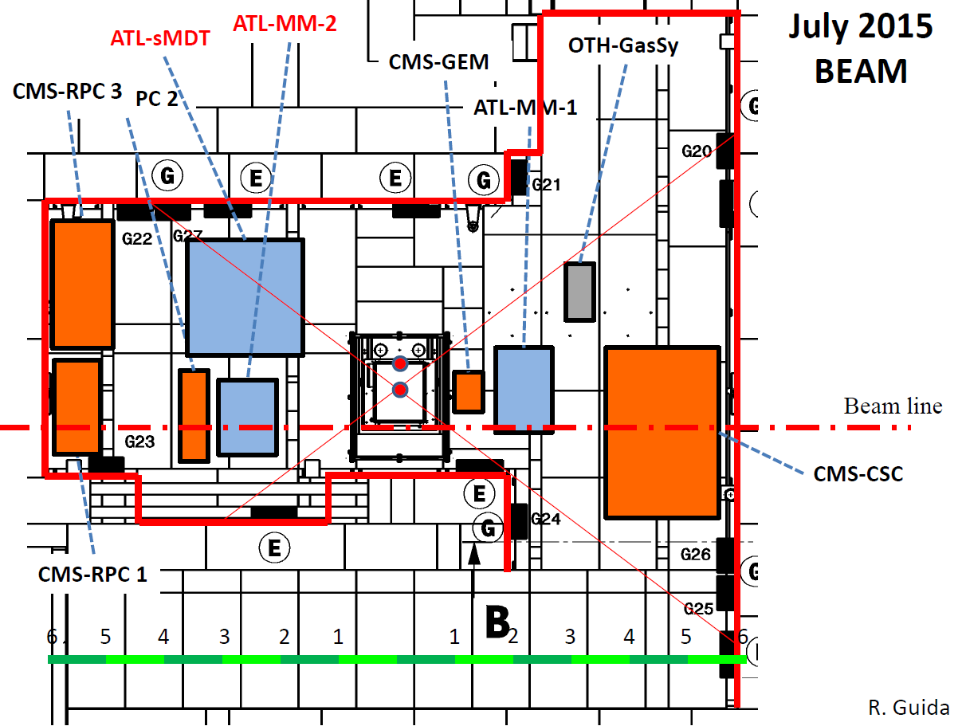
A typical lauyout for the GIF area

Slide 4
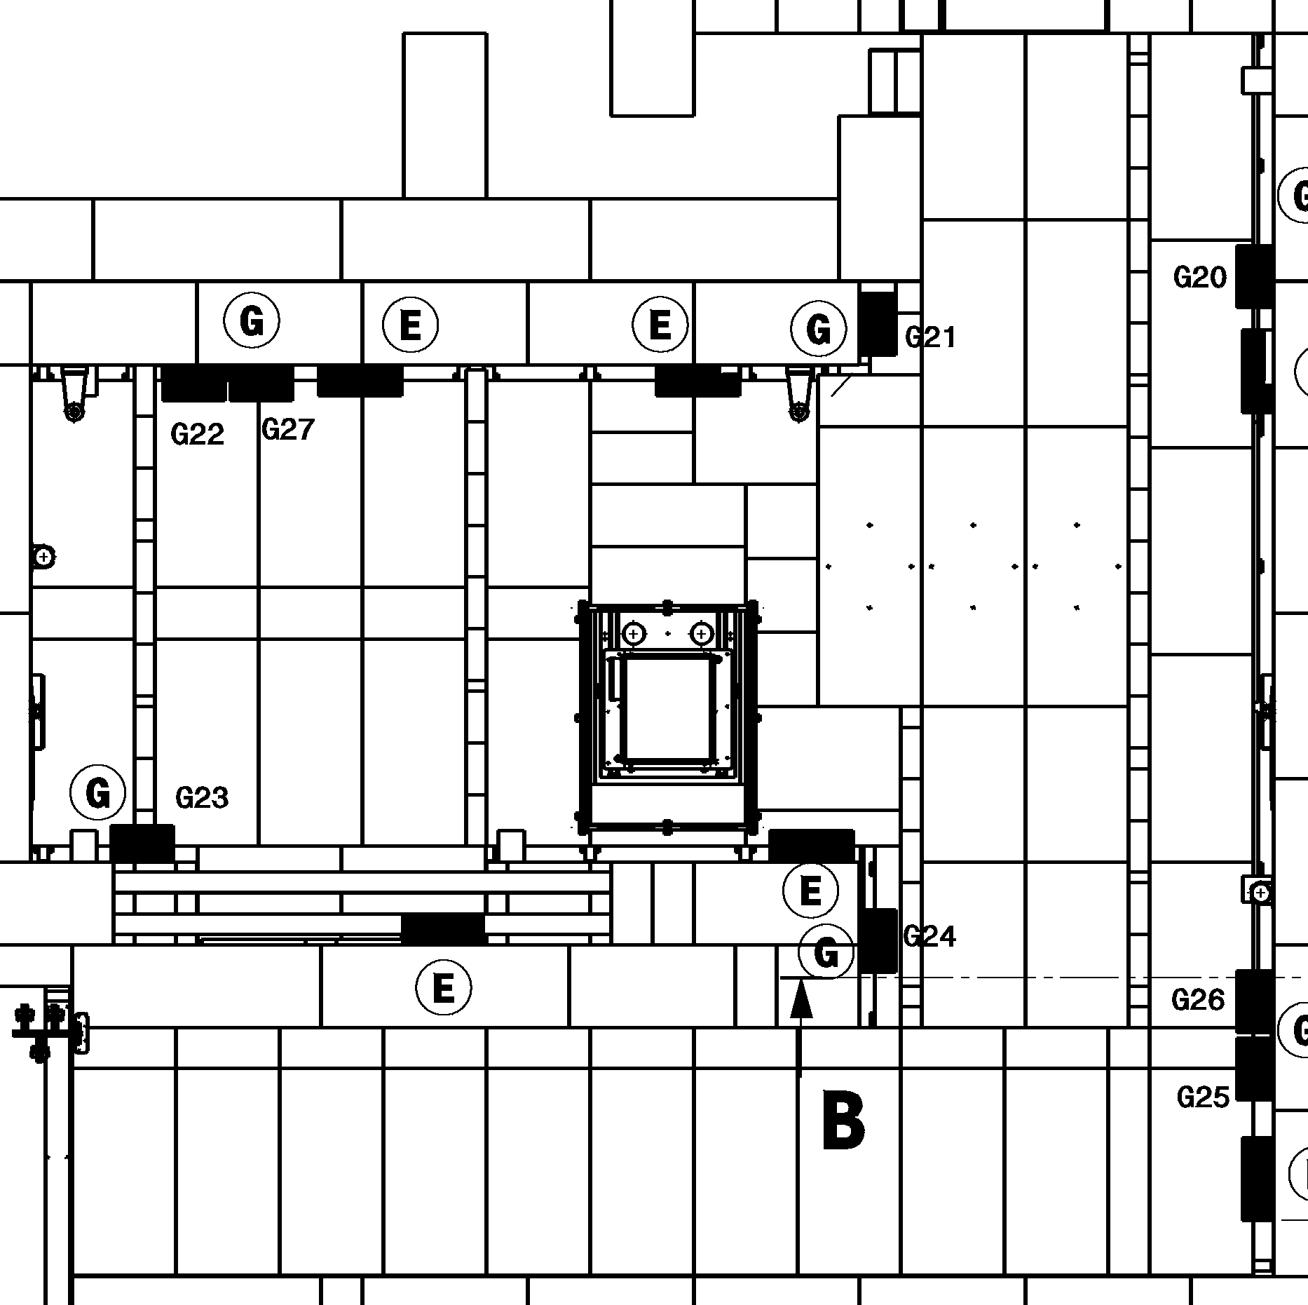

Slide 5
2 independent installtions
Upstream
Down strream

Slide 6
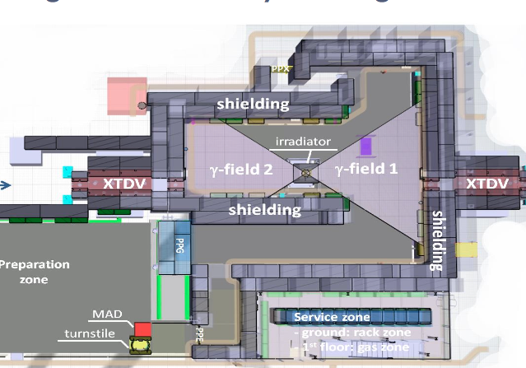
(Very) Preliminary set-up
RPCs High eta
RPCs Gas studies
RPCs consolidation
The detector position will better be defined as soon as the γ flux will be measured and when the requests of all users will be defined.

Slide 7
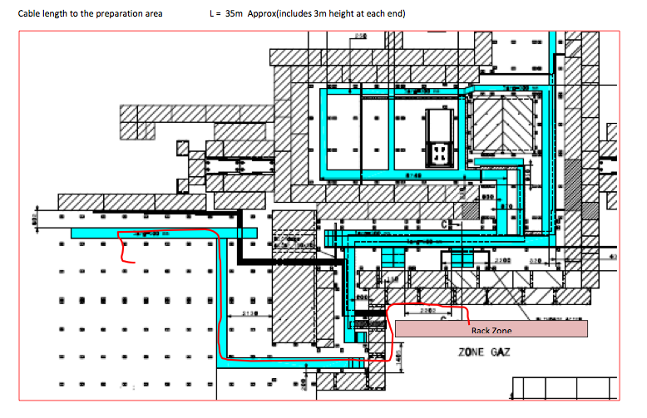
Preparation zone
HV
10 cables

