Slide 1
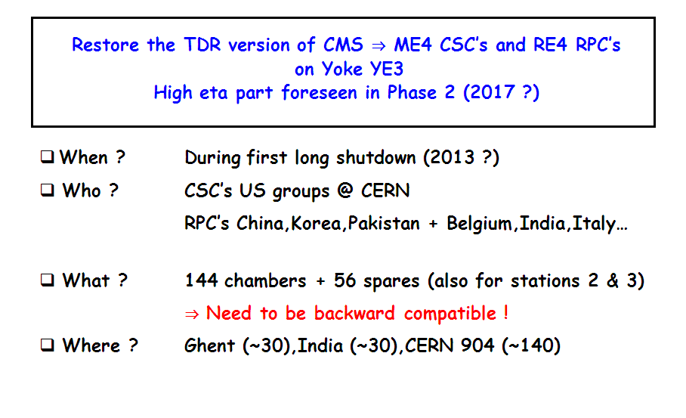
The CMS forward muon upgrade
Mechanics and Integration
Walter Van Doninck EDR 24/11/2011

Slide 2
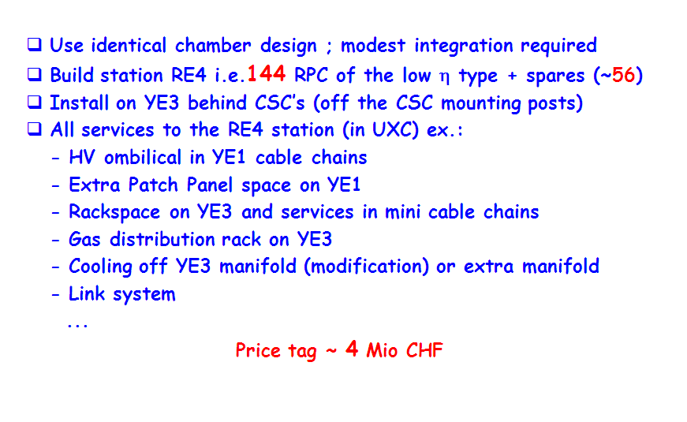
Restoring the TDR low eta system
( Use high eta ones )

Slide 3
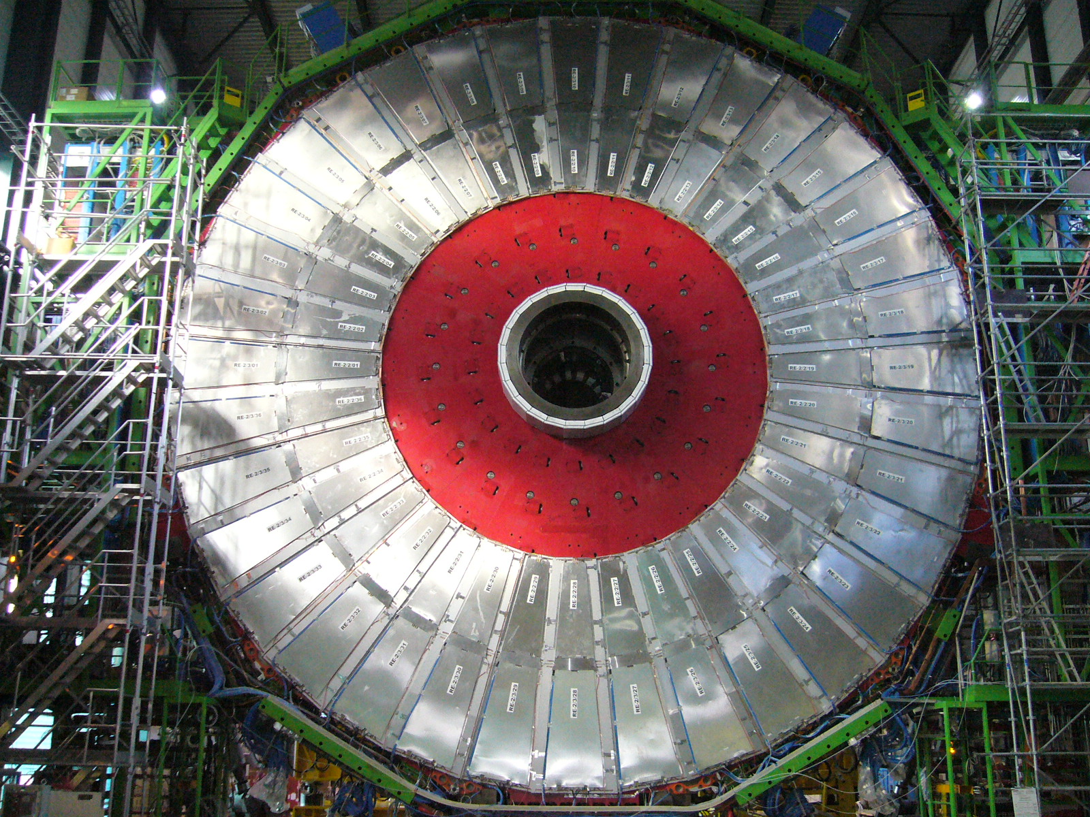
RE-2 station

Slide 4
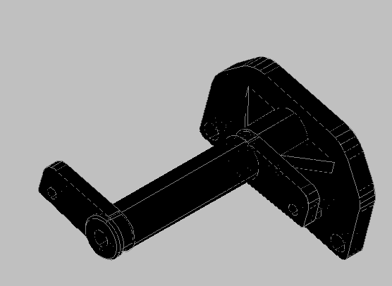
CSC mounting post
M24 hole

Slide 5
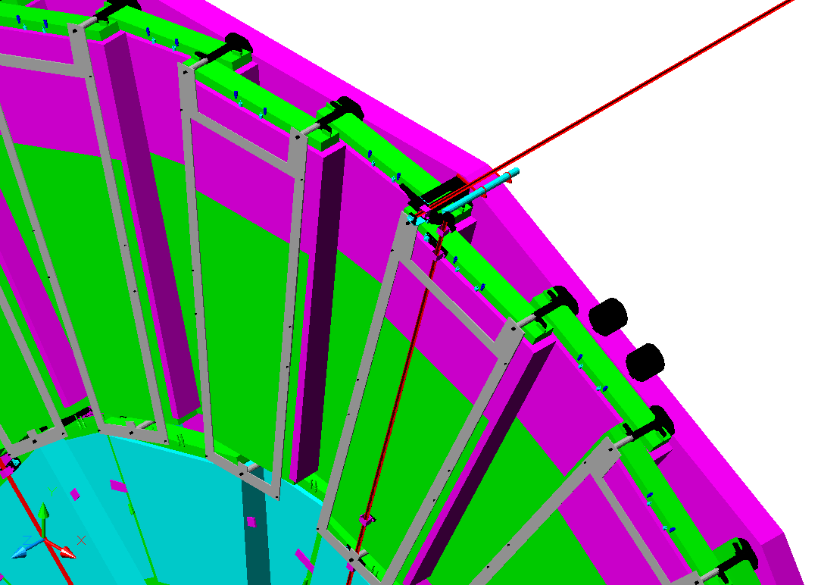
Interface frame (8mm) mounted on CSC posts

Slide 6
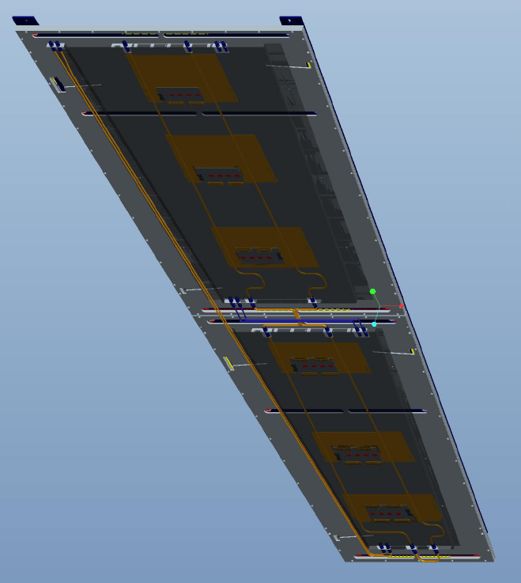
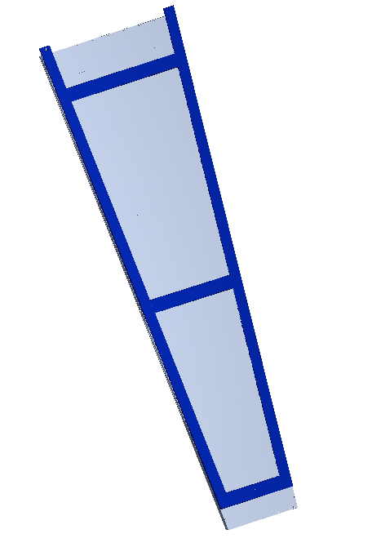
RE4 “super-module” preassembled 10 degree sector
Interface frame
Hidden connection

Slide 7
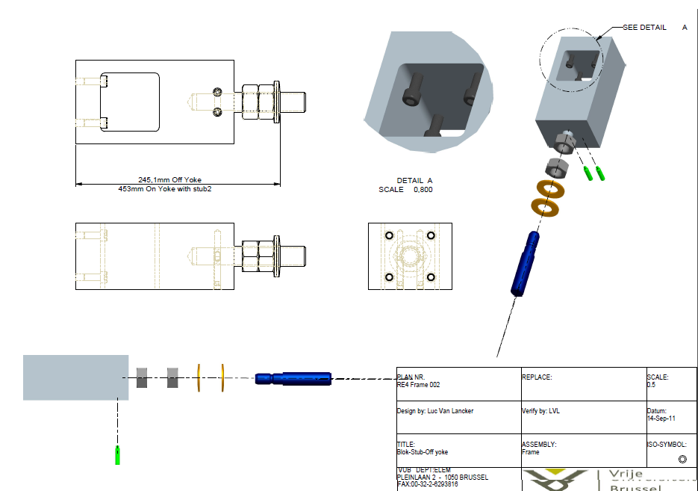
Interface pieces with laser passage
for hidden connection

Slide 8
RE4 3D model
Clearance to YE4: 12 mm

Slide 9
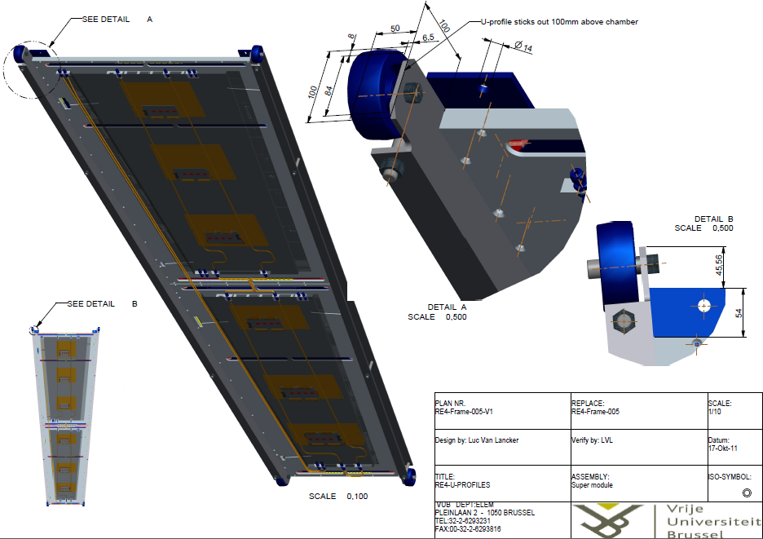
RE4 “super-module” with handling frame

Slide 10
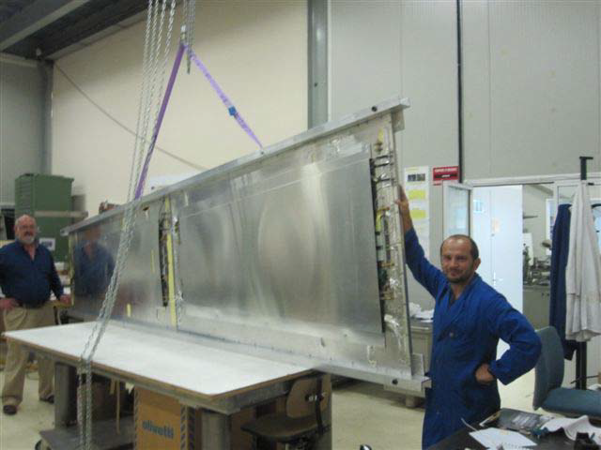
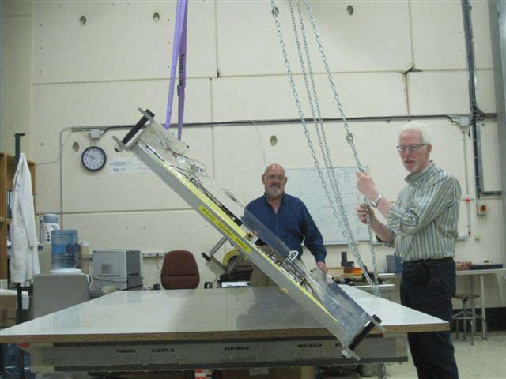
Handling a super-module

Slide 11
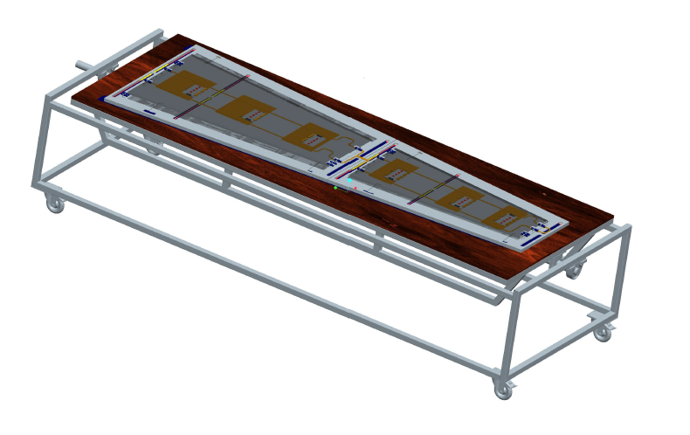
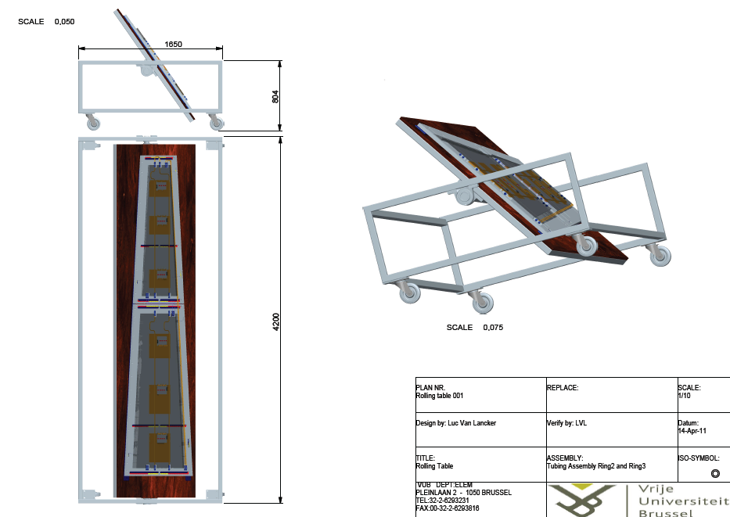
Super module swiveling

Slide 12
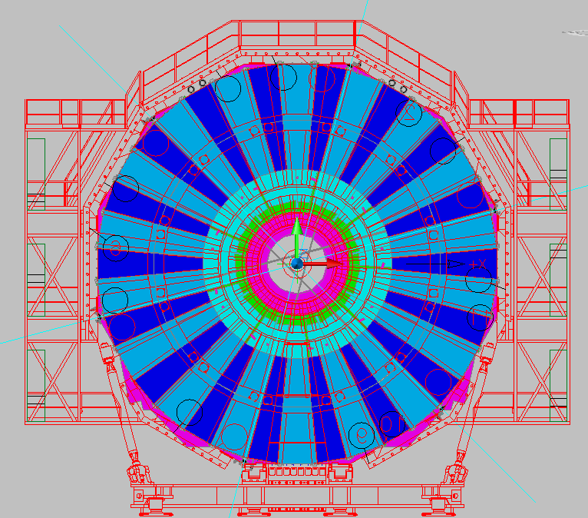
R1 R1 S1 S1 S2 S2 R2 R2
RE4 Bulkheads for gas
R1 R1 S1 S1 S2 S2 R2 R2
6
5
4
7
3
8
2
9
1
10
18
11
17
12
13
16
14
15

Slide 13
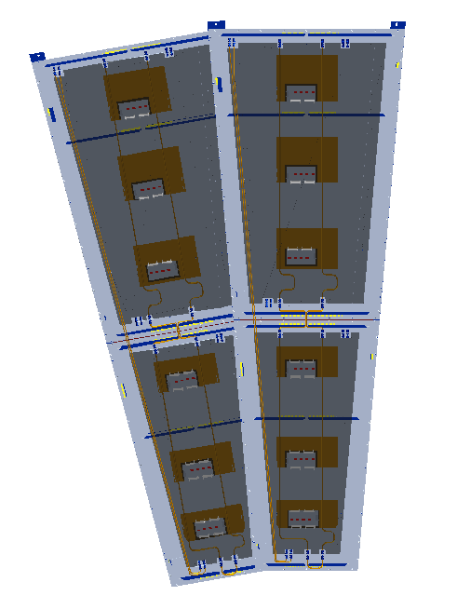
Gas
1 2 3 4 5 6 7 8
5
7
4
2
6
8
3
1
Top and bottom gas gaps on separate channels with “reverse” flow (HF)

Slide 14
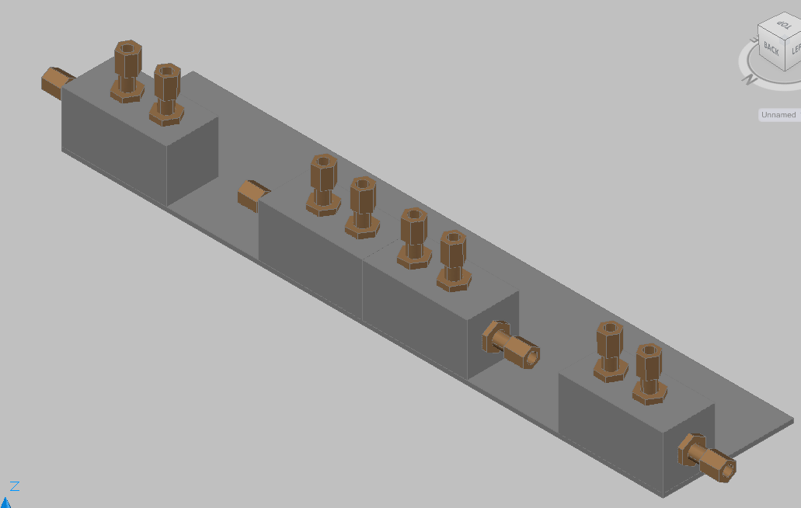
RE4 Bulkheads for gas
R
S
S
R

Slide 15
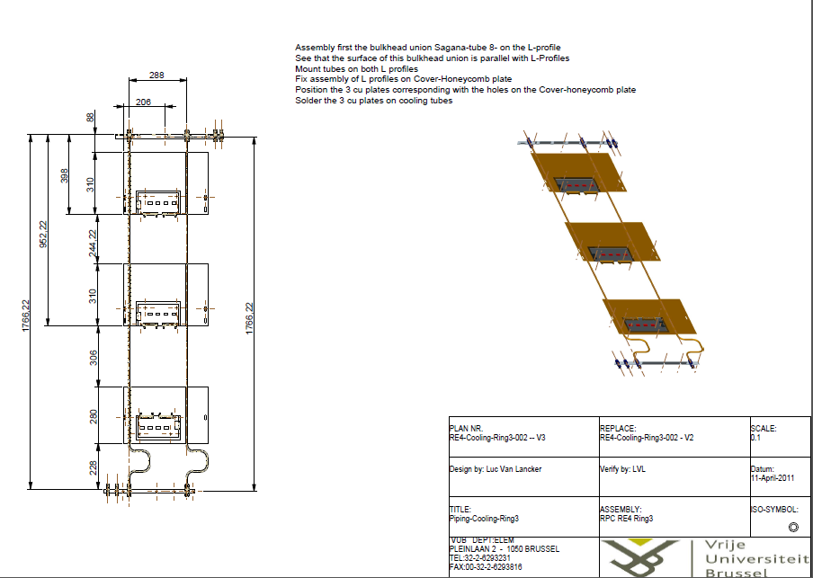
New chamber cooling circuit
Increased Cu surface soldered to 2 pipes

Slide 16
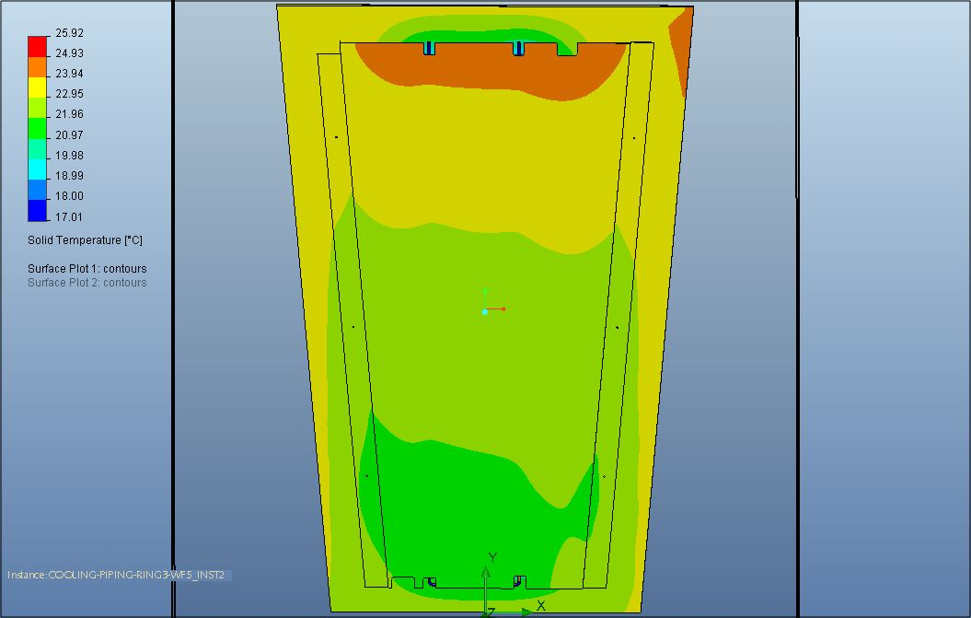
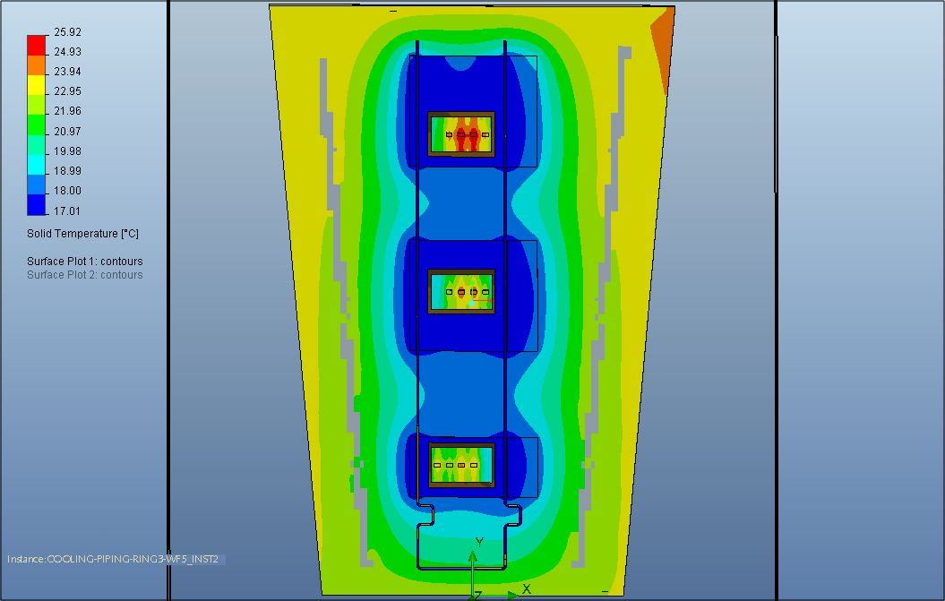
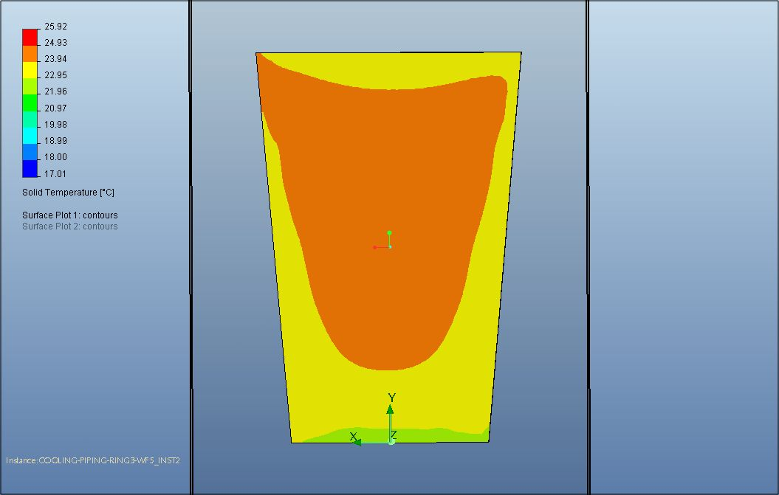
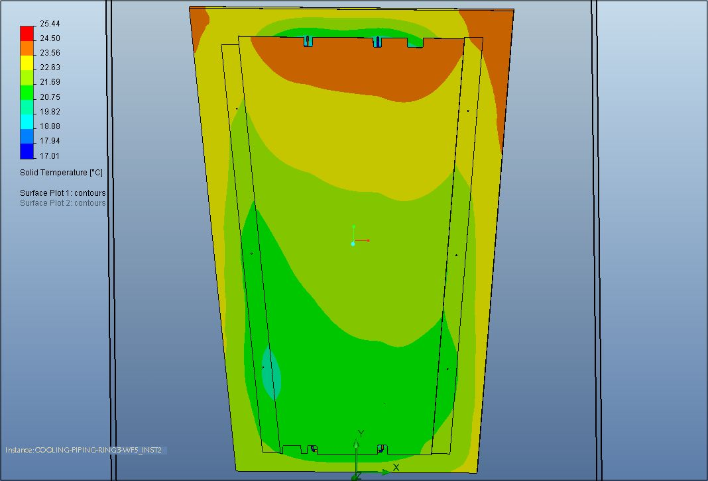
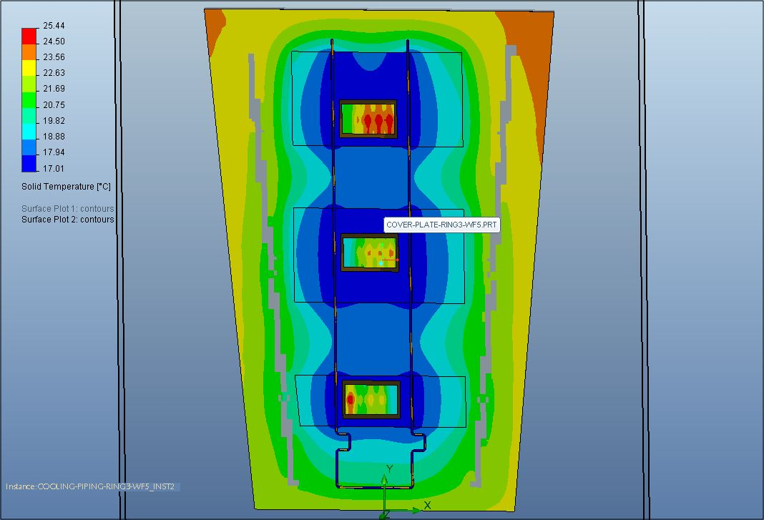
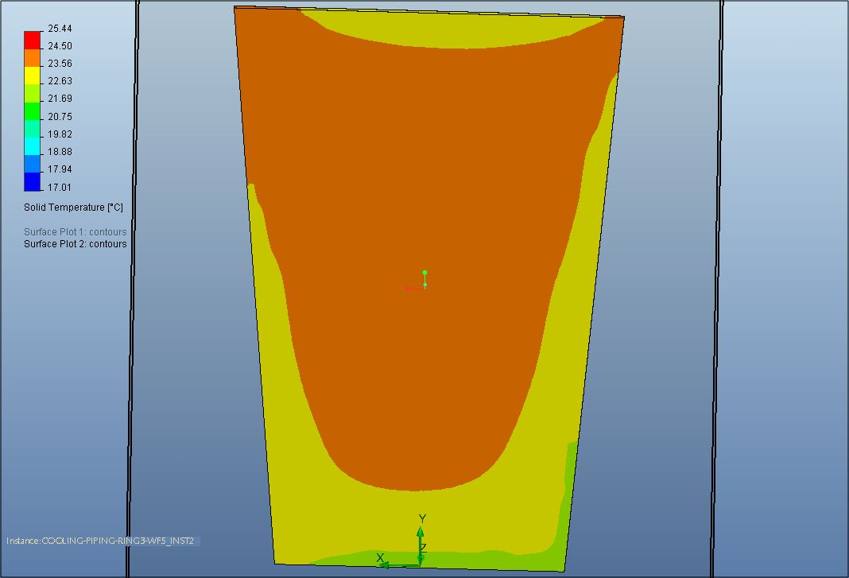
Cooling performance simulation
Design Cu surface
Extended Cu surface
Measured performance cfr. Yasser Assran

Slide 17
Cooling
Manifold

Slide 18
“Improvements” w.r.t. stations 1-2-3
  Gas Daisy Chain 2 “gaps” instead of 4 or 6 with “reverse flow”
  2 neighboring sectors in parallel ( 39 channel gas rack )
  Improved cooling circuit to also cool the RPC chamber ( tested )
  Daisy chain of 2 instead of 6
  Need manifold with 36 RPC channels ( supply-return )
  Backward compatibility with 2-3 maintained ( spares )

Slide 19
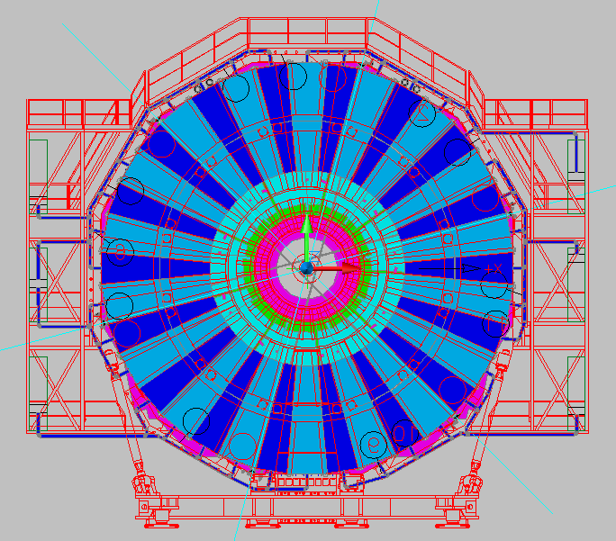
Cabling: e.g. signal

Slide 20
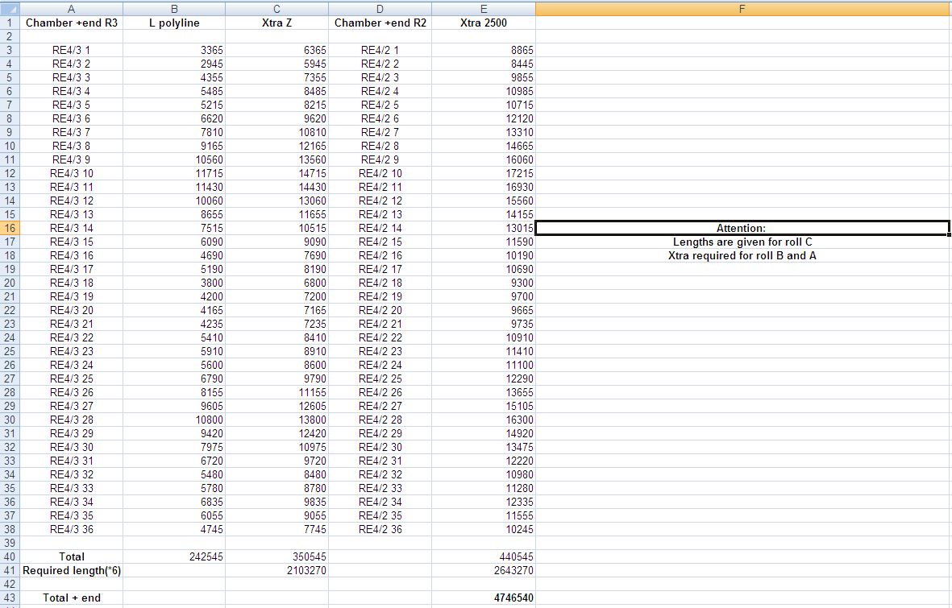
Cable lengths: Signal

Slide 21
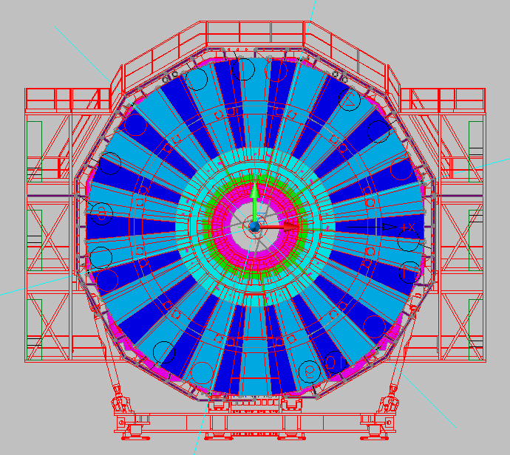
Cabling: e.g. HV

Slide 22
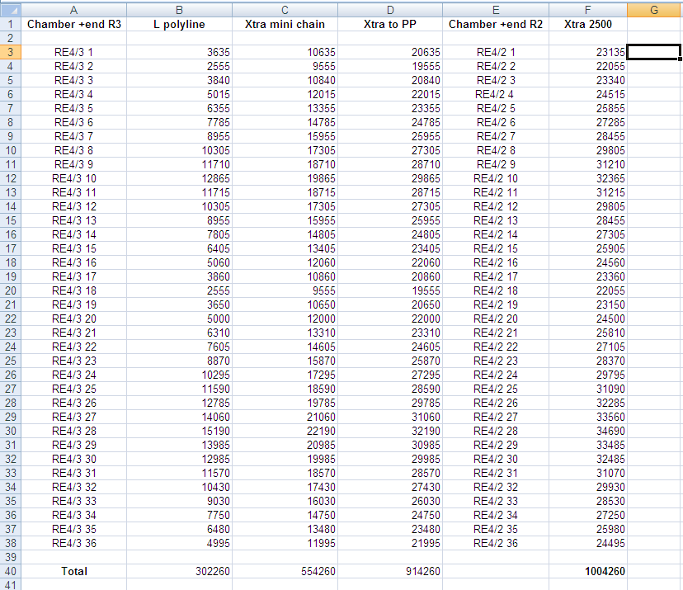
Cable lengths: HV

Slide 23
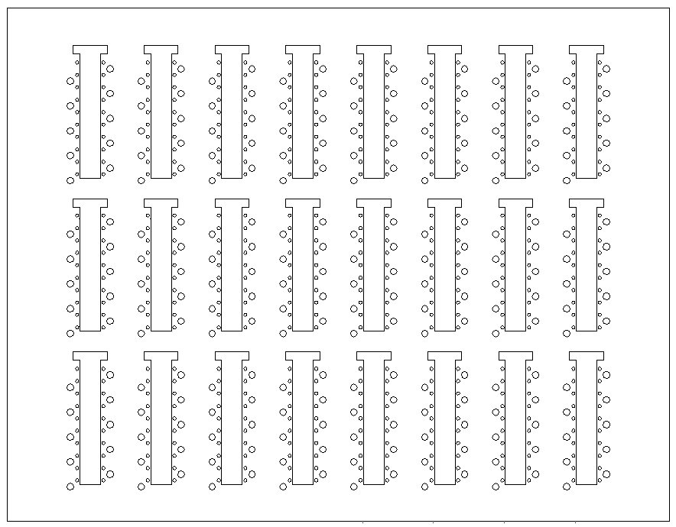
Cables in back of rack
2
4
6
8
13
14
15
16
RE YE+1 Near (+x) HV PP as seen from IP
1
3
5
7
9
10
11
12
PP in UXC
RE1/1
Sp
09
08
07
06
05
04
03
02
01
RE1/1
Sp
36
35
34
33
32
31
30
29
10
RE2/1
RE3/1
spare
spare
spare
spare
9
16
RE1/2
Sp
09
08
07
06
05
04
03
02
01
RE1/2
Sp
36
35
34
33
32
31
30
29
10
RE2/2
Sp
09
08
07
06
05
04
03
02
01
RE2/2
Sp
36
35
34
33
32
31
30
29
10
RE3/2
Sp
09
08
07
06
05
04
03
02
01
RE3/2
Sp
36
35
34
33
32
31
30
29
10
RE4/2
RE4/2
11
14
13
7
8
6
2
RE1/3
Sp
09
08
07
06
05
04
03
02
01
RE1/3
Sp
36
35
34
33
32
31
30
29
10
RE2/3
Sp
09
08
07
06
05
04
03
02
01
RE2/3
Sp
36
35
34
33
32
31
30
29
10
RE3/3
Sp
09
08
07
06
05
04
03
02
01
RE3/3
Sp
36
35
34
33
32
31
30
29
10
RE4/3
RE4/3
15
10
12
4
3
5
1

Slide 24
Conclusions
RE4 mechanics and integration well understood and implemented
Handling and installation tests end November (ISR) & January (P5)
Cabling lengths determined for Signal and HV
LV requires placement of LV modules in agreement with CSC
Improved gas and cooling distribution and performance
Backward compatibility maintained (spares)
Lets get going

