Slide 1
Some material for your presentations. I hope it fits your needs
Ian

Slide 2
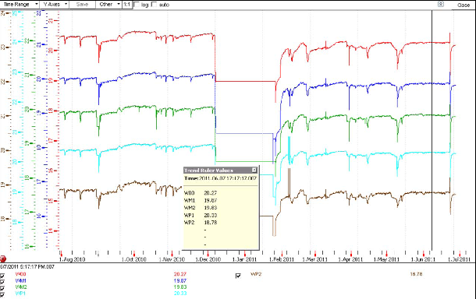
RB temperatures for 1 year, down by 0.3 ˚C since Oct last year

Slide 3
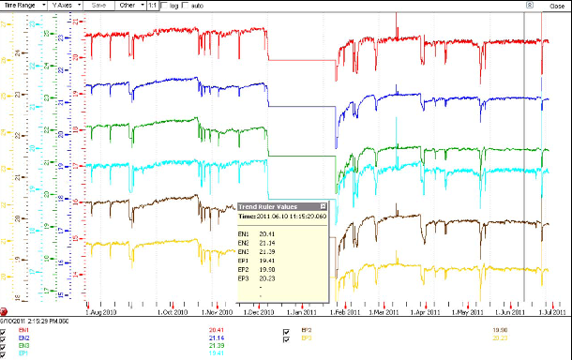
RE temperatures down by 0.3 – 0.9˚C over one year

Slide 4
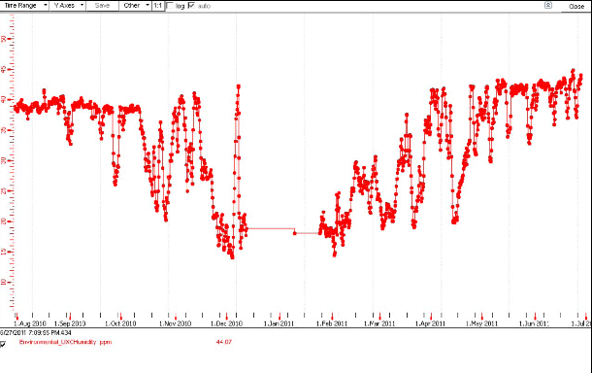
RH upper limit increased since last year

Slide 5
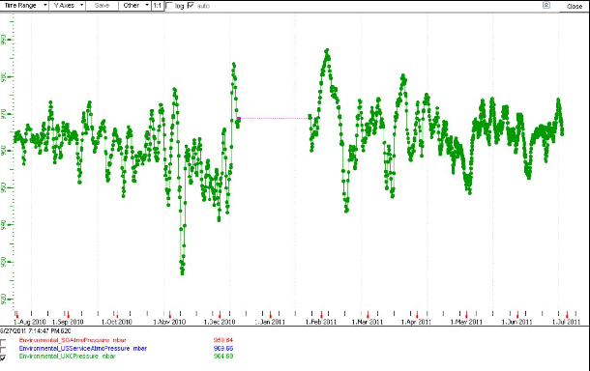
Pressure in UXC since1 year showing sudden changes that are dealt with in the gas system even if there is a power cut due to the passing storm.

Slide 6
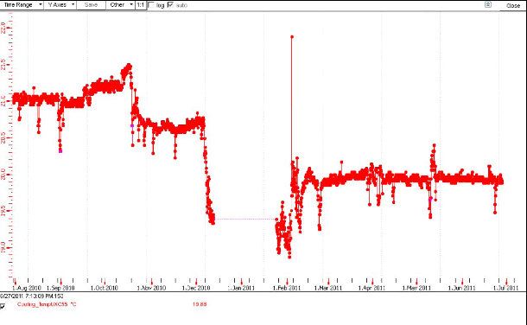
Chambers are cooler than last year also largely due to a substantial reduction (21.24- 19.97 = 1.27˚C)of the ambient UXC temperature

