Slide 2
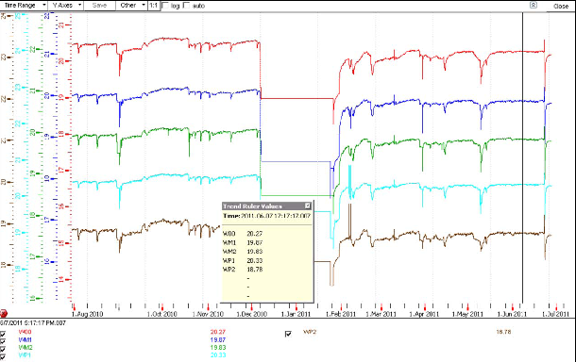
RB temperatures for 1 year

Slide 3
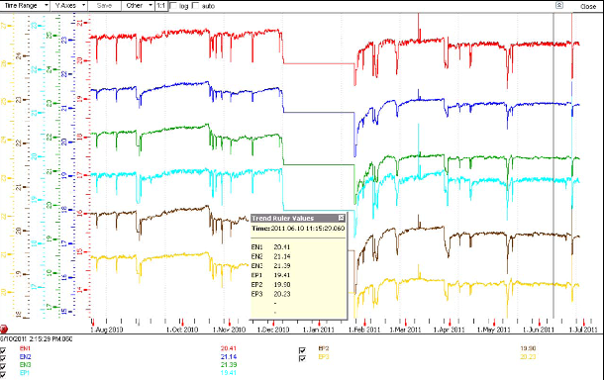
RE temperatures down by 0.3 – 0.9˚C over one year

