Slide 1
Observation of the RPCs after UXC Set point change from 19 to 17degC
What we can observe.
Average Chamber temperatures just before and after 18 Oct 2010.
Yoke temperature.
Individual examples of chamber temps.
Distribution in Z
Longer term
Conclusions.

Slide 2
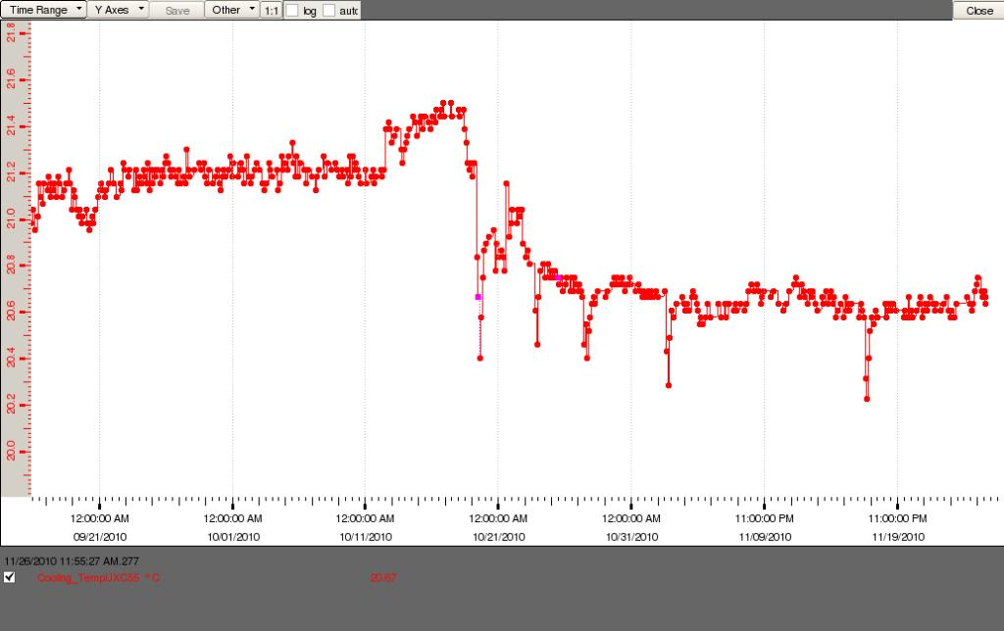
Ambient temp change did change on the 18 Oct.
SPC = Set Point Change
19 -17 degC

Slide 3
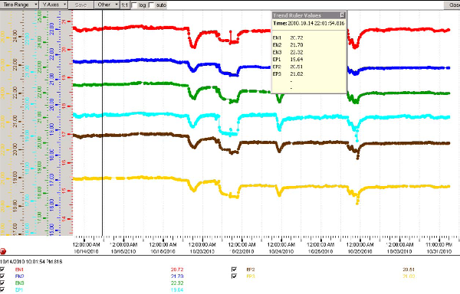
Average Chamber temps before SP change

Slide 4
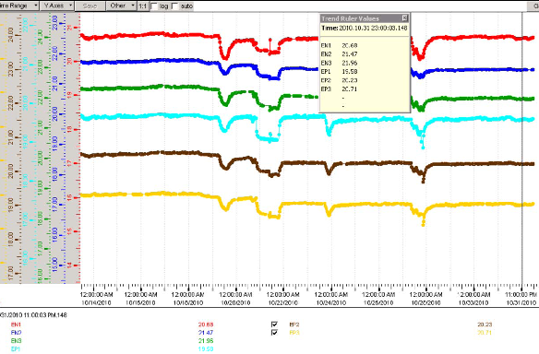
Average temps after SP Change
0.04degC
0.23degC
0.36degC
0.06degC
0.28degC
0.31degC
Set Point 19 -17
18 Oct 2010

Slide 5
Observation of the RPCs after UXC Set point change from 19 to 17degC
The SPC caused the temperatures to slightly decrease, which is good.
In addition the changes were more pronounced with distance from IP.
The very small differences in the RE1s can be explained by the enclosed nature of their installation behind the CSCs.
The RE2 and 3s are greater due to the greater exposure in that the CSCs are on the opposite wall (yoke).
The difference between the RE2 and 3 may be due to the distance from the IP and associated heat sources.
It should be pointed out that absolute values differences are small.
The following slides give some individual cases

Slide 6
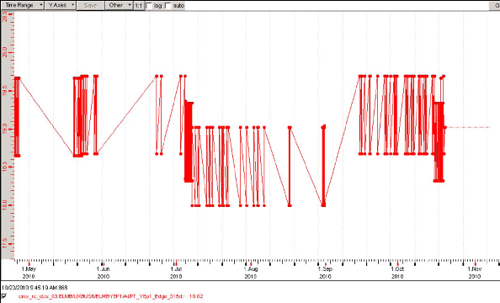
Logged Yoke temps are not representative of the real conditions.
Unfortunately these logs of temperature do not allow us to improve our understanding of the actions taken and the impact on the RE system
1 degC variation in less than a day

Slide 7
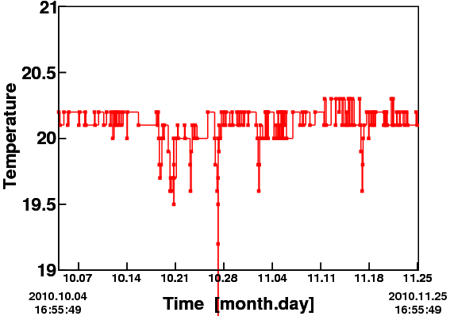
Temperature change of RE1/207. This chamber is on the YE+1
18 Oct 2010 SPC

Slide 8
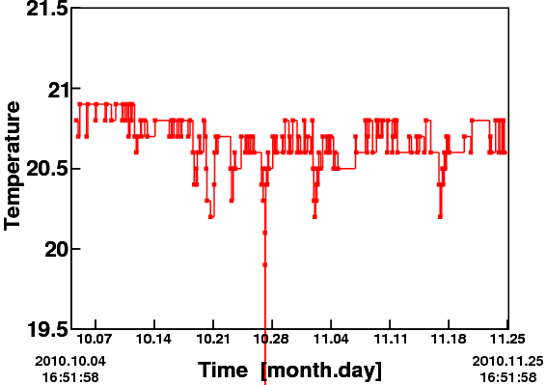
Temperature change of RE3/307. This chamber is on the YE+3
18 Oct 2010 SPC

Slide 9
Temperature change of RE-3/307. This chamber is on the YE-3
18 Oct 2010 SPC

Slide 10
RPC Temp Distributions in June 2010
20.83C
21.92C
20.25C
19.41C
18.67C
20.25C
20.33C
19.90C
19.79C
20.32C
21.33C
+Z
-Z
RB0
0.5C
0.8C
0.75C
0.8C
0.7C
0.6C
Gains since April 2010

Slide 11
RPC Temp Distributions on 30 Nov 2010
StDev
21.58C SD=0.36
20.80C SD=0.4
22.08C SD=0.35
20.34C SD=0.28
19.71C SD=1.10
19.00C
20.57C
20.55C
20.12C
20.05C
20.81C SD=0.61
Mean
+Z
-Z
RB0
Increases are mitigated by the work undertaken during the year
0.03C
0.09C
0.3C
0.49C
0.25C
0.16C
Small increases since June 2010

Slide 12
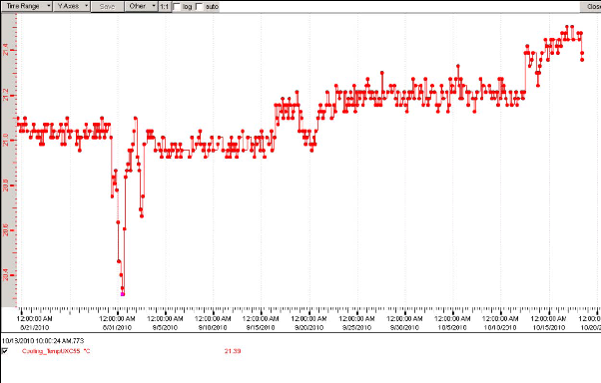
Increasing of UXC temp since Aug
Part of the reason for the increase on the long term

Slide 13
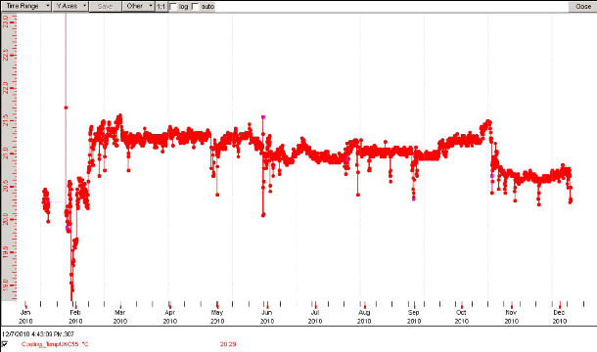
Temperature plot of UXC for 2010
The structure is similar to the following slide showing chamber temps but without the increase since June
June to SPC

Slide 14
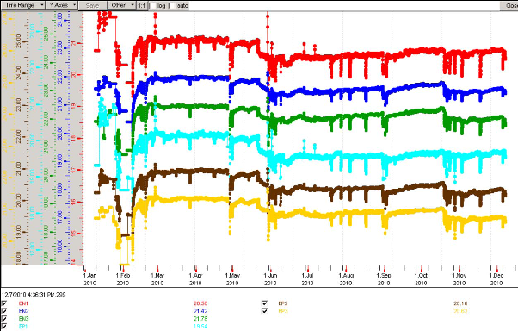
RE average temperatures during 2010
Steady temp increases since June until SPC

Slide 15
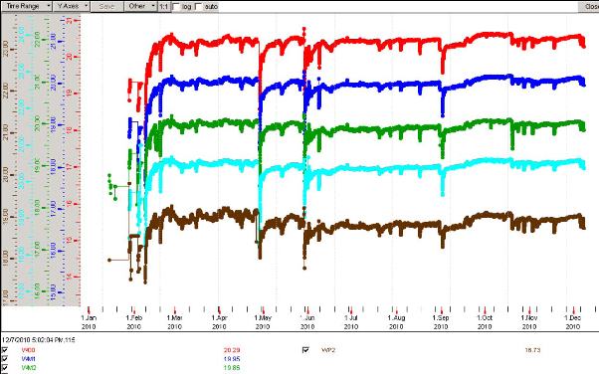
RB average temperatures during 2010
Temperatures are far more stable

Slide 16
Observation of the RPCs after UXC Set point change from 19 to 17degC

Slide 17
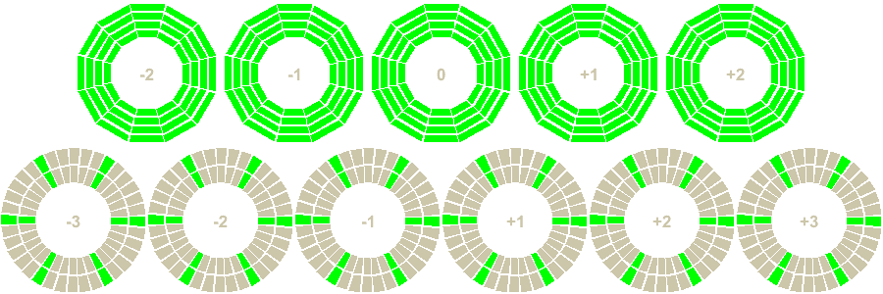
Web Based Monitoring source
RPC Temperature
Now 2010.11.30 19:20:58 UTC Heartbeat 2010.11.30 19:20:33 UTC
The green sections represent those chambers which have sensors. Clearly the RB are better instrumented than the RE.

Slide 18
Conclusions
The Set Point Change (SPC) in the UXC reduced by 2 degrees.
The ambient temperature at the X3 level in UXC reduced by 0.6-0.8degC.
The chamber temperature reduction reached 0.3-0.4 degrees at best in the RE3 regions.
There is a persistent asymmetry in the temperatures of the RE3s.
Increases since June have been greater in the RE1s.
From June to November there has been a steady increase in RE temps that is not evident in RB.
As well as remnant heat emanating from the central detector region of CMS as has been suggested perhaps we see well cooled chambers in the barrel region and an influence of the ambient air temperature on the RE2 and RE3s. This implies that any attempt to circulate cool enough ambient air between the yokes will help.
We need a solution to keep the present RE stations as cool as the barrel and also the future RE4 that we have started building.

