Slide 1
Pertubations in Climatic Conditions in UXC55
Ian Crotty 9 Jan 2012

Slide 2
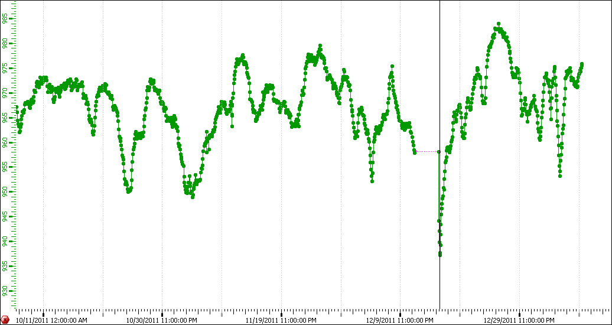
Maximium for all the year 983mbar on 26 dec 2011
Minimium for all year 937mbar on 16 Dec 2011

Slide 3
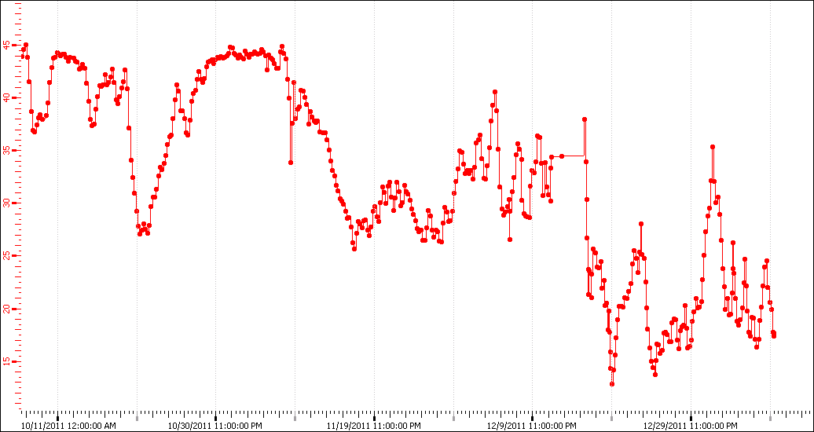
Lowest RH 14.36% 19 Dec 2011

Slide 4
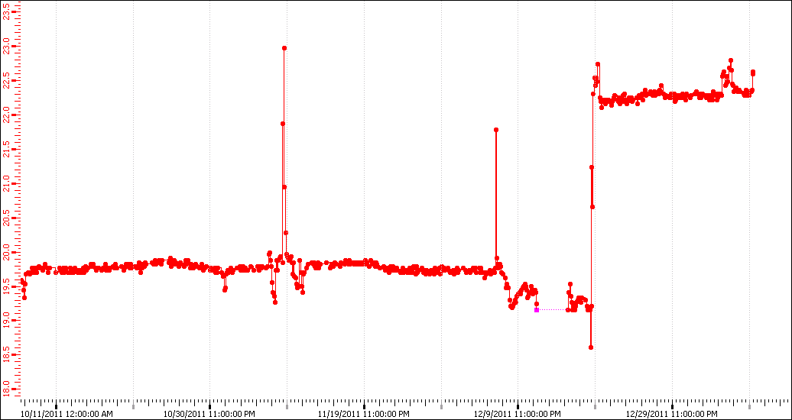
Temp Jump from 19.5-19.7 to 22.2to 22.3deg C. With a min of 18.6degC

Slide 5
Cooling and some AC (?) off
Gas off since 9 Dec 2011.
Argon will be back on 9 Jan 2012.
Chambers not flushed since 1 month, with dry conditions. Then no or dry gas for almost 2 months.
We should check that pressure regulation has been operational due to exteme pressure changes.
Chambers will have been 3 deg C warmer than normal.

