Slide 1
RE+4 gas tubes routing
Proposal 00
22 October 2012
Wojciech Szczęsny

Slide 2
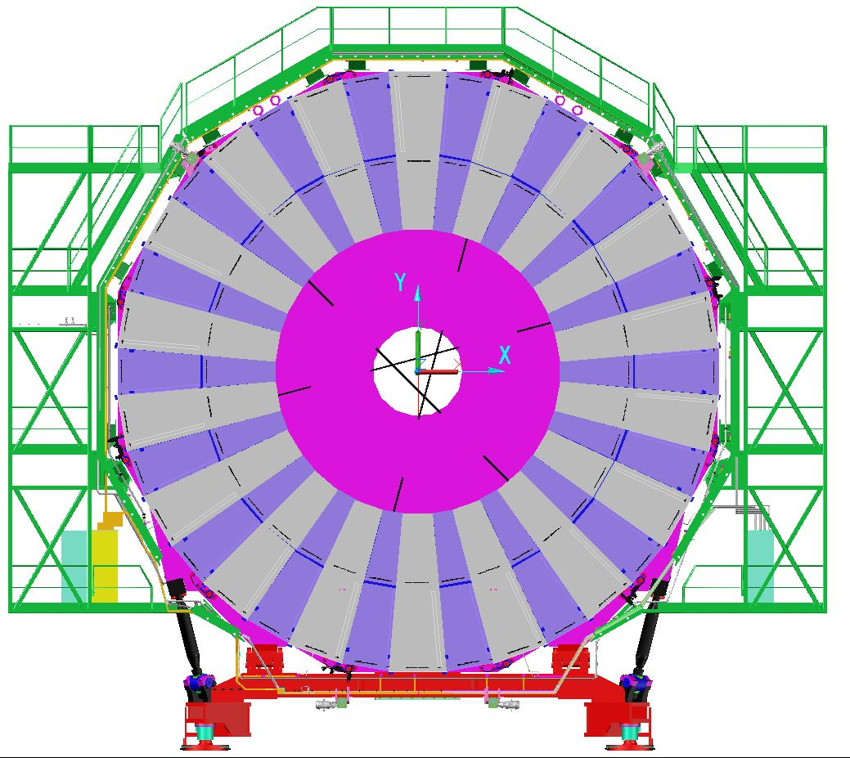
YE+3. View toward IP.
RE+3 gas rack
ME+4 gas rack
New, RE+4 gas rack

Slide 3
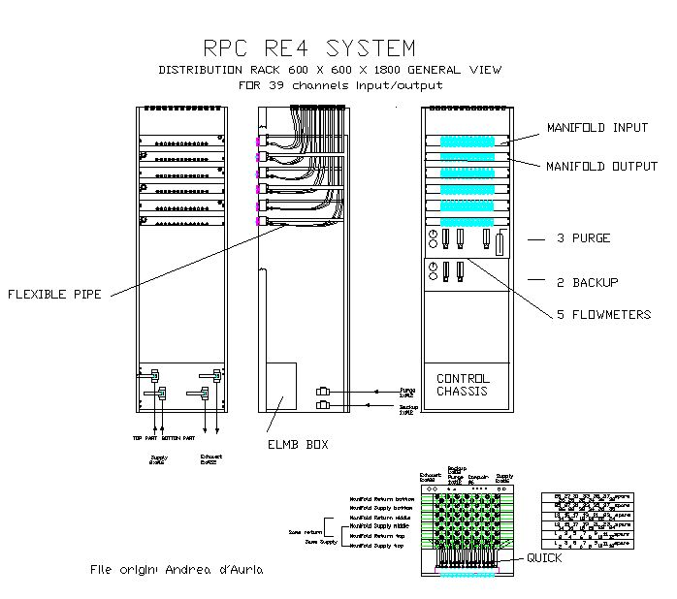
RE+4 gas rack

Slide 4
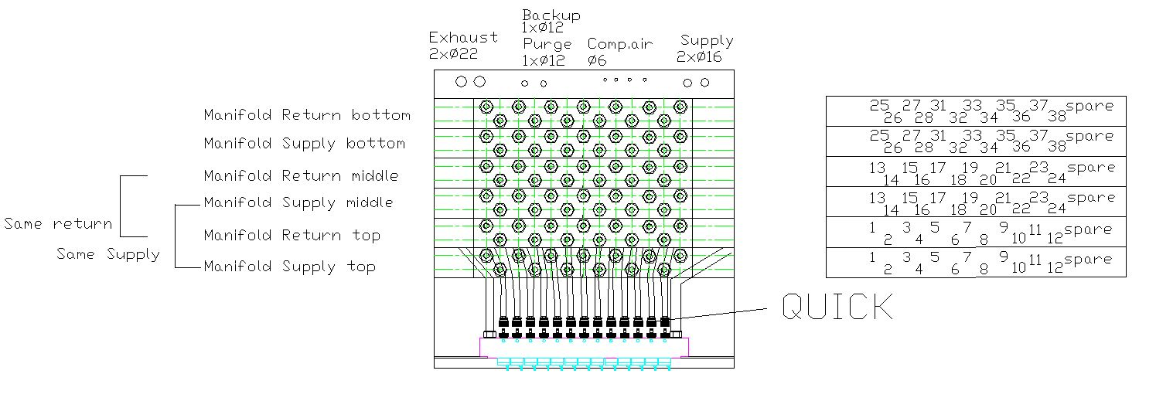
RE+4 gas rack
39 channels on the gas rack (supply and return)
We use 36 channels 72 x 8mm OD copper tubes

Slide 5
YE+3. View toward IP.
RE+3 gas rack
ME+4 gas rack
New, RE+4 gas rack

Slide 6
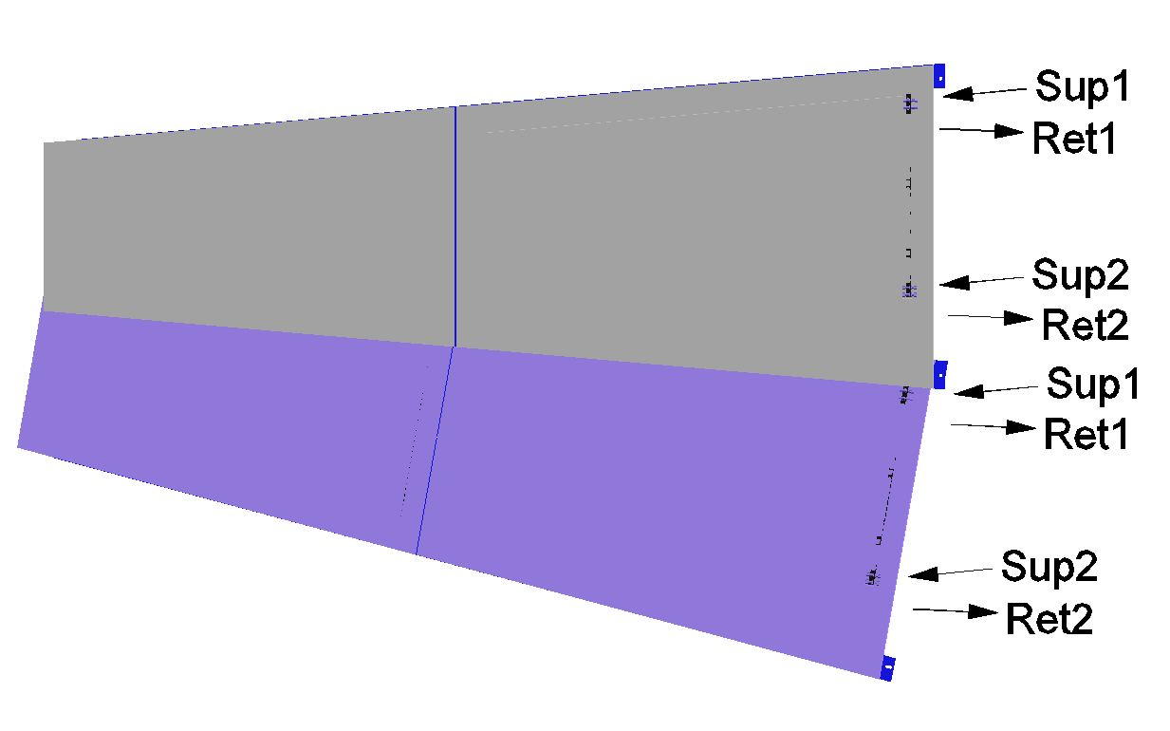
RE+4 super-modules
Each channel supplies 2 gas gaps in 2 different super-modules

Slide 7
YE+3. View toward IP.
RE+3 gas rack
ME+4 gas rack
New, RE+4 gas rack

Slide 8
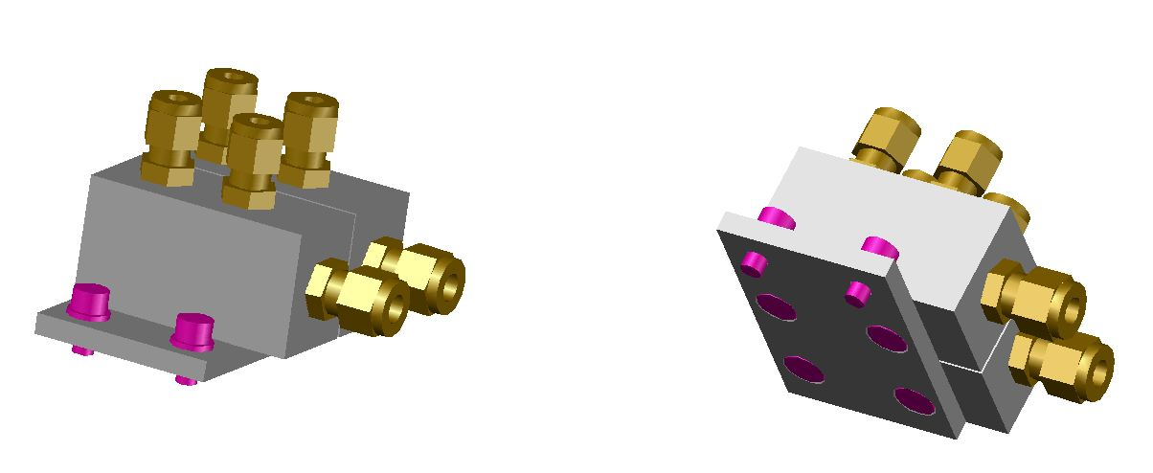
RE+4 gas patch panel
36 patch panels around the green structure
Sup1 (To a super-module)
Ret1 (From a super-module)
Ret1 (From a super-module)
Sup1 (To a super-module)
Sup1 (From the rack)
Ret1 (To the rack)

Slide 9
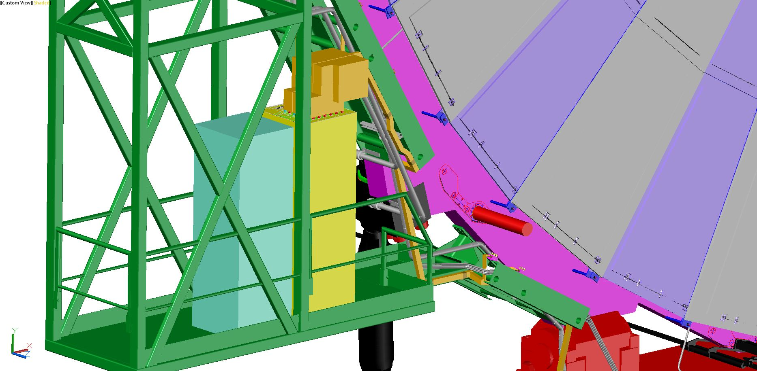
RE+4 gas tubes routing

Slide 10
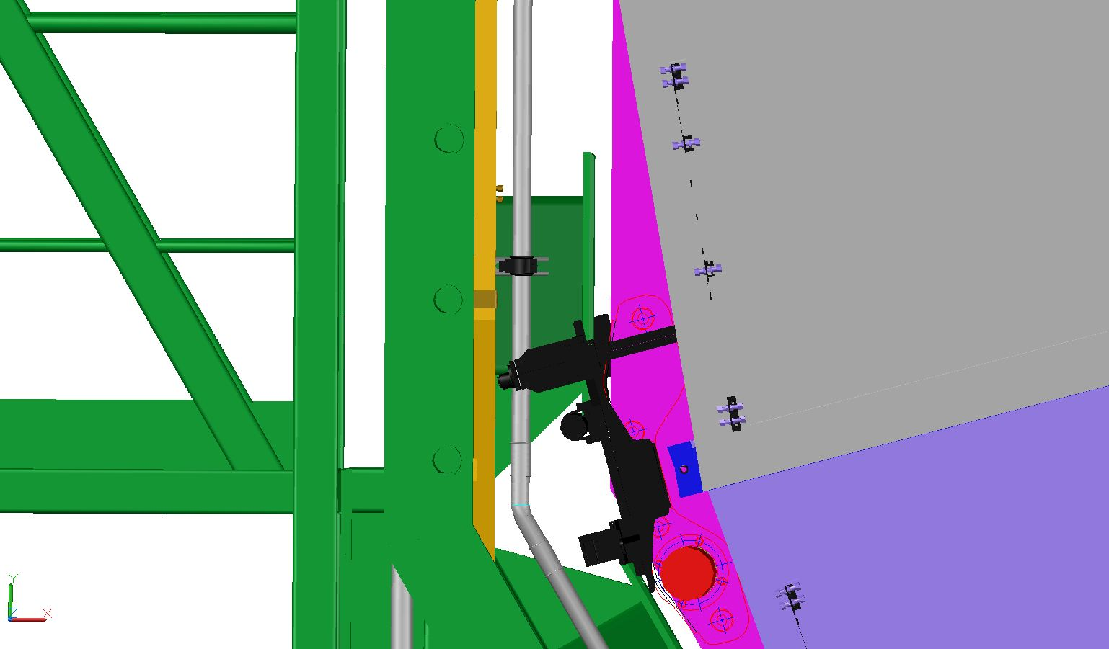
RE+4 gas tubes routing

Slide 11
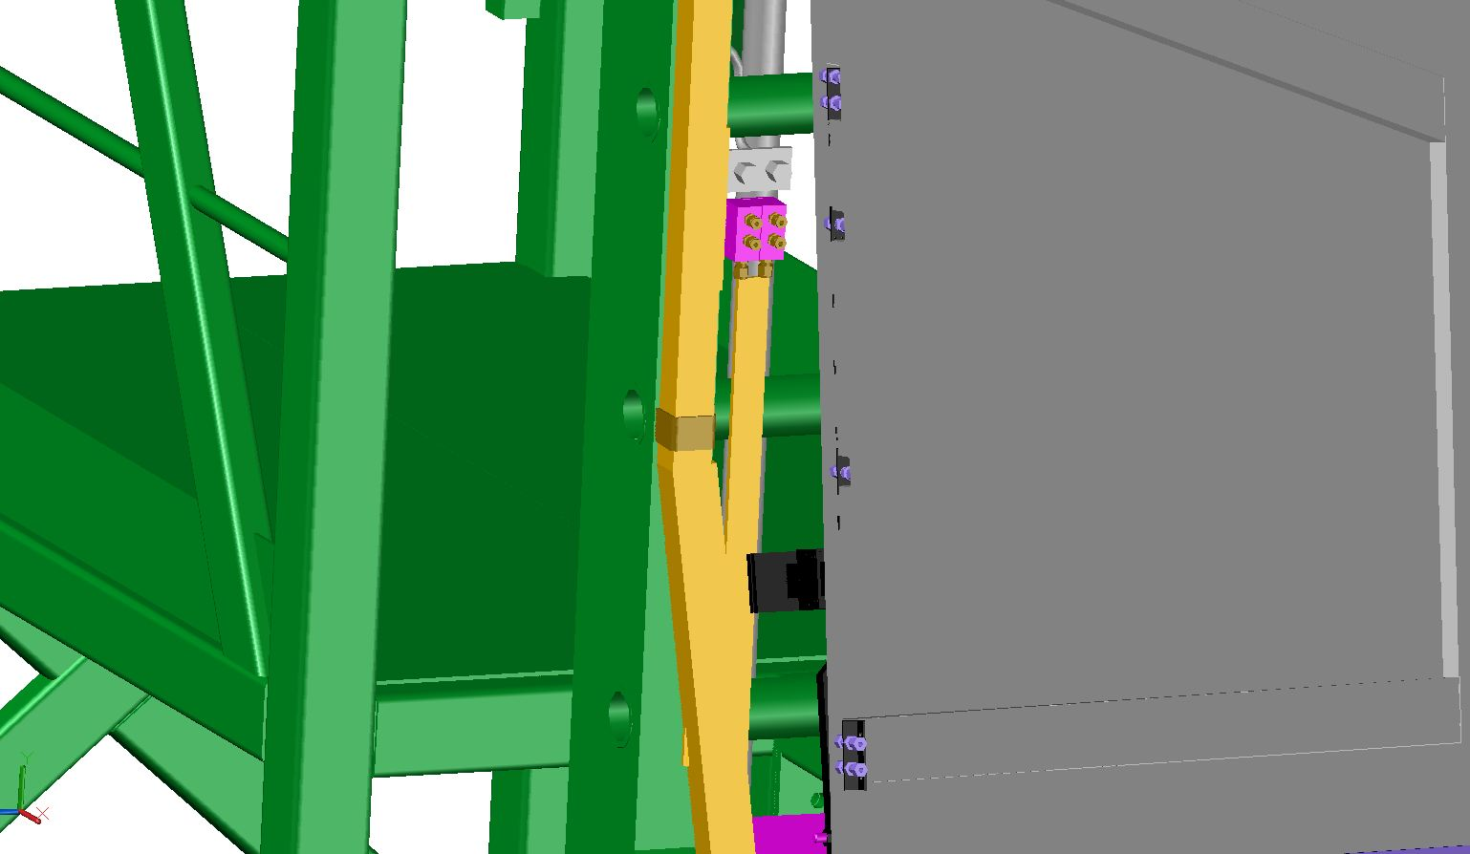
RE+4 gas tubes routing

Slide 12
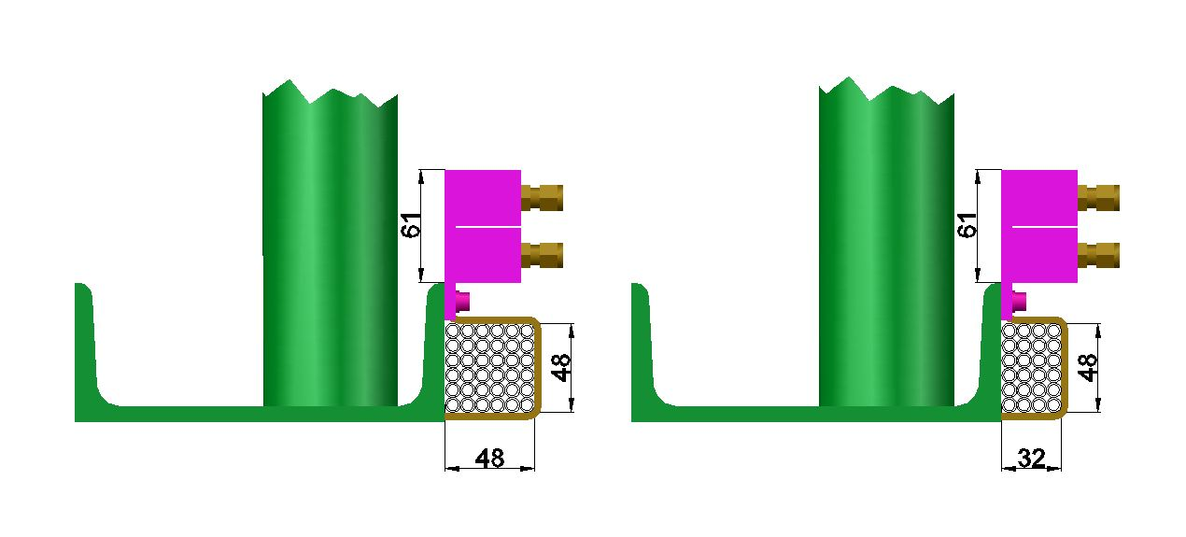
RE+4 gas tubes routing

Slide 13
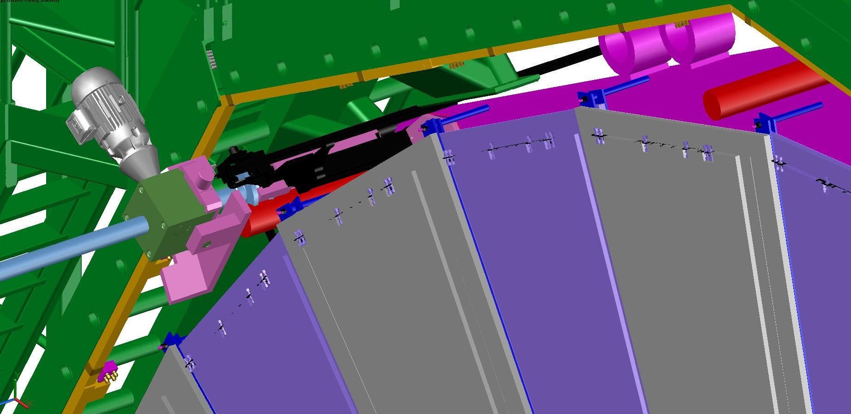
RE+4 gas tubes routing

Slide 14
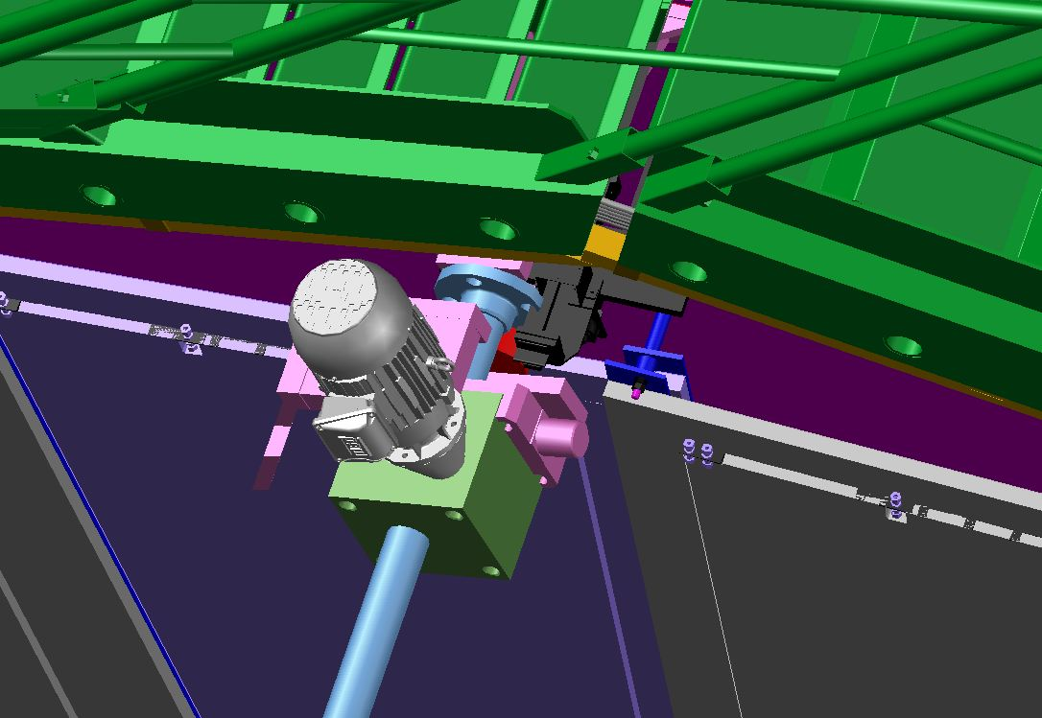
RE+4 gas tubes routing

Slide 15
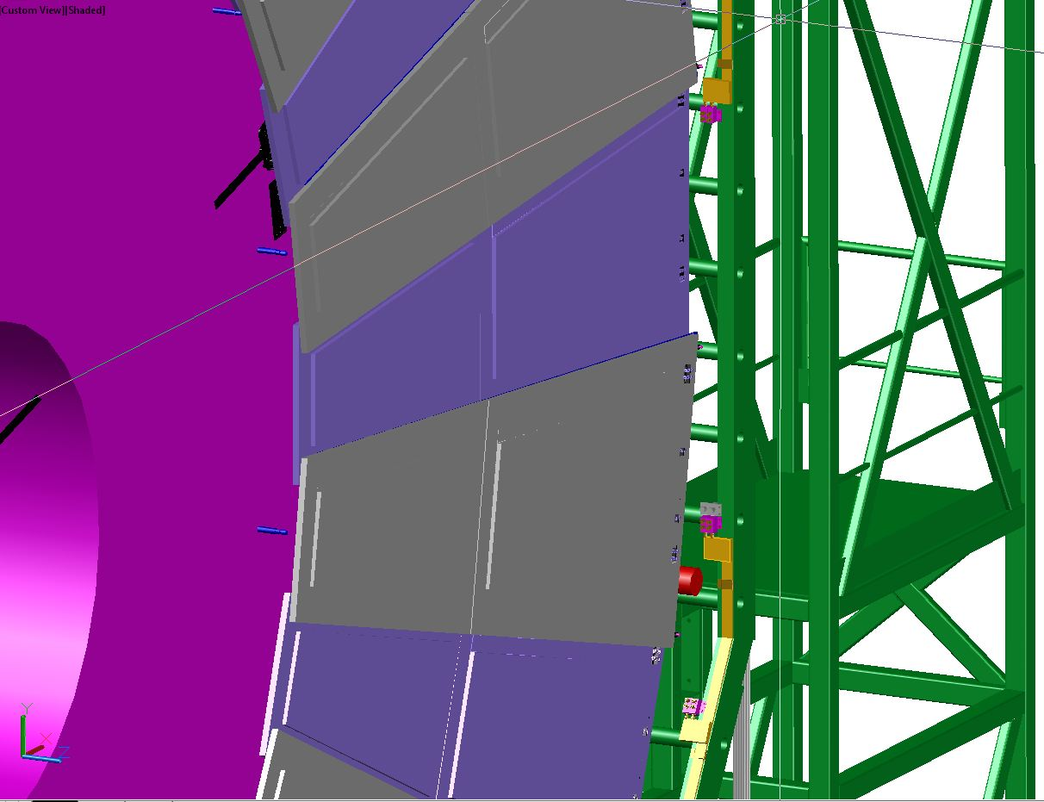
RE+4 gas tubes routing

Slide 16
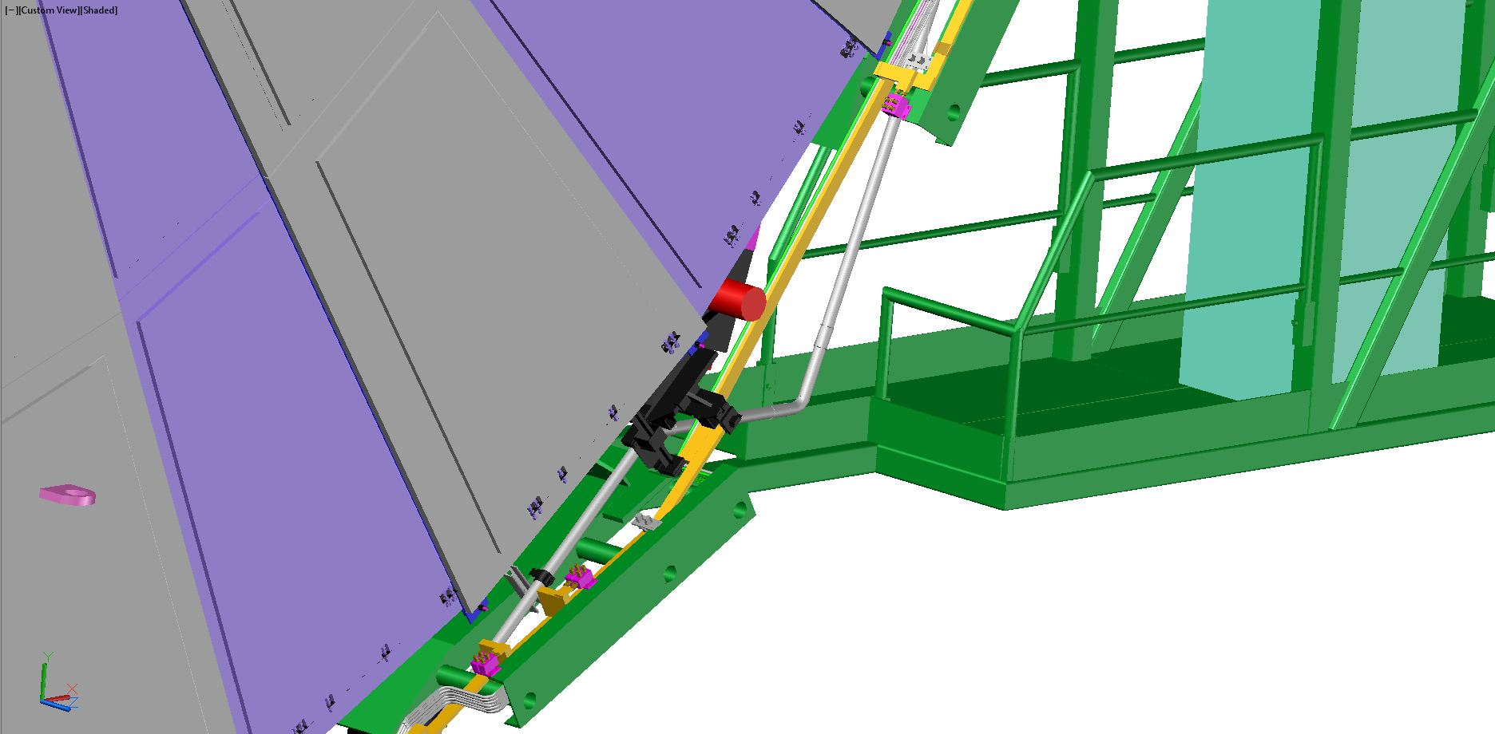
RE+4 gas tubes routing

Slide 17
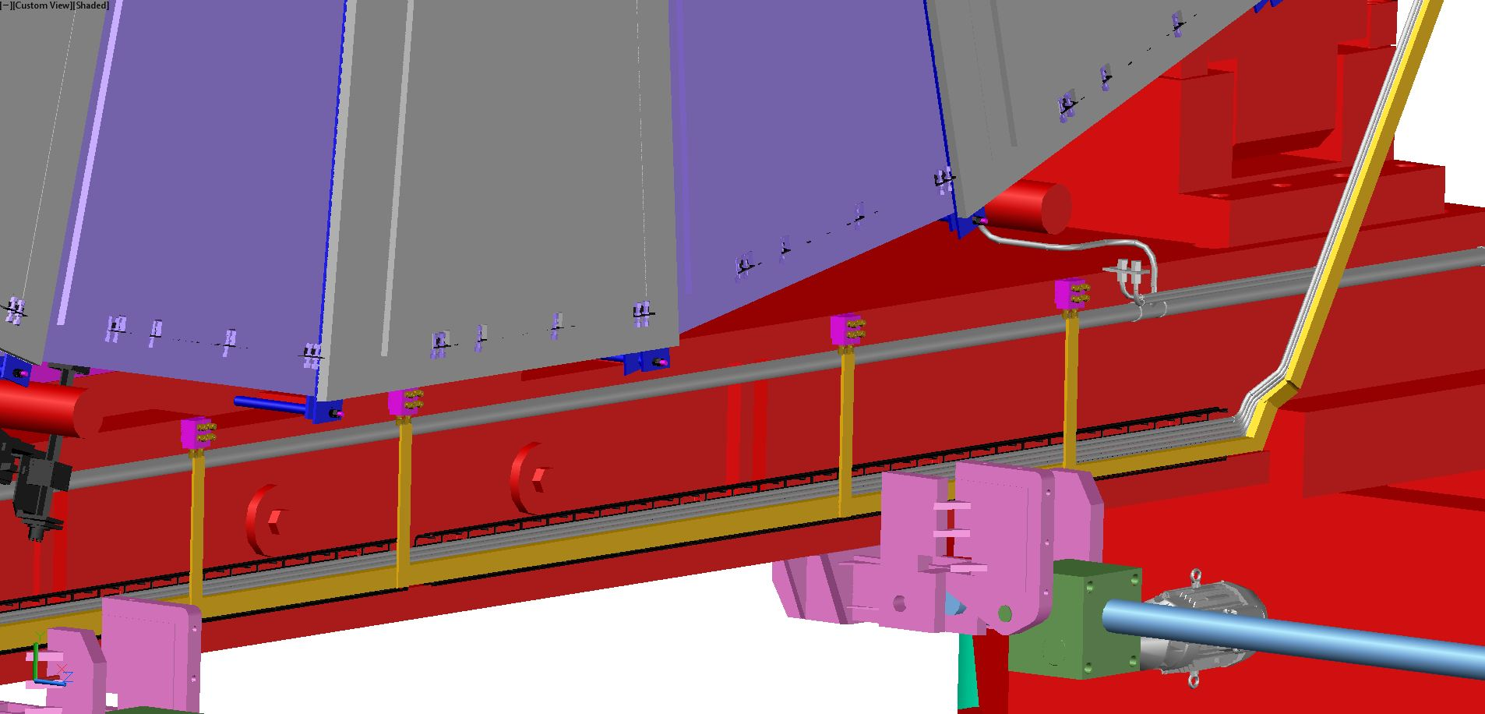
RE+4 gas tubes routing

Slide 18

RE+4 gas tubes routing
Alignment system
RE+4 tubes
ME+4 tubes
YE+3 cart
RE+4 tubes
Y
X

Slide 19
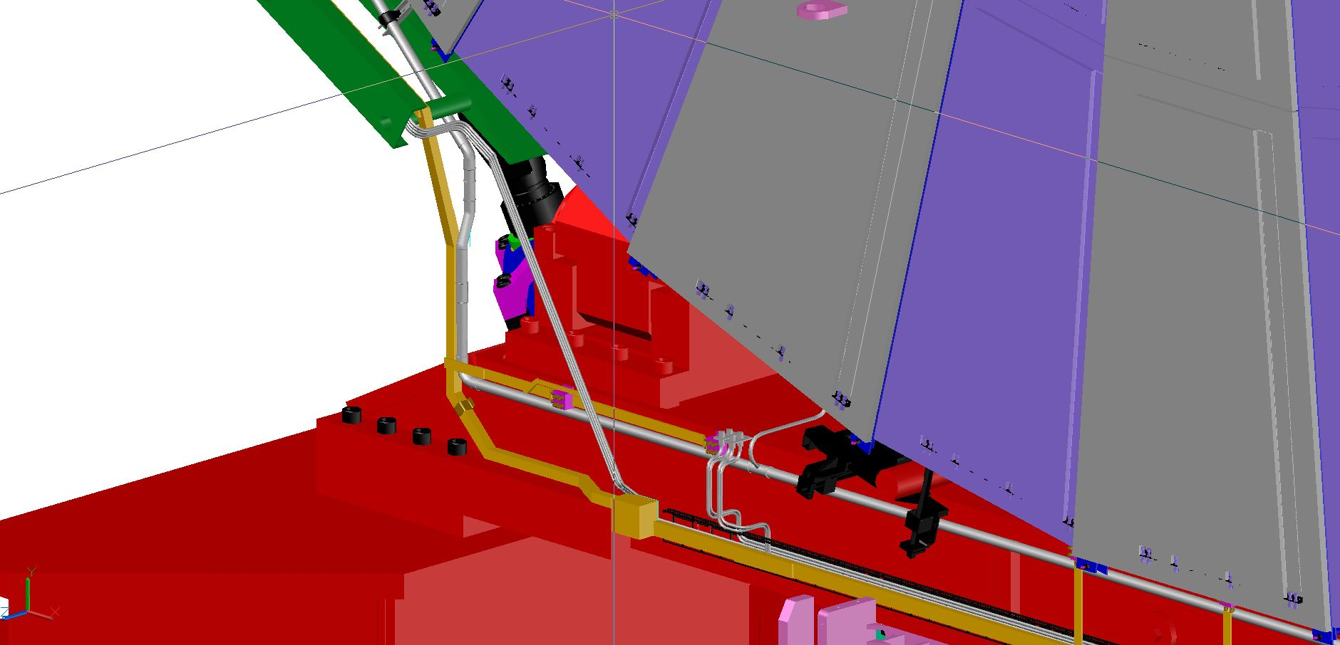
RE+4 gas tubes routing

Slide 20
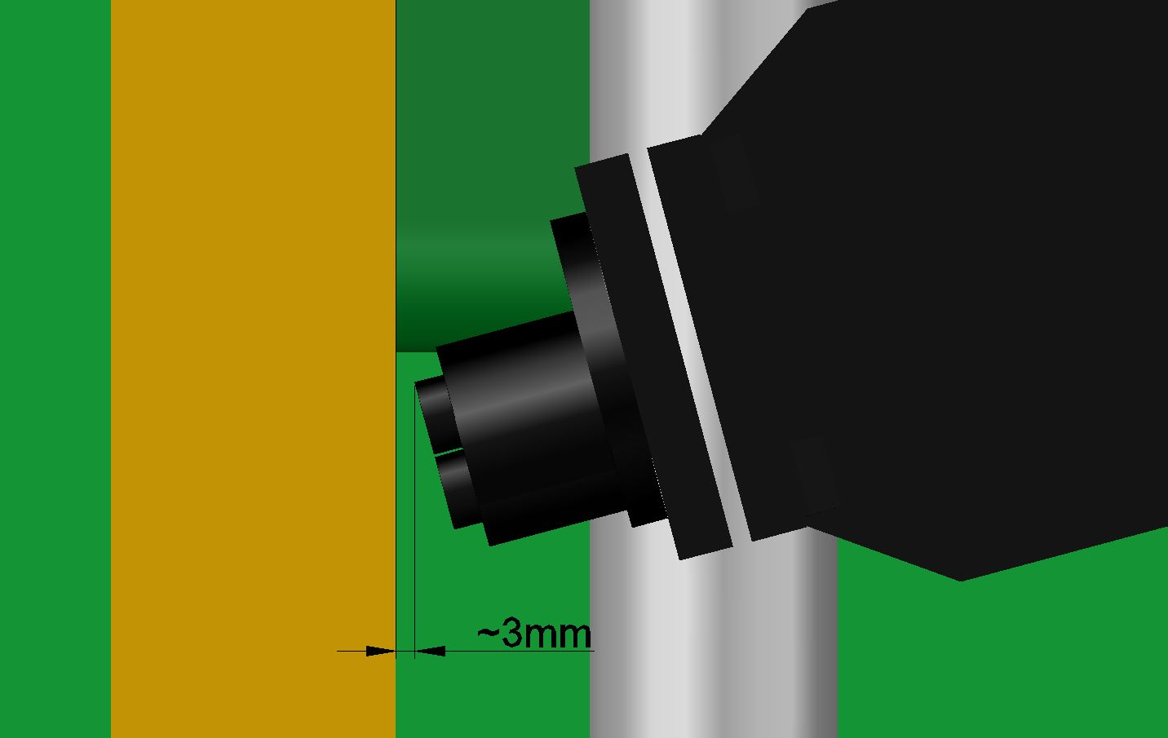
RE+4 gas tubes routing
Alignment system
RE+4 tubes
Y
X

Slide 21
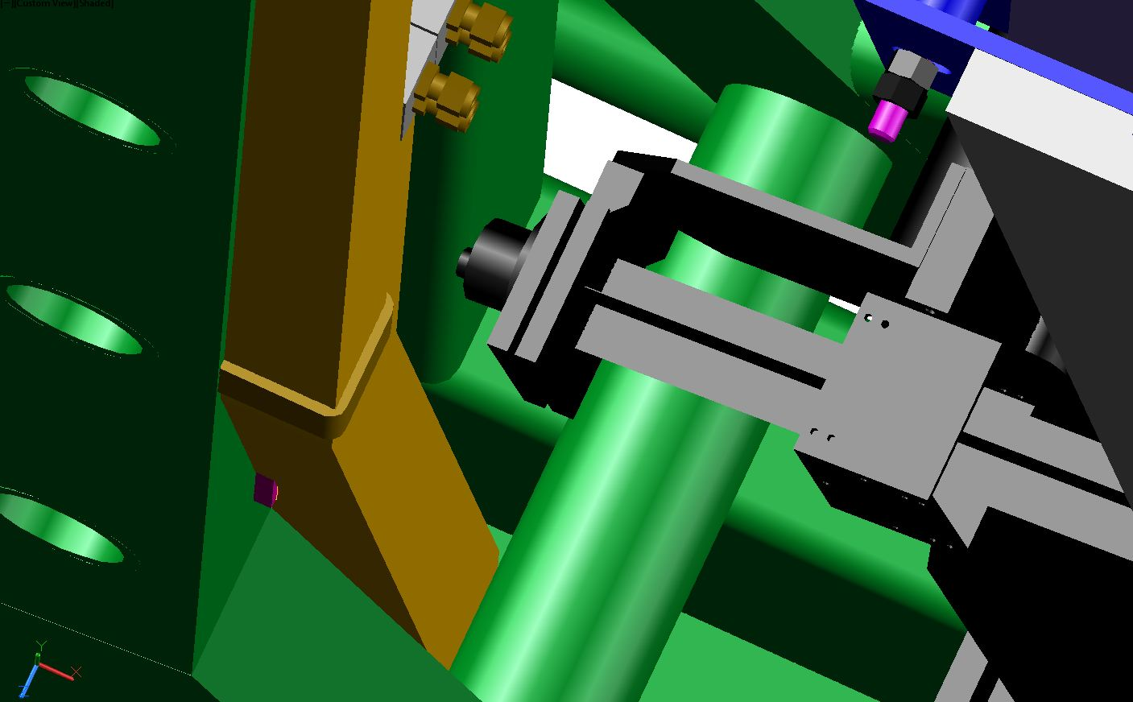
RE+4 gas tubes routing
Alignment system
RE+4 tubes
Y
X

Slide 22
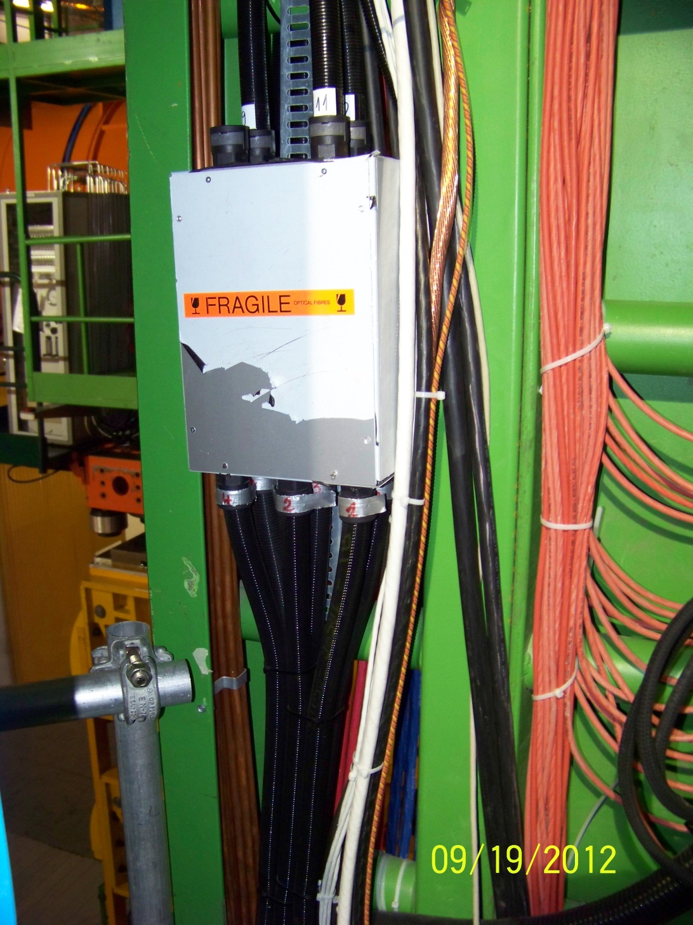
YE+3 photos
The inside of
the green C-bar
Alignment system
RE+4 tubes
Y
X

Slide 23
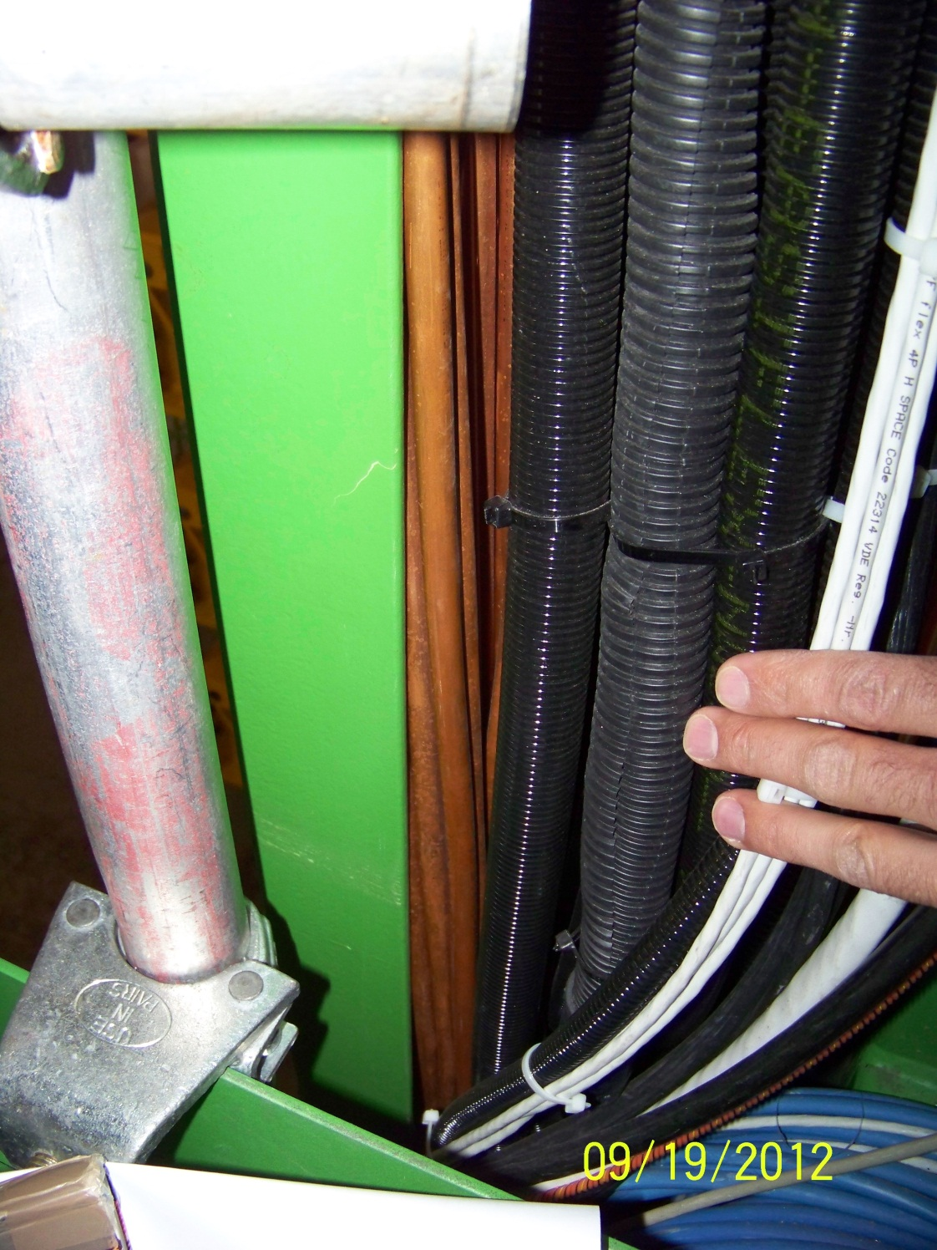
YE+3 photos
The inside of
the green C-bar
Alignment system
RE+4 tubes
Y
X

Slide 24
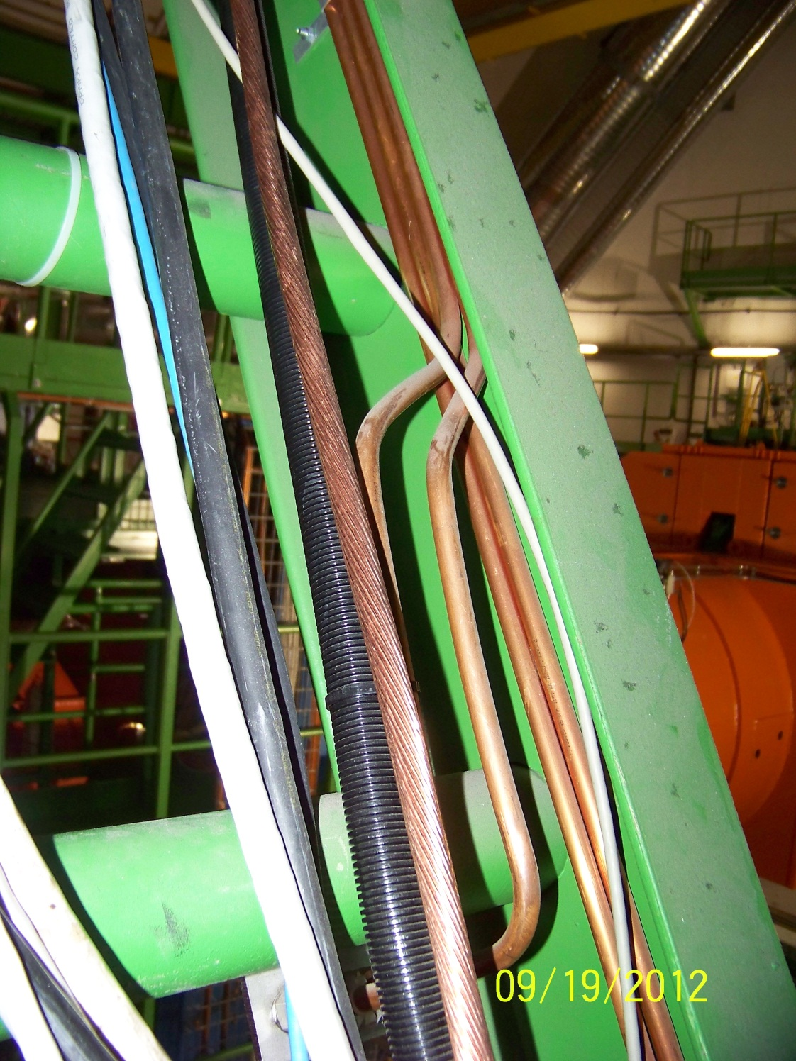
YE+3 photos
The inside of
the green C-bar
Alignment system
RE+4 tubes
Y
X

Slide 25
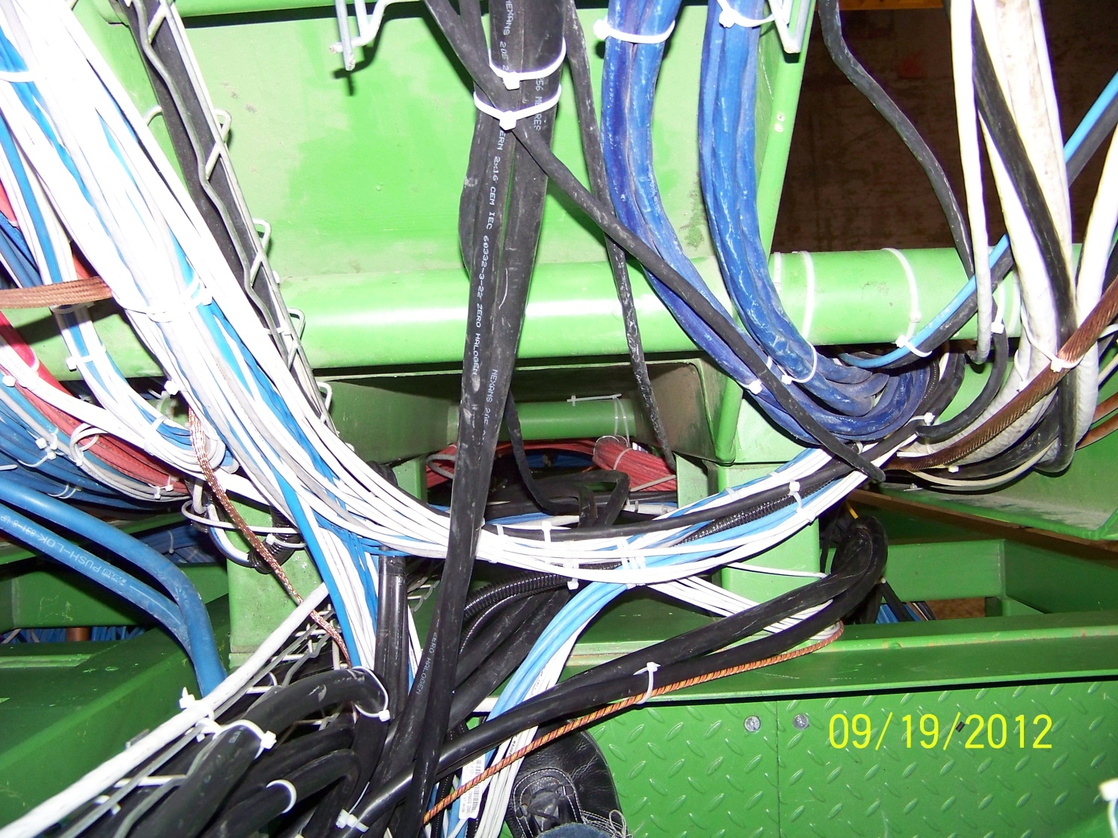
YE+3 photos
Alignment system
RE+4 tubes
Y
X

Slide 26
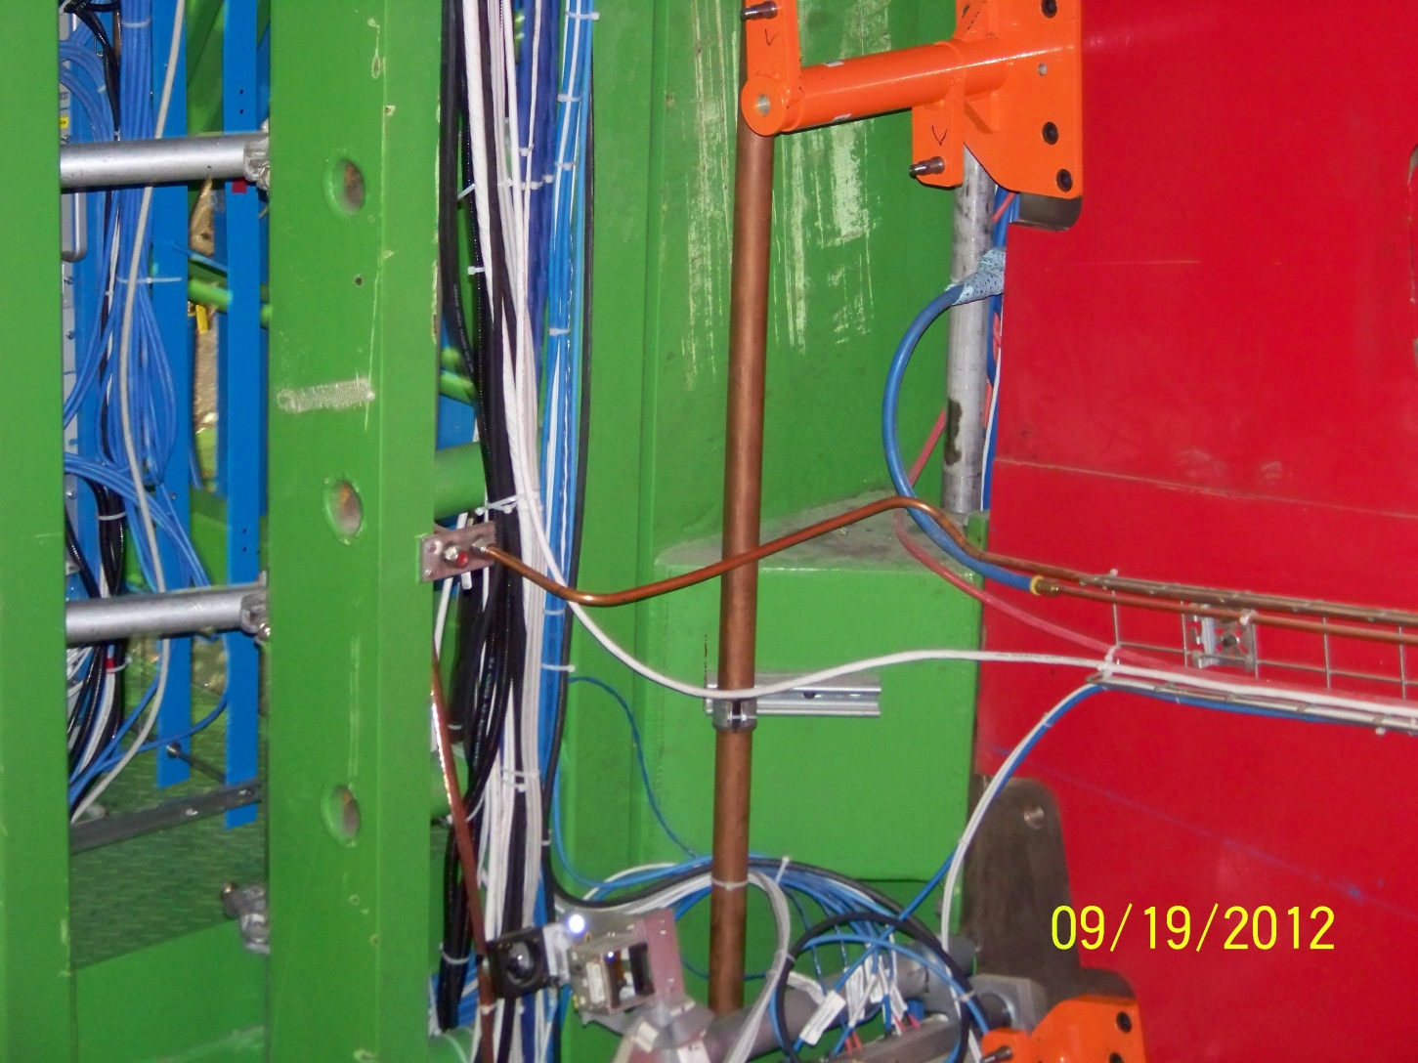
YE+3 photos
The external
face of the
C-bar is free
Alignment system
RE+4 tubes
Y
X

Slide 27
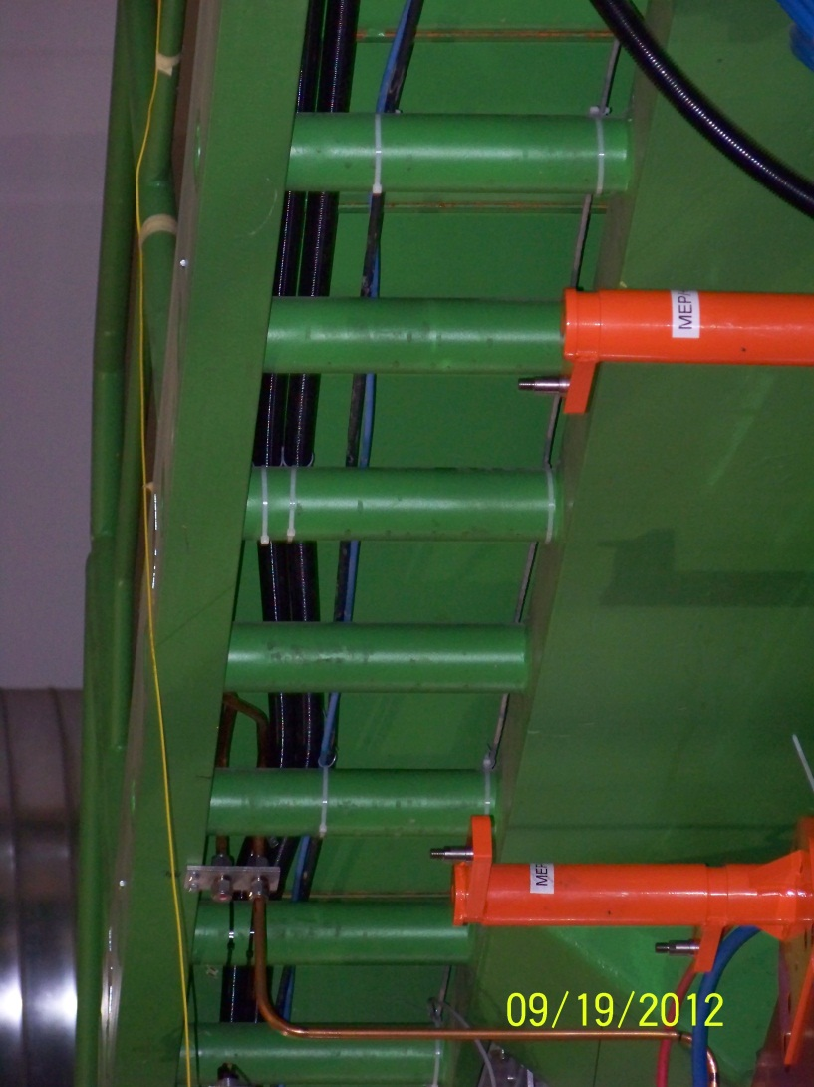
YE+3 photos
The external
face of the
C-bar is free
Alignment system
RE+4 tubes
Y
X

Slide 28
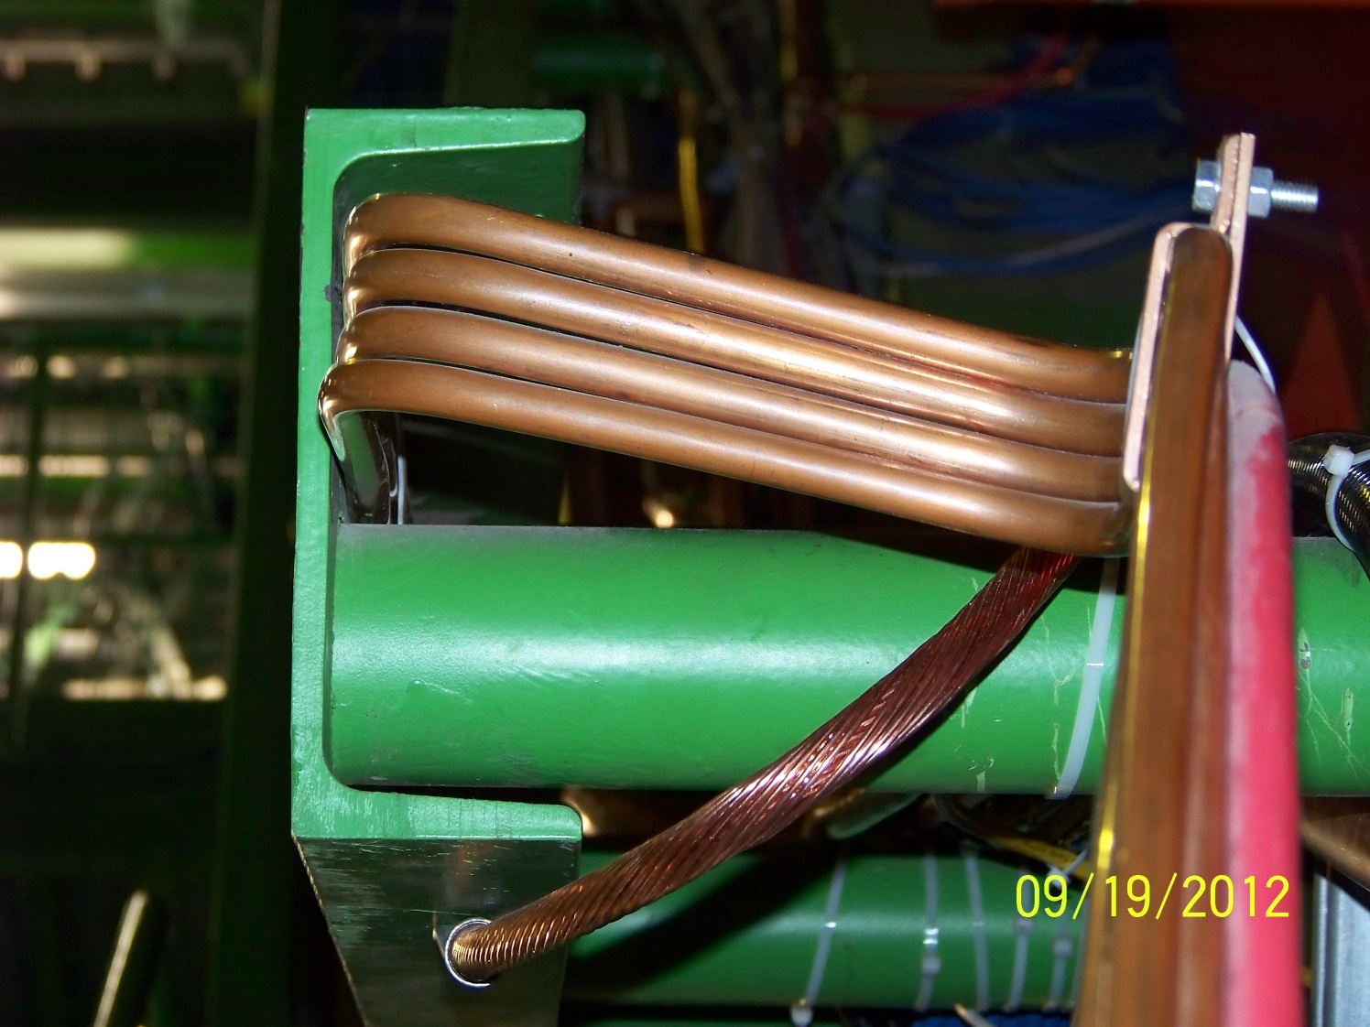
YE+3 photos
Cables to
be moved
Alignment system
RE+4 tubes
Y
X

Slide 29
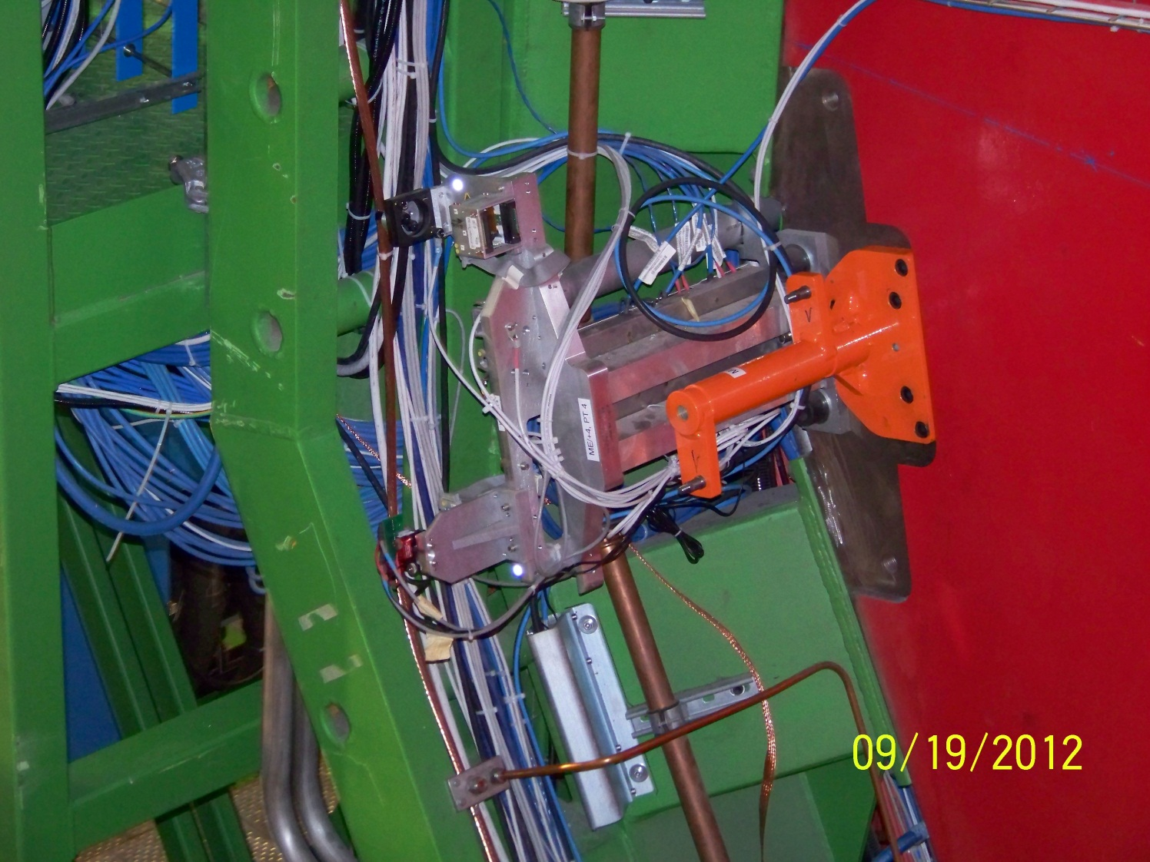
YE+3 photos
Cables to
be moved
Alignment system
RE+4 tubes
Y
X

Slide 30
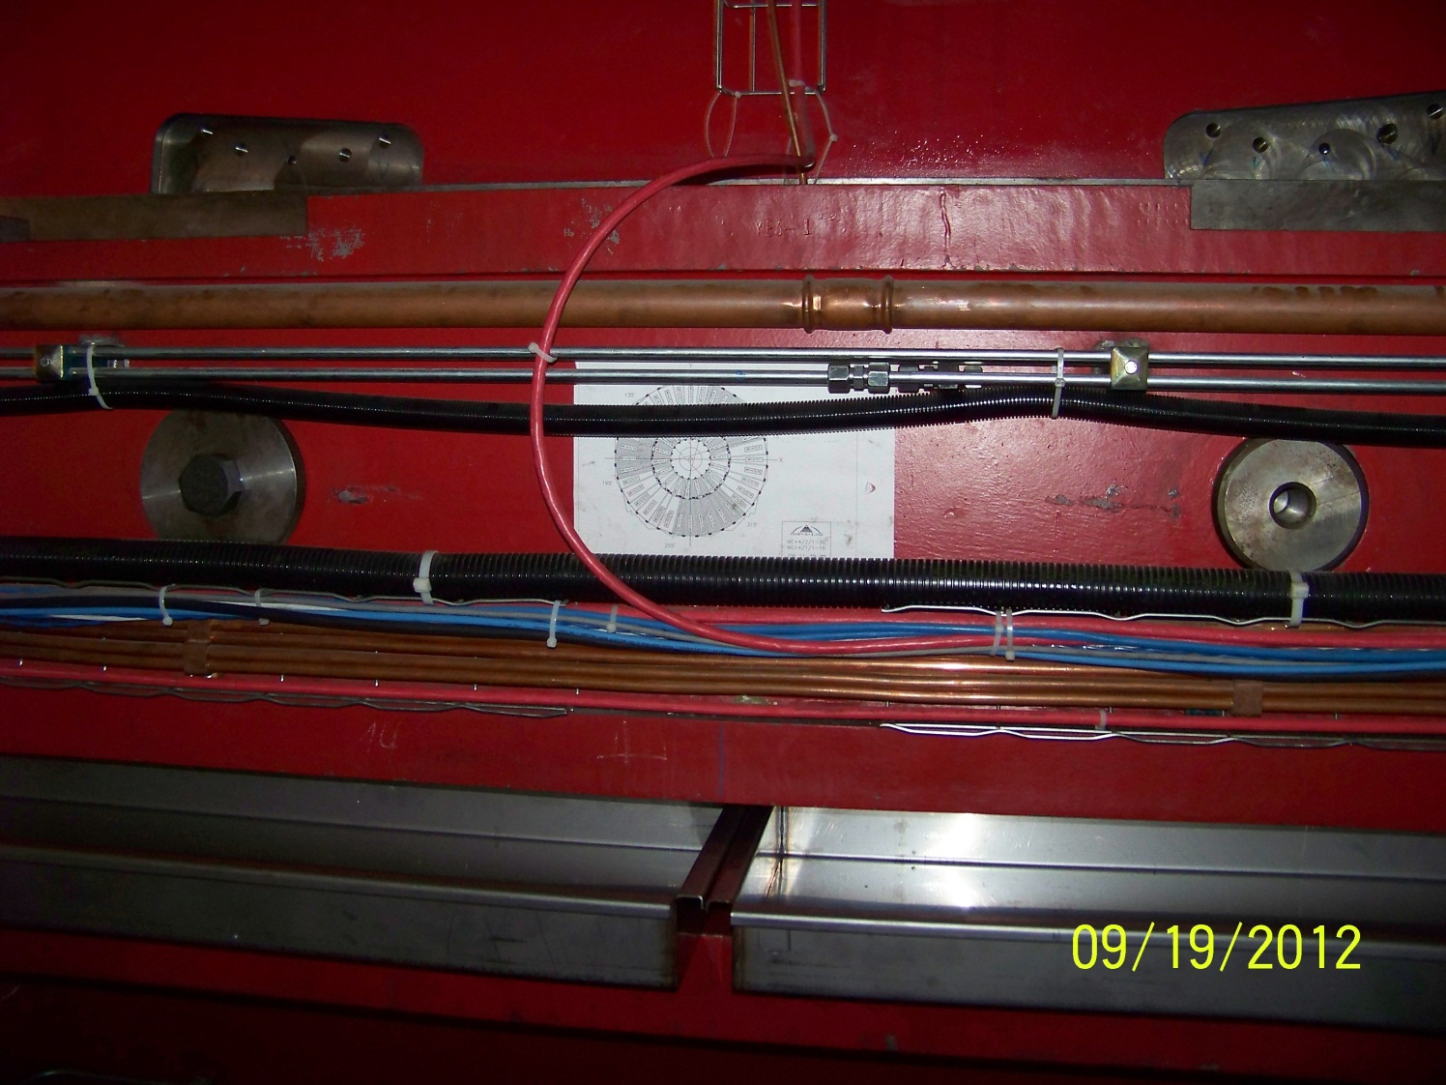
YE+3 photos
Cables to
be moved
Alignment system
RE+4 tubes
Y
X

Slide 31
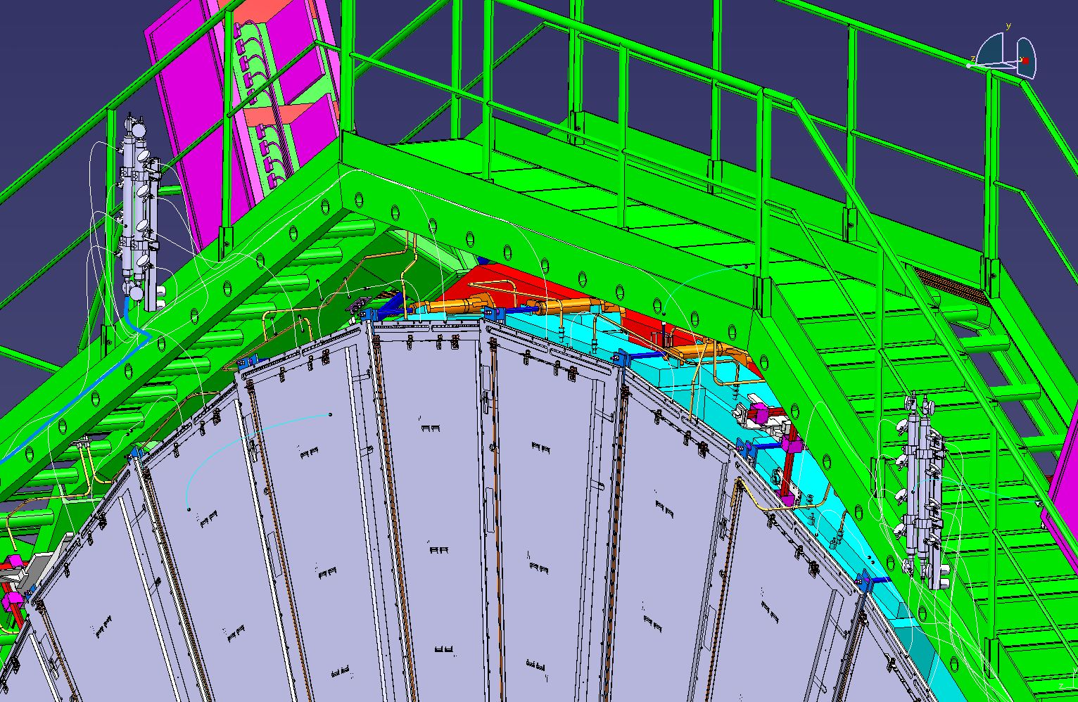
RE+4 cooling?

