Slide 1
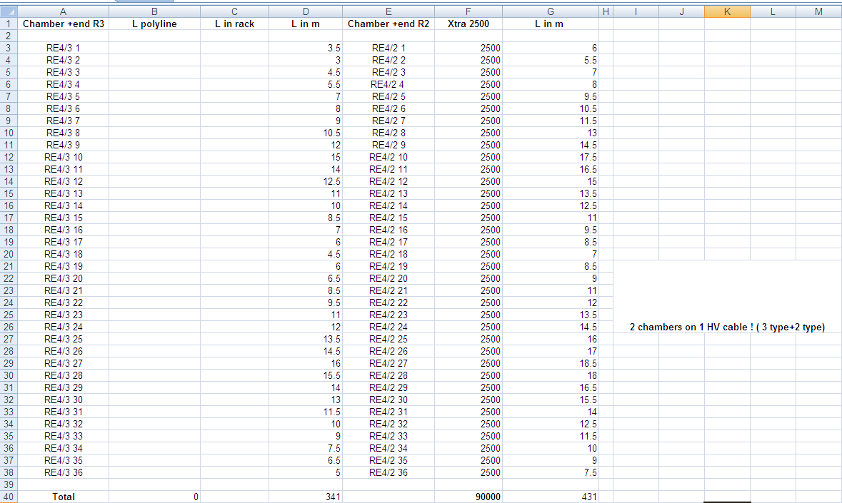
New LV cable lengths via top of racks (NO slack included)
WVD 9/9/2013

Slide 2
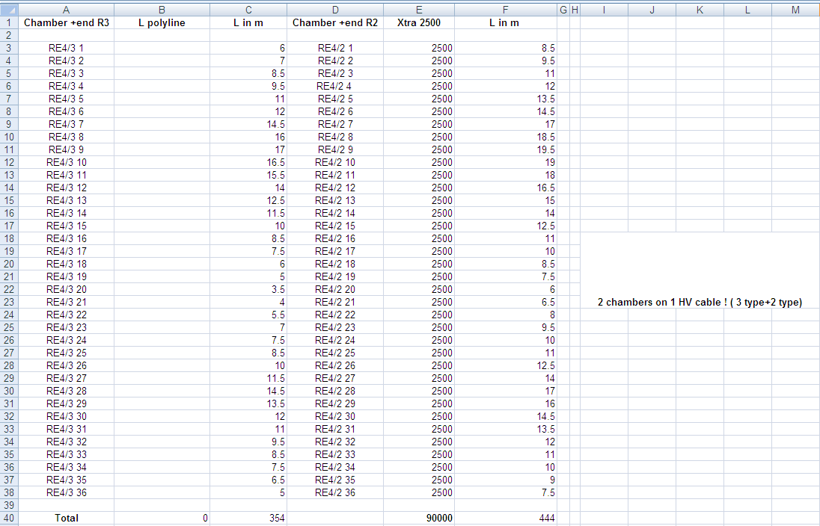
New LV cable lengths via bottom of racks (NO slack included)
WVD 9/9/2013

