Slide 1
Proposed LV Racks layout for RE4
Prepared By: Hassan, Ian, Nicolas, Walter in June 2011
Modified by: Hassan & Nicolas (14.11.2011)

Slide 2
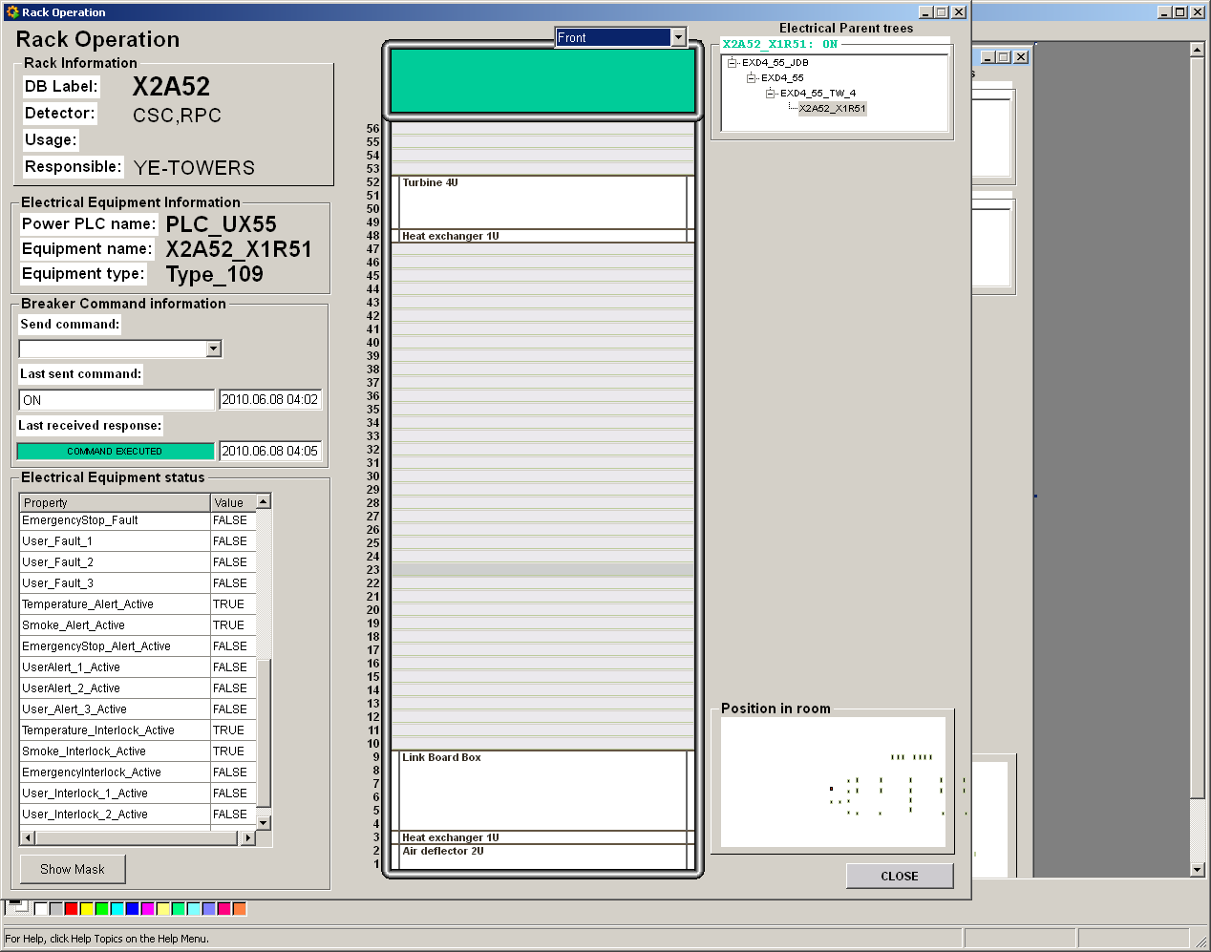
X2A52
LBB RE4

Slide 3
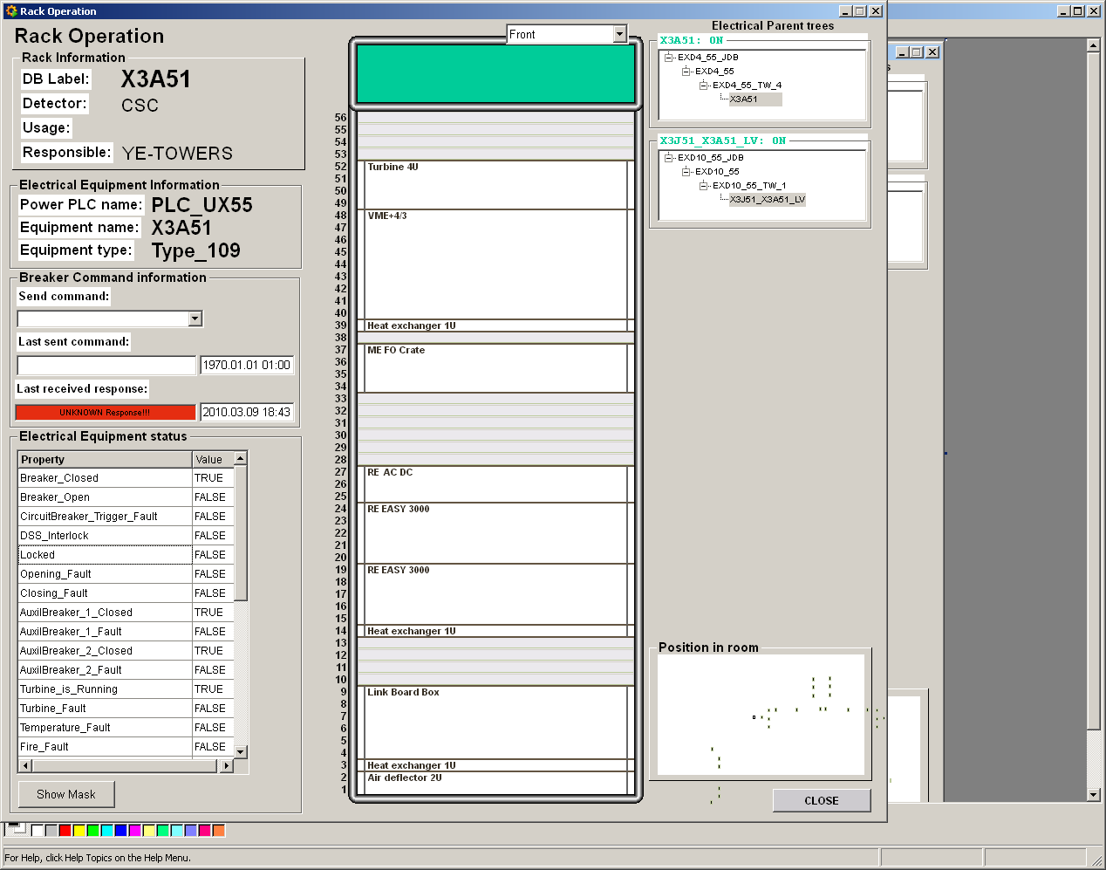
X3A51
LBB RE4
Notes:
IT SEEMS MAO CAN BE MOVE DOWN, or ME FO CRATE MOVE 1 UNIT UP

Slide 4
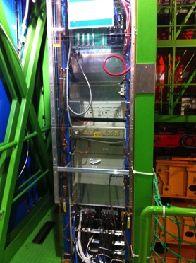
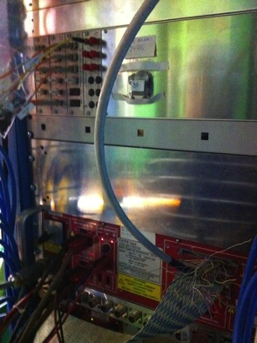
Far X3 YE+3

Slide 5
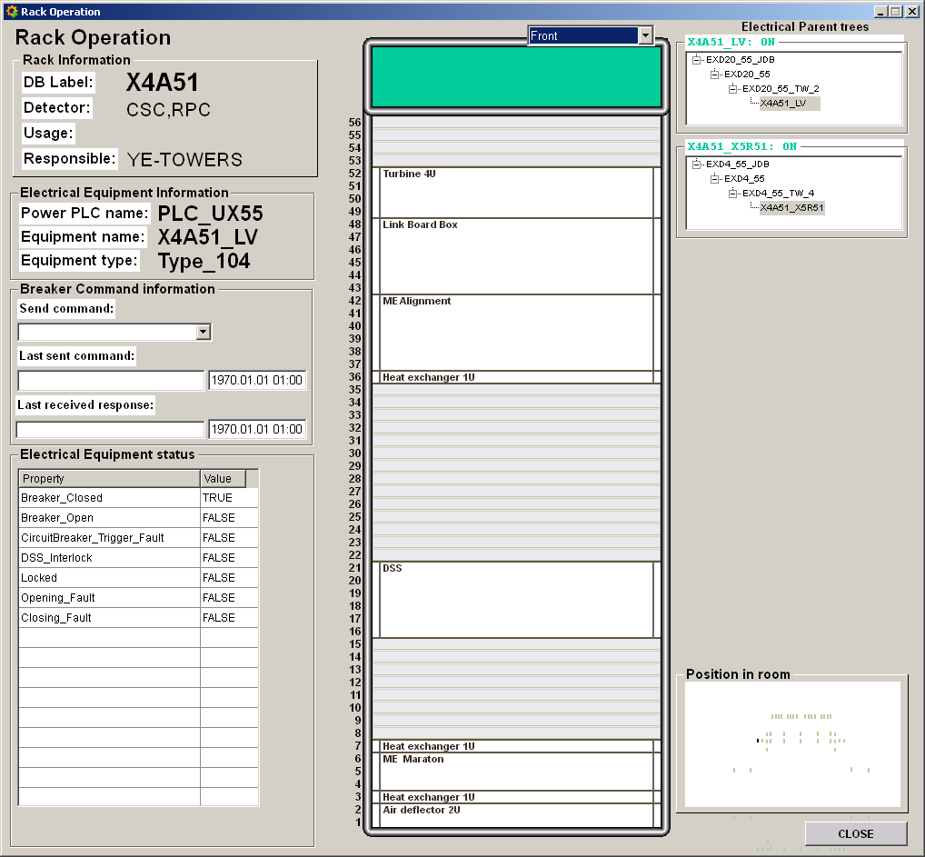
X4A51
LBB RE4

Slide 6
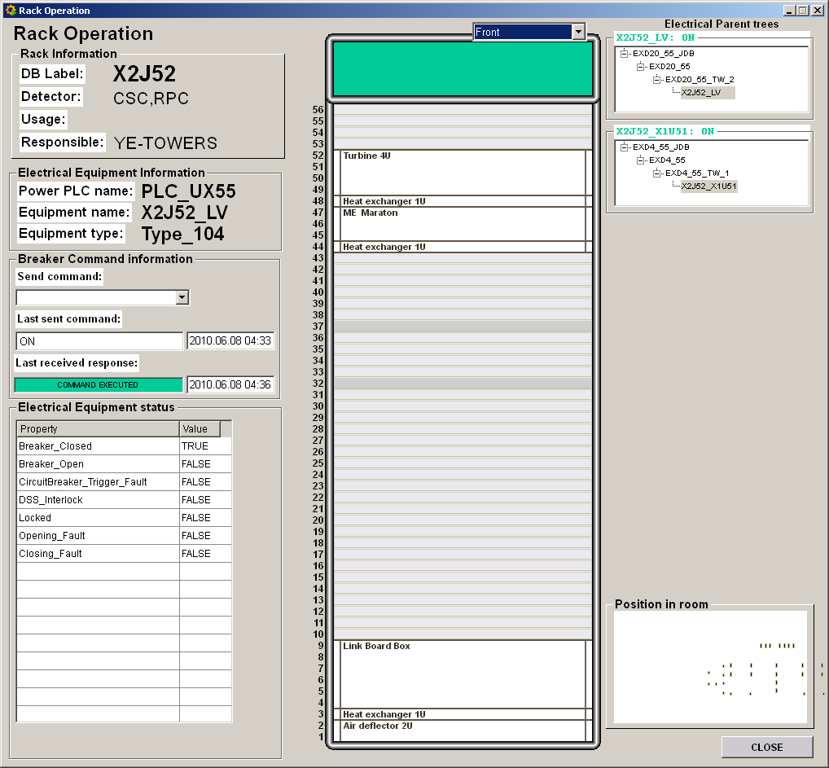
X2J52
LBB RE4

Slide 7
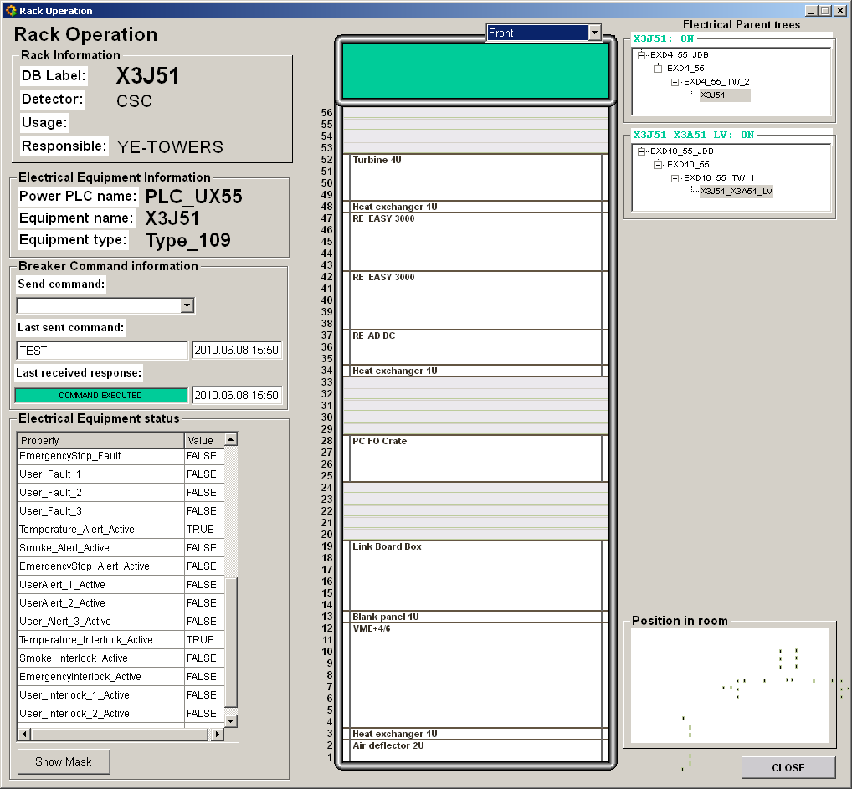
X3J51
LBB RE4
Notes:
It seems plenty of space above the already installed LBB. If not we can move pc FO crate one unit up which is also compatible with the direction of the cable.

Slide 8
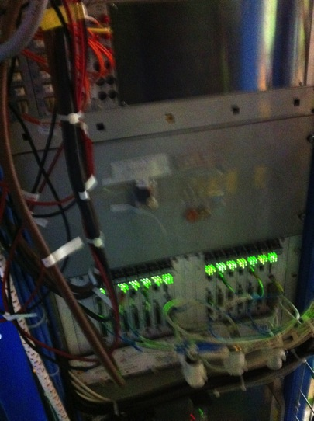
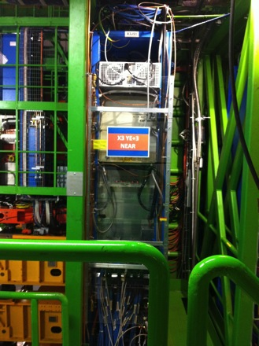
Near X3 YE+3

Slide 9
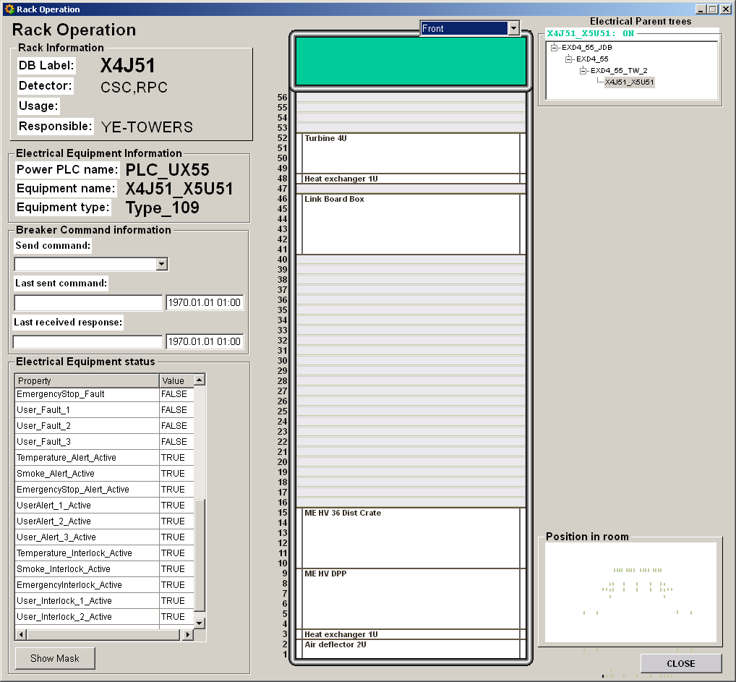
X4J51
LBB RE4

Slide 10
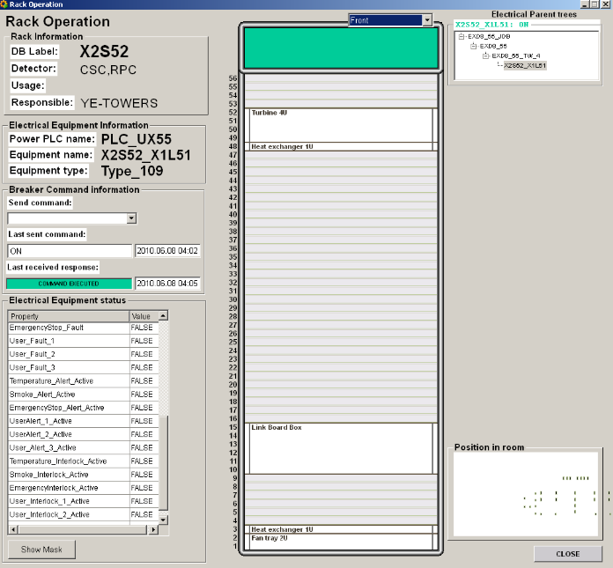
X2S52
LBB RE4

Slide 11
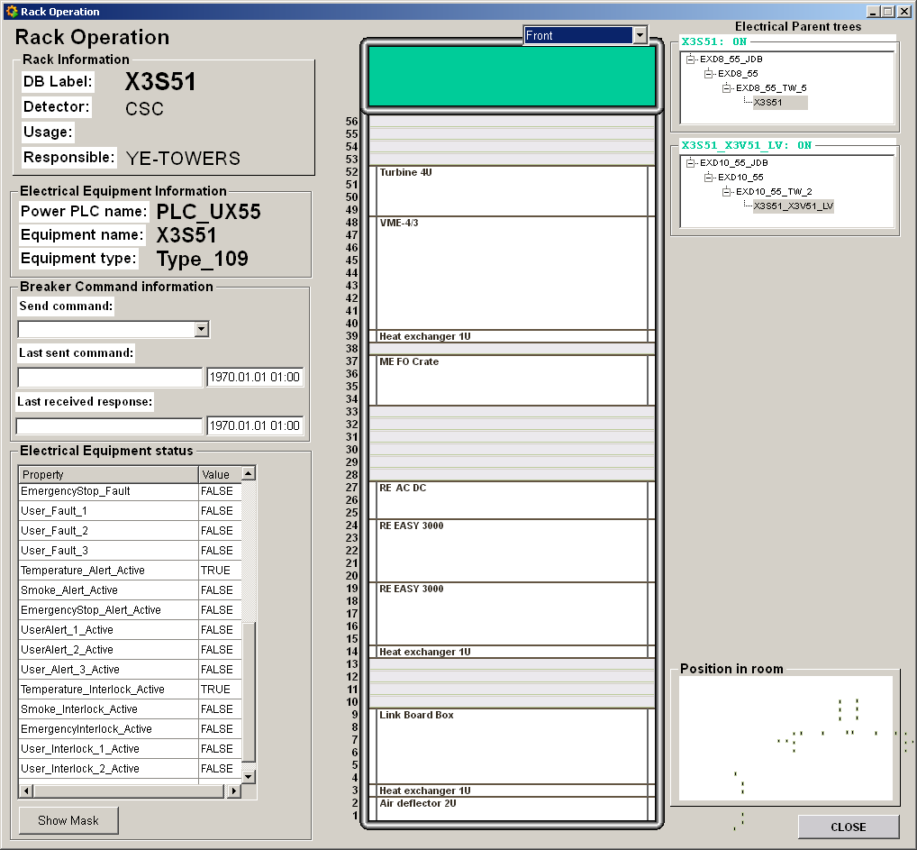
X3S51
LBB RE4
Notes:
The above rack layout is wrong. Secondly, from the pictures taken it is clear that there is 6 unit space available above the existing LBB. So we can put the LBB there OR to move our EASY Crate down and put LBB on top of them to have a better access on the signal cables.

Slide 12
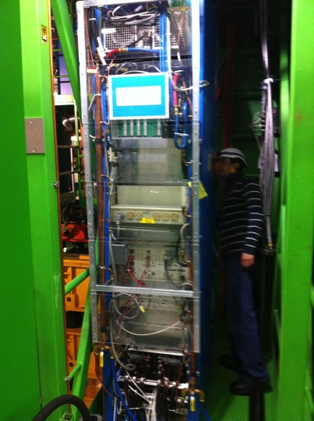
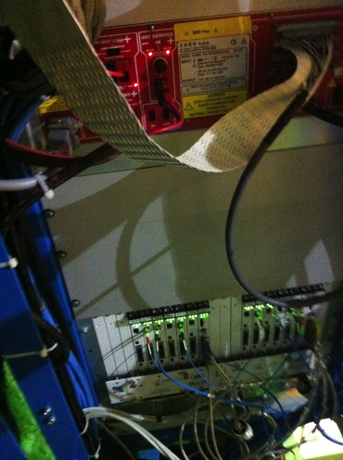
Far X3 YE-3

Slide 13
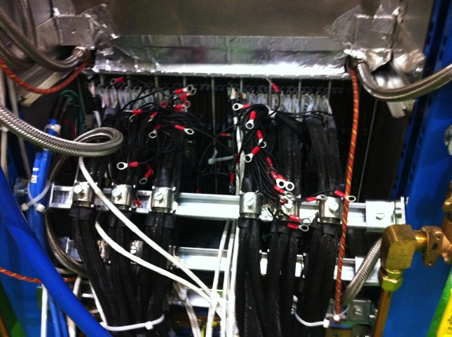
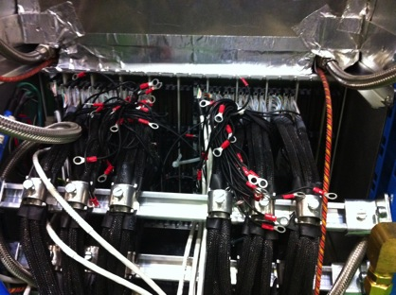
Far X3 YE-3 Link Boards

Slide 14
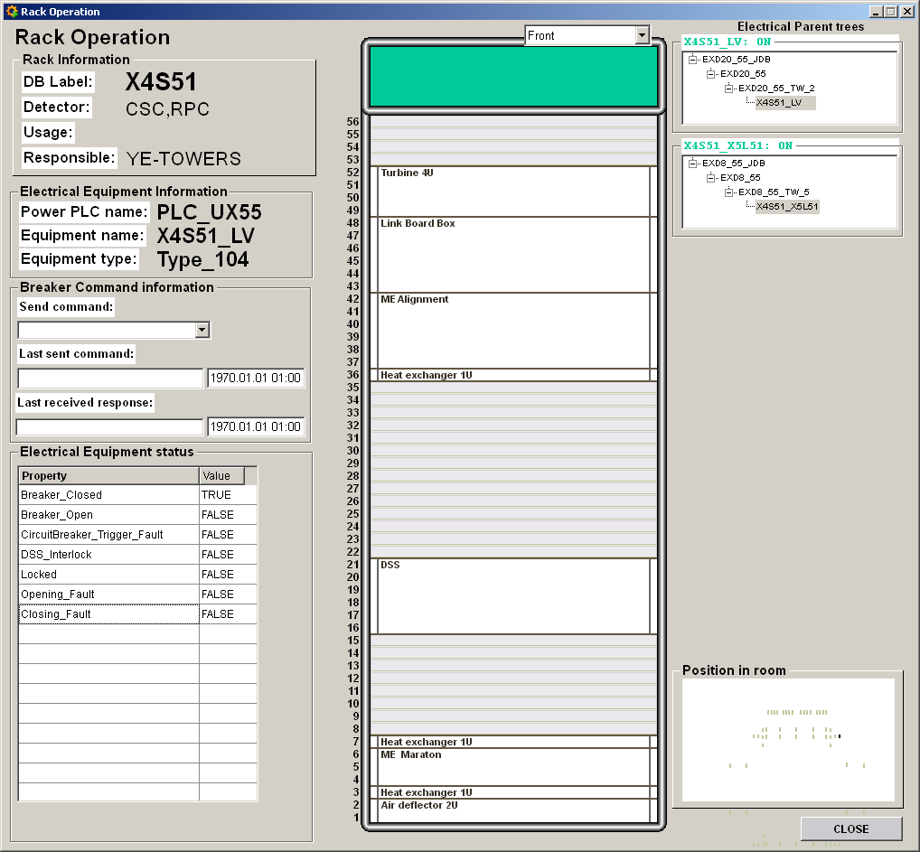
X4S51
LBB RE4

Slide 15
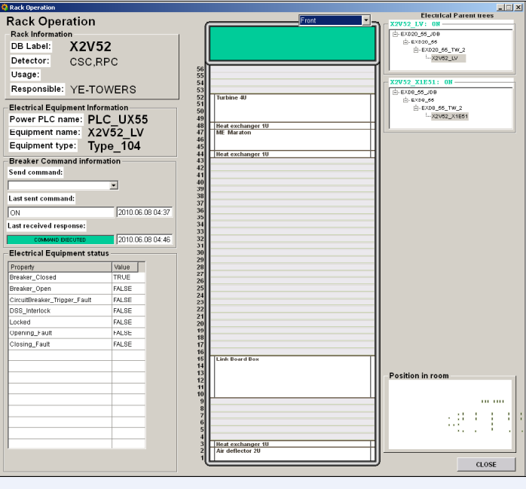
X2V52
LBB RE4

Slide 16
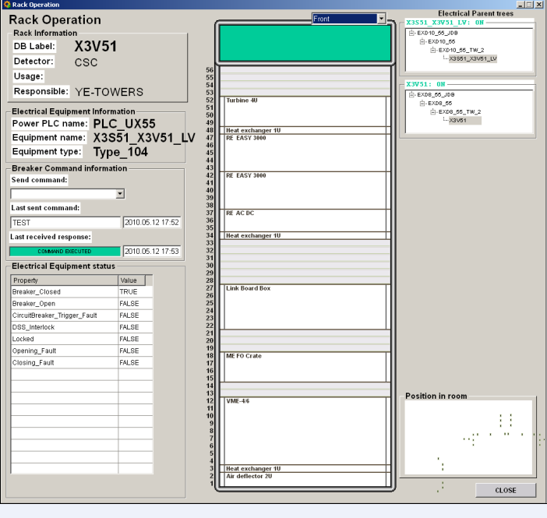
X3V51
LBB RE4
Notes:
It seems that 4 individual units are available on different places in the rack, moreover 2 units are available on top of turbine. But needs more closer look on the rack in ETS.

Slide 17
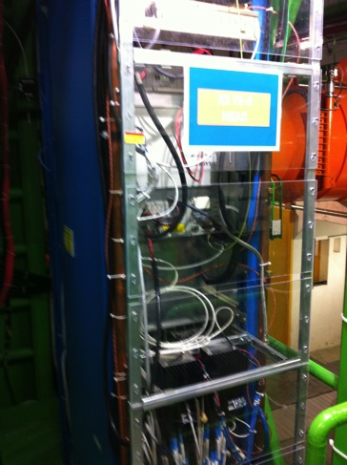
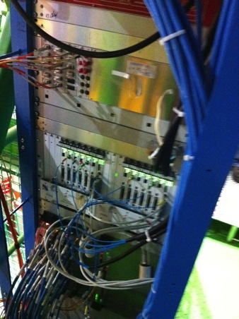
Near X3 YE-3

Slide 18
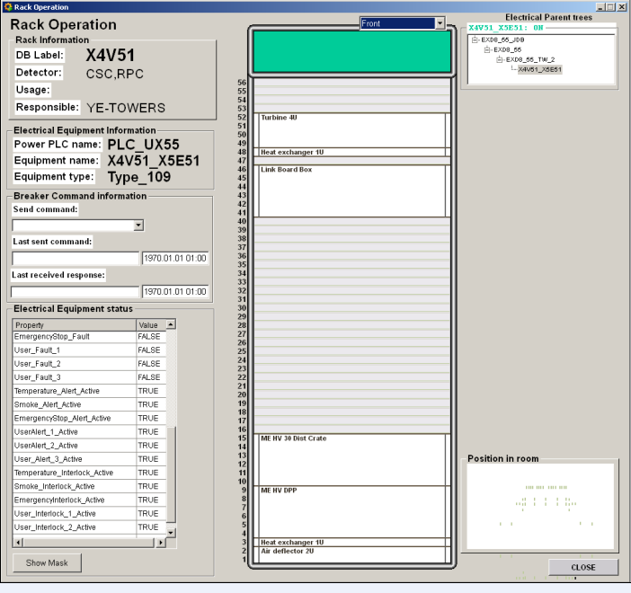
X4V51
LBB RE4

