Slide 1
Proposed LV Racks layout for RE4
Hassan, Ian, Nicolas, Walter

Slide 2
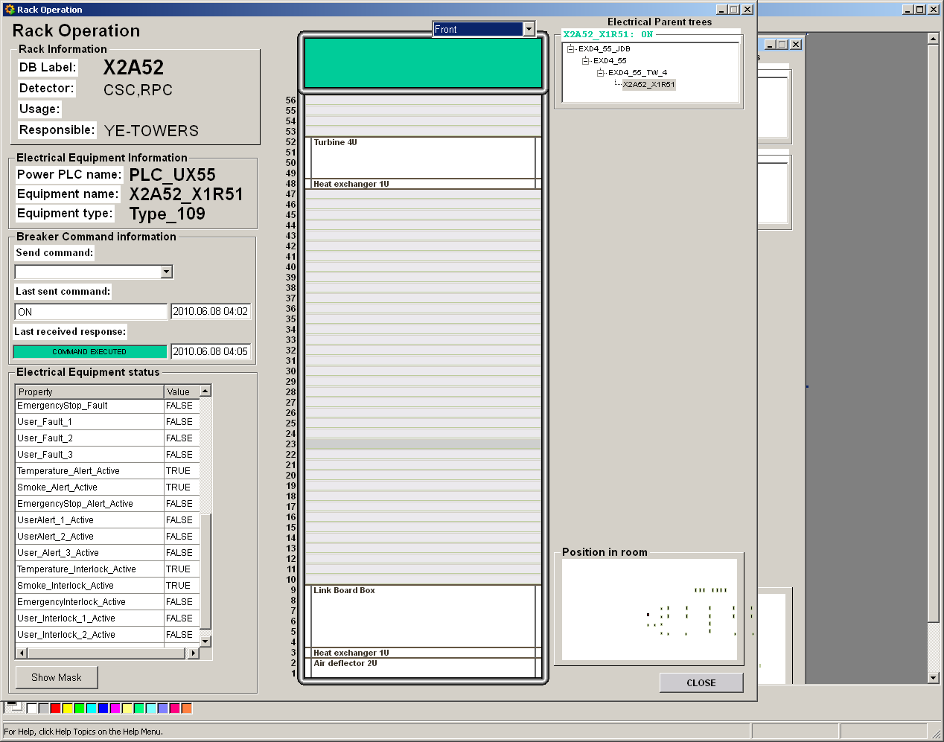
X2A52
LBB RE4

Slide 3
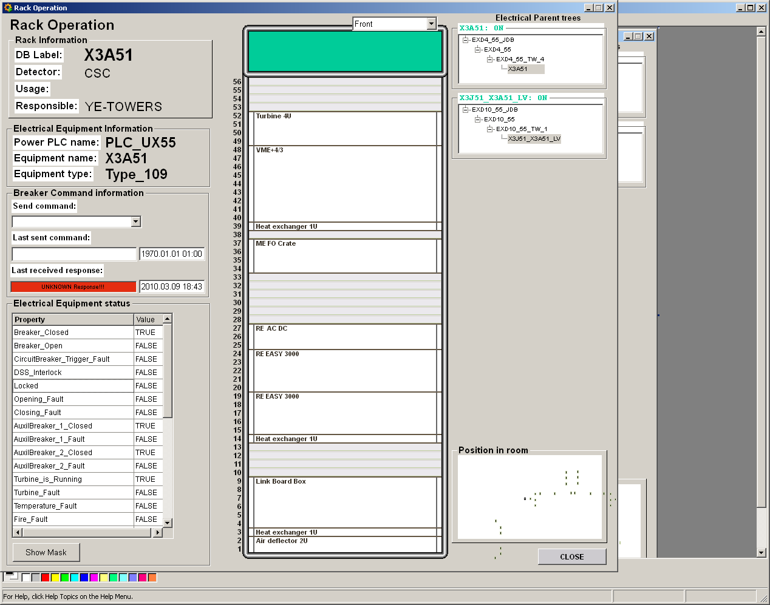
X3A51
LBB RE4

Slide 4
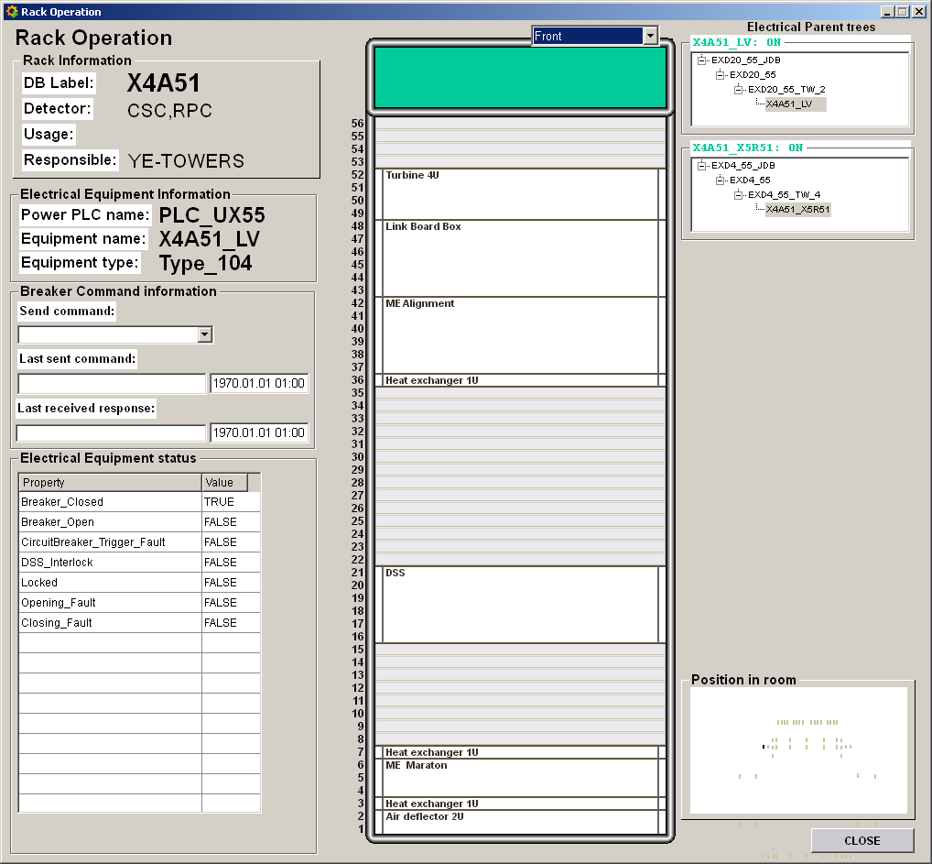
X4A51
LBB RE4

Slide 5
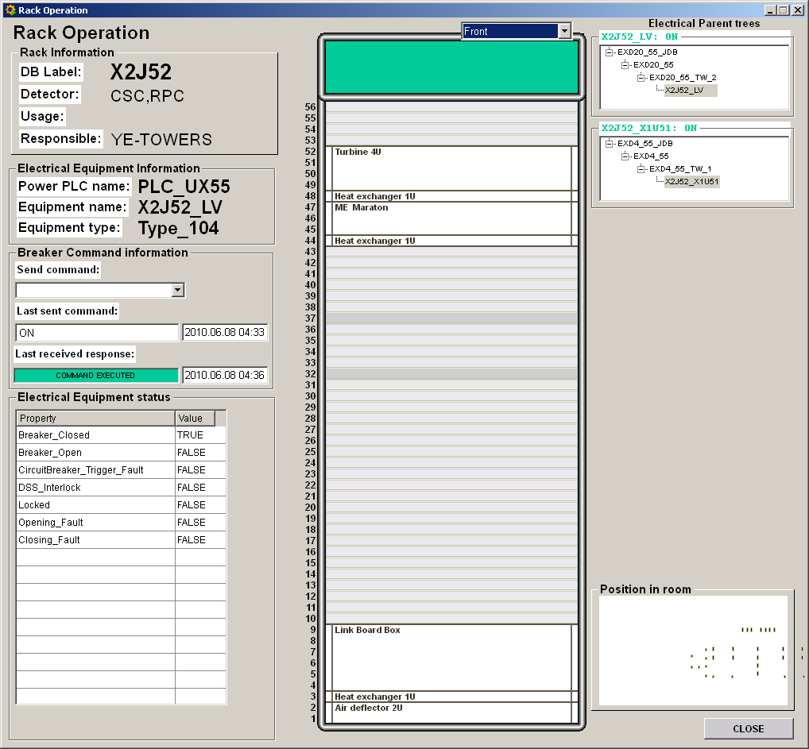
X2J52
LBB RE4

Slide 6
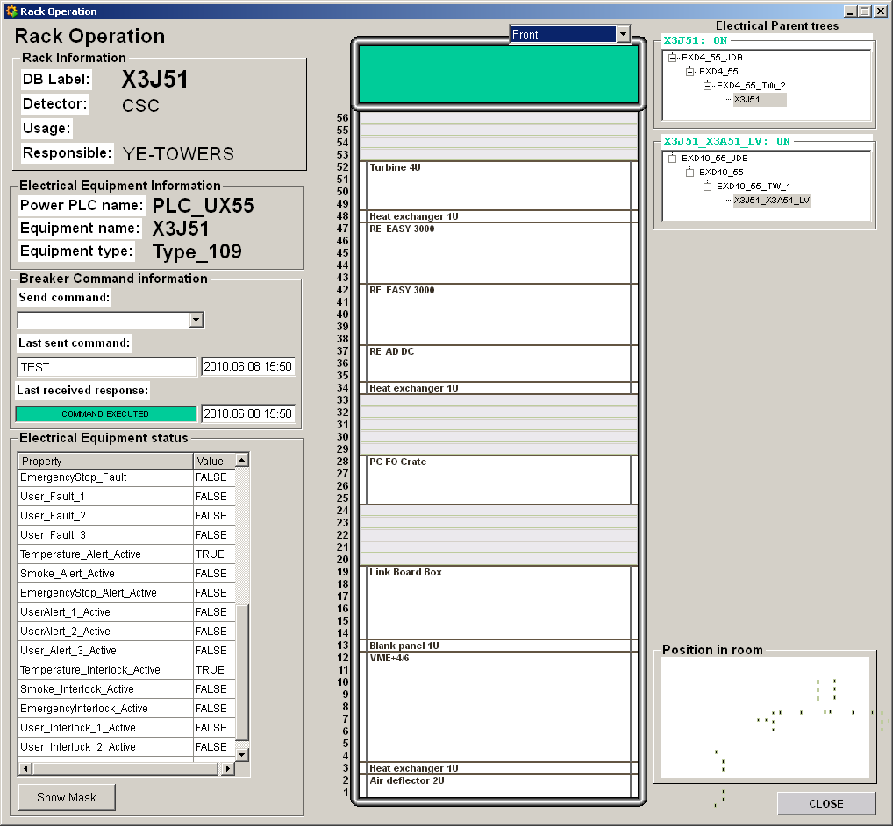
X3J51
LBB RE4

Slide 7
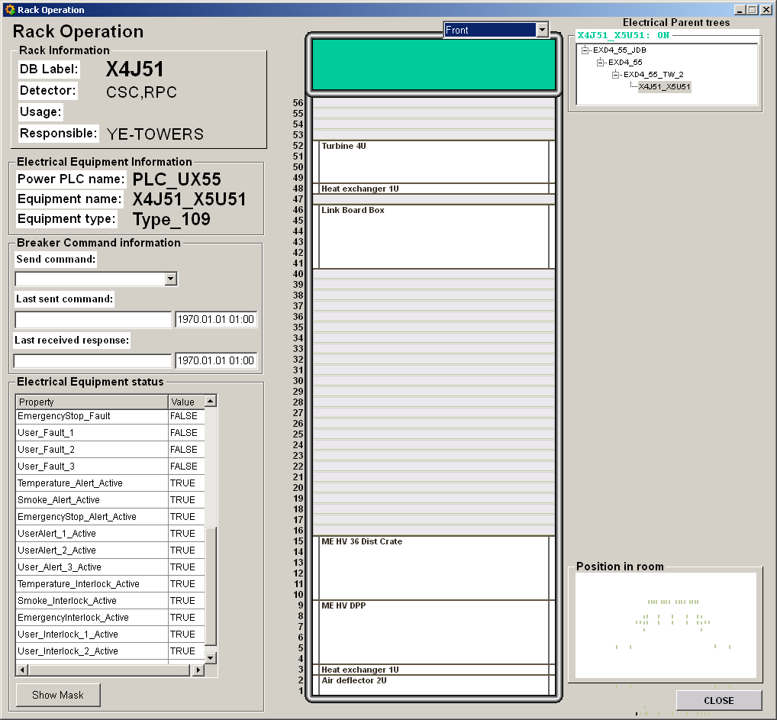
X4J51
LBB RE4

Slide 8
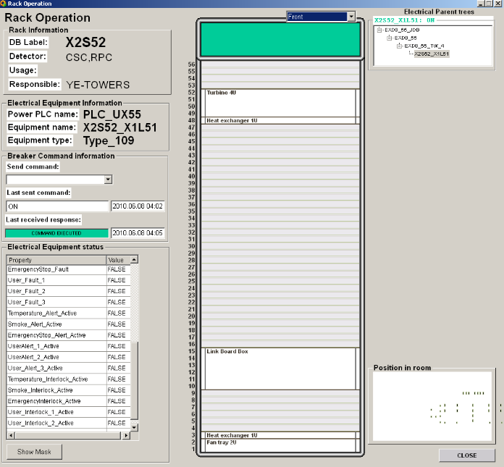
X2S52
LBB RE4

Slide 9
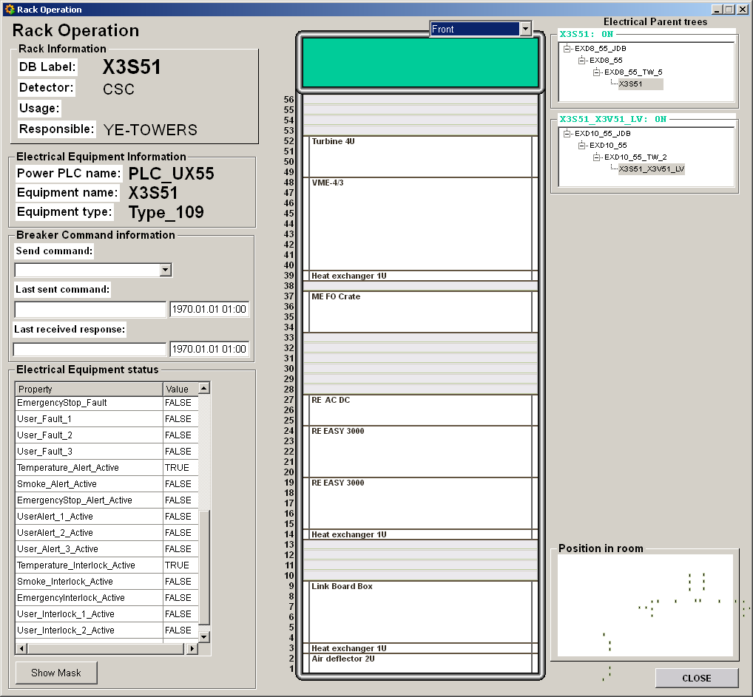
X3S51
LBB RE4

Slide 10
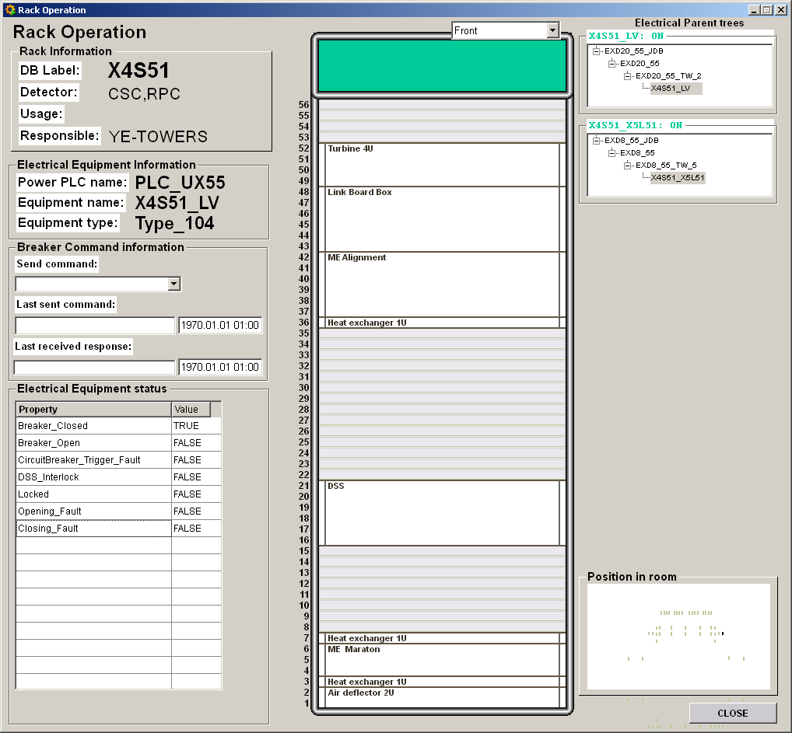
X4S51
LBB RE4

Slide 11
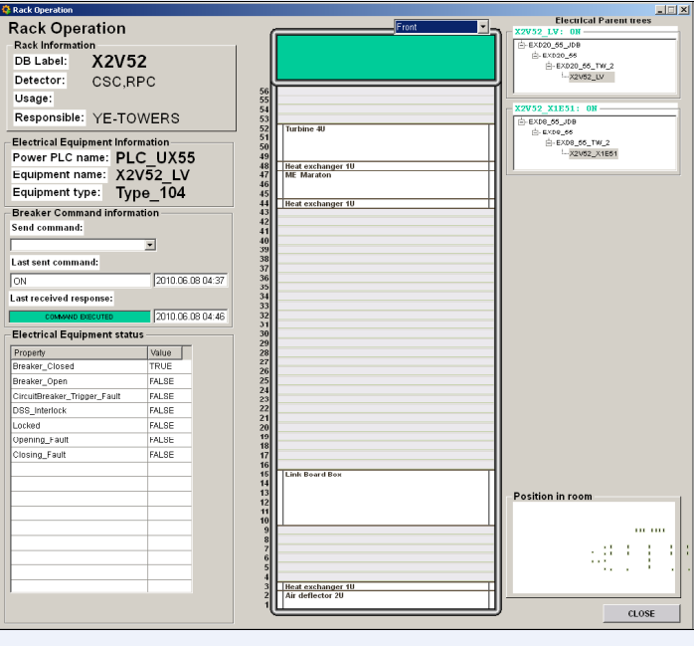
X2V52
LBB RE4

Slide 12
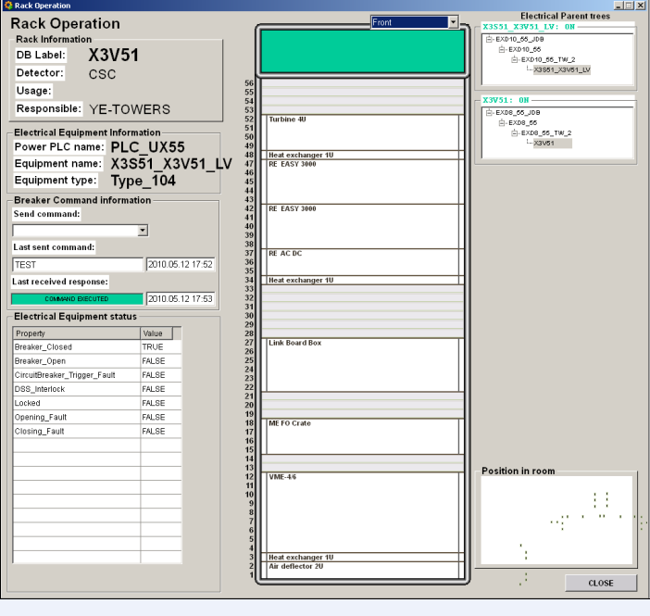
X3V51
LBB RE4

Slide 13
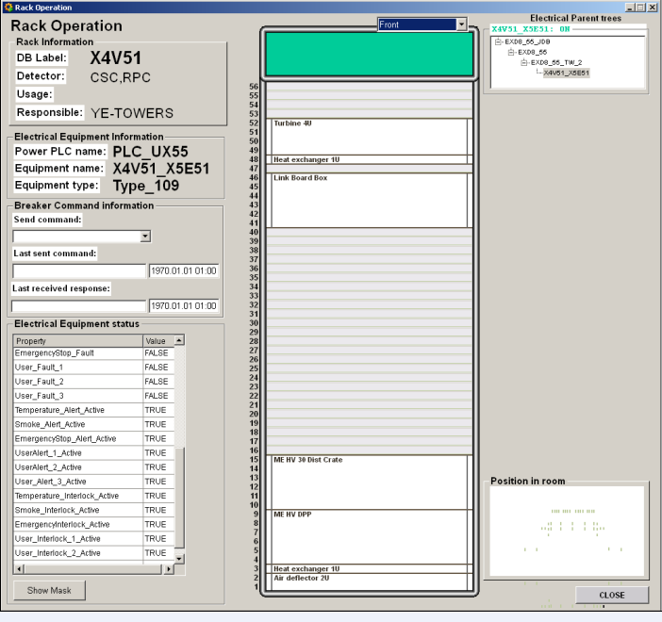
X4V51
LBB RE4

