Slide 1
Proposed LV Racks layout for RE4
Hassan, Ian, Nicolas, Walter

Slide 2
CT = cable tray
CH = Mini Cable Chain

Slide 3
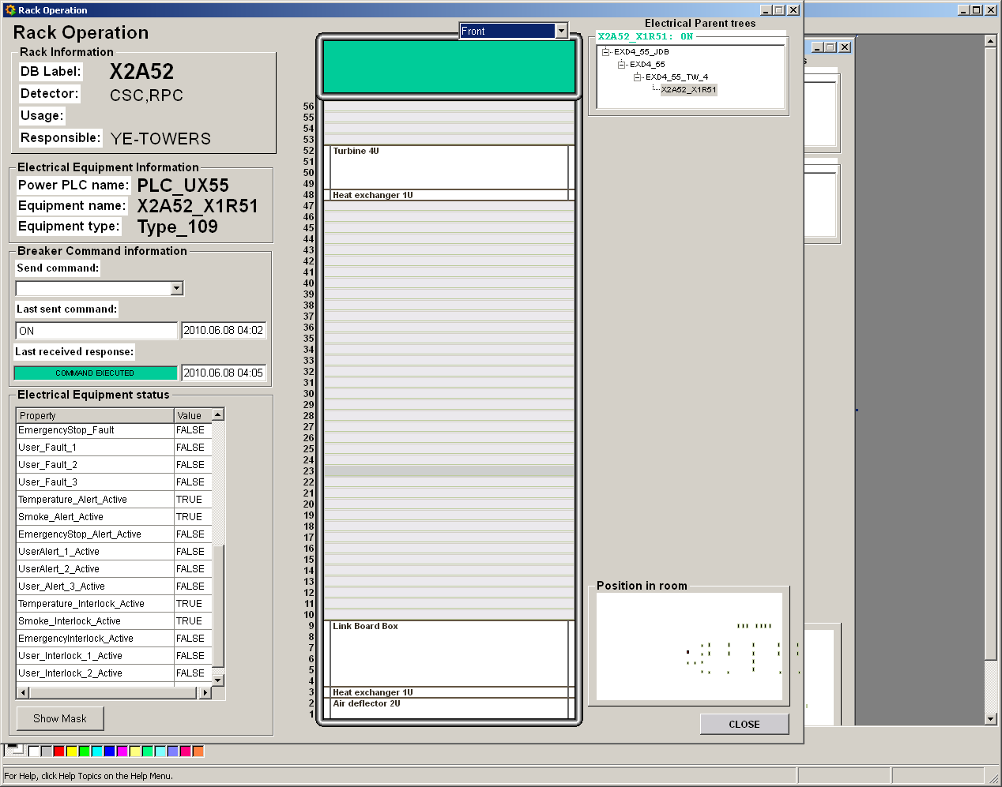
X2A52
CT = cable tray
LBB RE4
Need bigger hole in floor

Slide 4
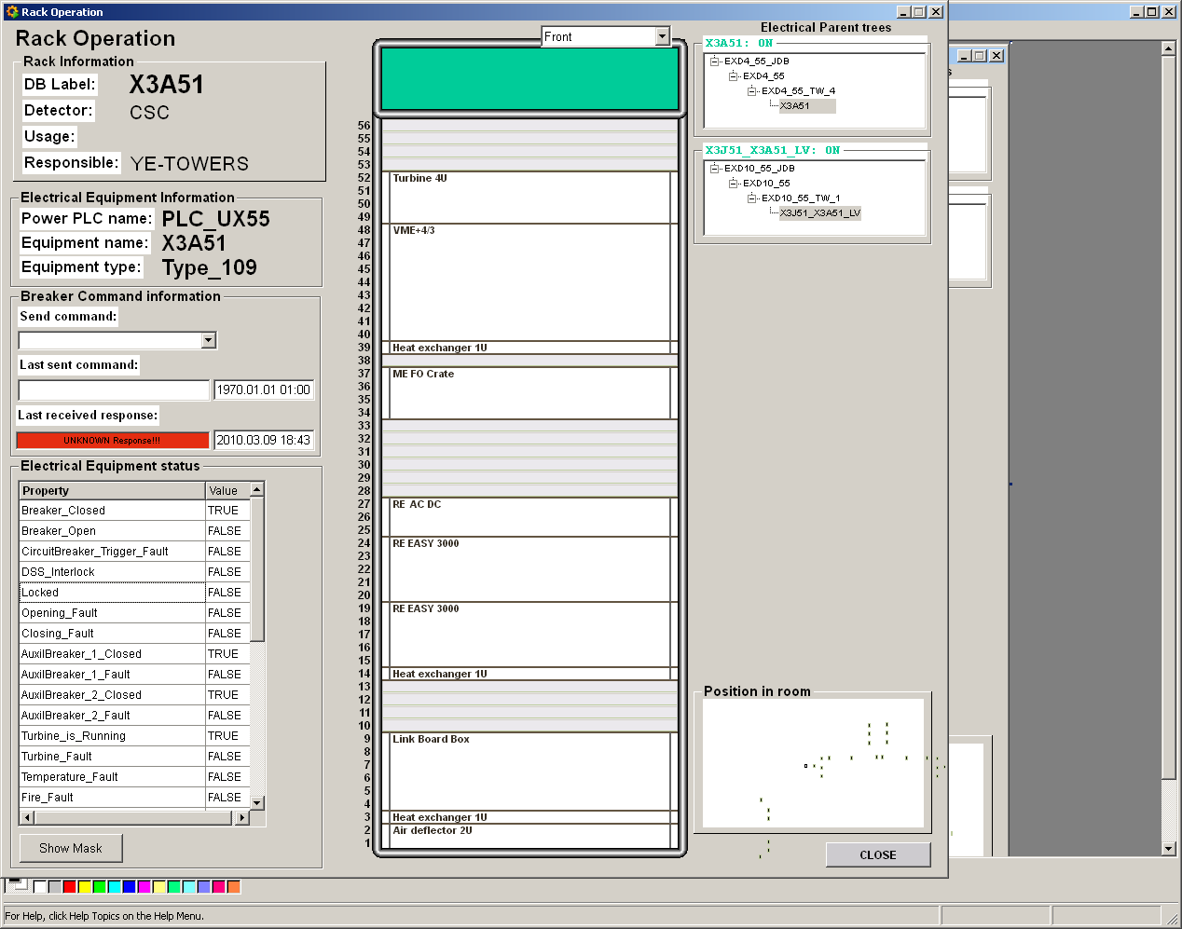
X3A51
LBB RE4

Slide 5
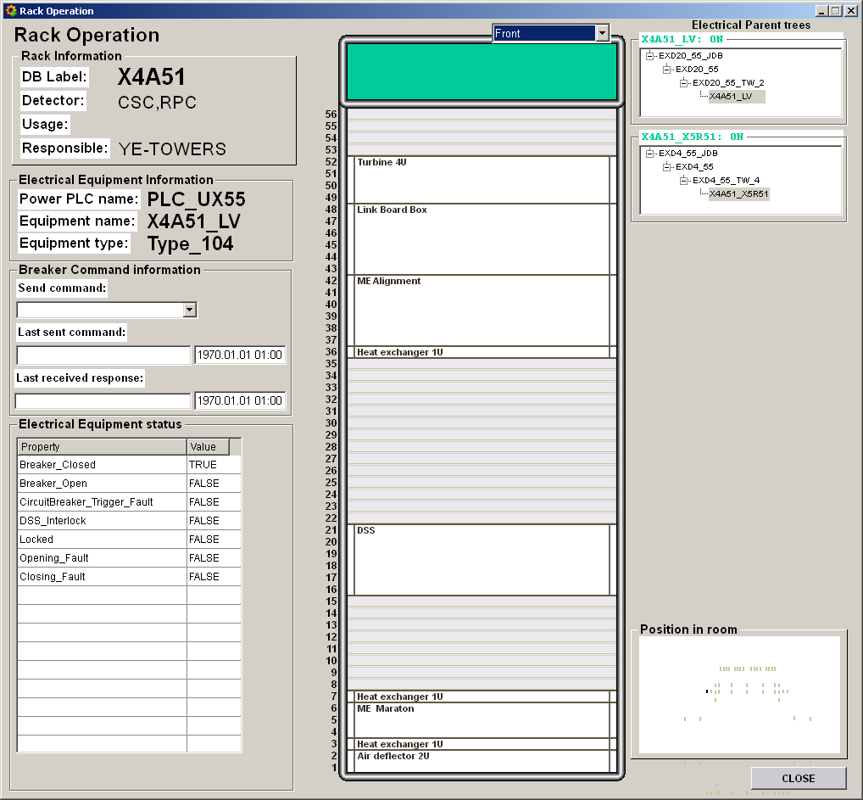
X4A51
LBB RE4

Slide 6
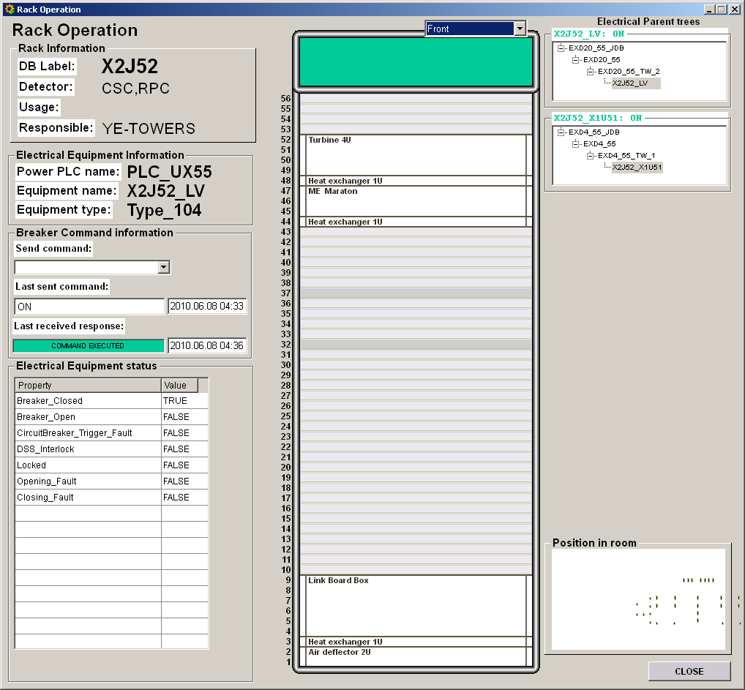
X2J52
LBB RE4

Slide 7
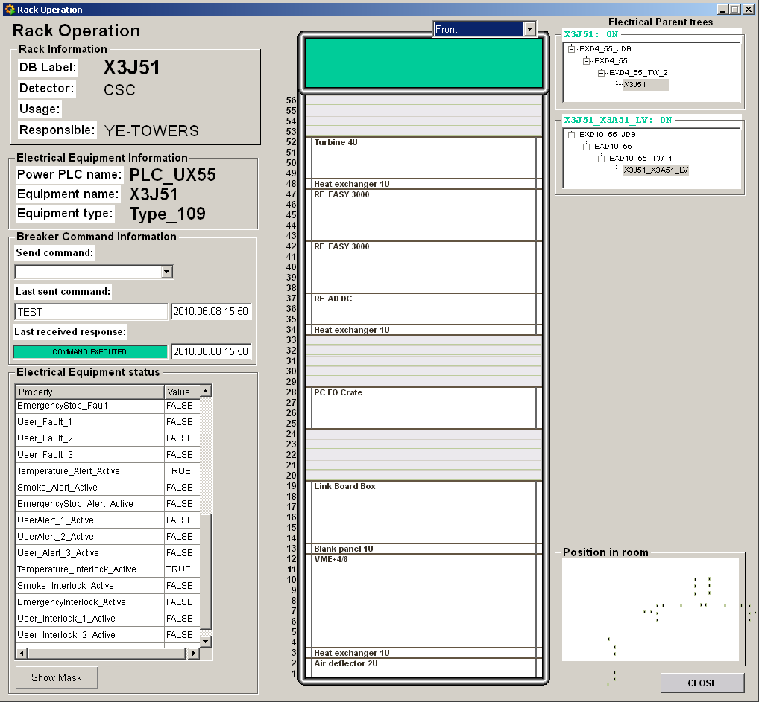
X3J51
LBB RE4

Slide 8
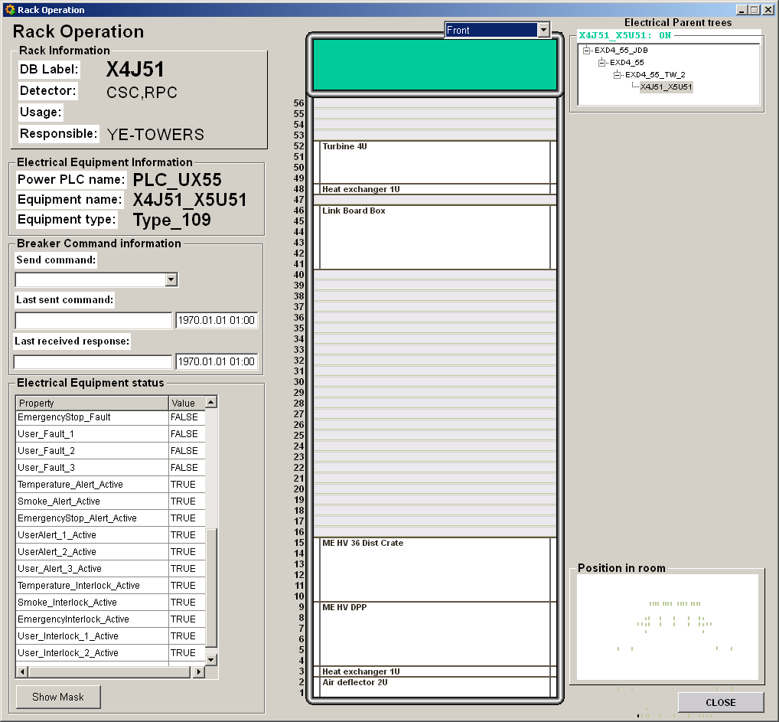
X4J51
LBB RE4

Slide 9
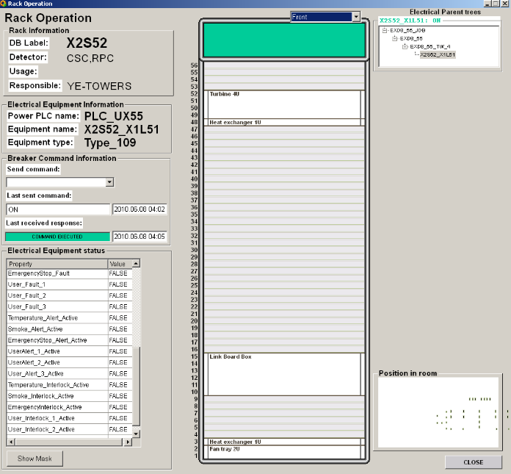
X2S52
LBB RE4

Slide 10
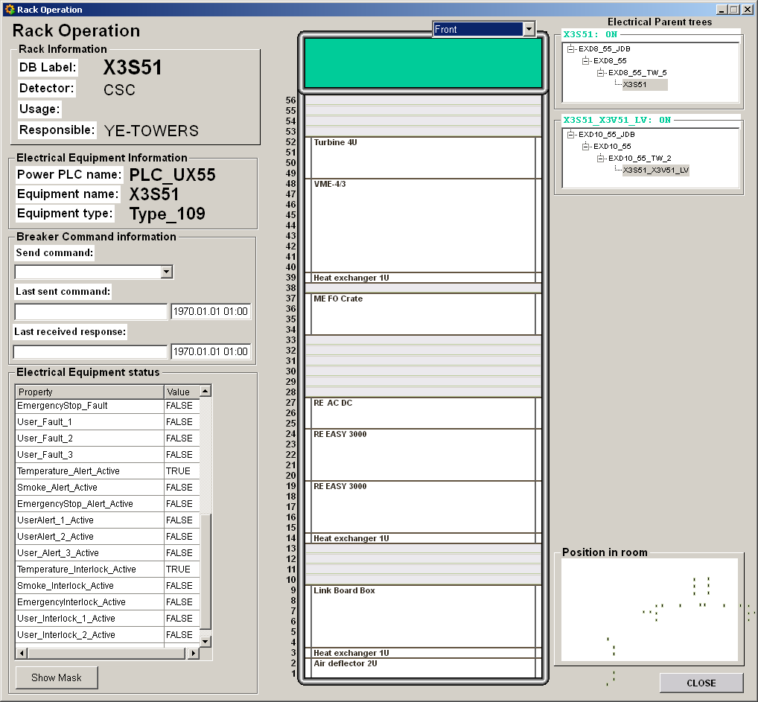
X3S51
LBB RE4

Slide 11
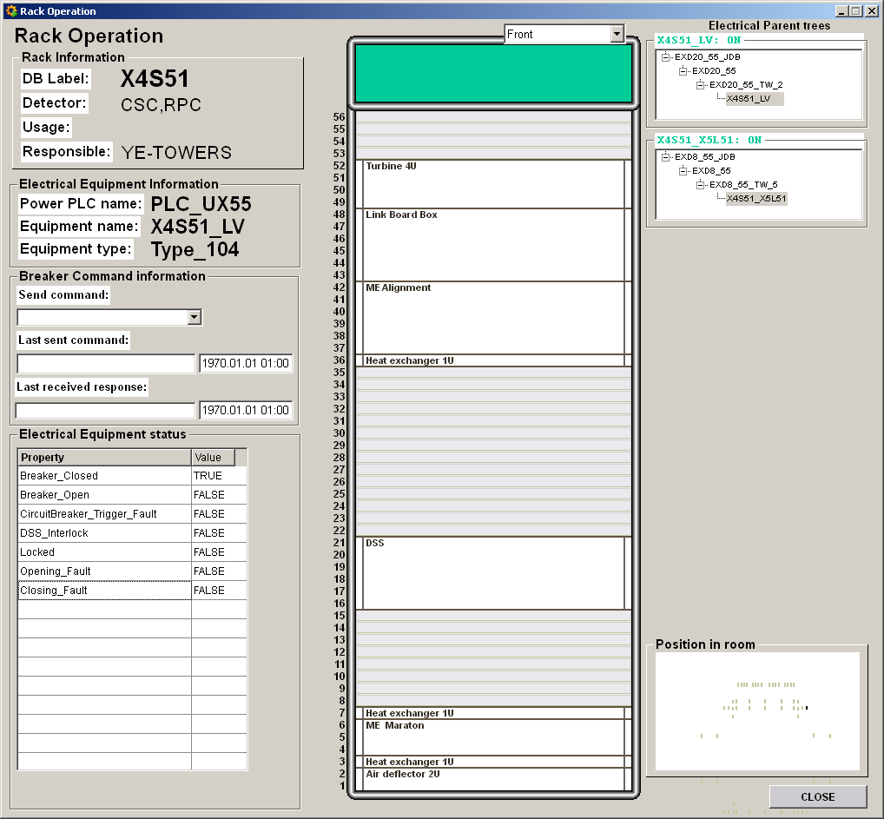
X4S51
LBB RE4

Slide 12
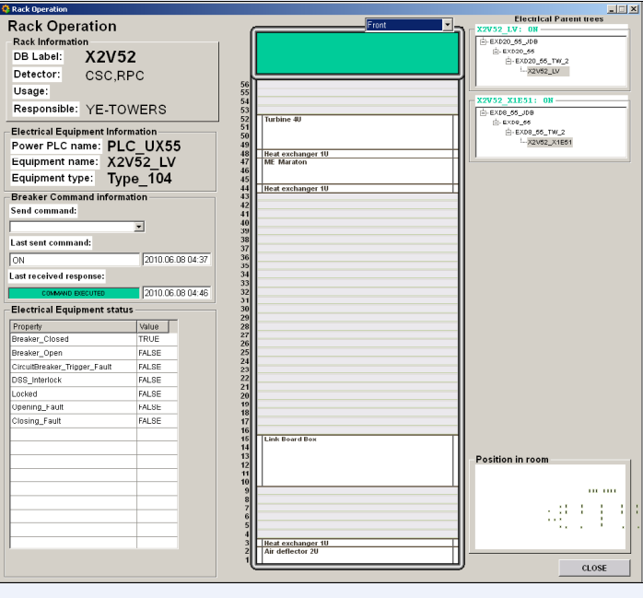
X2V52
LBB RE4

Slide 13
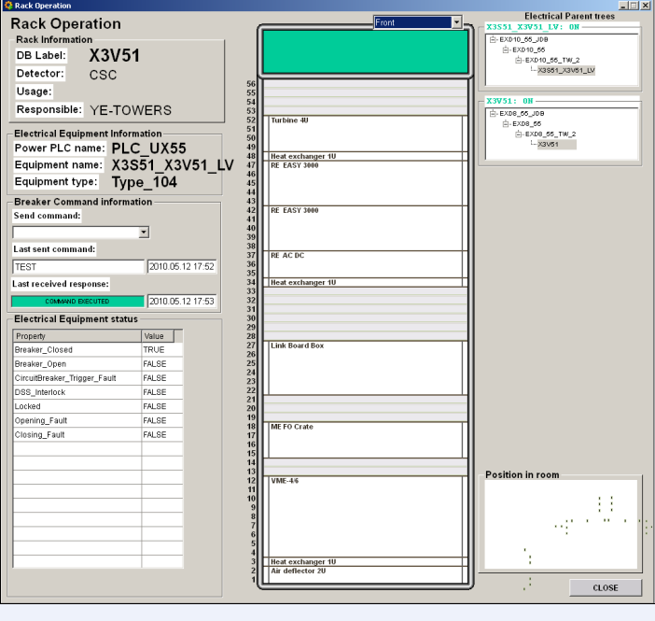
X3V51
LBB RE4

Slide 14
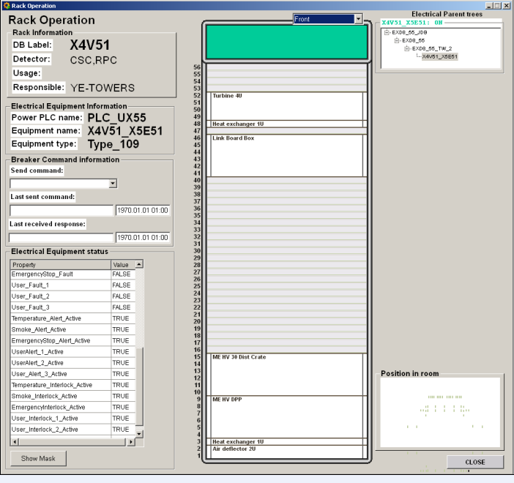
X4V51
LBB RE4

