Slide 1
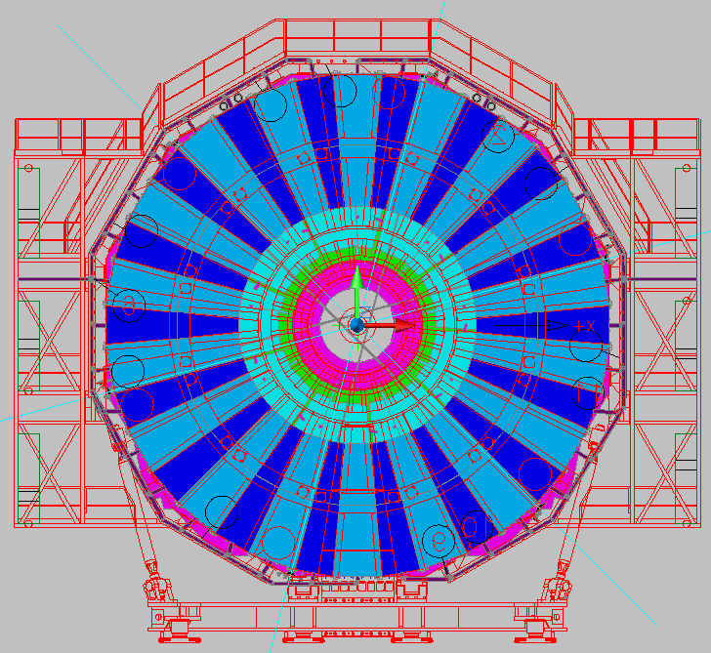
HV cable RE+4

Slide 2
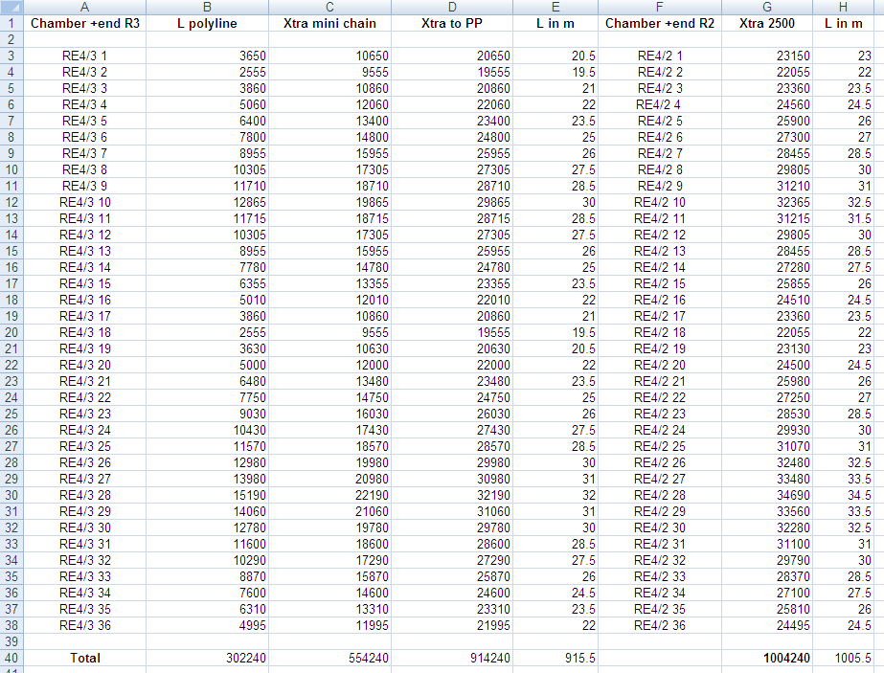

Slide 3
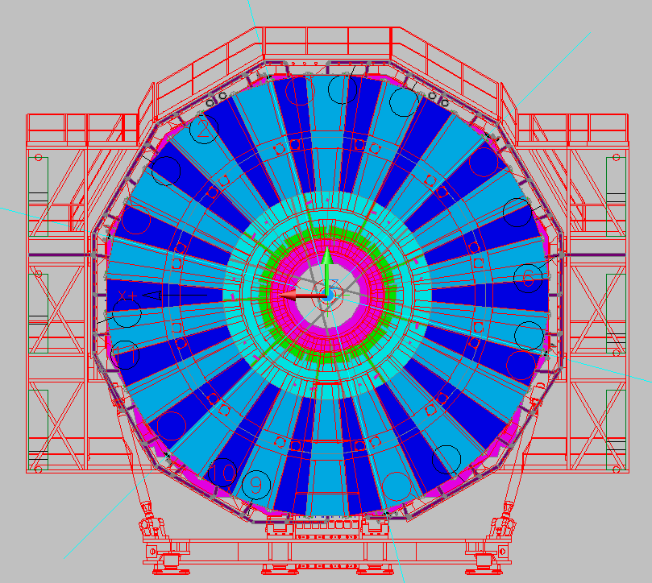
HV cable RE-4

Slide 4
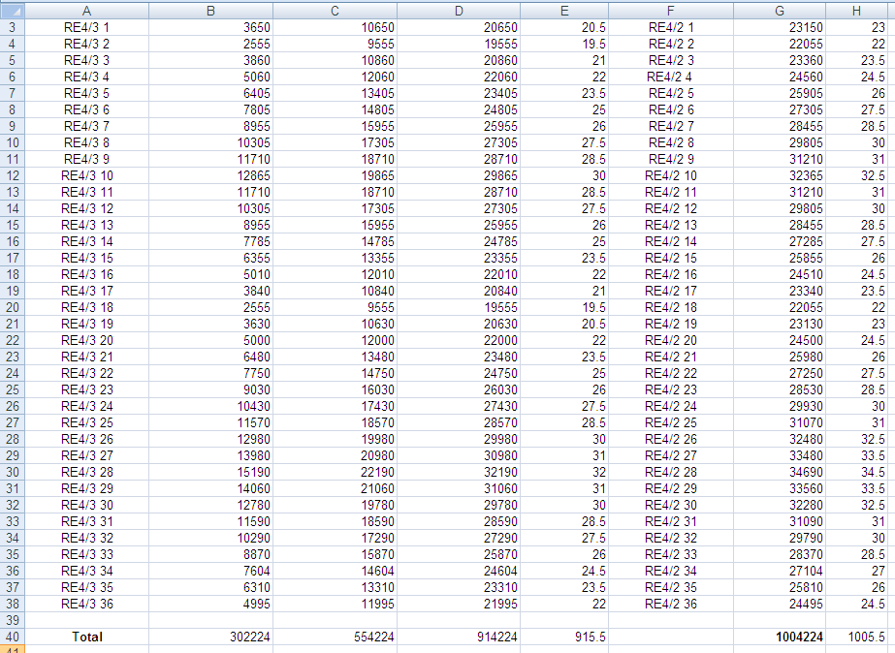

Slide 5
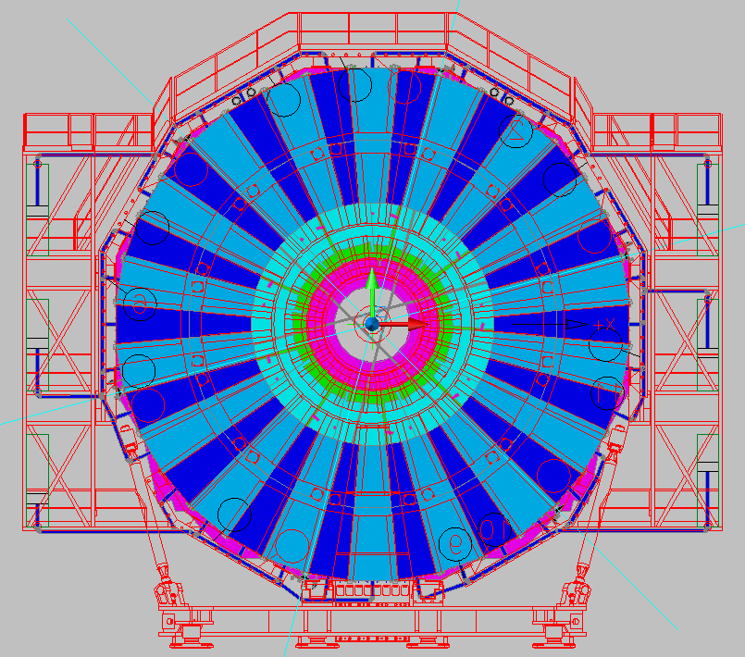
Signal Cable RE+4

Slide 6
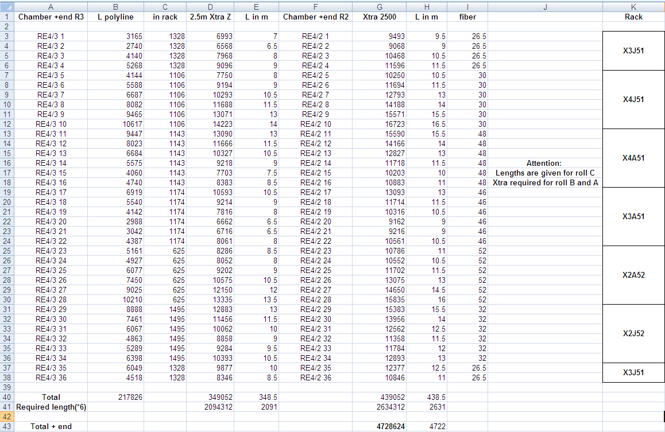
Signal Cable RE+4

Slide 7
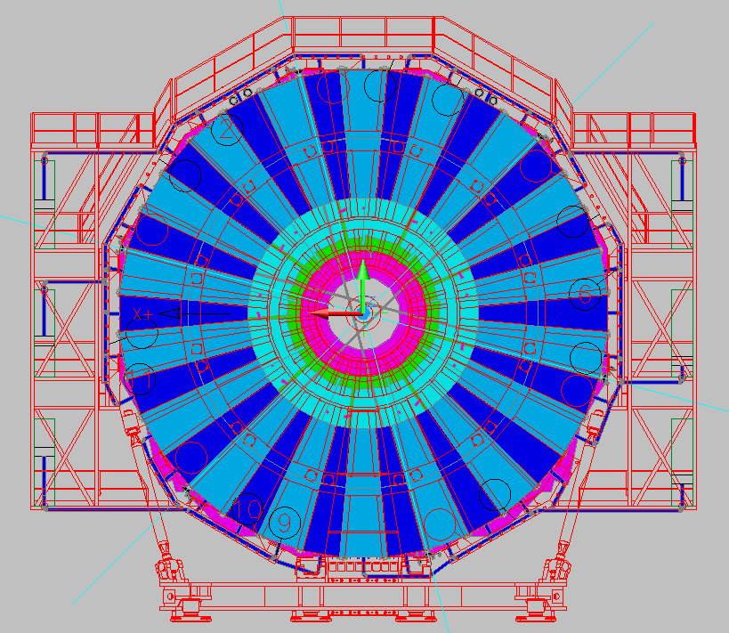
Signal cable RE-4

Slide 8
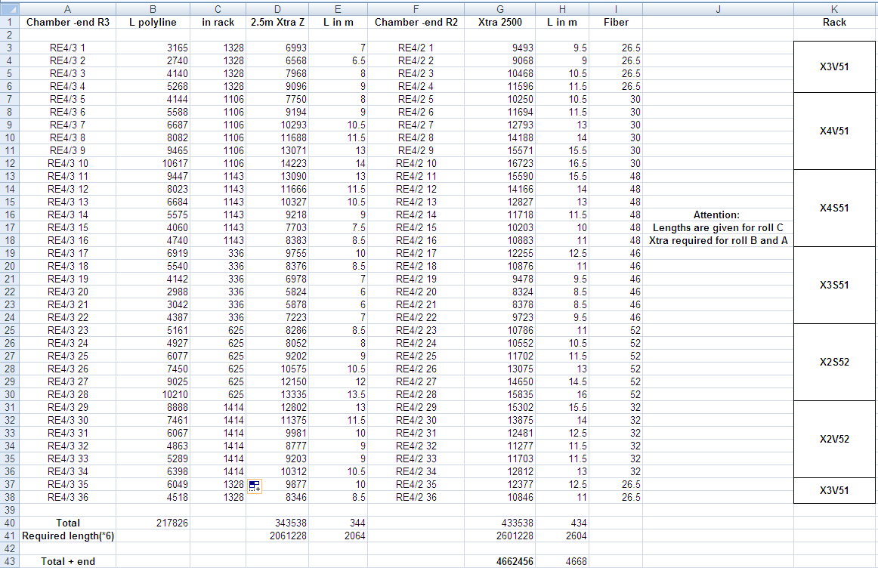
Signal cable RE-4

Slide 9
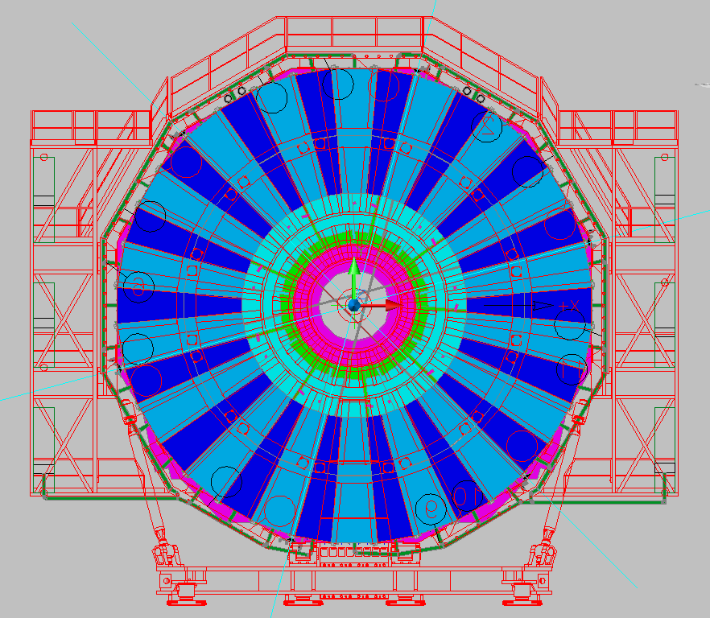
LV cable RE +&- 4 (entry from bottom)

Slide 10
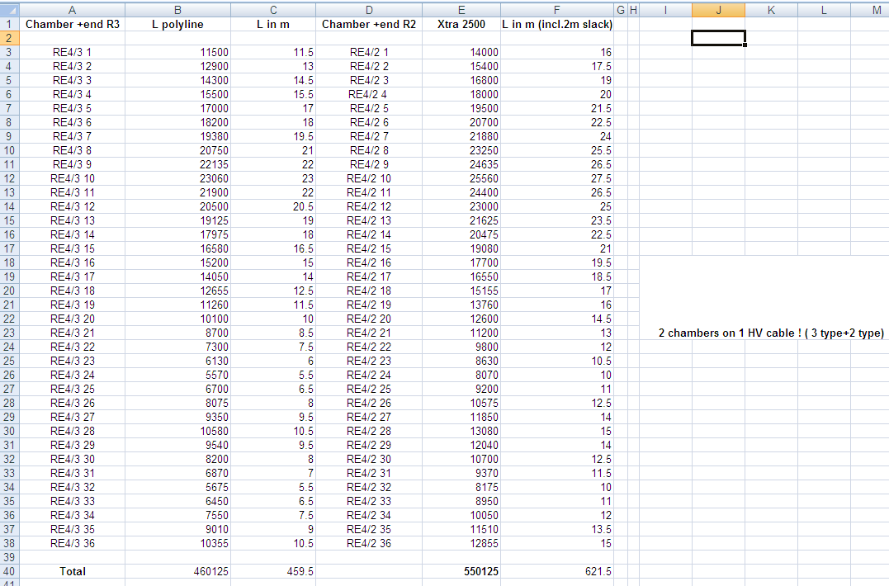

Slide 11
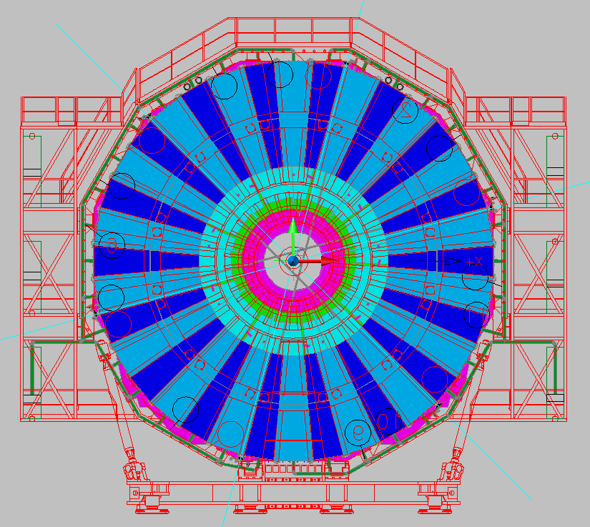
LV cable RE +&- 4 (entry from top)

Slide 12
